Slide 1
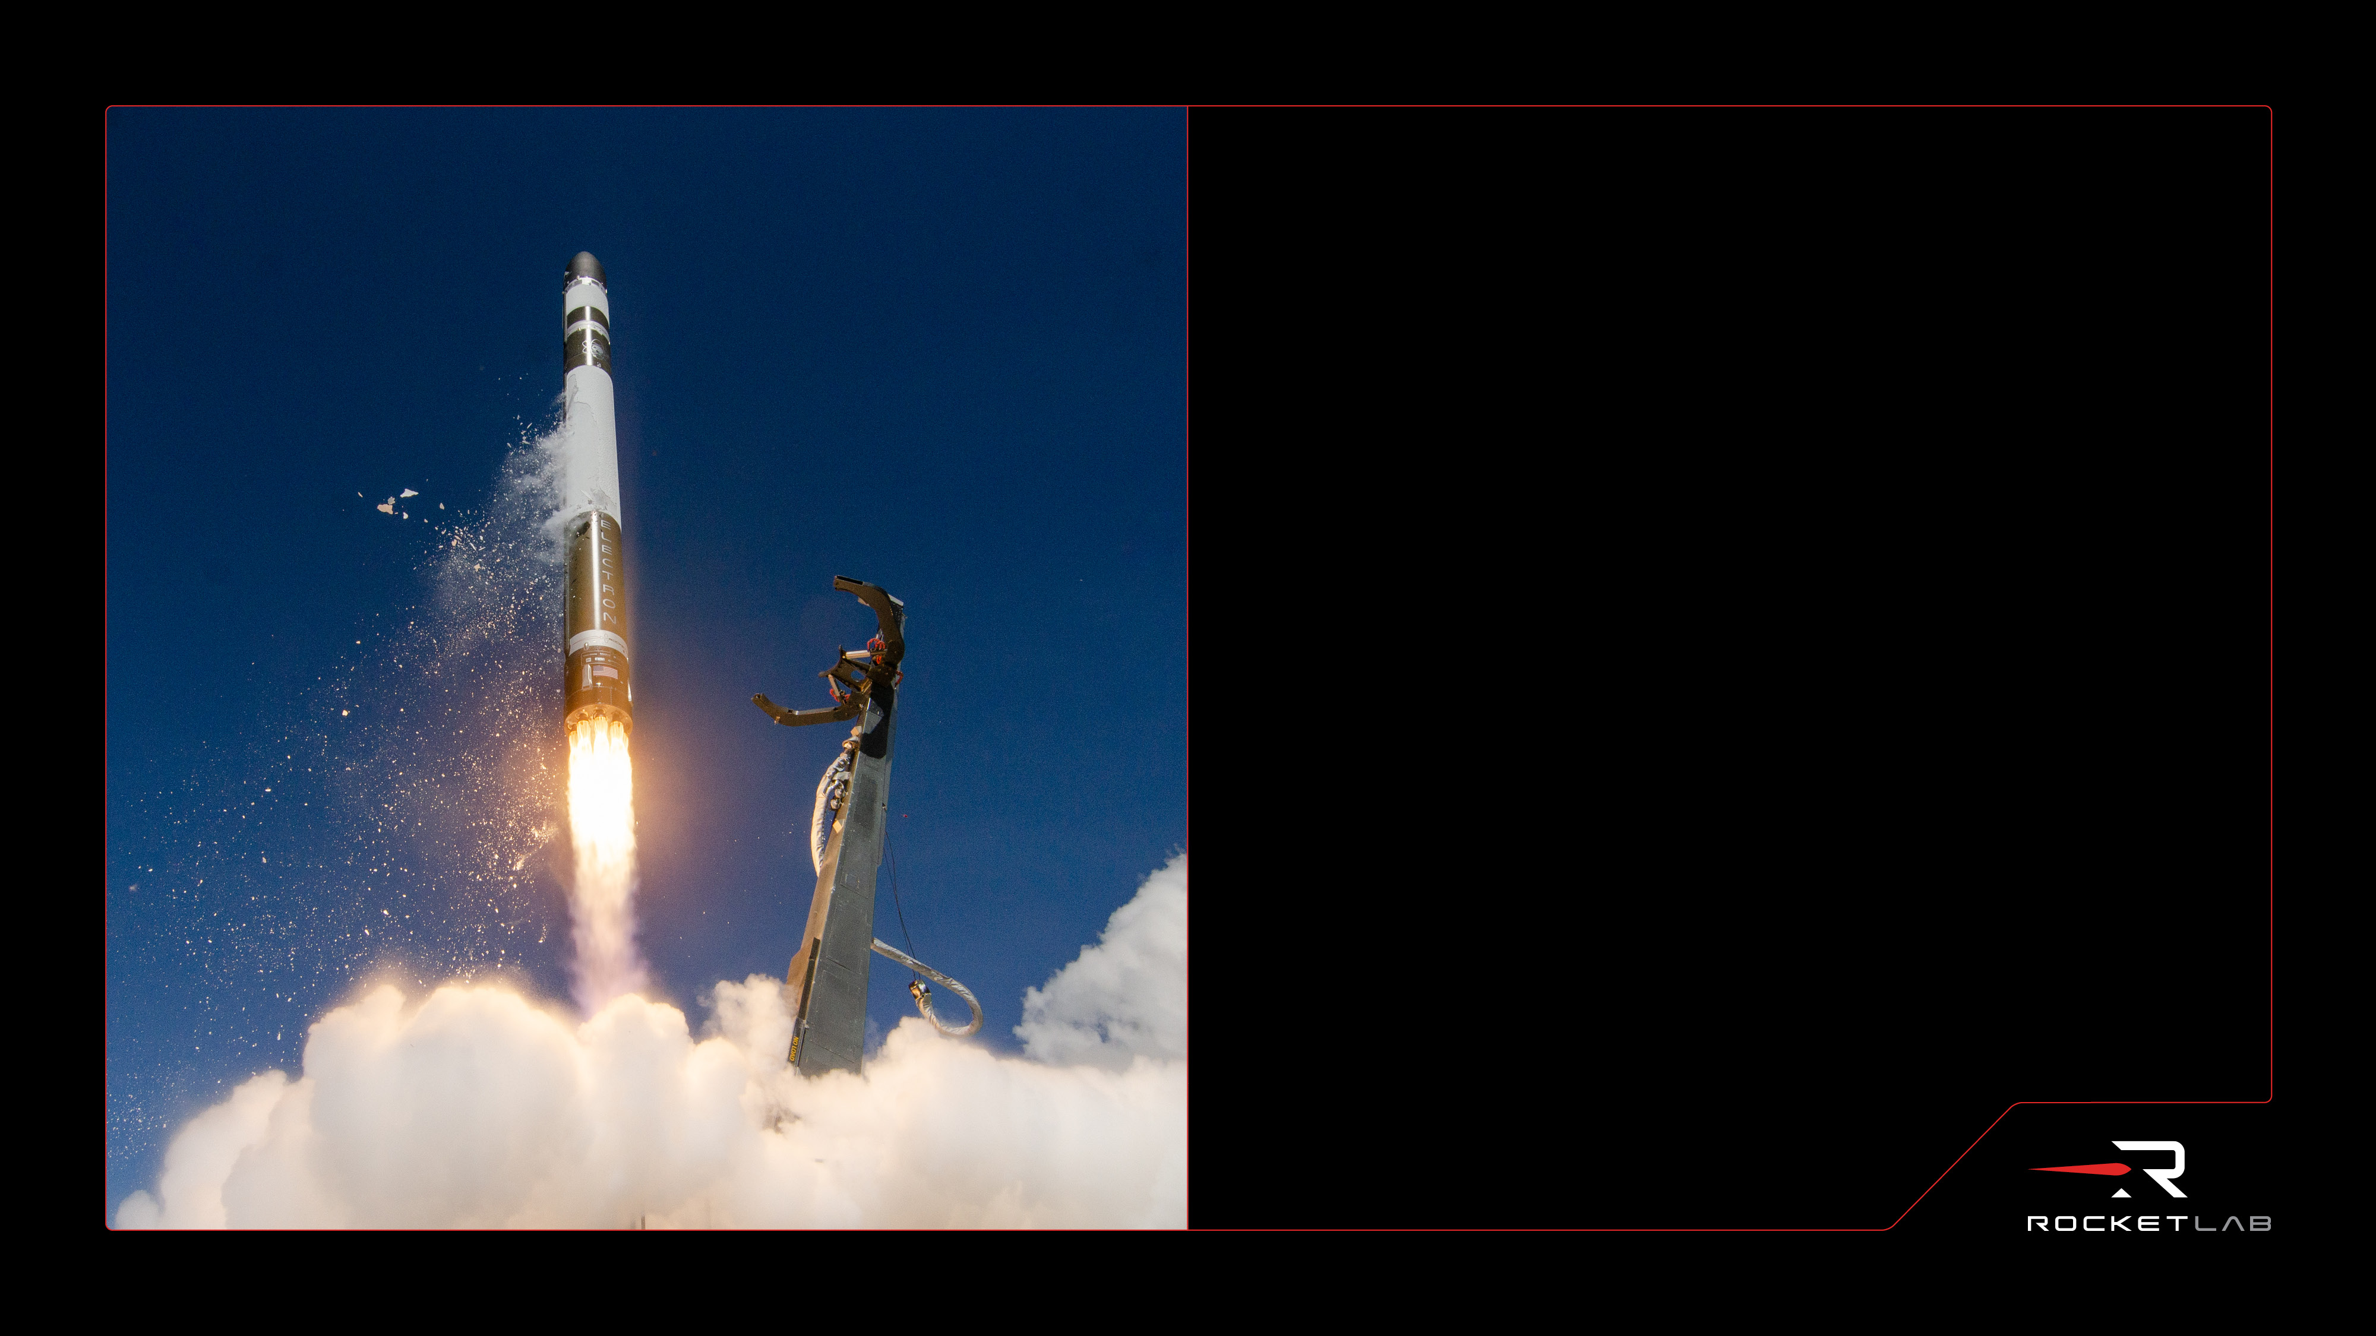
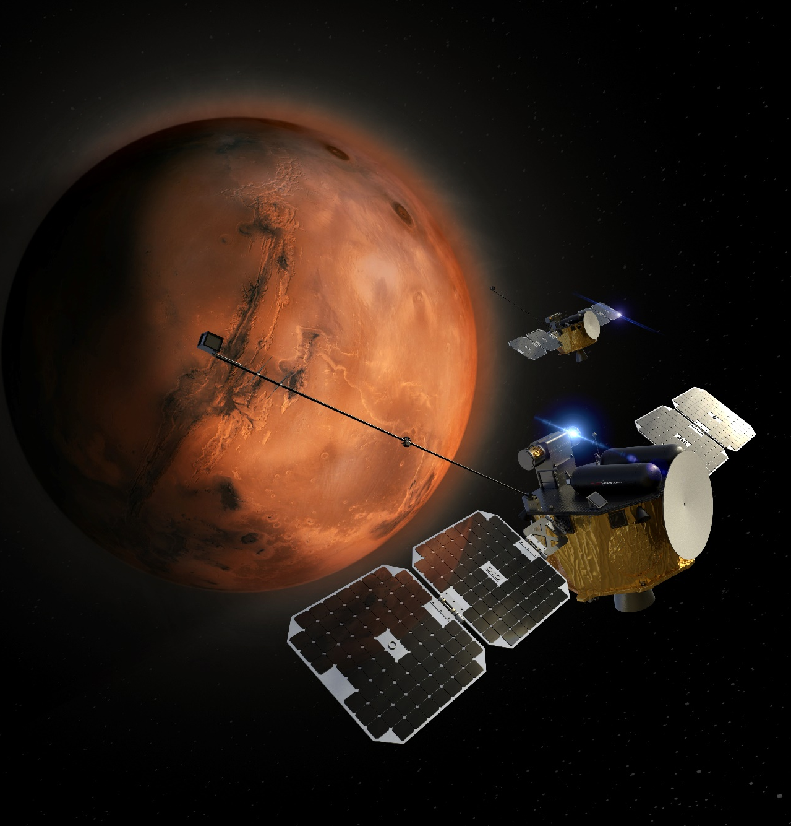
Rocket Lab USA, Inc.
Solving Momentum Management in the Martian Atmosphere
Antoine Bichara
Non Sufficit Hic Orbis
*Subject to Export Control

Slide 2
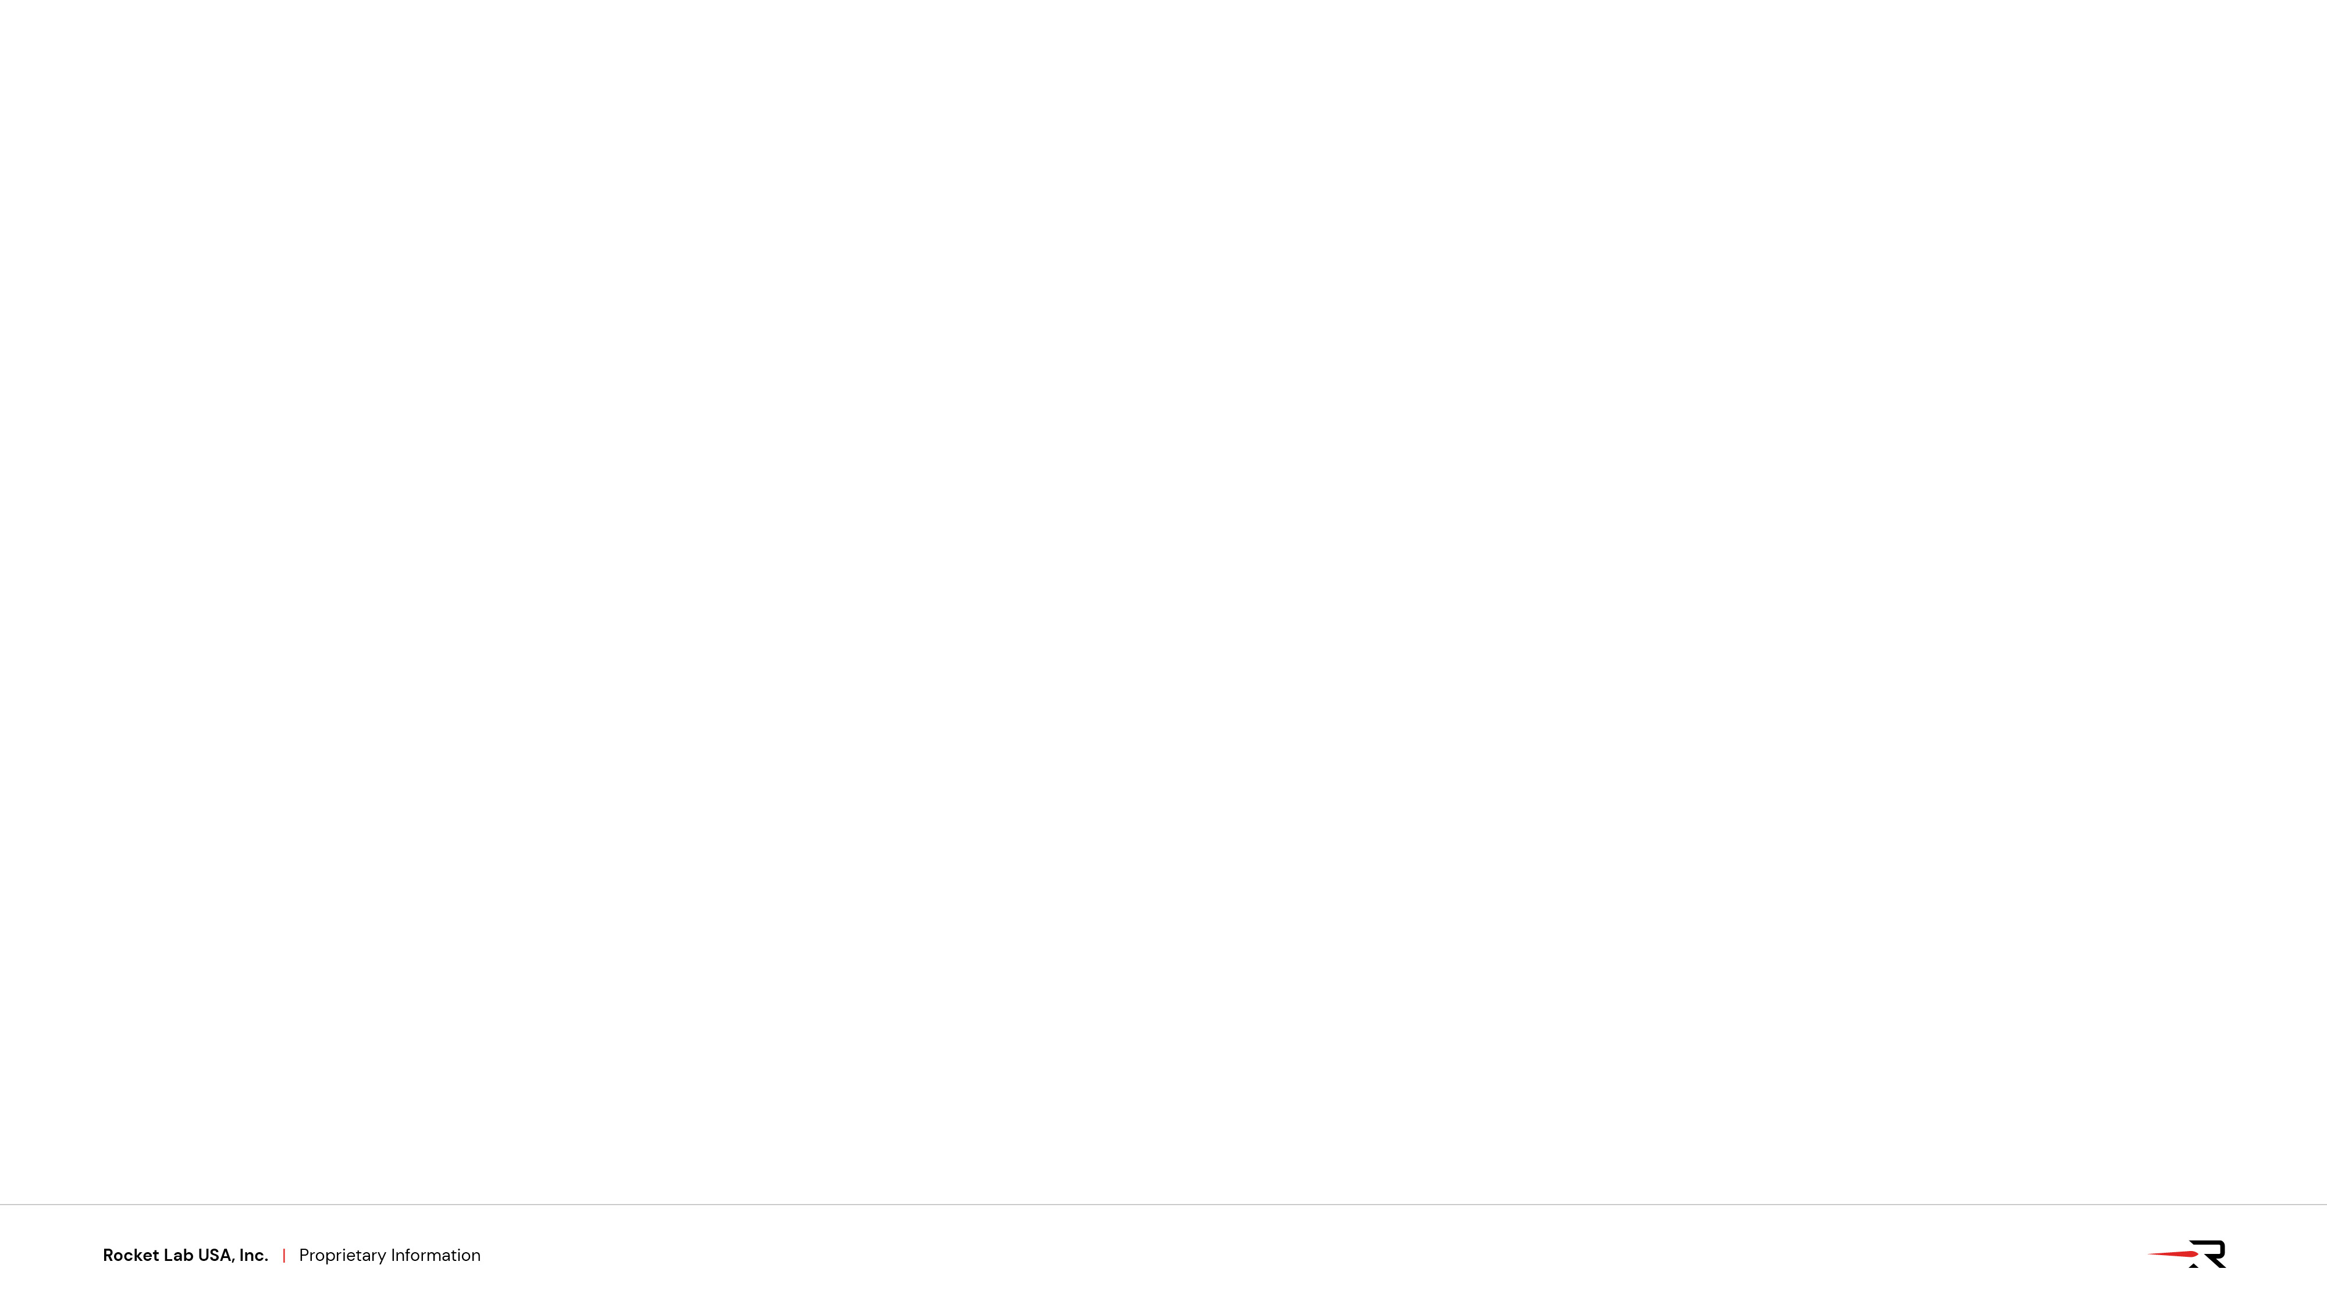
Problem Statement:
Mars’ atmospheric density variability over short-term (orbit to orbit) and seasonal timescales creates challenges with modeling and predicting spacecraft aerodynamic angular momentum build up
Causes: thinner, CO₂ composed atmosphere leads to more significant temperature and pressure fluctuations, dust storms, seasonal CO₂ cycle, lack of oceans, etc.
Momentum build-up caused from asymmetric shape -> drag forces not evenly distributed around center of mass
This is relevant to missions that are:
Orbiting Mars at low-enough altitudes, < ~200km
Missions aerobraking at Mars, or otherwise entering Mars’ atmosphere
What it affects on these missions:
Mission Design
  More cautious approach to incrementally lowering orbit periapsis into the atmosphere
  Targeting an atmospheric density corridor
GNC Architecture
  Needs to maximize the available momentum envelope to minimize desaturations
  Robust to varying atmospheric profiles
Propellant Budget to Desaturate Atmospheric Momentum Build-Up
  Large uncertainty in necessary propellant to counter atmosphere leads to inflated budgets and tank sizing
System Design
  Are backup periapse raise maneuvers needed
  Safe mode, Fault-Detection-Isolation-Recovery
Use or disclosure of data contained on this sheet
is subject to the restriction on the title page of this deck

Slide 3
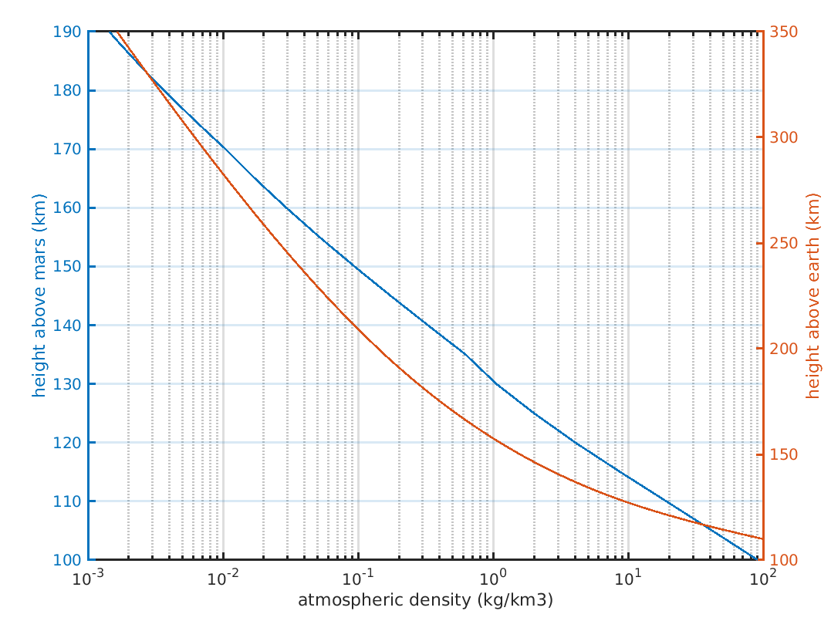
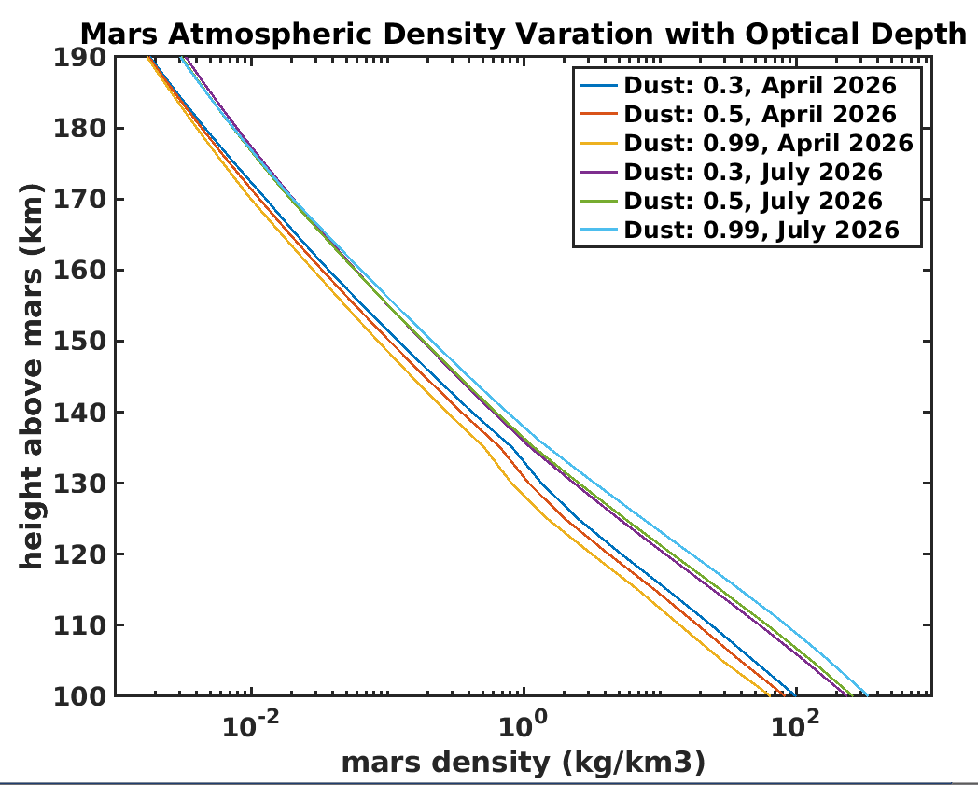
Tools Available:
Mars Global Atmospheric Reference Model (Mars-GRAM)
Engineering oriented atmospheric model that estimates mean values and statistics of Mars’ atmosphere
Uses output results from the NASA Ames Mars General Circulation Model (MGCM) and the University of Michigan Mars Thermospheric General Circulation Model (MTGCM)
Can provide it an input file of time, latitude, longitude, altitude, and it outputs density, pressure, temperature etc.
MGCMConstantDustLevel, optical depth of background dust level, is an input to bound feasible atmospheric variability
Problem: Mars-GRAM can still be off by at least 2-3 times the predicted density, creating a huge 3σ range for expected densities to close the mission design
Good news: Mars-GRAM keeps improving with new data from existing orbiters, and new releases planned
Monte Carlo Analysis of Varying Atmospheric Parameters
Can take the outputs of Mars-GRAM and run a variety of simulations dispersing the atmosphere with different parameters
Problem: Still leaves large uncertainty in actual expected performance
Use or disclosure of data contained on this sheet
is subject to the restriction on the title page of this deck

Slide 4
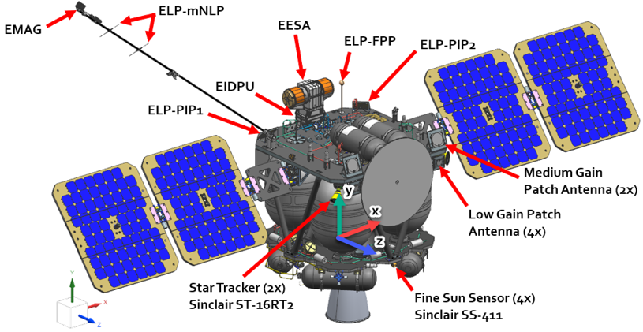
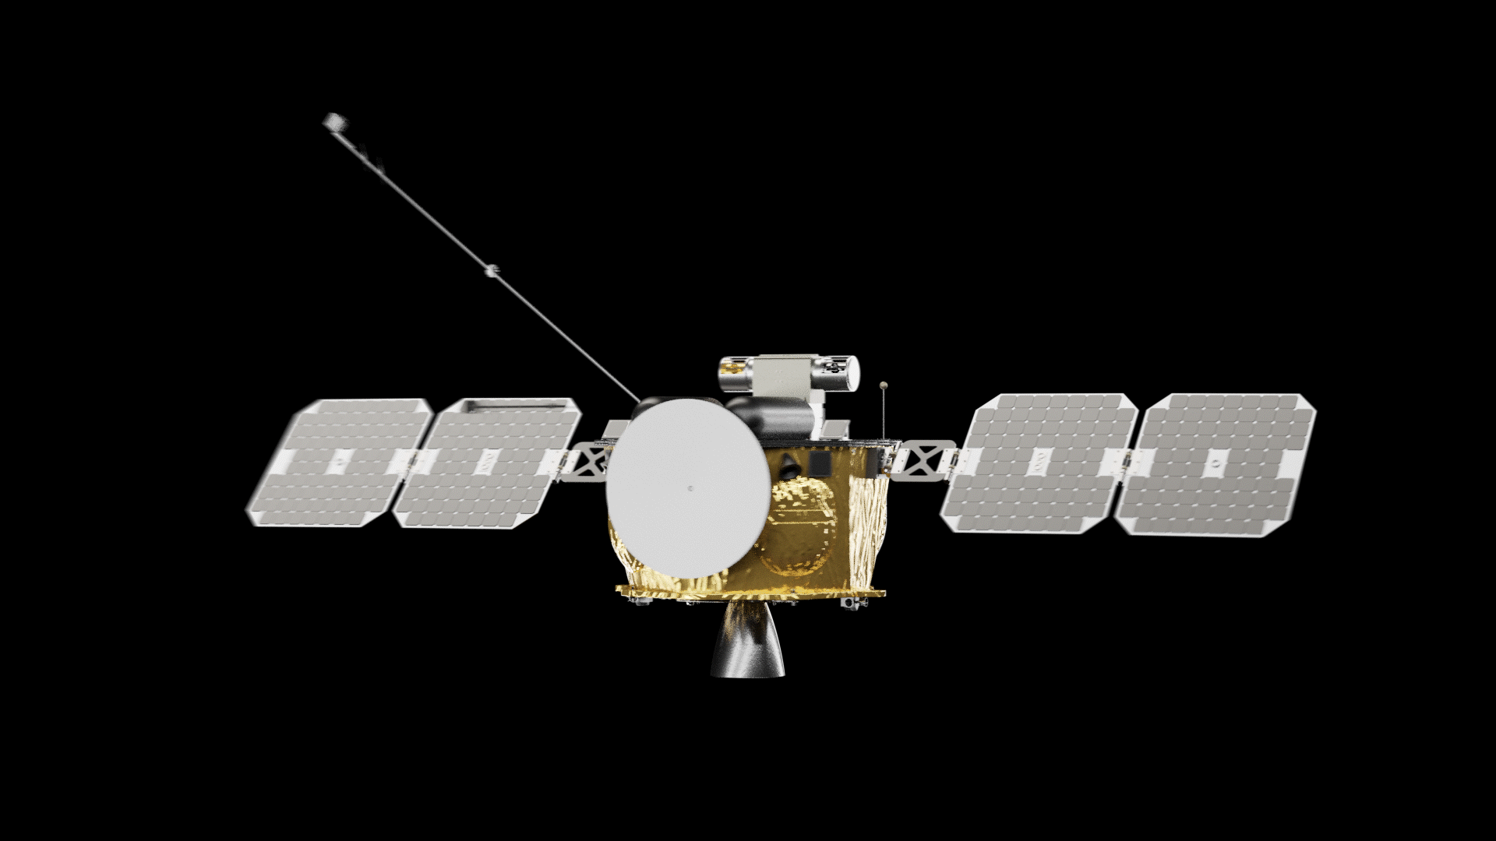
Solving Problem on ESCAPADE :
For twin science mission, the spacecraft orbit Mars and must maintain specific science attitudes or point antenna to Earth during atmospheric passes
Constraints:
Can’t run any trim-attitude control algorithm to minimized torques because attitude is fixed
Actuator sizing forces spacecraft to do automated reaction wheel desaturations throughout periapse -> can’t schedule outside of atmospheric passes
Like most interplanetary spacecraft, ESCAPADE is mass and propellant constrained -> goal to minimize propellant usage, while maintaining desired attitudes
Work supported under NASA contract 80MSFC19C0041 and Subcontract 00010676
Use or disclosure of data contained on this sheet
is subject to the restriction on the title page of this deck

Slide 5
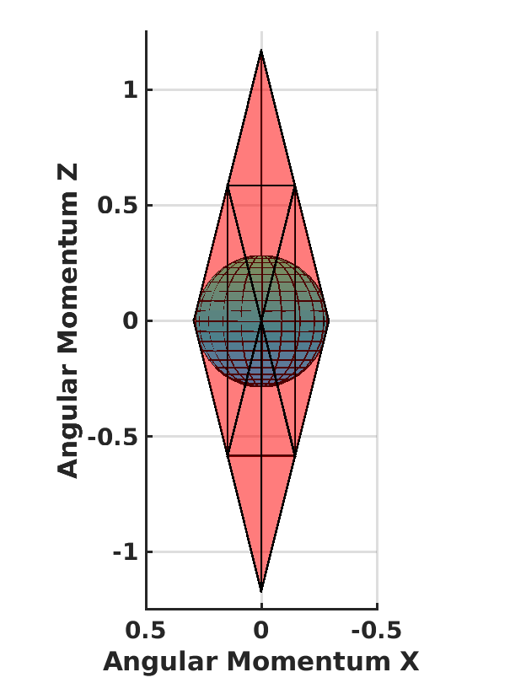
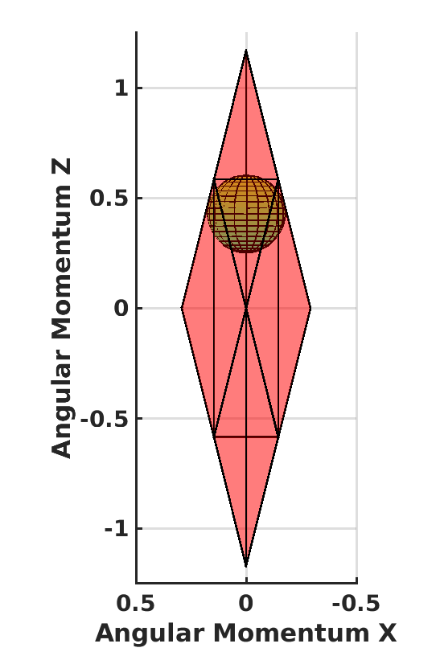
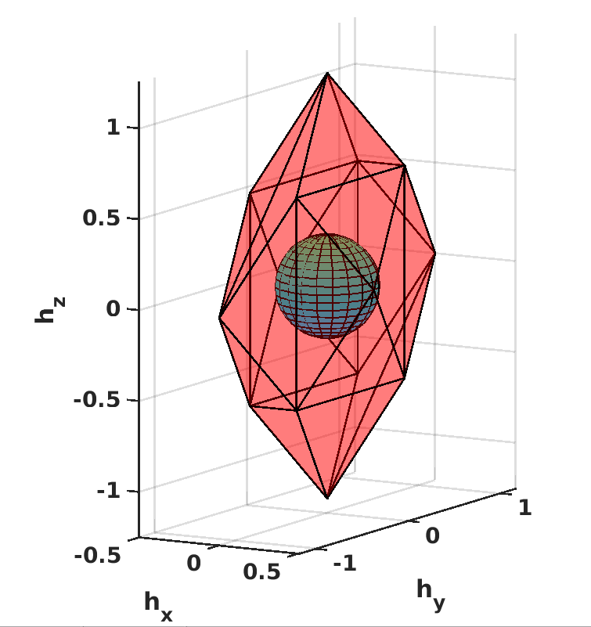
Angular Momentum Envelope:
Spacecraft has given momentum envelope dictated by actuator selection within which it can control without using propellant
Asymmetric momentum envelope design chosen to optimize for directions where momentum is expected to build up
To best utilize the existing momentum envelope while minimizing propellant usage, the spacecraft must be optimized in three key areas:
  Slew Planning
    What is the maximum slew rate we can allow around a given axis?
  Momentum Control
    When is it the right time to desaturate momentum?
  GNC Mode Transitions
    How far within the envelope is an allowable starting point for each mode?
At origin, furthest inside the envelope
Inscribed sphere is one possible metric of how close to going outside the envelope
Use or disclosure of data contained on this sheet
is subject to the restriction on the title page of this deck

Slide 6
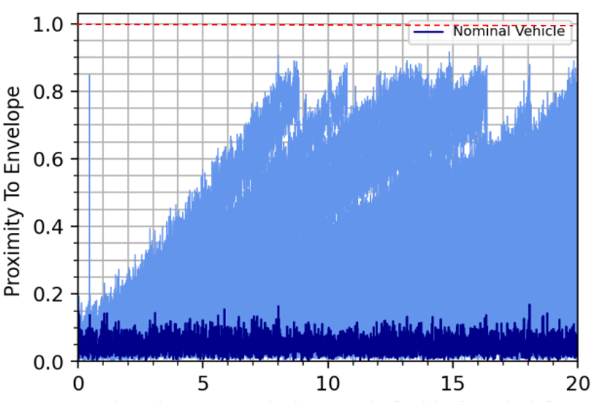
Monte Carlo Analysis:
Ran analysis (scattering all environmental parameters and orbital states) to directly tune how close algorithms allow getting to edge of momentum envelope in each GNC mode while minimizing propellant usage over long durations.
Slewing, momentum control, and mode transitions all have configurable parameters which are optimized for propellant usage, while requiring:
All simulations maintain pointing requirements
No simulations saturate the momentum envelope, even for the extreme density ramp ups
All simulations correctly transition between all modes
Compared propellant use for different strategies of filtering the on-board momentum estimate
Running this analysis led to significant improvements in total propellant consumption
Use or disclosure of data contained on this sheet
is subject to the restriction on the title page of this deck

Slide 7
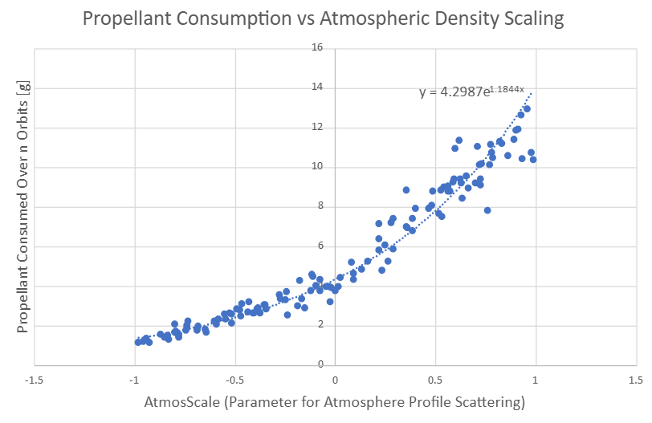
Example:
Propellant Budget For Desaturating Momentum:
How do we best budget and margin for density with large uncertainty?
Must maintain flexibility in the mission design, (timing and magnitude of expected trajectory correction maneuvers)
  Will be able to estimate density while in-orbit from orbit determination using doppler and ranging measurements to make orbital adjustments
Can’t use huge 3σ uncertainty factors on density as this can inflate budget
Prior to Launch:
For each mission phase, initially target an expected (as designed) average density for this phase. Curve fit all propellant consumption analyses for varying densities.
During the Mission:
Once the mission phase is completed, input actual measured average density of that phase into the budget
Budgets then automatically recalculate allowable average density for each remaining mission phase and associated margins
Avoids continuous re-running of all analyses feeding into budgets
Allows mission designers to track and directly manipulate how different density targets are constrained by propellant usage, making better decisions for remainder of the mission
Mission Phase | Avg. Density from Trajectory file for Reference [kg/m3] | User Input Average Density [kg/m3]
Science 1 | 0.6 | 0.9
Science 2 | 0.7 -> 0.5 | TBD
Science 3 | 0.8 -> 0.6 | TBD
Use or disclosure of data contained on this sheet
is subject to the restriction on the title page of this deck

Slide 8
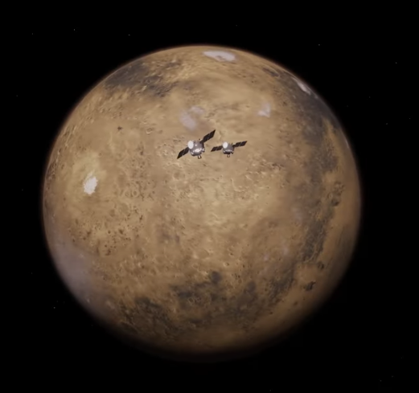
Conclusion/Next Steps:
Missions including ESCAPADE itself will continue to improve the modeling of Mars’ atmospheric density:
In the meantime:
Can design robust missions through optimizing the usage of the momentum envelope to best utilize propellant during atmospheric passages, by directly tuning the following:
    Maximum allowable slew rate around a given axis
    Timing of momentum desaturations
    How far momentum desaturations push state into the envelope
Design and maintain better propellant budgets through tracking expected vs. actual density in each mission phase, and maintaining flexibility in the mission constraints
Questions?
Use or disclosure of data contained on this sheet
is subject to the restriction on the title page of this deck

Slide 9
References:
Justh, H. L., Burns, K. L., Dutta, S., & Hoffman, J. (2024, October 23). Mars Global Reference Atmospheric Model (MarS-GRAM) 2024: User Guide. NASA Technical Reports Server (NTRS). https://ntrs.nasa.gov/citations/20240012934
ESCAPADE Spacecraft – ESCAPADE. (n.d.). https://escapade.ssl.berkeley.edu/spacecraft/
Use or disclosure of data contained on this sheet
is subject to the restriction on the title page of this deck

