Slide 1
An Updated Parametric Design of a Torsion Pendulum to Demonstrate Attitude Control Using Microoptoelectromechanical System
Control of Radiation Pressure
Jonathan Messer
Doctoral Student
jmesser@usc.edu
Joshua Pastizzo
Graduate Student
pastizzo@usc.edu

Slide 2
Conserve Momentum Dumping Fuel by Controlling Solar Radiation Pressure

Slide 3
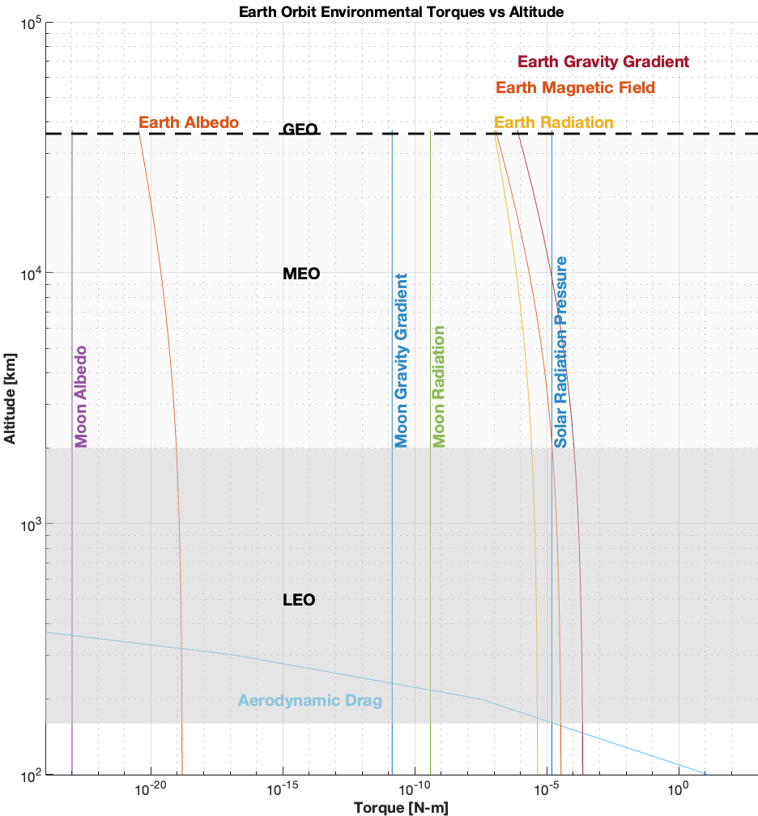
The Problem
Environmental Torques act against Spacecraft continuously
Spacecraft attitude is maintained by storing angular momentum using Reaction Wheels or Control Moment Gyroscopes
Momentum Dumping is required to prevent material failure
  Magnetic Torquers are ineffective at or above GEO (especially for the pitch axis)
  Reaction Jets consume finite fuel
Fuel for Momentum Dumping becomes a Mission Lifetime Limitation
Solar Radiation Pressure is normally a perturbing force

Slide 4
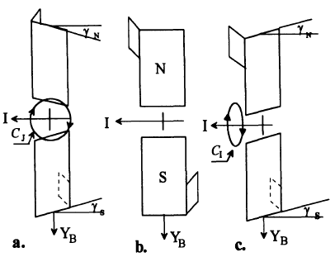
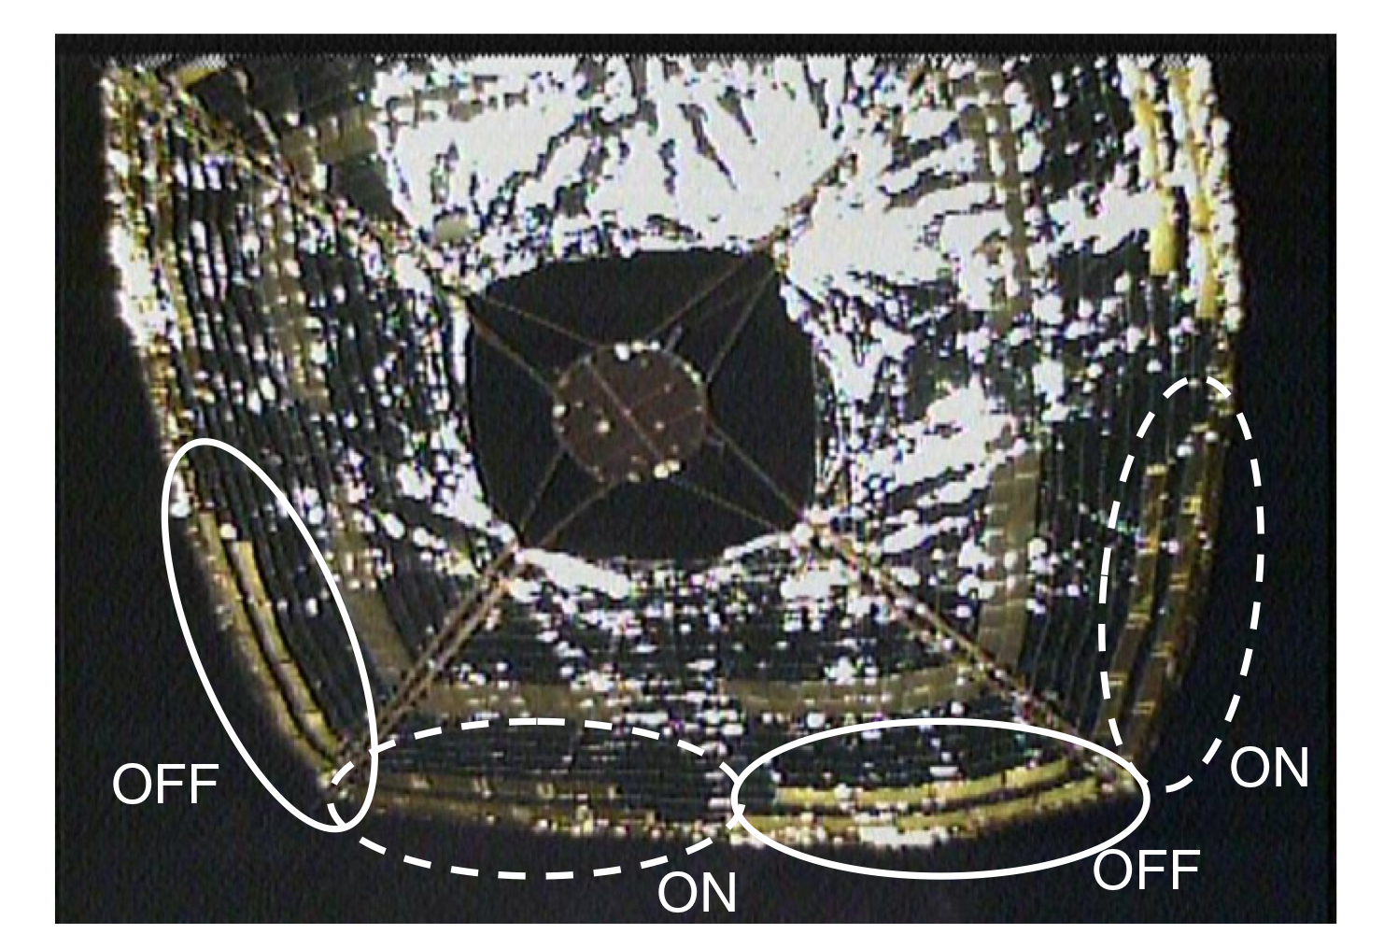
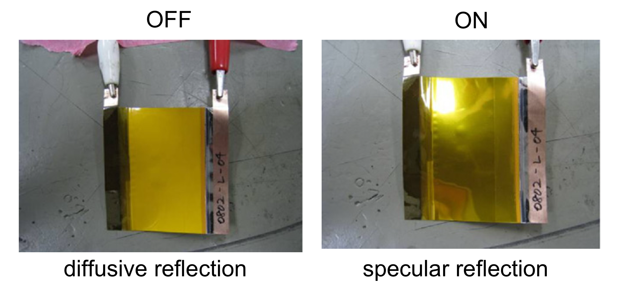
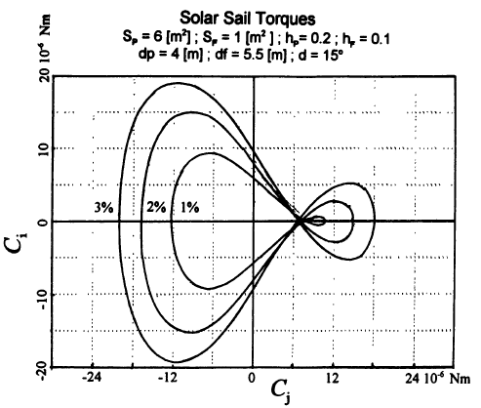
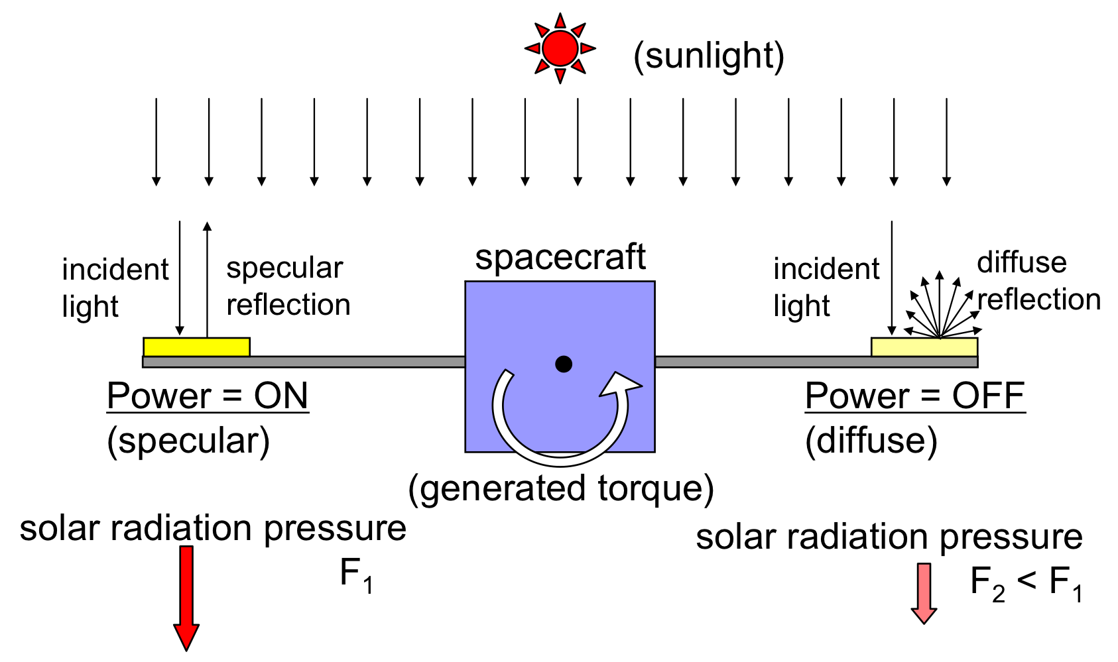
Existing Methods of Attitude Control using Solar Radiation Pressure
Lievre Method
IKAROS Method
Yaw
Roll
(Lievre, 1985)
(Sidi, 1997)
(T. Tsuda et al, 2011)

Slide 5
Utilizing Digital Micromirrors Devices for Satellite Attitude Control

Slide 6
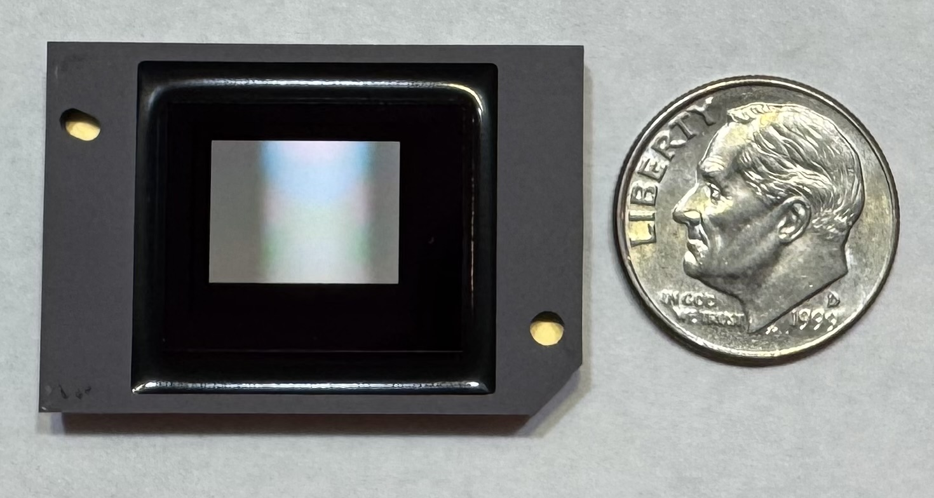
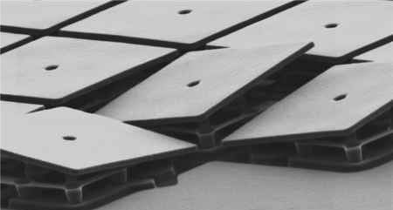
Digital Micromirror Device (DMD)
786,432 micromirrors on this DMD
An array of individually addressable pivoting mirrors
  Developed in 1987 by Texas Instruments, commercially available since 1992
  By 2002, over 1.5 million units sold
Each mirror is electrostatically commanded to a fixed tilt
The method of manufacturing is similar to semi-conductors
Emerging Applications
  3D Printing and Scanning
  Lithography
  Volumetric Displays
  Space-Based Astronomy
Micromirrors under Electron Scanning Microscope
A human blood cell is 6-8µm
Today’s Micromirrors are 5.4 µm
Printed with permission of Texas Instruments Inc.

Slide 7
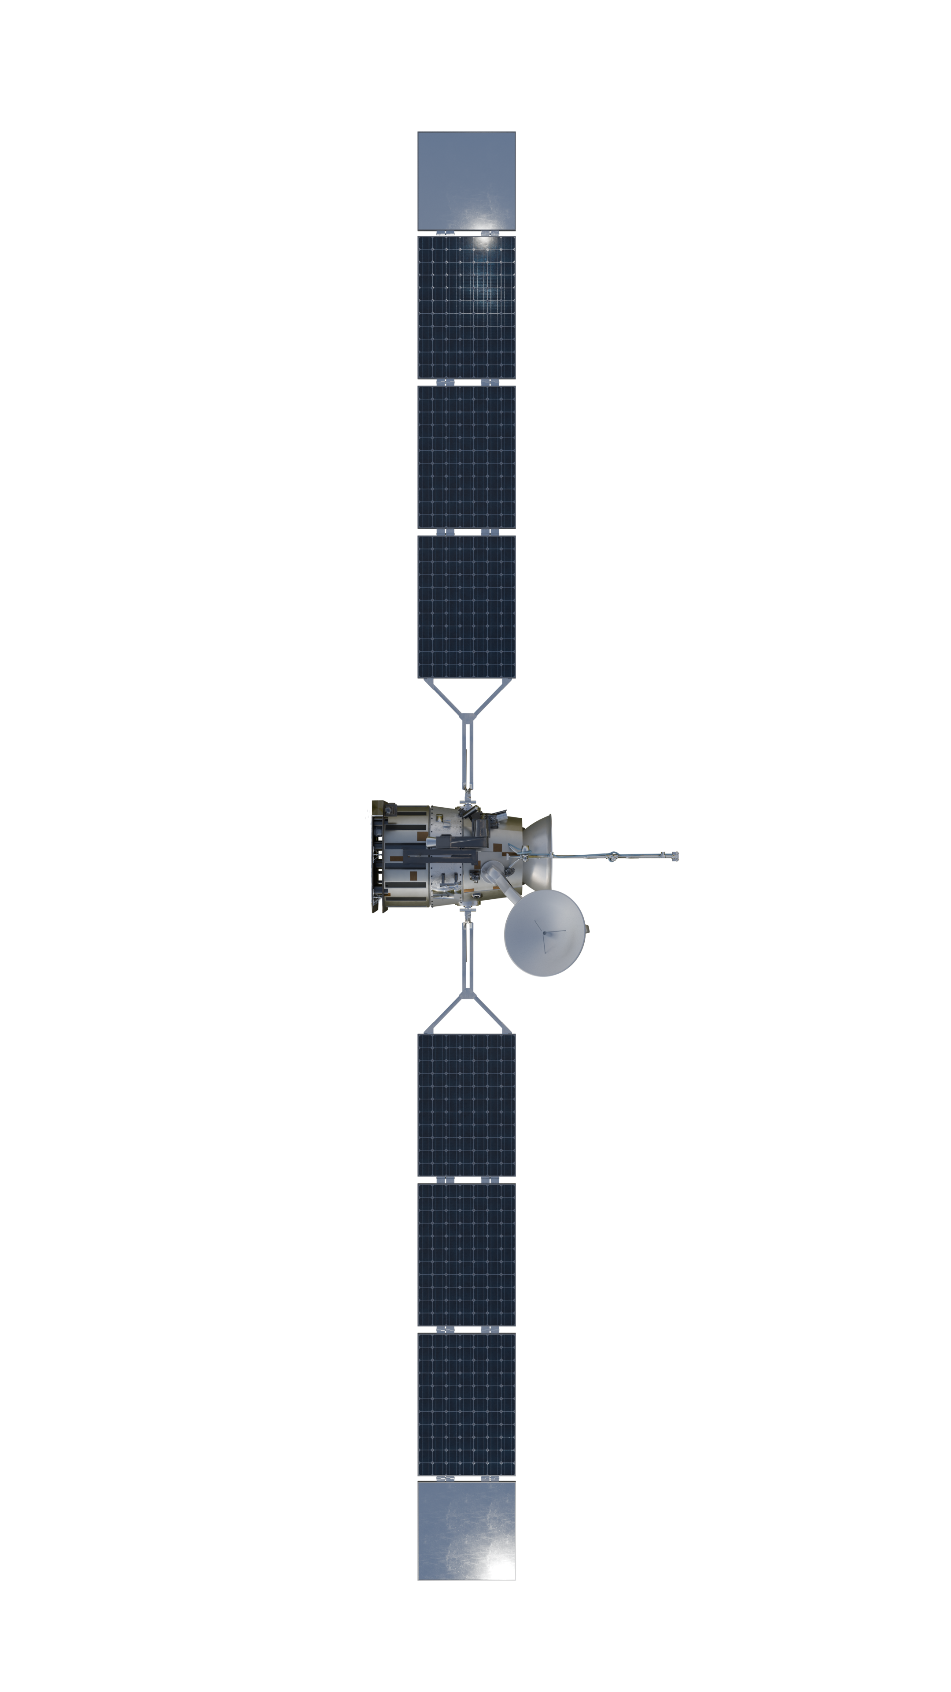
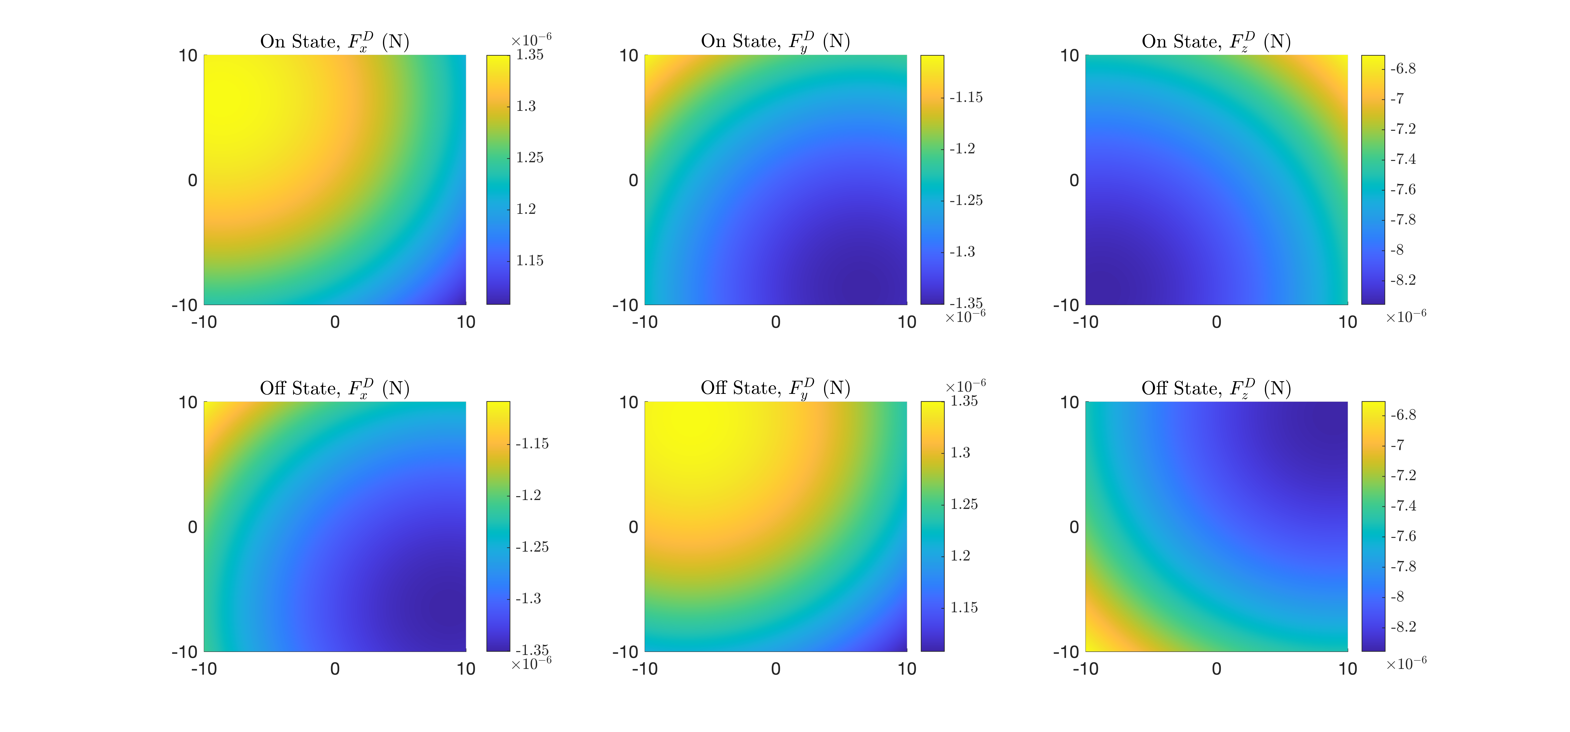
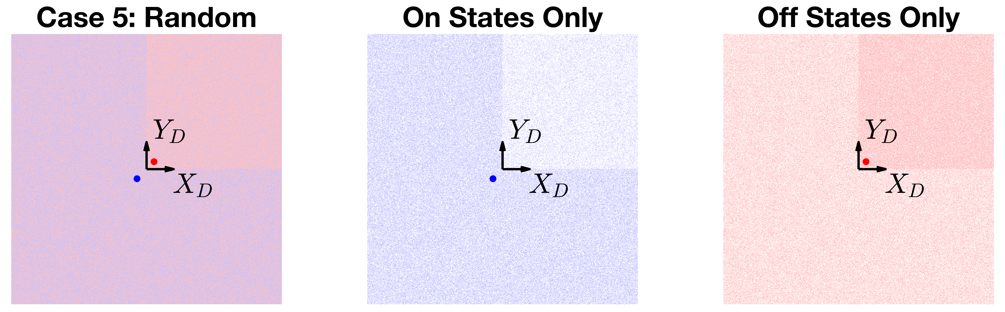
Application of DMDs to Satellite Attitude Control
Force On/Off States for one square meter
y_{D}
Torque Example Array Patterns and Varying Sun Angle
x_{D}
On
Rotation about X_{D}
All On
Off
Rotation about Y_{D}
Max Cumulative Force per square meter
for varying sun angles
z_{B}
Left On, Right Off
y_{B}
Center of Pressures Example Random Array
Top On, Bottom Off
Notice that the COP location differs for each state
Checkerboard
This method generates torque about all three axes

Slide 8
Experimental Verification Using Vacuum Torsion Pendulum

Slide 9
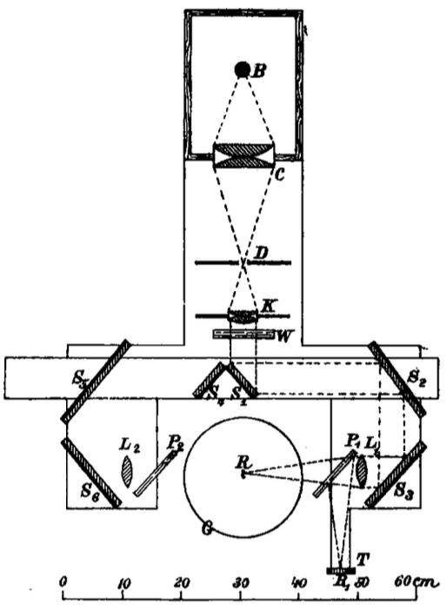
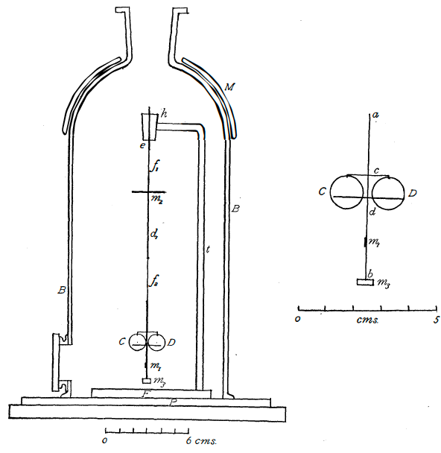
Original Measurement of Radiation Pressure using a Torsion Balance
P. Lebedew (1900)
University of Moscow
E. F. NICHOLS AND G. F. HULL (1901)
Dartmouth College
Both teams developed a similar torsion balance inside a chamber with the air evacuated.

Slide 10
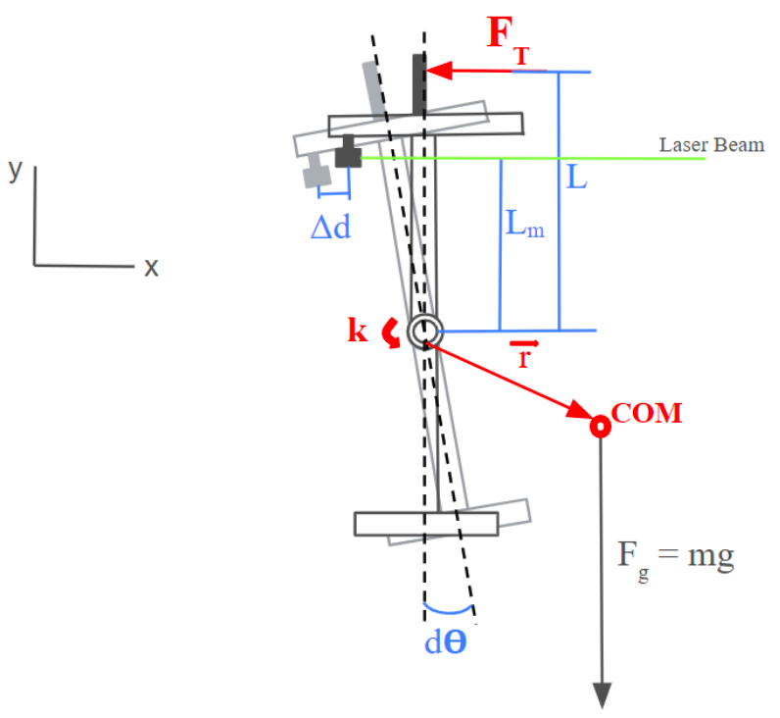
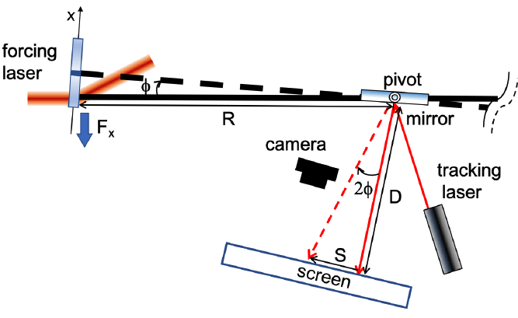
Recent Work with Radiation Pressure using a Torsion Pendulum
Chu et al. (2019)
Rochester Institute of Technology
Chandrasekar et al. (2025)
University of Michigan
Both teams drive their system at the natural frequency to amplify the system response.

Slide 11
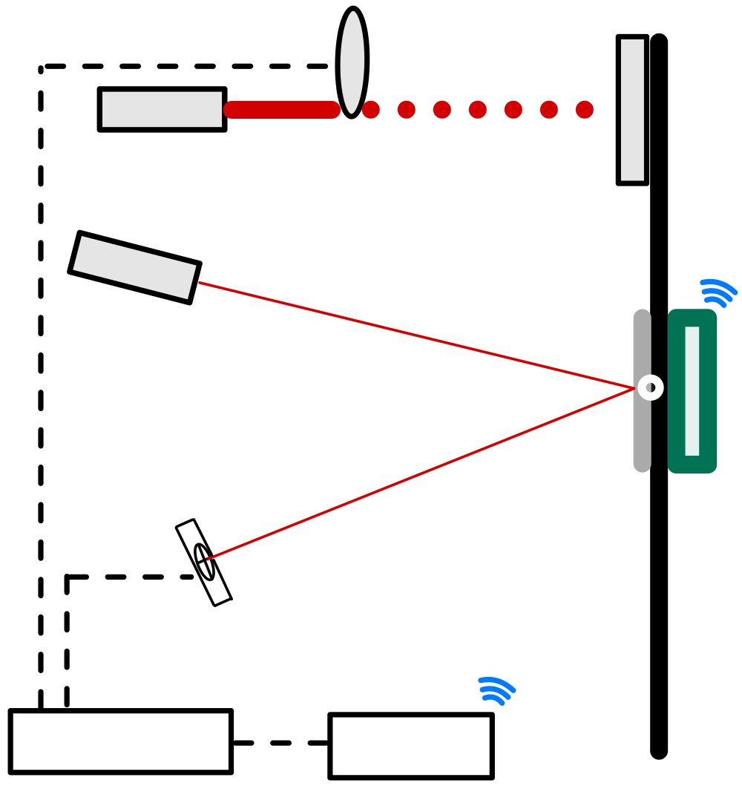
Proposed Method of Verifying DMD Control of SRP with Torsion Pendulum
Optical
Chopper
Drive the Torsion Pendulum at the Operating Frequency
Pendulum Arm
  DMD Mounted at the furthest moment arm
  Wireless Microcontroller and Battery
  Self-contained within a Vacuum Chamber
Optical Lever
  The tracking laser reflected off a mirror at the pivot
  Displacement measured by Photodetector
Minimizing External Disturbances
  Lock-in Amplifier to match optical chopper with Photodetector
Demonstrate Closed-Loop control by both actively damping and amplifying pendulum response
DMD System
Forcing
Laser
Tracking
Laser
Mirror
Microcontroller
Battery
4-Quadrant
Photodetector
Torsion Wire Pivot
Lock-In
Amplifier
Interpreter &
Transmitter
Pendulum Arm

Slide 12
Parametric Design of Experimental Setup with System of Equations

Slide 13
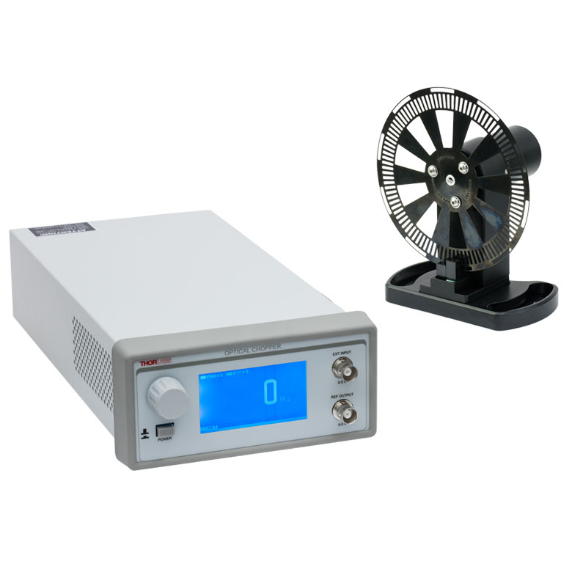
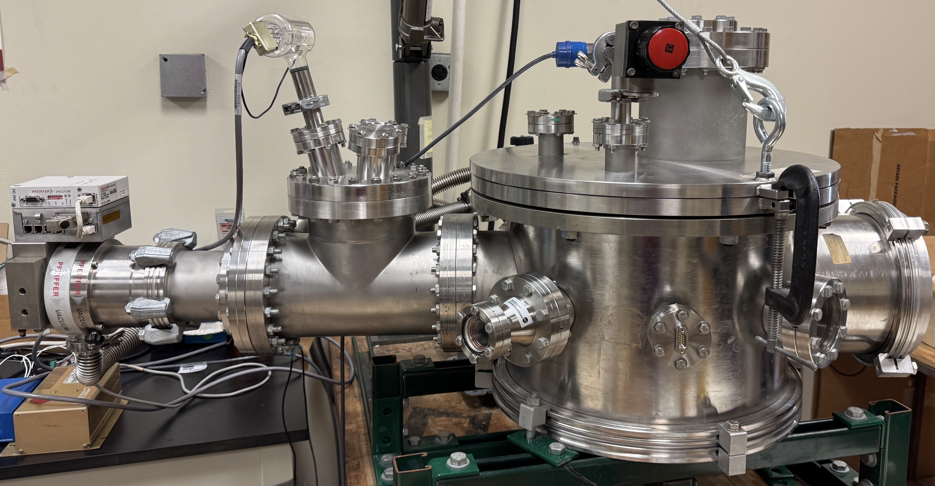
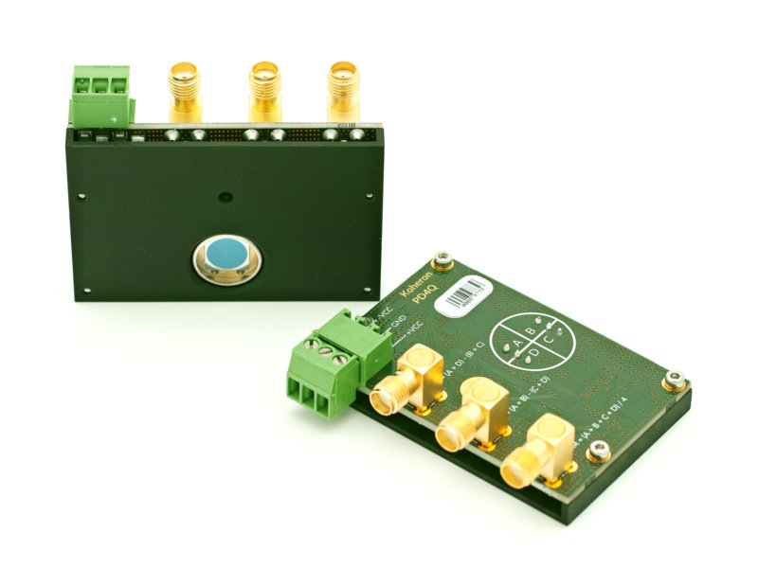
System of Equations and Initial Inputs
Vacuum Chamber
Optical Chopper
ThorLabs MC2000B
4Hz-10kHz
0.1-0.5 Duty Cycle
Photodetector
39 cm Diameter Vacuum Chamber
31 cm Height
10-5 Torr Vacuum Capable
Koheron 4-Quadrant Photodetector
8mm Diameter Target
We will endeavor to design the experiment to use the available equipment.

Slide 14
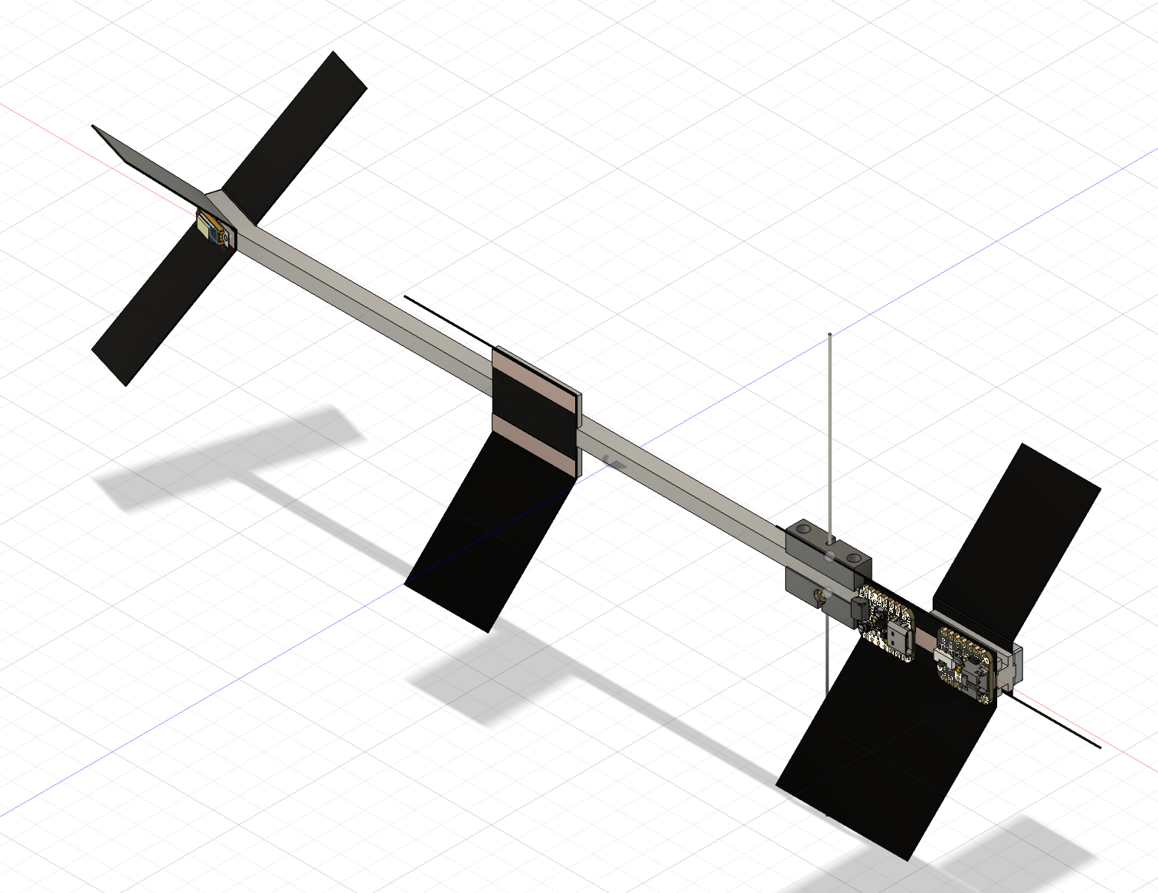
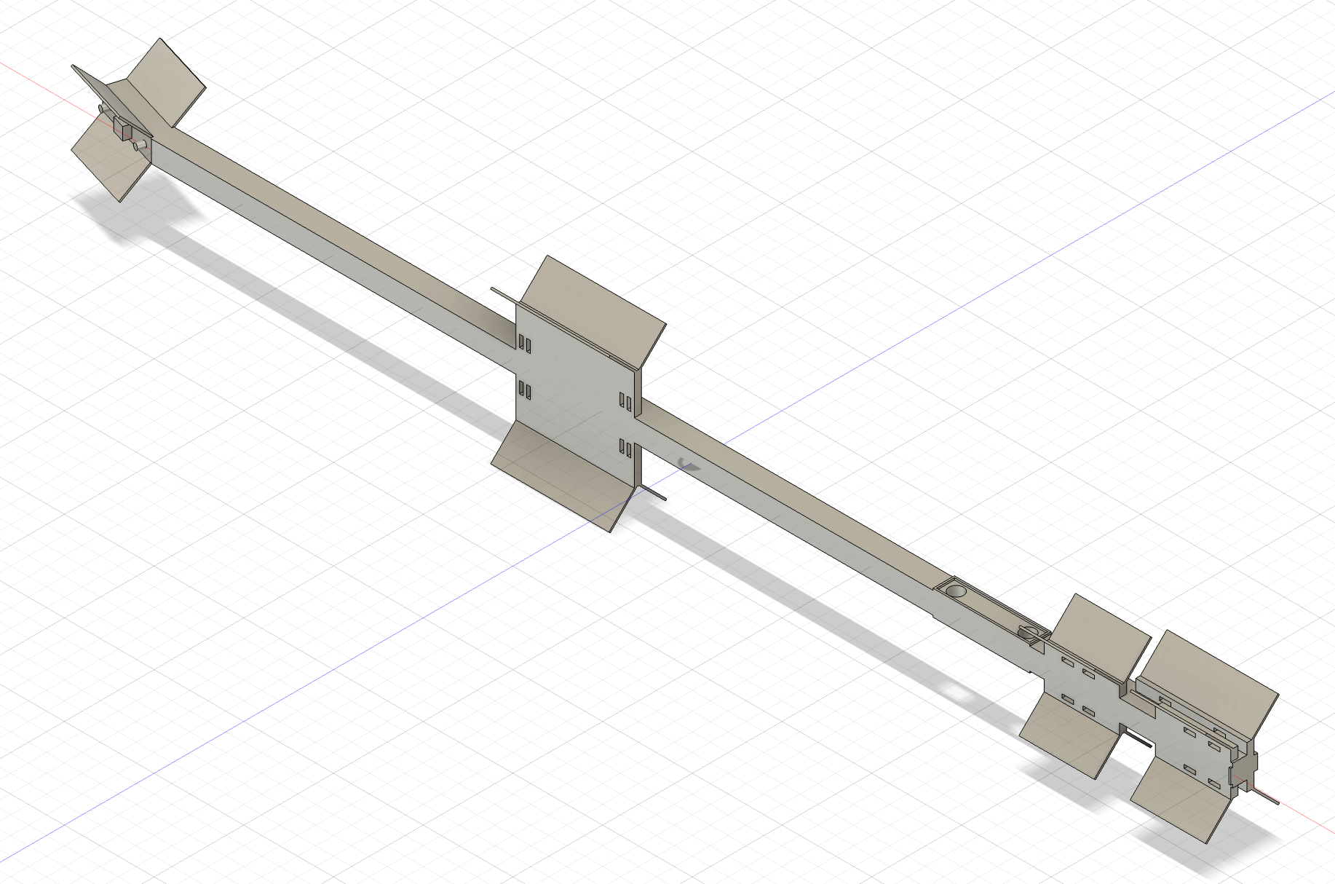
Mechanical Considerations
Recent Work
Updated Work
Combining PEEK, Copper Tape, and Black Anodized Aluminum.
Bulk material AlSi10Mg with copper tape heat piping
41 grams
35 grams
A polymer pendulum arm allows heat sources to be isolated while the copper tape and aluminum fins move heat away from the heated components. Further refinement is necessary.

Slide 15
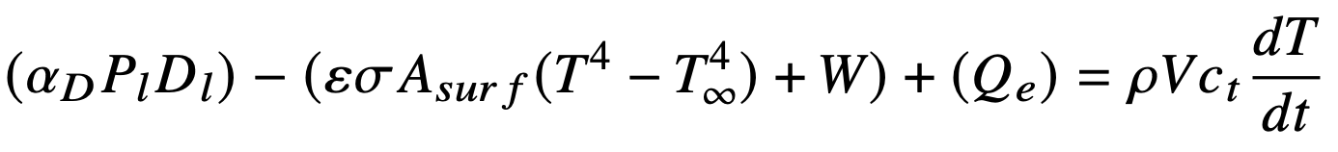
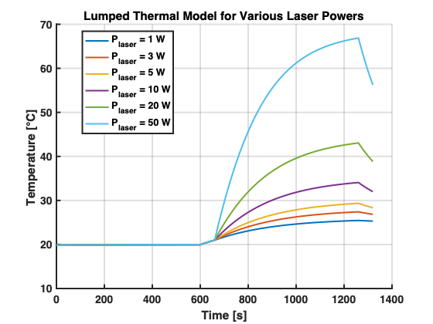
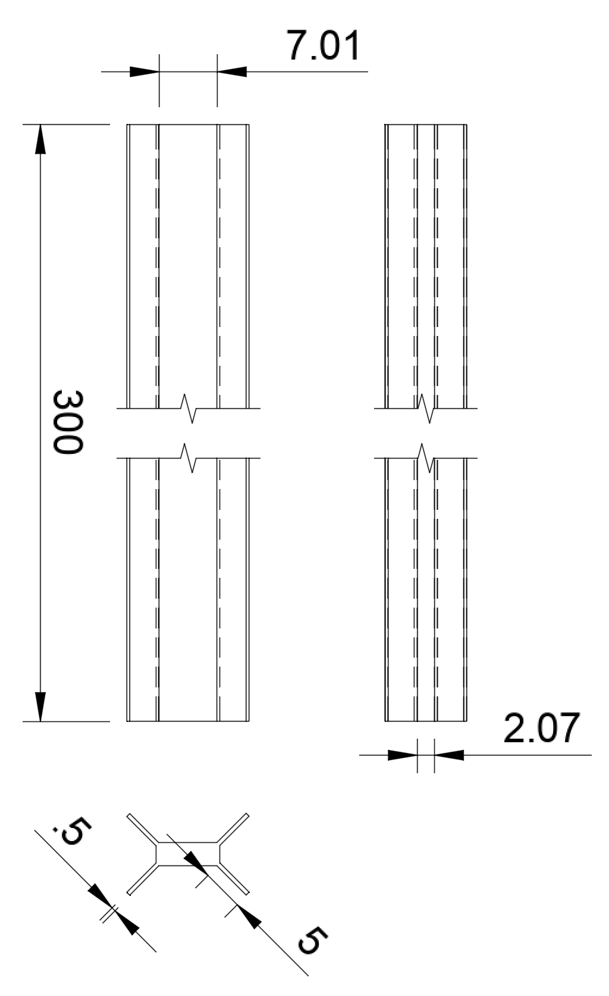
Thermal Considerations
Recent Work
Updated Work
Measuring Actual Thermal Output
  Bell Jar to low vacuum
  8x Thermocouples routed to components
  Multiple IR Cameras
Investigating Black Anodized Aluminum
  Anodize test aluminum samples
  Attempt to use Anodization Masking Tape for conductive surfaces
Improving DMD thermal interface
  Mill a copper block to fit DMD interface
Grid Fins
Measuring the components as they are intended to be used will further refine our predictions.

Slide 16
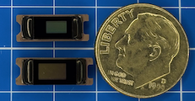
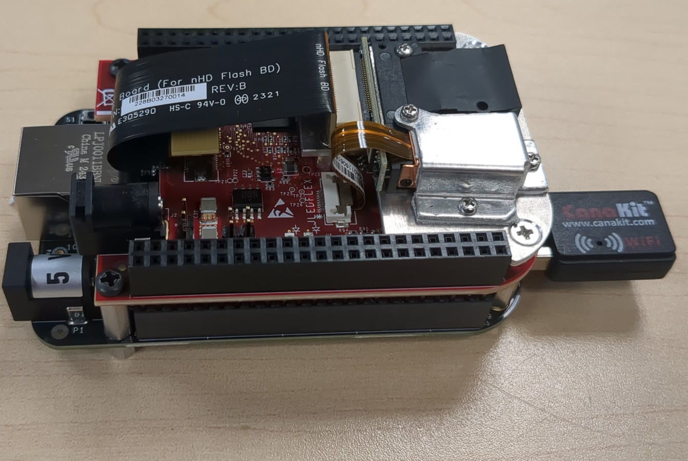
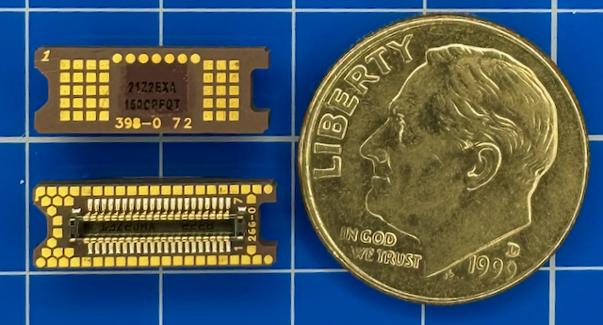
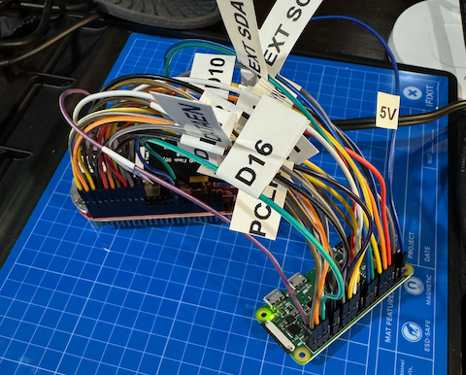
Digital Micromirror Device Selection
Commercially available DLP® Pico™
Examples of Thermal Interfaces
DMD | Diagonal (in.) | Max Vis. Illumination (W/cm²) | Typical Elect. Power (W) | Thermal Interface
DLP2000 | 0.20 | * | 0.045 | No
DLP160AP/CP | 0.16 | 26.1 | 0.07 | Yes
DLP2010 | 0.20 | 26.1 | 0.07 | No
DLP230GP/KP/NP | 0.23 | 26.1 | 0.17 | Yes
DLP3010 | 0.30 | 26.1 | 0.10 | Yes
DLP3310 | 0.33 | 26.1 | 0.16 | Yes
DLP4710 | 0.47 | 20.5 | 0.25 | Yes
DLP472TP | 0.47 | 20.5 | 1.0 | Yes
DLP160CP
DLP2000
DLP160CP
DLP2000
The Pico DMD systems are effectively interchangeable, which accelerates design between systems.
* Thermally Limited

Slide 17
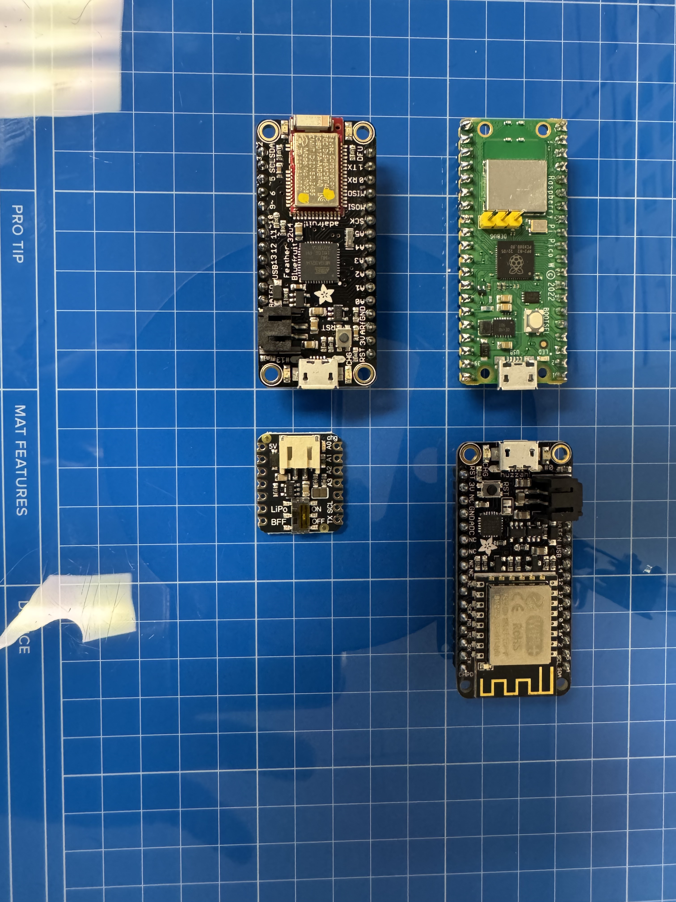
Wireless Microcontroller Selection
Commercially available DLP® Pico™
Microcontroller | Mass (g) | Typical Power (mW) | Typical Max Current (mA) | Interfaces
 |  |  |  | I2C | SPI | UART
Raspberry Pi Pico W | 4 | 238 | 150 | Yes | Yes | Yes
Adafruit Feather HUZZAH | 8 | 925 | 250 | Yes | Yes | No
Adafruit Feather Bluefruit | 7.4 | 96 | 26 | Yes | Yes | No
Adafruit QT Py Pico | 3.9 | 370 | 100 | Yes | Yes | Yes
RPi Pico W
HUZZAH
Bluefruit
QT Py
WiFi Bluetooth
Experimenting with the different microcontrollers will help identify the minimum requirements.

Slide 18
Electrical Considerations
Power Consumption Analysis
Updated Vacuum Operational Estimates
Configuration | Average Current (mA) | Peak Current (mA)
Initial Estimate | 177 | -
DLPC2000EVM | 232.24 | 270.61
DLP2000EVM + MCU* | 292.89 | 332.40
DLP2000EVM + MCU + LEDs OFF | 116.39 | 128.67
DLP2000EVM + MCU + LEDs OFF + 1 Hz | 111.21 | 130.96
Event | Duration (min) | Electrical Capacity (mAh) | Average Current (mA)
Pump Down | 10 | 10.11 | 60.65*
Preparation | 1 | 1.85 | 111.21
Execution | 10 | 18.54 | 111.21
Shutdown | 1 | 1.85 | 111.21
*Average current consumption of current MCU board.
Value expected to be lower with differing MCU board selection
Total Electrical Capacity | 32.35 mAh
Peak Operational Current | 130.96 mA
*MCU board used for analysis: Raspberry Pi Pico W
Possible savings by reducing pump down time by not requiring high vacuum conditions
Successfully able to reduce power consumption below initial estimates
Replacing the Raspberry Pi Pico W will further reduce power requirements.

Slide 19
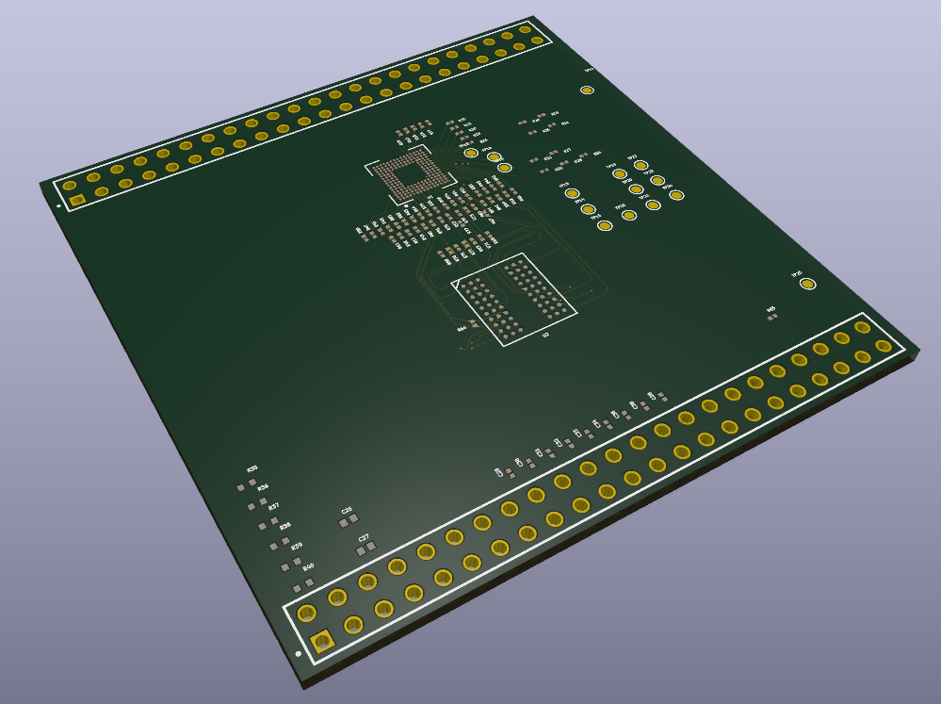
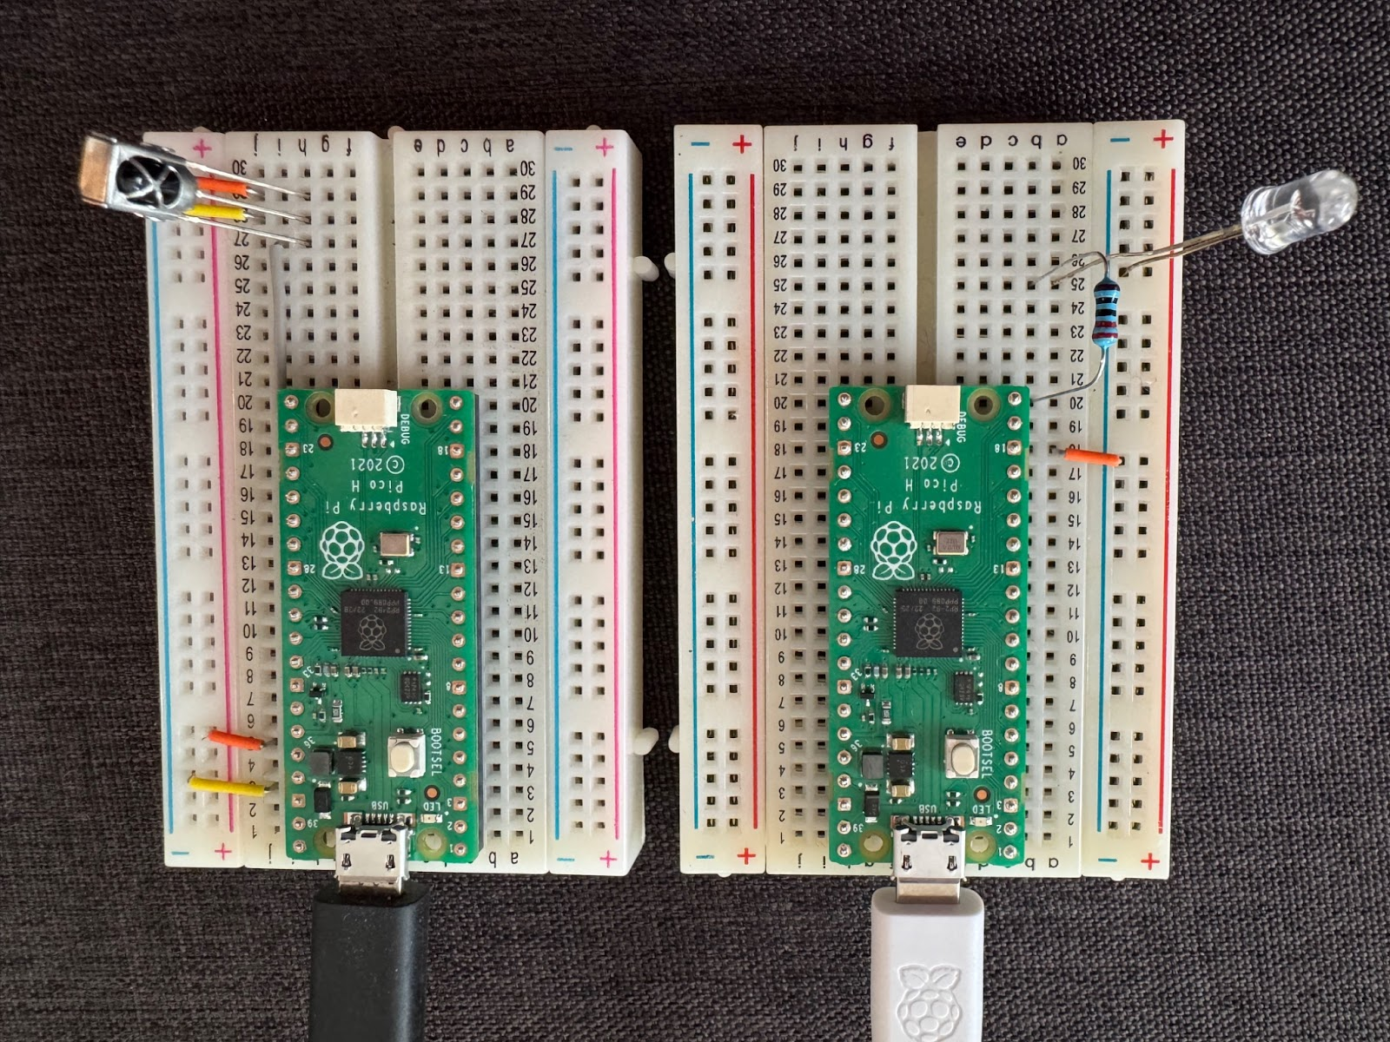
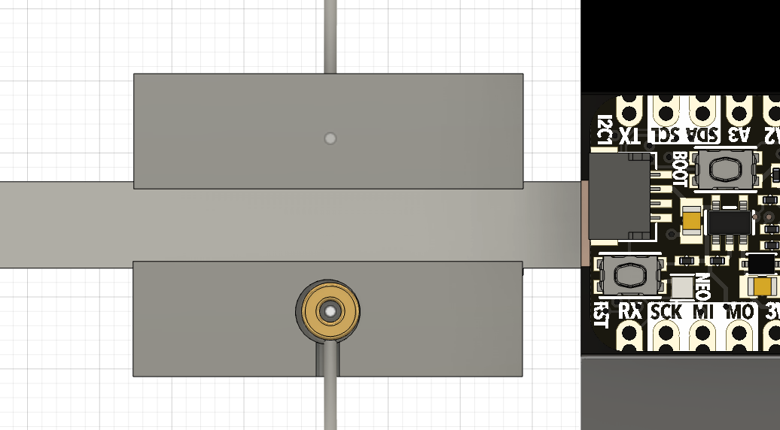
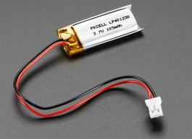
Areas for Further Work
Breakout
Boards
Optical
Comms
Narrow interfaces and define thermal and electrical requirements
Capable of 30 kbps one-way for only 3mA. Support deep sleep microcontroller operations.
External
Power
LiPo
Battery
Revisiting assumptions concerning using external power
LiPo battery meets power requirements for only 3 grams. Investigating reinforced epoxy resin.

Slide 20
Areas for Further Work

Slide 21

Questions?
Suggestions?
Upcoming Conferences
International Symposium on Space Sailing
July 1st Delft, NLD
ASCEND
July 22nd Las Vegas, NV
jmesser@usc.edu
pastizzo@usc.edu

Slide 22
Electrical Considerations
Initial Estimation
Updated Work
Function | Component | Average Current (mA)
DMD | DLP2000 | 30
DMD Controller | DLPC2607 | 63
PMIC | DLPA1000 | 12
Microcontroller | Raspberry Pi Pico W | 72
Commanded via RPi Pico I2C
Average Current from 110mA to 55mA
Max Current from 105mA to 68mA
Event | Duration (min) | Electrical Capacity (mAh) | Max Current (mA)
Pump Down | 45 | 54 | 72
Preparation | 1 | 3 | 177
Execution | 10 | 30 | 177
Shutdown | 1 | 3 | 177
90 | 177
Saft LS 14500 HT (Li-SOCl₂)
2200 mAh & 100 mA
AA-Size & 17 g
We are designing breakout boards to further identify opportunities to reduce power requirements.
Thank you, Joshua Pastizzo

Slide 23
Solar Sailing Attitude Control of GEO Satellite (Lievre)
Yaw
Roll
Derivations of this method are found on several GEO satellites
Fixed Solar Trim Tabs are attached to solar arrays. Solar Array Drive Actuator is used to create a torque bias about Roll and Yaw
  Does not provide Pitch control
  Control Torque 10-20x10⁻⁶ N⋅m
Requires Solar Arrays to be pivoted away from solar vector to generate torques
  Acceptable control with 1% loss of Solar Array Efficiency (Azor 1992)
(Liever, 1985)
For GEO satellites, Pitch continues to
require Momentum Dumping
(Sidi, 1997)

Slide 24
IKAROS Method
Launched in 2010 on Venus flyby
Employed a novel reflectance control device (RCD) for attitude control
  IKAROS was spun to deploy solar sail
  Flexible liquid crystal sheets were affixed to the perimeter of the solar sail
  The optical reflectivity of the RCD changed with the applied voltage
  Specular when ON and diffuse when OFF
The sequence of the RCD was synchronized with the satellite’s spin for fuel-free changes to the satellite’s spin axis
This propellant-free attitude control method still requires momentum-dumping fuel to maintain its Roll rate
(T. Tsuda et al, 2011)
(T. Tsuda et al, 2011)

Slide 25
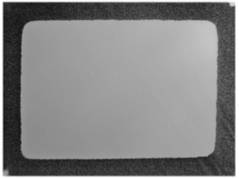
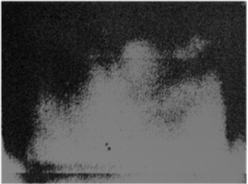
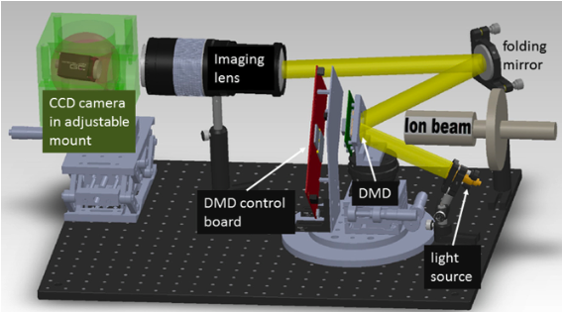
Evaluation for the Space Environment
Gamma Radiation Exposure Testing
COTS DMD 20.0 krad(Si)
Re-windowed DMD 20.0 krad(Si)
Normal Operation MTBF >650,000 hours
  Individual hinge lifetime >3x10¹² duty cycles
  Duty cycle patterns can effectively extend lifetime indefinitely
Testing conducted for Space-Based Multi-Object Spectroscopy
  Vibration and Shock
  Gamma Radiation
  Heavy Ion Irradiation
  Proton Radiation
  Cryogenic Temperatures (78K)
Space Environmental Testing indicated DMDs self-healed through annealing
(Oram et al, 2019)
18.6 krad(Si) Typical for L2 over a 4-year mission
Heavy Ion Radiation Exposure Testing
(Travinsky et al, 2016)
Inherent Recovery from Single Event Upsets

Slide 26
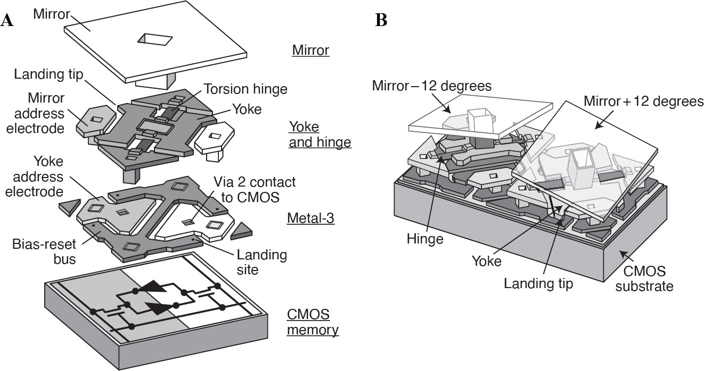
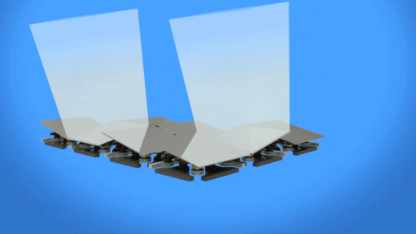
How does a DMD work?
The next micromirror tilt state is stored in the memory immediately beneath the micromirror.
A “mirror clocking pulse” is applied to the mirrors, flexing their spring tips attached to the yoke.
The bias voltage is turned off, releasing the mirrors from their latch.
Opposing electric fields are applied to the mirrors to rotationally separate the mirrors staying in their current state from those transitioning to a new state.
The bias voltage is turned back on to finish landing and latching the mirrors in their new state.
The memory is again updated for the next state, and the process repeats.
(Hornbeck, 1997)
(Texas Instruments, 2024)
Each micromirror is individually commanded and globally executed

Slide 27
Initial Considerations for Assembling the System of Equations
Electrical
Thermal
Mechanical
Sufficient capacity for the duration of setup and experiment
Provide necessary maximum current
Safely operate inside a vacuum
Must quickly transfer heat away from heat sources
Must either store heat in pendulum arm or transfer heat into surroundings
Pendulum arm must operate within vacuum chamber
Displacement measurement must observe with sufficient sensitivity

Slide 28
REFERENCES
1. Oram, K., Vorobiev, D., Ninkov, Z., "The effects of gamma radiation on digital micromirror devices," Vol. 10932, SPIE, 2019, pp. 109320V–12.
2. Lievre, J., "Solar Sailing Attitude Control of Large Geostationary Satellite," IFAC Proceedings Volumes, Vol. 18, No. 4, 1985, pp. 29–32.
3. Sidi, M.J., "Spacecraft Dynamics and Control: A Practical Engineering Approach," Cambridge University Press, 1997,
4. Ito, T., Ikari, S., Funase, R., "Active use of solar radiation pressure for angular momentum control of the PROCYON micro-spacecraft," Acta Astronautica, Vol. 152, 2018,
5. Scull, J., "Guidance and Control of the Mariner Planetary Spacecraft," IFAC Symposium on "Automatic Control in the Peaceful Uses of Space",
6. Kawaguchi, J., and Shirakawa, K., "A Fuel-Free Sun-Tracking Attitude Control Strategy And the Flight Results in Hayabusa (MUSES-C)," Advances in the Astronautical Sciences, Vol. 127, 2007, pp. 1989–1996.
7. Tsuda, Y., Saiki, T., Funase, R., "Generalized Attitude Model for Spinning Solar Sail Spacecraft," Journal of Guidance, Control, and Dynamics, Vol. 36, No. 4, 2013, pp. 967.
8. Travinsky, A., Vorobiev, D., Ninkov, Z., "Effects of heavy ion radiation on digital micromirror device performance," Optical Engineering, Vol. 55, No. 9, 2016,
9. FLAMENT, and PATRICK, "ATTITUDE CONTROL DEVICE USING SOLAR SAILS FOR A SATELLITE STABILIZED ON THREE AXES," No. US5133518A, 1992,
10. Goodzeit, N.E., and Ratan, S., "Spacecraft disturbance trimming system," No. 7104506, 2006,
11. Orphee, J., Diedrich, B., Stiltner, B., "Solar Sail Attitude Control System for the NASA Near Earth Asteroid Scout Mission," [online database]
12. Chu, Y.L., Tabiryan, N.V., and Swartzlander, G.A., "Experimental Verification of a Bigrating Beam Rider," Physical Review Letters, Vol. 123, No. 24, 2019,
13. Nichols, E.F., and Hull, G.F., "The Pressure Due to Radiation. (Second Paper.)," Physical Review (Series I), Vol. 17, No. 1, 1903, pp. 26–50.
14. Hornbeck, L.J., "Digital light processing for high-brightness high-resolution applications," Projection Displays III, Vol. 3013, SPIE, 1997, pp. 27–40.
15. Chandrasekar, K., Carman, A.E., Watts, R.M., "Characterization of a Sensitive Inverted Pendulum Thrust Stand for Pulsed Propulsion With Optical Heterodyne Sensor and Lock-In Detection," AIAA SCITECH 2025 Forum, American Institute of Aeronautics and Astronautics, 2025,
16. Lebedew, P., "Untersuchungen über die Druckkräfte des Lichtes," Annalen Der Physik, Vol. 311, No. 11, 1901, pp. 433–458.

