Slide 1
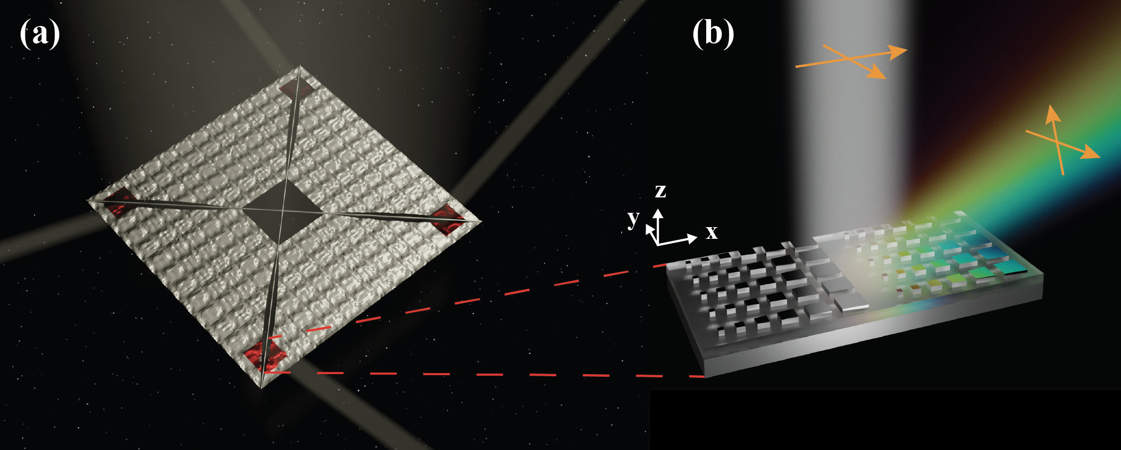
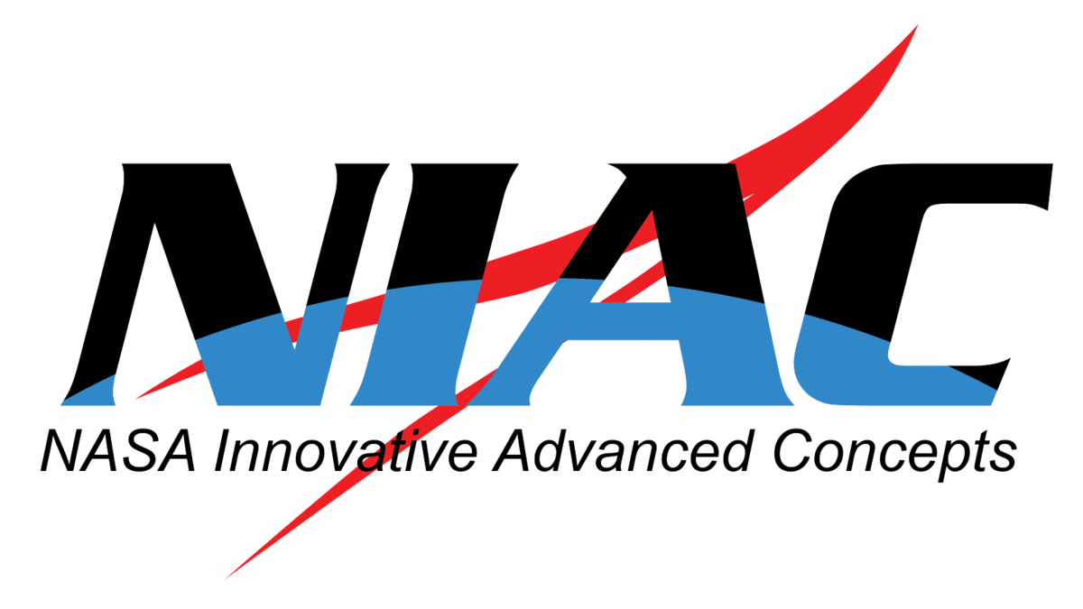

Phase gradient metasurfaces for solar sail attitude control
4-28-2025
Tom Joly-Jehenne – Ph.D. Student / Artur Davoyan - P.I.
Department of Mechanical and Aerospace Engineering, University of California, Los Angeles

Slide 2
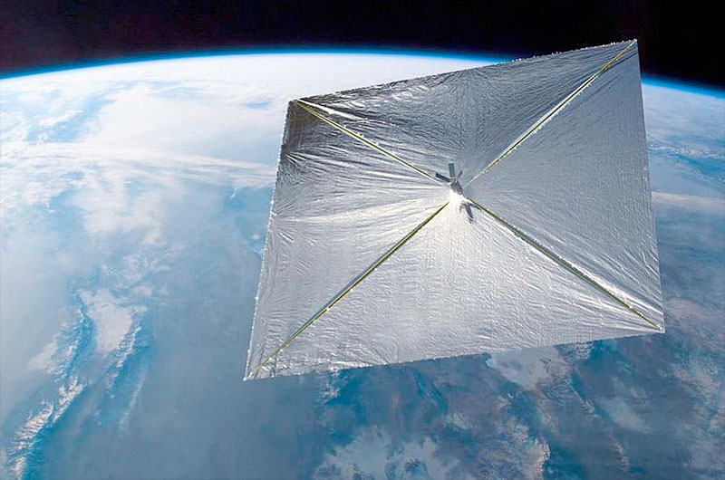
Objectives
Examine novel methods of sail attitude controls
  Reflect sunlight in non-mirrorlike way to induce in-plane forces
  Allow a complete attitude and direction control with a lightweight structure

Slide 3
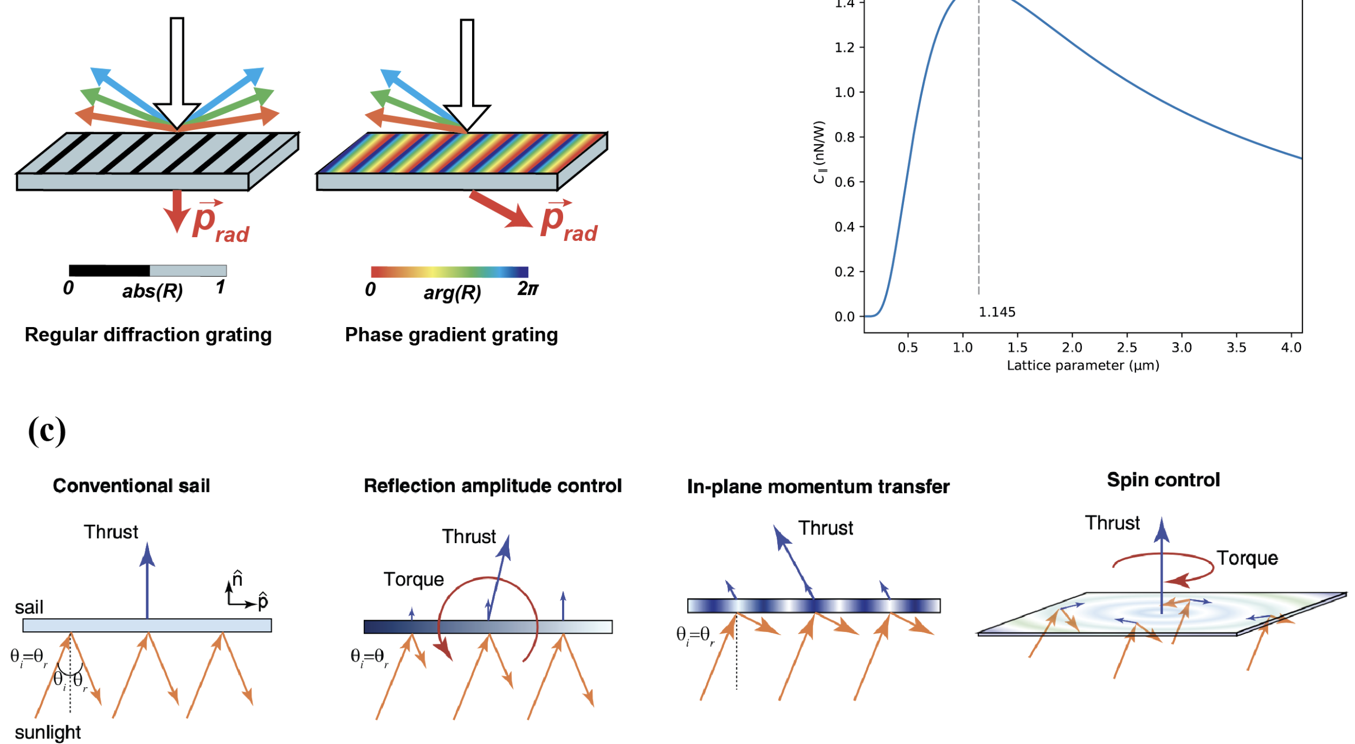
In-plane impulse transfer
Allows to perform maneuvers in the 6 degrees of translation and rotation
Allows to control the local shape of the sail

Slide 4
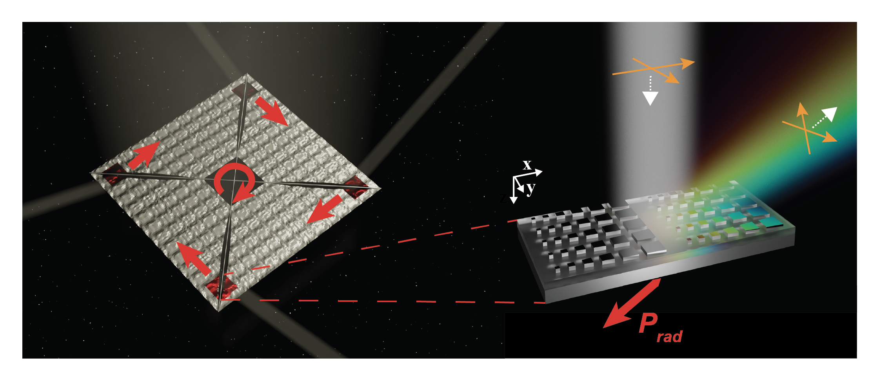
In-plane impulse transfer
Example of rotation around the Roll axis

Slide 5
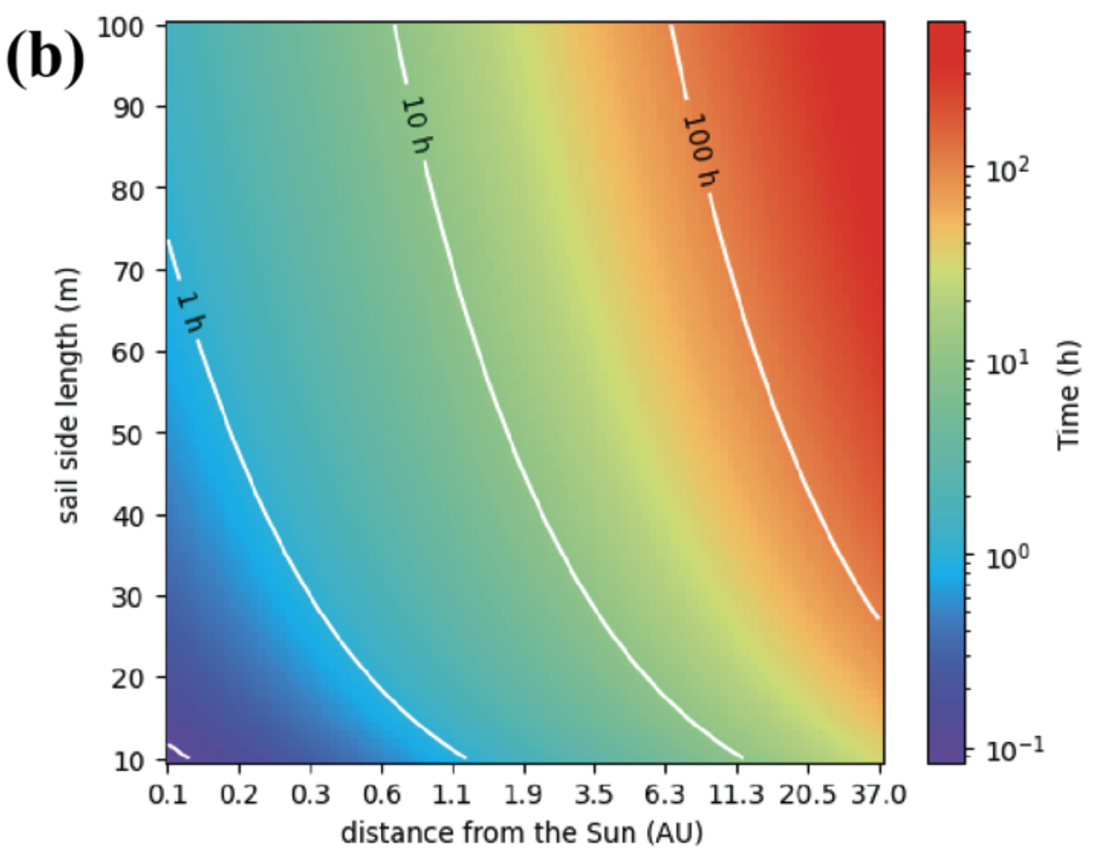
In-plane impulse transfer
Reasonable amounts of time (<300h) even as far as Neptune’s orbit
Time needed to perform half a turn around the roll axis

Slide 6
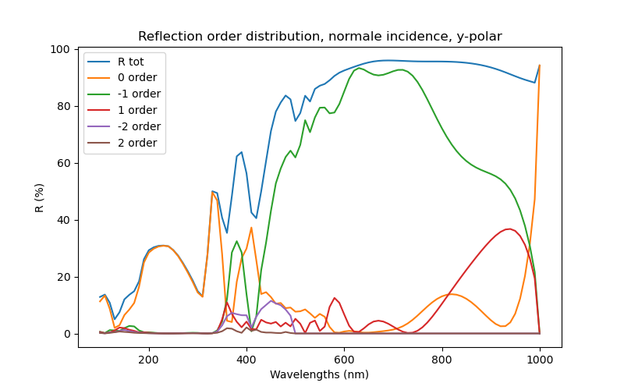
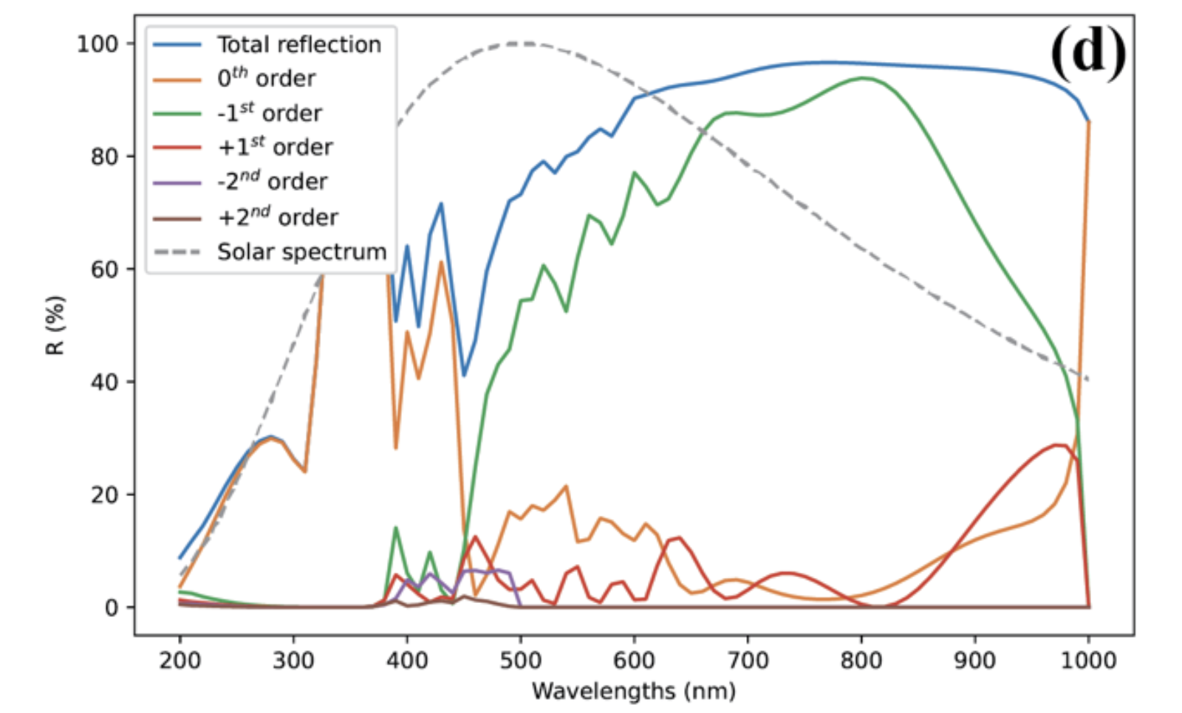
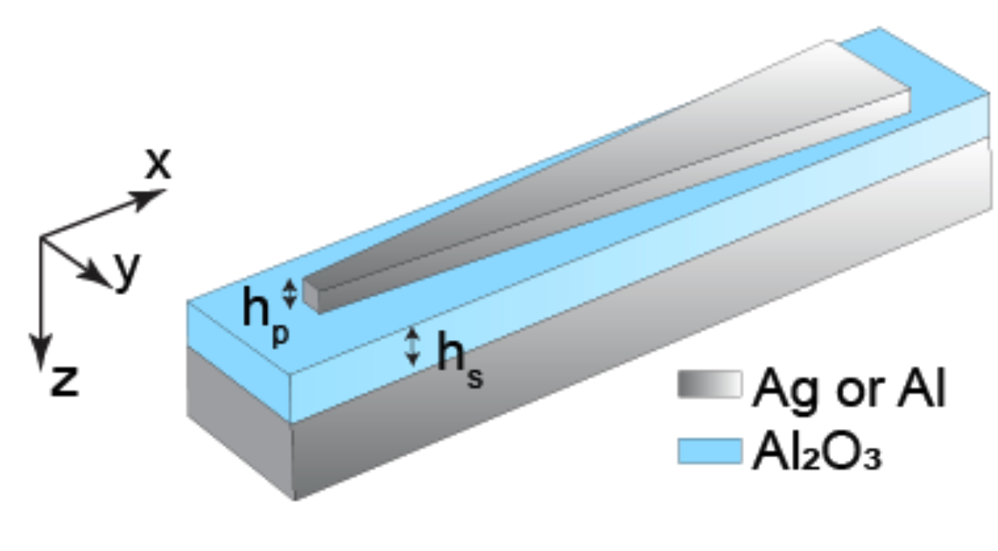
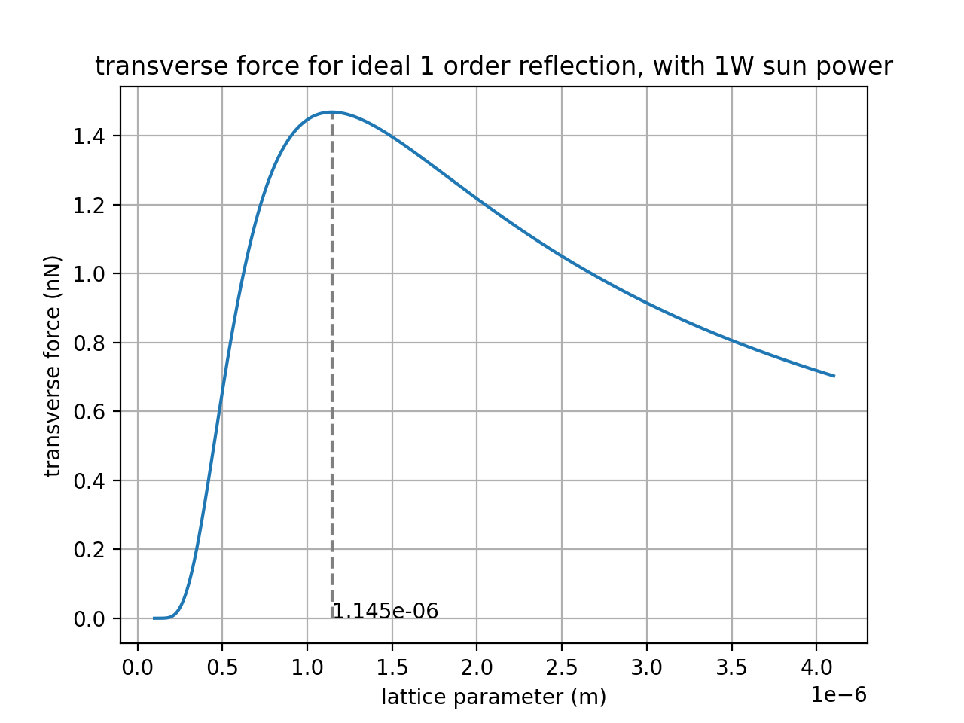




Optimized coating – solar spectrum
$$1 μm$$
broadband
$$\vec{E_{i_{y}}}$$
Broadband
$F_{||}≈0.4nN/W$
Overlaps parts of the solar spectrum
$$\sim 1μm$$

Slide 7
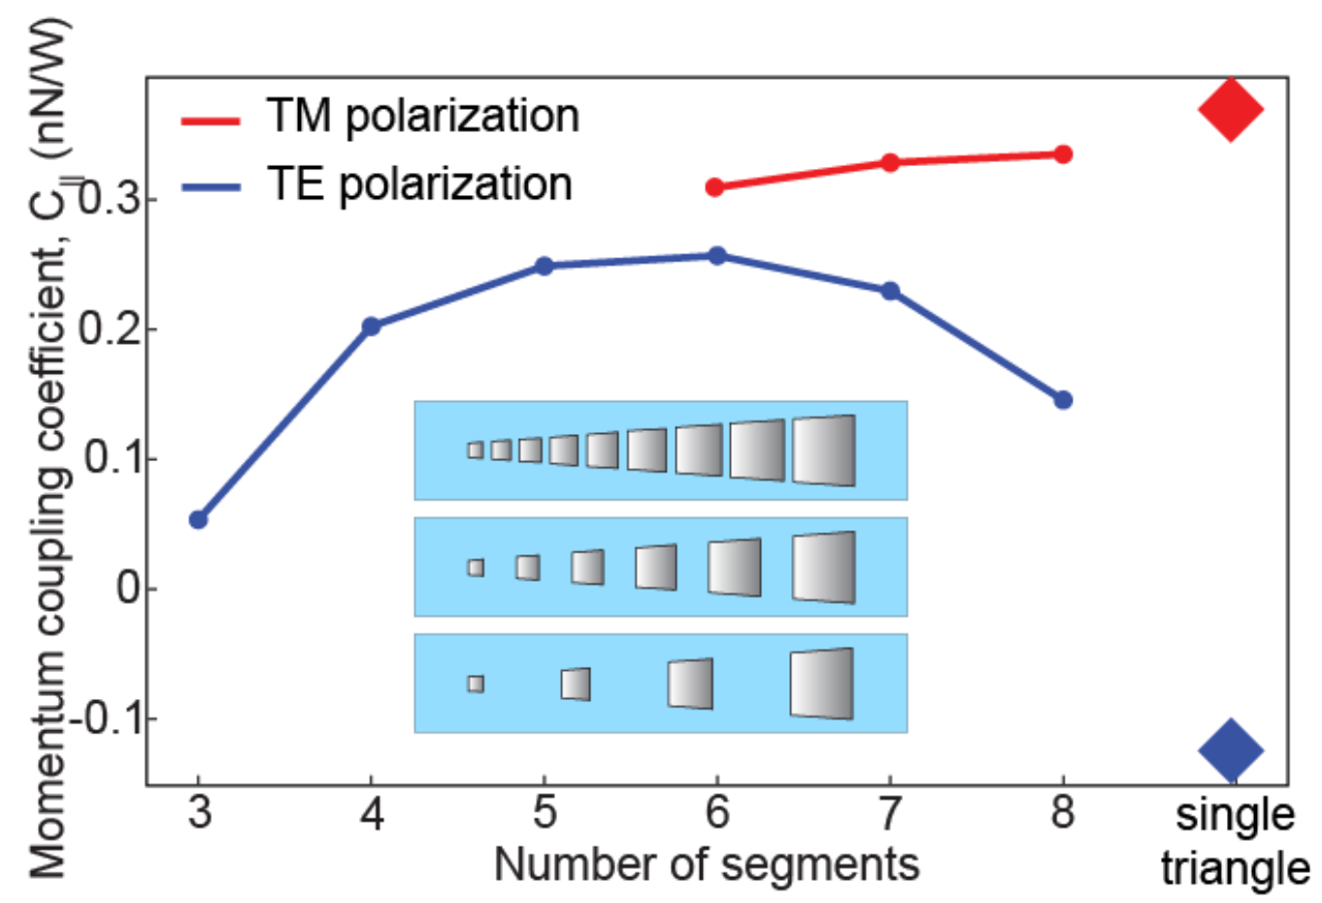

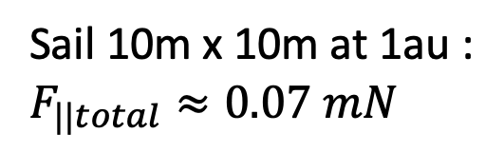
Optimized coating – unpolarized light
Works with unpolarized light (sunlight)
$F_{||total}≈0.56nN/W$
Sail 10m x 10m at 1au :
$F_{||total}≈0.07 mN$

Slide 8
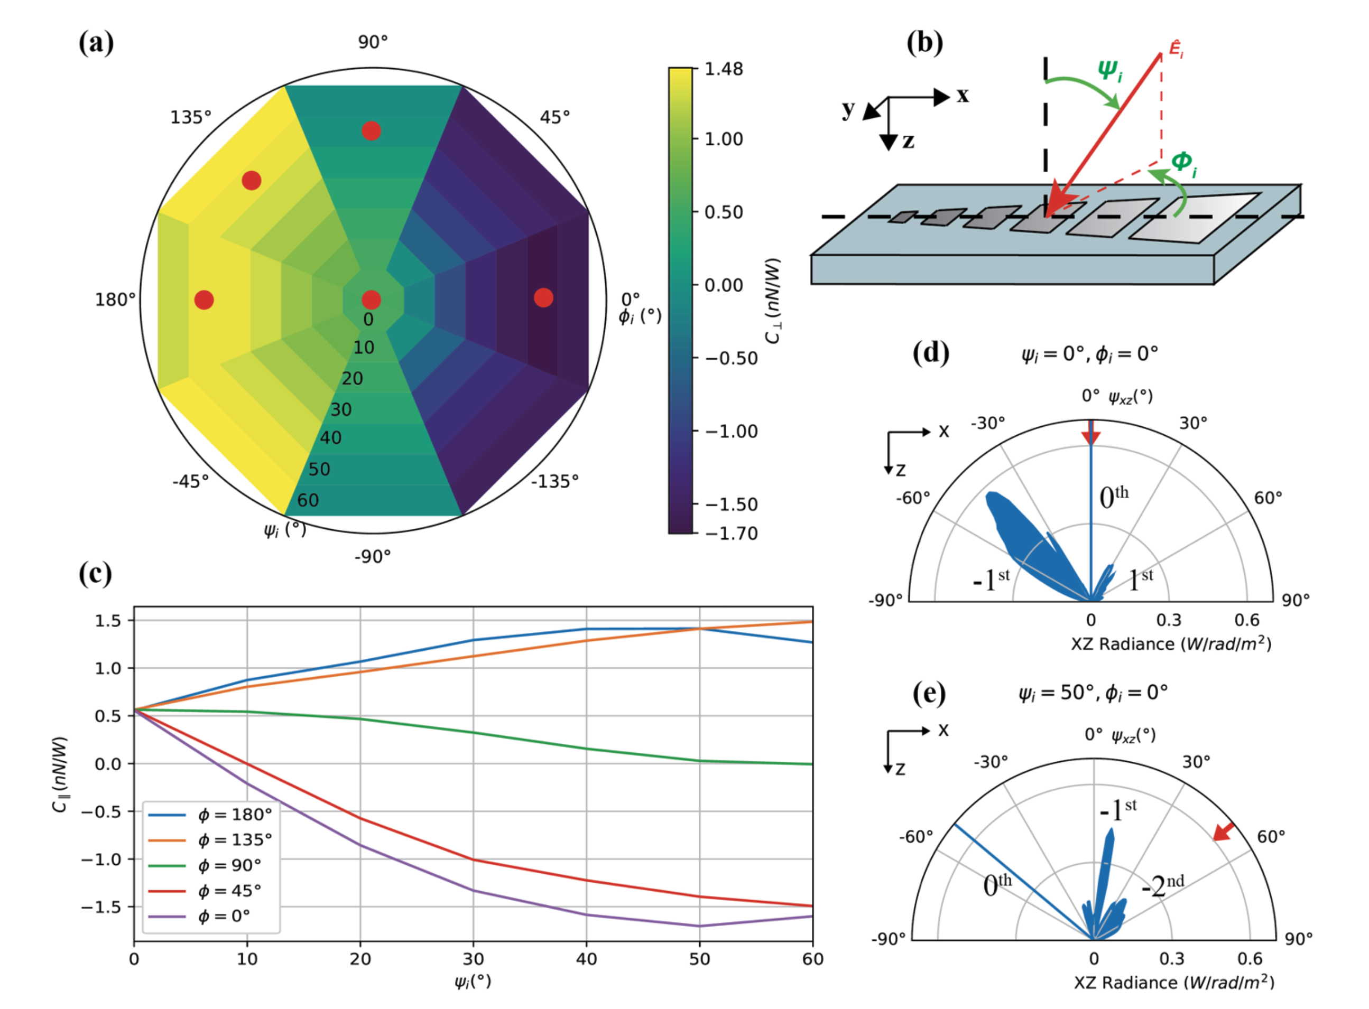
Incidence sensitivity
Transverse force cancels for a small negative incidence angle
possibility to turn off the anomalous reflection by slightly tilting the patch
No rapid variations of the transverse force with the sail orientation
good resilience to small variations of local flatness of the sail.

Slide 9
Current optimizations
Ag/Si -> Si/SiO₂
compatible with industry standard for cheap and precise fabrication
Large area covering
Extend to short wavelengths (200-500nm)
Investigate the active tunability of such structures and their application as optical antennas for Free Space Optic space communication (FSO)
In-plane permanent force open possibilities for new space trajectories ! (orbit stabilization, higher acceleration…)

Slide 10

Acknowledgments
Research supervised by Professor Artur Davoyan
Funded with NIAC program
And now ?
Small lightweight exploration probes
Cheap
High rate
Large Heavy exploration missions
Expensive
Low rate
What future for solar sailing ?
A cheap propulsion method enabling fast missions towards distance places …
Thank you for your attention

