Slide 1

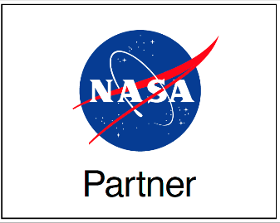
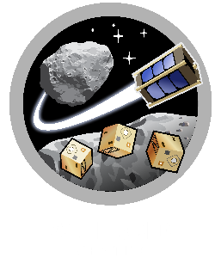
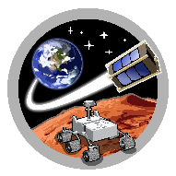
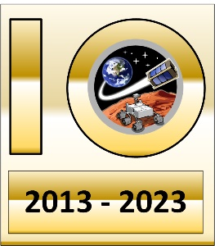
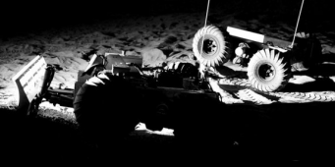
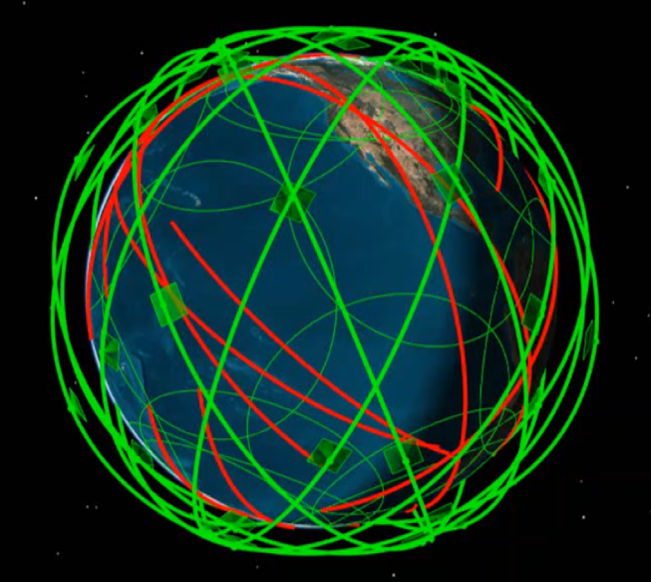
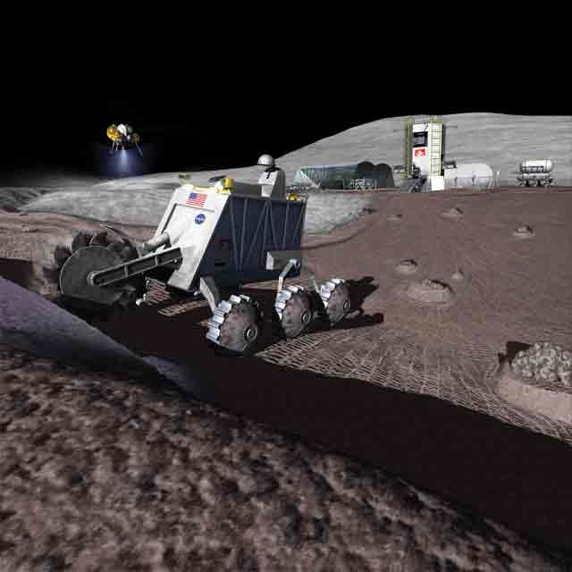
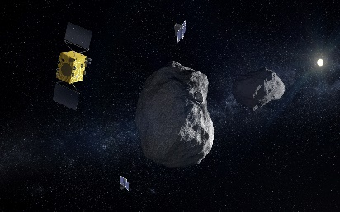
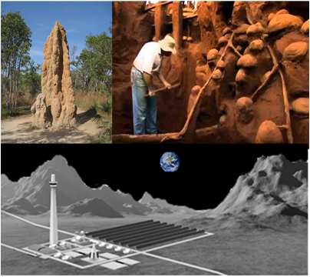
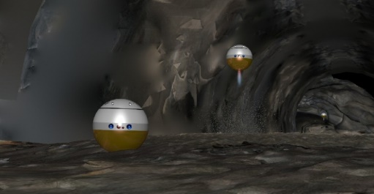
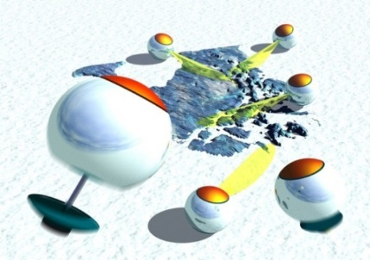
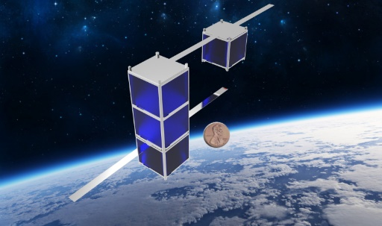
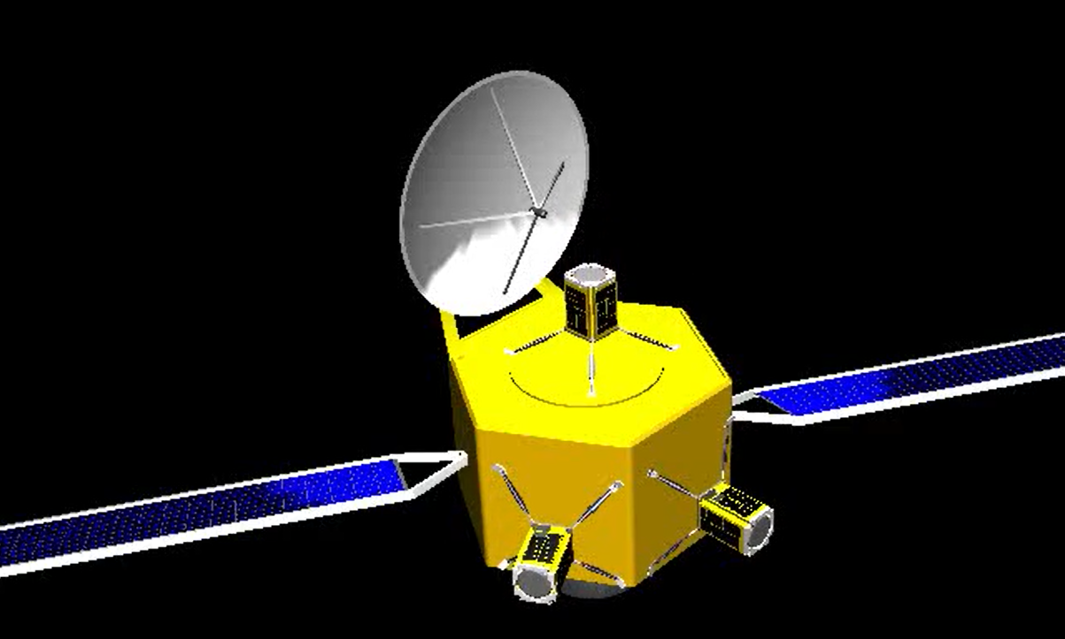
ASTEROIDS
SpaceTREx
A Nano-Lander Concept for In-Situ Exploration of Titan’s Hydrocarbon Lakes: A Hitch hike with Dragonfly
Hrithik Thukral & Nathaniel van der Leeuw
Space and Terrestrial Robotic Exploration (SpaceTREx) Laboratory
Aerospace and Mechanical Engineering Department
University of Arizona

Slide 2
Outline
Motivation
Challenges
Objectives
Approach
Results and Discussions
Conclusion and future work

Slide 3
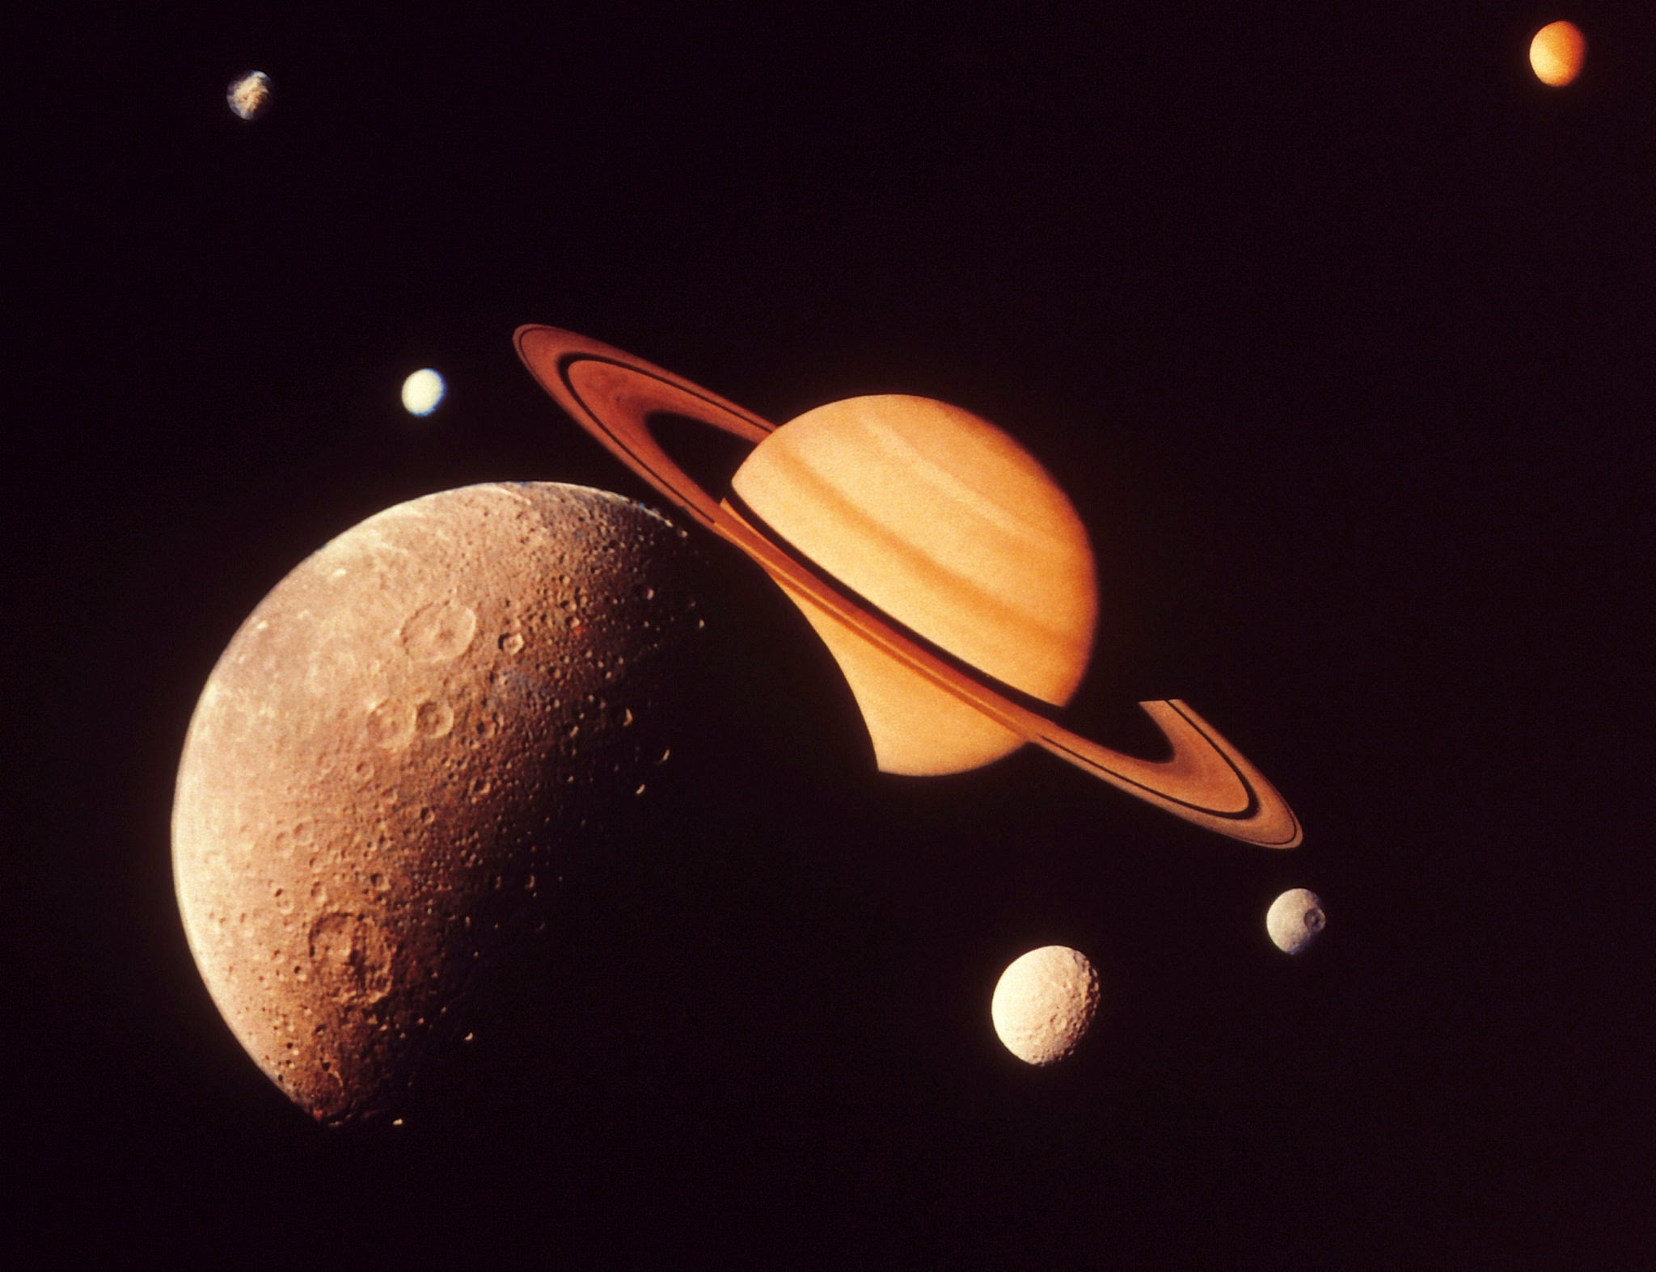


Motivation
Titan: Prime candidate for Astro biological study
Atmosphere analogous to early Earth
Shared launch and cruise phase
Insights to prebiotic chemistry and organic evolution
Dense atmosphere and stable surface liquids
Kraken Mare: Largest known hydrocarbon lake
No direct sampling of fluid or lakebed characterization
No mission has landed in or sampled extraterrestrial liquids
Piggyback opportunity

Slide 4
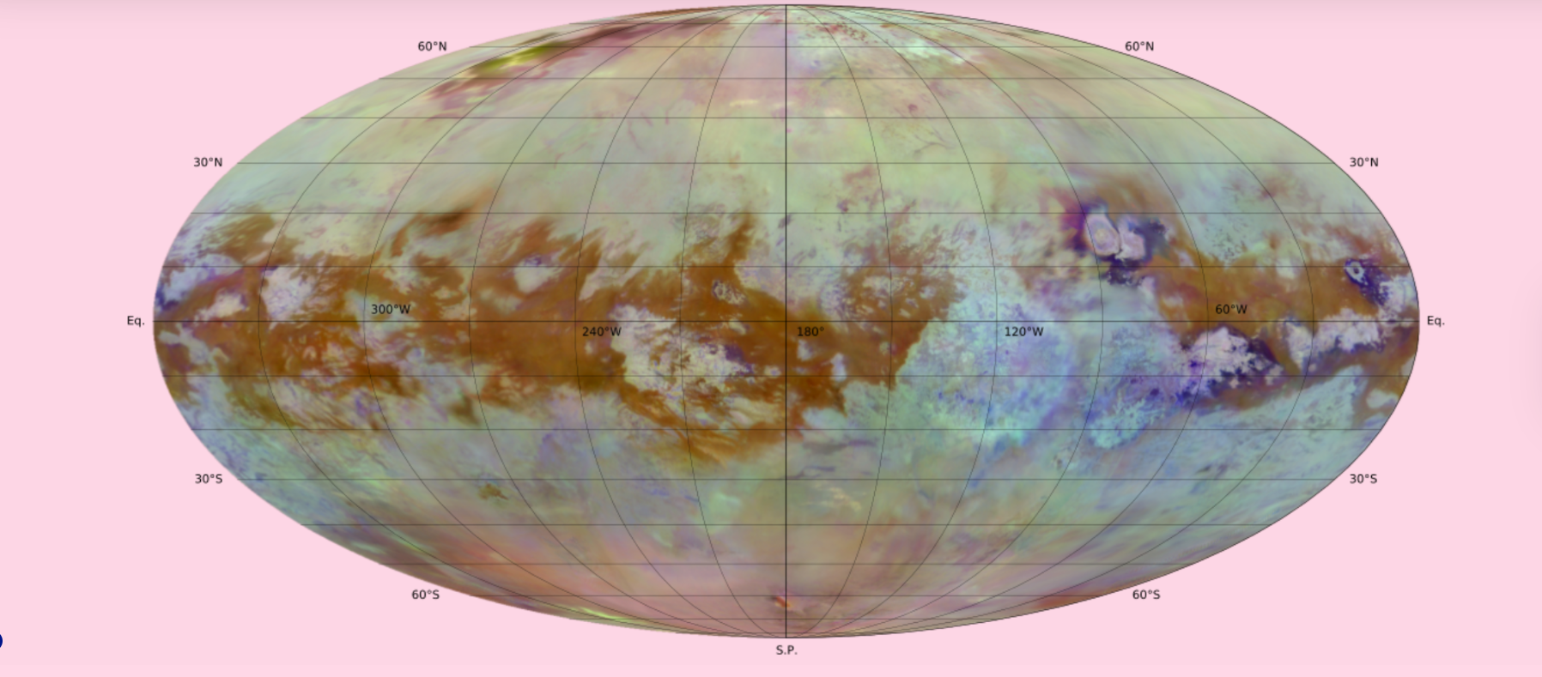
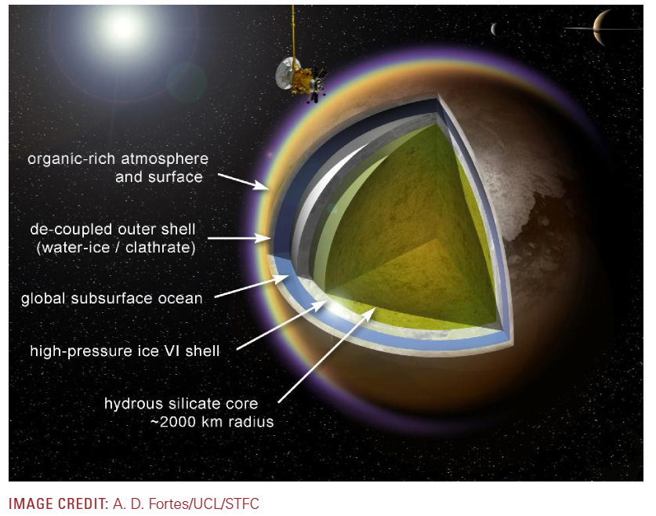
Affholder, A., P.M. Higgins, et al. (2025), The Viability of Glycine Fermentation in Titan’s Subsurface Ocean. The Planetary Science Journal

Slide 5
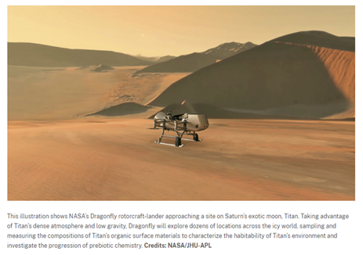
DragonFly concept

Slide 6
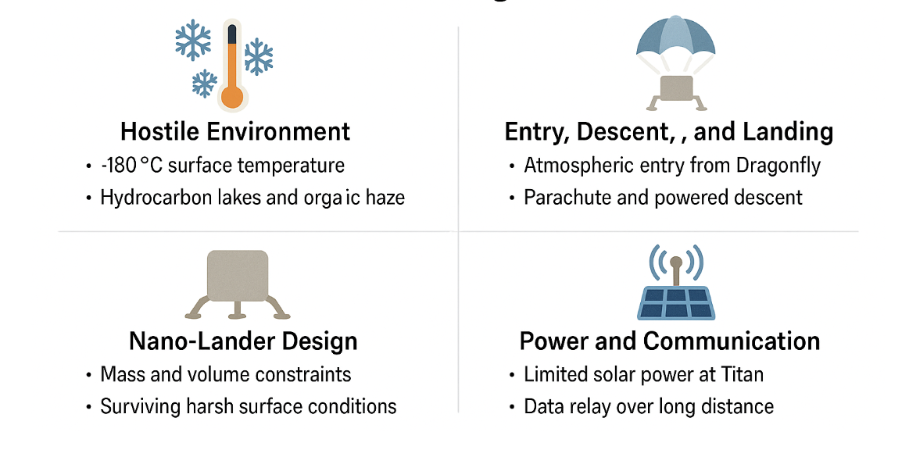
Challenges
n

Slide 7
Mission Objective
To conduct in-situ investigation of the chemical and physical properties of Kraken Mare’s shoreline and subsurface lake environment on Titan using a nano scale amphibious lander with the goal of advancing our understanding of prebiotic chemistry and potential habitability in hydrocarbon seas.

Slide 8
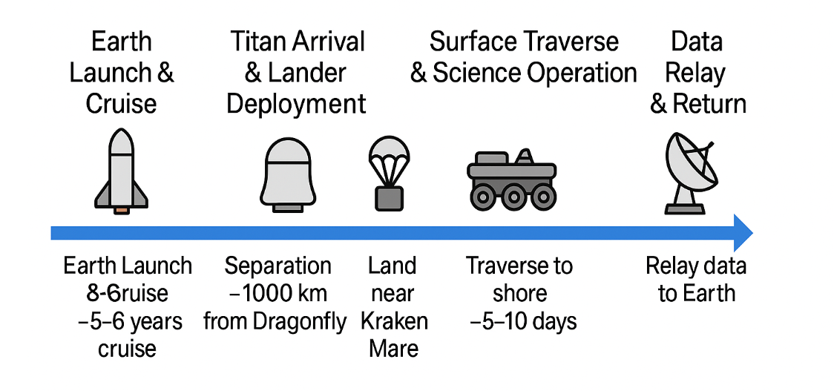
Mission Conops

Slide 9
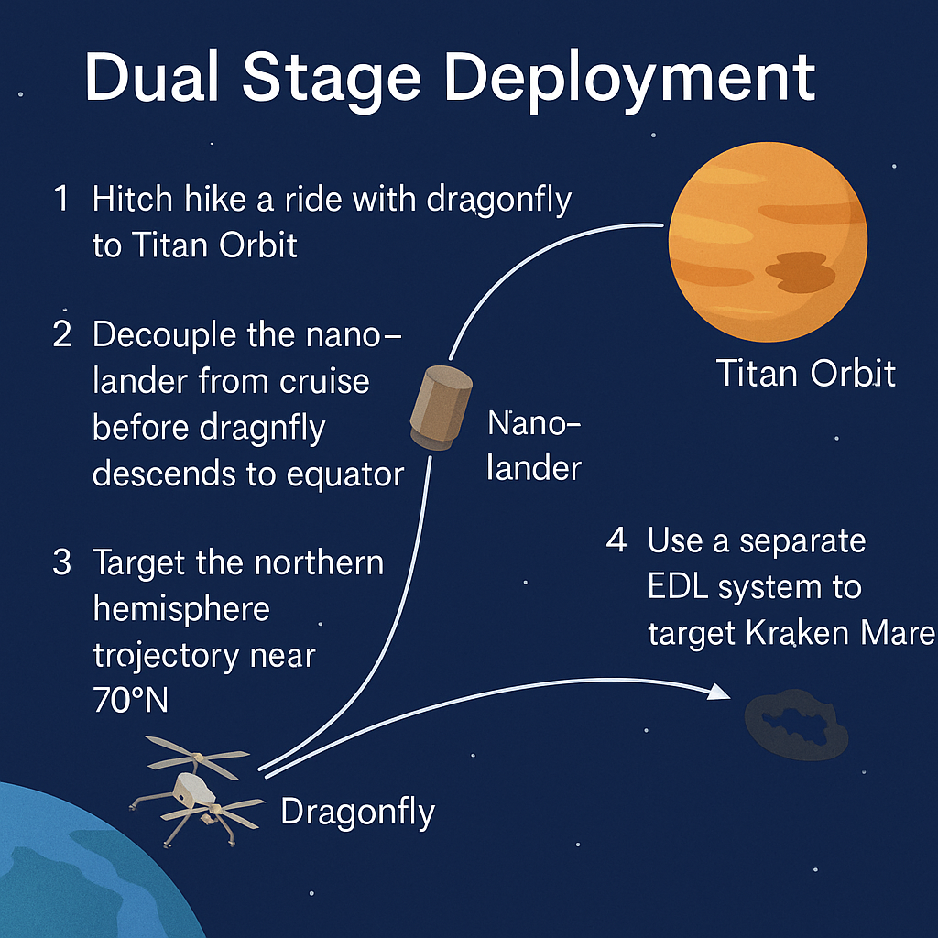

Slide 10

EDL system
Leveraging titan’s dense atmosphere for passive aerobraking
Target shoreline
Drogue and main parachute system

Slide 11
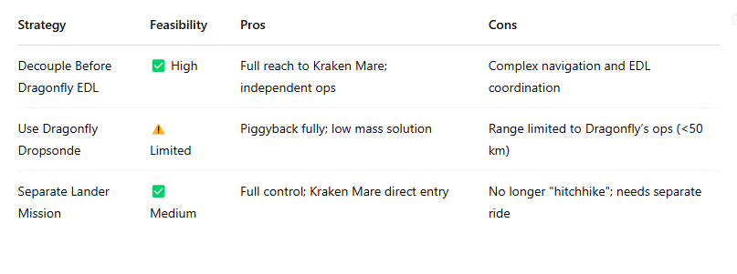
Alternate approach comparisons

Slide 12
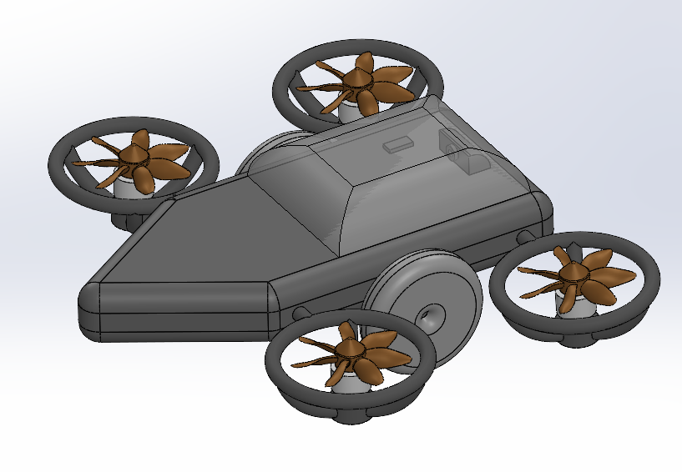
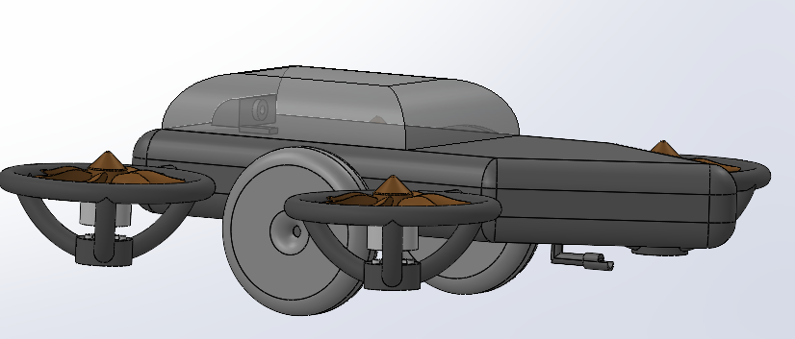
Nano Lander
Dimensions:
Chassis:
1.15 m x 0.5 m x 0.25 m
Wheels: diameter - 0.2 m, width - 0.08 m
Wings: diameter - 0.25 m,
height - 0.12 m

Slide 13
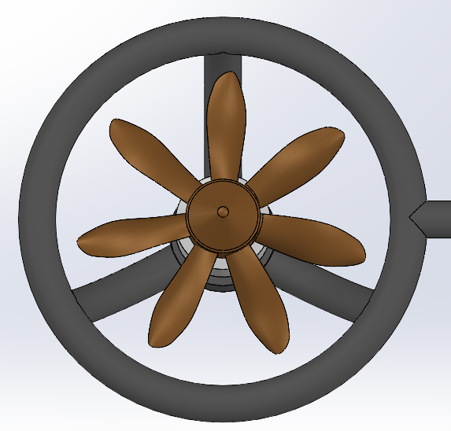
Nano Lander Design
Propellers are made from C6 3000 aluminum bronze and are wider than traditional blades to generate thrust in a primarily methane liquid fluid with a density of 0.657 kg/m^3
Chassis is made from 3D printed Polyetherimide (PEI) in order to facilitate moderate flexibility to prevent permanent warping of outer shell
Wheels are aluminum plated on the outside with interior spokes

Slide 14
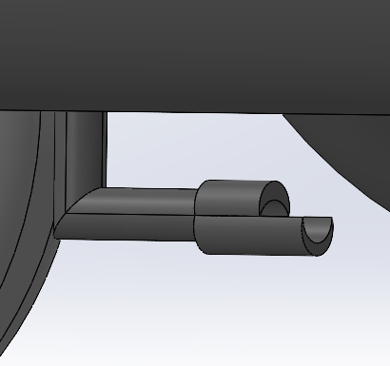
Nano Lander Design
Mechanical Scoop used to collect samples operates based on a sliding mechanism which slides the bottom plate outward for larger initial sample quantity

Slide 15
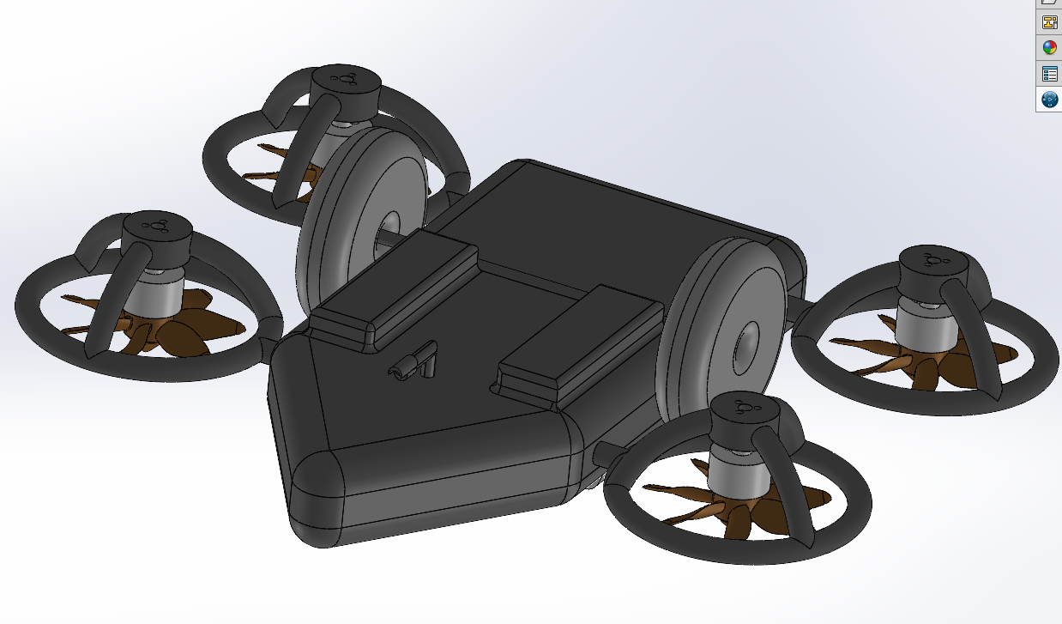
Nano Lander Design
Ballast tanks utilized on the underside of the design provide stability when navigating a fluid environment and control buoyancy
The Nano Lander can switch from using wheels on solid surfaces to a propellor system which can rotate 90° in fluid in order to facilitate propulsion with the aid of an adjustable ballast system
Ballast Tanks

Slide 16
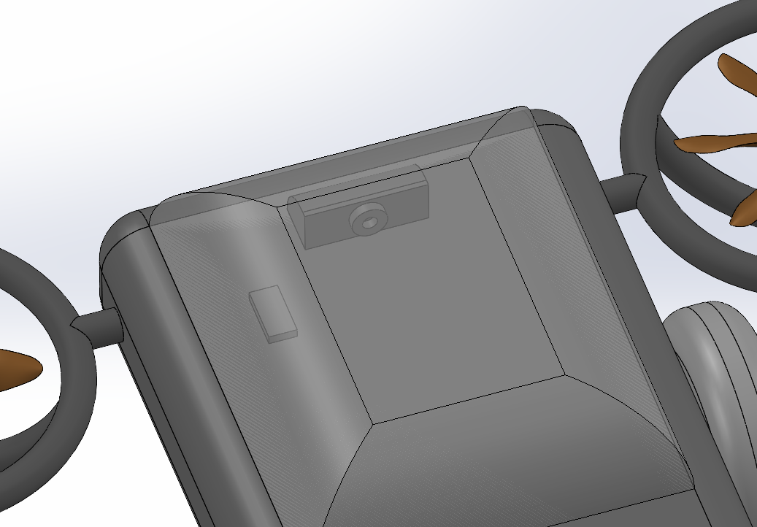
Instrumentation
Rotating Panoramic Camera
Raman Spectrometer

Slide 17
Power and Communication
Power - Miniaturized Multi-Mission Radioisotope Thermoelectric Generator (MMRTG), utilize radioactive decay to generate both power and excess heat utilized throughout the structure
Estimated Power Production from MMRTG: 110 Watts
Estimated Peak Power Consumption: 800-900 Watts
Estimates based off of MMRTG power production utilized in the Perseverance mission
Communication - Miniature Ultra High Frequency (UHF) antenna utilized for orbital satellite communication

Slide 18
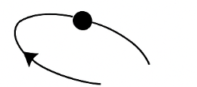
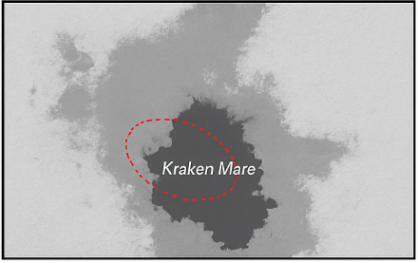
Results and Discussion
Feasibility hitchhike Architecture
Integrates nano-lander within Dragonfly’s cruise module
Landing Precision Achievable
Simulated descent dispersion places land near Kraken Mare (∓10 km)
Low Power Surface Mobility
Traverse simulations confirm access to shoreline within 10 days
Science Objective Meeting
Organic analysis, and imaging enabled with 10 titan days
Discussion Highlights
Trade off between autonomy vs communication with dragonfly relay
Thermal constraints addressed via passive insulation and combined power generation
Dragonfly’s navigation can be leveraged

Slide 19
Future Work
Detailed Mission analysis
Detection algorithms
Communication relay design
Feasibility analysis
Lander testing
GNC algorithms

Slide 20
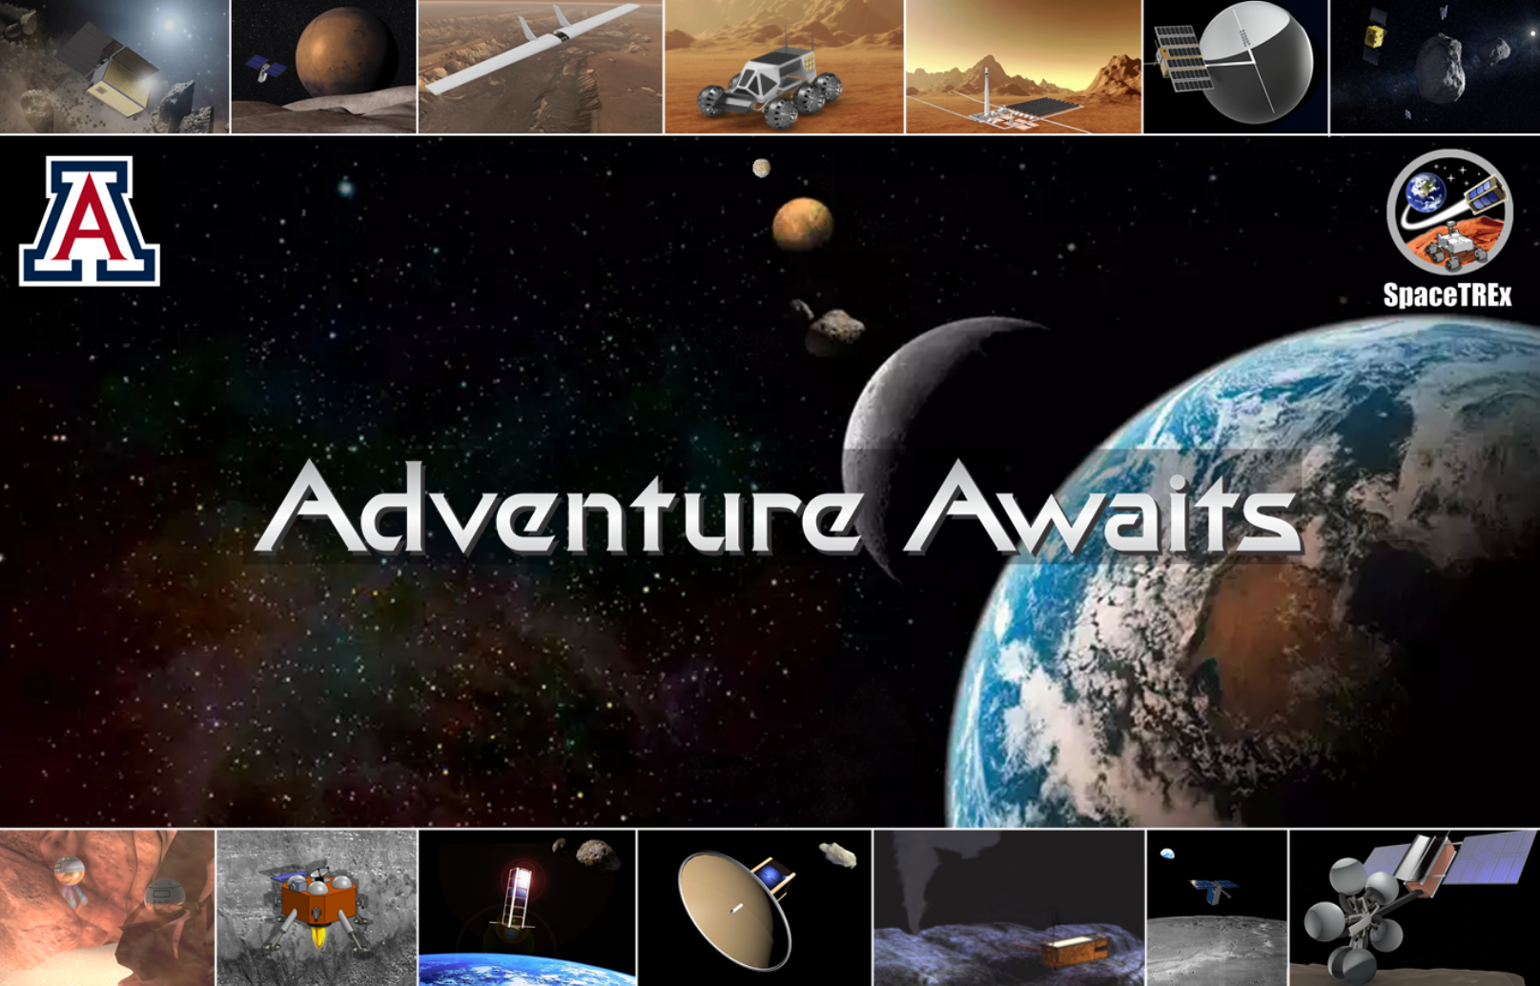
Thank You!

Slide 21
Questions ?

