Slide 1

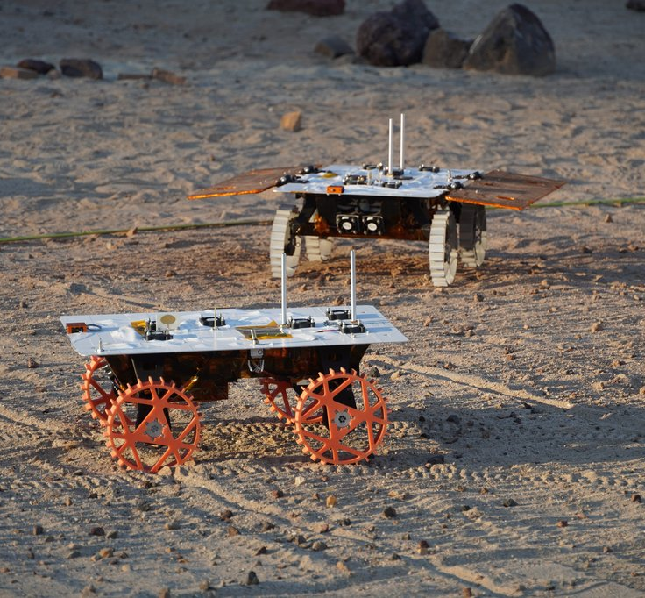
SmallSats with Wheels: A Discussion of the V&V Approach for the Cooperative Autonomous Distributed Robotic Exploration (CADRE) Mission
Presented by: Celeste Smith
With work from: Sawyer Brooks, Nihal Dhamani, Adit Sahasrabudhe, Jean-Pierre de la Croix (PI)
Jet Propulsion Laboratory, California Institute of Technology

Slide 2
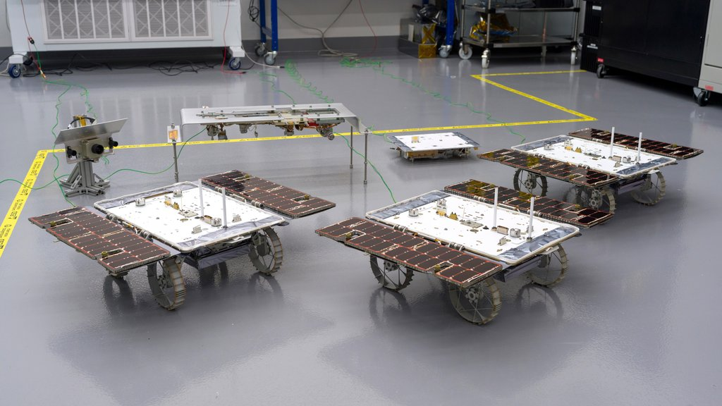
CADRE Mission Key Points
Team of three miniature moon rovers and a base station
Technology demonstration of multi-agent autonomous exploration and formation driving on the moon
Operation team provides high level goal, and system will autonomously make plan and execute
Equipped with Ground Penetrating Radar
Synchronized soundings will allow creation of a detailed subsurface map of the moon
Flight hardware posing before shipment
Notes:
Say it a mission or not?

Slide 3
CADRE = SmallSat
Similarities
  COTS components
    Main computer, radios, sun sensor, IMU, Cameras
  JPL Type II Designation
    Higher risk acceptance and ambitious development timeline
  Compact, low mass
  Rideshare/Secondary Payload
  Utilizing F Prime FSW Framework created for SmallSats
Differences
  Not enough to test in static lab environment
    Must be validated in motion
    Interact with real-world terrain/environments/lighting conditions
  Plan for surface operations
  Shorter mission timeline (1 lunar day)
    Deal with different temperature extremes though the day

Slide 4
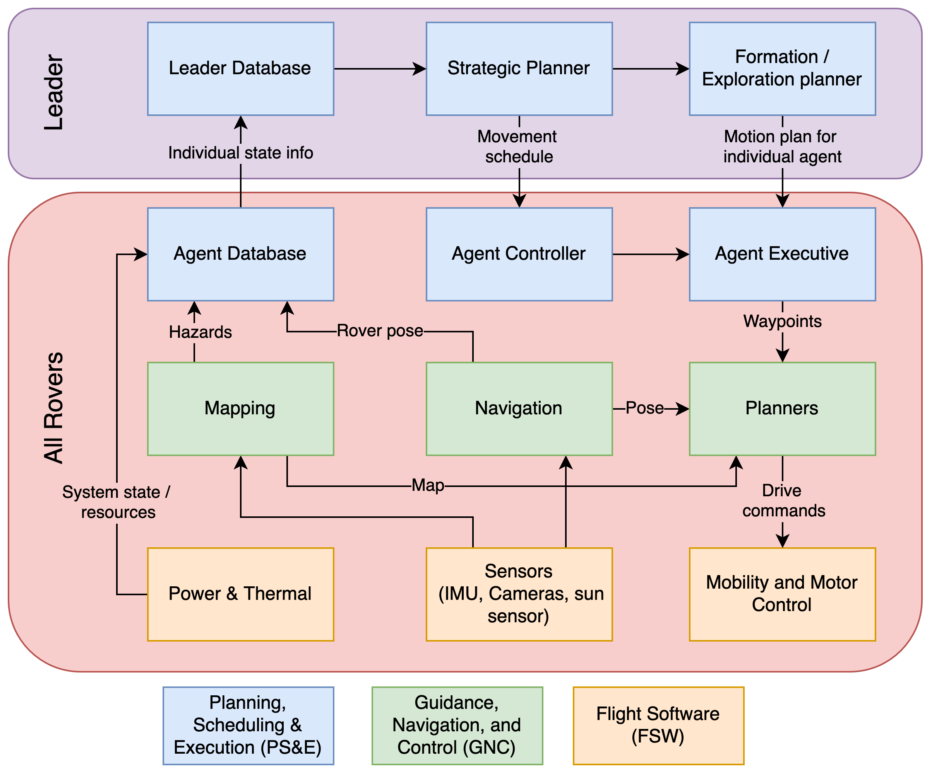
CADRE Autonomy
Notes:
Bottom/yellow boxes at the bottom
Be clear about what the leader is doing

Slide 5
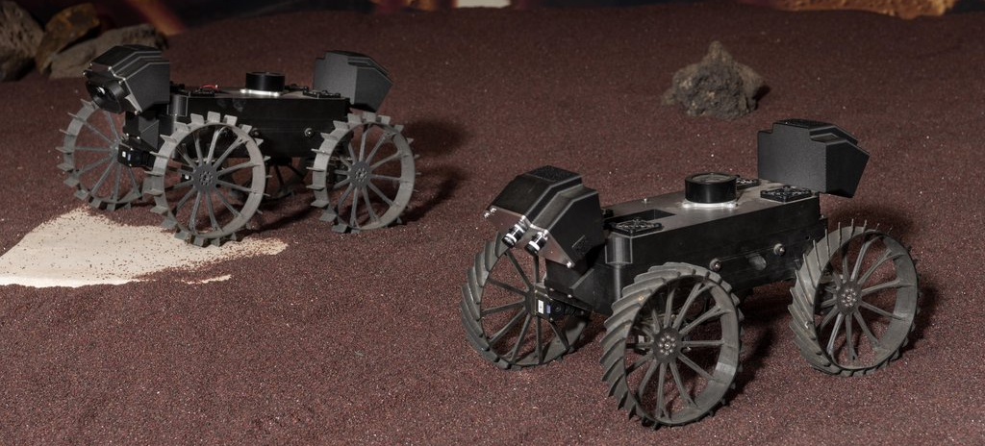
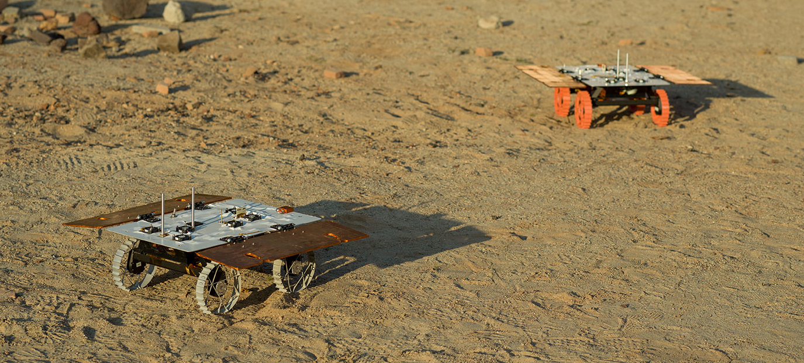
Variety of Test Venues
GNC Simulation environment
Set of main processors for FSW testing (Dragonfarm)
Mercury 7’s (M7s): Low-fidelity small rovers for GNC / PS&E testing
Development Models (DM): Higher fidelity stand-ins for flight units – venue for most V&V activities
Flight Models (FM): Actual flight hardware

Slide 6
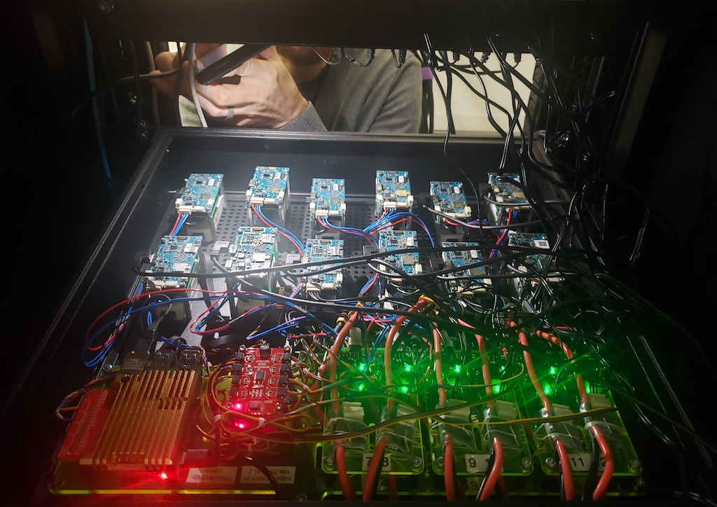

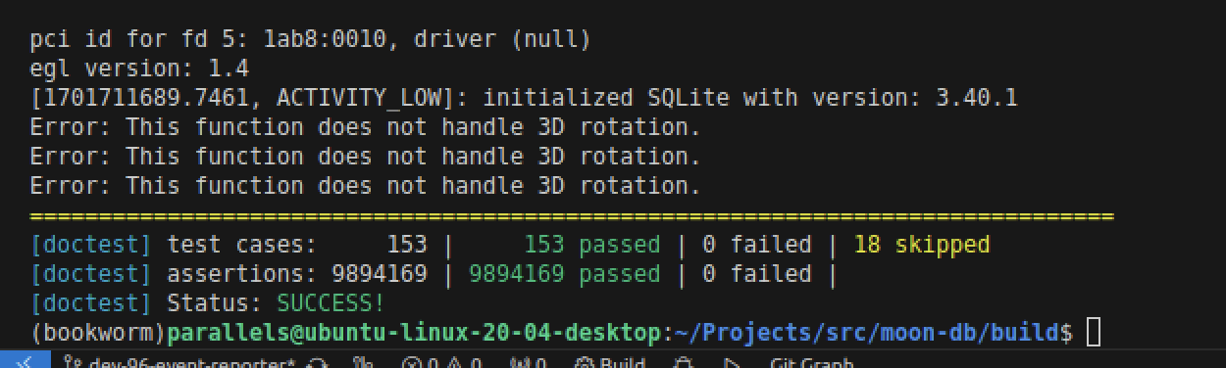
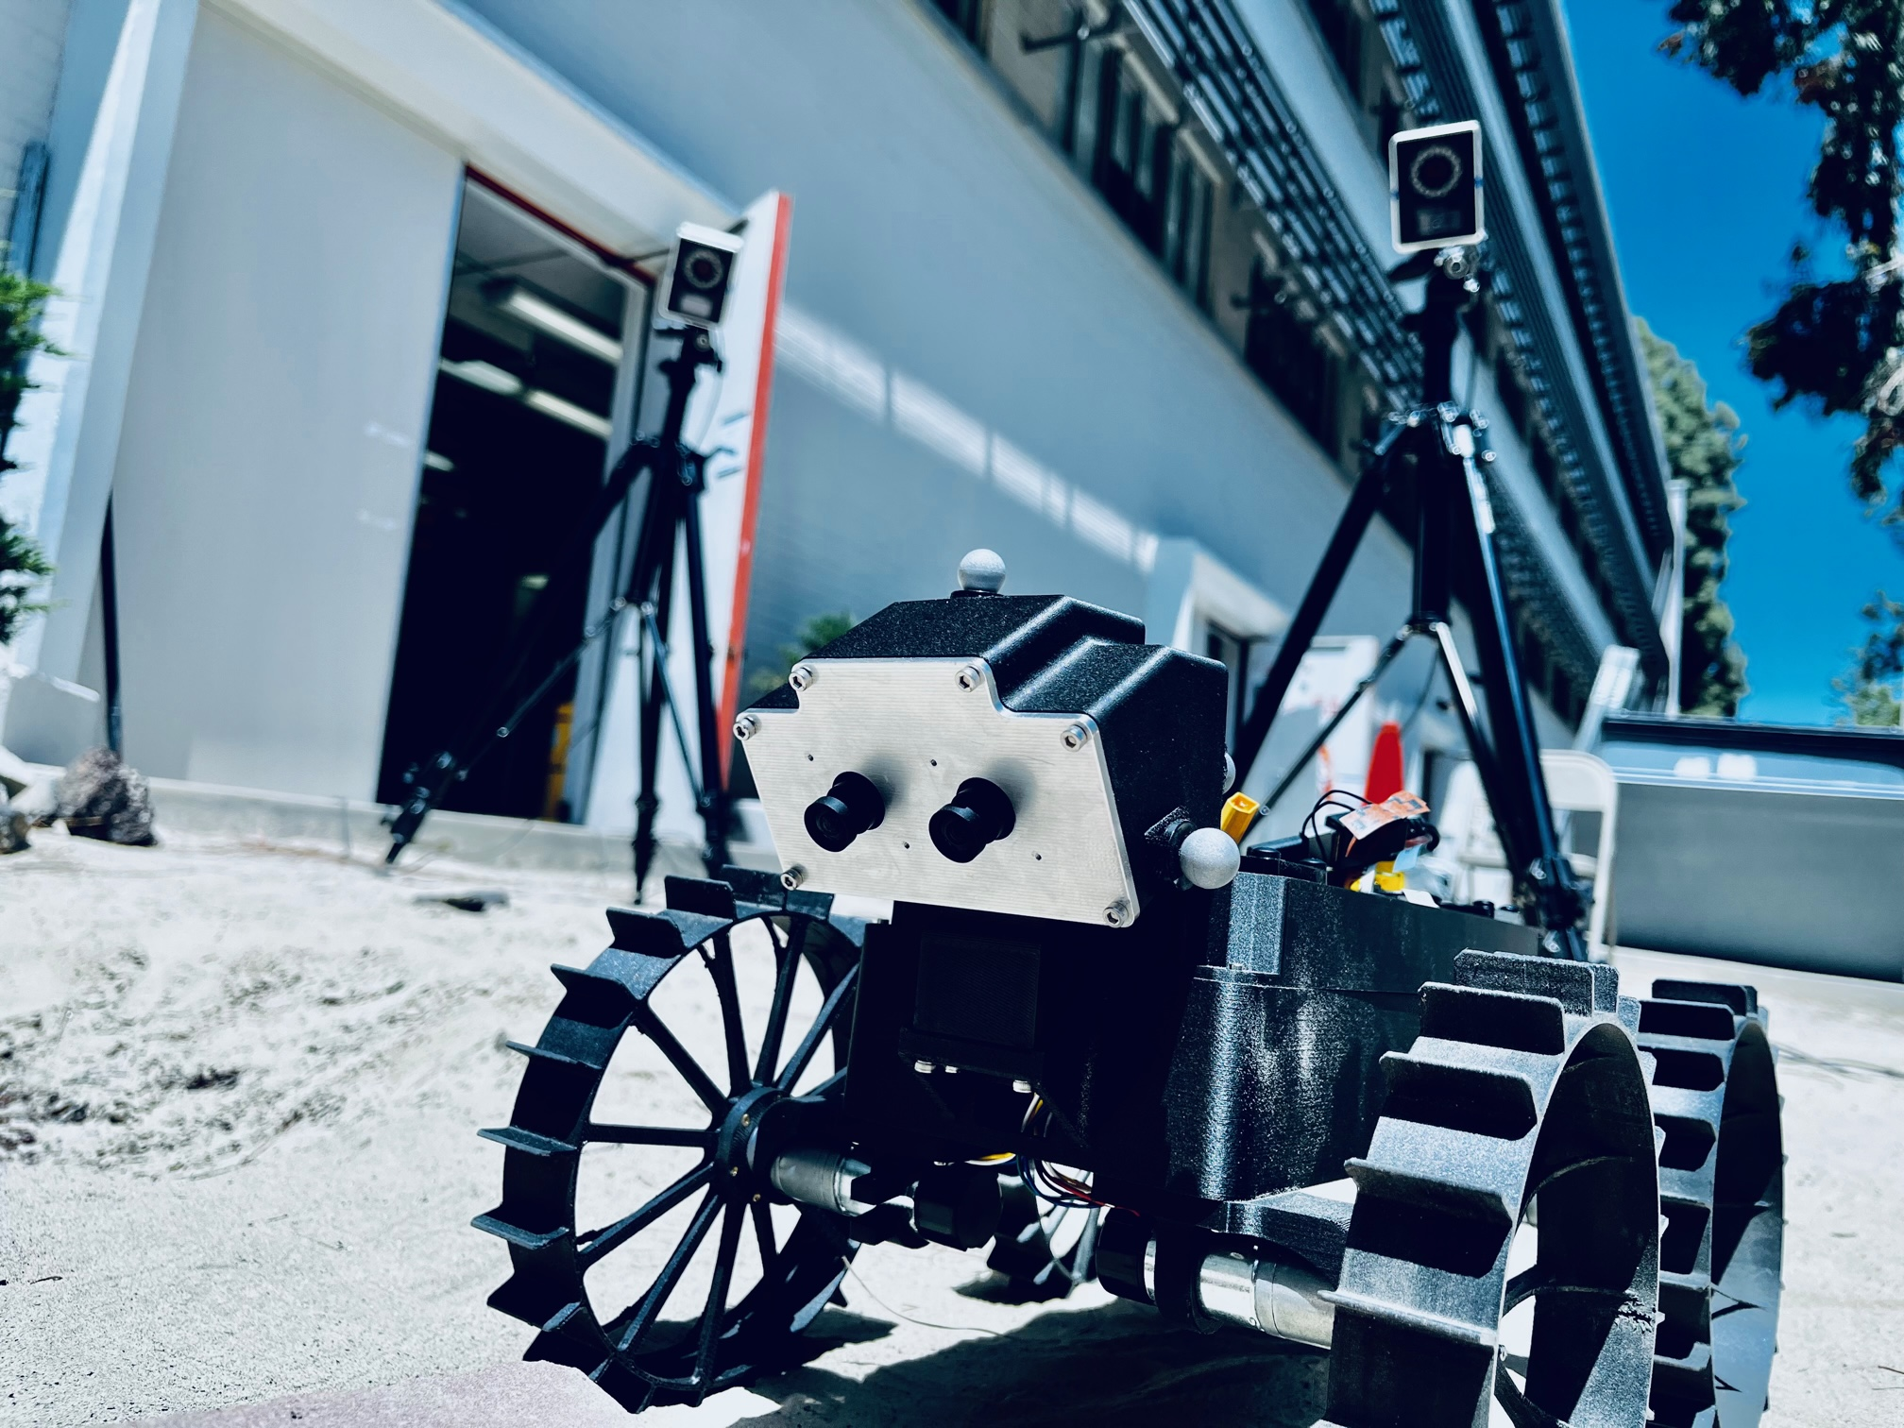
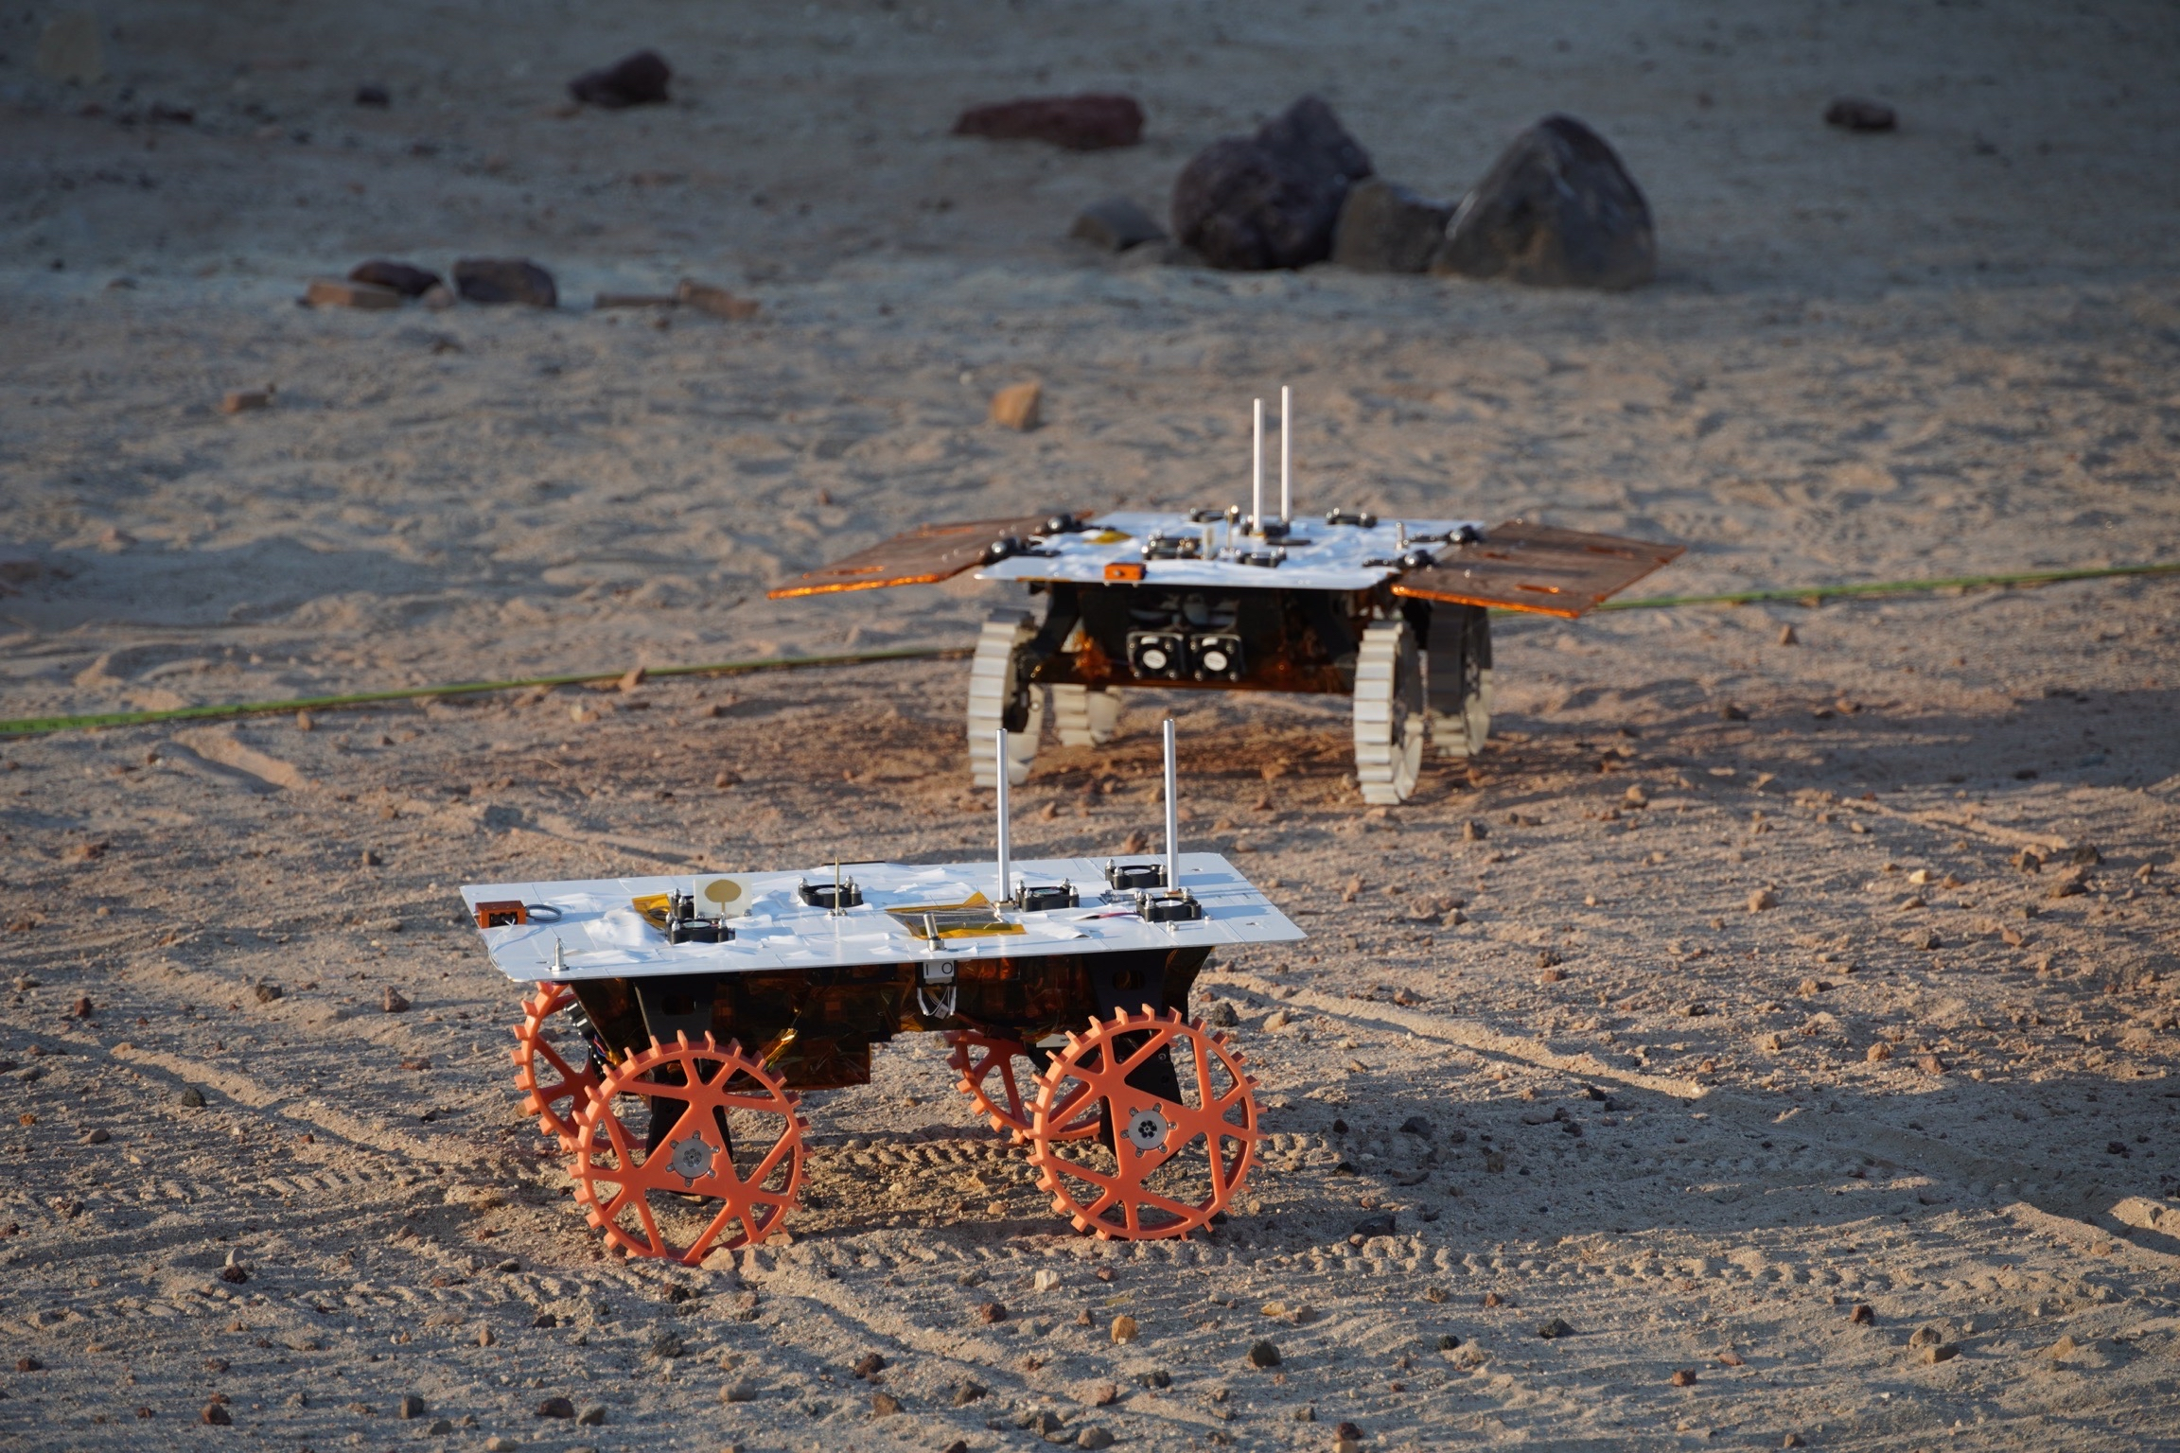
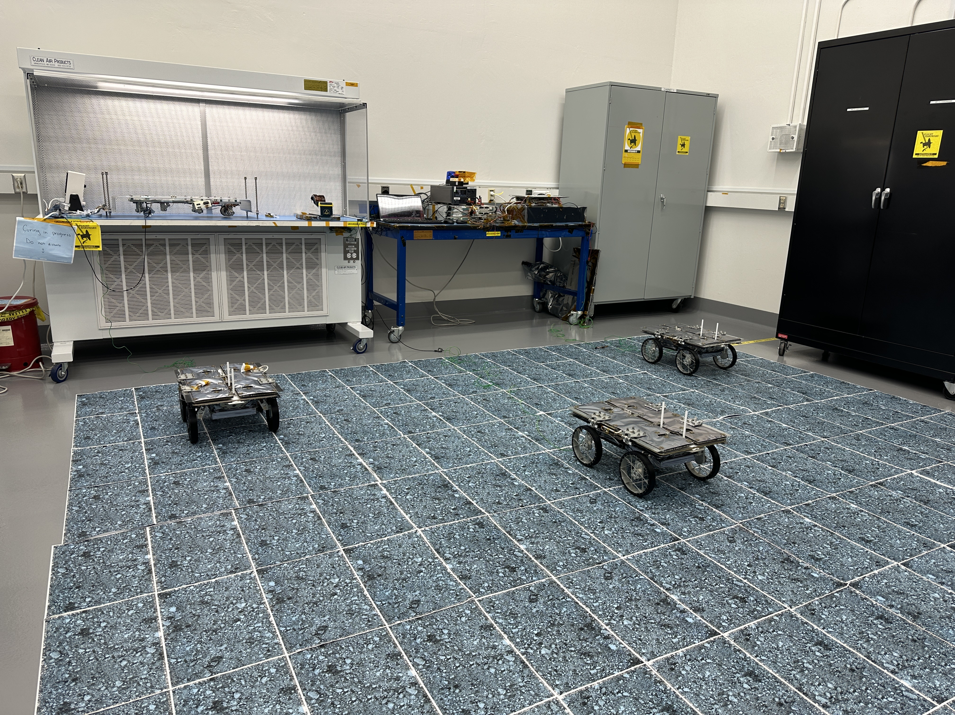
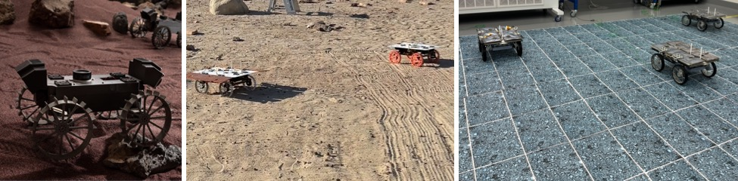
Testing Venues
Cooperative Autonomous Distributed Robotic Exploration (CADRE)
Unit tests
“Dragonfarm” embedded CPUs
Simulation
Mercury 7 (M7s)
Development Models (DMs)
Flight models

Slide 7
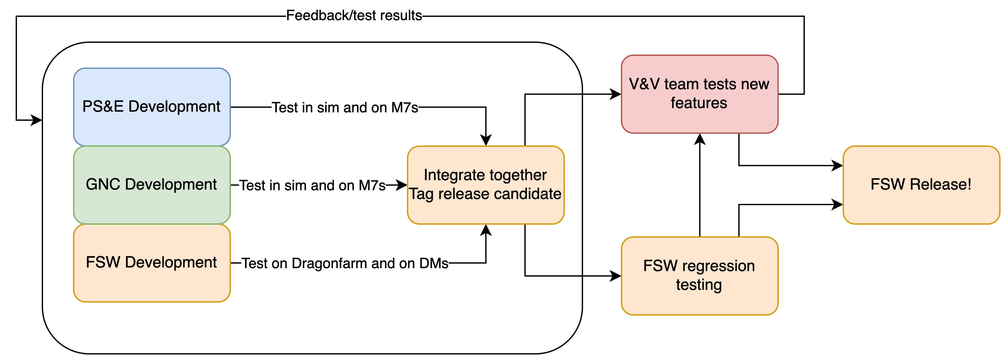
Testing flow
Keep feedback cycles as short as possible
  Could iterate through a loop in a couple days
Parallelize development

Slide 8
Testing flow
FSW Releases
  FSW developers create components, test on DM’s before merging
  PS&E/GNC developers implement design, test in simulation and on Mercury 7’s throughout
  Autonomy/GNC delivery changes to FSW and FSW tags a release candidate
  FSW team does regression testing on each component
  V&V team works with PS&E/GNC to test new features
  FSW is released!

Slide 9
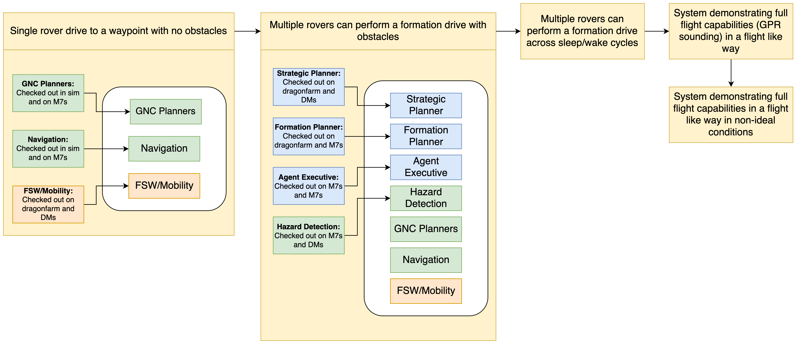
Milestone Driven Testing Campaign
Notes:
One of the challenges here was making sure all the interfaces were synced up and requirement implementation matched intent

Slide 10
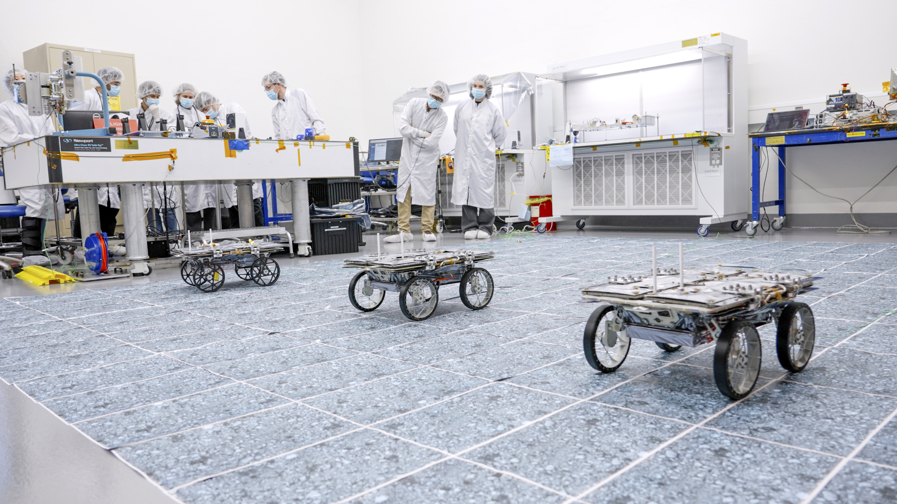
Culmination: End-to-end systems test
Spent a week leading up to end-to-end test exercising necessary capabilities
  Comms through the lander
  GPR soundings
  Autonomy on FMs
  Etc.
Tested scripts and sequences as much as possible on DMs
Successfully demonstrated running full autonomy stack with GPR!
FM formation drive testing

Slide 11
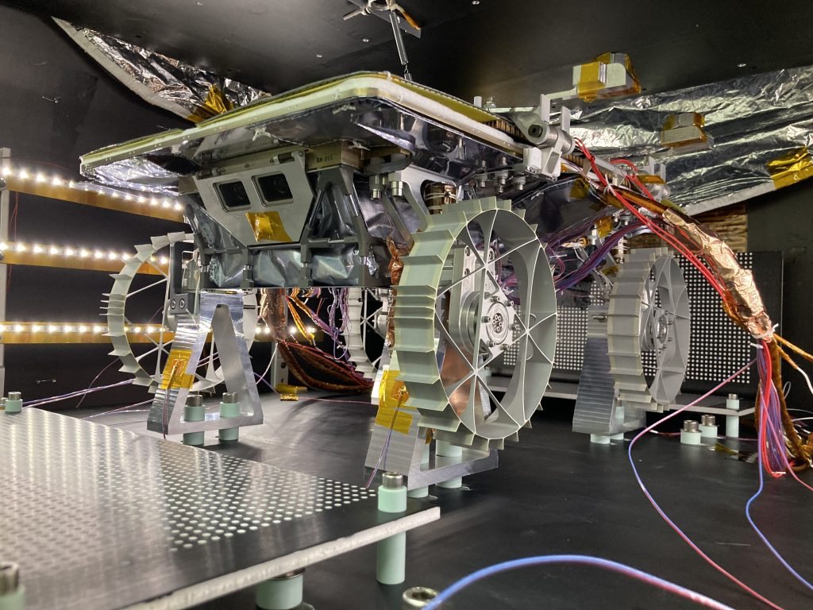
Lessons Learned
Efficient testbeds are essential
  Needed suites of tools for rapid startup and management of multiple agents
  Bring new team members up to speed
You always need more hardware
  Test schedule bottleneck
  High fidelity models find problems sooner
  Having a variety helps with parallelization
  Simulation validation
Systems engineering is key
  PS&E/GNC/FSW interfaces are critical
  Requirement clarity reduces unexpected behaviors
FM undergoing TVAC testing
Notes:
Simulation validation

Slide 12
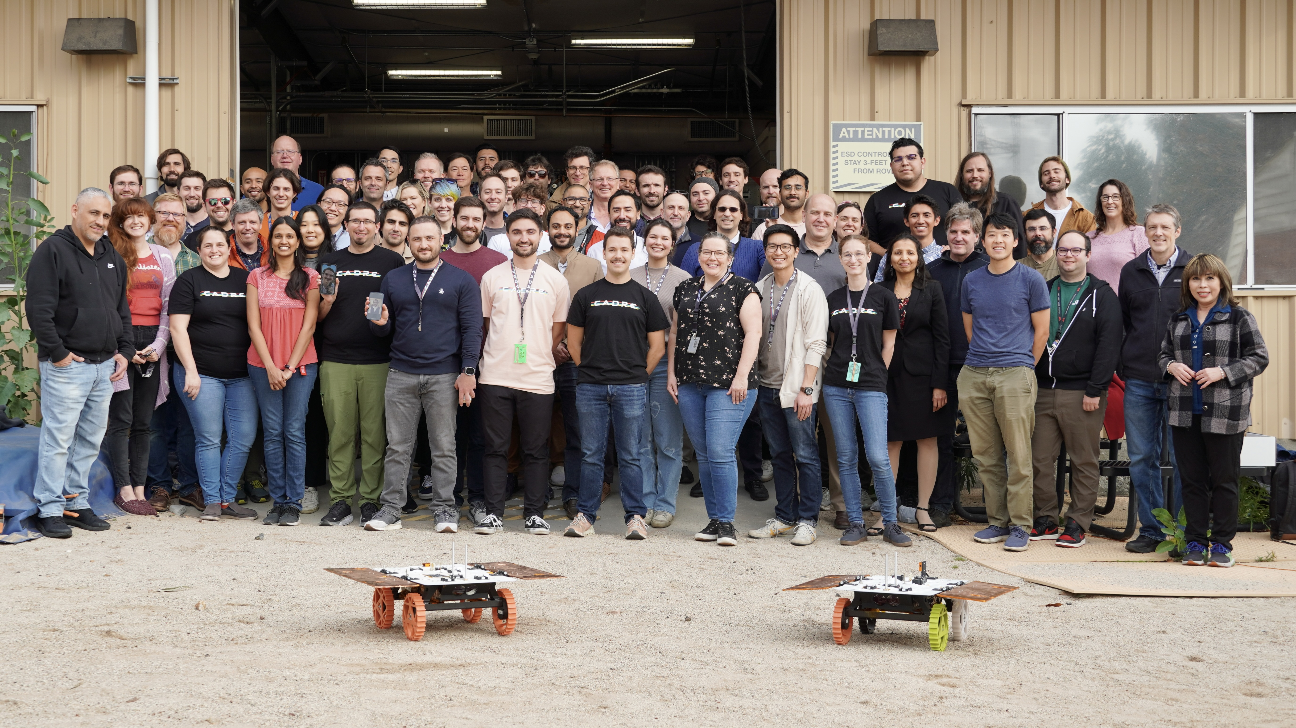
Team!

Slide 15
To access additional layout options, on the Home tab, click the down arrow next to New Slide on the menu bar.
To obtain the appropriate marking and handling instructions for your information, visit the Marking and Handling Wizard at https://mh.jpl.nasa.gov and answer a few questions about the information's content. The Wizard complies with JPL’s Prime Contract requirements, and by implementing the marking and handling instructions provided by the Wizard, the document will be in compliance with JPL’s Marking and Handling requirements.
When you find your correct marking, copy it to your clipboard; then on the Insert tab, click Header & Footer, and paste it in the Footer box.

