Slide 1
Mars InfraRed Compact Atmospheric Temperature Sounder (MIRCATS)
T. Pagano, M. Mischna (NASA/JPL)
Interplanetary Small Satellite Conference
Pasadena, California
April 30, 2025
© 2025 California Institute of Technology. Government sponsorship acknowledged.

Slide 2
Agenda
Hyperspectral IR (HSIR) Sounders measure atmospheric Temperature, Water Vapor and Trace Gases
  NASA JPL 23 Year Anniversary of the Atmospheric Infrared Sounder (AIRS) on Aqua
  AIRS has provided among the highest impact to the operational forecast of any other single instrument
  New technology enables flight in CubeSat. Airborne demonstration later this year.
HSIR Sounders use CO₂ to measure temperature profiles. Mars is rich in CO₂ and well suited to a nadir-viewing IR sounder
Mars InfraRed Compact Atmospheric Temperature Sounder (MIRCATS) can bring AIRS-Like sampling with Global Daily Coverage to Mars in a CubeSat
  Lower-tropospheric/PBL sensitivity complements other Mars temperature sounding approaches.
  Expected to provide high value to regional and local weather forecasting for EDL and Surface Operations.
  Science investigations include studies of dust lifting and dust storm evolution.

Slide 3
Temperature Sounding of Mars Atmosphere Addresses
Fundamental Mars Weather Operations and Research Needs
Map the state of the present-day climate of Mars (T, p) → winds. Characterize dynamics and thermal structure of atmosphere (MEPAG Goal II.A1). “Future orbital mission concepts…should therefore seek to…significantly improve spatial and temporal coverage and resolution beyond the existing data and ideally span multiple Mars years to capture the full range of variability of the current Mars weather and climate.”
Determine aspects of the atmospheric state that affect EDL for human-scale missions to Mars (MEPAG Goal IV.A1). “At all local times, make long-term (>5 Mars years) observations of the global atmospheric temperature field (both the climatology and the weather variability) from the surface to an altitude ~80 km with ~5 km vertical resolution and a horizontal resolution of <300 km.”
Determine how atmospheric waves drive atmospheric dynamics and energetics…by observing wave amplitudes, periods, phases, and spatio-temporal distributions in thermal …measurements over multiple annual cycles on Mars. (Origins, Worlds and Life: A Decadal Strategy for Planetary Science and Astrobiology 2023-2032, pg. 9-13). “The episodic and often unpredictable nature of wave-driven dynamical changes can only be understood via long-term atmospheric measurements of planetary atmospheres, combined with theoretical/modeling studies.”

Slide 4

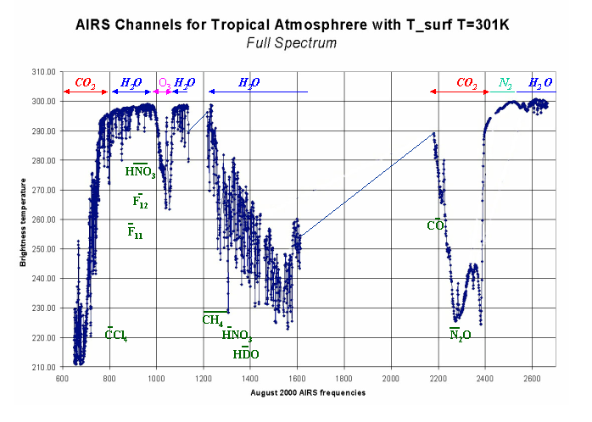
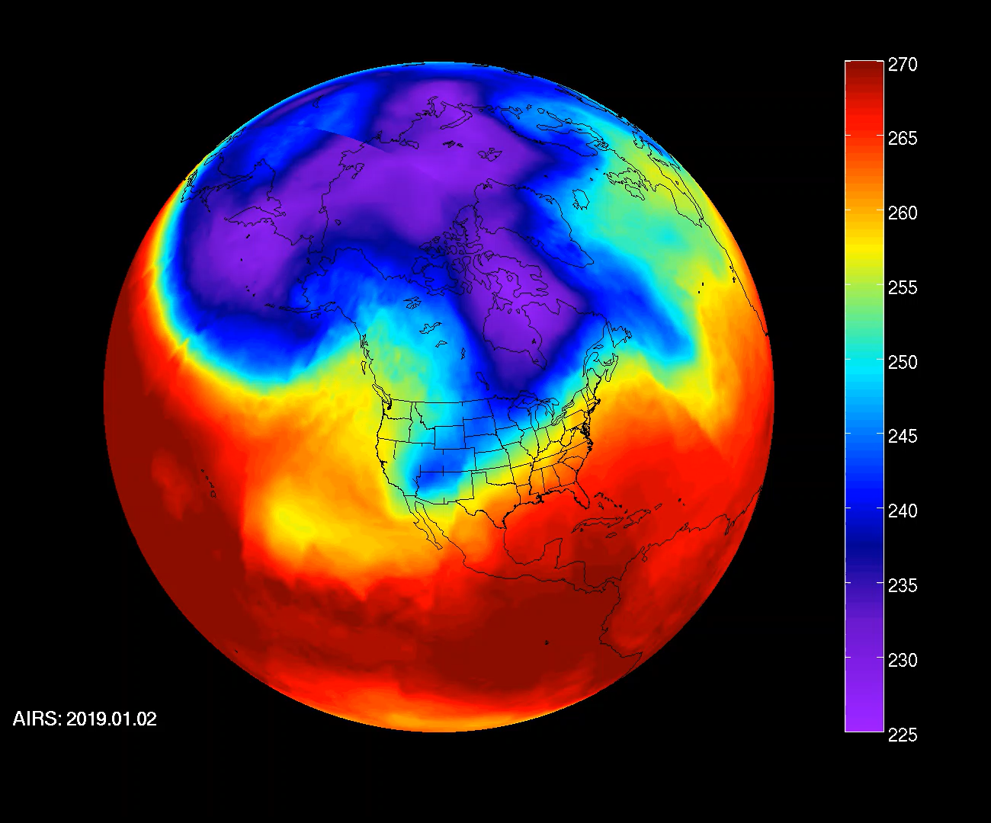
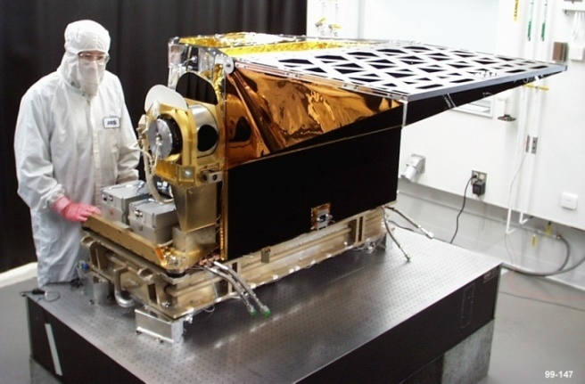
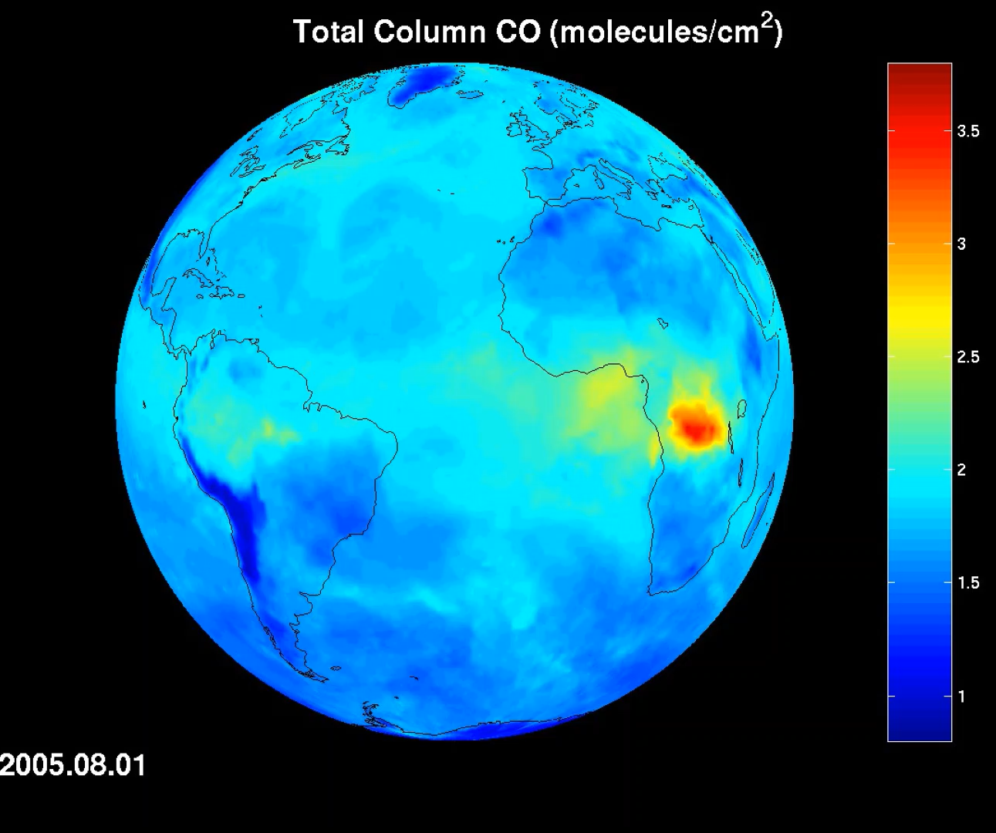
IR Sounders Measure Temperature and Water Vapor Profiles and Trace Gases
National Aeronautics and Space Administration
Jet Propulsion Laboratory
California Institute of Technology
AIRS Channels for Tropical Atmosphere with T_surf = 301K
AIRS Global Daily Temperature at 600 mb
Atmospheric Infrared Sounder (AIRS)
BAE Systems/JPL
AIRS Global Daily Total Column CO
LWIR
CO₂
13-14 µm
MWIR
CO, CO₂
4-5 µm
https://airs.jpl.nasa.gov

Slide 5
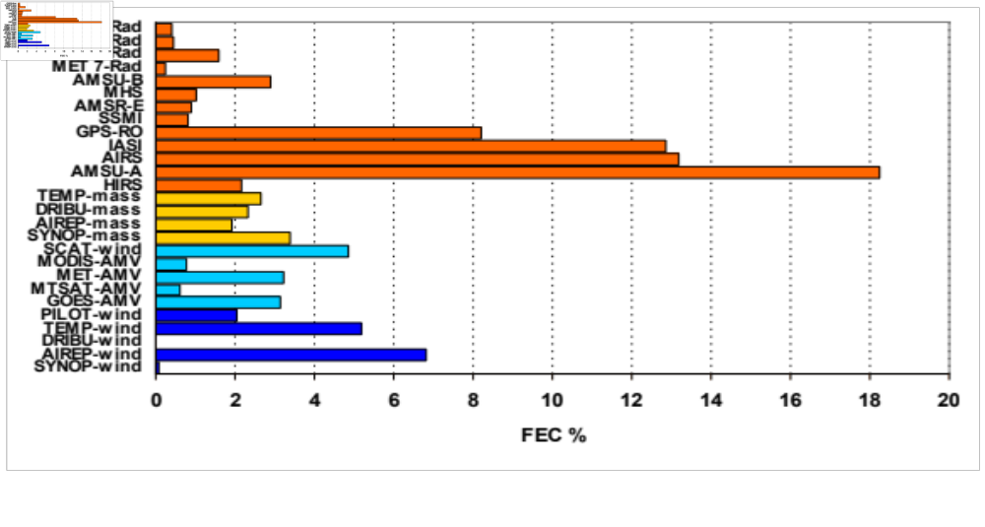
AIRS Data Provided Highest Improvement to Operational Earth Weather Forecast of Any Single Instrument During First Flight Decade
ECMWF
IASI
AIRS
there are several AMSU-A
Forecast error reduction (%)
Cardinali, 2011

Slide 6
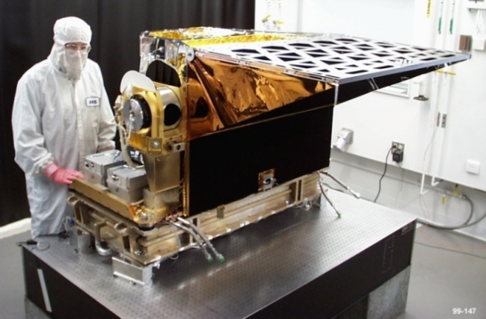
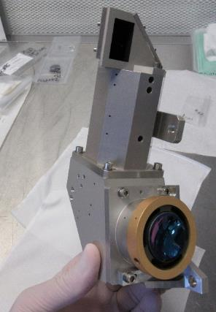
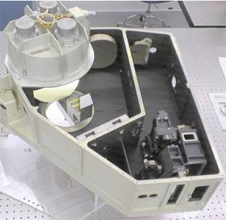
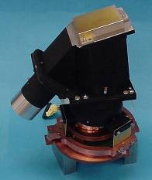
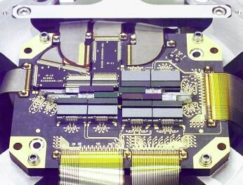
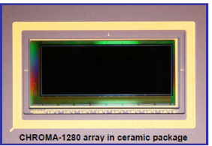
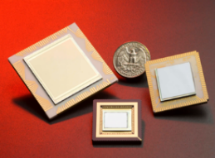
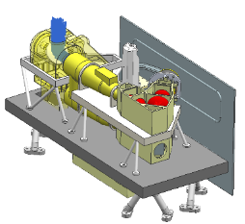
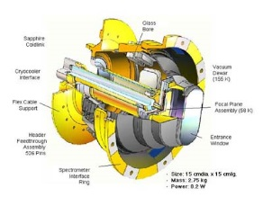
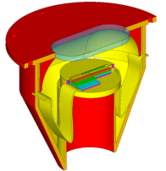
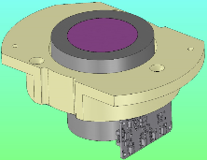
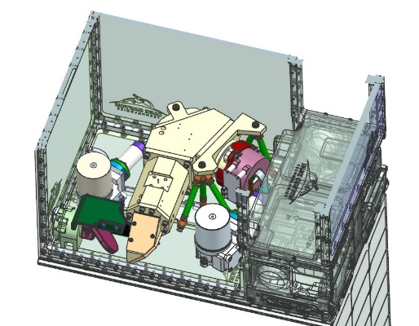
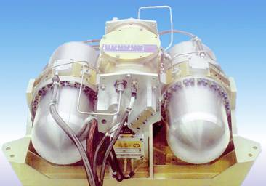
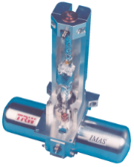
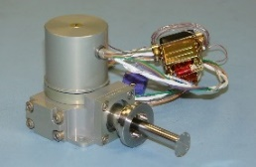
Advancements in grating spectrometer technology at NASA and industry have reduced the size and improved performance of IR sounders
AIRS
MIRIS
CIRAS
Spectrometers
AIRS
BAE Systems
Pupil-Imaging
Grating Spectrometer
FOV = 1.1°
D = 2 mm
MIRCATS
BAE Systems/
JPL Imaging
MWIR Immersion
Grating Spectrometer
FOV = 16°
D = 15 mm
SIRAS, SIRAS-G
Ball Aerospace
Imaging MWIR
Grating Spectrometer
FOV = 16°
D = 25 mm
AIRS
2002
(TRL 9)
Detectors
AIRS
BAE Systems
PV/PC HgCdTe
17 modules
2 x ~180
100 x 50 um
CHROMA
Teledyne
PV HgCdTe
13.5 um Cutoff
480 x 1280
30 x 30 um
HOTBIRD
JPL
5.5 um Cutoff
640x512
24 x 24um
SIRAS, MIRIS
LEO & GEO
Concepts
2007-2013
(TRL 6)
Dewars
AIRS
BAE Systems
Cryo Dewar
SIRAS
Ball Aerospace
Reflecting Warmshields
MIRCATS
IR Cameras
IDCA
Cryocoolers
CIRAS
Concept
2015-Present
(TRL 5)
AIRS
Northrop Grumman
Pulse Tube Cryocoolers
ABI / OCO-2
Northrop Grumman
Smaller
Pulse Tube Cryocoolers
Ricor
K508
Integral Sterling
Cryocooler

Slide 7
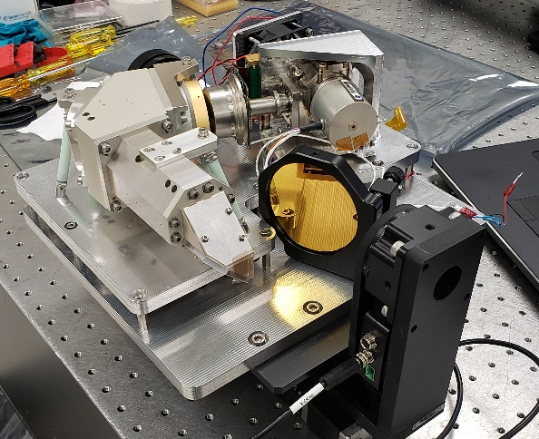
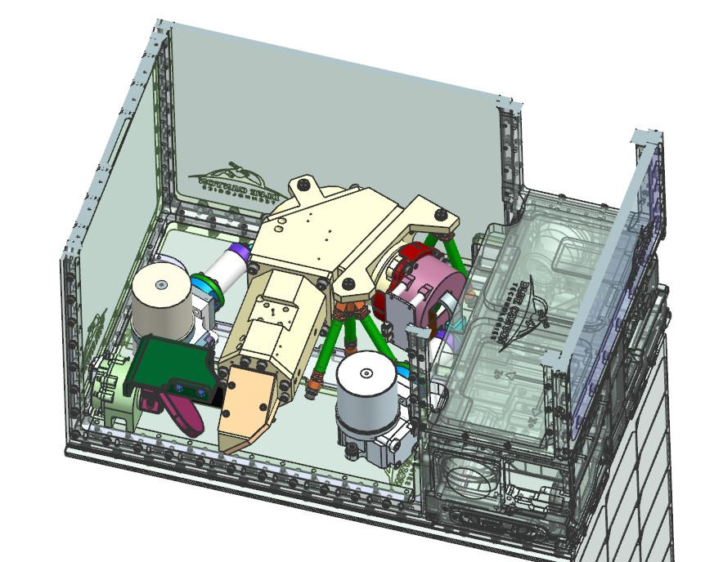








The CIRAS achieves IR Sounding in a CubeSat
The CubeSat InfraRed Atmospheric Sounder (CIRAS) achieves AIRS-Like Soundings using only MWIR in a CubeSat
CIRAS uses CO₂ ,H₂O, and CO absorption features to measure lower troposphereic temperature, humidity and CO
CIRAS fits comfortably in 12U CubeSat. Room for propulsion for orbit adjust maneuvers.
CIRAS Brassboard Instrument Built and Tested To Flight Scale
Payload Control Electronics (PCE)
Detector Readout Electronics (DRE)
Spacecraft
Spectrometer
Detector Mount
Optics
Cryocooler
Thermal Strap
Scan Motor
Optics
Mounts
Blackbody
Cal. Target
Scan
Mirror
Telescope
Fold Mirrors
Detector Cryocooler

Slide 8
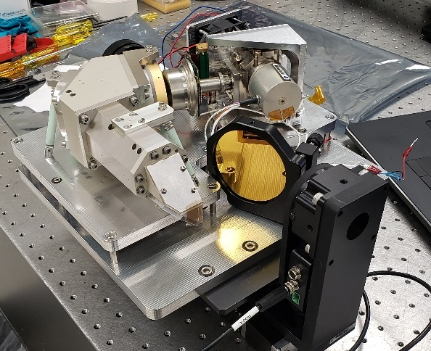
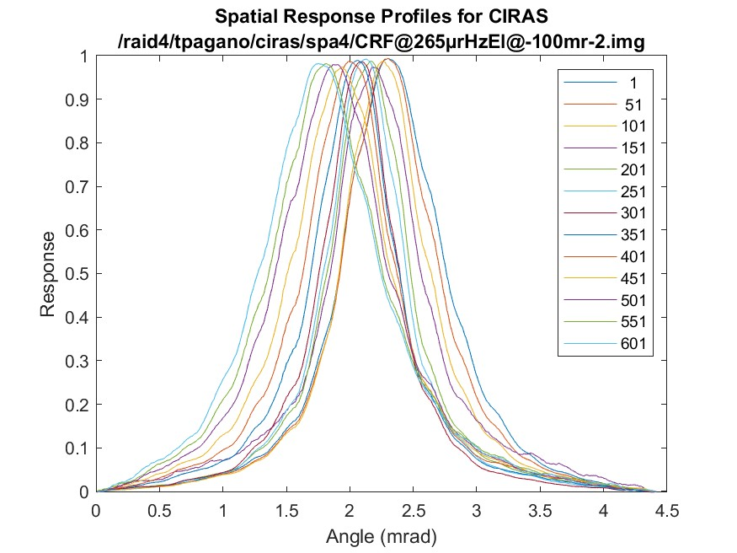
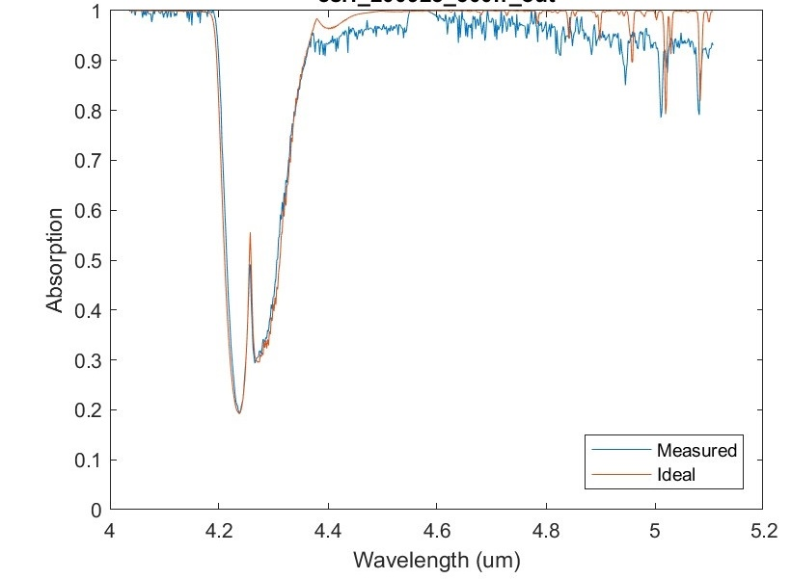
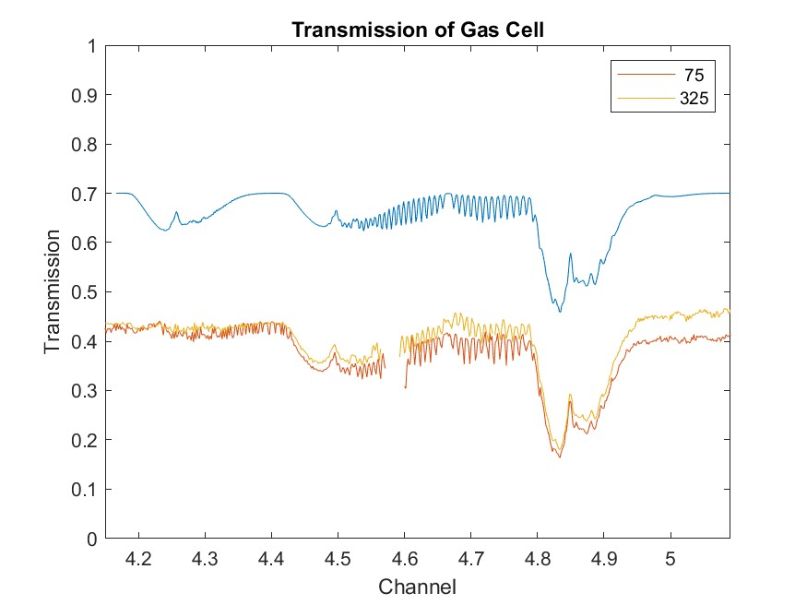
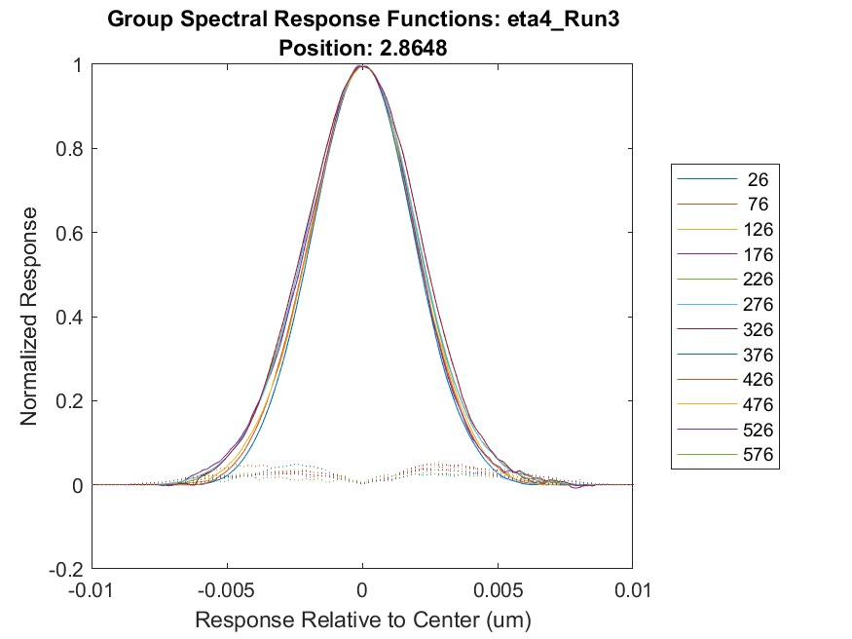
CIRAS Breadboard Meets Key Performance Metrics
Measured Spatial Response Functions
Room Air Measurement (Ambient)
H₂O
Transmittance
CO₂
(For Temperature)
Measured Spectral Response Functions
Breadboard Meets Performance Requirements
Gas Cell Measurement in TVAC
Parameter | Required | Measured | Uncty
Spatial Performance
Min Spatial Field of View (deg) | 15.65 | 15.4 | 0.1
Max Spatial Resolution (mr) | 3.20 | 1.8 | 0.1
Max Spatial Sample Spacing (mr) | 0.53 | 0.55 | 0.05
Spectral Performance
Min Wavelength (μm) | 4.08 | 4.04 | 0.05
Max Wavelength (μm) | 5.13 | 5.12 | 0.05
Max Spectral Resolution (nm) | 5 | 4.4 | 0.3
Max Spectral Distortion (pixels) | 2 | 1 | 0.5
Min Number of Channels (pixels) | 625 | 640 | 1
Radiometric Performance
Operability | 0.95 | 99.8 | 0.02
Max NEdT @ 4.9 μm 280K (K) | 0.35, 0.5 | 0.25, 0.45* | 0.06, 0.1
Gas Cell Transmission x 0.4 + 0.3
CO₂
N₂O
CO
OCS
Measurement
Gas cell located outside chamber. CO₂ in gas cell same as air so feature not seen in differential measurement

Slide 9
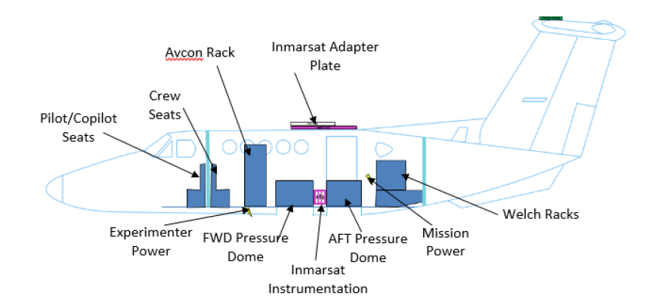

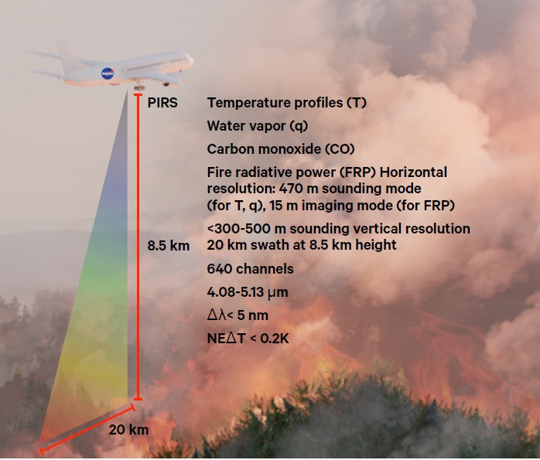
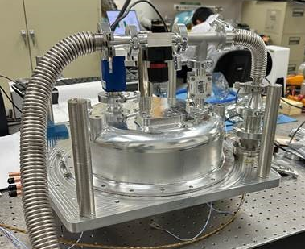
Pyro-Atmosphere Infrared Sounder (PIRS) Airborne Instrument to fly CIRAS Brassboard over Fires
Measurement Goals
  Measure T and q profiles simultaneously with fire radiative power to monitor the initiation and development of wildland fire events.
  Map instantaneously the atmospheric thermodynamic conditions to the initiation of pyrocumulonimbus (pyroCb)
  Track smoke plume with CO measurements and relate its transport to fire characteristics and atmospheric thermodynamic conditions.
Beechcraft B200 King Air
PIRS Instrument currently in integration and test phase
First flight in late 2025

Slide 10
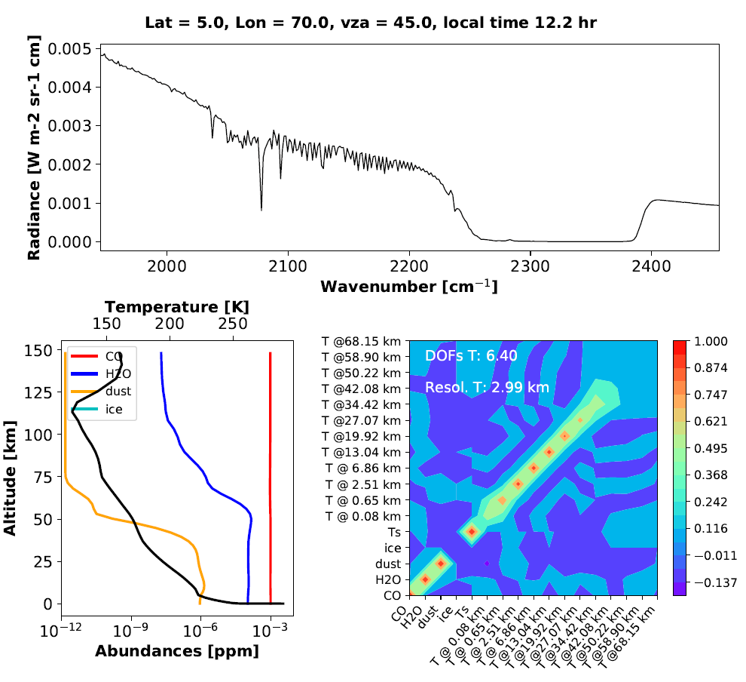
Simulations show MWIR Sounder can retrieve lower tropospheric T(p), H₂O, CO in Martian daytime atmosphere
Simulated IR Sounder Mars Spectrum and Information Content
(1950 cm⁻¹ ≤ ν ≤ 2450 cm⁻¹, 4.08 μm ≤ λ ≤ 5.12 μm, Δλ = 3.3 nm)
CIRAS in Mars Orbit = Mars InfraRed Compact
Atmospheric Temperature Sounder (MIRCATS)
144 Mars atmospheric cases studies
  4 Locations: Equator, Syrtis Major, Tharsis,
  Northern Polar Cap
  Day and Night
  Water ice scaling: 0.1, 1, 10 x ‘standard’
  Dust scaling: 0.1, 1, 10 x ‘standard’
  Zenith Angle (0°, 45°)
Temperature Retrievals
  Max sensitivity between 2-24 km
  Good sensitivity during the day (DOFs>6)
  Good in mid-latitudes
  Low sensitivity at night (less thermal contrast)
  Good sensitivity to Tsurf
Other Species
  Good sensitivity to CO
  Good sensitivity to dust (high and low column)
Giuliano Liuzzi (Unibas, Italy)

Slide 11
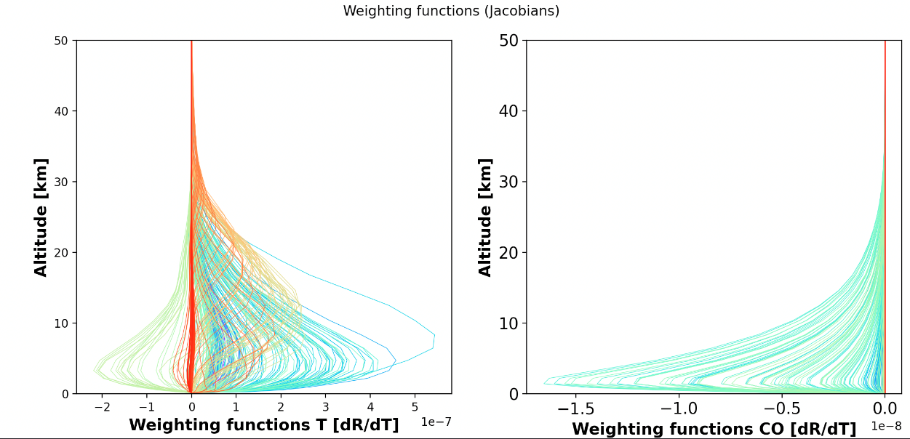
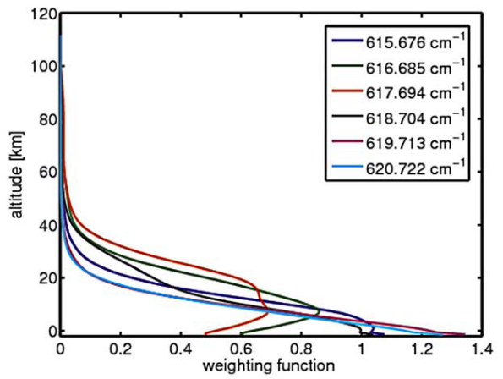
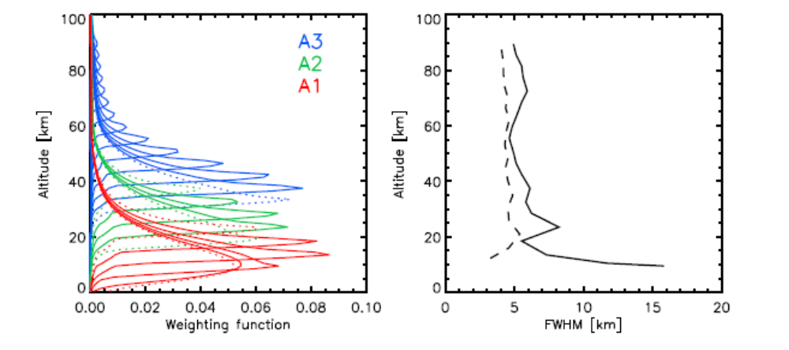
MIRCATS improvements will complement existing
Mars infrared sounders
MIRCATS Weighting Functions
MIRCATS complements capabilities of MRO Mars Climate Sounder (MCS) and MEX Planetary Fourier Spectrometer (PFS)
  MIRCATS complements the strengths of existing approaches, targeting new vertical regions, covering more of the surface and enabling greater TOD coverage
  MIRCATS provides better lower tropospheric/surface sensitivity (and poorer upper tropospheric and nighttime sensitivity)
  MIRCATS provides over 100x more soundings per day.
Temperature
Carbon Monoxide
Instrument | Planetary Fourier Spectrometer | Mars Climate Sounder | CubeSat IR Sounder
Spacecraft | Mars Express | MRO | Future
Altitude | 250-10,142 km | 275 km | 275 km
View Angle for T Profiles | Nadir | Limb | Nadir
Vertical Range | 1-40 km | 5-10, 80-90 km | 2-24 km
Vertical Resolution | < 5 km | 4-6 km | 2-5 km
Horizontal Range | 12 km x 20 km | 105 km x 105 km | 715 km
Horizontal Resolution | 12 km x 20 km | 4.4 x 8.2 km Nadir 200 km Limb | 13.5 km
Soundings Per Day | 429 | 2541 | 345,000
Retrieval Accuracy | 2-6 K | 0.5-2 K | <2-6 K
IR Spectral Range | 270-1800 cm-1 | 220-870 cm-1 | 1950-2450 cm-1
IR Spectral Resolution | 2 cm-1 | 15-100 cm-1 | 1.6 cm-1
Number of IR Ch. | 3060 | 8 | 625
Mass | 31.2 kg | 9 kg | 4 kg
Power | 35 W | 11 W | 23 W
PFS WF
MCS WF
Kleinböhl et al. (2009}; Wolkenberg et al. (2009); Formisano et al. (2005)

Slide 12
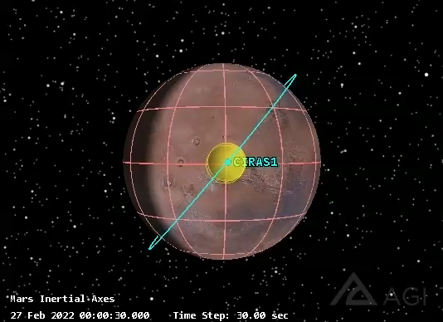
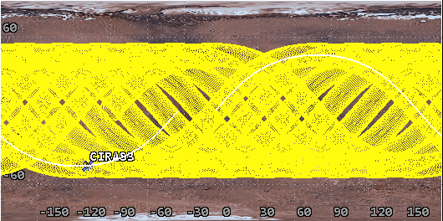
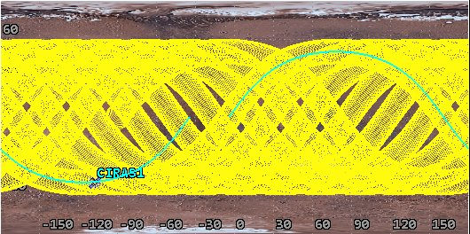
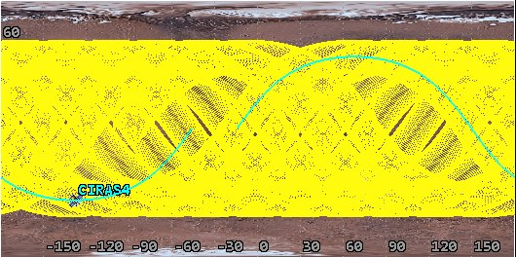
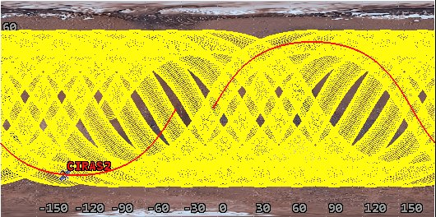
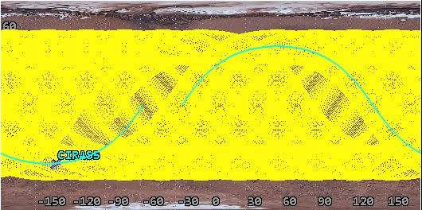
Orbit Simulations show MIRCATS Provides
Global Daily Coverage
H=500 km, i=45
Single Satellite in Non-Sun Synchronous Orbit Observes Diurnal Cycle
Coverage in 20 hrs of orbit
Low Inclination
45 deg sensor cone angle
H=500 km, i=50
H=500 km, i=50
H=600 km, i=50
Casey Heeg (JPL)
12pm
H=500 km, i=50
4pm
H=500 km, i=55
H=700 km, i=50
8am
Constellation of Satellites in Sun Synchronous for Diurnal Cycle
View from over north pole

Slide 13
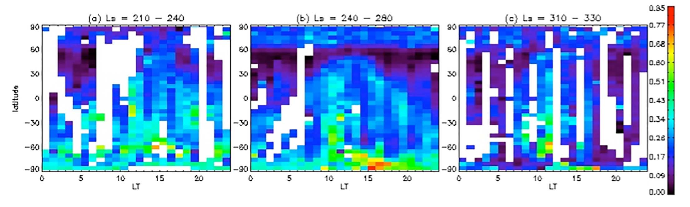
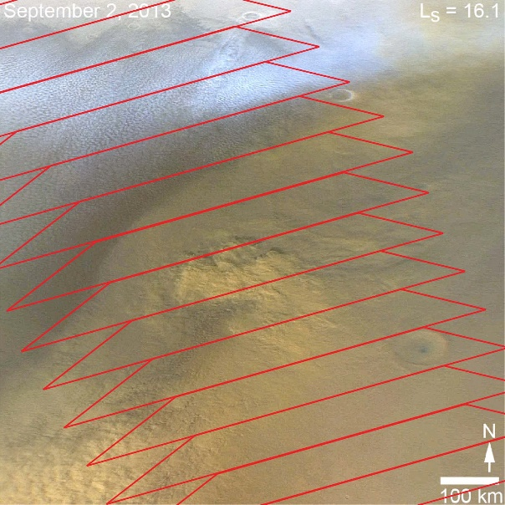
Science Use Case Examples
Small size and large surface coverage enables
heretofore unexplored aspects of the martian
global circulation and dust cycle.
Dust Lifting:
  Small size enables multiple copies in different TOD orbits
  or independent flight in CubeSat in low inclination orbit
  This provides intradiurnal measurements of surface/
  atmospheric temperature and dust storm growth/evolution
  Addresses hypothesis that dust lifting has TOD variability. Ref. Wolkenberg and Giuranna (2021); Smith et al., (2025)
  Mars Express PFS instrument hints at this (top right) with good TOD but coarse spatial coverage.
  MIRCATS will complement this with excellent spatial (but reduced TOD) coverage
Storm Evolution:
  The scanning capability of MIRCATS (>700 km cross-track) along with potential multiple TOD observations enables increased coverage over regions where dust storms form.
  ‘Local’ storms (right), the most common, initiate on scale smaller than MIRCATS scanning footprint. This allows measurements of the pre-storm, near-surface conditions, both ‘inside’ and ‘outside’ the growing storm.
  MIRCATS loses sensitivity once the storm grows, but we emphasize the initiation phase
  Many storms grow in mid-latitude baroclinic region where MIRCATS has excellent sensitivity.
Opacity
Wolkenberg and Giuranna (2021)
Illustration of northern hemisphere, early spring, local dust storm, overlaid with approximate MIRCATS footprints along notional orbit, showing ability to span local dust storms during formation phase.

Slide 14
Summary
Hyperspectral IR sounding enables measurement of temperature profiles, water vapor profiles and atmospheric trace gasses.
IR sounders, e.g. AIRS, have improved weather forecast on Earth and validated weather and climate models.
Technology exists today to provide this capability on CubeSat configuration (CIRAS). Current Technology Status: Airborne demonstration of MWIR sounding in Earth’s atmosphere, (PIRS)
Same compact instrument is suitable for IR sounding of Mars’ atmosphere:
Mars Infrared CubeSat Atmospheric Temperature Sounder (MIRCATS)
  >75% global daily coverage from a single instrument with 13.5 km spatial resolution. Multiple satellites in sun-synchronous orbit to get multiple times per day. Low inclination orbit to sample the diurnal cycle over a longer period.
  Results show good sensitivity to temperature profiles and carbon monoxide in the lower troposphere (2-24 km) during daytime conditions.
MIRCATS should be viewed as complementary to the capabilities of the MCS instrument that samples the mid to upper troposphere, and the PFS by providing better horizontal coverage.
High vertical and horizontal resolution, and global daily coverage expected to provide high value to regional and local weather forecasting for EDL and Surface Operations.
Science investigations include studies of dust lifting and dust storm evolution.

