Slide 1
Accounting for Orbital Long-Duration Eclipses for Lunar Trailblazer
Mission Operations
Miina Anveltª, Bethany Ehlmannª, Lee Bennett^{b}, Judy Adler^{b}, Elise Furlan^{b}, Elena Scire^{b},
Sergio Fajardo-Ascosta^{b,} Jacob Llamas^{b}
ªCalifornia Institute of Technology, 1200 E. California Blvd. Pasadena, CA 91125;
^{b}Caltech/IPAC, 1200 E. California Blvd. Pasadena, CA 91125
This document has been reviewed and determined not to contain export-controlled CUI.

Slide 2
Outline
Introduction
Background and Past Mission Solutions
Methods
Results
Conclusions
Fig. 1 A rendering of the Lunar Trailblazer spacecraft created by Lockheed Martin
(Source: Ehlmann et. al., 2022)
This document has been reviewed and determined not to contain export-controlled CUI.

Slide 3
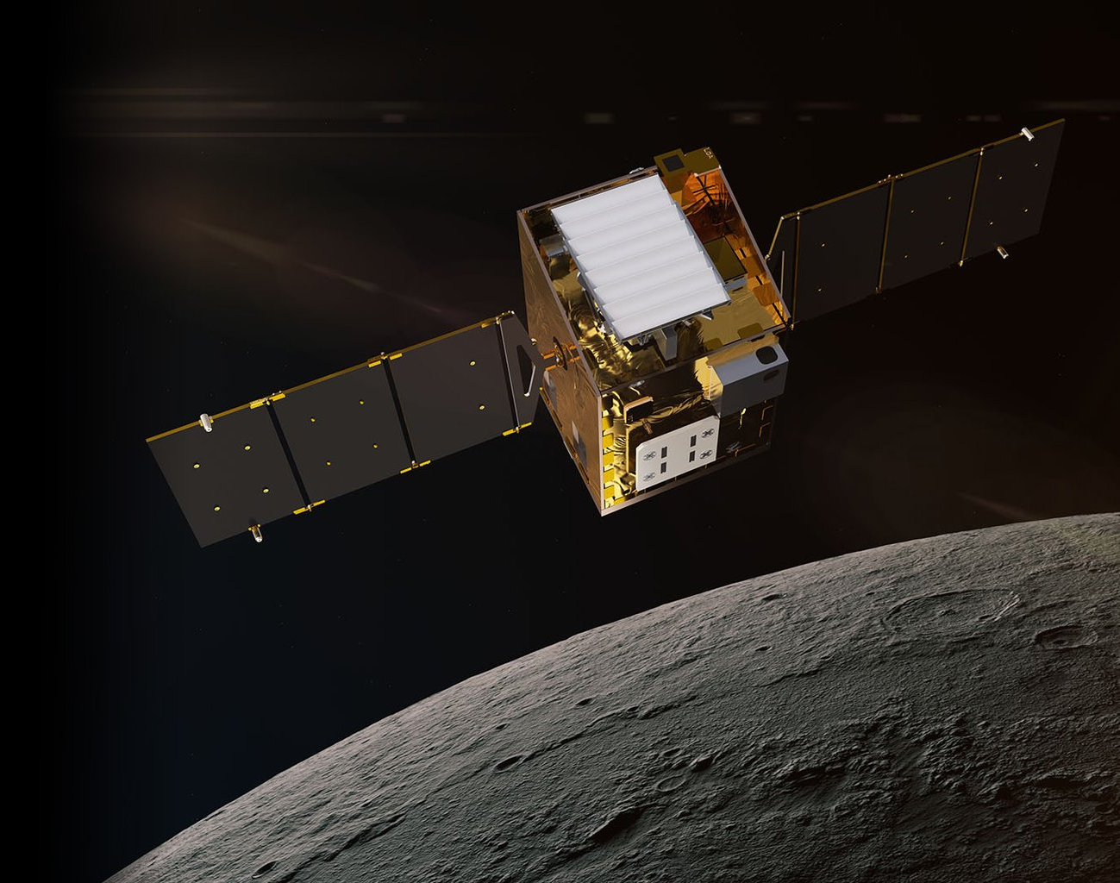
What is the Lunar Trailblazer Mission?
A SIMPLEx mission on a lunar orbit that aims to investigate the presence of water on the Moon and the thermophysical properties of the lunar surface
Launched on February 27th, 2025
Based on its reference trajectory, the Lunar Trailblazer (LTB) spacecraft was expected to experience three total lunar eclipses
  March 14, 2025
  September 7, 2025
  March 3, 2026
Fig. 1 A rendering of the Lunar Trailblazer spacecraft created by Lockheed Martin (Source: Ehlmann et. al., 2022)
Current Spacecraft Status:
Solar panels are oriented away from the Sun: this means no attitude control or radio
From ground-based observation, solar panels may reorient towards the Sun in next weeks
Listening for signal with ground stations because spacecraft has delta-v to return to the Moon, if commanding/function can be re-established
Thank you to NASA and the broader space community for all their support!
This document has been reviewed and determined not to contain export-controlled CUI.

Slide 4
Goals
Develop and test a procedure for the LTB spacecraft mission operations to ensure power management through a long-duration eclipse scenario
The main objectives:
1.
Spacecraft can enter the long-duration eclipse procedure through an autonomous sequence for pre-planned eclipse scenarios
2.
Spacecraft uses minimal battery power while in the eclipse scenario
3.
Spacecraft exits eclipse scenario and restores nominal operations to continue scientific research
This document has been reviewed and determined not to contain export-controlled CUI.

Slide 5
Spacecraft in Earth Orbit vs. Lunar Orbit
Approximate number of spacecraft launched into a Lunar orbit:
<100
Source: (Wikipedia Contributors, List of Extraterrestrial Orbiters, 2025)
Approximate number of spacecraft still in an Earth orbit:
~14,050
Source: (European Space Agency, 2023)
Difference highlights how dealing with long-duration eclipses in a lunar orbit is a relatively newer concern and different strategies have been used by past missions
This document has been reviewed and determined not to contain export-controlled CUI.

Slide 6
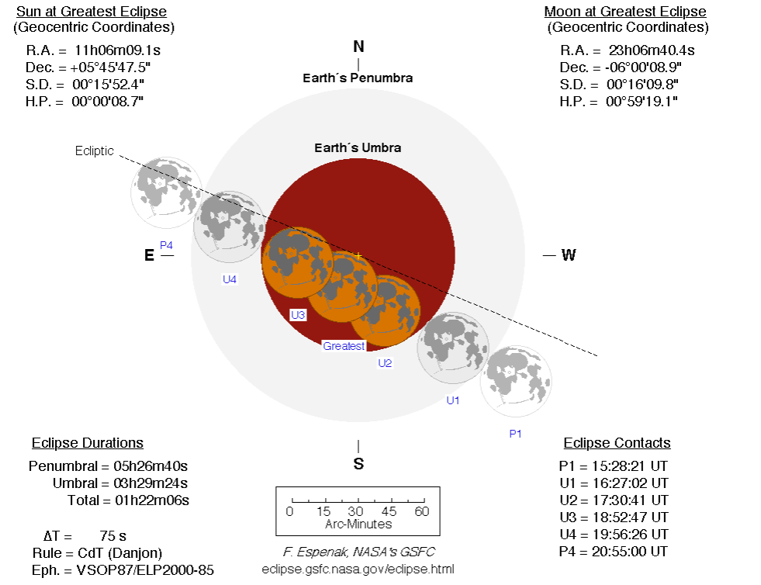
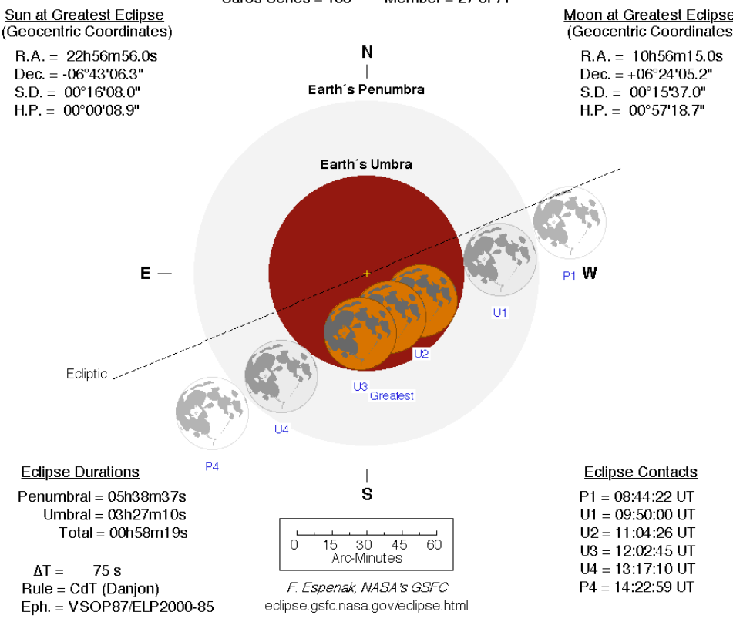
Background - Eclipses
September 7, 2025:
March 3, 2026:
Fig. 2 and Fig 3. Fig. 4. The lunar eclipses and their spatial parameters described and modeled against Earth shadows for the September and March lunar eclipses (Source: NASA - Lunar Eclipses, n.d. and Espenak, 2020)
This document has been reviewed and determined not to contain export-controlled CUI.

Slide 7
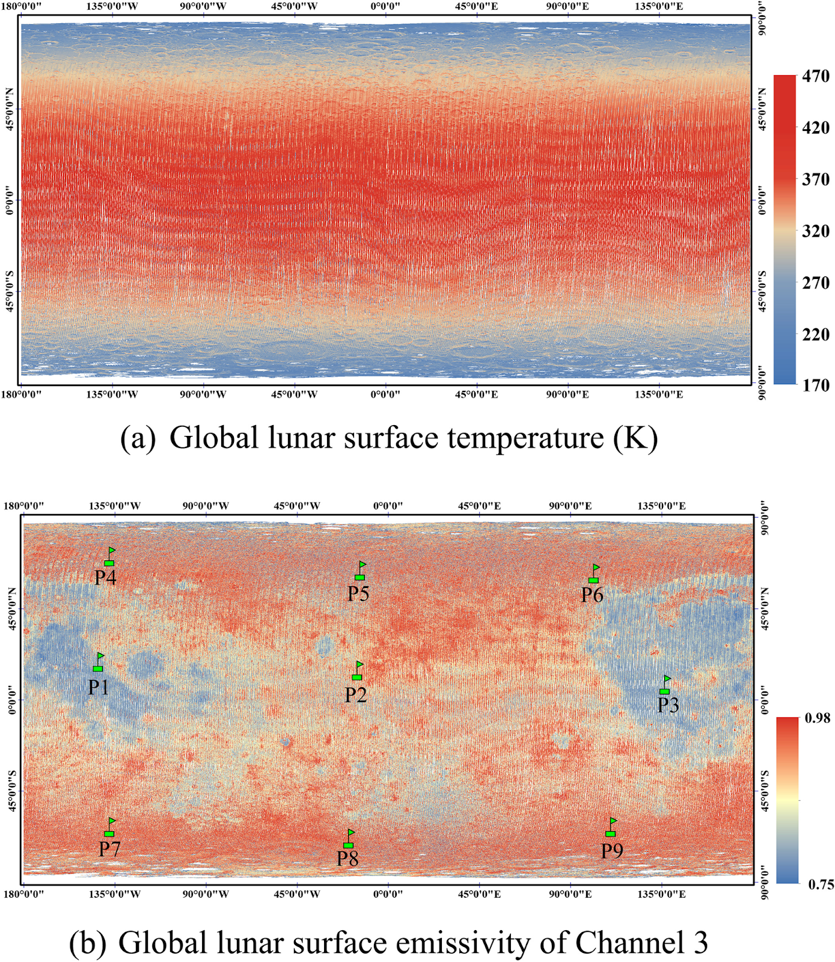
Background – Heat Flux Considerations
Penumbra: the outer region of shadow where the Sun may have a partial visibility
Umbra: the region where the Sun is not visible in the orbit
Factors that affect heat losses of lunar orbiting spacecraft:
  The beta angle of the spacecraft’s orbit
  The Moon’s emitted radiation
  The Moon’s reflected radiation based on the reflectivity of the lunar surface
Figure 4. A graph of global lunar surface temperatures and the lunar emissivity based on Diviner Lunar Radiometer Experiment Sensor 2015 observation data (Source: Ren et. al., 2020)
This document has been reviewed and determined not to contain export-controlled CUI.

Slide 8
Background - Past Missions Strategies:
Lunar Reconnaissance Orbiter (Mesarch, 2023)
  Changing the direction of the orbit
  Pre-heating subsystems to maintain the instruments within the thermal limits
  Minimizing the battery usage overall
NASA Magnetospheric Multiscale Mission (Williams et al., 2020)
  Determined that different orbital maneuvers would have varying effects on eclipse duration
  Sensitive equipment and subsystems will be preheated up to 24 hours prior to eclipse
These are strategies similarly considered for the development of the long-duration procedure for LTB
This document has been reviewed and determined not to contain export-controlled CUI.

Slide 9
Methods
To manage the long-duration eclipse scenario:
  A mission operations procedure
  An onboard autonomous software procedure
General flight software program considerations:
What data is recorded and sent to ground systems?
How is information processed by the computer?
What subsystems considerations are present?
How is an anomaly scenario dealt with?
Software procedure created based on power, thermal, and orbital parameterizations with input from the Jet Propulsion Laboratory Navigation Team and Lockheed Martin LTB Systems Engineers
This document has been reviewed and determined not to contain export-controlled CUI.

Slide 10
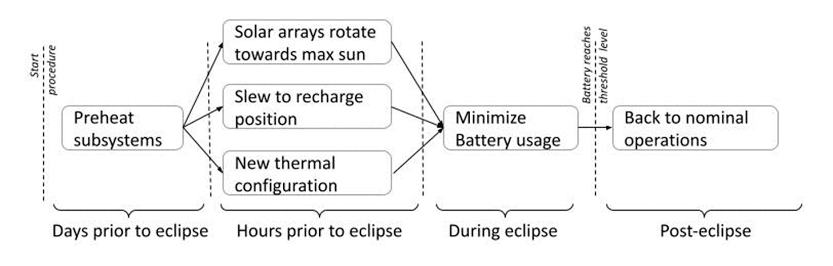
Methods – Strategies Implemented
2. Re-maneuvering to maximize solar radiation and solar panel position
1. Pre-heating of vulnerable subsystems
3. During eclipse duration, a new thermal configuration
4. Minimizing battery usage by all subsystems
Procedural
Block
Diagram::
This document has been reviewed and determined not to contain export-controlled CUI.

Slide 11
Methods – Testing Implemented
Procedure was tested using a software simulation and hardware spacecraft testbed
Methods:
  The autonomous procedure was uploaded to a software spacecraft simulation which simulated how the procedure would run and be reflected in spacecraft data while in-orbit
  The simulation tests were run separately to verify each strategy implemented and then also with all commands compiled
    Tests for syntax verification were completed with a shortened pre-heat period
  An initial test of procedure was run on the hardware spacecraft testbed
Testing objectives:
  Verify that the long-duration eclipse software procedure worked concurrently with pre-existing flight software structure
  Determine whether all commands were sent and the changes that were desired were reflected in simulation
    Ex. If a heater was set to a temperature by the procedure, did the simulation test reflect this change?
This document has been reviewed and determined not to contain export-controlled CUI.

Slide 12
Test Results
Software Simulation Run Results:
Expected Output of Simulation | Syntax Verification | Simulation Output Verification
Turn heater subsystems on/off | All verified | Met expected
Manually set thermal heaters to desired temperatures | All verified | Not quite expected; spacecraft simulator not able to simulate heater sensors
Turn general subsystems on/off | All verified | Met expected
Spacecraft to a desired orientation relative to Sun | All verified | Met expected
Rotate solar arrays into a recharging configuration | All verified | Met expected; solar arrays rotated to maximize solar input
  Main Implications:
  Thermal parameters can be configured as desired
  Procedure accepted by pre-existing software structure
  Procedure can configure solar arrays to a desired position based on the eclipse scenario requirements
This document has been reviewed and determined not to contain export-controlled CUI.

Slide 13
Conclusions
Procedure met the main objectives of entering a long-duration eclipse autonomously and exiting to regain the nominal operation status based on simulation and testbed tests
Procedure provides:
  Adaptability to on-orbit measurements or new long-duration eclipse considerations
  A versatile solution to power and thermal management for within 3-5 hour long-duration eclipse periods
Future Considerations:
  Further research and implementation of strategies to shorten the duration of the long-duration eclipse
    Ex. Orbital maneuvers such as maneuvering to an orbit that minimizes the period in darkness
  Incorporation of on-orbit performance measurements
This document has been reviewed and determined not to contain export-controlled CUI.

Slide 14
Thank you,
any questions?
Acknowledgements: I would like to express my gratitude to my mentor Professor Bethany Ehlmann, and my co-mentors Judy Adler and Lee Bennet, along with the rest of the Lunar Trailblazer Mission Operations team, for their valuable time and technical advice. Thank you to the Caltech Summer Undergraduate Research Fellowship program for their support and additionally the Lockheed Martin LTB Systems Engineers and the JPL Navigation team for their systems research and analysis support.
This document has been reviewed and determined not to contain export-controlled CUI.

Slide 15
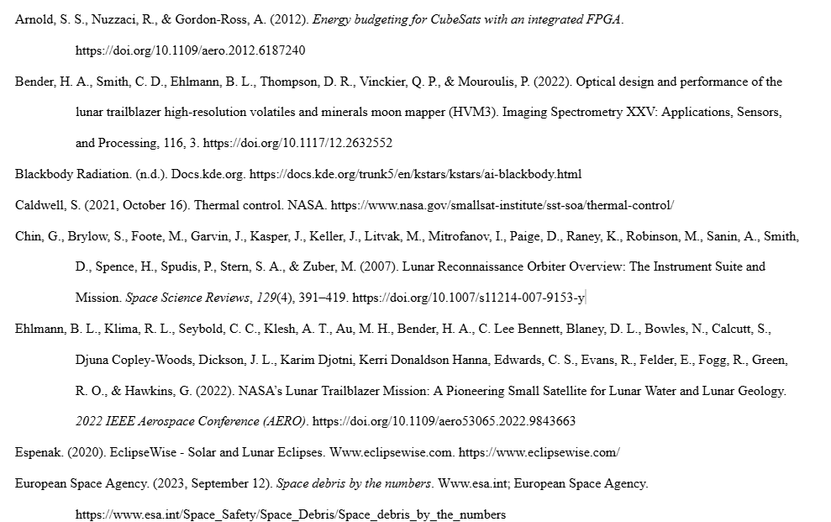
References
This document has been reviewed and determined not to contain export-controlled CUI.

Slide 16
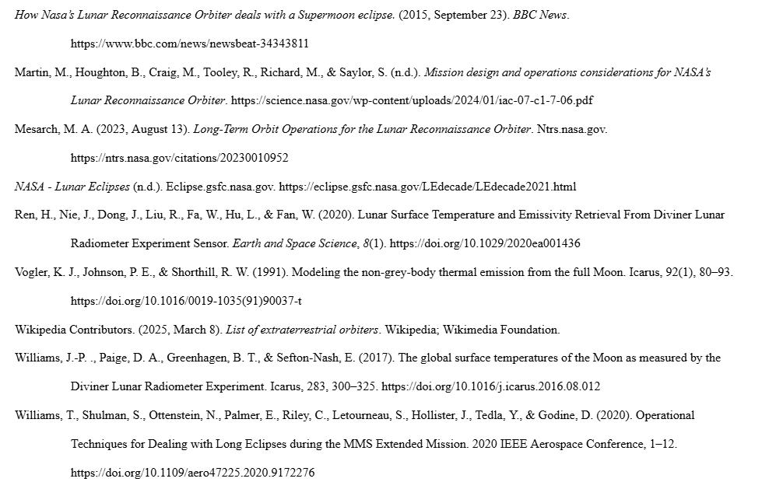
References
This document has been reviewed and determined not to contain export-controlled CUI.

