Slide 1
Lunar Cube Sat Mass Spectrometer
Stojan Madzunkov
J. Raines, P. McNally, J. Simcic, D. Nikolic, M. Darrach
1

Slide 2
Our Goal
Deliver TRL6 LCMS ready for integration to the lunar lander (TBD)
DALI QITMS – PROTOFLIGHT-1 (w/ kitted complete duplicate set of parts)
KEY POINTS:
      Compact form factor (reduce electronics volume and RF tank volume) - where practical
      PWBs footprint to accommodate, but not be populated with, flight parts
      Build with Military Grade parts – with flight parts only where there is no military part available
      EXCEPTION – DCB to be built with commercial parts (in situ radiation shielding)
UTILIZATION:
      Demonstrate TRL6 (TVAC, Dynamics, EMI/EMC)
      Prove out performance - thorough and deep test program
      Fly to the moon for a one-day mission (tech demo, possibly with swap-in of a better DCB)
KEY MILESTONES:
Long Lead Parts List -> Dragan: November 5, 2020
All not-swappable/not-in hand parts on order: December 31, 2020
-------36 WEEKS------
Last not-swappable part delivers to SPRL: Sept, 2021
All boards, sensor, chassis ready (flat sat configuration): Dec, 2021
First power on of complete system: March, 2022
START TRL 6 tests: June, 2022
Deliver to JPL to START performance test: Sept, 2022
-------24 WEEKS----------
COMPLETE performance characterization: March, 2023
2
Notes:
2

Slide 3
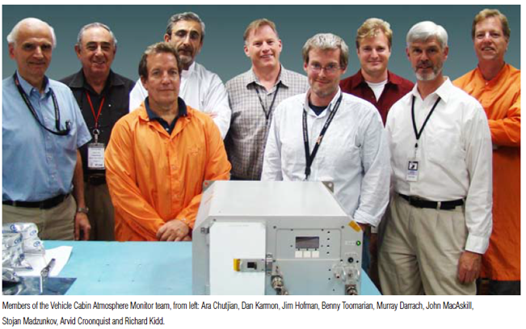
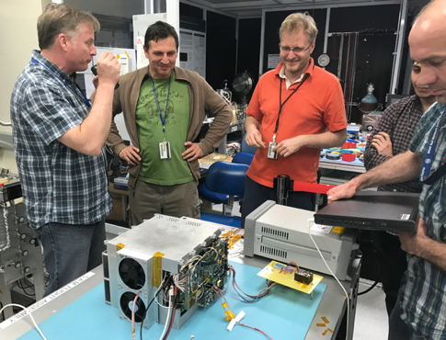
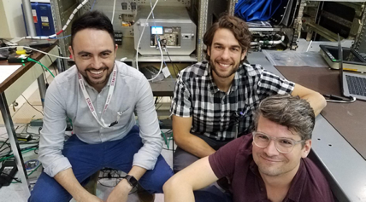
Development History
Vehicle Cabin Air Monitor (VCAM)
  GC-QIT-MS for trace species detection for ISS cabin heath monitoring
Spacecraft Atmosphere Monitor (S.A.M.)
  Significant reduction in mass, power, volume, and data rate over past decade
  Focus on TRL enhancement for flight applications and transition to commercialization
MCA (Major Constituent Analysis) with 2 sec updates and fraction of a percent error (performance checkout underway)
TGA (Trace Gas Analysis) with daily 20 minutes runs, down to 10-1000ppb
Dynamic range 10⁰ to 10⁻⁸
M. Darrach, S. Madzunkov, E. Diaz, B. Moore, R. Kidd, B. Bae, J. Simcic, S. Schowalter, R. Purcell, I. Cisneros, R. Schaefer, F. Cheung, K. Reichenbach, T. Loc, J. Lam, A. Oyake, D. Nikolic, R. Murdock
Vehicle Cabin Atmosphere Monitor (VCAM) ISS deployment in 2010
Funded by NASA AEMC
Spacecraft Atmosphere Monitor (S.A.M.) ISS powered on in August 2019
Funded by NASA AEMC & AES
3
Notes:
3

Slide 4
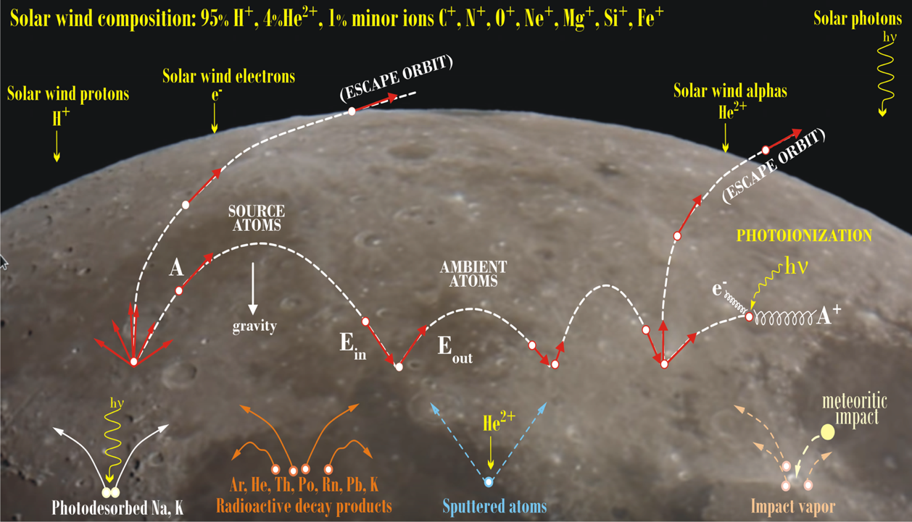
Lunar Exospheric Composition
Observation of time variability of multi-day lunar surface exospheric and radiation changes
Identifying and quantifying exosphere species with abundances ≥ 10 molecules/cm³
  e.g. low abundance of CO and N2; not measured before e.g. Kr, Xe
Primary mechanism for creation of lunar exosphere are:
  Solar wind activities with next expected maximum in 2026+/-2 years
  Radioactive decay
  Meteorite impact
D. Nikolić and M. Darrach, LADEEVIEW: Elemental Composition Analysis of Lunar Surface, 3rd International Workshop on Instrumentation for Planetary Missions, October 24–27, 2016, Pasadena, CA; article 4014, 2pp (2016).
Notes:
4

Slide 5
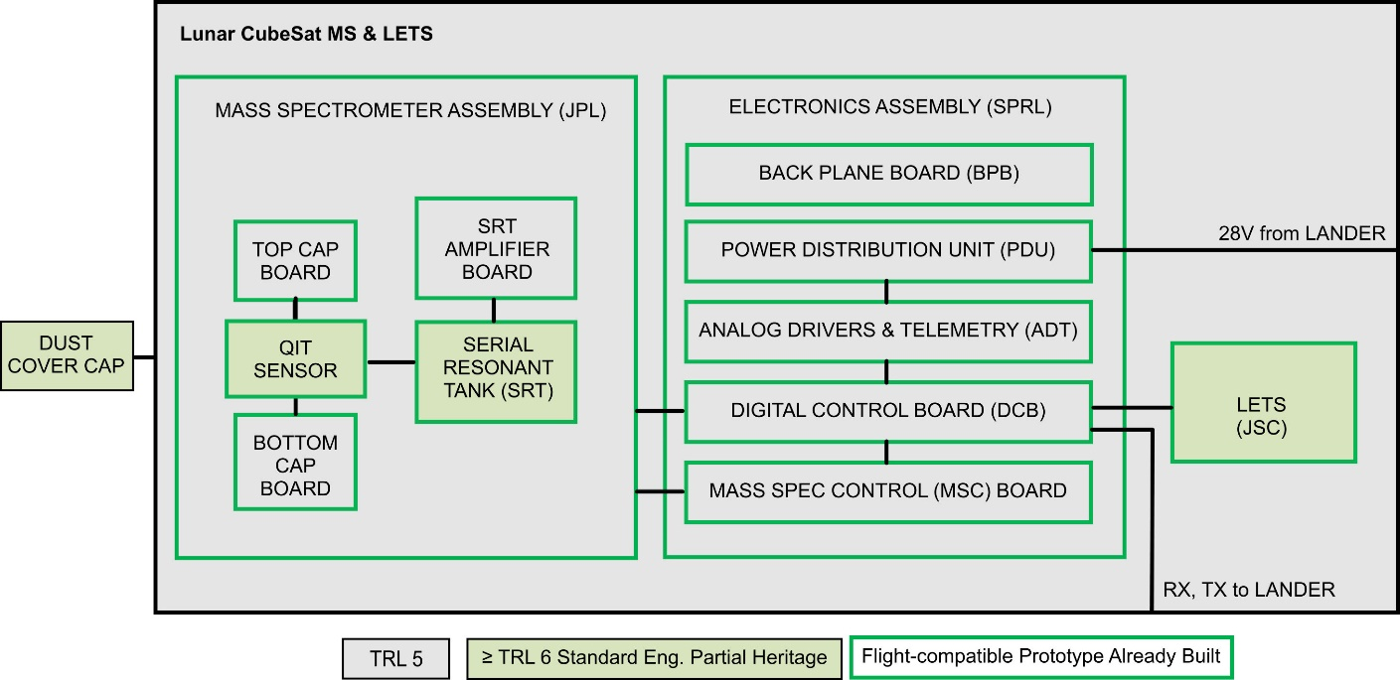
Readiness for Flight Implementation
Development over past years allowed to increase the TRL level of all components to 5 with design implementations to support TRL 6.
Notes:
5

Slide 6
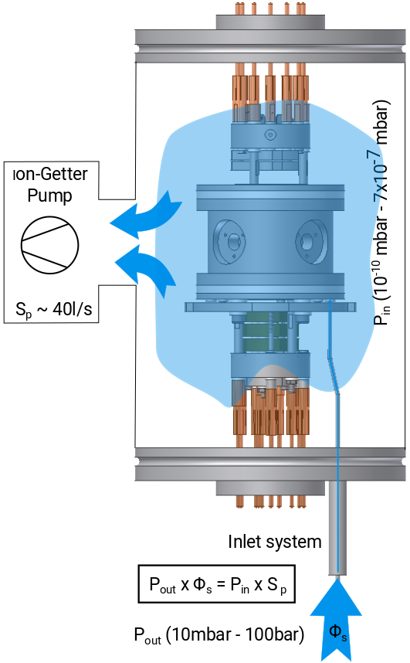
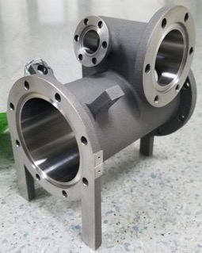
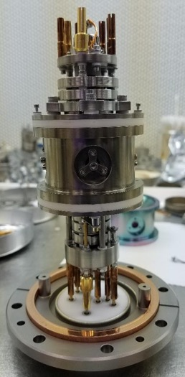
Main Component of QIT-MS
QIT-MS base pressure high 10⁻¹¹ torr
Operates without He buffer gas
Different modes of operation (dynamic, static, resonant ejection)
S.A.M operating pressure ~5x10⁻⁹ torr
S.A.M. operating sensitivity 5x10¹² cnts /torr/sec (dynamic)
Inlet = fussed silica tube (single)
Allows for MCA every 2 sec
4.7”
Notes
QIT-MS = Quadrupole Ion Trap Mass Spectrometer
S.A.M. = Spacecraft Atmosphere Monitor (launch 2019)
Notes:
6

Slide 7
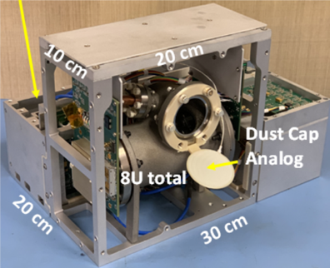
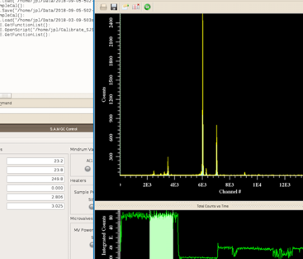
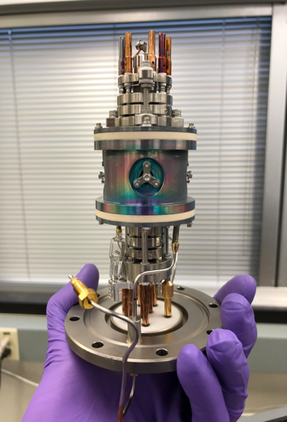

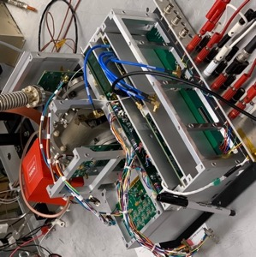
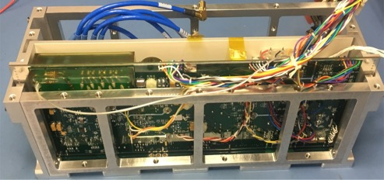
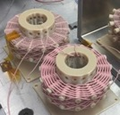
Compact QIT-Mass Spectrometer for Lunar and Planetary Applications
Integrated Software
Prototype QIT-MS
D. Nikolić, et al., Mass Spectra Deconvolution of Gaseous Mixtures Containing Volatile Organic Compounds, 48th International Conference on Environmental Systems, article 313, 6 pages (2018).
Cap electronics
High Q diamond weave Litz wire coil
Sensor
J. Simcic, et al. Miniature Gas Chromatograph Mass Spectrometer (GCMS) For Planetary Atmospheres In Situ Studies, 3rd International Workshop on Instrumentation for Planetary Missions, 2016
Power and CPU Electronics
Mechanical Integration
Notes:
7

Slide 8
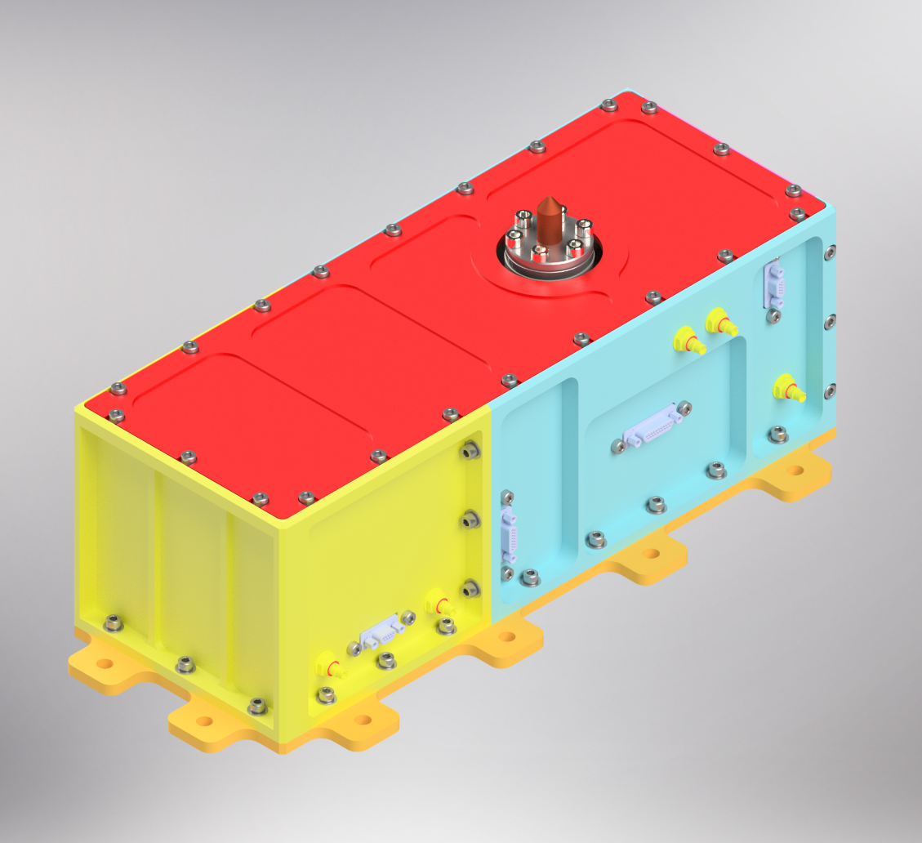
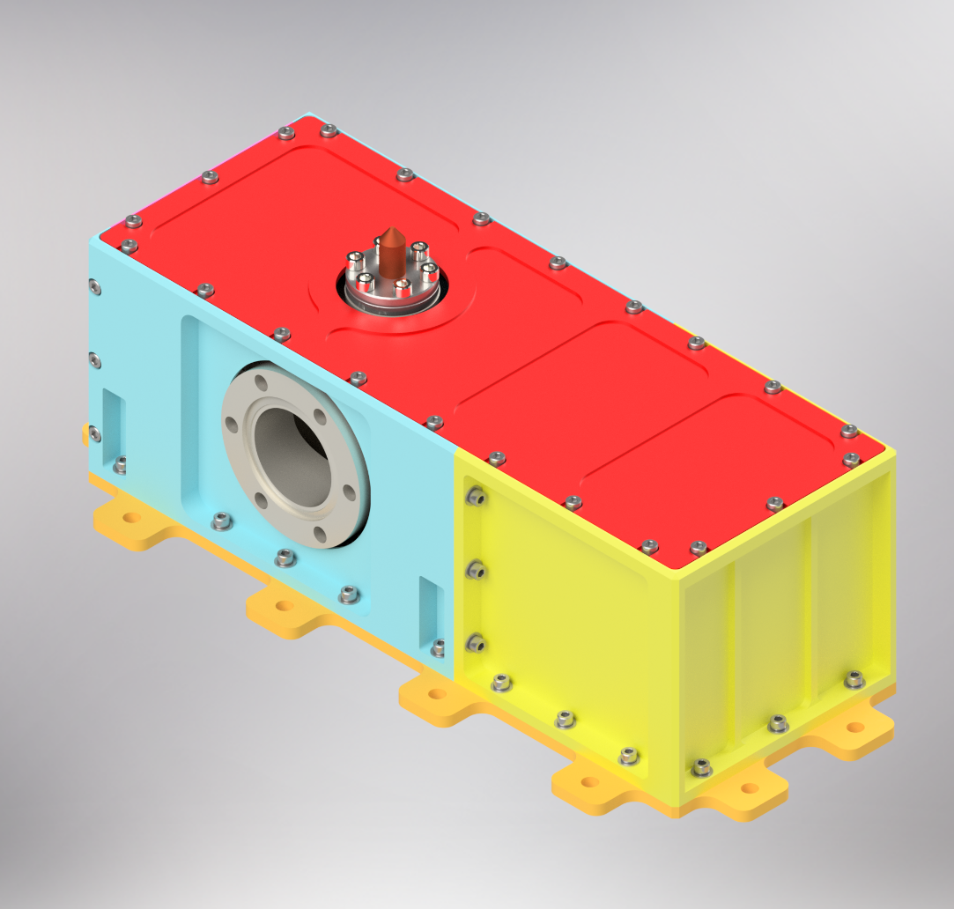
Mechanical (Sensor Chassis)
Notes:
8

Slide 9
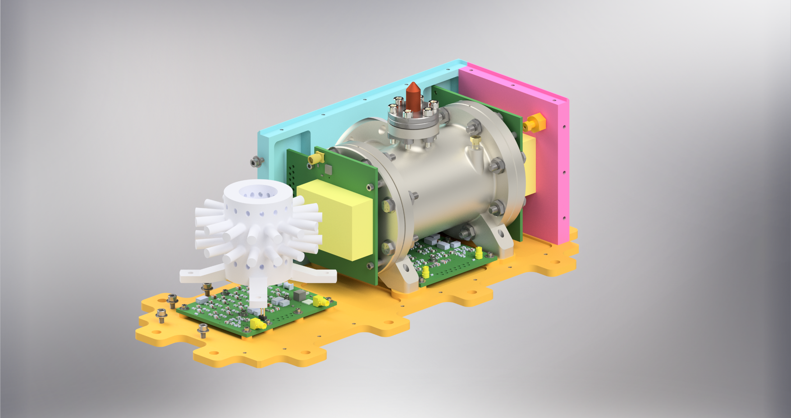
Mechanical – Sensor Chasis
Notes:
9

Slide 10
Requirements demonstrated in the Laboratory
Driving Measurement Requirement | Lunar Surface Observable | Instrument Performance Requirement |  | Projected Performance | Margin*
Determine which volatile species are present at the lunar surface at abundances ≥10 cm⁻³ | H, H₂, ³He, ⁴He, Ne, N₂, O₂, Ar, CH₄, CO, CO₂, Kr, Xe, OH, H₂O | Mass Range (Da) | 1-140 | 0.75-230 | 65%
 |  | Mass Resolution (m/Δm FWHM) | 200 | 1000 | 400%
 |  | Sensitivity (molecules/cm³/sec) | 0.001 | 0.0005 | 100%
 |  | Target species partial pressure (Torr), 2:1 SNR | ≤1×10⁻¹⁴ | ≤1.3×10⁻¹⁵ | 700%
Sources used in compiling the required LUNAR targets are:
1) 2013-2022 Planetary Decadal Survey, Visions & Voyages, p. 118, critical science goal for the moon and other inner solar system bodies: “Understand the Composition and Distribution of Volatile Chemical Compounds…”
https://www.nap.edu/login.php?record_id=13117&page=https%3A%2F%2Fwww.nap.edu%2Fdownload%2F13117
2) 2007 NRC Report: Scientific Context for Exploration of the Moon
https://www.nap.edu/login.php?record_id=11954&page=https%3A%2F%2Fwww.nap.edu%2Fdownload%2F11954
8a. Determine the global density, composition, and time variability of the fragile lunar atmosphere before it is perturbed by further human activity.
8c. Use the time-variable release rate of atmospheric species such as 40Ar and radon to learn more about the inner workings of the lunar interior.
8d. How water vapor and other volatiles are released from the lunar surface and migrate to the poles where they are adsorbed in polar cold trap.
3) LEAG Specific Action Team Report, Goal 8a: “Systematically detect trace volatile species, like water, OH, and hydrocarbon in the exosphere.”
4) LEAG Specific Action Team Report, Goal 8b: “Detect volatile transport from mid- to high-latitudes as a function of driving space environmental (solar storm, meteor stream) conditions.”
https://www.lpi.usra.edu/leag/reports/vsat_report_123114x.pdf
5) HEOMD / Lunar Human Exploration Strategic Knowledge Gap (SKG) Special Action Team Report, September 2016: I-C, Regolith Volatiles, in situ. “Quality/ quantity/ distribution/ form of H species and other volatiles in nonpolar mare/highlands regolith.”
https://www.nasa.gov/sites/default/files/atoms/files/leag-gap-review-sat-2016.pdf
Notes:
10

Slide 11
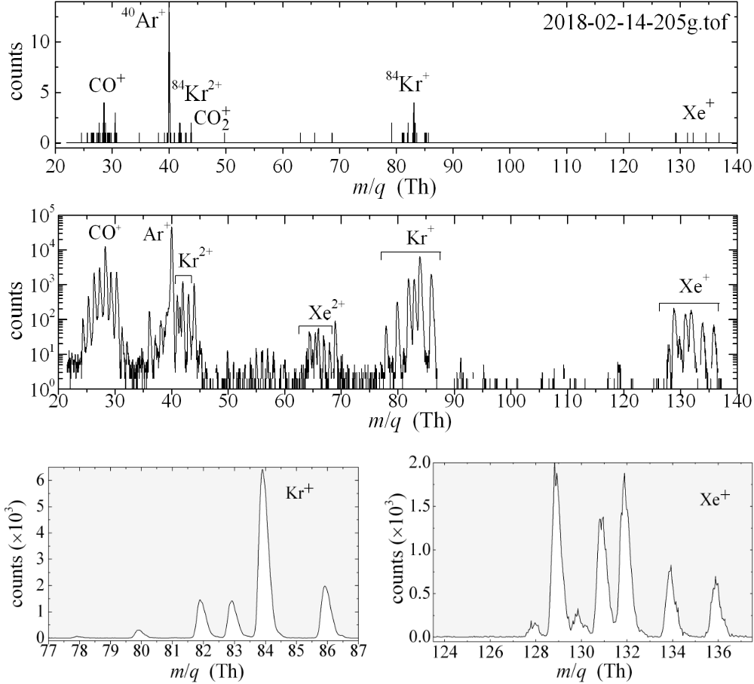
Noble Gas Mass Spectrum
Isotope spectra of an aliquot of calibrating gas (1.7E-10 Torr of Kr and 1.3E-11 Torr of Xe) measured continuously for 7 hours yielded a 0.6 ‰ precision on the ⁸⁶Kr/⁸⁴Kr ratio
50 ms
1 minute
*G. Avice, A. Belousov, K. A. Farley, S. M. Madzunkov, J. Simcic, D. Nikolic, M. R. Darrach and C. Sotin, “High-precision measurements of krypton and xenon isotopes with a new static-mode quadrupole ion trap mass spectrometer,” JAAS, Vol 34, January 2019
Notes:
11

Slide 12
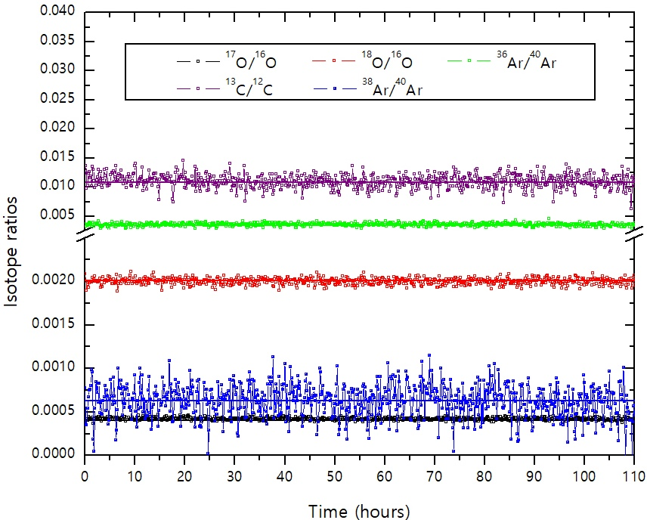
Isotopic long term stability from S.A.M. data (calibrated)
Notes:
12

Slide 13
Conclusion
Notes:
13

