Slide 1
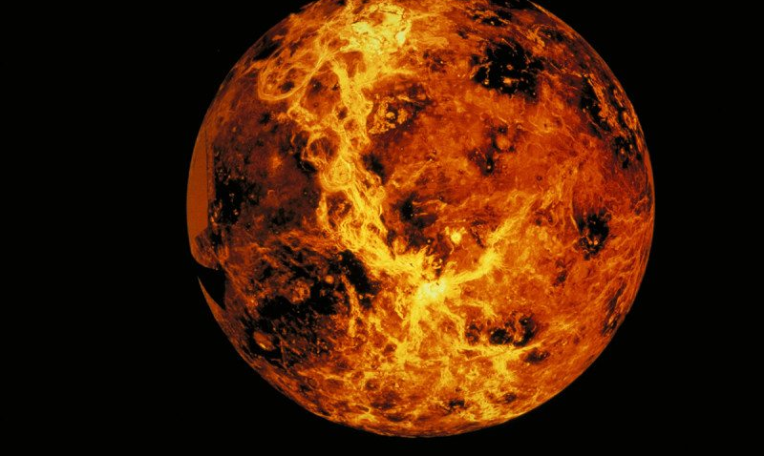

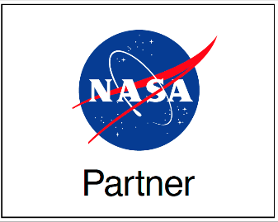

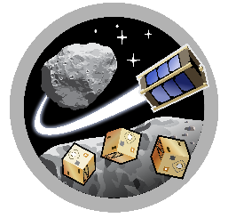

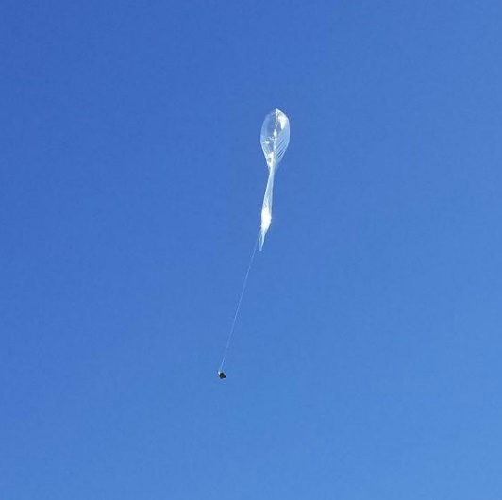
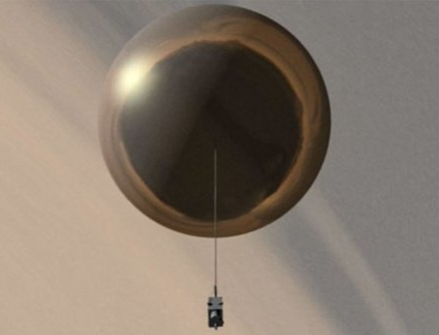
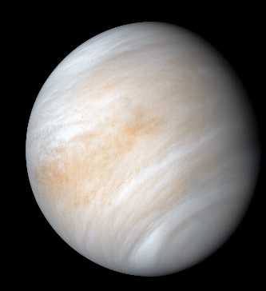
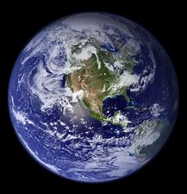
MIRO
Space Grant
ASTEROIDS
Pico Balloon Platform for Venusian Atmospheric Exploration
Josh Crest and Jekan Thangavelautham
Space and Terrestrial Robotic Exploration (SpaceTREx) Laboratory
Aerospace and Mechanical Engineering Department
University of Arizona

Slide 2
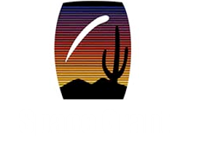
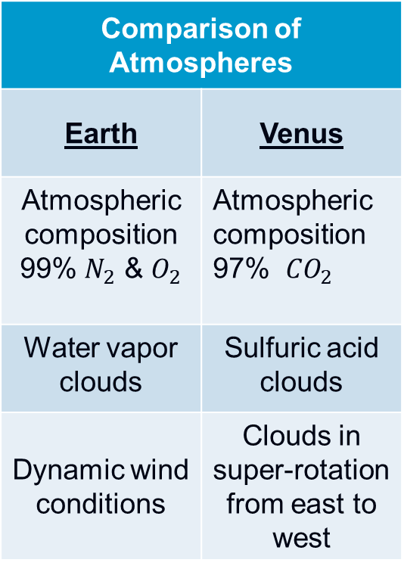
Introduction
Comparison of Atmospheres
Earth | Venus
Atmospheric composition 99% $N_{2}$ & $O_{2}$ | Atmospheric composition 97% ${CO}_{2}$
Water vapor clouds | Sulfuric acid clouds
Dynamic wind conditions | Clouds in super-rotation from east to west
NASA has expresses interest in revisiting Venus to perform life detection experiments
Challenges make current exploration costs high
Average surface temperature 450° C
Surface pressure ~90 atm
Sulfuric Acid Clouds

Slide 3
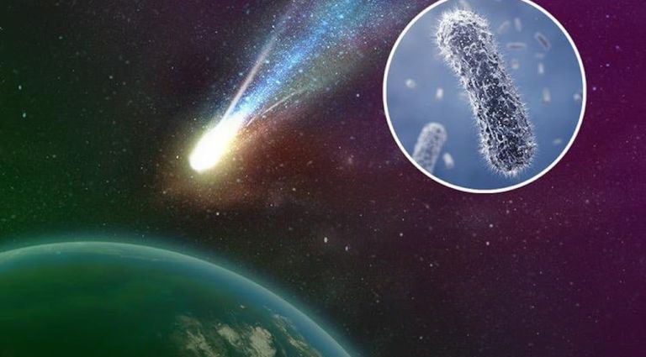
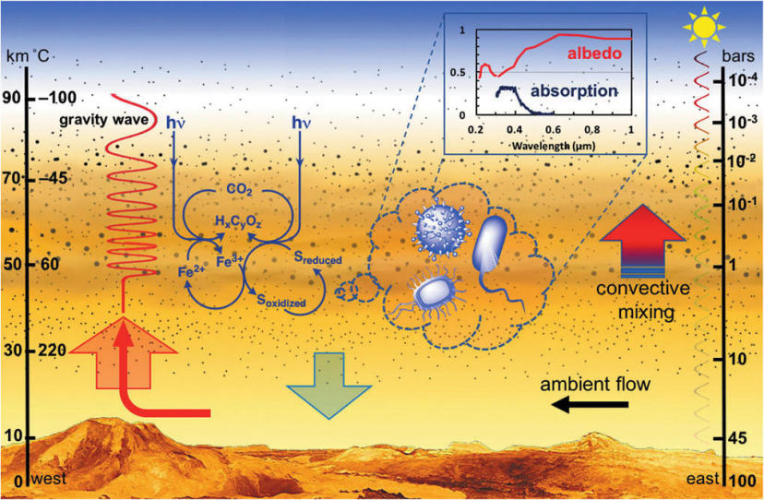
Introduction
Panspermia – origins of life could be interplanetary or interstellar
Life originated on surface and migrated into the clouds
Source: [curiosmos.com]
Source: [S. Limaye et al (2018)]

Slide 4
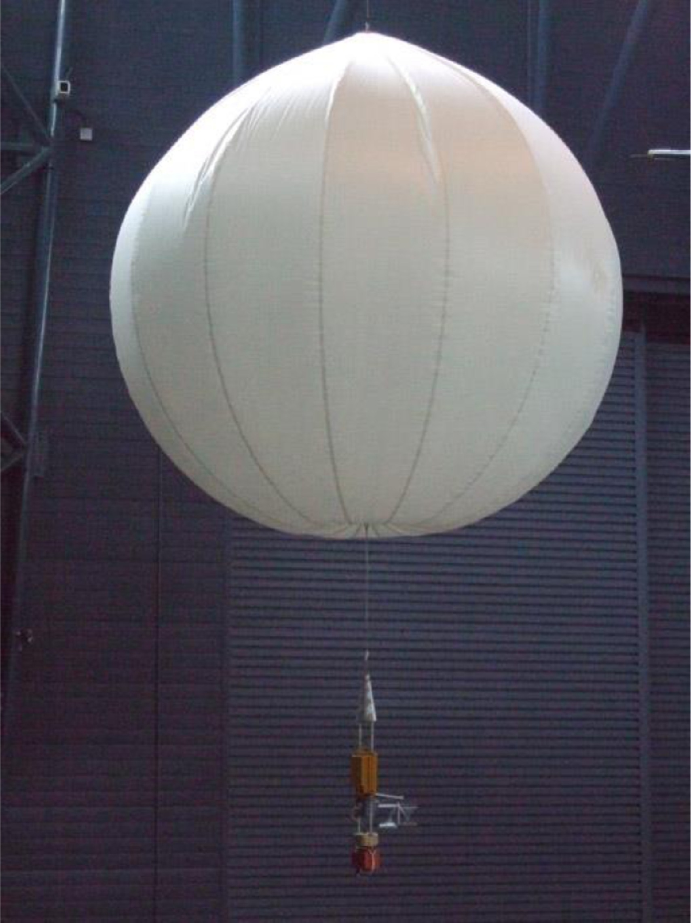
Why Balloons?
Optimal exploration platform for Venus
Low-cost & Low risk missions
Proven for Venus (Vega mission)
Source: [R. Lorenz et al (2018)]

Slide 5
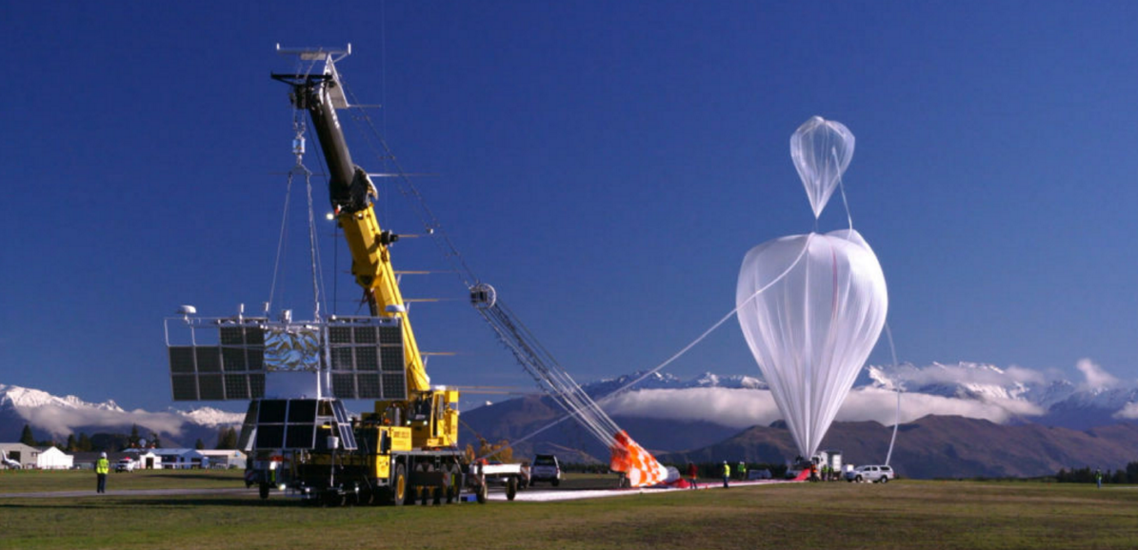
NASA Roadmap for Scientific Ballooning 2020-2030
Recommends increased funding for balloon payload research, super pressure balloons, downlink bandwidth.
Recommends to engage the National Space Grant program to support training of next generation of scientists and engineers
Source: [Executive Summary: A Roadmap for Scientific Ballooning 2020-2030]

Slide 6
Proposal: Pico-Balloon Platform
Study the dynamics and composition of Venusian atmosphere & perform life detection experiments
Teflon cloth balloon envelope & helium lifting gas
Miniaturized scientific equipment
Source: [JPL/NASA]

Slide 7
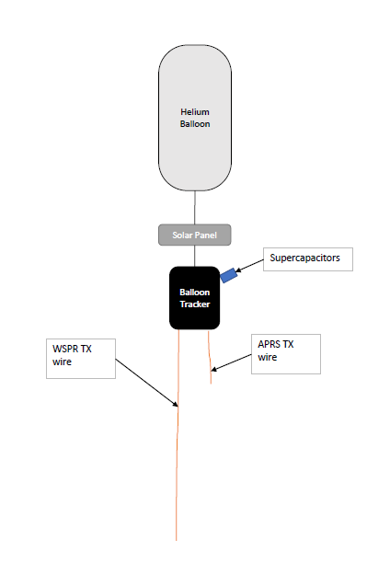
Objective
Develop a pico-balloon platform that can be used for terrestrial atmospheric exploration
In situ measurement device for earth’s jet streams
Currently satellites observe the jet streams from a distance

Slide 8
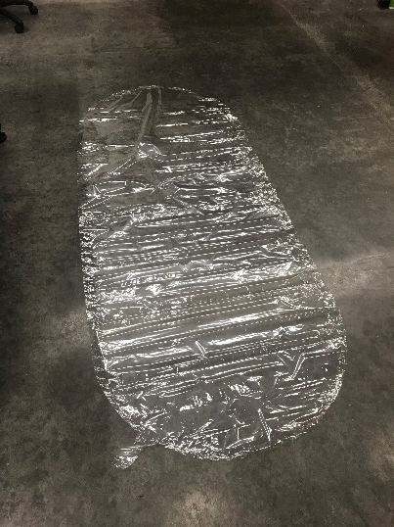
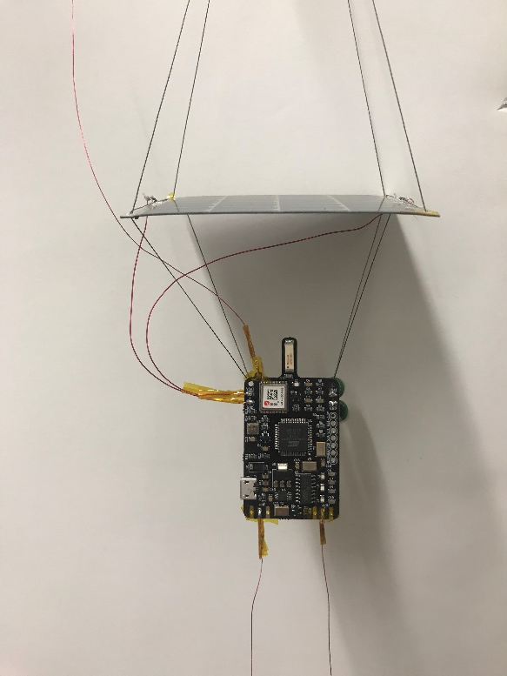
Prototype
Transmits via amateur radio
Relay's location, altitude, temperature, pressure, speed, and direction
LightAPRS-W balloon tracker
50cm APRS TX wire
5m WSPR ground wire & TX wire
SBS-13 Balloon envelope
2.5V 3.3F super capacitors x2
50 mA @ 4.8V Powerfilm solar panel
15 lb. fishing line
4
7
3
6
5
1
3
2
APRS: Automatic Packet Reporting System
WSPR: Weak Signal Propagation Reporter

Slide 9
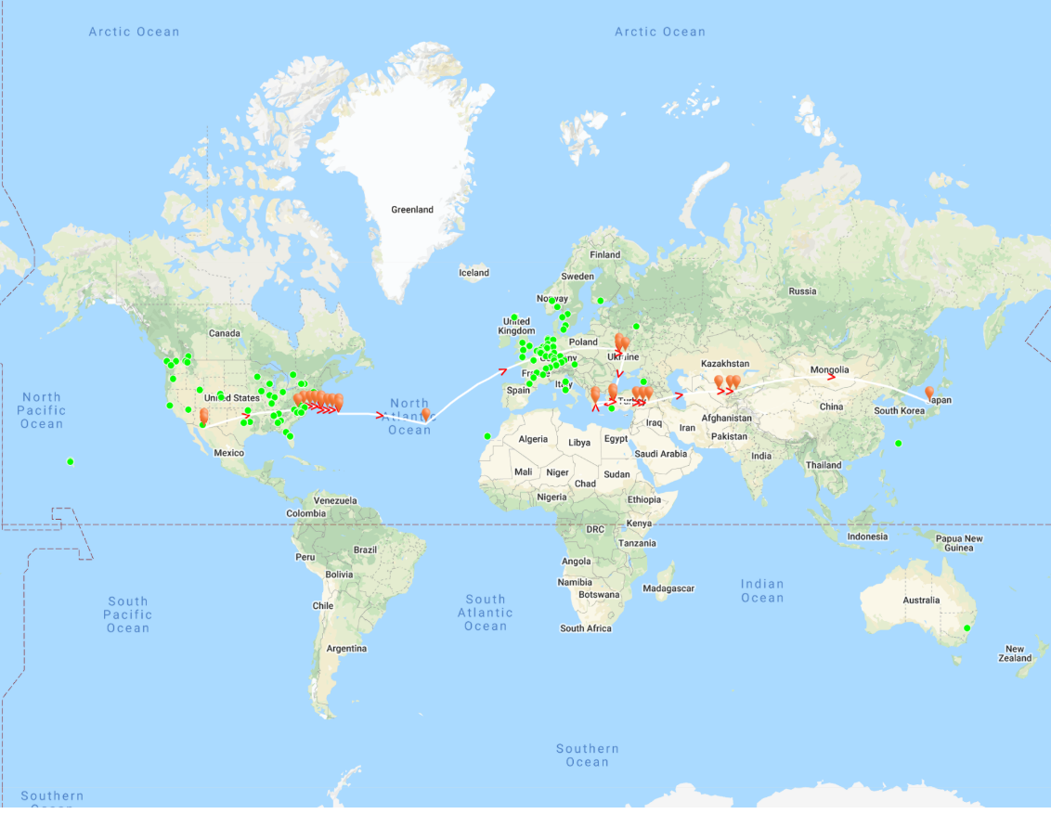
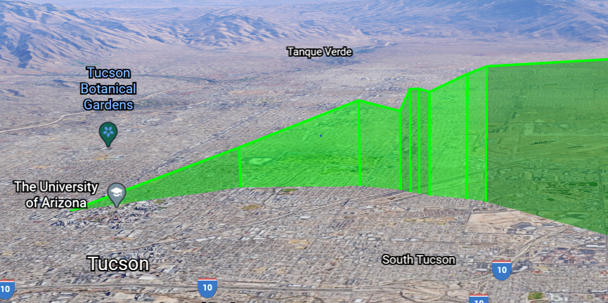
Flight 1
Total payload weight: 37.5 grams
6.5 grams free lift
Target altitude
35,000 - 40,000 ft.
247 hours flight time
Max speed 289 MPH

Slide 10
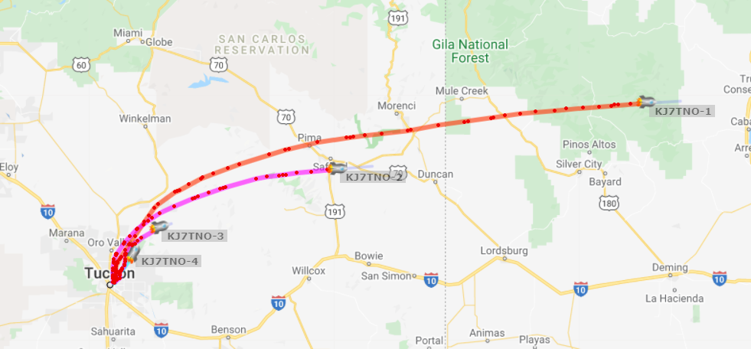
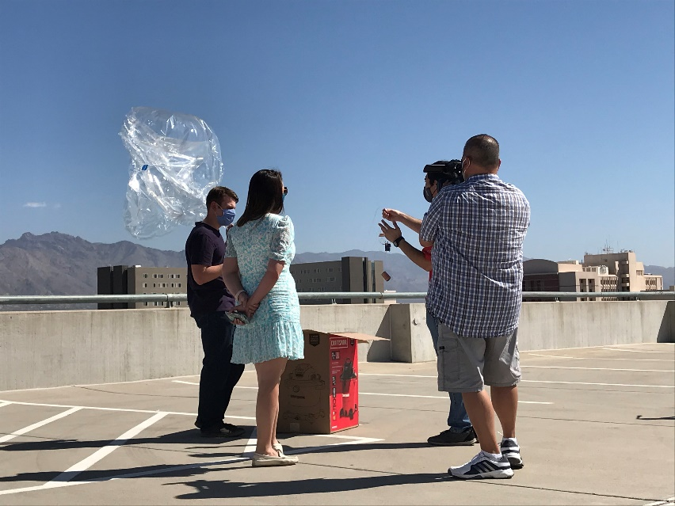
Flight 2
4 pico-balloons
Payload weight
~22 grams
Testing different balloon envelope materials (mylar and SBS-13)
6.5 grams free lift
Target altitude
35,000 - 40,000 ft.

Slide 11
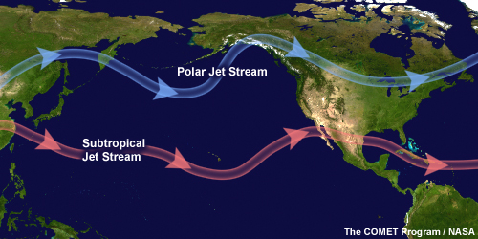
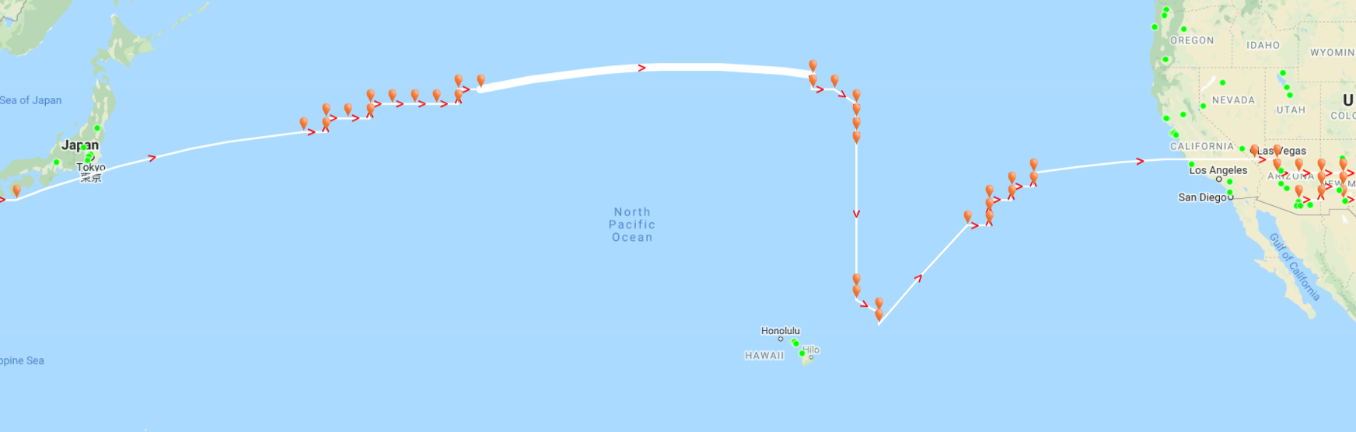
Flight 2 - Results
Circumnavigated in 13 days
Total flight time 14 days
Over 30,000 km traveled
Concluded SBS-13 more reliable than mylar
Source:

Slide 12

Necessary Development
Miniaturized life detection equipment in development by Prof. Linda Powers
Teflon balloon envelope and payload coating to survive sulfuric acid
Develop communication method to link swarms of Pico-balloons
Source: [biovoicenews.com]

Slide 13
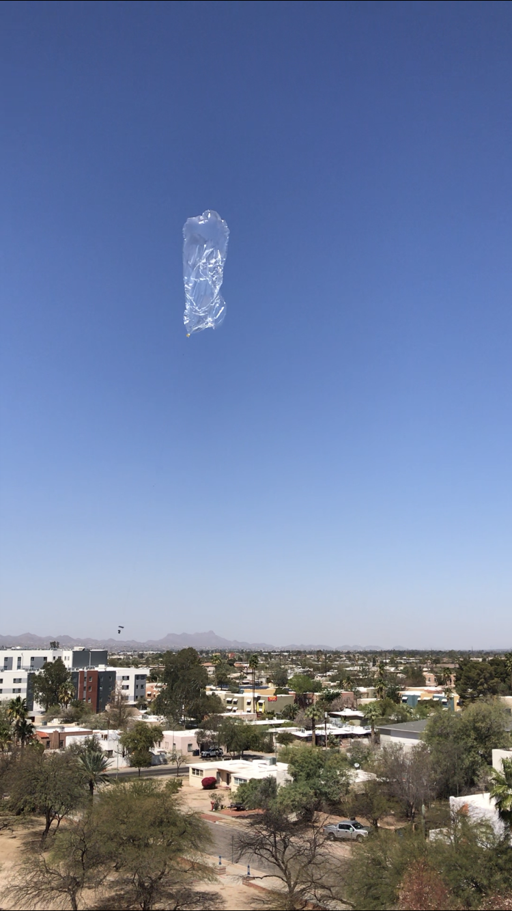

Conclusions
Successfully created a pico-balloon platform for terrestrial atmospheric exploration
In situ measurements of the jet streams
Can be expanded to fly on Venus
Swarms of pico-balloons could be launched to form a constellation around Venus.
Long duration in situ detectors identifying regions with the highest potential for life.

Slide 14
Acknowledgements
Jekan Thangavelautham - Mentor
Tristian Schuler – Graduate Student
Layne Crawford – Administrative Program Manager Asteroids laboratory
Michelle Coe – Manager, Arizona/NASA Space Grant Program
Michael Debbins – Undergraduate researcher

Slide 15
Thank you

Slide 16
References
  Ford, Kevin. (1997). Optimizing Aerobot Exploration of Venus.
  Limaye, Sanjay & Mogul, Rakesh & Smith, David & Ansari, Arif & Słowik, Grzegorz & Vaishampayan, Parag. (2018). Venus' Spectral Signatures and the Potential for Life in the Clouds. Astrobiology. 18. 10.1089/ast.2017.1783.
  Greaves, Jane & Richards, Anita & Bains, William & Rimmer, Paul & Sagawa, Hideo & Clements, David & Seager, Sara & Petkowski, Janusz & Sousa-Silva, Clara & Ranjan, Sukrit & Drabek-Maunder, Emily & Fraser, Helen & Cartwright, Annabel & Mueller-Wodarg, Ingo & Zhan, Zhuchang & Friberg, Per & Coulson, Iain & Lee, E'lisa & Hoge, Jim. (2020). Phosphine Gas in the Cloud Decks of Venus.
  11th Lighter-than-Air Systems Technology Conference, Clearwater, Florida, May 16, 1995
  Lorenz, R. D., Crisp, D., & Huber, L. (2018). Venus atmospheric structure and dynamics from the VEGA lander and balloons: New results and PDS archive. ICARUS, 305, 277–283. https://doi-org.ezproxy2.library.arizona.edu/10.1016/j.icarus.2017.12.044
  Seager, Sara & Petkowski, Janusz & Gao, Peter & Bains, William & Bryan, Noelle & Ranjan, Sukrit & Greaves, Jane. (2020). The Venusian Lower Atmosphere Haze as a Depot for Desiccated Microbial Life: A Proposed Life Cycle for Persistence of the Venusian Aerial Biosphere. Astrobiology. 10.1089/ast.2020.2244.
  Gorham, Peter & Christopher, Walker & Jones, William & Kierans, Carolyn & Vieregg, Abigail & Anderson, James & Young, Elliot & Chakabarti, Supriya & Millan, Robyn & Bernasconi, Pietro & Guzik, Gregory. (2019). A Roadmap For Scientific Ballooning 2020-2030.

