Slide 1
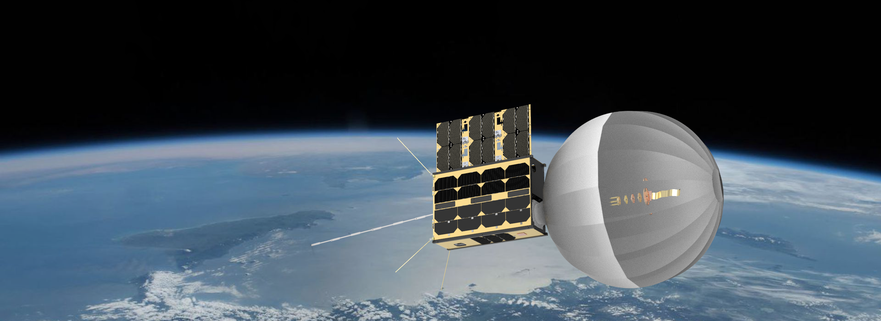
CATSAT: A 6U Inflatable antenna technology demonstrator mission
Aman Chandra¹, Christopher K. Walker^{1,2}, Juan Carlos Tonazzi²
¹ Aerospace and Mechanical Engineering, The University of Arizona
² FreeFall Aerospace, Inc

Slide 2
Introduction
High gain antenna (HGA) technology for CubeSats:
Table: HGA technology comparison*
Antenna Technology | Surface Area (m²) | Mass (kg) | Stowed Volume (m³) | Packing efficiency | Mechanical Complexity | Scalability
Fixed reflectors | 1.2 | 2 - 5 | 0.8 | 1:1 | None | Poor
Mechanically deployable reflectors | 1.2 | 2.1 | 0.04 | 5:1 | High | Poor
Foldable reflect-arrays | 1.1 | 0.6 – 0.8 | 0.05 | 3:1 | Low | Moderate
Inflatable reflectors | 1.2 | 0.2 - 0.3 | 0.02 | 20:1 | Low | High

Slide 3
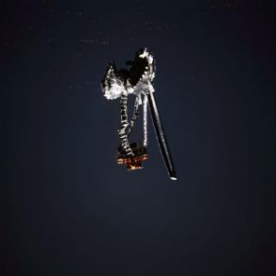
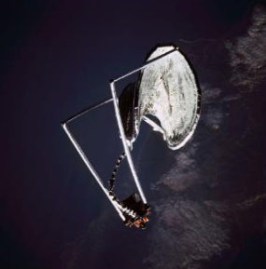
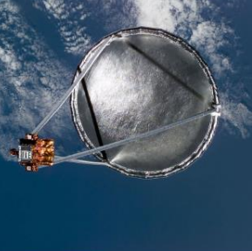
Challenges
Design:
Multi-scale, multi-disciplinary problem.
Inadequate numerical simulation tools.
Scaling laws not well understood.
Manufacture:
Complex and high-cost manufacturing processes.
Limited availability of high-performance materials.
Flight operations:
Risk of micrometeoroid damage.
Thermal gradients effect on membrane shape.
Degradation of membrane on orbit.
Un-characterized vibration modes
Figure: Inflatable antenna experiment on board STS 77

Slide 4
Related development
Inflatable antenna technology for CubeSats:
  Work has been underway to enhance reliability
  Technologies demonstrated in laboratory environments include
    Passively controlled inflation mechanisms - Babuscia., et al. (2014, 2015).
    Inflatable membrane rigidization - Babuscia., et al. (2016, 2017).
    CubeSat packaging and deployment systems - Chandra., et al.(2019).
    Actively controlled inflation systems - Chandra., et al. (2020).
  On-orbit demonstration needed to fully understand extent of reliability.

Slide 5
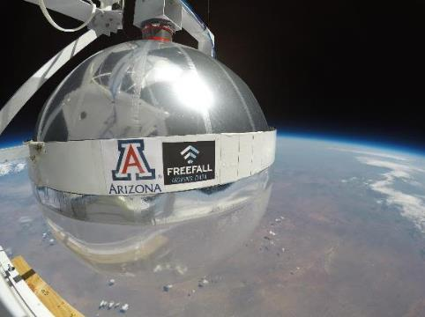
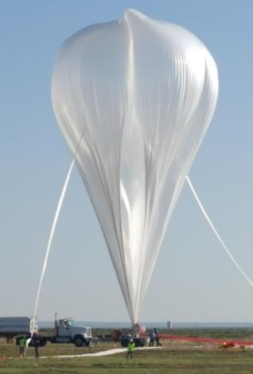
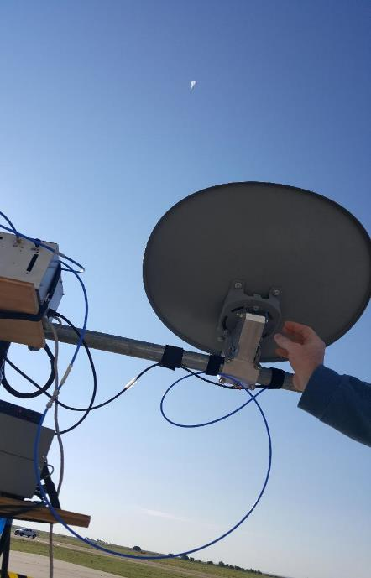
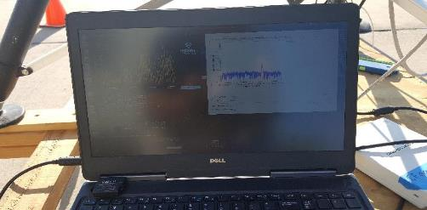
High altitude test
Tests performed on a NASA high altitude balloon flight funded by the Office of Naval Research (ONR).
Long time-scales in microgravity and vacuum needed to evaluate structural and communication performance of inflatable antenna.
LEO exposure will evaluate effect of micro-meteorites, oxygen corrosion, UV exposure, temperature cycling.
View at 30 miles altitude
“Big 60”: Aug. 2018
It works!

Slide 6
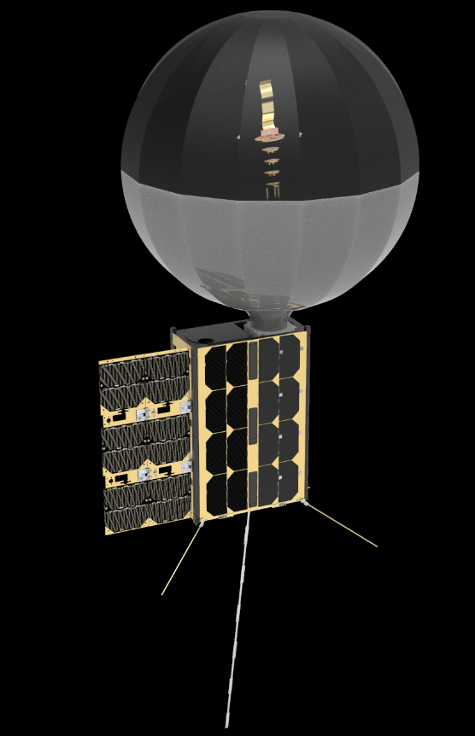
Mission Description
6U CubeSat technology demonstrator mission
  Selected for launch under NASA CSLI program.
  Sun synchronous orbit at 550 km.
  Launch NET April 2022 on board Fire-Fly Black Alpha.
  Nominal mission lifetime: 6 months.
Payload
  Inflatable antenna deployment system.
  Instrument module.
  WSPR antenna deployment system.
  Metrology module.

Slide 7
Mission Requirements
Primary Mission Objectives:
  High bandwidth transmission link demonstration from a 0.5 m diameter inflatable antenna system.
  Ionospheric measurements: WSPR implements a protocol designed for probing potential propagation paths between amateur radio stations utilizing low-power transmissions.
Secondary Mission Objectives:
  Metrological study of inflatable membrane surface

Slide 8
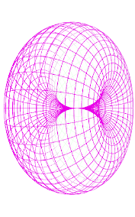
System Overview
Std. Camera
X-Band Patch
Antenna
Qorvo
TGC2510/2610
Duplexer
TRAK C800124/DK
I2C
Pwr Amp
Antenna Images
X-Band
Up/Down Converter
TGA2700
Power
Splitter
10.5 GHz
LNA
Spherical Reflector
TGA2511
3.5 GHz
RX1 TX1
Computer
AstroSDR
UART
ADCS
Deployment
System
CAN
RX0
PCS
Solar
Panels
10.5 GHz
~50 Mbps
Ethernet
UHF Radio
X-Band Antenna
435-438 MHz
HDMI Camera
UHF Antenna
Spacecraft Bus
130-155 MHz
HF/VHF
Upconverter
HD Images
5-30 MHz
HF Antenna
GPIO (3 pins)
46 cm Whip

Slide 9
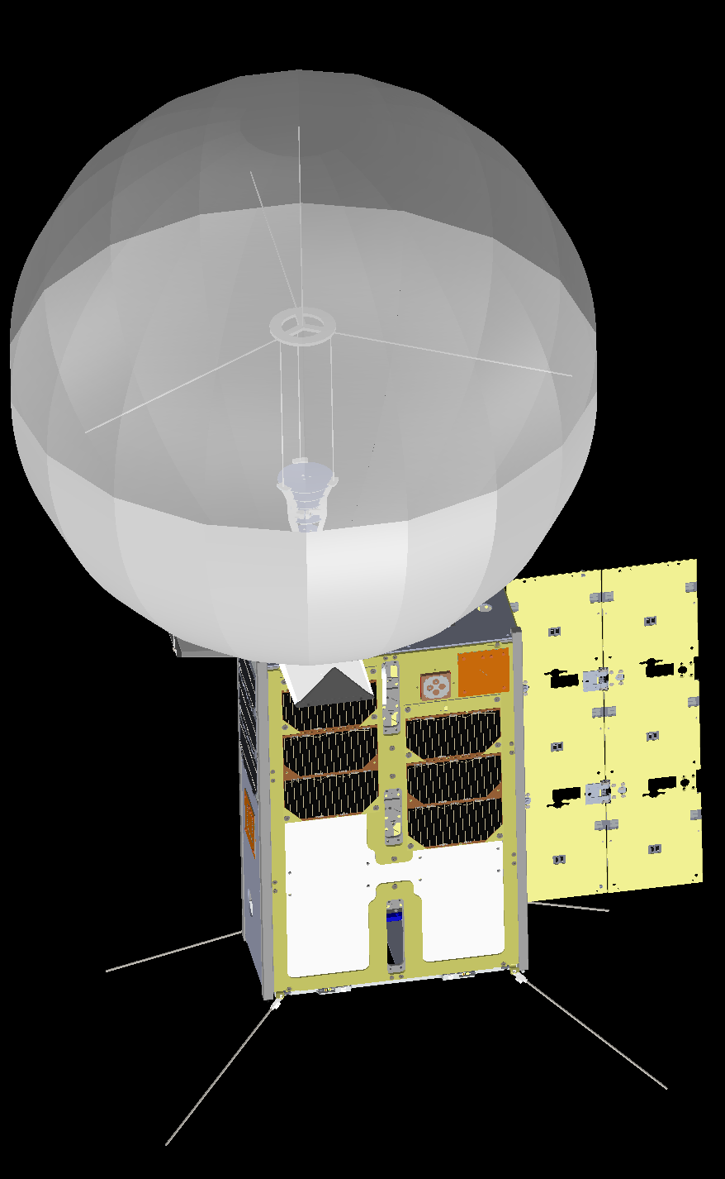
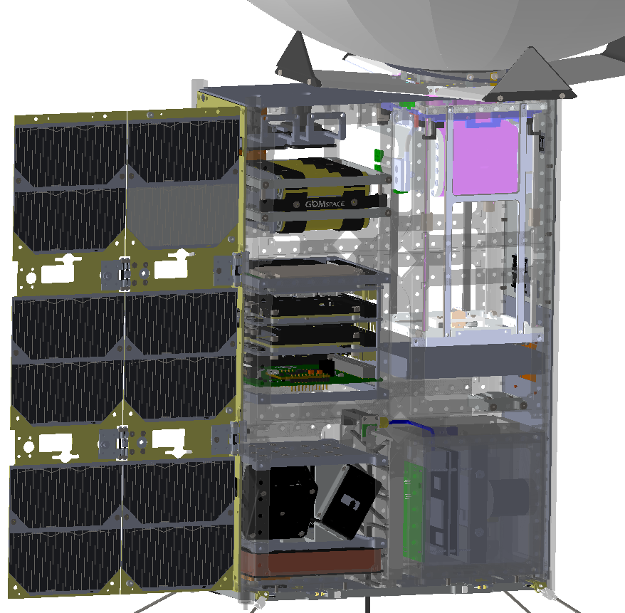
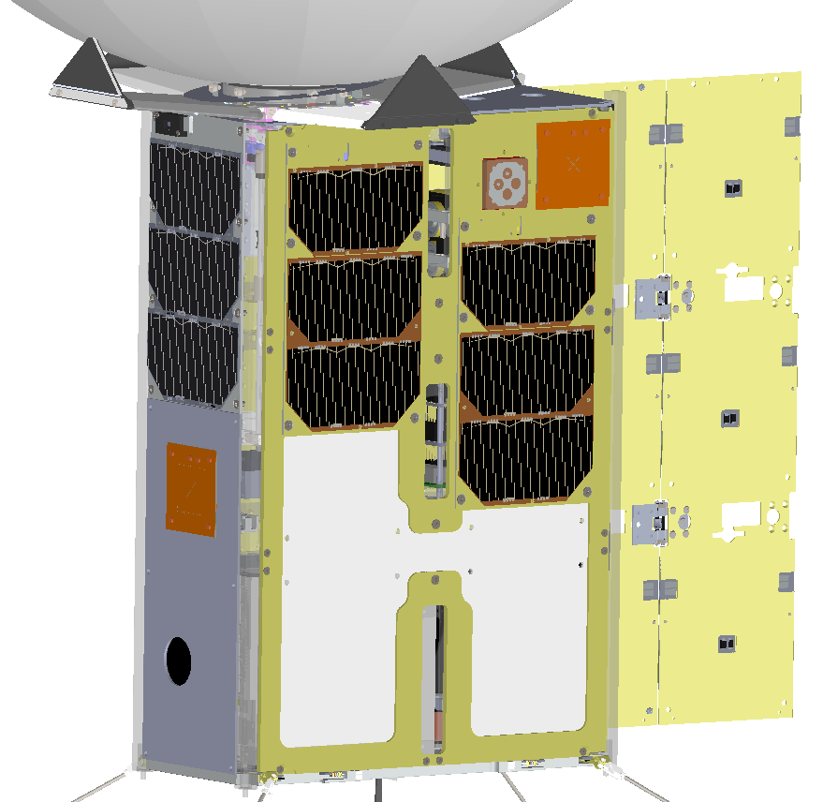
System Overview
Feed support structure
Vectran ties
Deployable solar panel
Antenna metrology module
Battery pack
X-band patch antenna
GPS antenna
Microwave upconverter
UHF antenna
ASTRO SDR
Avionics stack
Whip antenna deployer
WSPR antenna
Line feed unit
AD&CS
HD camera
Radiator panel

Slide 10
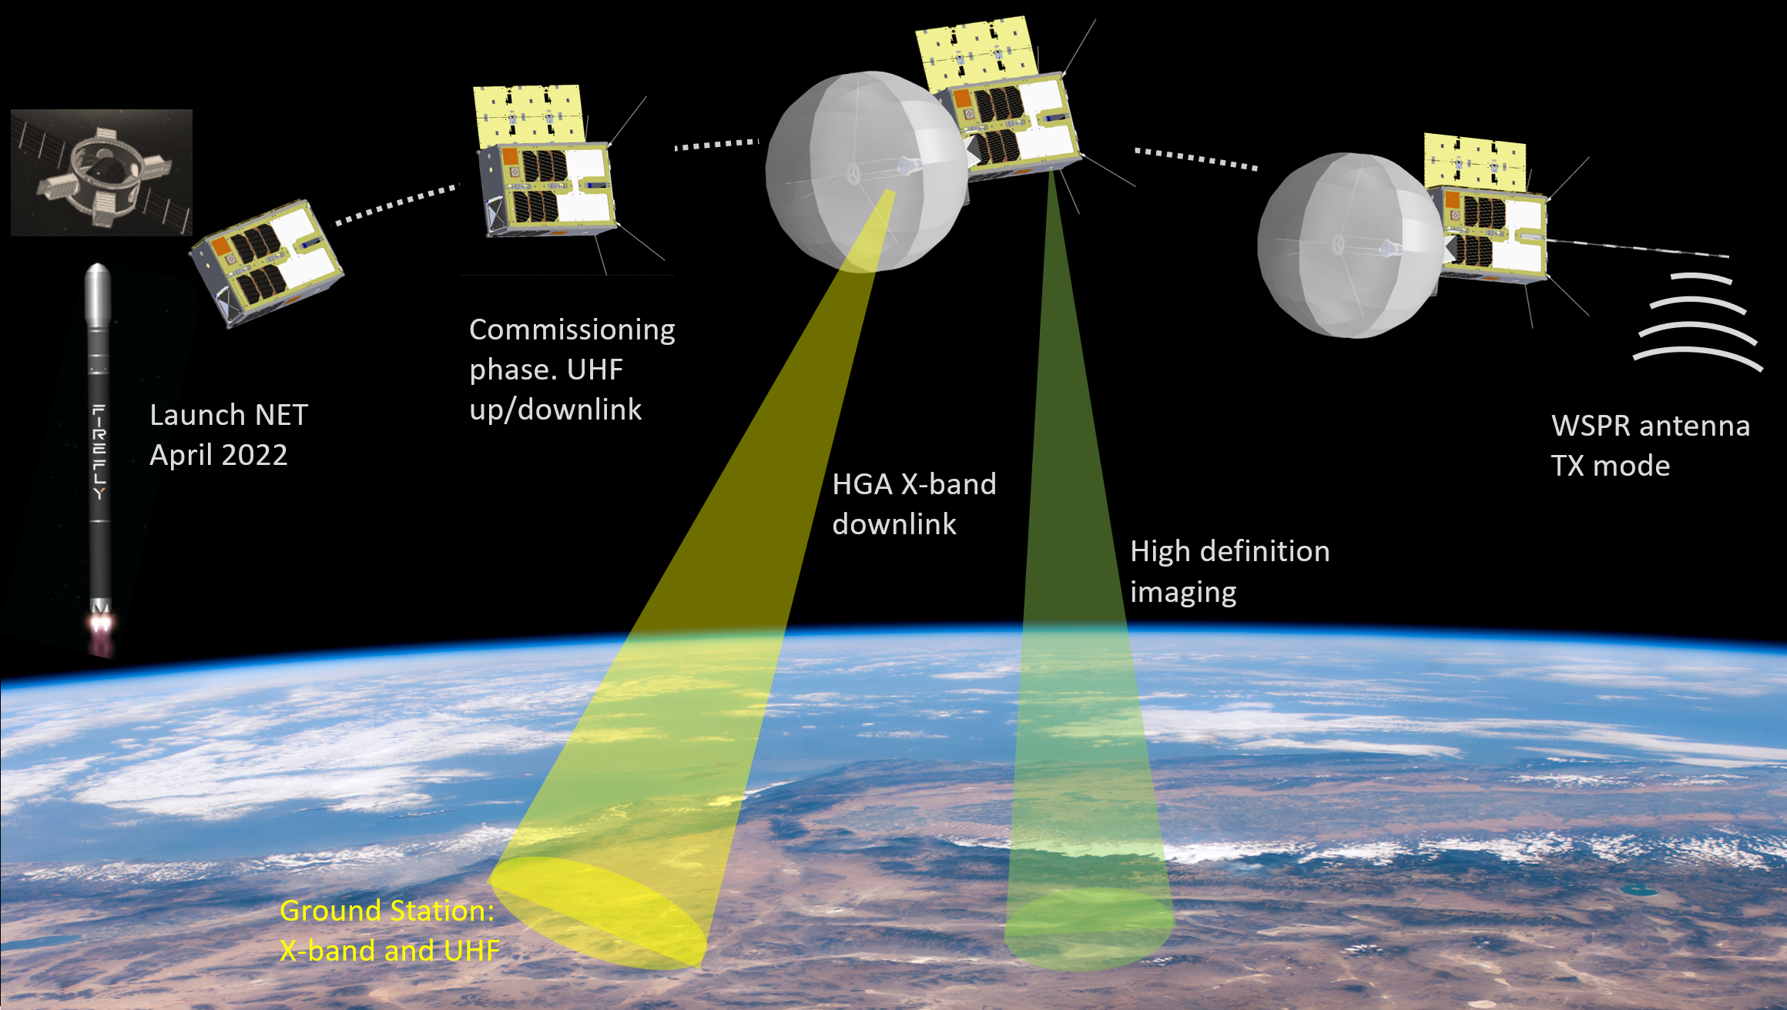
Concept of operation

Slide 11
Science traceability matrix
Science/Technology Questions | Objective | Measurement Requirement | Mission Requirement
How can high telecom bandwidths be achieved with a CubeSat? | Demonstrate a deployable, high gain antenna | Relay high- definition images from orbit in near real time | Orbital platform HD Camera imaging system Inflatable, 0.5m reflector X band data link ~550 km, sun synchronous orbit >1 month
How does the structure of the ionosphere vary from day to night? | Measure ionospheric structure along the terminator | Monitor multiple HF WSPR beacons above the ionosphere | Orbit along terminator >500 km altitude >1 month

Slide 12
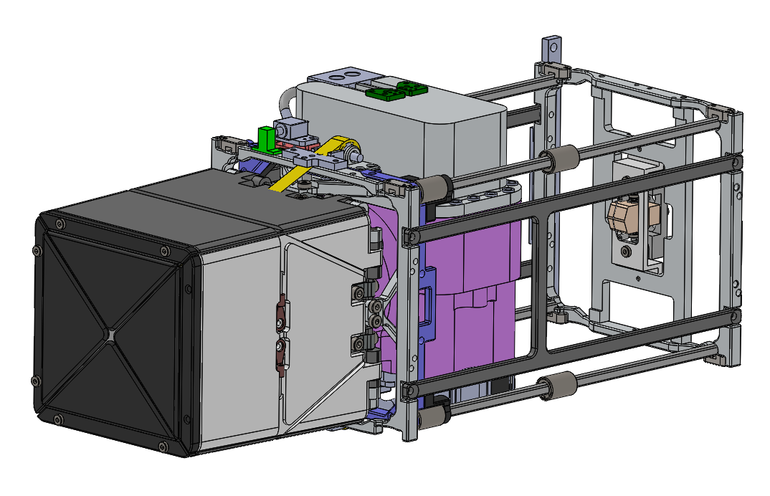
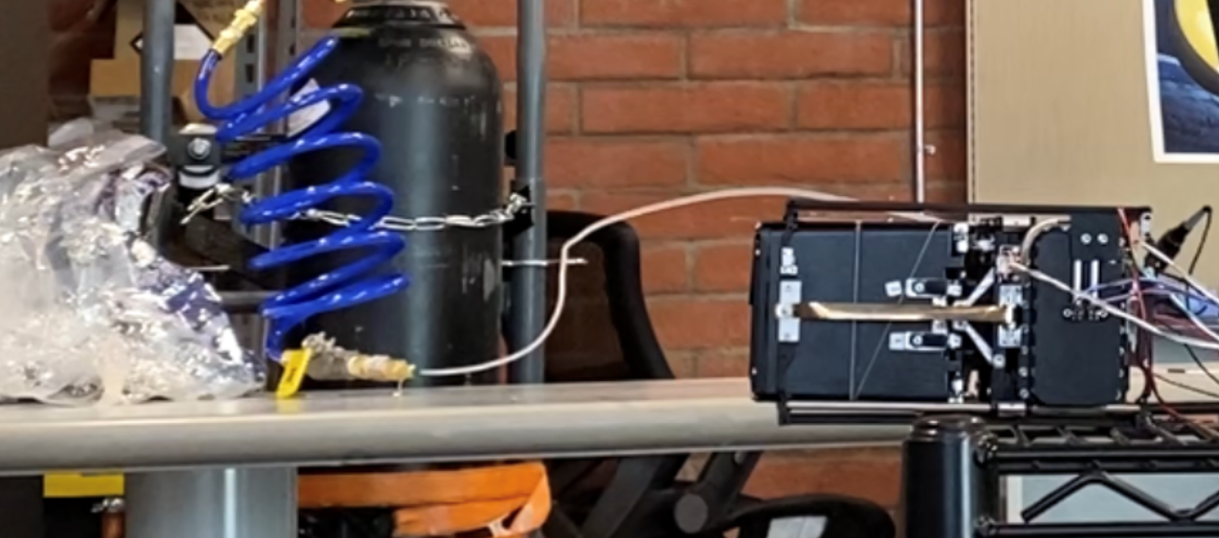
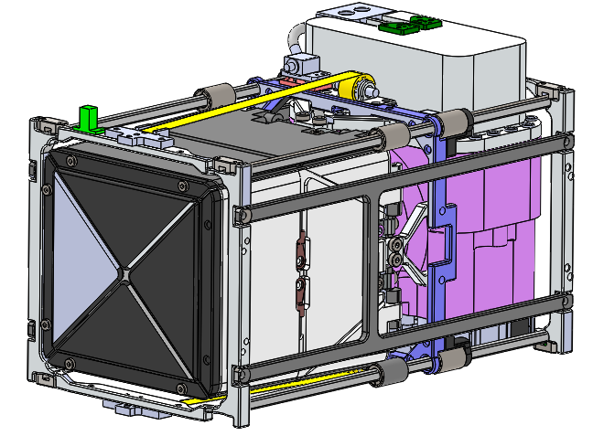
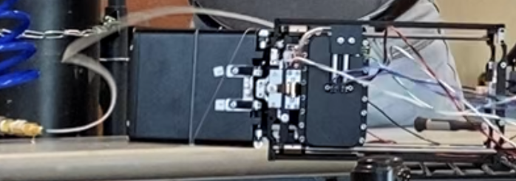
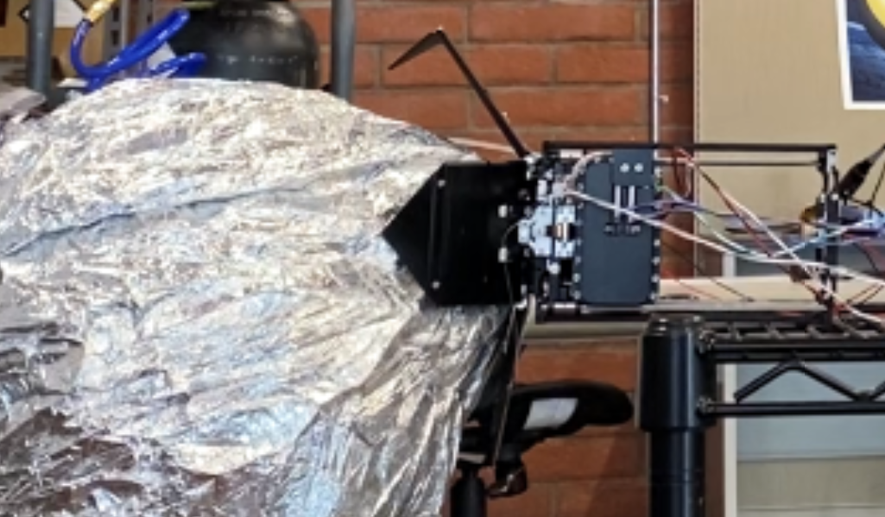
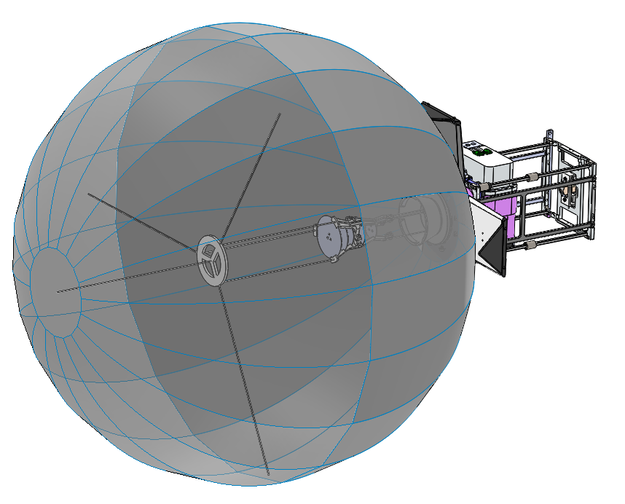
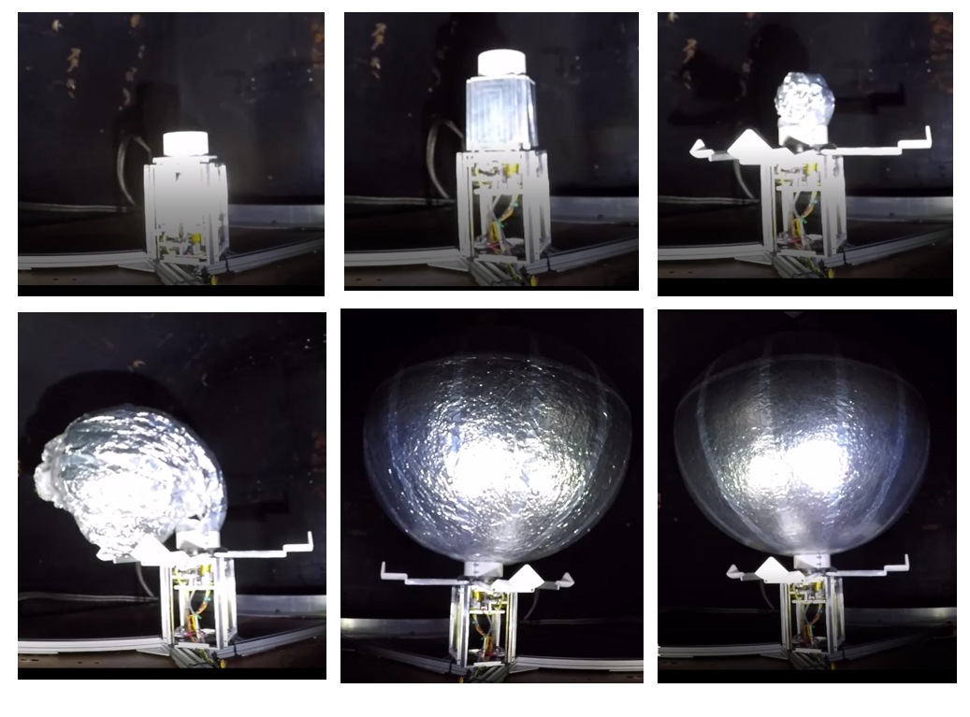
1.5 U Packaging and deployment system
150 mm
90 mm
80 mm
500 mm

Slide 13
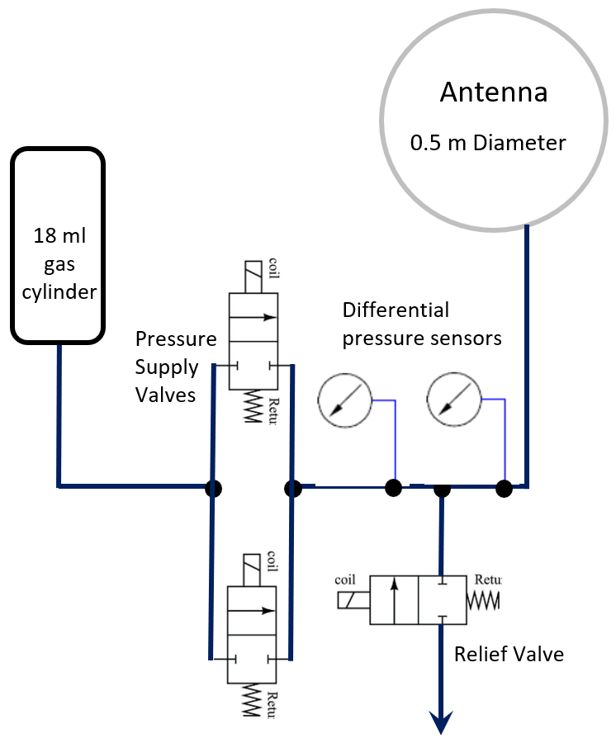
Inflation gas delivery and control system
95/5 Argon – Helium mixture for chosen for inflation.
Gas release and control system has been built and tested.
The intent is to over-pressurize the inflatable to compensate for relative loss in pressure during eclipse phases.

Slide 14
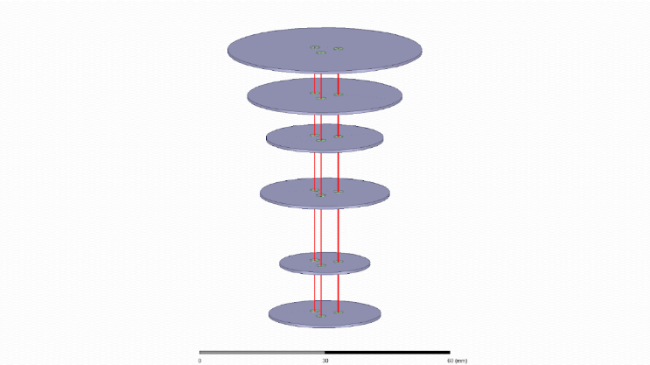
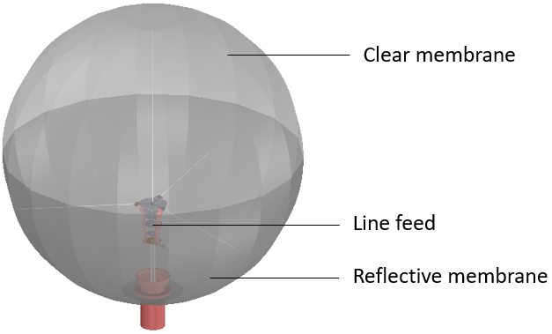
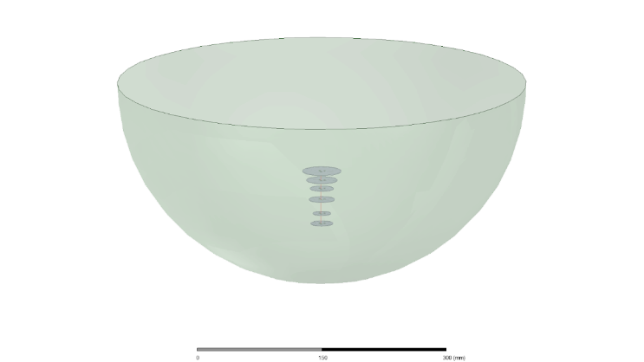
Line feed system – spherical correction
Bare line feed for the HGA
Line feed within the 0.5m reflector
Spherical reflector antenna

Slide 15
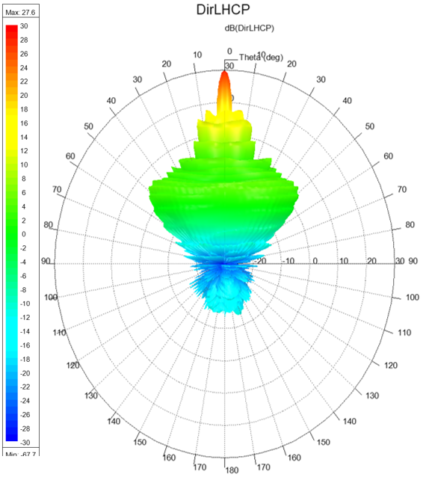
Line feed sensitivity
On-going and future work
The gain from just the antenna is 26.7 dBi and the first side-lobe level is -18 dB.
A peak directivity of 31 dBi is expected assuming no losses.
Figure 10 shows the LHCP component of the antenna pattern and shows it is primarily left-hand circular polarized.

Slide 16
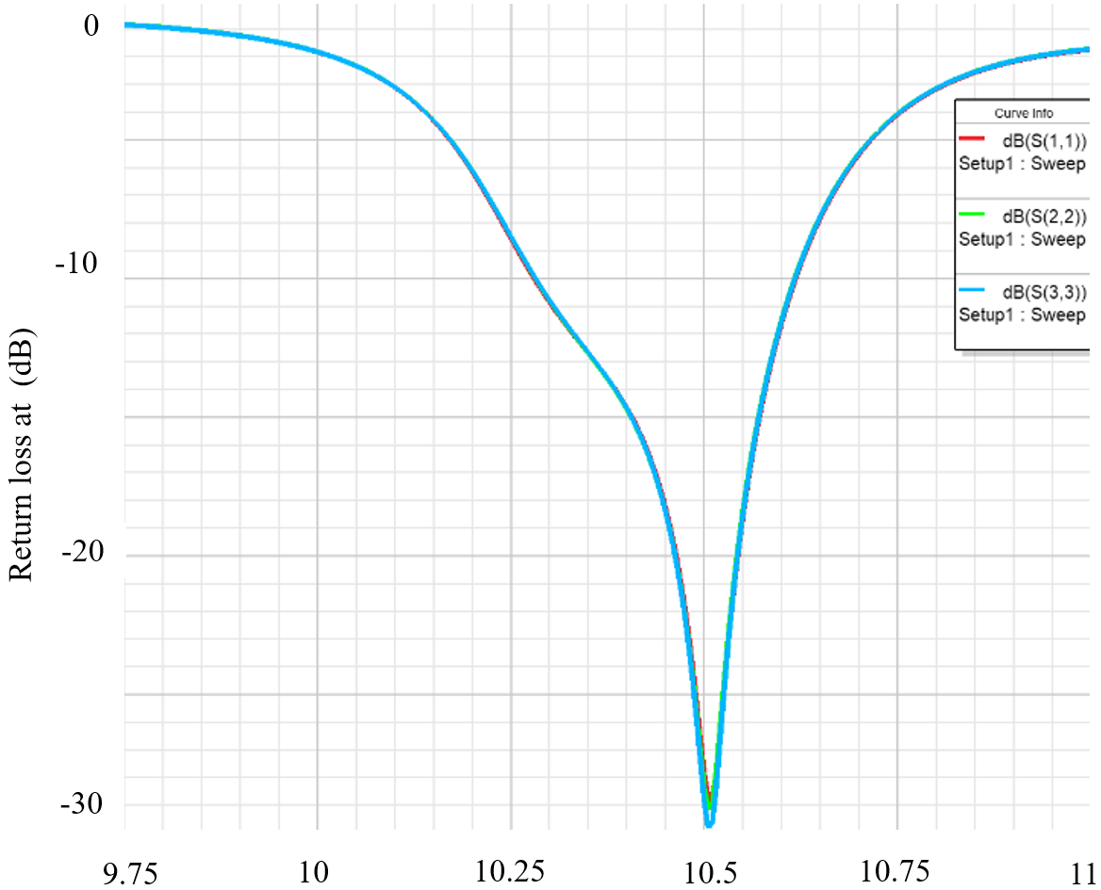
Line feed sensitivity
On-going and future work
The return loss of the feed shows it is optimized to be resonant at 10.5 GHz and impedance-matched with a 50ohm source.
The HGA is optimized for communications between the 6.1 m ground stations and the spacecraft.
The HGA will primarily be used to downlink image data taken by the spacecraft’s on-board cameras and serve as a technology demonstrator.

Slide 17
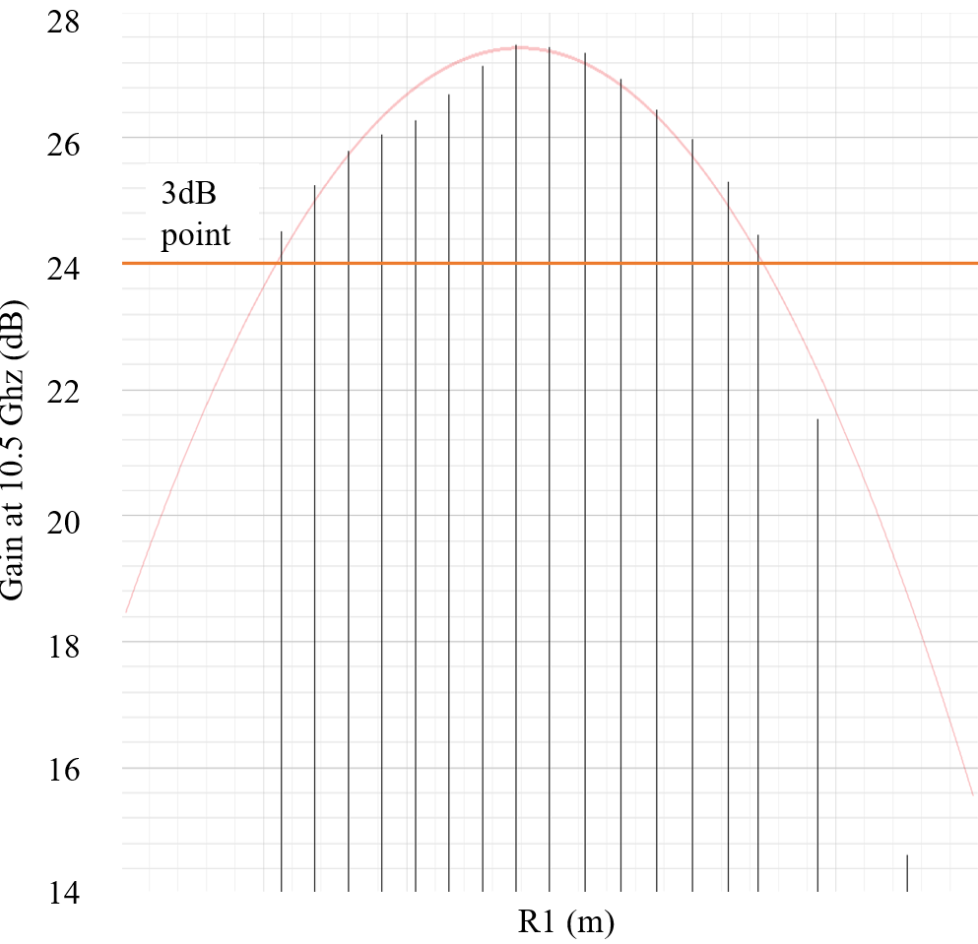
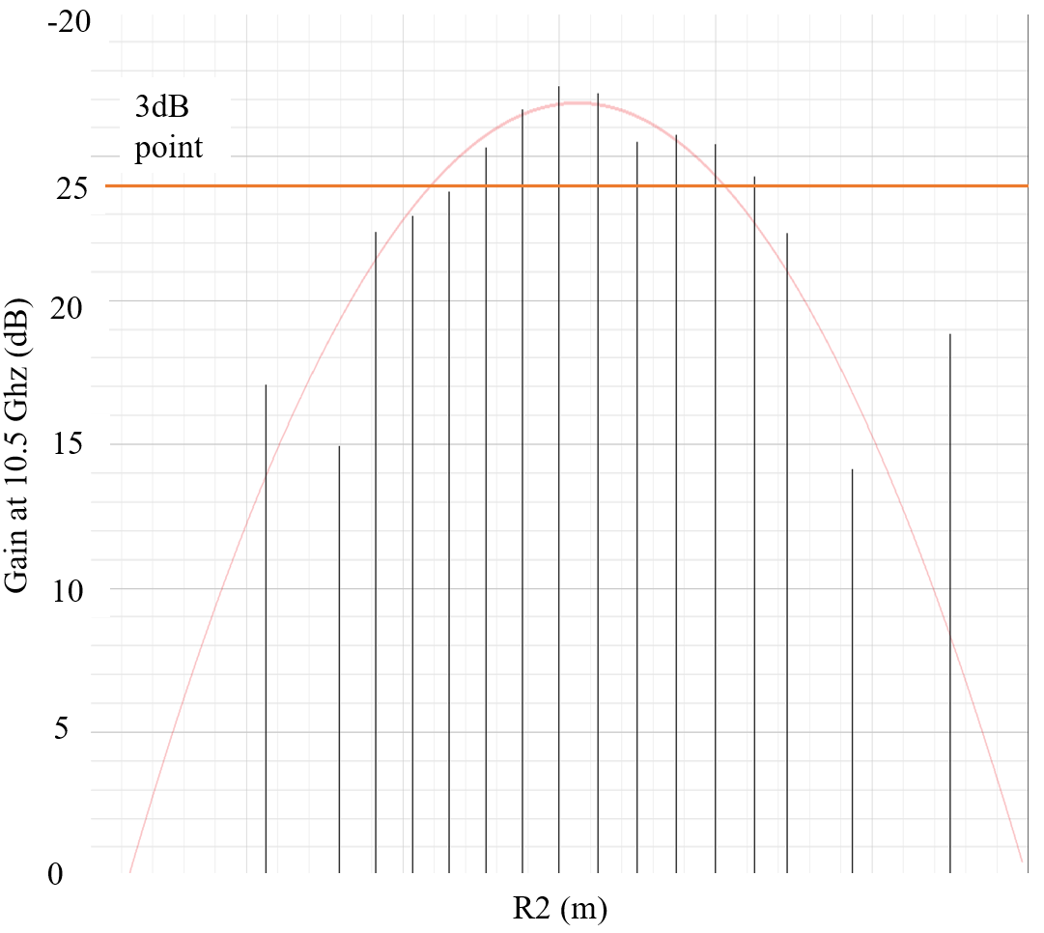
Line feed sensitivity – Antenna gain

Slide 18
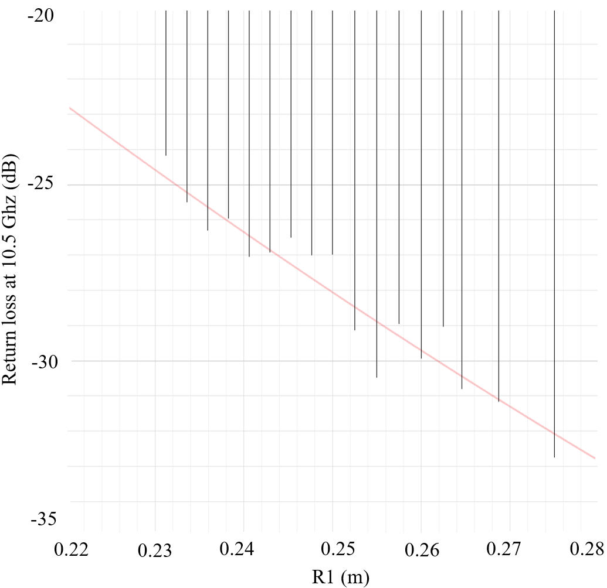
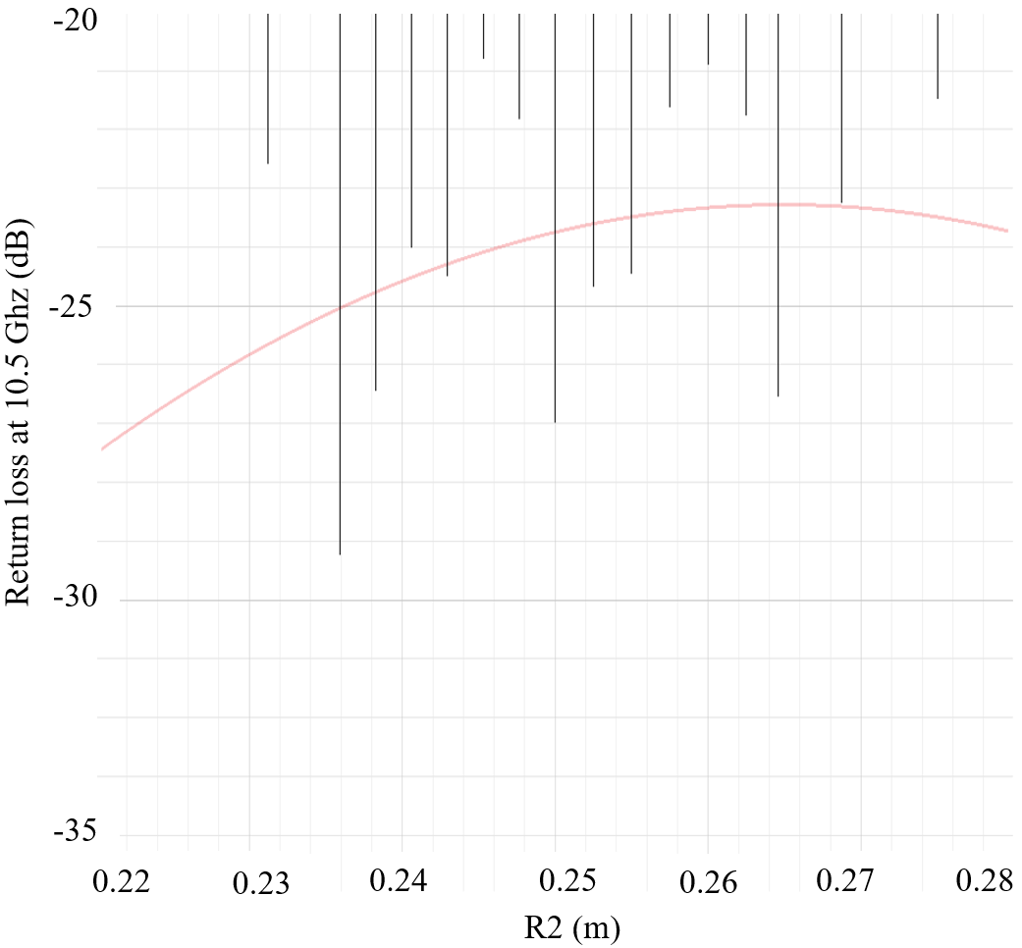
Line feed sensitivity – Return Loss

Slide 19
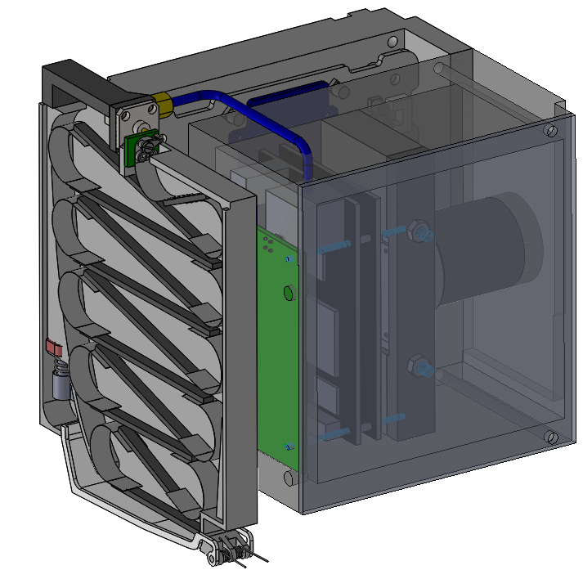
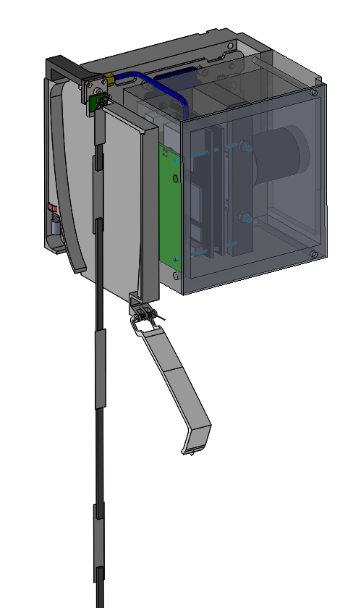
Instrument Module
ASTRO SDR
110 mm
80 mm
HD camera
90 mm
560 mm
Burn Wire release
Camera control boards
Stowed WSPR antenna
HF Upconverter

Slide 20
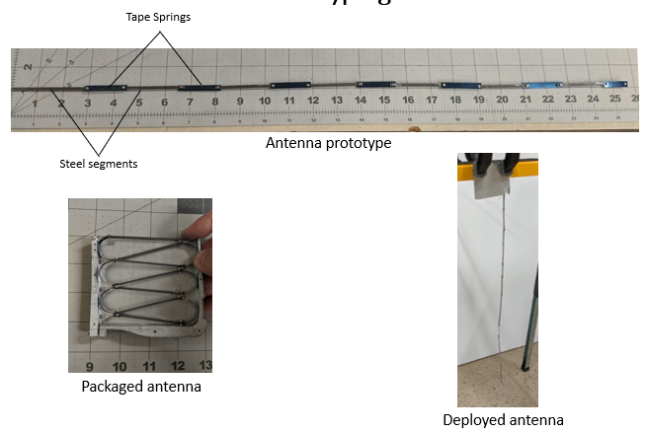
WSPR Antenna Deployment

Slide 21
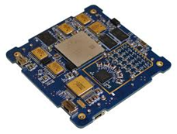
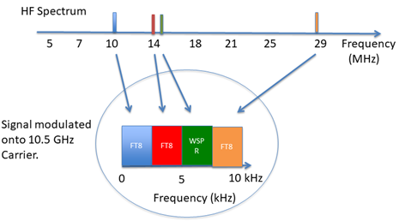
WSPR Downlink Channel Format
AstroSDR
Dual receivers & transmitters, 70 MHz to 6 GHz
Xilinx Zynq Z-7045 FPGA
Embedded Linux OS for reliable operation
64 GB eMMC flash

Slide 22
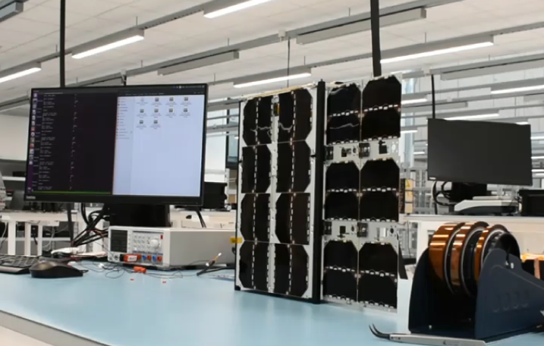
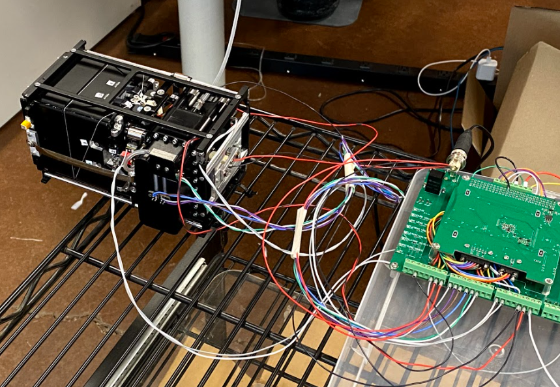
Current Status
On-going work:
Inflatable antenna system undergoing TVAC testing.
Pre-flight prototype hardware realized and undergoing testing.
Planned work:
Near-field measurements from reflector using line feed.
Measurement of S11 return loss.
Integration and testing with spacecraft bus.

Slide 23
References
A. Babuscia, T. Choi, and K.-M. Cheung, “Inflatable antenna for CubeSat: Extension of the previously developed S-Band design to the X-Band,” presented at the AIAA SPACE 2015 Conference and Exposition, Pasadena, California, Aug. 2015, doi: 10.2514/6.2015-4654.
A. Babuscia, J. Sauder, A. Chandra, J. Thangavelautham, L. Feruglio, and N. Bienert, “Inflatable antenna for CubeSat: A new spherical design for increased X-band gain,” in 2017 IEEE Aerospace Conference, Mar. 2017, pp. 1–10, doi: 10.1109/AERO.2017.7943897.
A. Babuscia, T. Choi, J. Sauder, A. Chandra, and J. Thangavelautham, “Inflatable antenna for CubeSats: Development of the X-band prototype,” in 2016 IEEE Aerospace Conference, Mar. 2016, pp. 1–11, doi: 10.1109/AERO.2016.7500679.
A. Chandra, J. C. Lopez Tonazzi, D. Stetson, T. Pat, and C. K. Walker, “Inflatable membrane antennas for small satellites,” in 2020 IEEE Aerospace Conference, Big Sky, MT, USA, Mar. 2020, pp. 1–8, doi: 10.1109/AERO47225.2020.9172737.
Chandra, J. C. Lopez Tonazzi, D. Stetson, T. Pat, and C. K. Walker, “Development of inflatable spherical reflector antenna for X-band operation,” in 2020 IEEE Aerospace Conference, Big Sky, MT, USA, Mar. 2021

