Slide 1
Integrated Communication and Controls for Swarms of Small Satellites
Colorado School of Mines: Jonathan Diller, Qi Han, Chris Dreyer
JPL: Federico Rossi, Saptarshi Bandopadhyay, Jean-Pierre de la Croix, Amir Rahmani, Pamela Clark
This project is supported in part by NASA SmallSat Technology Partnership (STP) program with grant number 80NSSC18M0048.
Notes:
Make sure to point out this is a joint project between Mines’ Pervasive Computing Systems (PeCS) research group and JPL’s Maritime & Multi-Agent Autonomy group and also their planetary scientist Dr. Pamela Clark

Slide 2
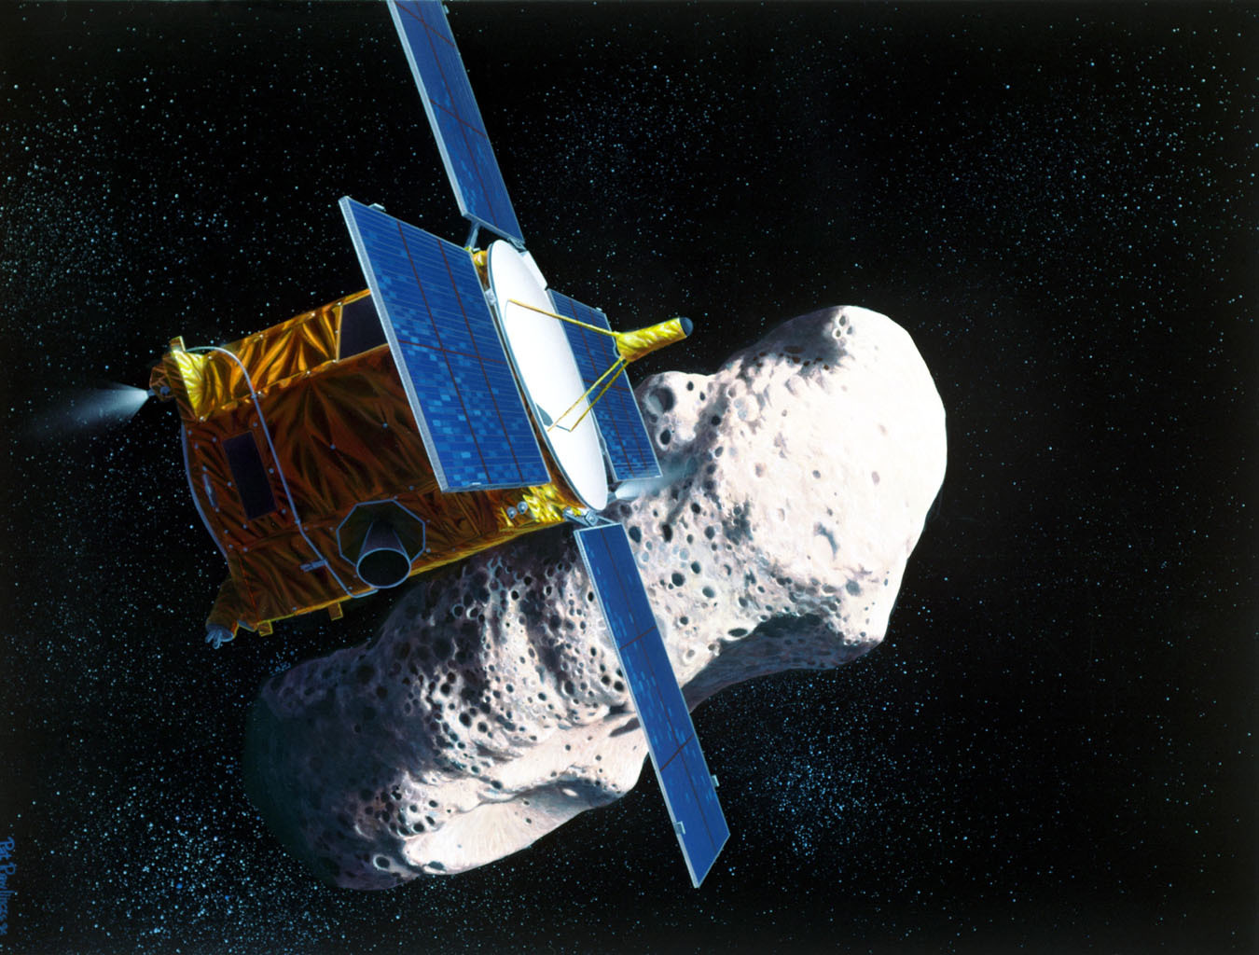
Current Practice
On February 17, 1996 we launched the NEAR-Shoemaker space probe to study asteroid 433 Eros
Near-Shoemaker had several sensors for collecting data
Different instruments had different optimal orbits for data acquisition
  Some sensors were not able to be used while others were due to probe positioning
This limitation reduced data collection
[solarsystem.nasa.gov]

Slide 3
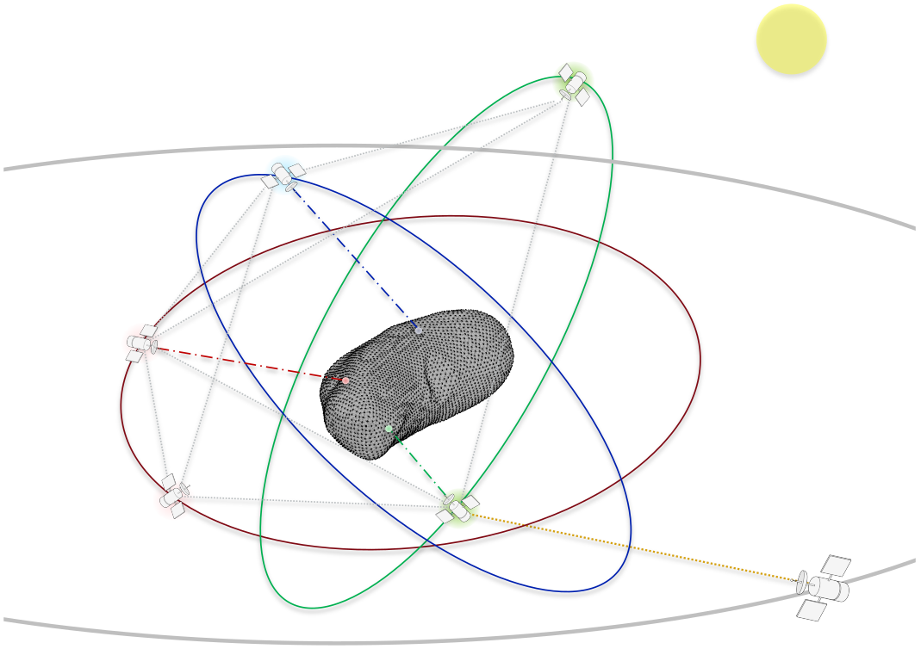
Our Approach: System Architecture
Swarm of Small Satellites
  Each small satellite has a single instrument or a set of compatible instruments
  Use a single, larger carrier satellite as central base, relaying data to Earth
[1]
[1] Rossi, Federico, Saptarshi Bandyopadhyay, Mark Mote, Jean-Pierre de la Croix, and Amir Rahmani. "COMMUNICATION-AWARE ORBIT DESIGN FOR SMALL SPACECRAFT SWARMS AROUND SMALL BODIES." AIAA/AAS Astrodynamics Specialist Conference, 2020

Slide 4
Our Approach: Main Innovation
Enable swarms of small satellites with integrating communication and control
  Plan orbits to optimize the quality of data collected
  Use mobile ad-hoc routing to connect satellite swarm with carrier, collect more data when storage is constrained
[1]
[1] Rossi, Federico, Saptarshi Bandyopadhyay, Mark Mote, Jean-Pierre de la Croix, and Amir Rahmani. "COMMUNICATION-AWARE ORBIT DESIGN FOR SMALL SPACECRAFT SWARMS AROUND SMALL BODIES." AIAA/AAS Astrodynamics Specialist Conference, 2020

Slide 5
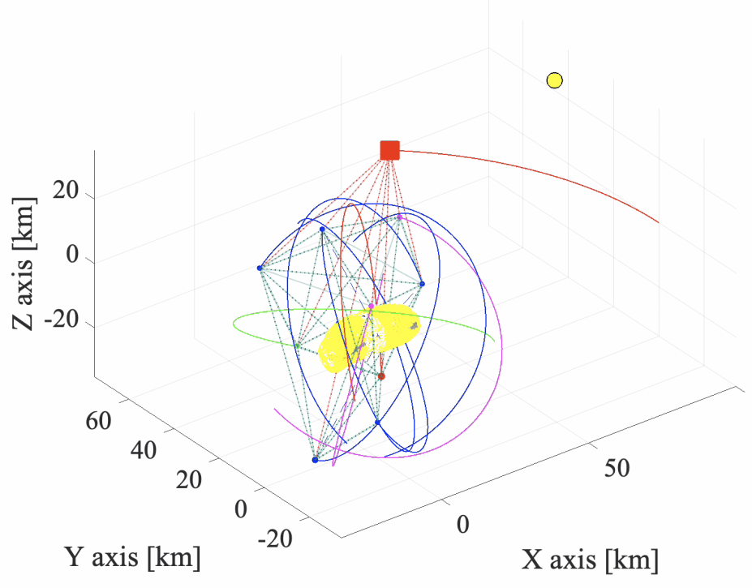
Communication-aware Orbit Planning
Assumptions:
  Uses store-and-forward approach to move data through network
  Heterogeneous instruments with varying requirements
Problem Definition
  Uses global search to maximize quality and quantity of data collected
    Constraints: Instrument requirements, communication bandwidth, on-board storage

Slide 6
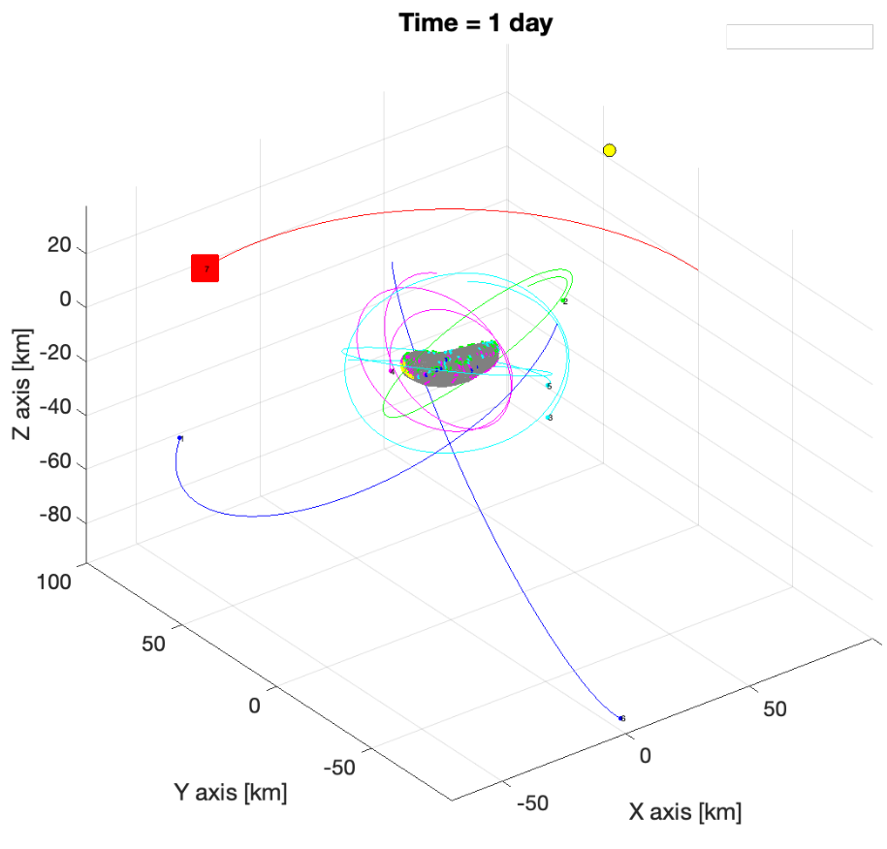
Communication-aware Orbit Planning: Solution
Maximize reward of data collected while satisfying networking constraints
Use network-flow graph to model data flow
Solvable using mixed-integer linear programming (MILP)
Found that Linear Relaxation approximates solution well and provides analytical insights

Slide 7
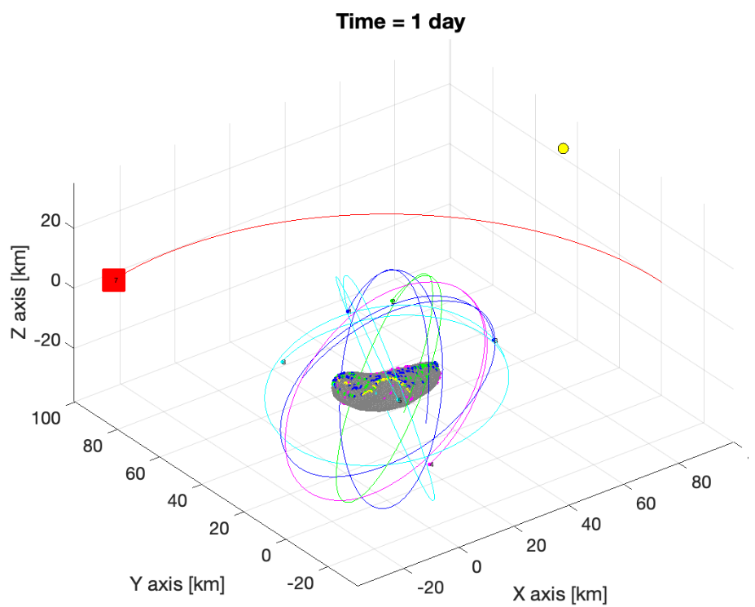
Communication-aware Orbit Planning
Simulated in MatLab using IBM’s CPLEX Optimizer with JPL's Small Body Dynamics Toolkit (SBDT)
Evaluated with 7 spacecraft orbiting 433 Eros
Compared with baseline: Monte Carlo approach to optimize quality of data without communication constraints

Slide 8
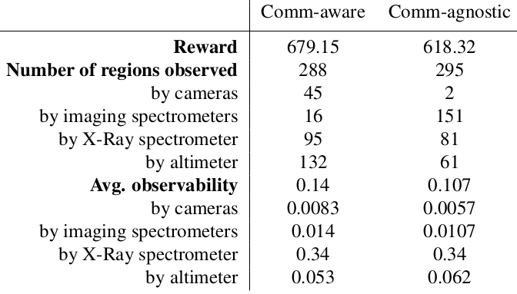
Communication-aware Orbit Planning
Simulation Results:
  10% increase in data collected
  30% increase in data quality
Increase in quality is credited to prioritizing data from instruments with higher reward

Slide 9
Network Monitoring
As networked nodes move, the network structure changes
Need system for monitoring network topology changes
Quality of known routes change and new routes become available as satellites move
Metrics include:
  Signal strength
  Packet loss rate
  Data transmission rate
  Age of known routes
  Network traffic

Slide 10
Mobile Ad-hoc Routing
Need to determine changes in network topology
Mobile Ad-hoc Routing (MANET) protocols are routing protocols for self-organizing mobile networks
Works by forwarding route discovery messages throughout network
Two main approaches:
  Table-driven: Always maintain routing information
  On-demand: Only update routes when needed

Slide 11
Mobile Ad-hoc Routing
Ad-hoc On Demand Distance Vector (AODV) [3]: MANET routing protocol
AODV maintains routing table, updates based on demand
  Forwards route discovery messages when needed, until route is found
  Based on number of hops
Recommended for small networks with moderate mobility [2]
[2] Elizabeth M. Royer, Chai-Keong Toh, A review of current routing protocols for ad-hoc mobile wireless networks, IEEE personal communications, April 1999
[3] C.E. Perkins ; E.M. Royer, "Ad-hoc On-Demand Distance Vector Routing” in ACM Workshop on Mobile Computing Systems and Applications (WMCSA), February 1999

Slide 12

Simulation Setup
Integrated NS-3 network simulator with 42 Spacecraft Simulator
  42 simulates small satellite movements
  NS-3 used to simulate mobile network and data collection
Generated orbits using Monte Carlo orbit generator to maximize data collection with homogenous sensors
Physical layer: IEEE 802.11n Wi-Fi
Notes:
Check to see if there is a logo for 42 simulator
-It doesn’t look they have one

Slide 13
Simulation Setup
Two approaches compared
  multi-hop ad-hoc network: AODV + Ideal MAC protocol [4]
    Uses RTS/CTS messages to avoid network congestion and adaptive data rates
  single-hop network: TCP + Standard Single-hop MAC protocol
    Probes network to determine optimal support data rate
Network monitoring:
  Total data returned to carrier
  Packet loss
[4] Holland, Gavin, Nitin Vaidya, and Paramvir Bahl. "A rate-adaptive MAC protocol for multi-hop wireless networks." In Proceedings of the 7th annual international conference on Mobile computing and networking, 2001

Slide 14
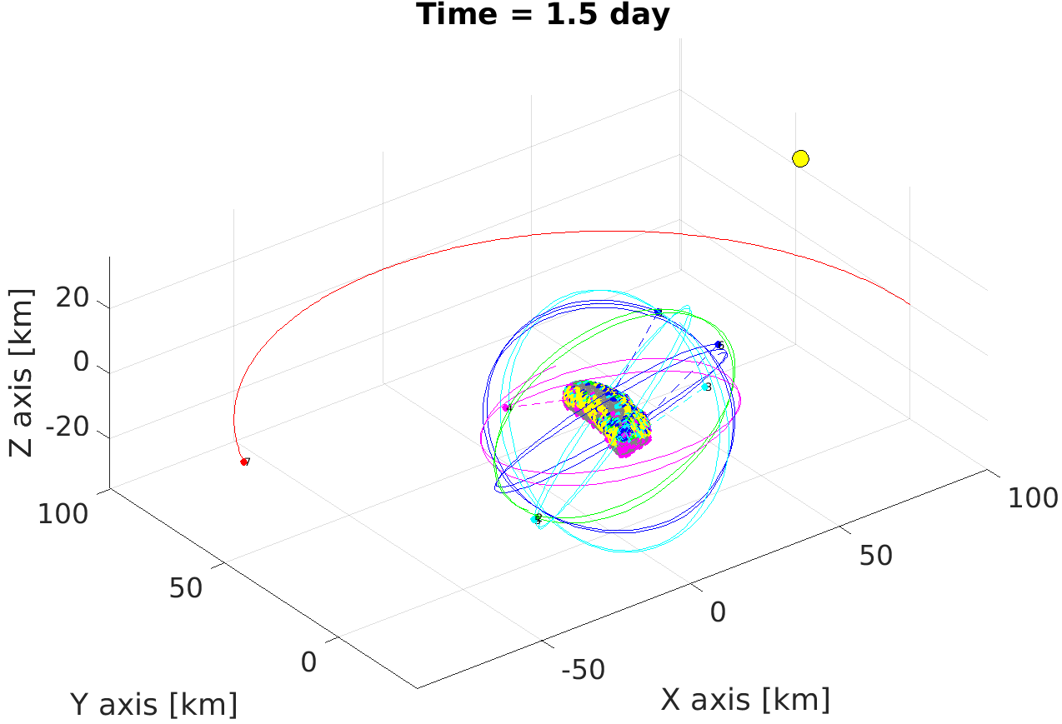
Sample Orbits from Monte Carlo based Orbit Planning Algorithm

Slide 15
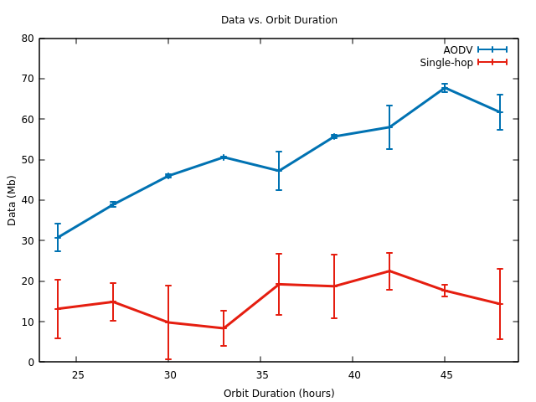
Data collected over varying orbit durations
Tested with 6 hours of storage capacity
Results show significant increase in data captured using AODV
Average increase in data collected: 229.2%
Notes:
6 hours of data storage capacity, data collection rate, size of data, 1.5 MB every 20 seconds
Merge slides 15 and 16

Slide 16
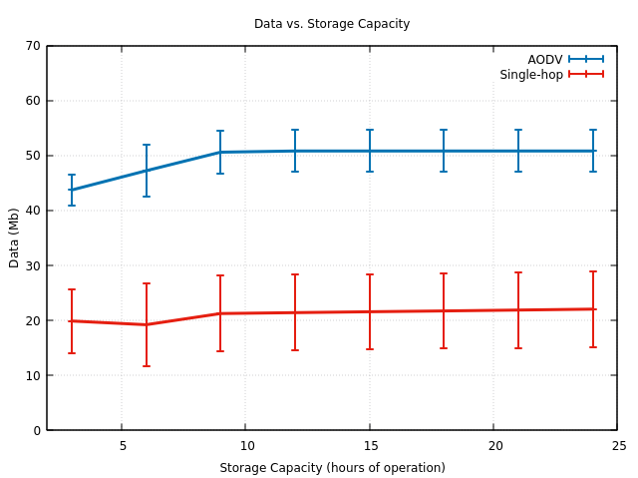
Data collected over varying storage capacities
Tested on orbits with 36 hour duration
Show that data collection improvements are mostly from networking approach
Drones that are disconnected, stay disconnected.
Notes:
36 hour long orbits
Add justification of this results

Slide 17
Discussion
Limitations:
NS3 unable to handle heavy packet loads
Future work:
Prototype with multi-drone testbed
Use MANET routing feedback in orbit generation
Notes:
If we aren’t talking about packet loss in the results then I don’t think we should include it as a limitation here

Slide 18
Publications
1) Gerald Henderson, Qi Han, Distributed Learning Automata based Data Dissemination in Swarm Robotic Systems, Master’s Thesis, Colorado School of Mines, August 2018
2) Josh Rands, Regression-based Network Monitoring in Swarm Robotic Systems, Undergraduate Research Honors’ Thesis, Colorado School of Mines, May 2019
3) Gerald Henderson, Qi Han, Distributed Learning Automata based Data Dissemination in Networked Robotic Systems International Conference on Mobile Computing, Applications, and Service (MobiCASE), June 2019. Best Paper Award.
4) Josh Rands, Qi Han, Regression-based Network Monitoring in Swarm Robotic Systems, Proceedings of International Conference on Mobile and Ubiquitous Systems: Computing, Networking and Services (Mobiquitous), November 2019
5) Sam Friedman, Qi Han, Request and Share then Assign (RASTA): Task Assignment for Networked Multi-Robot Teams, Proceedings of IEEE International Conference on Mobile Ad-hoc and Smart Systems(MASS), December 2020
6) Federico Rossi, Saptarshi Bandyopadhyay, Mark Mote, Jean-Pierre de la Croix, Amir Rahmani, “Communication-Aware Orbit Design for Small Spacecraft Swarms Around Small Bodies”, 2020 AAS/AIAA Astrodynamics Specialist Conference, AAS 20-603.
7) Optimization code is finalized and released as open source https://github.com/nasa/icc
8) Integration of 42-NS3 high fidelity simulation platform; available at open source project https://github.com/AeroNexus/42

