Slide 1


Tree of Life
Long Duration Telecommunication Concept Using Trees
ISSC 2021
Steven Anderson (337K)
Alessandra Babuscia (Mentor)
May 3, 2021
Credit: Jeff Siebrand

Slide 2
Agenda
Background
Previous Work
Mechanical Design
Measuring Effects on Performance
Data Volume Analysis
Antenna Arrays
Summary

Slide 3

Background
Objectives
Mechanical Design
Measuring Effects on Performance
Data Volume Analysis
Antenna Arrays
Summary
Proxima Centauri b is 4.2 light years away
42 year one-way trip at one tenth speed of light
Obsolescence of onboard technologies
Credit: NASA

Slide 4
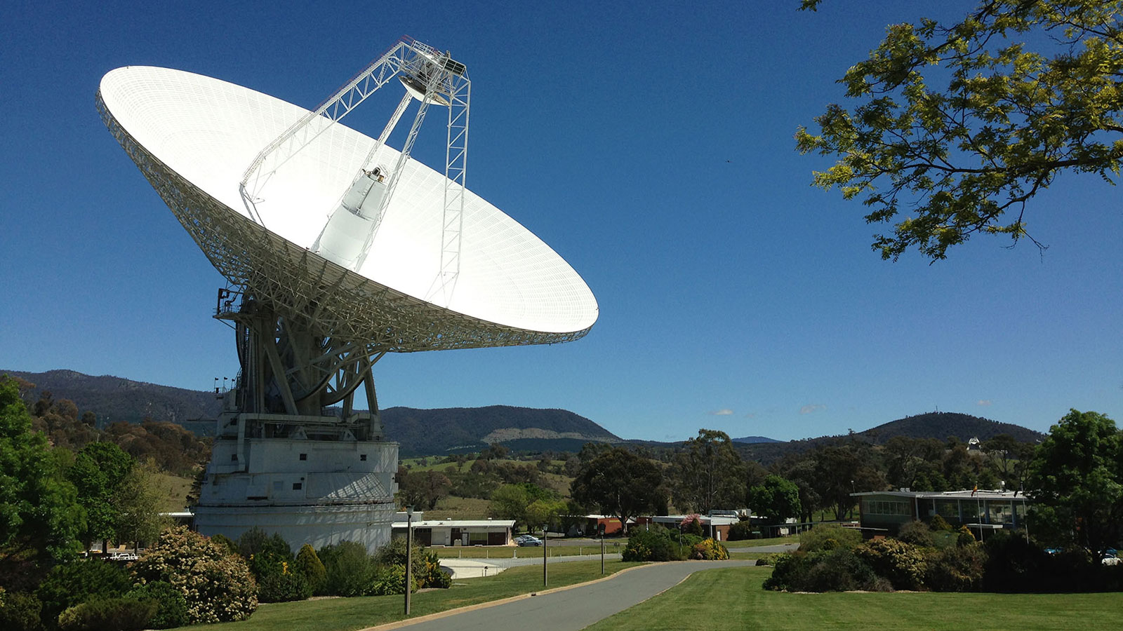
Background
Objectives
Mechanical Design
Measuring Effects on Performance
Data Volume Analysis
Antenna Arrays
Summary
Motivation
Objective
Overcome the obsolescence of telecommunication technology
Develop a long-duration telecommunication system that could aid in developing architecture for future deep space missions
Credit: NASA/JPL-Caltech
Notes:
Objective:
How are we going to do that?

Slide 5
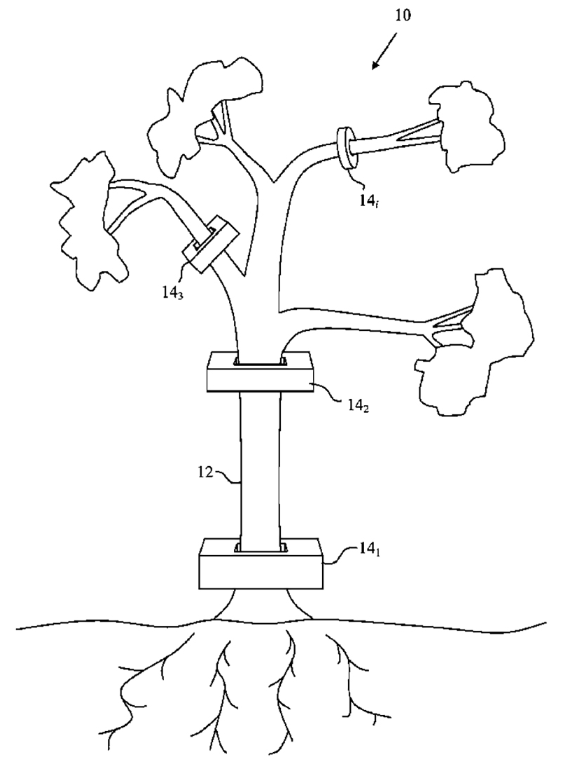
Background
Objectives
Mechanical Design
Measuring Effects on Performance
Data Volume Analysis
Antenna Arrays
Summary
Create a network of tree-based antennas
Communicate with an orbiting Cubesat via converted sonic frequencies
  Create a “song” between the pair
  Relay environmental conditions
Long-duration mission (200+yrs)
US Patent No. US8094083B1

Slide 6
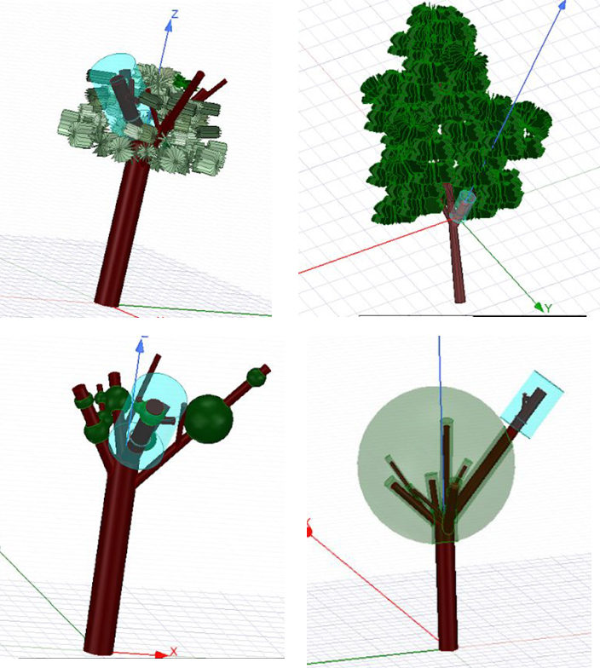
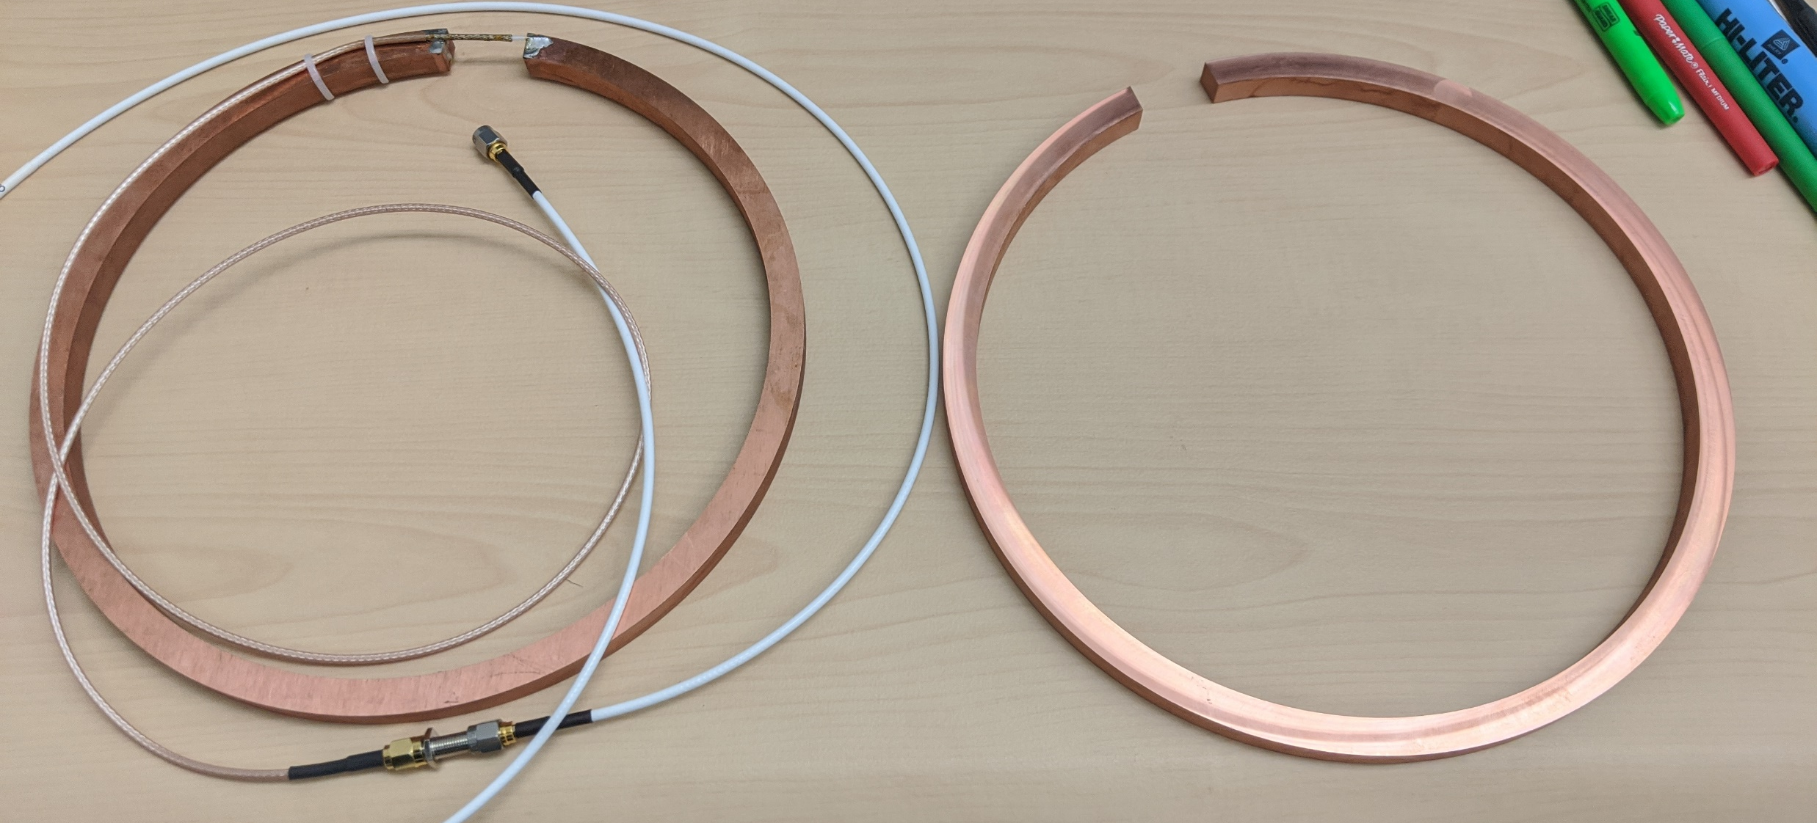
Background
Previous Work
Mechanical Design
Measuring Effects on Performance
Data Volume Analysis
Antenna Arrays
Summary
Determined ideal design of tree antenna
Determined dielectric constant
Simulated effects of trees
Developed initial design
Built prototype

Slide 7
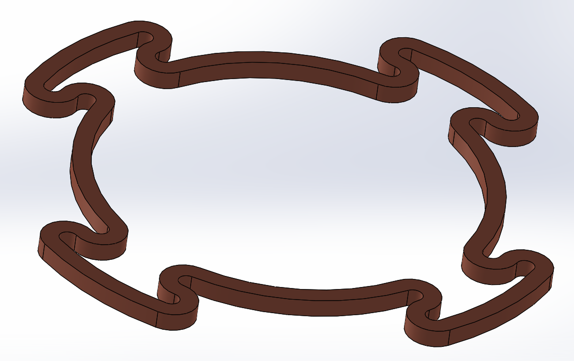
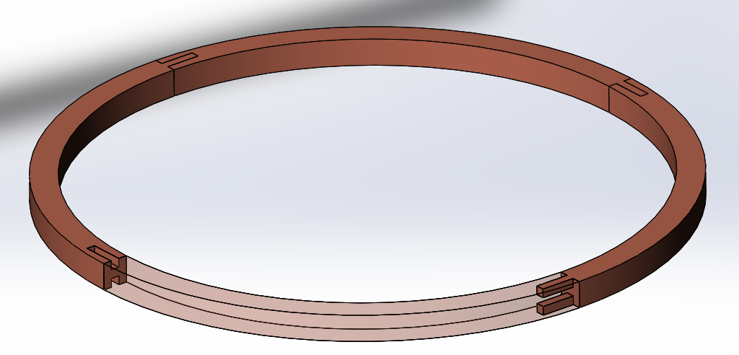
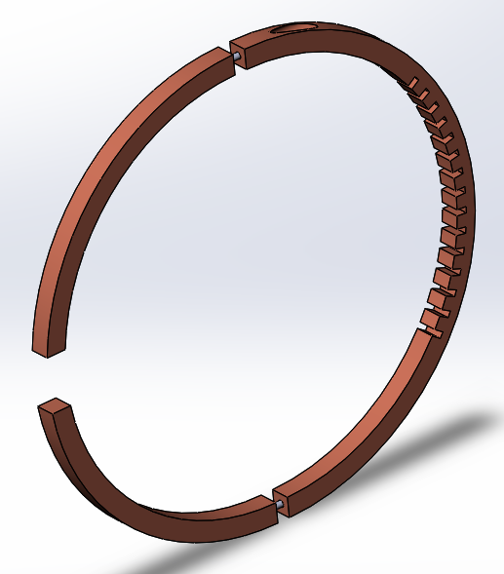
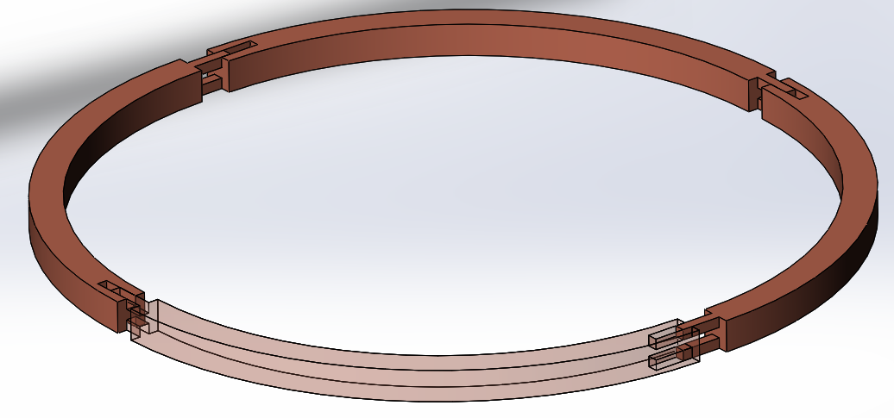
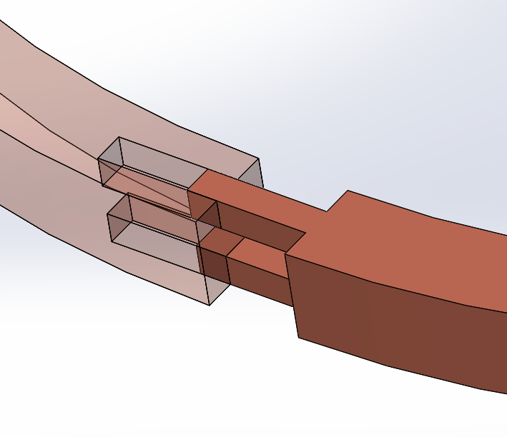
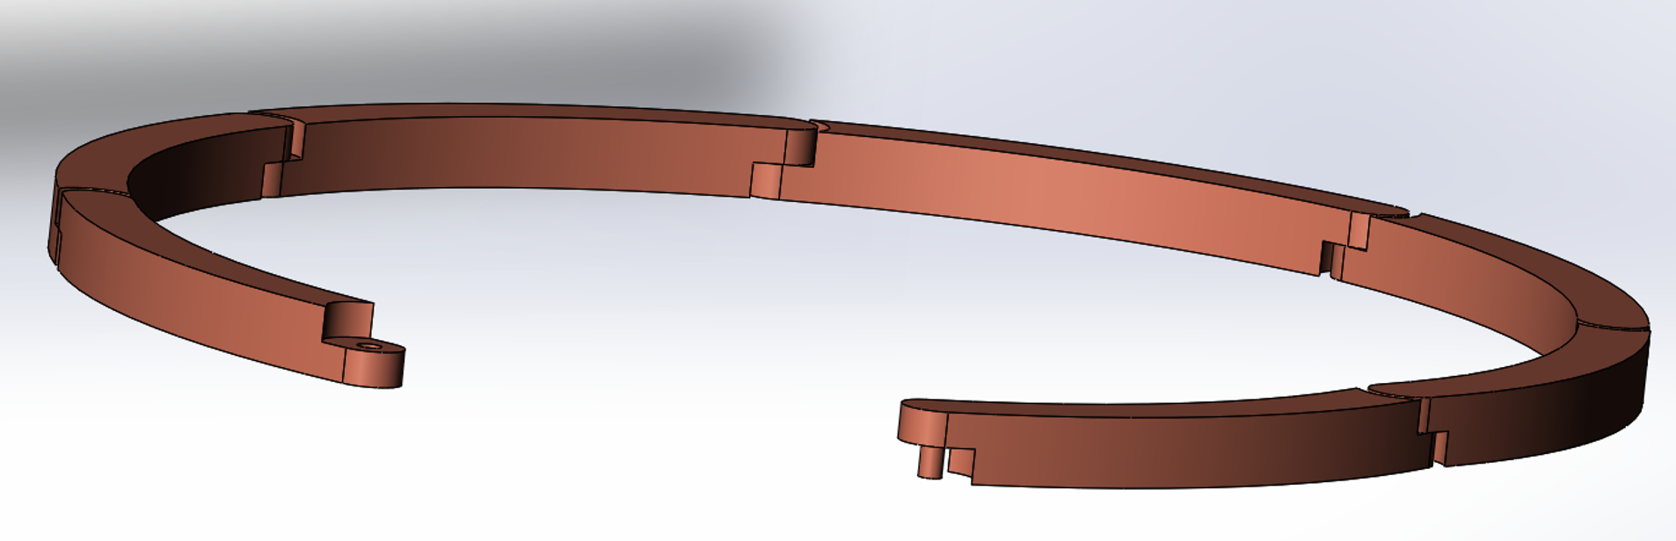
Background
Previous Work
Mechanical Design
Measuring Effects on Performance
Data Volume Analysis
Antenna Arrays
Summary
Develop designs to improve functionality and flexibility
Notes:
Designed both an L-band and UHF sized antenna

Slide 8
Background
Previous Work
Mechanical Design
Measuring Effects on Performance
Data Volume Analysis
Antenna Arrays
Summary
400 MHz Target

Slide 9
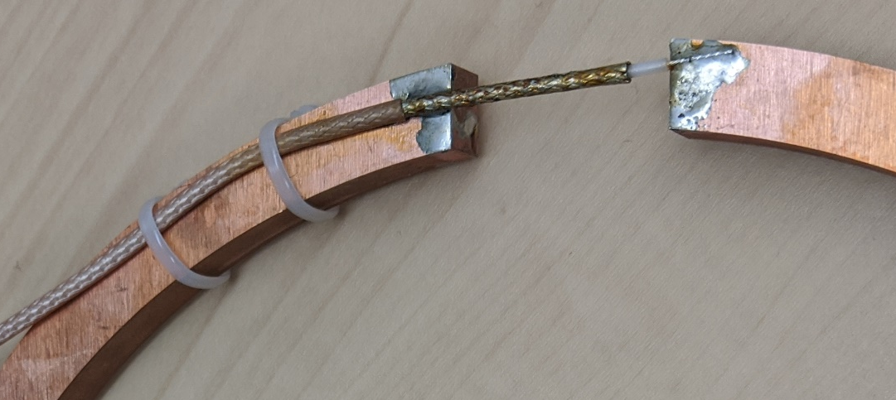
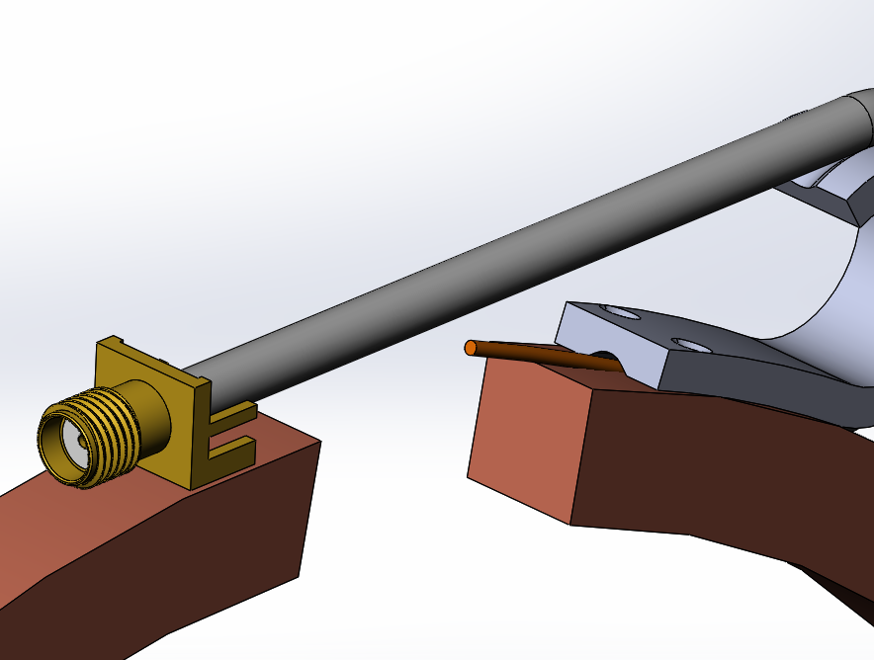
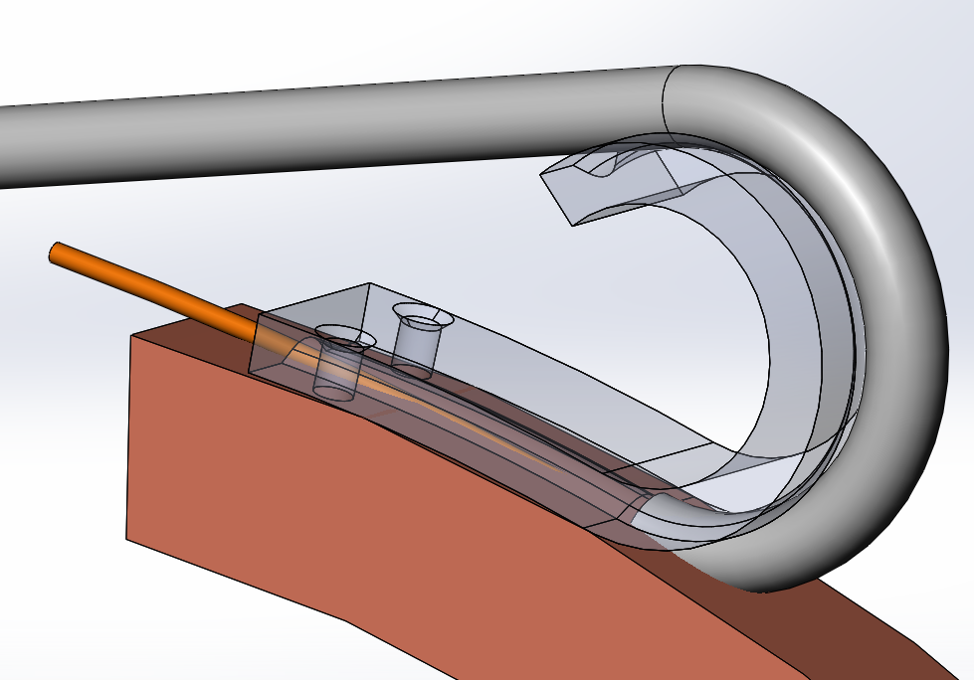
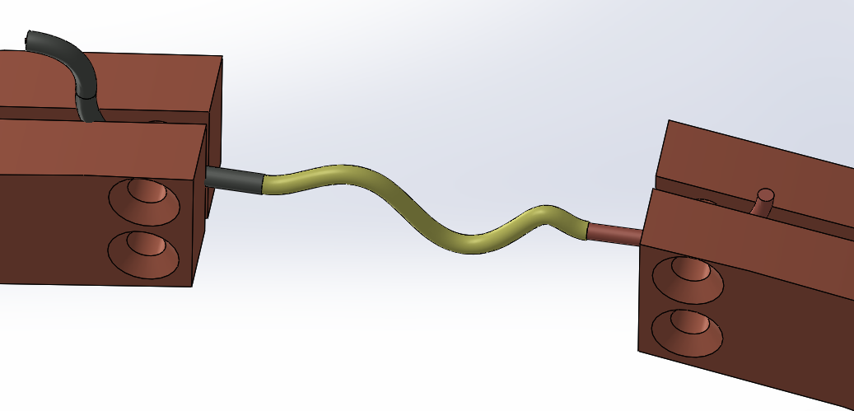
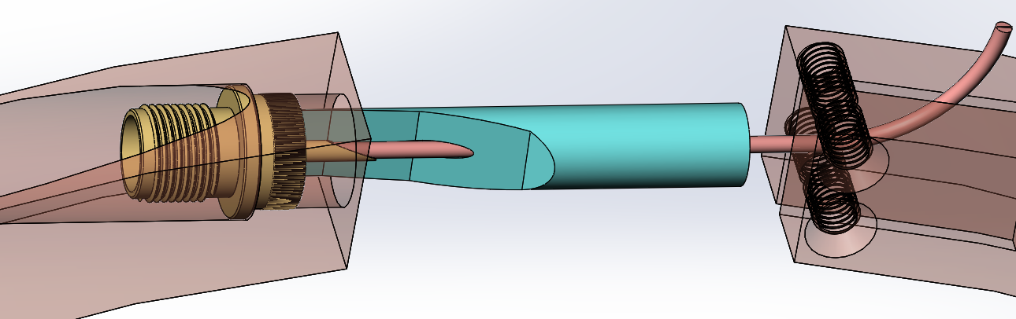
Background
Previous Work
Mechanical Design
Measuring Effects on Performance
Data Volume Analysis
Antenna Arrays
Summary
Improve upon the test setup for functional/expandable connector

Slide 10
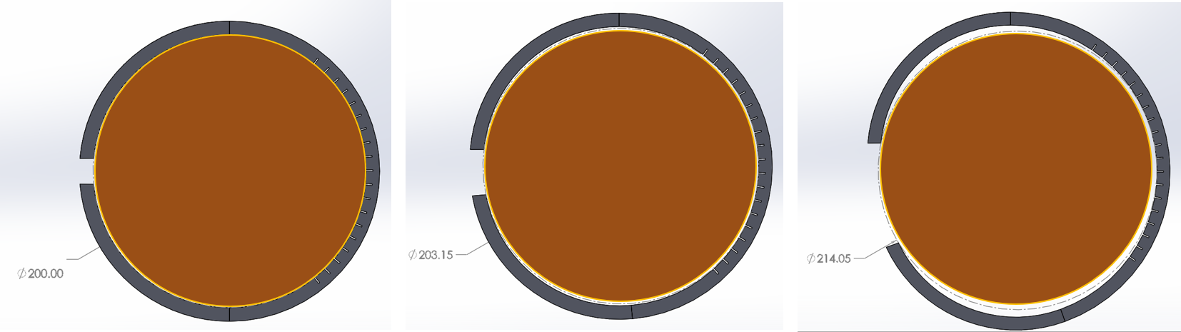
Background
Previous Work
Mechanical Design
Measuring Effects on Performance (Growth)
Data Volume Analysis
Antenna Arrays
Summary
0° Flex
10° Flex
40° Flex

Slide 11
Background
Previous Work
Mechanical Design
Measuring Effects on Performance (Growth)
Data Volume Analysis
Antenna Arrays
Summary
400 MHz Target

Slide 12
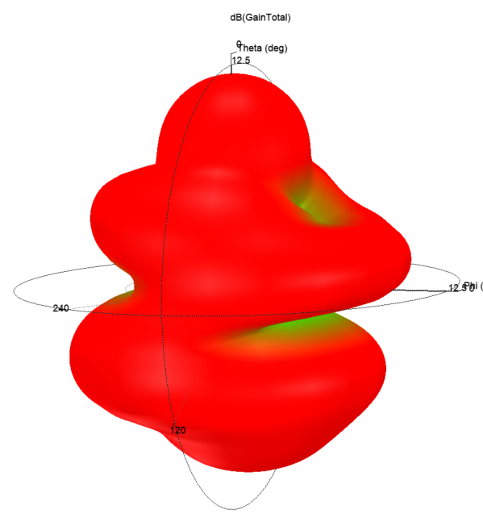
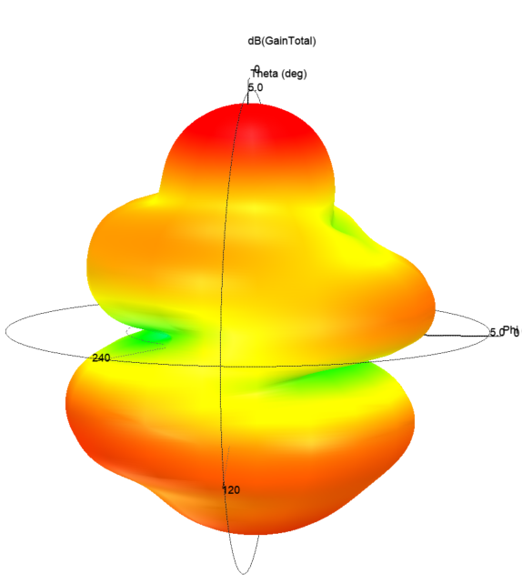
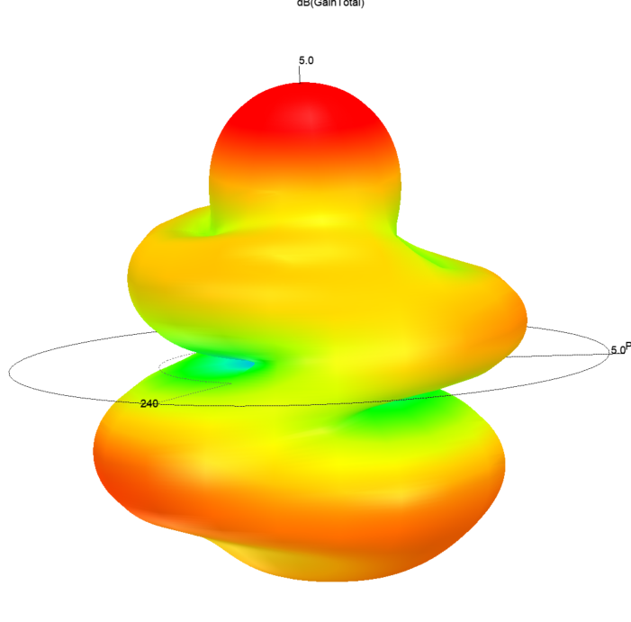
Background
Previous Work
Mechanical Design
Measuring Effects on Performance (Growth)
Data Volume Analysis
Antenna Arrays
Summary
0° Flex
11.0 dB Max
10° Flex
2.8 dB Max
40° Flex
2.9 dB Max

Slide 13
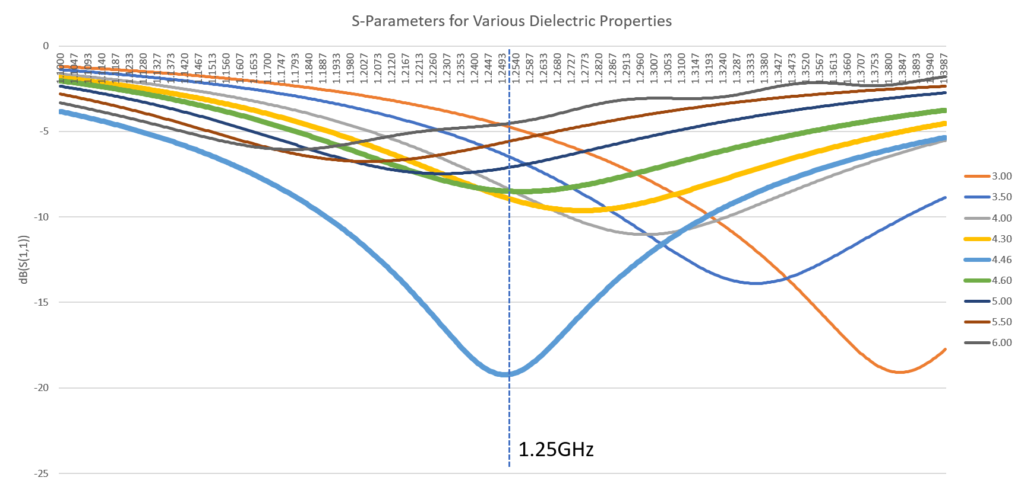
Background
Previous Work
Mechanical Design
Measuring Effects on Performance (Dielectric)
Data Volume Analysis
Antenna Arrays
Summary

Slide 14
Background
Previous Work
Mechanical Design
Measuring Effects on Performance
Data Volume Analysis
Antenna Arrays
Summary
Link Budget Calculator
Inputs:
Simulation Toolkit (STK)
Input:
Data Volume Calculations
Inputs:
Output:
Output:
Data Rate
Satellite data
Tree antenna data (location and beamwidth)
Tree antenna gain
Satellite data
Default environmental factors & parameters
Average Access Time
Output:
Total Data Volume (Kb)
Data Rate (bps)
Average Access Time (s)
Notes:
Data analysis is 3-step process

Slide 15
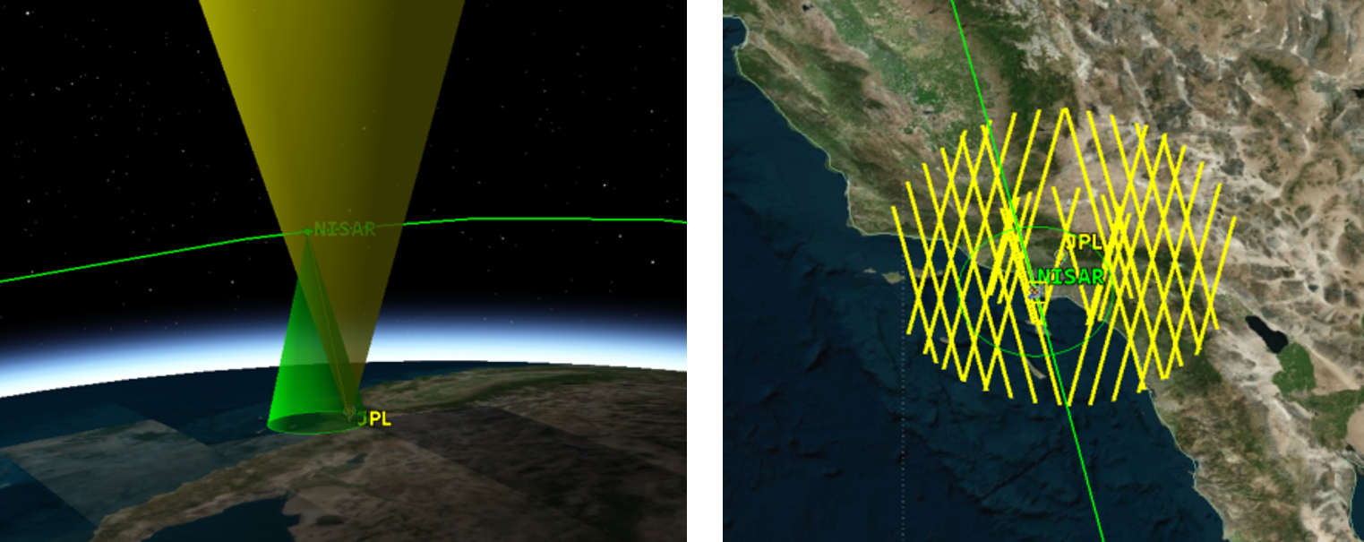
Background
Previous Work
Mechanical Design
Measuring Effects on Performance
Data Volume Analysis
Antenna Arrays
Summary
Transmission Target: 7258 kilobits (Kb) per month
2 month STK simulation

Slide 16
Background
Previous Work
Mechanical Design
Measuring Effects on Performance
Data Volume Analysis
Antenna Arrays
Summary
 | Peak Gain (dB) | Beamwidth (°) | Access Periods* | Average Access Time (s)* | Data Rate (Kbps) | Data Volume per Simulation (Kb)* | Data Volume per Month (Kb)
L-band | 7.8 | 34.27 | 10 | 19.382 | 110 | 21320 | 10660
UHF | 5.6 | 56.94 | 16 | 31.762 | 262 | 133148 | 66574
*Values from a 2-month simulation
Notes:
Both designs surpassed our monthly data target

Slide 17
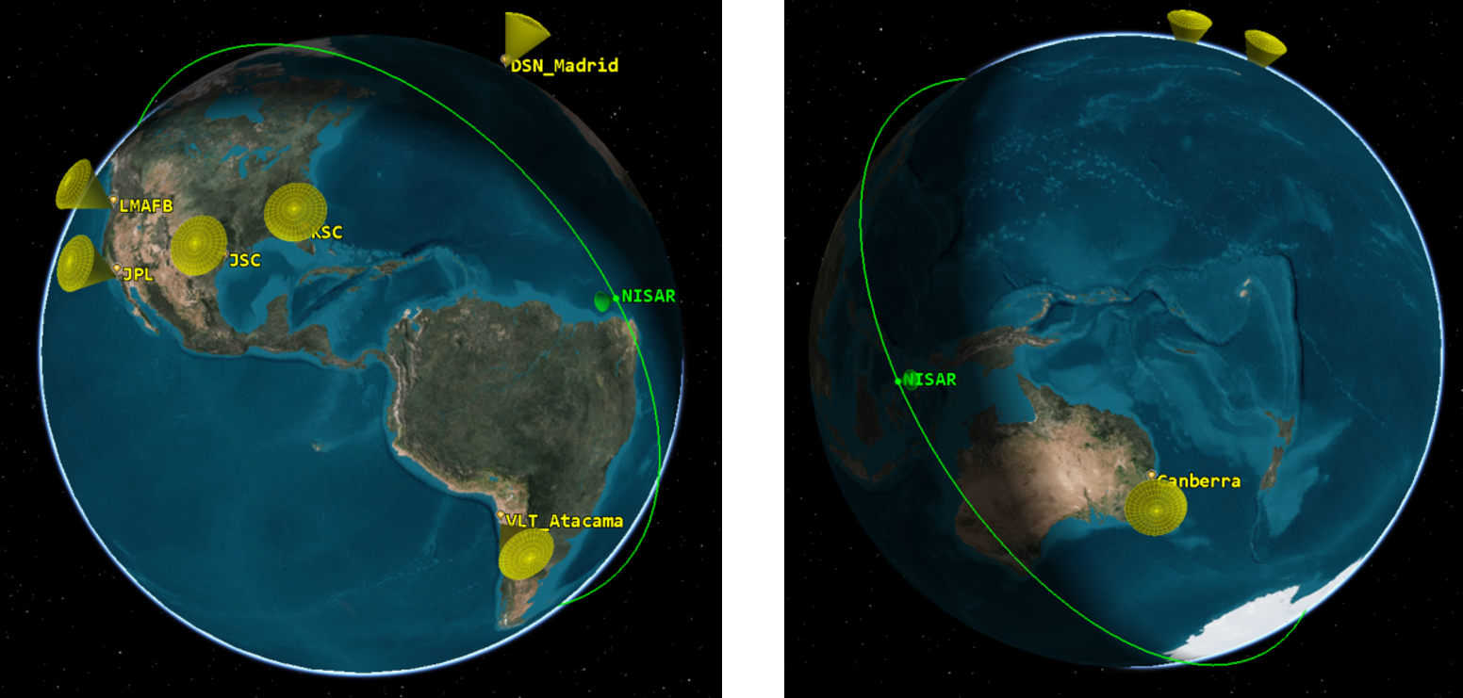
Background
Previous Work
Mechanical Design
Measuring Effects on Performance
Data Volume Analysis
Antenna Arrays
Summary
Notes:
Determine effects of location > 7 locations at variety of latitudes
Many were DSN antenna sites

Slide 18
Background
Previous Work
Mechanical Design
Measuring Effects on Performance
Data Volume Analysis
Antenna Arrays
Summary
Notes:
Northern latitudes saw slightly improved access times over entire 2-month simulation

Slide 19
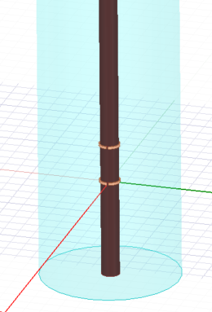
Background
Previous Work
Mechanical Design
Measuring Effects on Performance
Data Volume Analysis
Antenna Arrays
Summary
Antenna Spacing (wavelengths) | Peak Gain (dB) | Beamwidth (degrees)
Control (single) | 7.8 | 34.27
4 | 7.7 | 33.47
3 | 7.4 | 33.33
2 | 7.0 | 34.08
1 | 6.9 | 34.27
½ | 6.8 | 33.53
¼ | 6.3 | 56.79

Slide 20
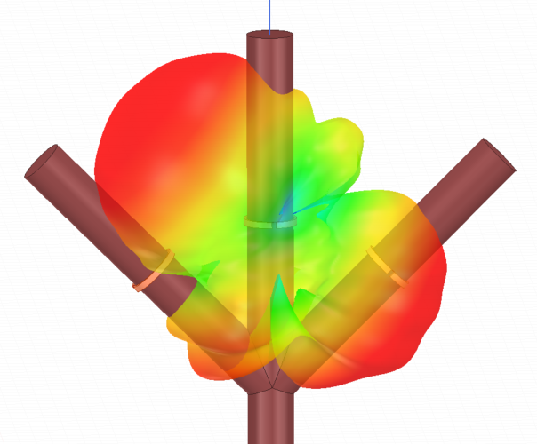
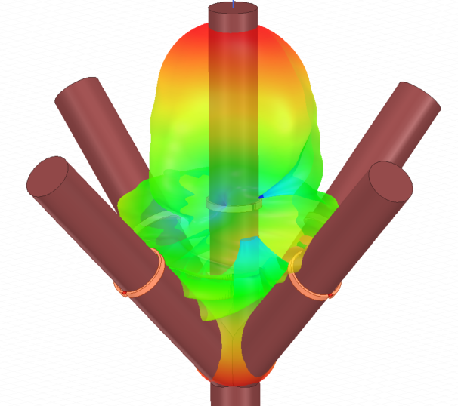
Background
Previous Work
Mechanical Design
Measuring Effects on Performance
Data Volume Analysis
Antenna Arrays
Summary
Notes:
The placement of additional antennas on other branches of the tree allowed for increasing the gain and optimizing the directionality of the transmitted field.

Slide 21
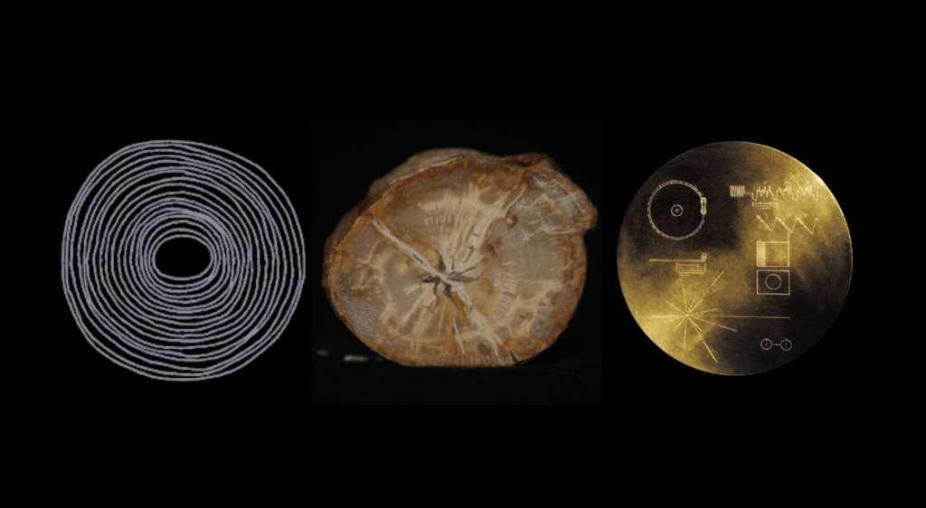
Background
Previous Work
Mechanical Design
Measuring Effects on Performance
Data Volume Analysis
Antenna Arrays
Summary
Development of mechanical designs
Measuring effects on performance (growth and dielectric)
Determined sufficient data volumes
Antenna arrays can be used to direct gain
For more info, visit:
http://www.thetreeoflife.space/
http://www.juliachristensen.com/portfolio/tree-of-life/

