Slide 1



S. Simonetti
HAWK
Copyright © Argotec S.r.l. 2021. All right reserved.
The deep space platform for navigation, communication, and scientific exploration

Slide 2
HAWK – The Deep Space Platform
Outline
Argotec Company Overview
HAWK Platform Overview
On-going Missions
  ArgoMoon
  LICIACube
  MARS COMM NAV
  ANDROMEDA
Next Targets

Slide 3
ARGOTEC Company Overview

Slide 4



ARGOTEC Company Overview
Location
Turin (Italy)
Cologne (Germany)
Noordwijk (Netherlands)
Argotec US subsidiary allows to work in close proximity to the key space players and customers (e.g. NASA)
Branches in Germany (EAC) and Netherlands (ESTEC) allow the company to support also ESA strategic activities
Largo, MD (USA)

Slide 5
HAWK Platform Overview

Slide 6
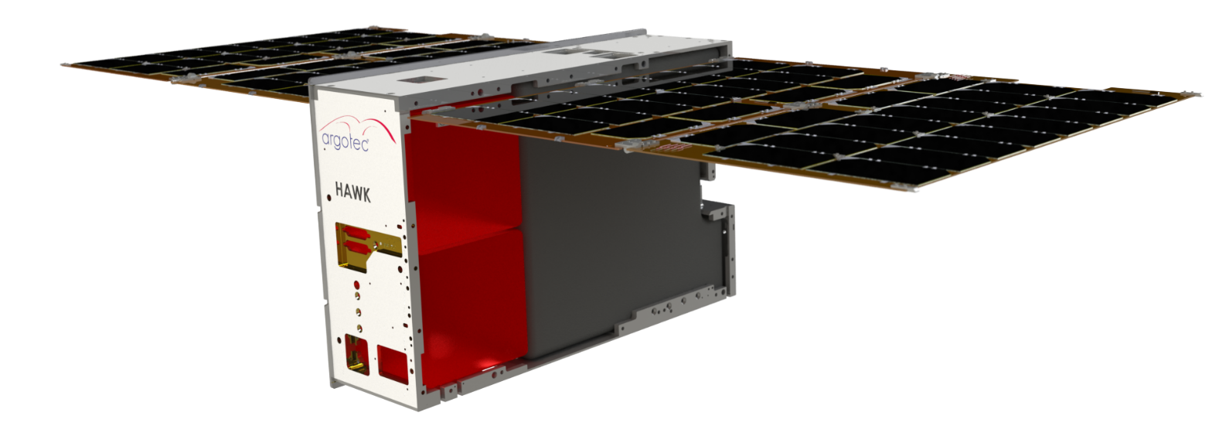
HAWK Platform Overview
Main Features
RAD-HARD & RELIABLE
AUTONOMOUS
300krad Deep Space Rad-Hard Avionics
HI-REL EEE components with flight heritage
Autonomous Target Tracking & Navigation
Autonomous Attitude Recovery
Autonomous FDIR
MISSION-ADAPTABLE
PERFOMANT
SADA
Up to 8/9 U of Payload bay
Fully compatible with various ground segment DSN connection
100 Mbps max Data Rate
5 + years Lifetime
Avionics processing capabilities able to support Artificial Intelligence

Slide 7
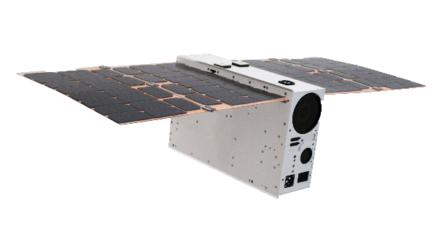
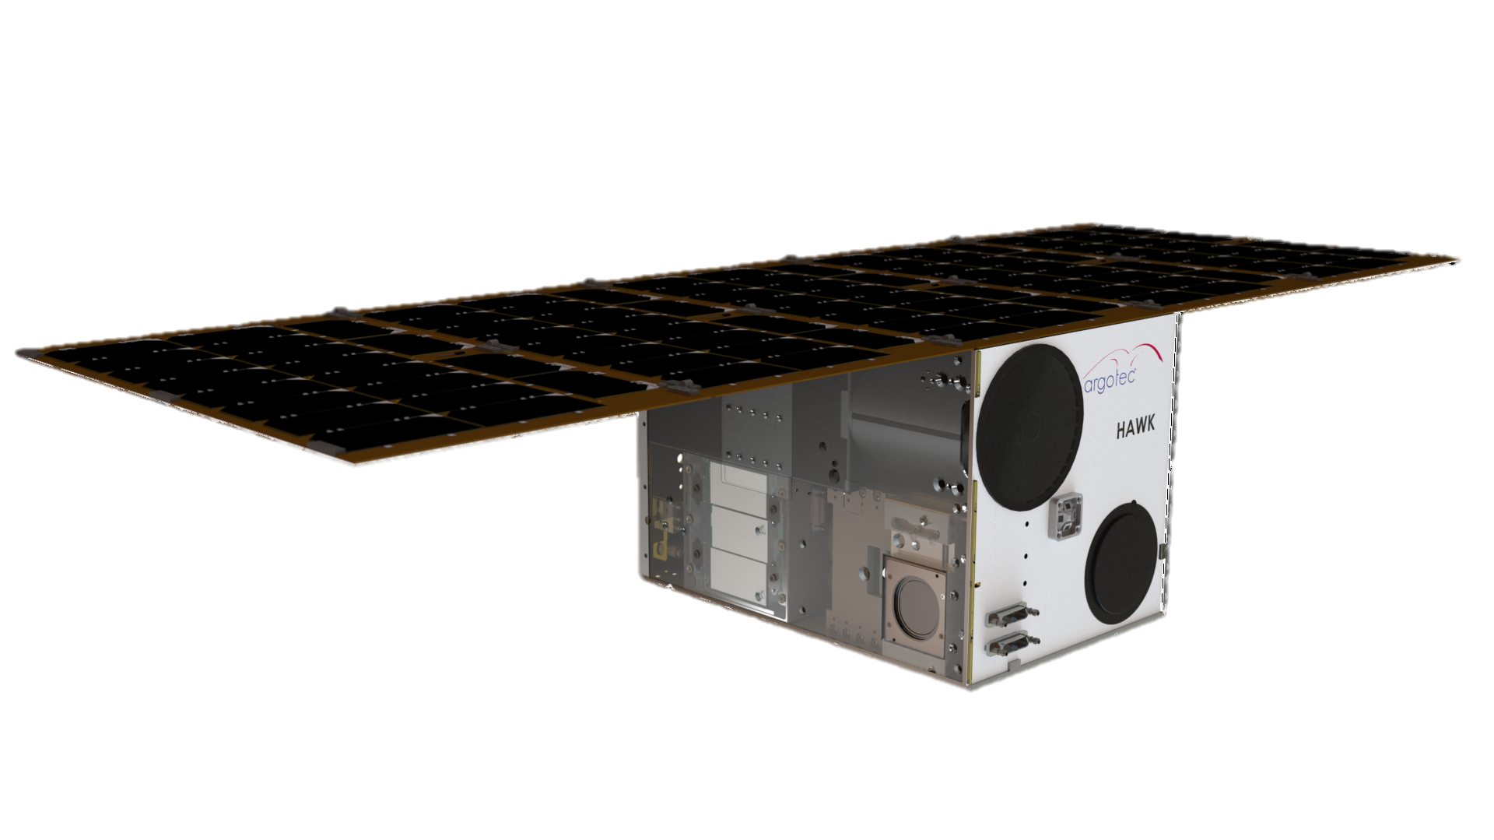
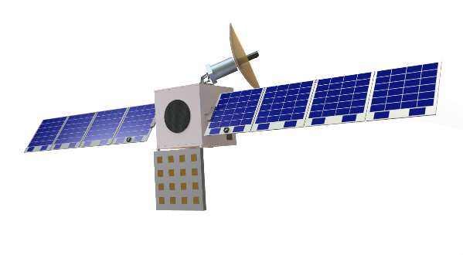
HAWK Platform Overview
Performance
6U
12U
27U
 | 6 U | 12U | 27U
PAYLOAD MASS | up to 3 kg* | up to 12 kg* | up to 30 kg*
PAYLOAD VOLUME | up to 3.5U* | up to 8U* | up to 15U*
PAYLOAD PEAK POWER | up to 40W | up to 40W | up to 80W
POWER SYSTEM | 3.3V, 5V, 12V, 28V Secondary battery up to 120Wh | 3.3V, 5V, 12V, 28V Secondary battery up to 250Wh | 3.3V, 5V, 12V, 28V Secondary battery up to 480 Wh
SOLAR ARRAY PEAK POWER | 40W, or 80W | 40W, 80W, or 120W | up to 300W
SINGLE AXIS SUN TRACKING SOLAR ARRAY DRIVE | Yes | Yes | Yes
ATTITUDE DETERMINATION | Sun sensors, Star Tracker, Accelerometers | Sun sensors, Star Tracker, Accelerometers | Sun sensors, Star Tracker, Accelerometers
GUIDANCE, NAVIGATION AND CONTROL | Delta DOR, sequential ranging, pseudonoise ranging, GNSS** | Delta DOR, sequential ranging, pseudonoise ranging, GNSS** | Delta DOR, sequential ranging, pseudonoise ranging, GNSS**
POSITION KNOWLEDGE | +/- 5m | +/- 5m | +/- 5m
DATA BUSES | RS422, LVDS, SpaceWire, SPI, I2C, CAN** | RS422, LVDS, SpaceWire, SPI, I2C, CAN** | RS422, LVDS, SpaceWire, SPI, I2C, CAN**
BUS PROVIDED DATA STORAGE | up to 32 GB | up to 32 GB | up to 64 GB***
COMM | Uplink: UHF, S-Band, X-Band, K-Band** | Uplink: UHF, S-Band, X-Band, K-Band** | Uplink: UHF, S-Band, X-Band, K-Band**
 | Downlink: UHF, S-Band, X-Band, K-Band** | Downlink: UHF, S-Band, X-Band, K-Band** | Downlink: UHF, S-Band, X-Band, K-Band**
COMMAND AND TELEMETRY RADIO TRANSMITTERS | 1kbps to 100Mbps | 1kbps to 100Mbps | 1kbps to 100Mbps
COMMAND AND TELEMETRY RADIO RECEIVERS | 100bps to 30Mbps | 100bps to 30Mbps | 100bps to 30Mbps
PROPULSION | up to 70 m/s (chemical propulsion) up to 600 m/s (electrical propulsion) | up to 160 m/s (chemical propulsion) up to 1 km/s (electrical propulsion) | up to 400 m/s (chemical propulsion) up to 3.5 km/s (electrical propulsion)

Slide 8
On-going Missions

Slide 9

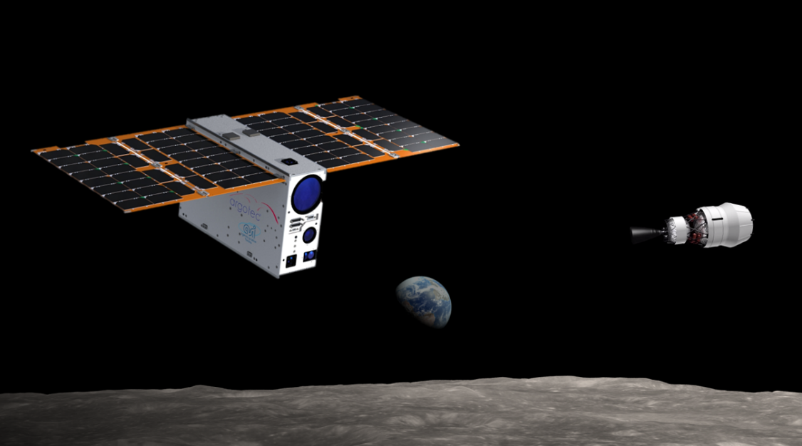

On-going Missions
ArgoMoon Mission Overview
2021
ArgoMoon
Artemis-1 mission (NASA)
Planetary Observation
Inserire foto AGM
Mass: 14 kg
Dimensions: 6U (34x20x10 cm)
Orbit: High Elliptical Orbit
Launch Vehicle: NASA
Sponsor: Italian Space Agency
Launch date: 2021
Features: Autonomous Tracking, High speed data relay, AI, Rad-hard technology

Slide 10
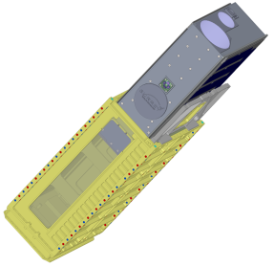
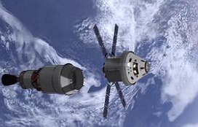
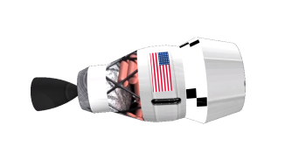
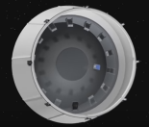




On-going Missions
ArgoMoon Mission Timeline
ATTITUDE reconstruction
T0 + 15 SEC
Pointing Cameras towards ICPS
1st picture
T0 : DEPLOYMENT
Closure of the separation switches: power to the system
T0 + 1 MIN
ICPS Targeted:
Tracking Mode
ORION DETACHMENT FROM ICPS
Put in a Translunar Trajectory
T0 + 8 HR
Geocentric orbit
Pictures of Earth and the Moon and validation of on-board Technologies
T0 + 5.5 MONTHS
Enter in heliocentric orbit for the disposal phase
T0 + 5 MIN
PS operational:
Relative dynamic maneuvers
100m-500m proximity flight

Slide 11
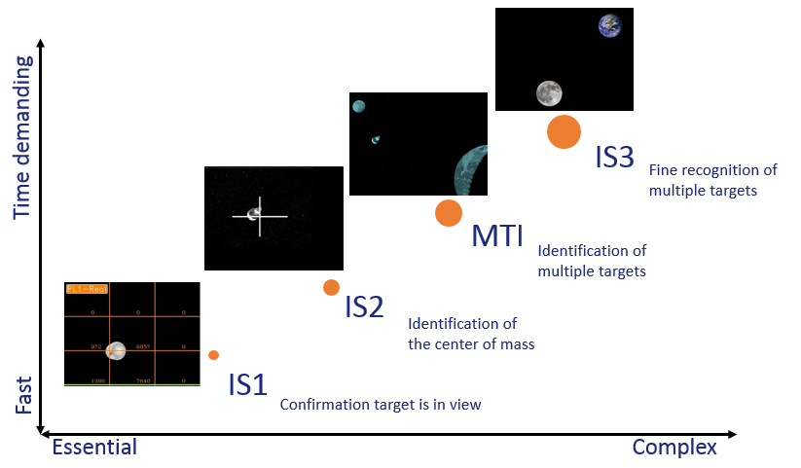
On-going Missions
ArgoMoon Autonomous Navigation

Slide 12

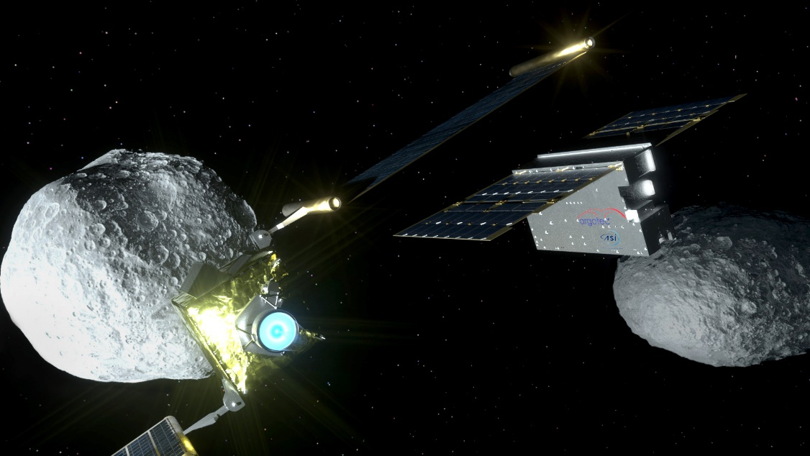
On-going Missions
LICIACube Mission Overview
2021
LICIACube
DART mission (NASA)
Planetary Defense
Mass: 14 kg
Dimensions: 6U (34x20x10 cm)
Orbit: Heliocentric Orbit
Launch Vehicle: NASA
Sponsor: Italian Space Agency
Launch date: 2021
Features: 2 Cameras, Fast Fly-by Maneuvering, Long Cruise Autonomous Re-activation, Autonomous Nav, Track & Pointing
Inserire foto LCC

Slide 13
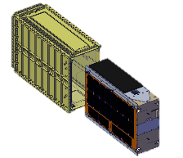
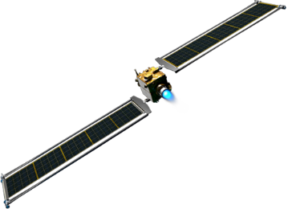
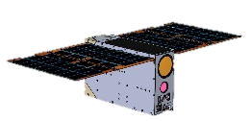




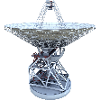

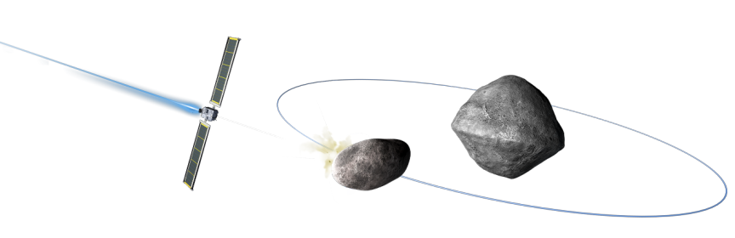
On-going Missions
LICIACube Mission Timeline
LICIACUBE DEPLOYMENT
DART S/C trigger the LICIACube deployment 120 hours before the impact
PIGGYBACK CRUISE PHASE
LICIACube is carried by DART S/C
APPROACHING PHASE
LICIACube establishes a link W/DSN to perform the satellite tracking and the orbit determination
LAUNCH
Launch Window June-July 2021
SCIENCE
LICIACube performs separation maneuvers and acquires pictures of Didymos B and plume generated by the DART S/C impact
SCIENCE
Downlink of acquired scientific data for 6 months

Slide 14

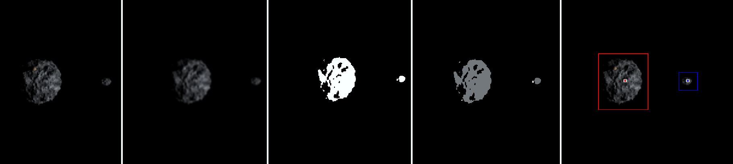
On-going Missions
LICIACube Autonomous Navigation
Attitude Determination and Control System
Nominal
Trajectory
Asteroid Tracking Control Loop
Attitude Control Loop
Objects Detection
Trajectory Recognition
Autonomous asteroid tracking
Multi-subsystem interaction
Robust to spatial and temporal uncertainties

Slide 15




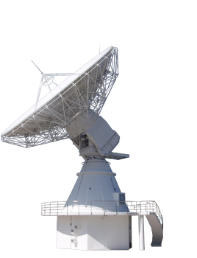
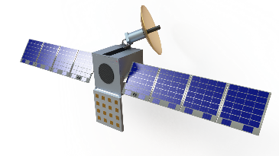
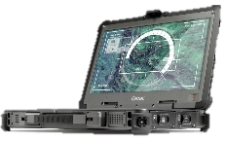
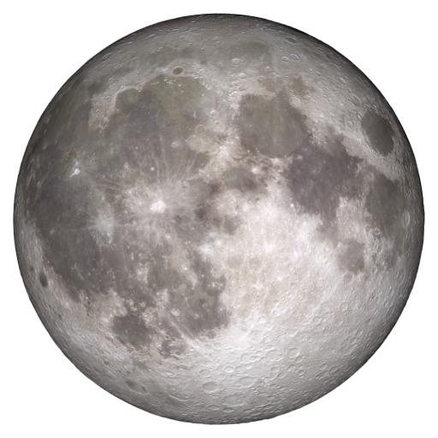
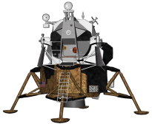
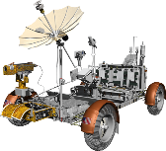
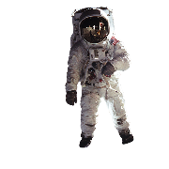
On-going Missions
Earth
Users
ANDROMEDA Concept
Satellite
Constellation
Service Control Center
Ground
Stations
Mission Control Center
Lunar
Users

Slide 16

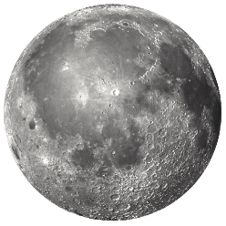
On-going Missions
ANDROMEDA Mission Features
ANDROMEDA is an innovative microsatellite constellation for communications in lunar environment to establish a service based on:
High speed communication system implementation
Small satellite platform architecture use
Multi-users service provision
Real time telecommunication network creation
24/7 Lunar South Pole coverage
Full Lunar coverage

Slide 17
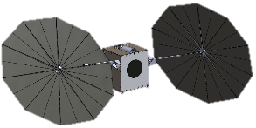

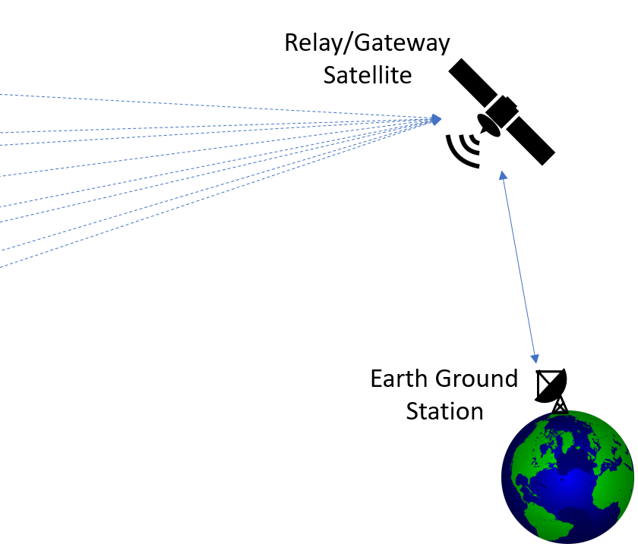
On-going Missions
MARS COMM NAV Mission Features
MARS COMM NAV is an innovative microsatellite constellation for communications and navigation in mars environment to establish a service based on:
High speed communication system implementation
Small satellite platform architecture use
Multi-users service provision
Real time telecommunication network creation
24/7 Global coverage of Mars

Slide 18
Next Targets

Slide 19
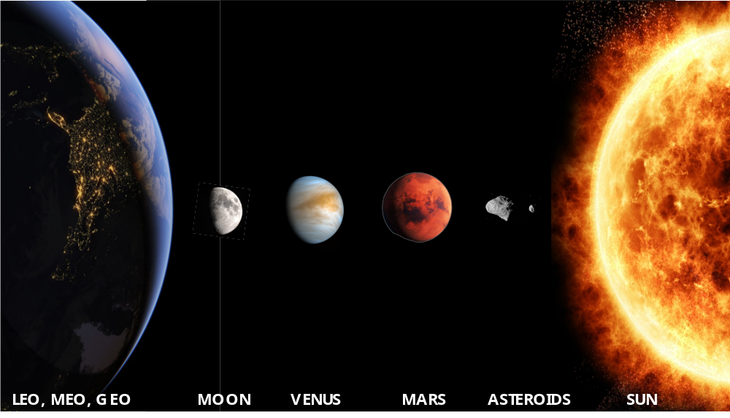
Next Targets
Possibile Application of HAWK Platform

Slide 20

THANK YOU!
www.argotecgroup.com
Copyright © Argotec S.r.l. 2021. All right reserved.

