Slide 1
Mars Small Spacecraft
The opportunity of the roaring 20ties
Vlada Stamenkovic, C. D. Edwards, N. J. Barba, R. C. Woolley, L. Giersch, T. A. Komarek, V. Cormarkovic, P. E. Clark, A. Chmielewski,
et al.
Jet Propulsion Laboratory, California Institute of Technology

Slide 2
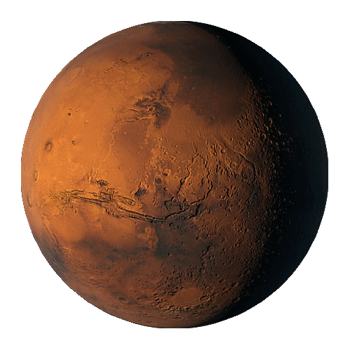
How to do it small?
What mission concepts?
What science?
Why Mars?
Last thoughts & summary

Slide 3
How to do it small?
What mission concepts?
What science?
Why Mars?
Last thoughts & summary

Slide 4
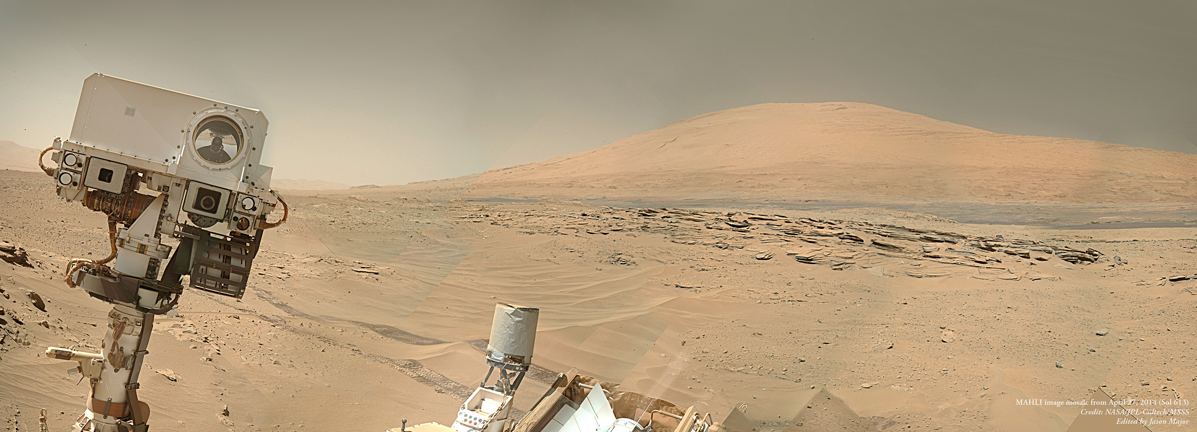
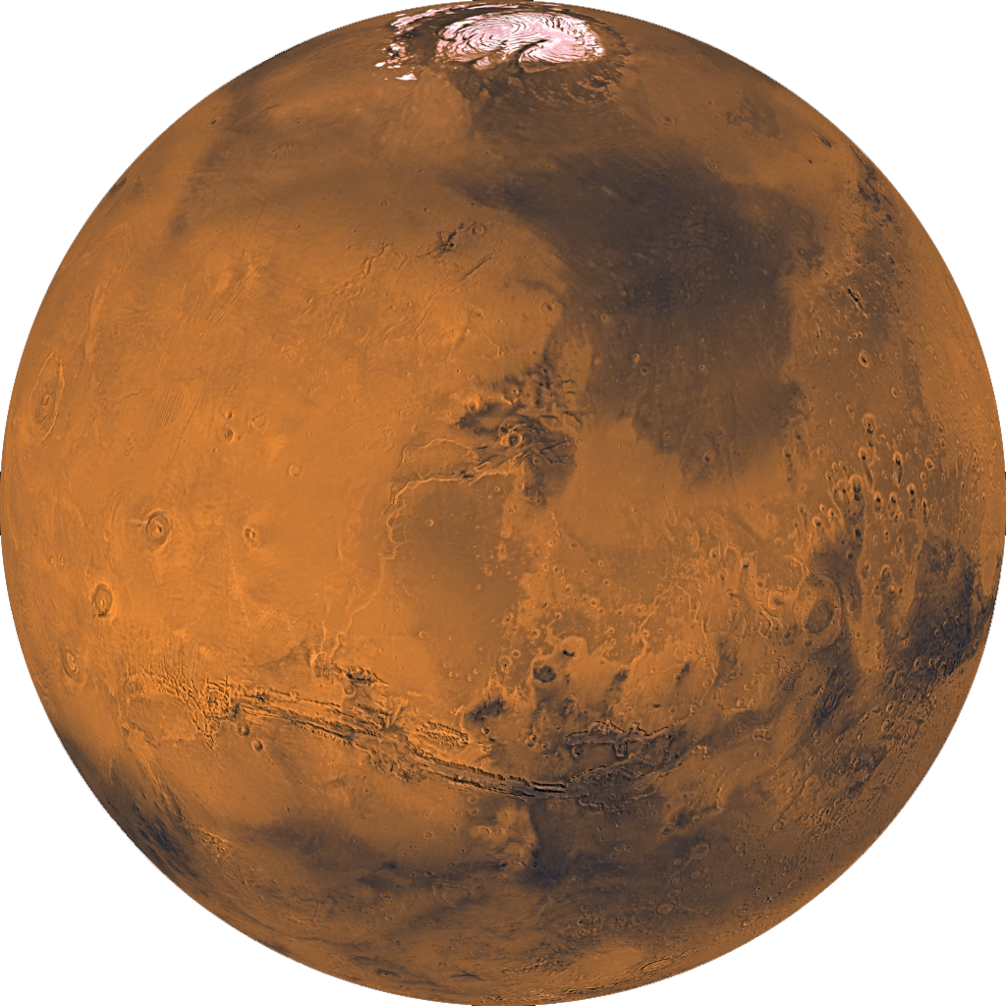
Mars today…been there, done that?
P = 6 mbar
T = 140-300
fO₂ = 0.146 %
Organics being destroyed on the surface

Slide 5

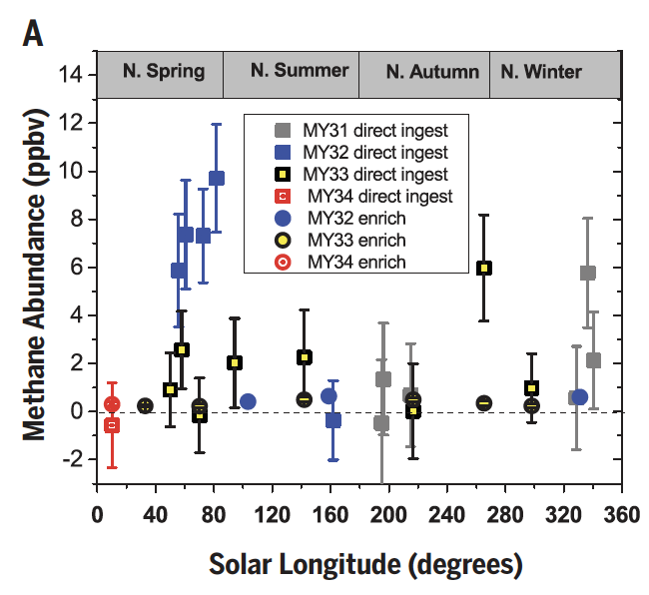
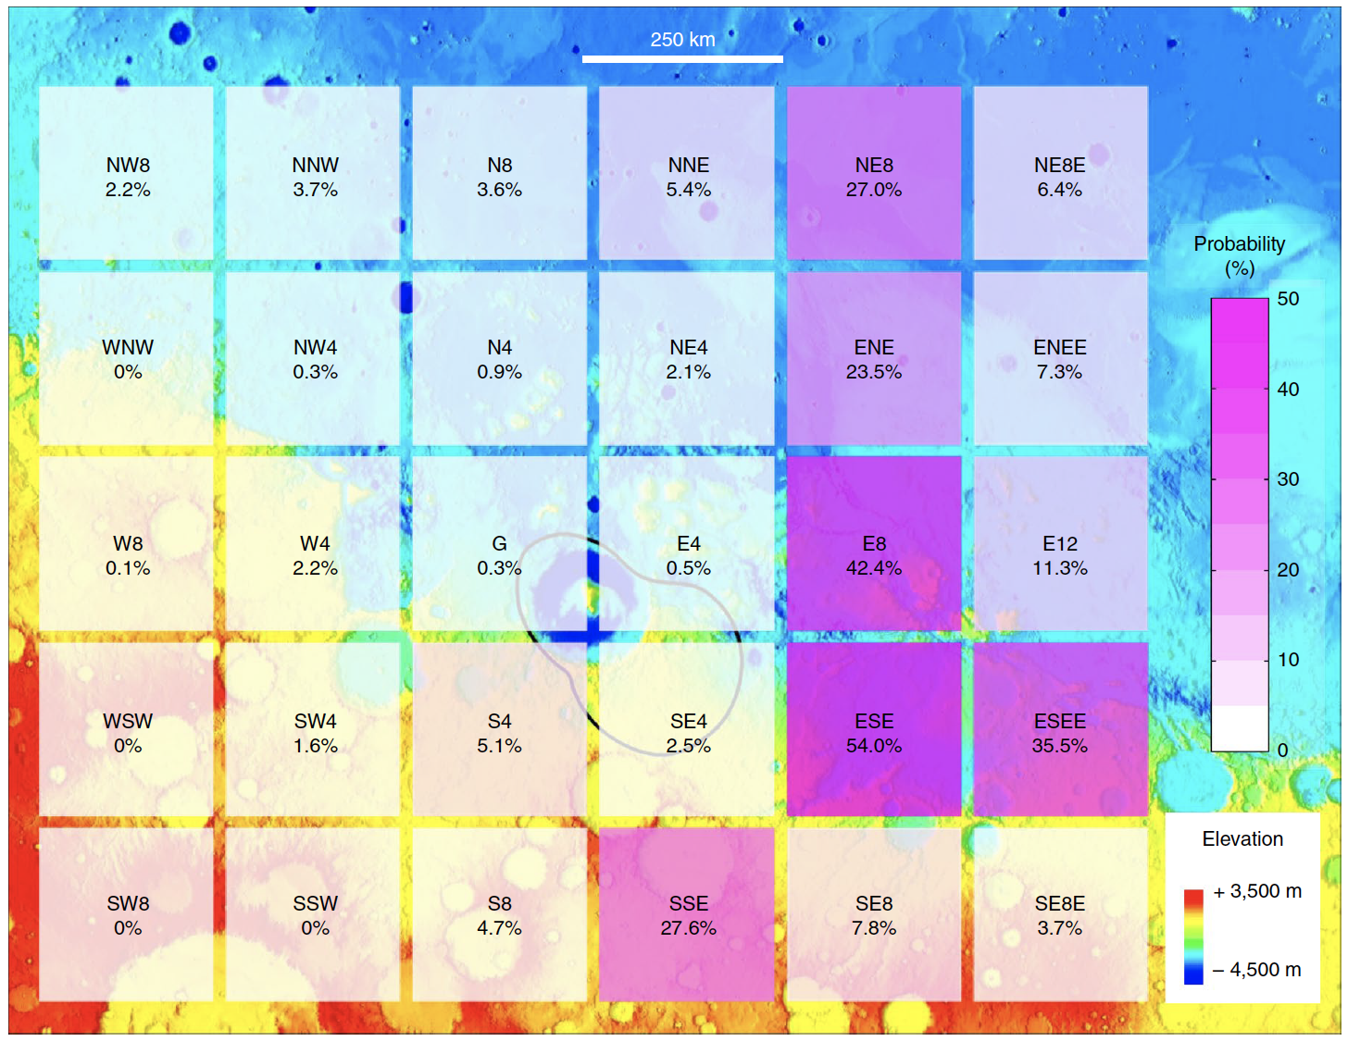
BUT…whiffs of weird gases…
Methane?
5
Webster + 2018
Trainer + 2019
Oxygen?
“The mysterious appearance and disappearance of methane in the Martian atmosphere remains the most compelling hint of possible life in the subsurface of Mars,”
Dr. Pratt (NASA PP).
Giuranna + 2019
Trainer + 2019

Slide 6
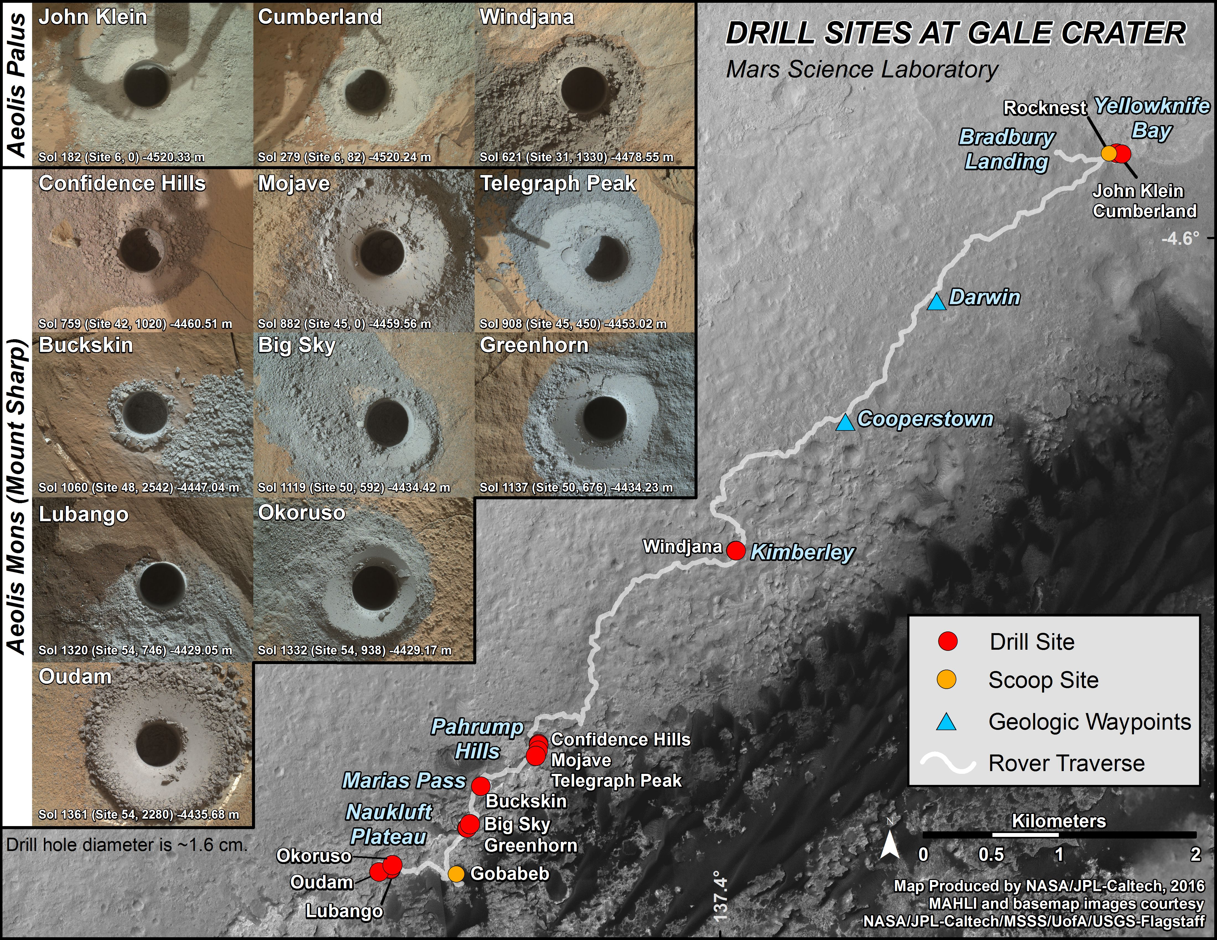
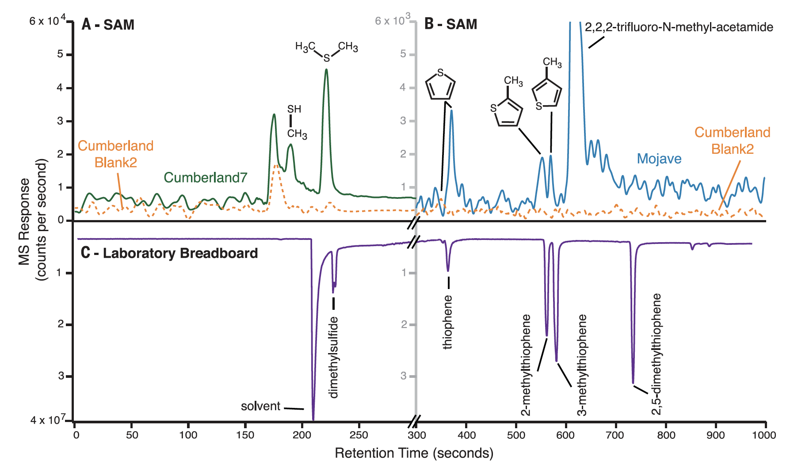
Hidden diversity below…power to fuel life?
Redox gradients with depth?
Where is the organics coming from?
Eigenbrode + 2018

Slide 7
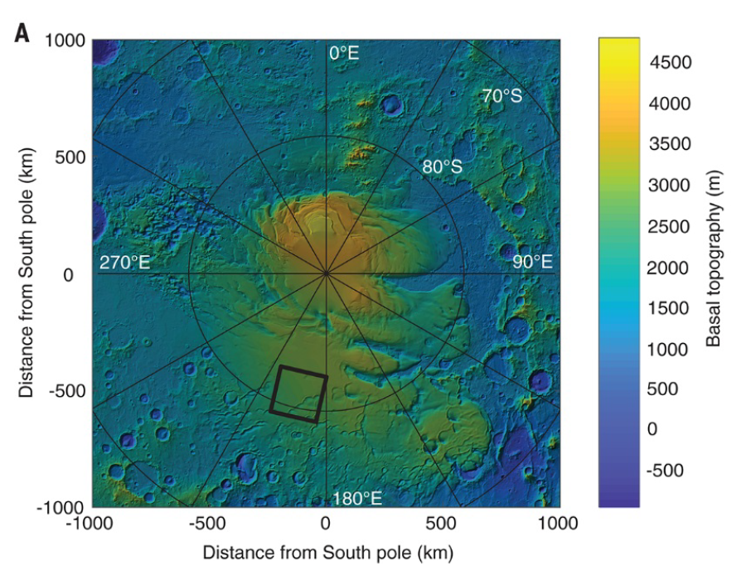
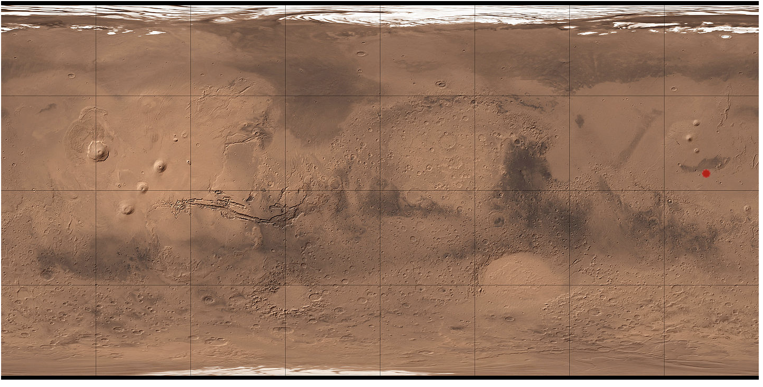
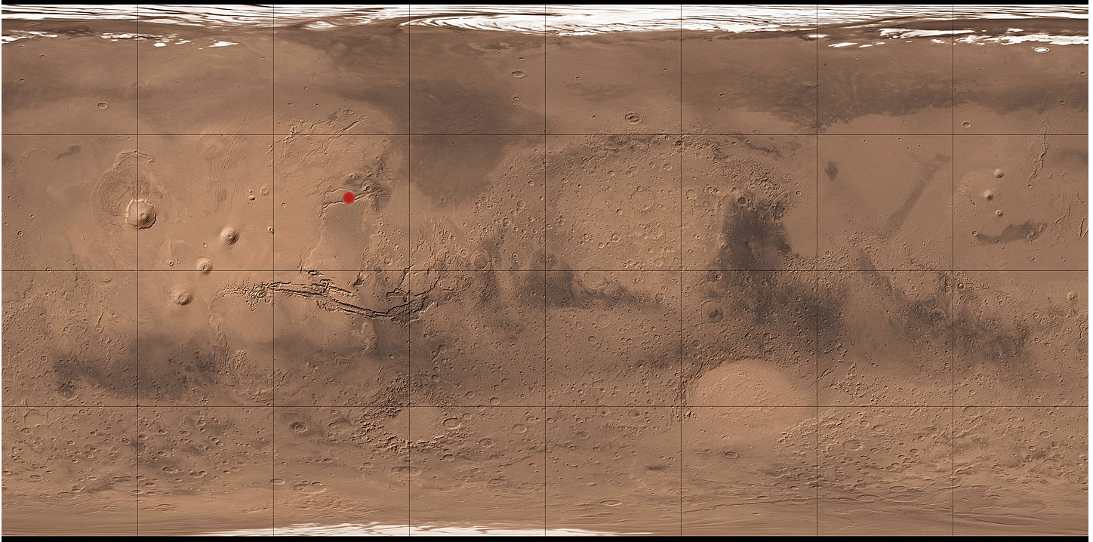
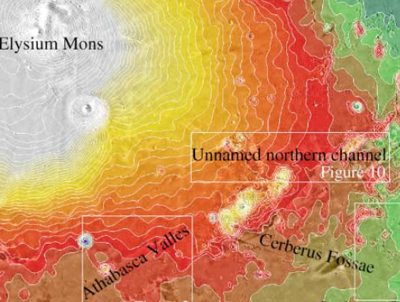
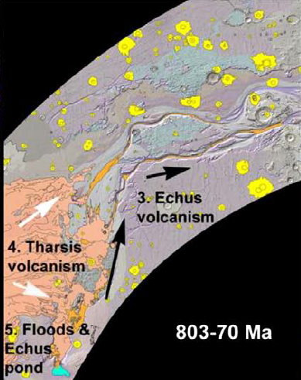
A refresher…young water?
Young Outflow Channels in Athabasca and Kasei
[Burr et al., 2002; Chapman et al., 2010]
Aquifer or juvenile water?
Liquid (ground)water today?
Orosei + 2018

Slide 8
Mars today…been there, done that?
P = 6 mbar
T = 140-300
fO₂ = 0.146 %
Organics being destroyed on the surface

Slide 9
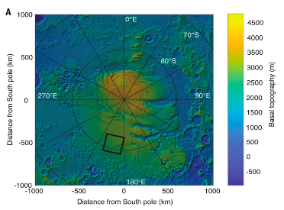

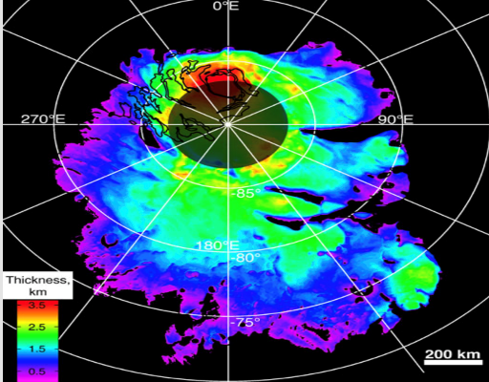

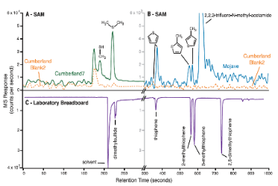
Been there…but haven’t done that!
Big, game-changing, Mars questions left unanswered.
Water?
Power to fuel life?
Climate record?
Orosei + 2018
Organics?
Trace Gases?
Eigenbrode + 2018
Webster + 2015, 2018
Trainer + 2019

Slide 10
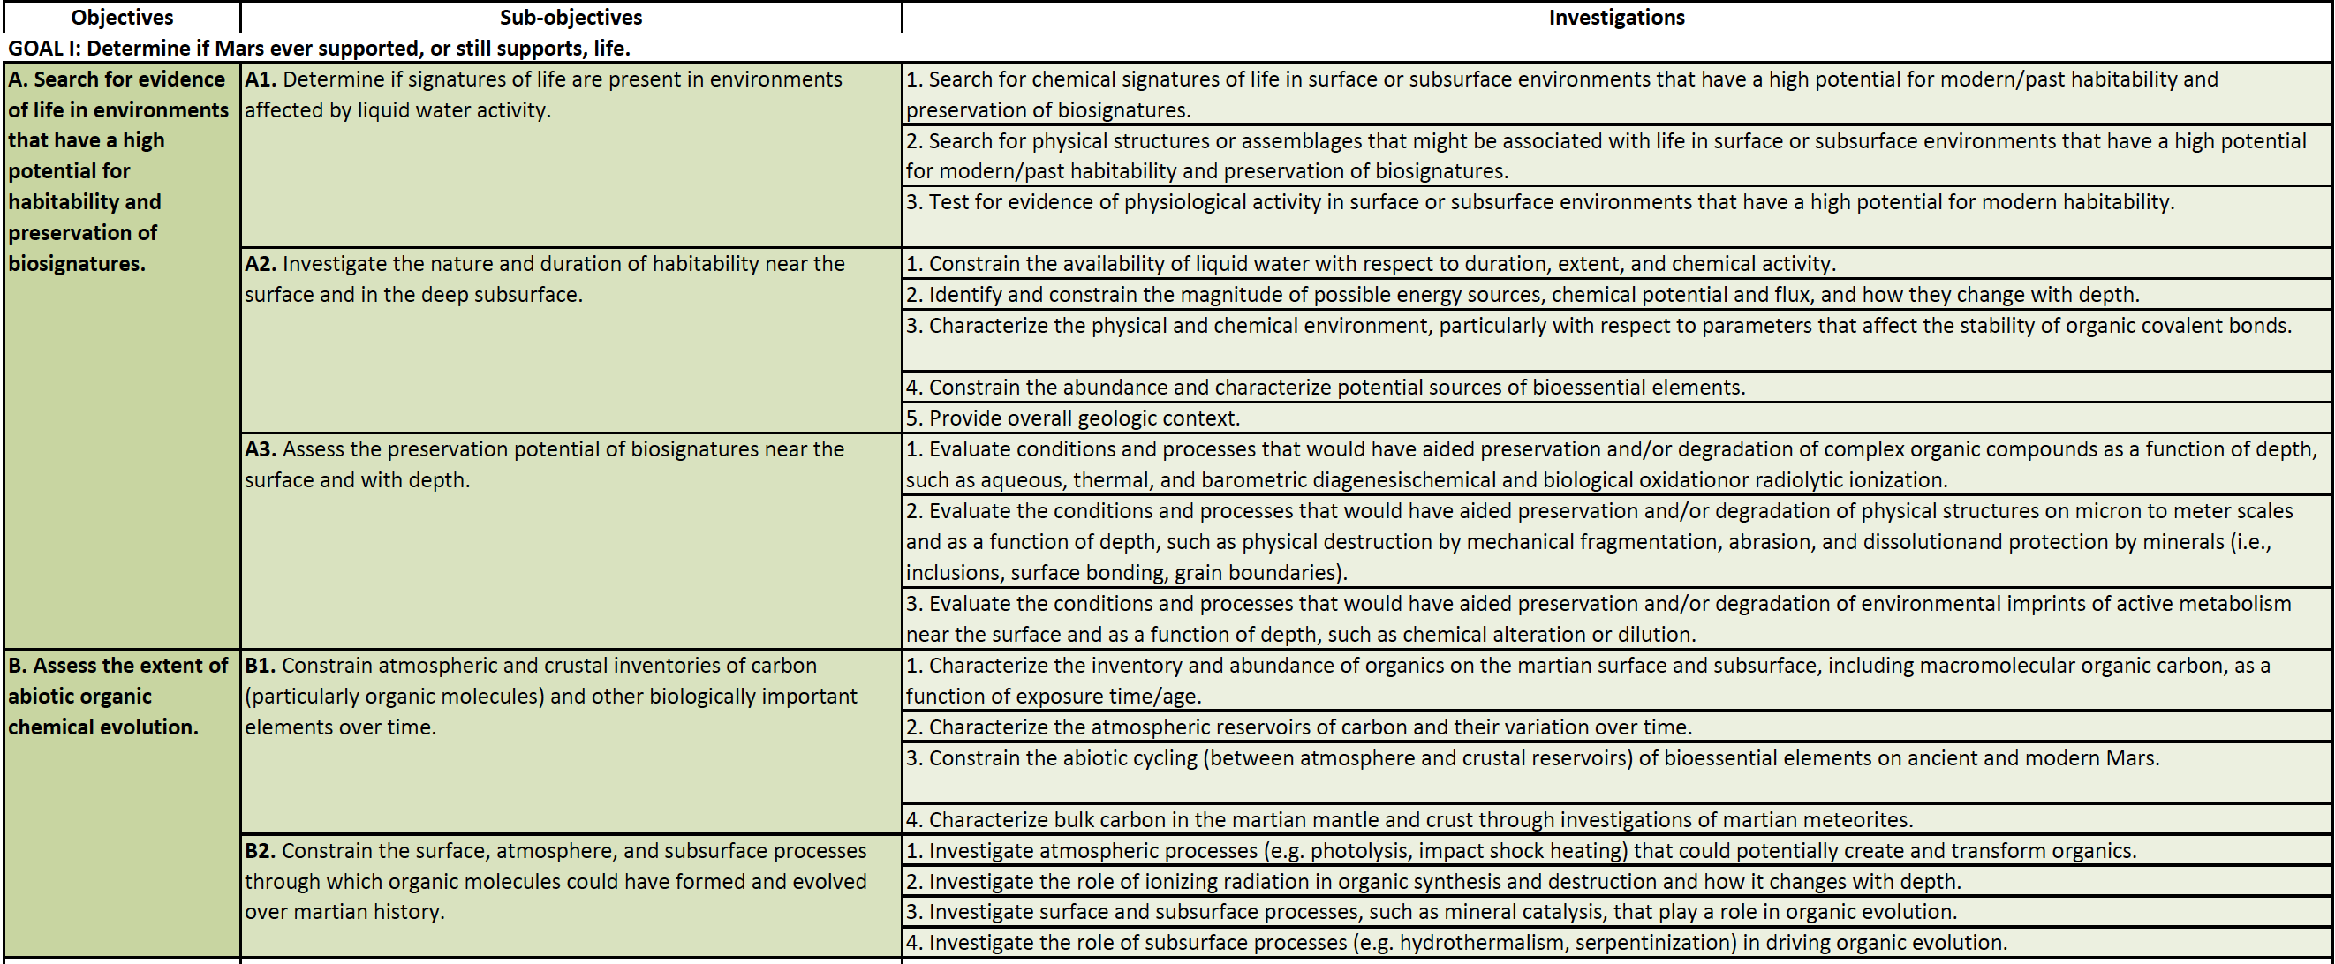
MEPAG changes: subsurface & extant life
These questions reflect recent (March 2020) changes in the MEPAG documents, especially to Goal I (Life).
Back to life, into the deep → tight new bonds to Ocean Worlds & Human Exploration

Slide 11
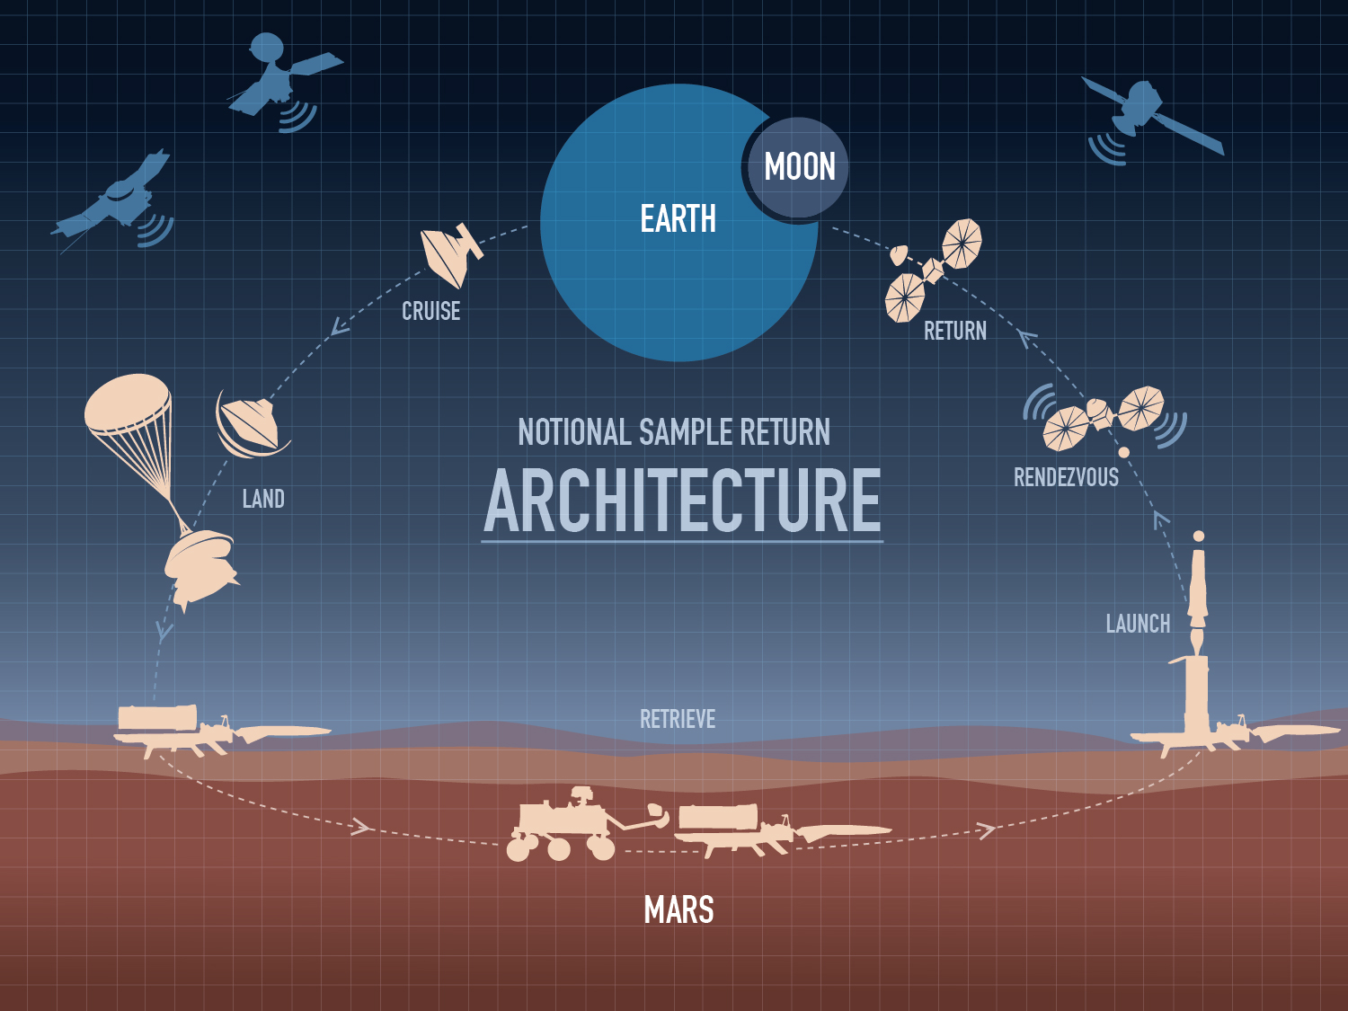
Planned Mars Sample Return Campaign
$$$
We need to find affordable options!

Slide 12
How to do it small?
What mission concepts?
What science?
Why Mars?
Last thoughts & summary

Slide 13

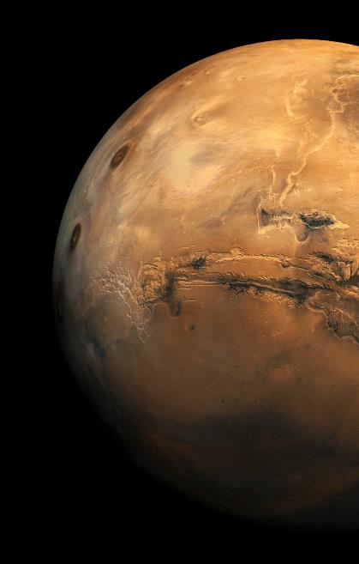
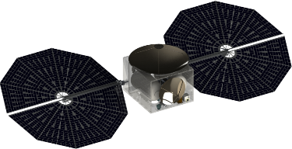

Small Spacecraft is the solution
Solution
Small spacecraft can provide low cost access to compelling science investigations at Mars.
From Mars orbit to the Martian surface/subsurface (the latter being key).
Orbiter
Scientifically Compelling
Low Cost
Technically Feasible
Surface
&
Subsurface
Mars small spacecraft can accomplish decadal class science while being complementary to Flagship missions in type of science investigation.
Mars small spacecraft can get to Mars for costs of ~$100M - 300M including phases A to D and the launch costs.
Mars small spacecraft can meet mass/volume constraints that allow reaching Mars via “rideshare” launches to GTO and/or new classes of small commercial launch vehicles.

Slide 14
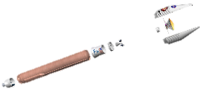


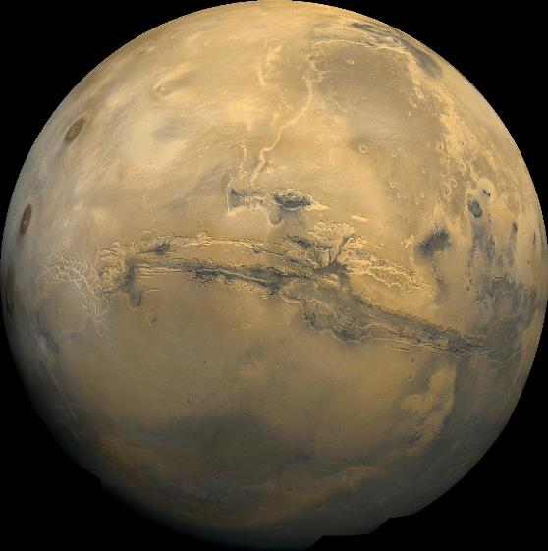




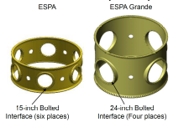

Three Key Methods to Get Small Spacecraft to Mars
Piggyback to Mars
  Pro: Cheap, direct delivery
  Con: Few reliable options
Earth Rideshare + Propulsion
  Pro: Cheap, lots of options
  Con: Secondary, need propulsion
Dedicated Launch
  Pro: Custom, full control
  Con: Kick stage, low TRL
MarCO
Flyby or
MOI
M2020 (2020)
Psyche FB (2022)
MSR (2026?)
IceMapper (2026?)
Beyond???
Mass: varies
Frequency: > 2 years
MarCo 2018
DS2 1999
Mass: 100-400 kg
Frequency: > 6 per yr
ESPA
Ring
Primary
LV Adapter
Many small LVs are in development with > 1000 kg to LEO . Firefly + solid motor would be capable to reach Mars. Others may follow.
Mass: 100-300 kg
Frequency: 2021+
Firefly Alpha
Can be used with EP
for delivery to orbit, or ballistically for direct entry
Notes:
Piggyback
Release after launch
Release prior to arrival
(Not included in the chart - for landers) Release during EDL or after landing – these devices should be considered “detachable instruments”.
Small launch vehicle + a solid motor. So far Firefly is the only one that seems to be capable to lift about 1000 kg to LEO, or with a STAR30 about 200 kg to Mars. But there are other emerging small LVs such as RocketLabs, VOX/Virgin, Astra, et al. Firefly status: We visited Firefly in September. CDR planned in January, USAF and NASA/LSP are invited. Funded through the 1st launch planned for end on 2019.
Rideshare 2ndary P/L on ESPA – the most promising option

Slide 15
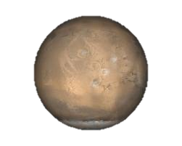

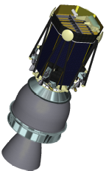
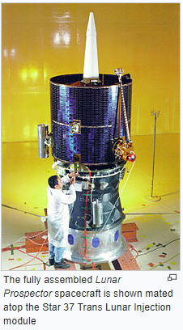
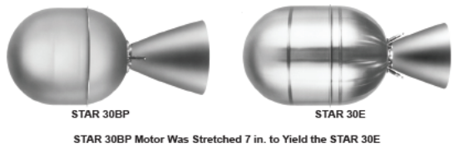
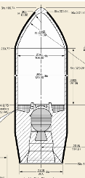



Promising Small Launch Vehicles for Mars
Company | Rocket | Cost | 1st Launch | Fairing | LEO | Mars Entry* | LMO* (w/ AB)
FireFly | Alpha | $15M | late 2019 | 2.0 | 1000 kg | 200kg | 130 kg
Relativity Space | Terran 1 | $10M | late 2020 | 1.9 | 1250 kg | 250 kg | 160 kg
ABL Space | RS1 | $12M | late 2020 | 1.8 | 1200 kg | 240 kg | 150 kg
*Additional “kick” stage required for Trans-Mars Injection
Assumptions
Use STAR 30E kick stage
May need to be stretched
20 kg for adapter
300 km LMO uses biprop to 24hr orbit
6 mos. for aerobraking
Lunette Concept (2009)
Star 27, 2 km/s LOI

Slide 16

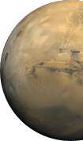

Path to Mars Orbit Via Rideshare
GTO
C3=0 (escape)
Deimos (20,000 km)
GTO
Vinf = 0 (capture)
Areo (17,000 km)
Phobos (6,000 km)
SEP
Chemical
SEP Delta V ~ 9.5 km/s
LMO (300 km)
2.8 +/- 0.7 km/s
5.7 km/s
1 km/s
200 - 500 days
350-600 days
30-80 days
1-1.5 km/s
770 m/s
80-200 days
LV
2.5 – 3.3 km/s
C3 ~ 10
Vinf ~ 3
200 - 400 days
LV “Disposal”?
Areo
1900+ m/s
A possible Lunar gravity assist Flyby may save about 1 km/s. Not included in the baseline.
Incl. plane change and orbit transfers
~1200 m/s
Ballistic Coast
1200 m/s*
Rigid constraints on date and orientation!
*Includes ~6 months aerobraking
2300 m/s
SEP delivers ~60% more mass to High Mars Orbit
Inclination constraints
Notes:
Notes:
ΔV’s are approximate; ΔV’s don’t necessarily add, especially with SEP; SEP ΔV’s based on 300 kg and 45 mN
Most values require proper Earth-Mars alignment (i.e. Launch/arrival dates)
Positive C3 departures require correct asymptote (i.e. stringent constraints on the launch geometry), C3=0 does not

Slide 17
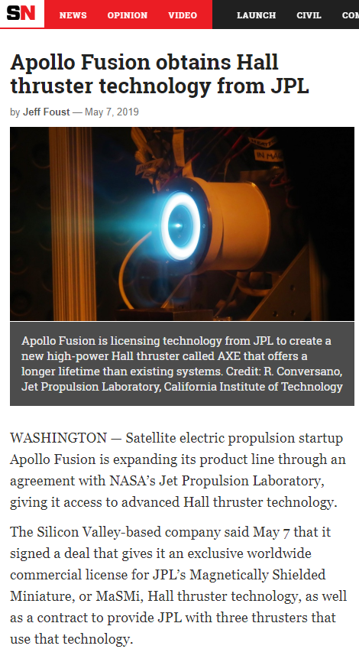
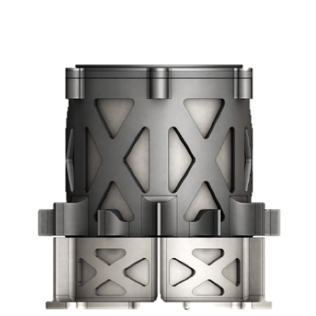
MaSMi (AXE) Interplanetary EP Thruster
MaSMi thruster ideally suited for small EP missions to Mars
  Magnetically Shielded Miniature Hall Thruster
  Developed and tested at JPL
  Recently licensed to Apollo Fusion for production (labeled Apollo Xenon Engine or AXE)
Shielding → 10x lifetime vs. conventional Hall
Lifetime: 10,000+ hrs
Production: 2020
Mass: < 5 kg
Xenon: 200+ kg
Max Power | 1075 W
Min Power | 160 W
Isp | 1935 s
Thrust | 69 mN
Efficiency | 51%

Slide 18
How to do it small?
What mission concepts?
What science?
Why Mars?
Last thoughts & summary

Slide 19
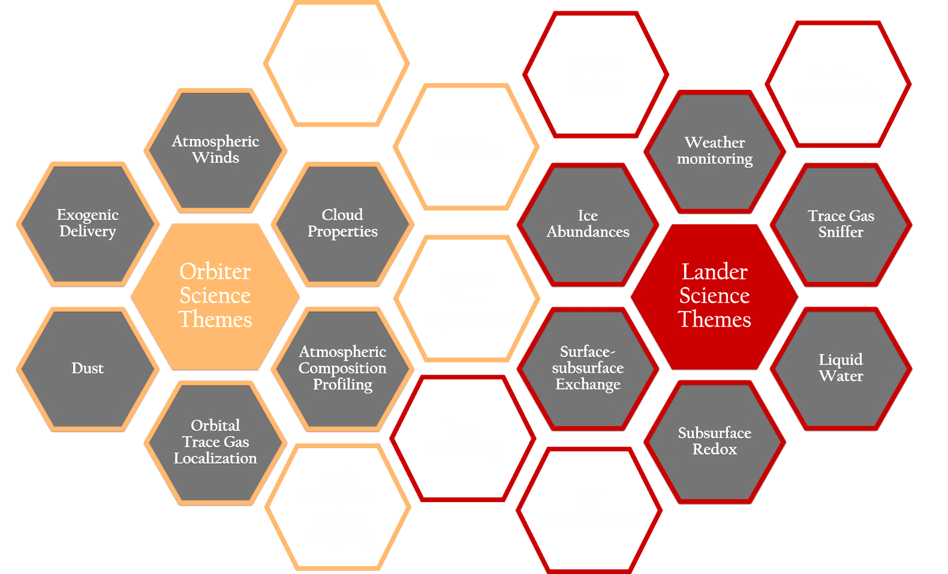
Compelling Science from Small Spacecraft
Fundamental & New Single Measurements
Targeted Science
One instrument drives all.
Special Landing Zones are Enabled
3D/4D is the Science
Global Coverage
Networks
Causality
Processes
Scouts
High value science at low cost, complementary to MSR.
Notes:
Note: add a MEPAG goals matrix/HEO SKGs → update for small s/c

Slide 20
Compelling Science from Small Spacecraft
Fundamental & New Single Measurements
Groundwater; EM Fields; H₂O/CO₂ Condensation at Poles; Subsurface Redox Profiles; Exogenic Influx; etc.
Targeted Science
One instrument drives all.
High Resolution Imaging (Visual, IR, Spectroscopic) for landing site selection and reconnaissance; Exogenic Influx & Chemistry; Trace Gas Sinks, Sources, and Transport; Groundwater, etc.
Special Landing Zones are Enabled
Special Locations, such as Poles, Valles Marineris, Southern Highlands, Lowest Altitude, Caves, etc.
3D/4D is the Science
Global Coverage
Networks
Causality
Processes
Scouts
Atmospheric Erosion Drivers; Trace Gas Sinks, Sources, and Transport; Weather Dynamics; Wind Dynamics; Dust & Aeolian Dynamics; Surface-Subsurface Exchange of Vapor Dynamics/Transport.
3D Seismology; 3D Radar; EM Propagation, etc.
High value science at low cost, complementary to MSR.
Notes:
NOTE: 3D can be done from orbit with one asset.
3 landed assets can cost up to 200 M.

Slide 21
How to do it small?
What mission concepts?
What science?
Why Mars?
Last thoughts & summary

Slide 22
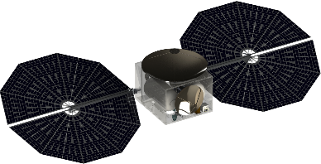

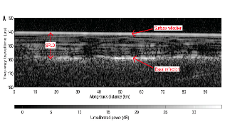

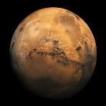
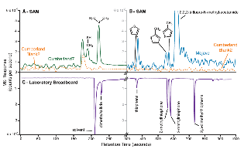
Compelling Smallsat Science
From Orbit and On the Surface
Recon
Methane?
Organics?
Groundwater?
4D: Trace gas sniffers
Orosei et al. (2018), Science
Webster et al. (2018), Science
Scouts?
Eigenbrode et al. (2018), Science
Organic Matter at Gale Crater
Areostationary
Low orbit
Notes:
Note: add a MEPAG goals matrix/HEO SKGs → update for small s/c

Slide 23
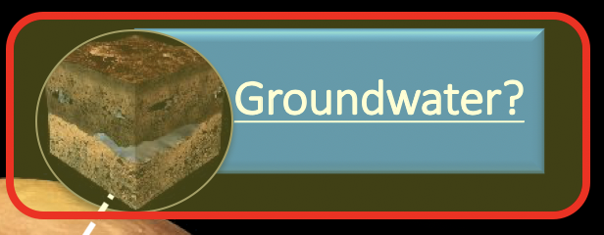
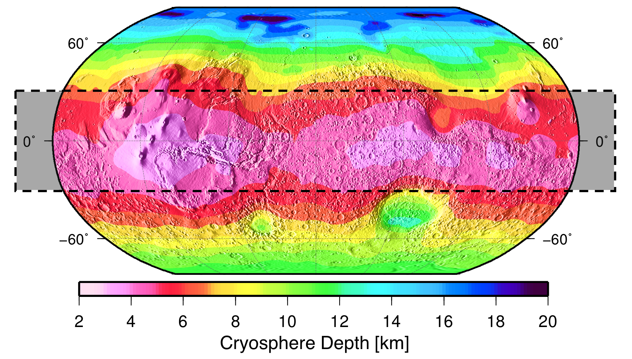
Find the water with SHIELD & TH₂OR!
PURE WATER IN THE TROPICS ~2-6 km depth
VALKYRIE proposal, Stamenkovic + 2019
Groundwater Table Depth [km]

Slide 24
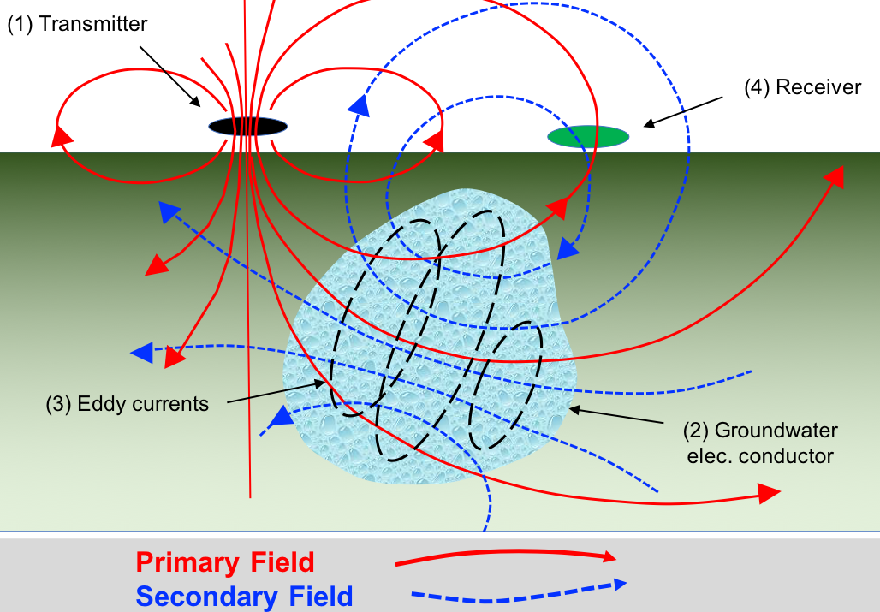
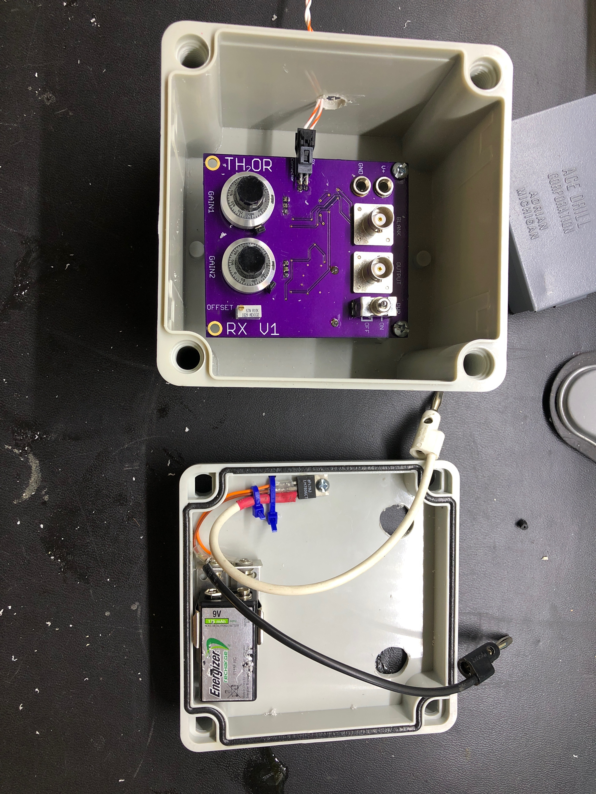
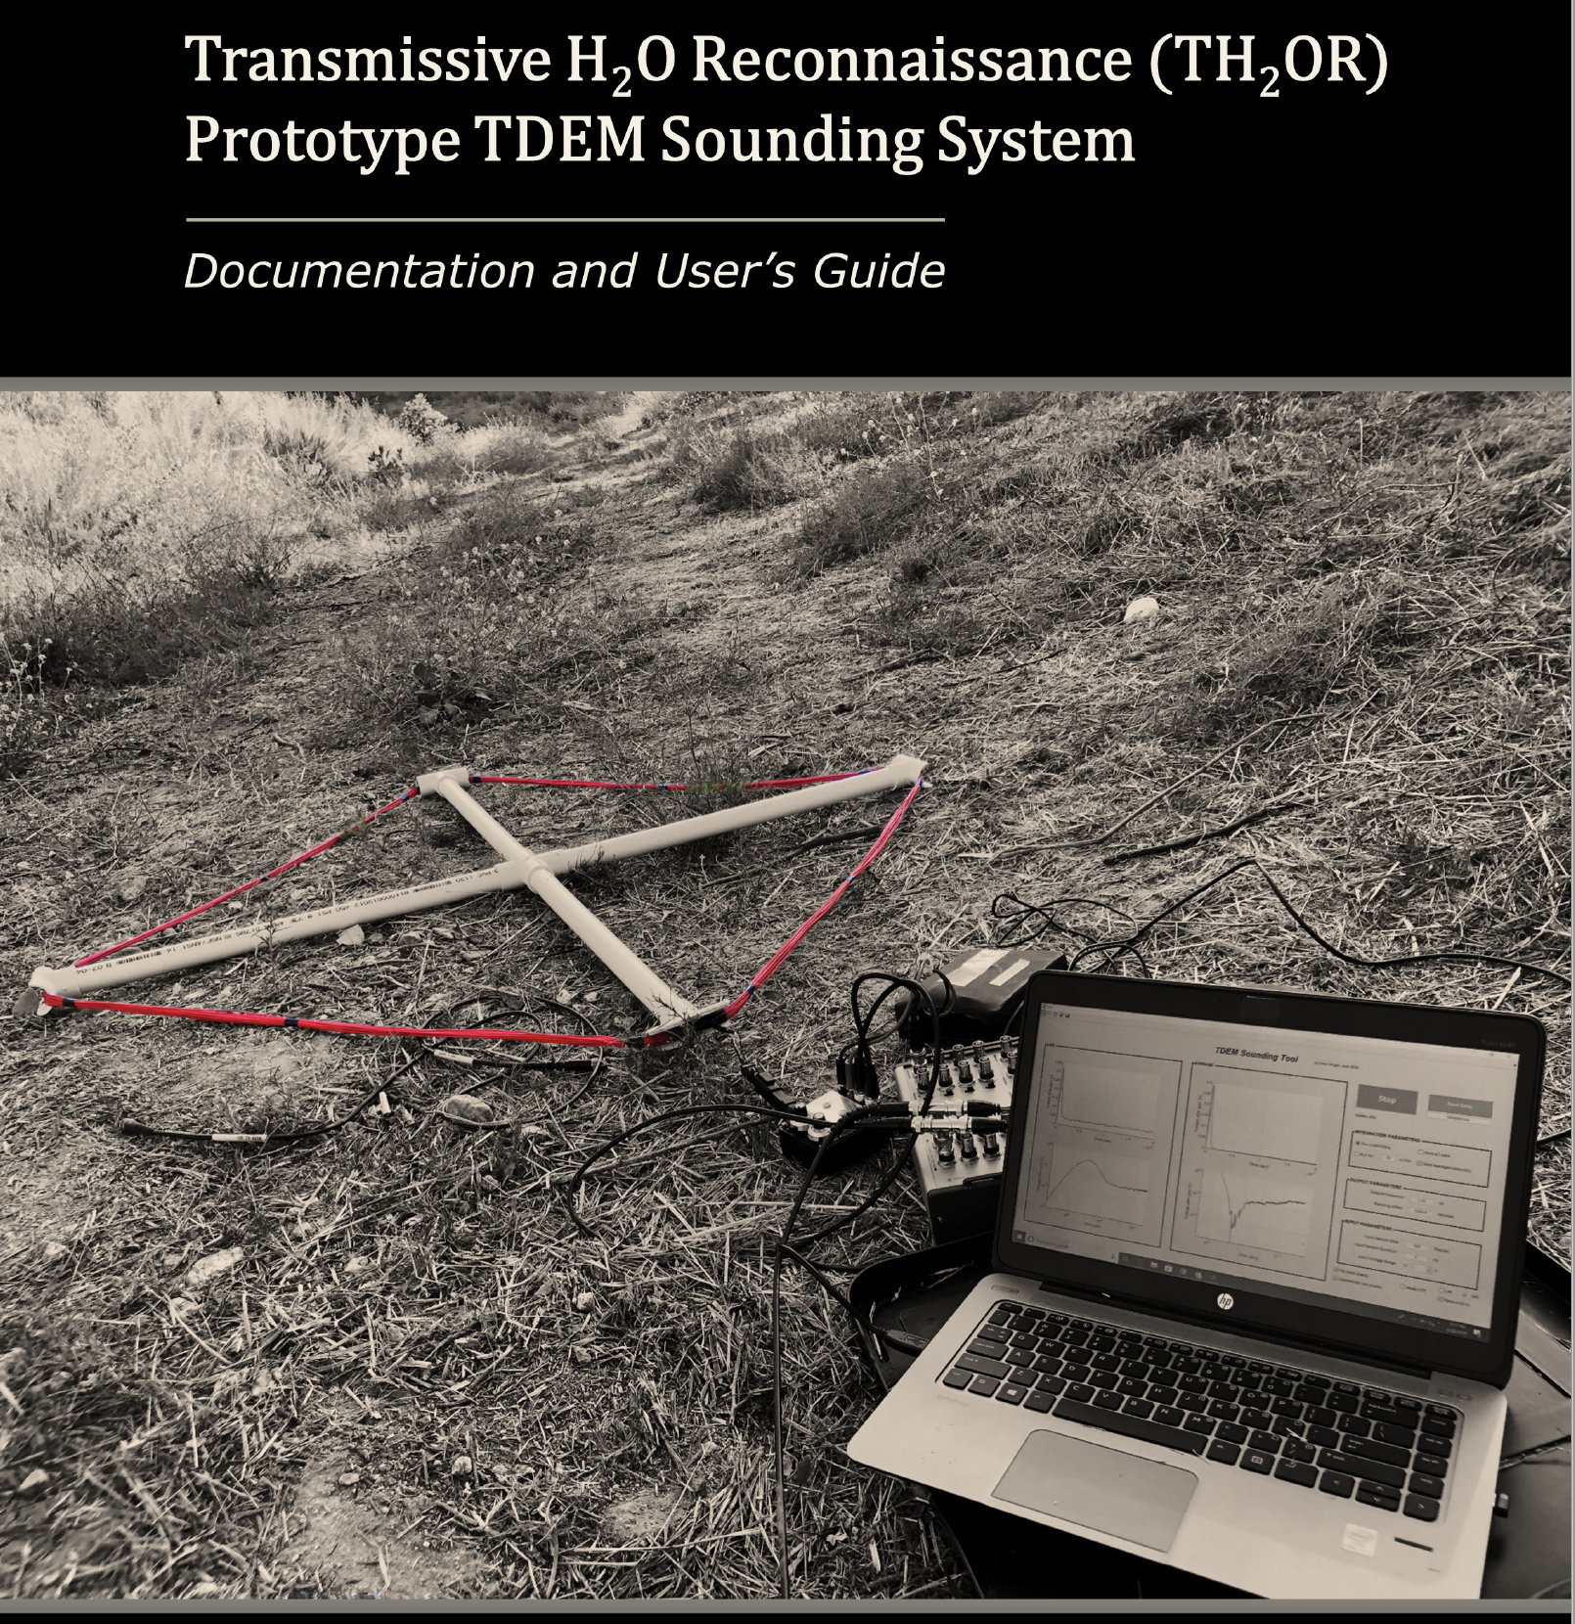



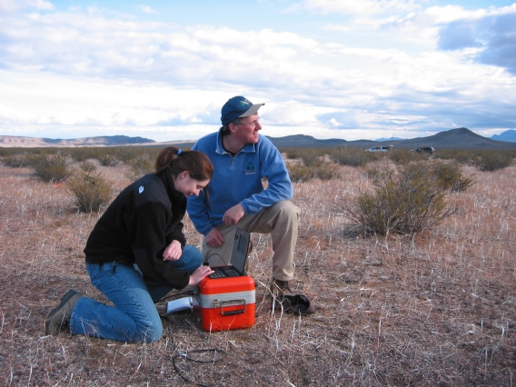

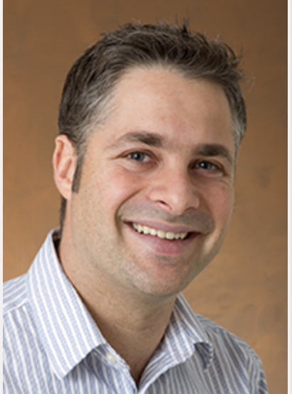




Find the water with SHIELD & TH₂OR!
Challenge: Is there liquid water on Mars? What is its composition? Could this be a modern habitat?
Objectives: Demonstrate that we can uniquely sound from the Martian surface for groundwater, expected to be at depths of kilometers, using a low-mass (<5-10 kg) and low-power (<10-100 W average) EM system and to determine its salinity.
Mars is ideal for TEM groundwater search:
 | Earth | Mars
Typical crustal conductivity | 10⁻² S/m | 10⁻⁷ S/m
Ocean water | 1 S/m
Contrast | ~10² | ~10⁷

Slide 25
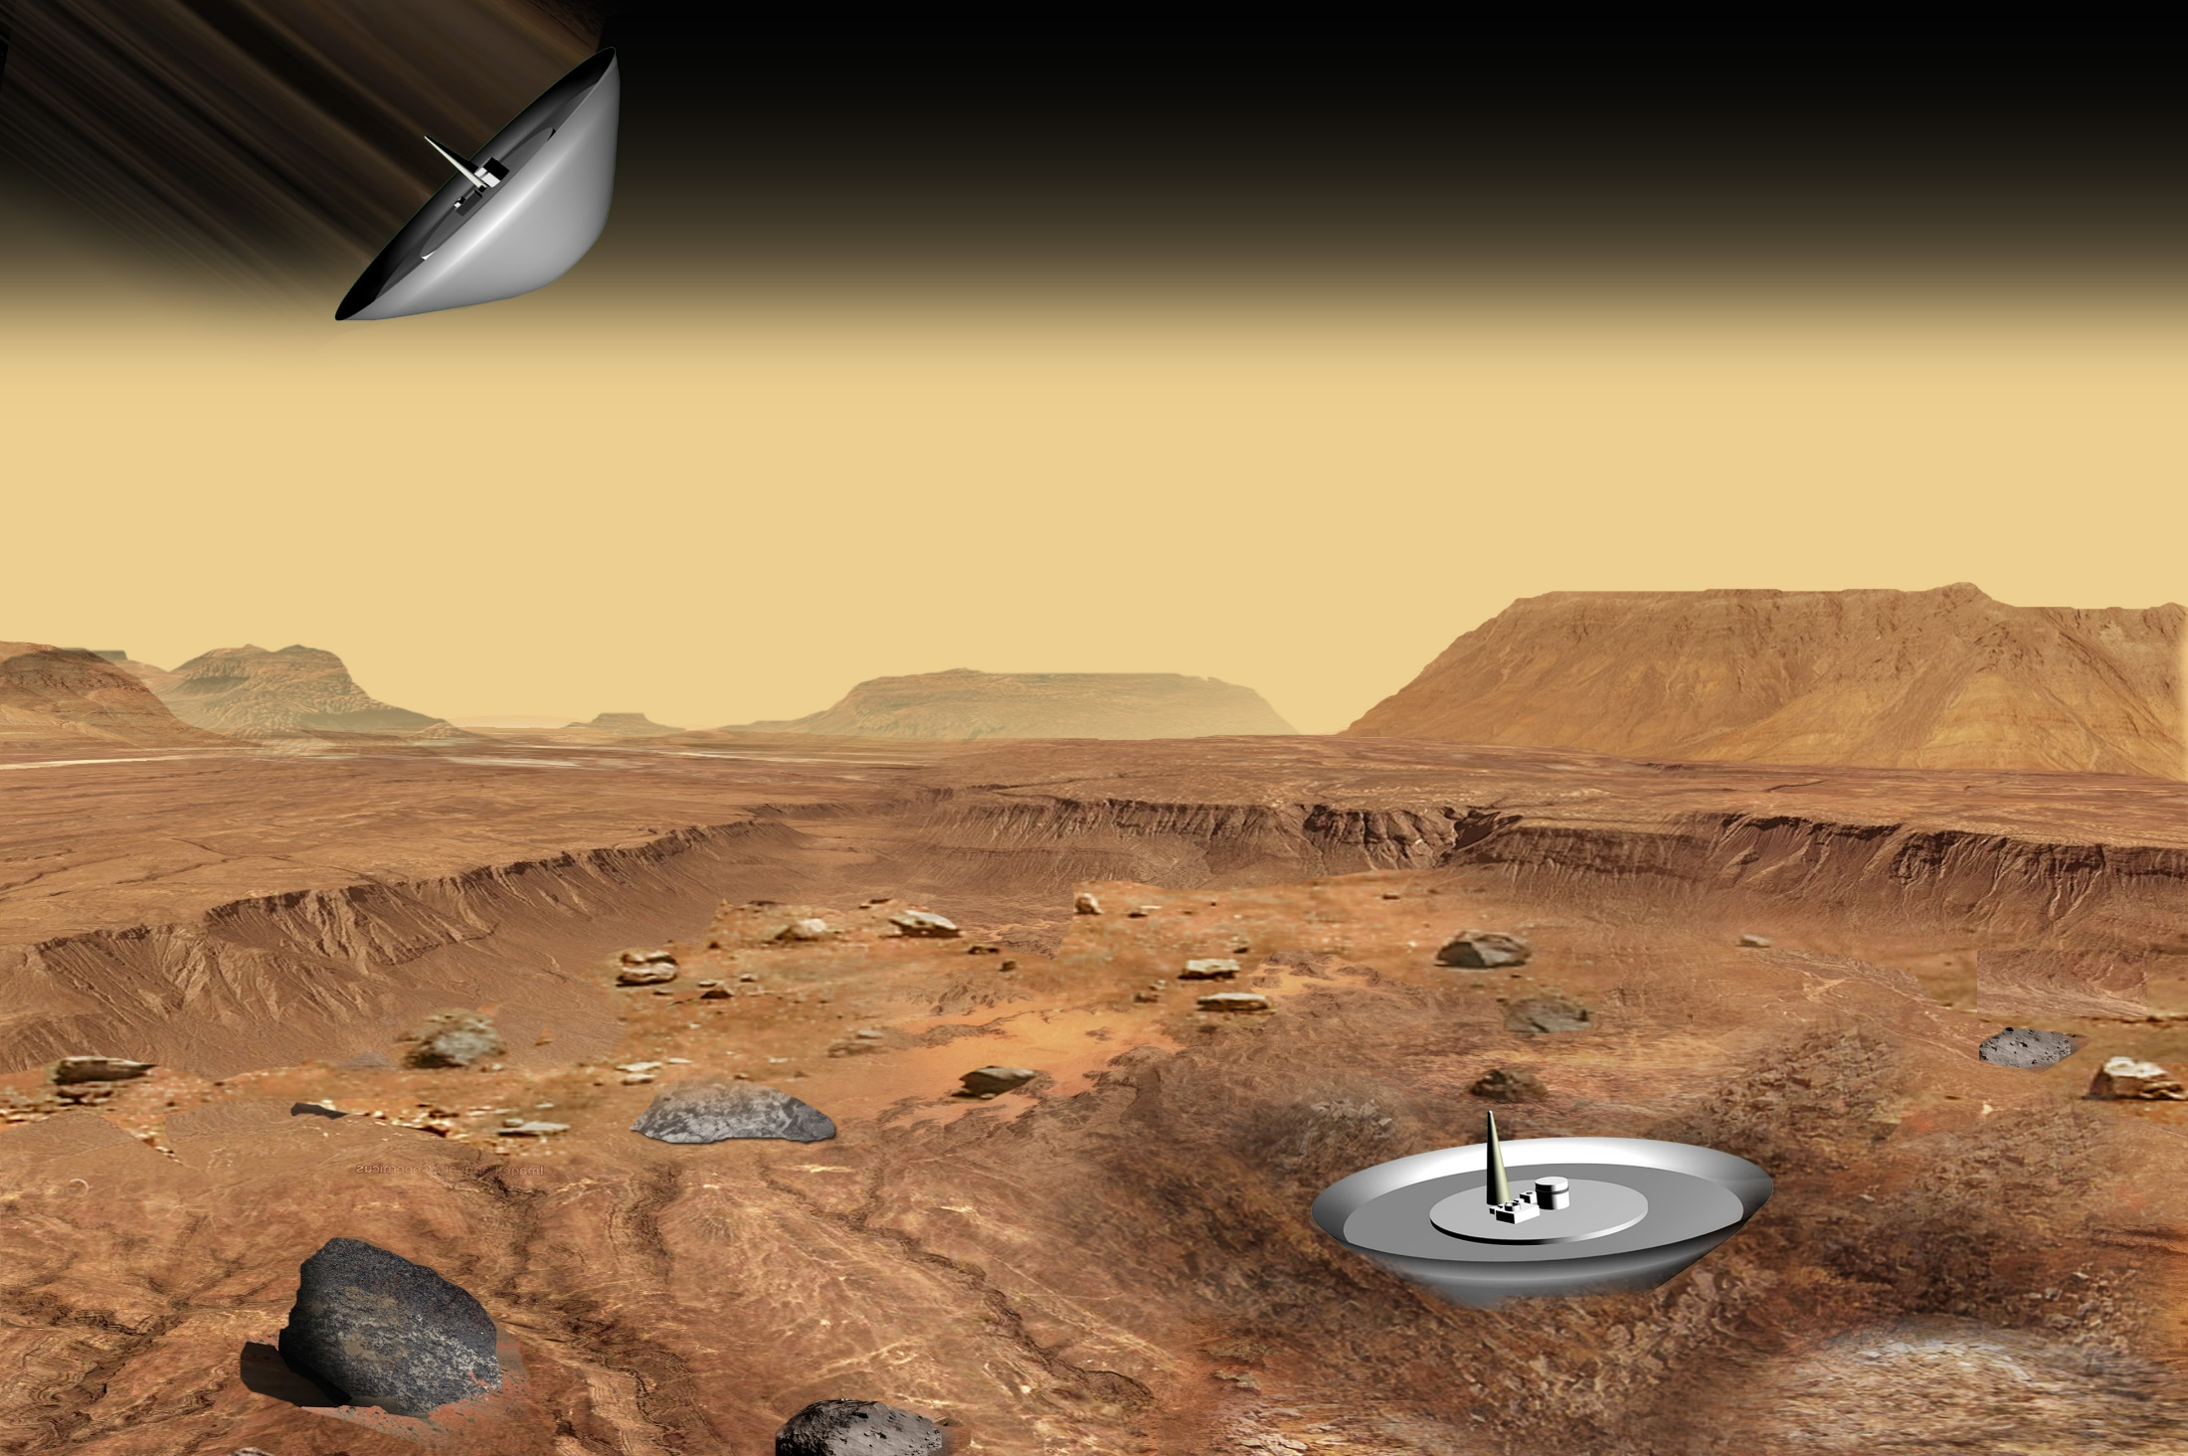
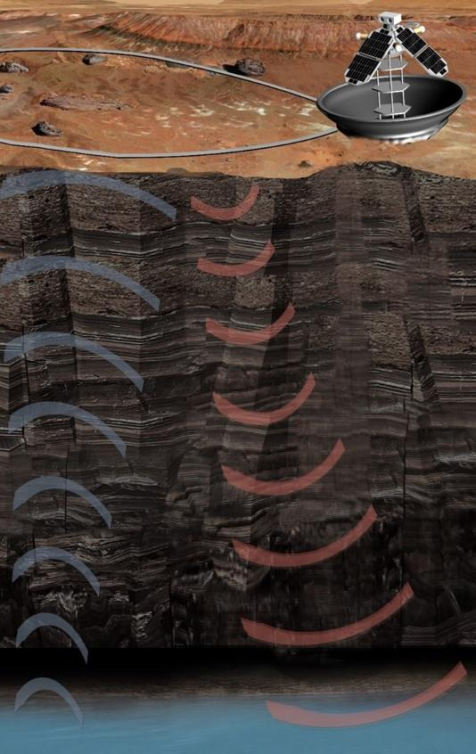
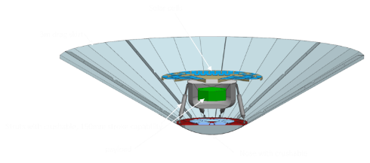

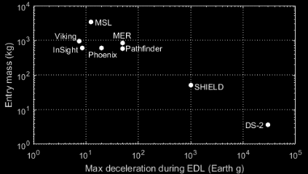
Find the water with SHIELD & TH₂OR!
TH₂OR Mission Concept
SHIELD enables the transportation of small scientific payloads affordably to the surface.
Landed Mass: 50kg
Science Payload Mass: 6kg
Impact load range 1000 g – 2000 g.
Static science platform, options for surface and aerial mobility.
Target mission duration: 90 sols to 1 Martian year (latitude dependent)
Low Cost Approach
Hosted, secondary, or dedicated P/L configurations.
No parachute or propulsive deceleration. Low ballistic coefficient to slow down.
Science Objective:
Subsurface liquid water detection using transient electromagnetic sounder.
Primary Instrument:
TH₂OR TEM Liquid Sounder; 100 m transmit loop, receive loop, detector electronics.
Secondary Instrument:
Meteorological sensors, trace gas sensors, dust sensors, and/or imager(s). Ruggedized for impact and environment
Mission Duration:
Primary -1 month, Extended -1 Mars year
Configuration:
Multiple SHIELD landers with cruise stage
Mission Design:
Ballistic trajectory, landing at equator +/- 30° latitude
5/10/20
Pre-decisional. For planning and discussion only.
© 2020. California Institute of Technology. Government sponsorship acknowledged.
25

Slide 26
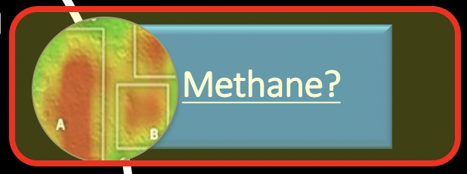
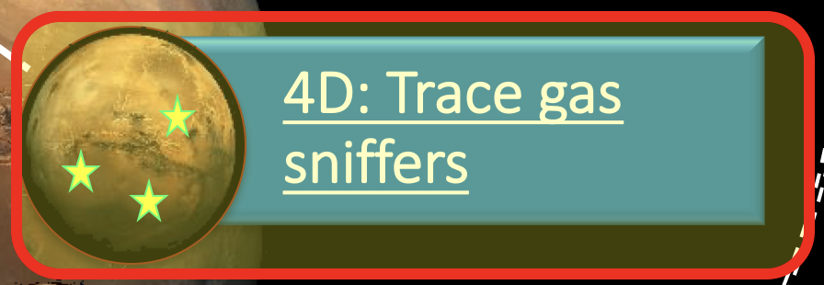
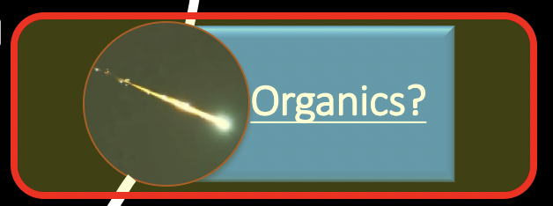
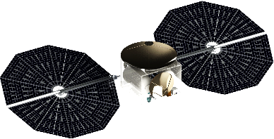







Find the source of organics
LOKI (Localizing Organic Key Ingredients)
Organics, exogenic or endogenic?
Ground CH₄, O₂ data in 4D.
Science Goal:
Measure exogenic organic influx.
Measure atmospheric CH₄/O₂/H₂O/H₂O₂ variability on the surface.
Surface Instruments:
Mini-TLS [2 (CH₄ and H₂O)-4 channels (+O₂, H₂O₂)]
Orbiting Instrument:
Widefield camera with appropriate filter (likely UV).
Mission Duration:
Primary: 1 Mars year, Extended: 2 Mars Years
Configuration:
One SHIELD lander with cruise stage, cruise stage stays in orbit as mothership
Mission Design:
Ballistic trajectory
Landing at equator +/- 30° latitude
Orbit areostationary
Localize the sources and sinks for methane and organics on Mars.
Science Objectives:
LOKI

Slide 27




Global Monitoring & 4D science
The Example of Areo-TGL
4D SCIENCE
Constellation
Science Objective
Localization and diurnal concentrations of methane and water and its isotopologues.
Features
Mass: ~190 kg dry mass
Target: Mars – Areostationary Orbit
Instrument: Spacial Heterodyne Spect.
Configuration: Single s/c, constellation
Launch: Secondary P/L on ESPA Grande
Cruise: Solar electric propulsion
Risk Class: D
Lifetime: ~3 years in orbit then replenished
Telecom: Ka-Band, Direct to Earth, MAVEN-class data rates.
Notes:
(Telecom of up to MAVEN-class relay could be included, but it is not in the baseline.)

Slide 28
How to do it small?
What mission concepts?
What science?
Why Mars?
Last thoughts & summary

Slide 29
Summary Thoughts & Discussion
Several emerging trends are creating a unique new opportunity for compelling Mars science missions at radically reduced cost relative to Discovery
  Low-cost rideshare and new commercial launch vehicle providers
  Efficient smallsat-scale EP solutions for Mars transfer from GTO
  New small-mass instruments that can achieve decadal-class science.
  Low-complexity hard-lander concepts for Mars surface access
  $100M - $300M represents a technological “sweet spot” with high science return above current SIMPLEx $55M cap.
Opportunities?
  Refine focused Mars science mission concepts suited to smallsat implementation
  Consider smallsat missions for critical Mars infrastructure (e.g., telecom relay, hi-res recon…)
  Seek international partnerships leveraging complementary capabilities to further affordability.
  Going together massively reduces the cost/unit.
Total Mission Cost
New Smallsat Class?
SIMPLEx
Discovery
New Frontiers
$55M
$500M + ELV
$850M + ELV
0
$200M
$400M
$600M
$800M
$1B

Slide 30







Why particularly Mars for SmallSats?
Mars is especially well suited for a SmallSat Opportunity because:
Close enough to keep costs low enough to enable SmallSats to perform decadal-class science.
Hotspot for international collaboration (in the early 20ies missions lifting off from China, the Emirates, ESA, JAXA, and India; plans growing in Australia, Canada and Poland as well)
Commercial capabilities will enable soon to explore Mars: Mars as a testbed and catalyzer for commercial contributions to the exploration of Venus, asteroids and beyond.
BUT ALSO: Mars Exploration support from the Artemis program and growing HEO support for Mars Program in SMD.

Slide 31


Mars SmallSats in the 2020ties can…
Ⓒ National Geographic, 1967.
Ⓒ 20th Century Fox’s “The Martian”

