Slide 1


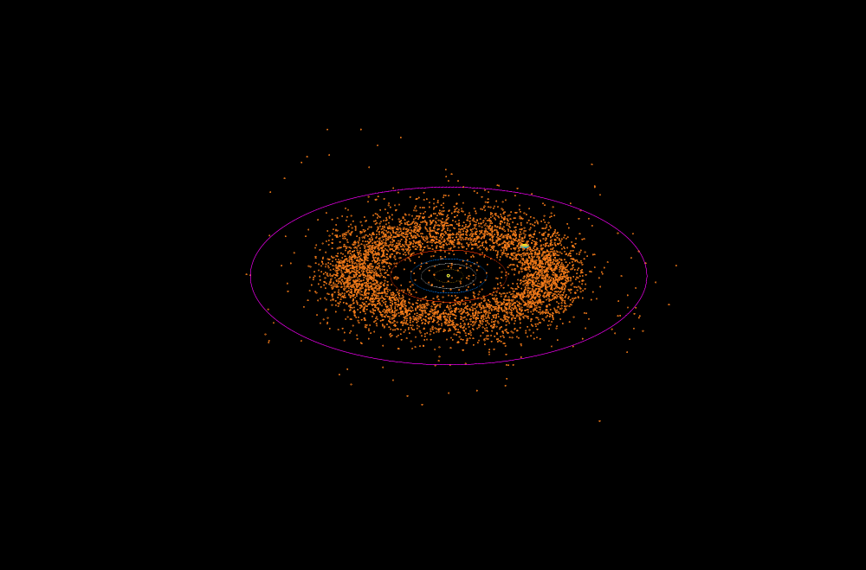
Evaluation of Mother-Daughter Architectures for Asteroid Belt Exploration
Leonard Vance, Jekan Thanga, Erik Asphaug
University of Arizona
Notes:
1

Slide 2
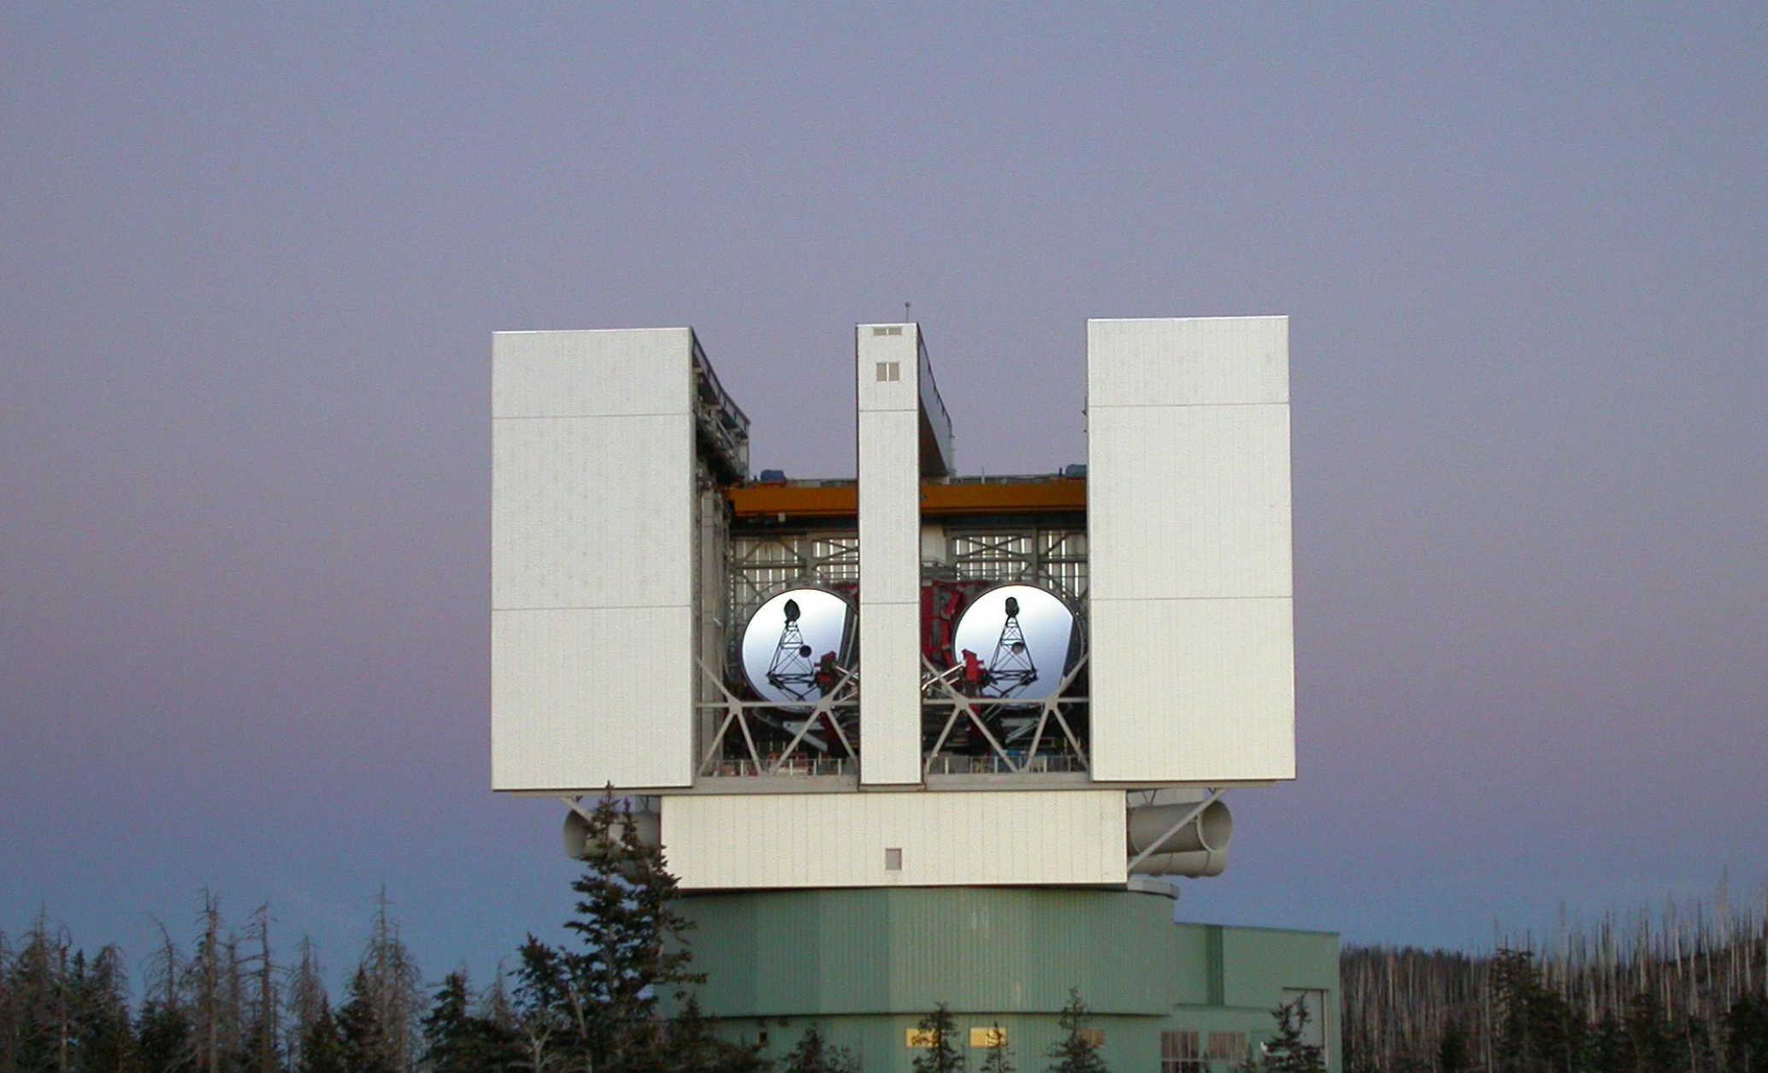
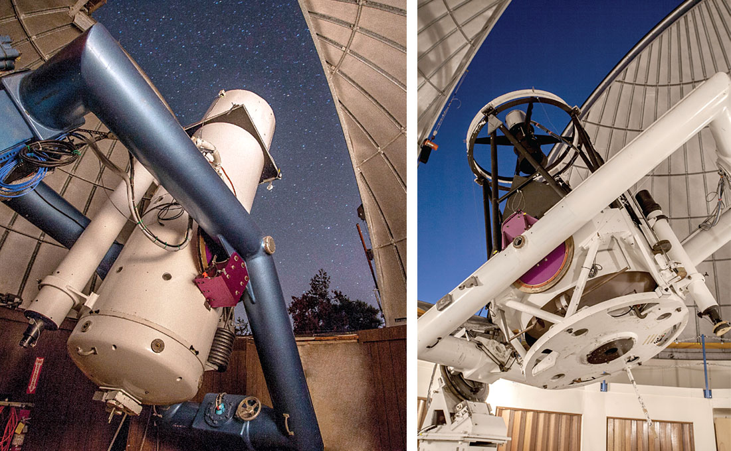
Over 700,000 asteroids are currently cataloged
- Some as small as a few meters
Each tracked asteroid represents a potentially large source of material for development.
Low gravitational potential reduces the cost of visitation.
We have little understanding of their individual composition
Large Binocular Telescope
Catalina Sky Survey

Slide 3
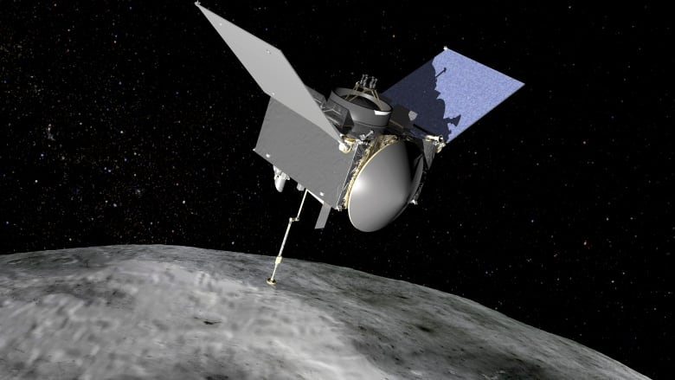
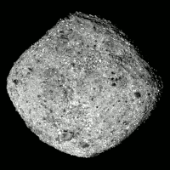
Individual sample and return missions from a significant number of asteroids allows us to understand the statistical make-up of the belt, improving in-situ resource development.
Bennu
OSIRIS-Rex Sample Return Mission to to Near Earth Asteroid Bennu

Slide 4
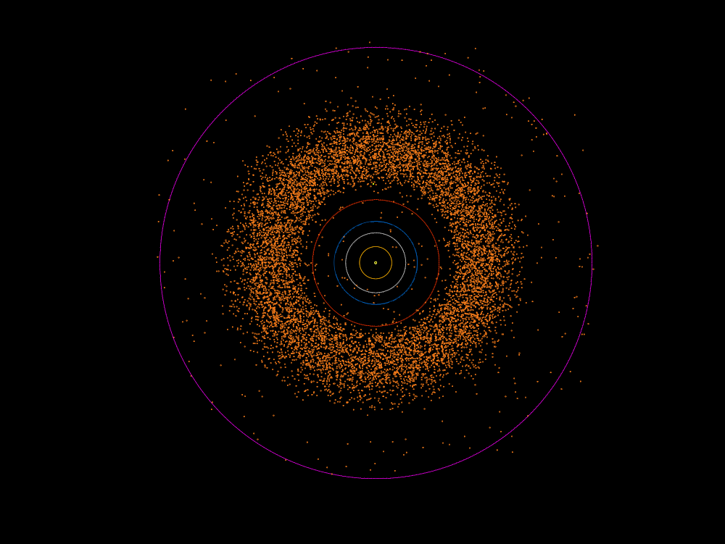
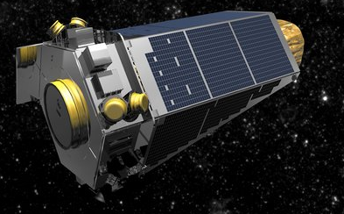
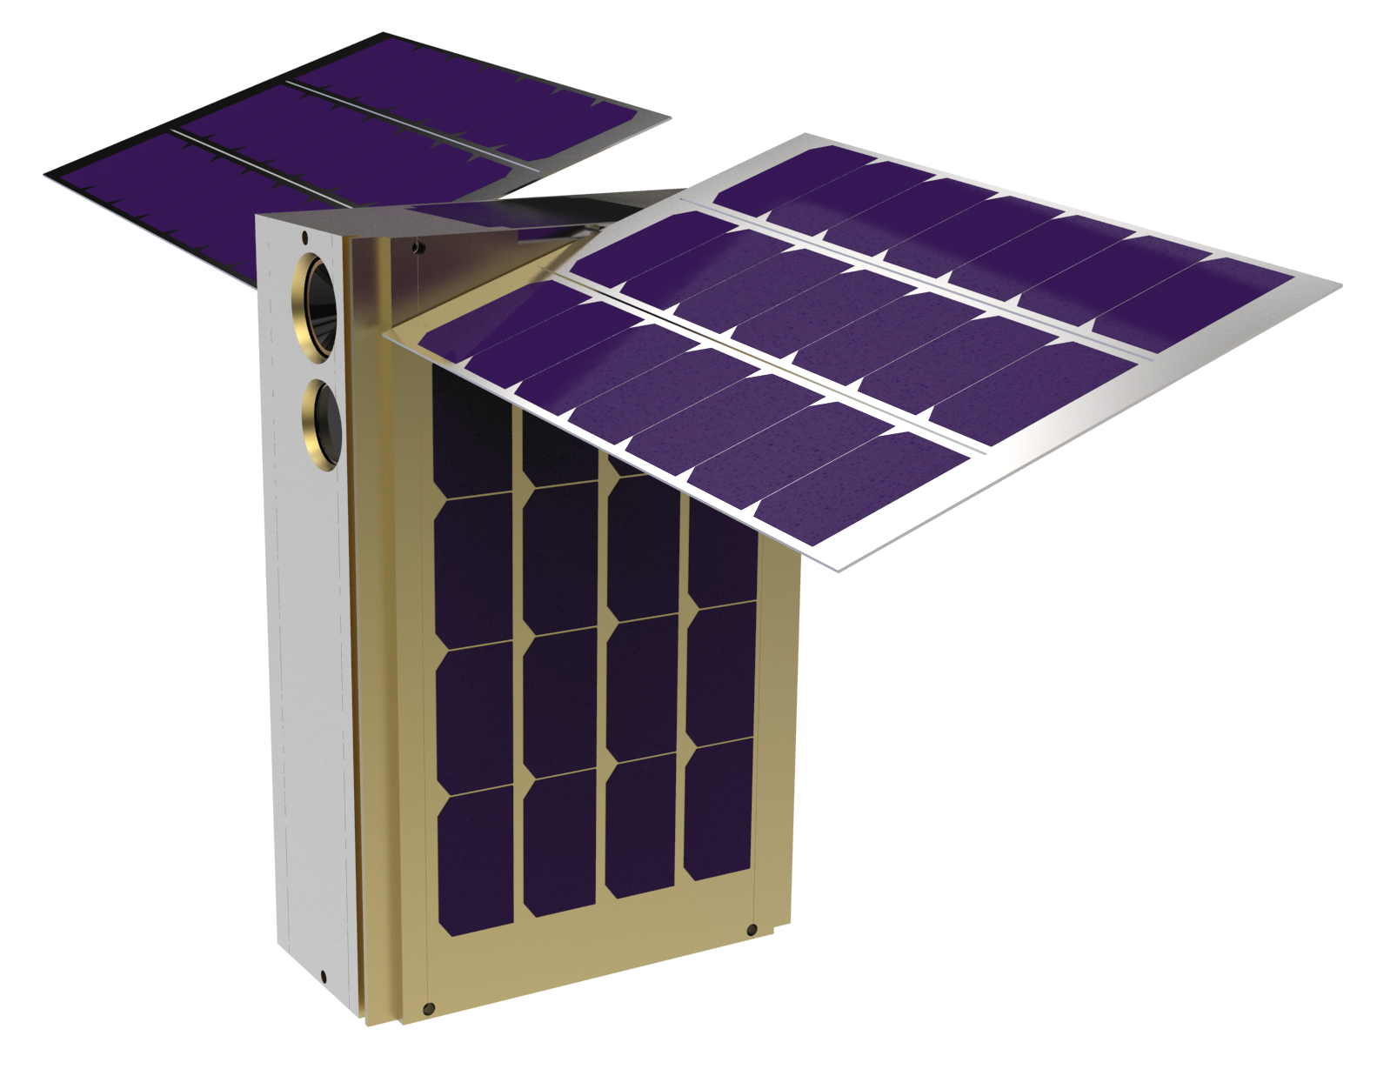
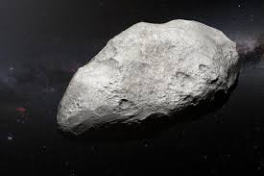
Mission Overview:
Multiple Nano-spacecraft are deployed from a mothership within the asteroid belt, each executing a sample and return from a known asteroid.
Solar System
MotherShip
Nano-Spacecraft
1) Intercept
MotherShip Trajectory
To Other
Asteroids
Asteroid
2) Brake
4) Return Brake
2 Year Mission Maximum
3) Return
Question:
How effectively can a nano-spacecraft swarm explore the asteroid belt when limited to a 2 year lifespan?

Slide 5
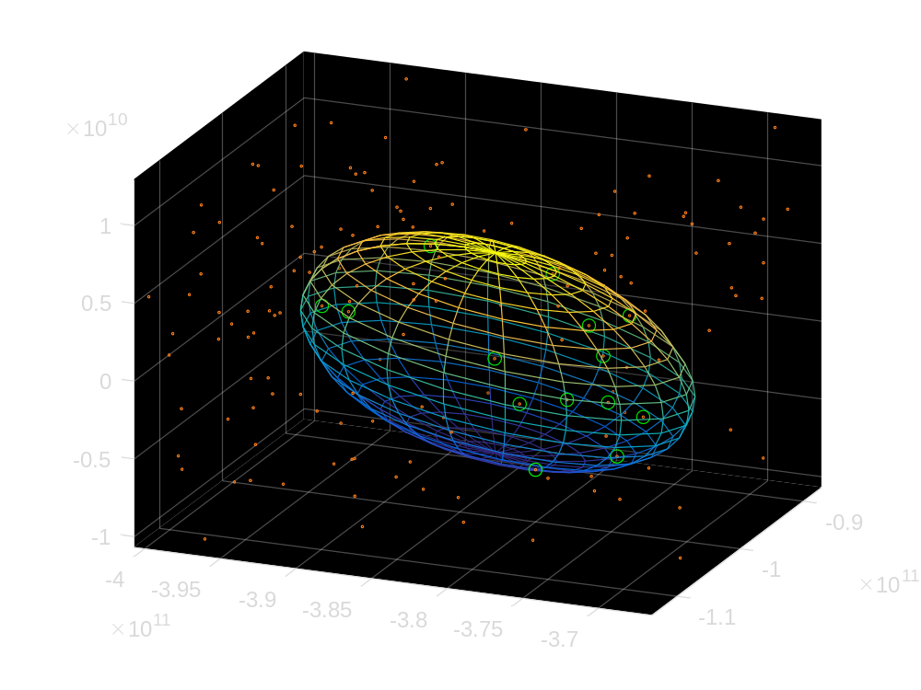
Intercept Potential is established by determining inclusion within a nano-spacecraft maneuver boundary
Inner Solar System
Mother ship in median asteroid belt
Example: 300 m/s Initial burn
1 year orbital propagation
14 asteroids within resulting volume
Maneuver Boundary
Multiple intercepts appear possible even using a small delta-V within the limited lifespan of a Nano-satellite
Next Question: What does an optimal initial orbit look like?

Slide 6
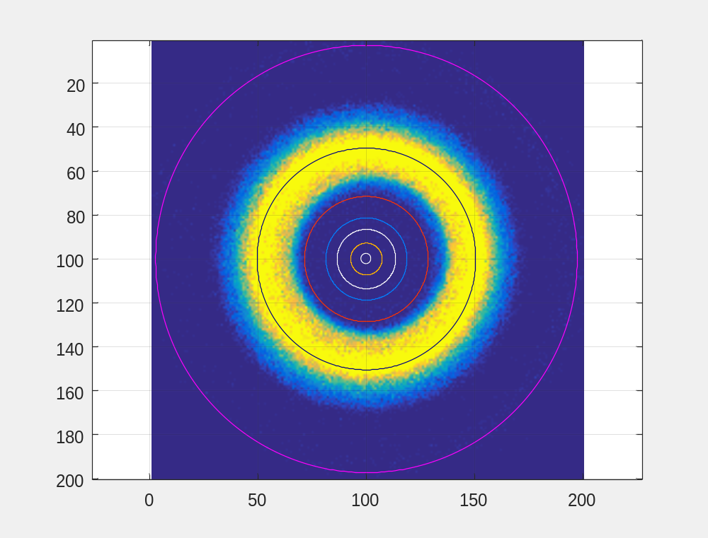
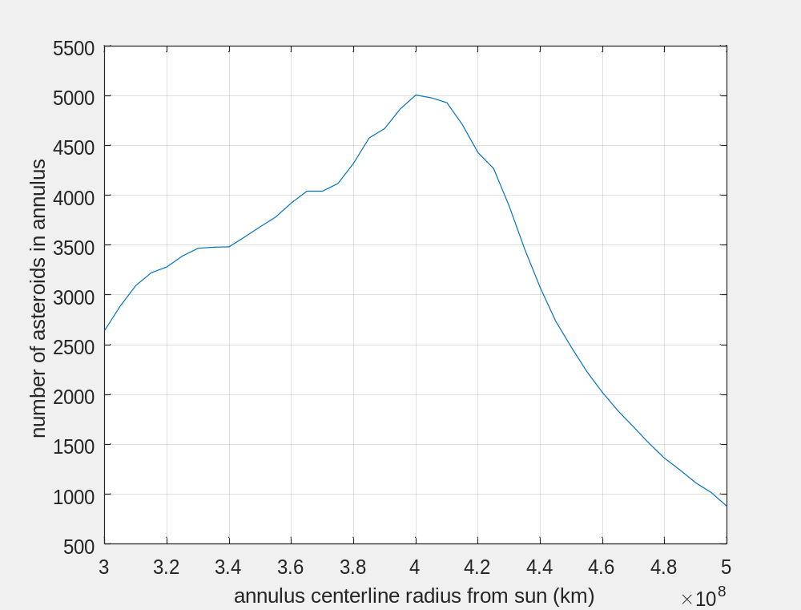
Place nominal mothership orbit at the location of highest asteroid density
Asteroid Density in Solar System
Density afo Distance from Sun
Jupiter Orbit
Chosen Altitude for Exploration
3.95x10¹¹ m
Median Asteroid Orbit
Asteroids inside an annulus with 6.46x10⁶ Km radius and specified radius from sun

Slide 7
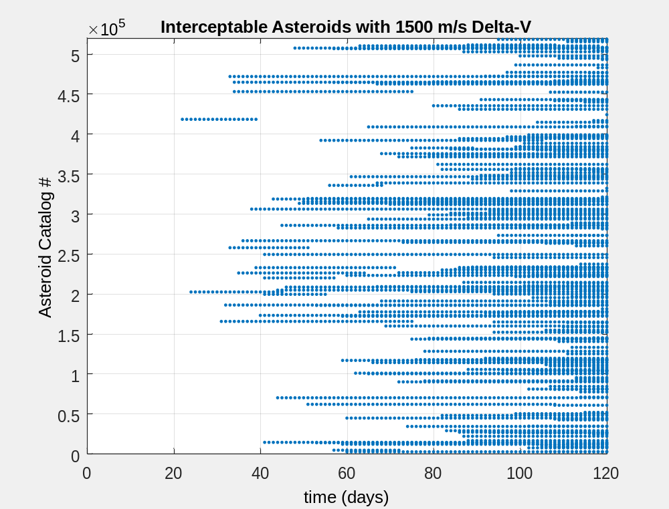
Many asteroids can be reached as nano-spacecraft flyout time increases
Hundreds of asteroids can be reached given reasonable delta-Vs and flyout times
Next Question: How much delta-V does it then take to stop and return to the mothership?
Orbit Radius = 3.95x10¹¹ m
Mothership Mean Anomaly = 0
Inclination = 0 deg

Slide 8
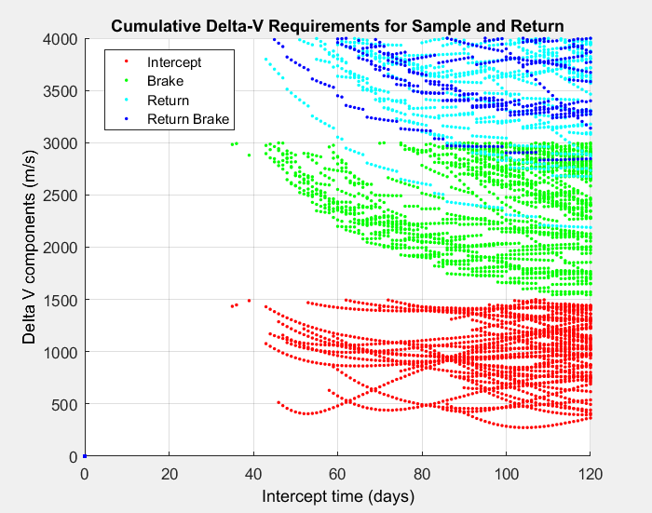
Overview of Nano-Spacecraft Delta-V components for Asteroid Sample and Return
1500m/s limit imposed on intercept
3000m/s limit imposed after braking to halt
Asteroid entering kinematic boundary
Minimum Sample and Return Delta-V
In this epoch
Min. Delta-V to Intercept
Combining elements of the sample and return flight provides an initial assessment of the total Delta-V necessary

Slide 9
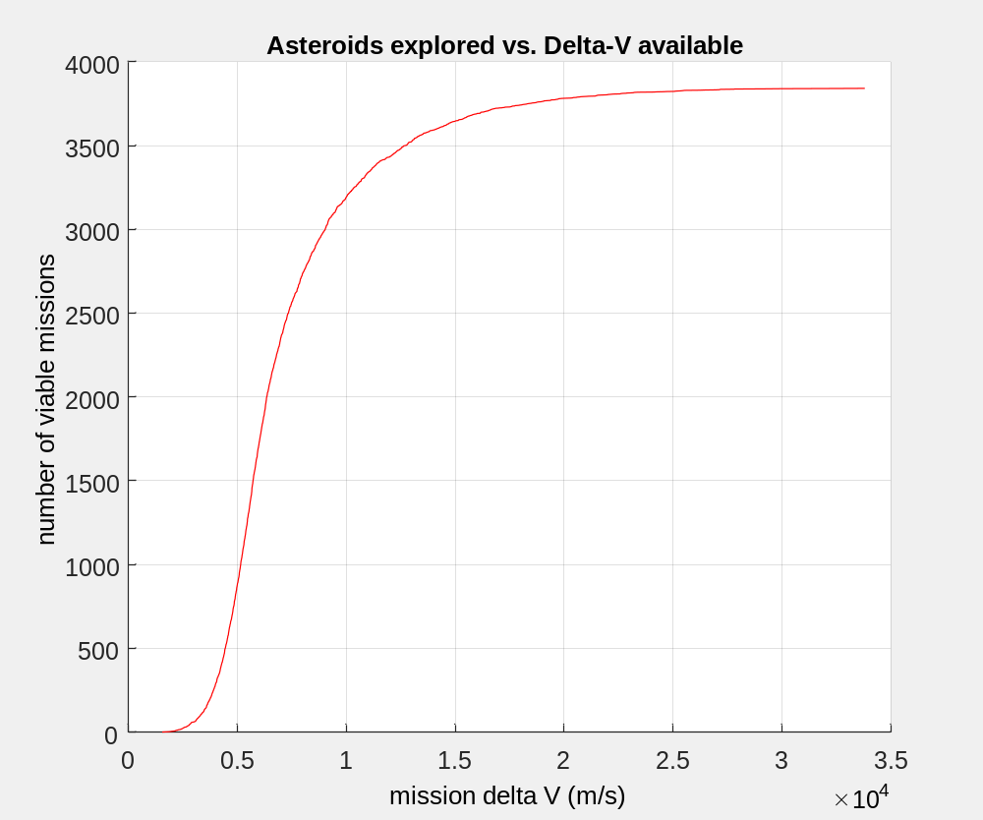
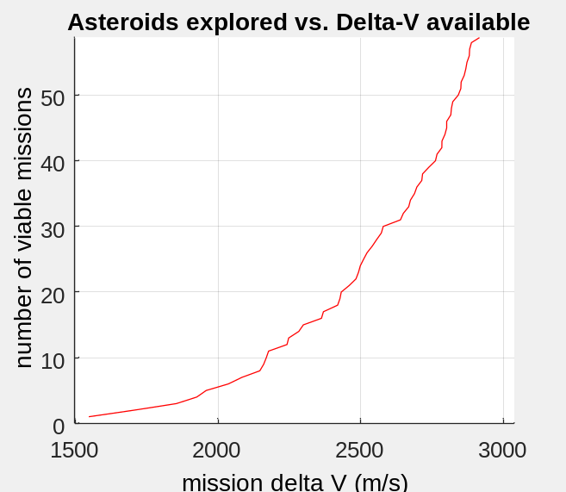
Number of viable missions rise quickly as nano-spacecraft delta-V increases above 2000m/s
A cutoff at 2500 m/s total mission delta-V provides 23 mission opportunities
Nano-spacecraft limited to 2 year lifespan
Nominal Baseline
(2500 m/s)

Slide 10
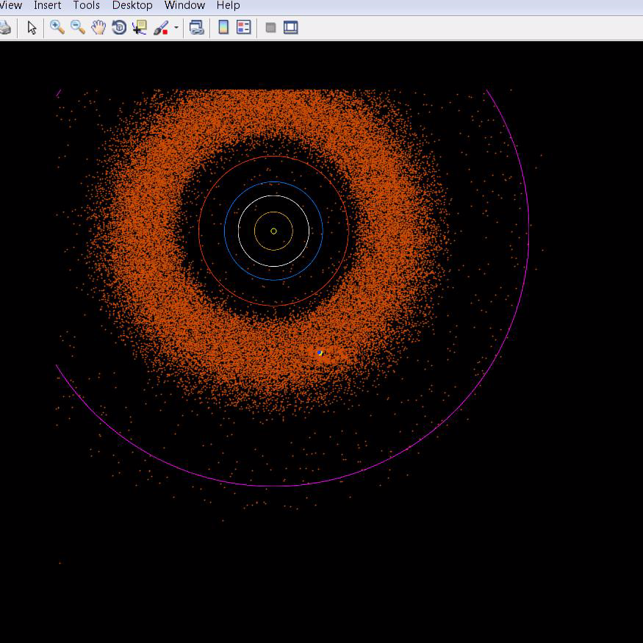
Mission Example:
2 year lifespan limit
2.5 km/s delta-V per spacecraft
Mothership in median Asteroid orbit (yellow)
All nanospacecraft launched at beginning of epoch (Blue)
All nanospacecraft return at two years
23 Asteroids sampled

Slide 11
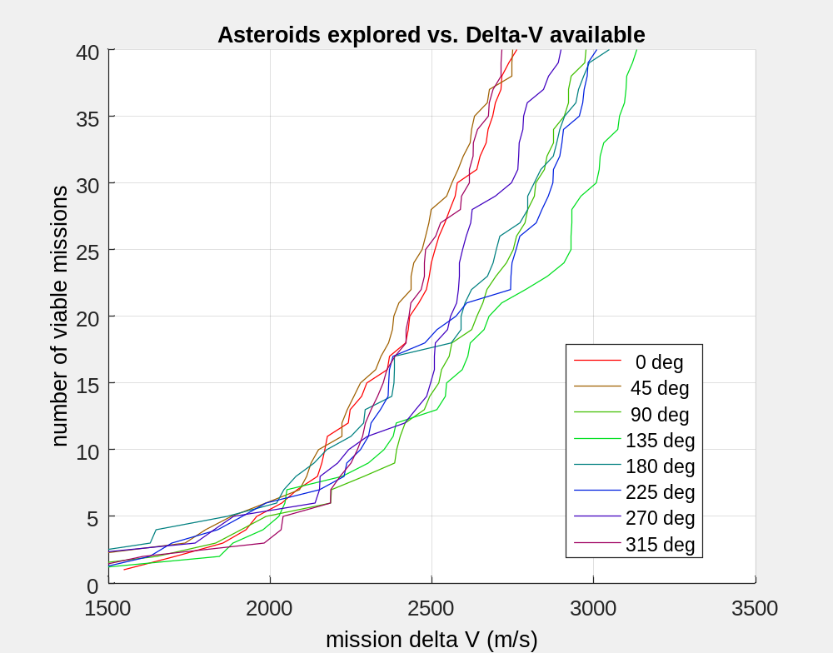
Choice of initial orbit anomaly can significantly effect mission opportunities
A factor of two difference depending upon the choice of initial phase of orbit.
2 year lifetime assumed
Range of available potential sample and return missions
mothership initial mean anomaly

Slide 12
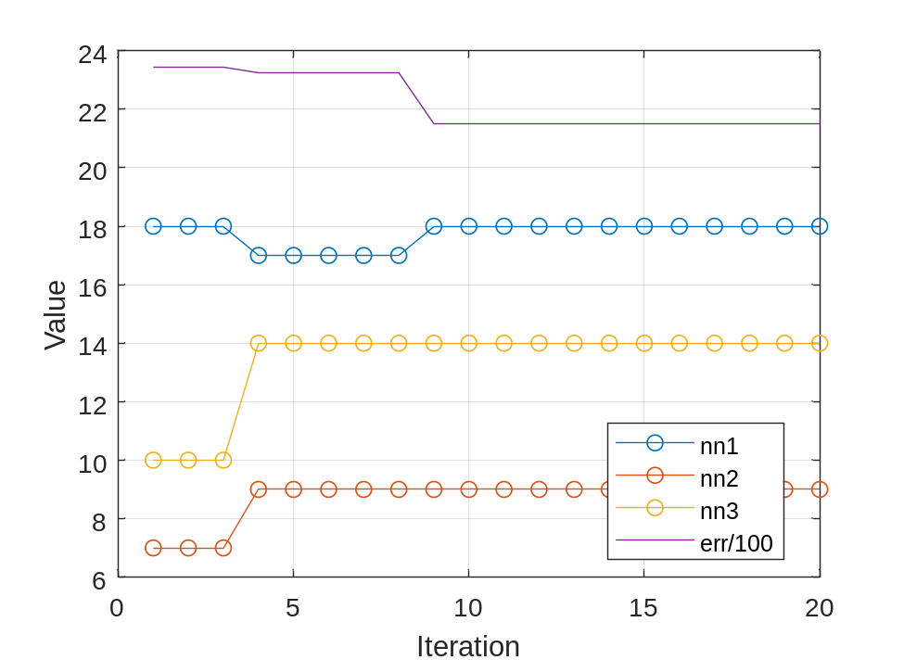
Establishing number of missions for each location is computationally intensive
    - Only 8 points derived for 6 hours of CPU work
Use of a neural network to approximate delta-V calculations could significantly improve speed
Process:
Sample random asteroid pairs
Throw out pairs which are more than 1 AU apart
Bootstrap until 500,000 pairs are selected
Use conventional Computation to calculate sample and return Delta V for each of those 500,000 pairs
Provide this database as input to a Neural Net for supervised training
Run trades on number of hidden layers and nodes in each layer to establish best performance
Optimization of Number of Nodes for a 3 layer Configuration

Slide 13
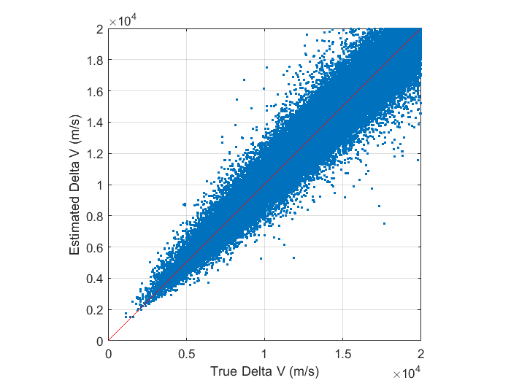
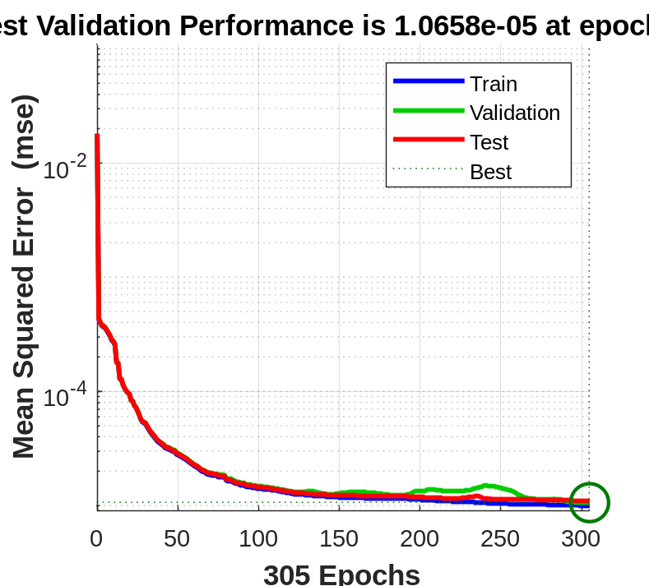
Input
Hidden Layer 1
Hidden Layer 1
Hidden Layer 1
The chosen 3 layer configuration provides a respectable estimate of sample and return delta-V
w
w
w
Output
TanSig
TanSig
TanSig
12
+
+
+
b
b
b
1
18
9
14
a = tansig(n) = 2/(1+exp(-2*n))-1
Training Error History
Actual vs. Estimated Delta-V

Slide 14
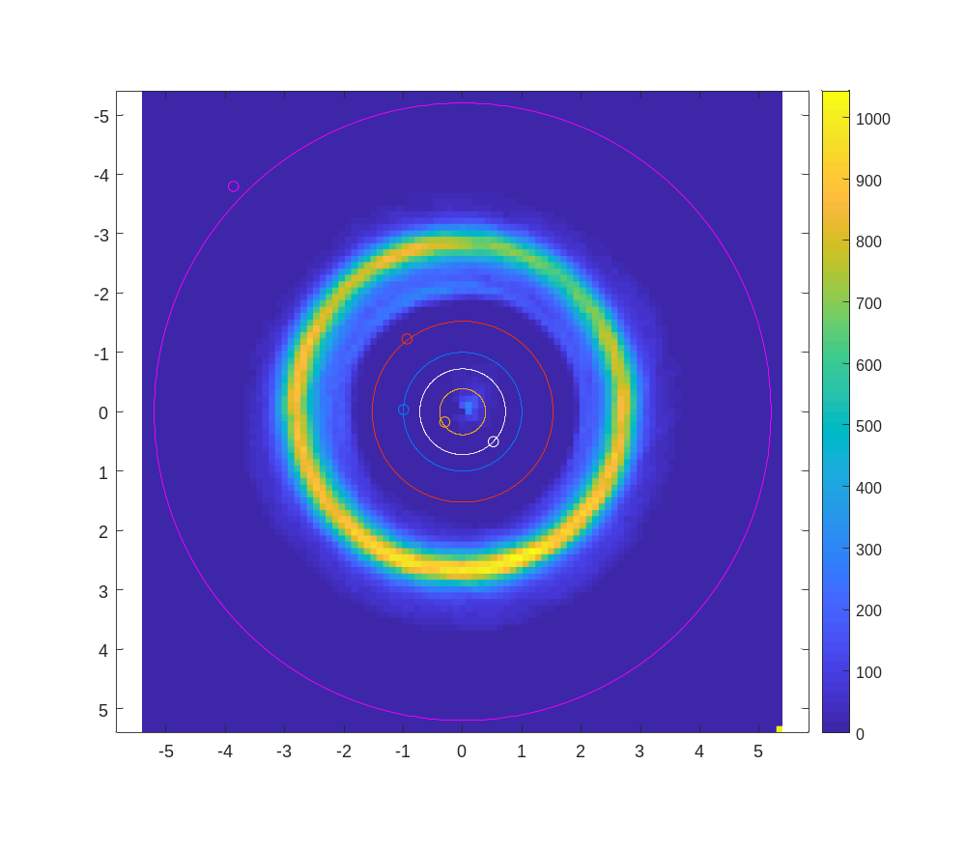
Sample and Return Missions Available
# of Available missions
Neural Network Delta-V approach increases calculation speed by over 1000x
Sample and Return opportunities from a Mothership can now be mapped over the entire solar system
2 year nano-spacecraft lifetime
5 km/s delta-V per spacecraft
Assume mothership circular orbit
Julian epoch 2458200.5 (March 2018)
Max = 766
Heliocentric Y coordinate (AU)
Heliocentric X coordinate (AU)

Slide 15
Conclusions and Summary
The large number of tracked asteroids suggests use of swarms for exploration
The Delta-V required to enable large scale sample and return from a single mothership is approximately 2.5 km/s
A two year nano-spacecraft lifespan is adequate for this approach
Large scale sample and return exploration of asteroids is plausible with nano-spacecraft utilizing single stage propulsion

