Slide 1


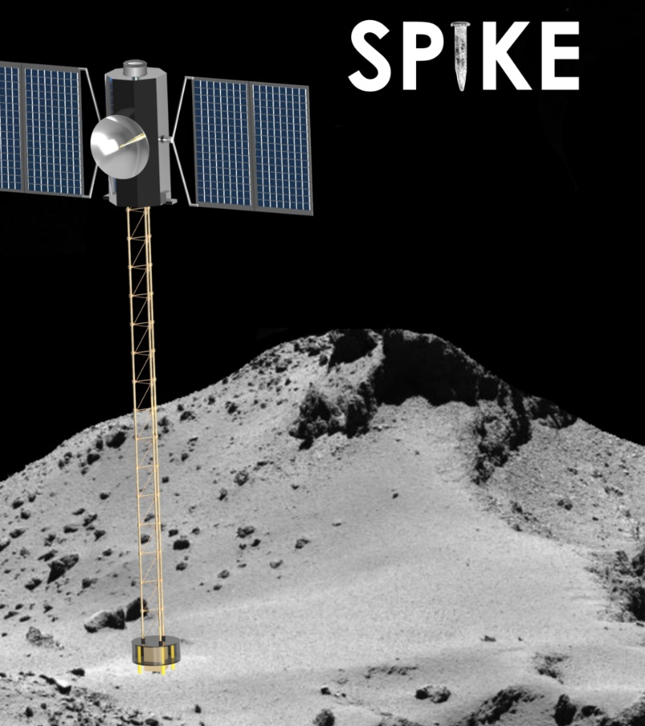
GUIDANCE, NAVIGATION AND CONTROL OF SPIKE FOR DESCENT, LANDING AND HOPPING ON AN ASTEROID
Himangshu Kalita, Jekanthan Thangavelautham
Space and Terrestrial Robotic Exploration (SpaceTREx) Laboratory
Aerospace and Mechanical Engineering Department
University of Arizona

Slide 2
Outline
Introduction
SPIKE Spacecraft
Mission Concept
Asteroid Dynamical Environment Modeling
Spacecraft Dynamics Model
Descent Phase Simulations
Landing Phase Simulations
Hopping dynamics
Conclusion

Slide 3
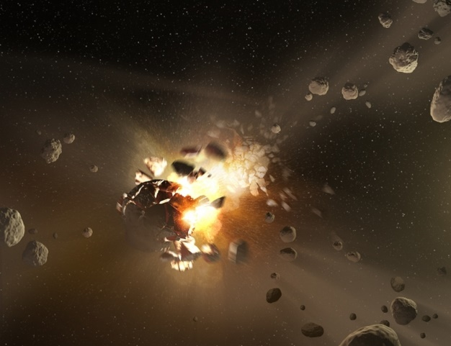
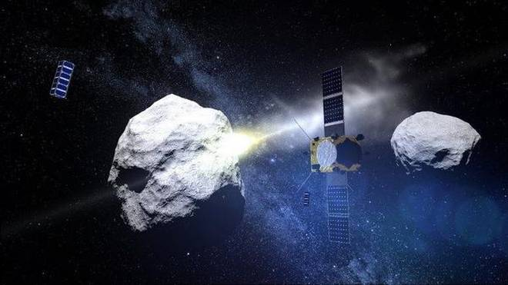
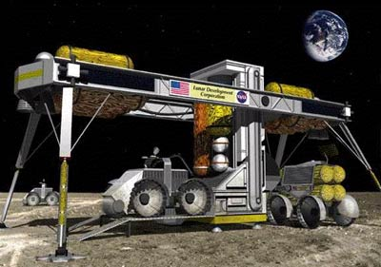

Asteroid Surface Exploration
Geohistory
Security/Deflection
ISRU
Short, focused, high-risk, high-return…
Complements flyby and orbital observation science.

Slide 4
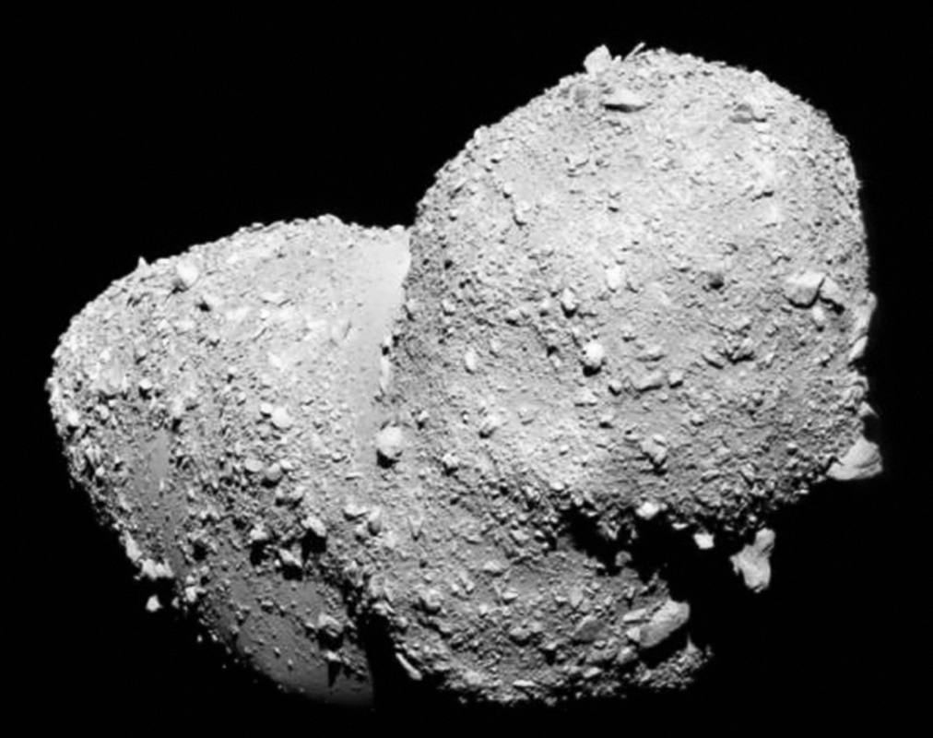
Science Focused
Determine early geo-history, composition
Seismic analysis from multiple locations
Analyze pristine, unearthed regolith
Take a step back in time to the primordial solar system…

Slide 5
Challenges
Asteroid mobility
  Low-gravity, low-escape velocity
Surface contact risks
  Dust
  Static charge
  Tracking and communication
Varying high and low temperature

Slide 6
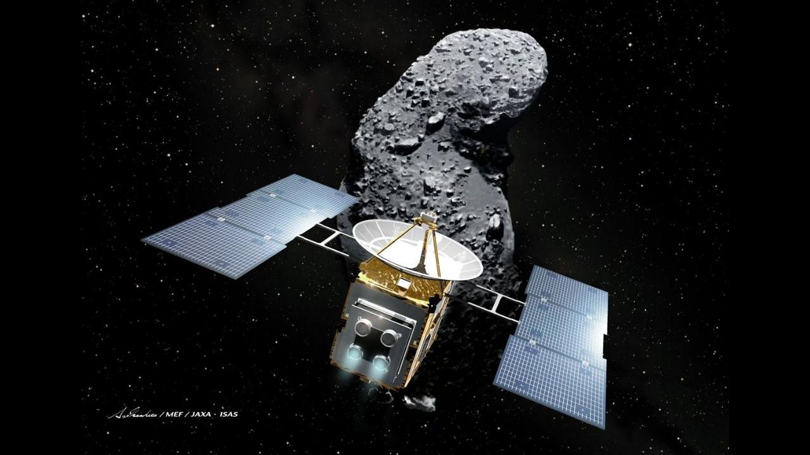
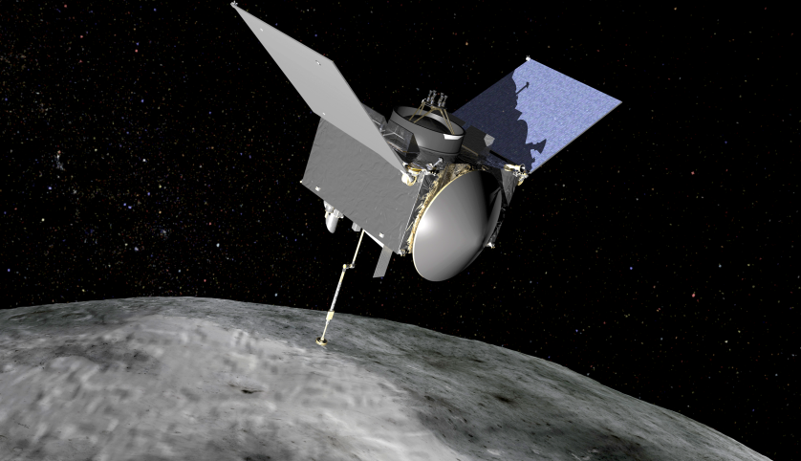
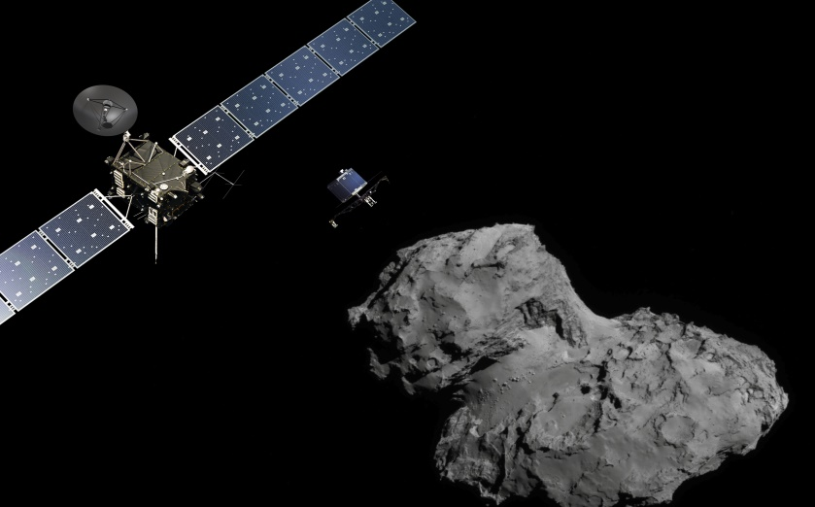
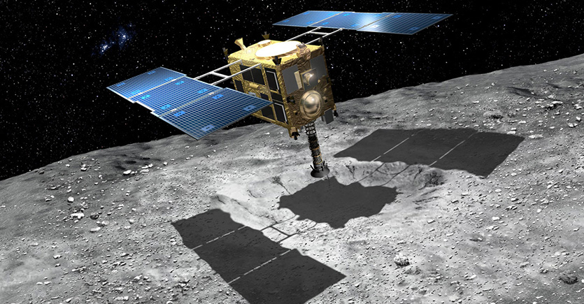
Related Work
Hayabusa I
OSIRIS-Rex
Hayabusa II
Rosetta
Current missions envisions performing touch-and-go operations over an asteroid surfaces

Slide 7
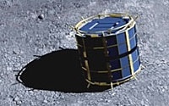
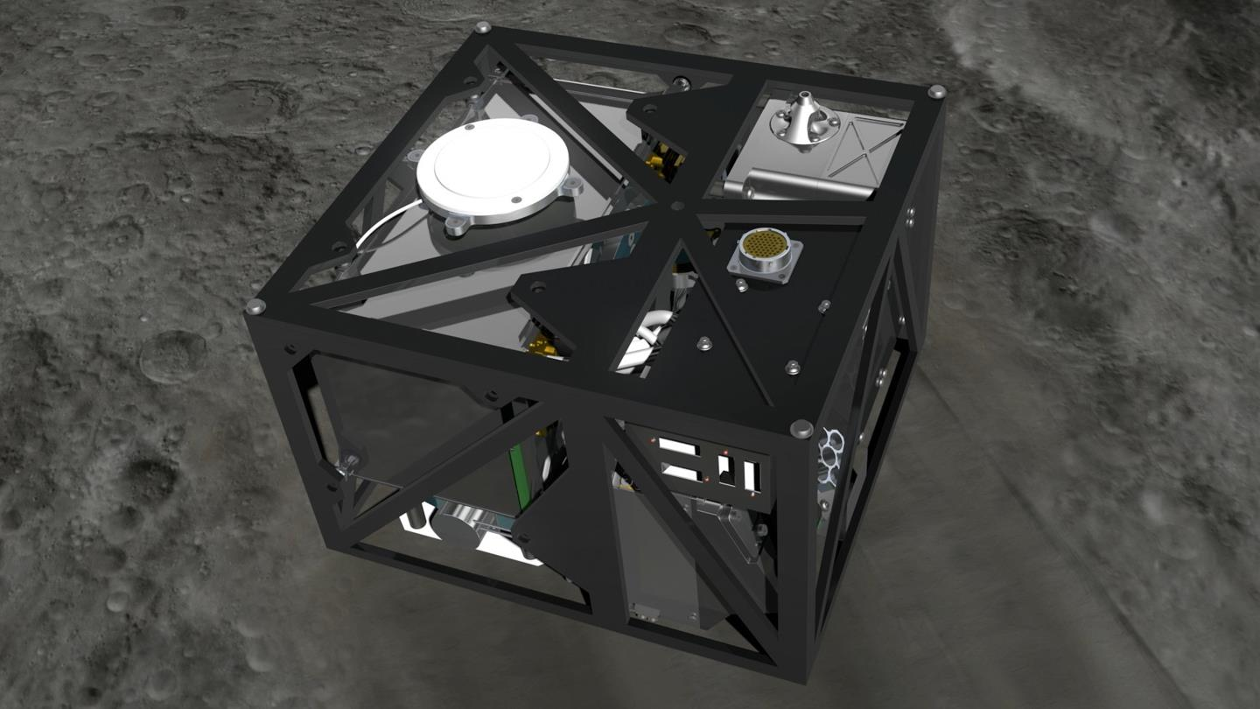
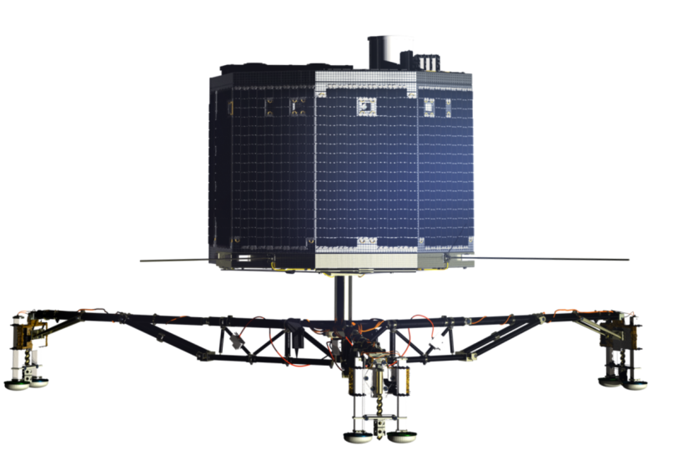
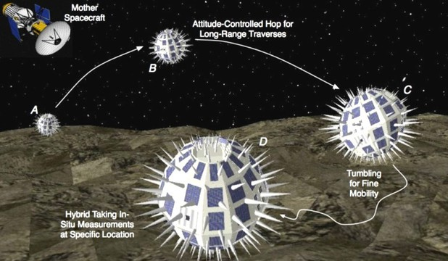
Related Work
MINERVA
MASCOT
Philae
Hedgehog
Augmented with small landers….

Slide 8
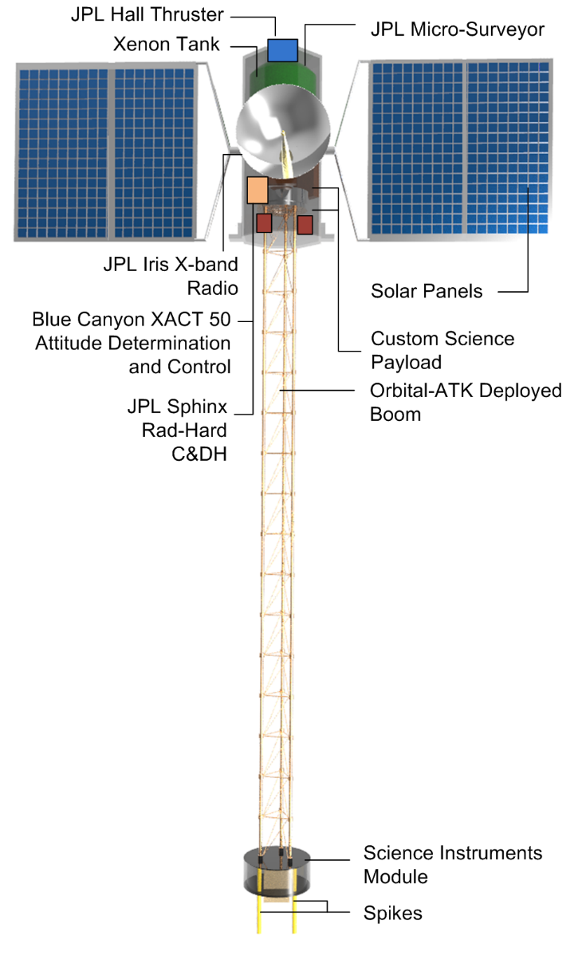
SPIKE Spacecraft
Keep the spacecraft at a safe distance
Amphibious lander/flyby spacecraft
Based on JPL Micro Surveyor
Propelled by xenon fueled solar-electric Hall thrusters (5km/s delta v)
Solar panels can generate 750W
Blue Canyon’s XACT 50 (star-tracker, IMU, 3-axis reaction wheels)
JPL’s DSN compatible IRIS X-band Radio V2.1 (256 KBps)

Slide 9
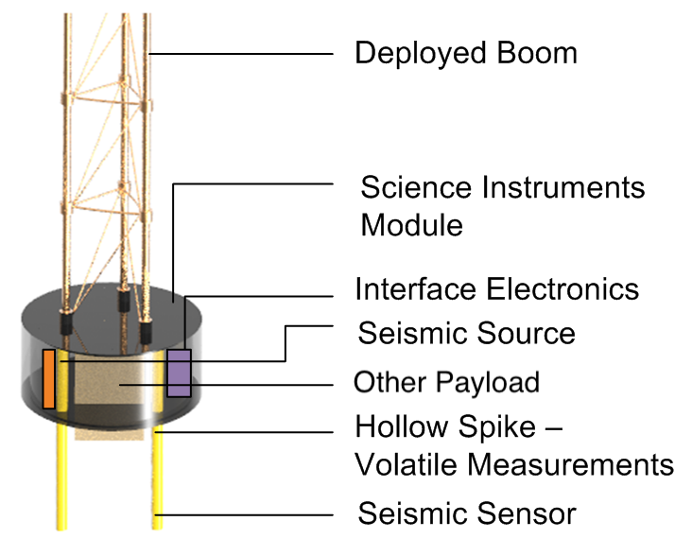
SPIKE Spacecraft
Onboard instruments would be used to
  Analyze subsurface volatiles and organics
  Conduct seismology on asteroids
Science Payload includes
  Seismometers
  Cameras
  Other instrument will be designed to access >10 cm beneath the surface of the asteroid

Slide 10
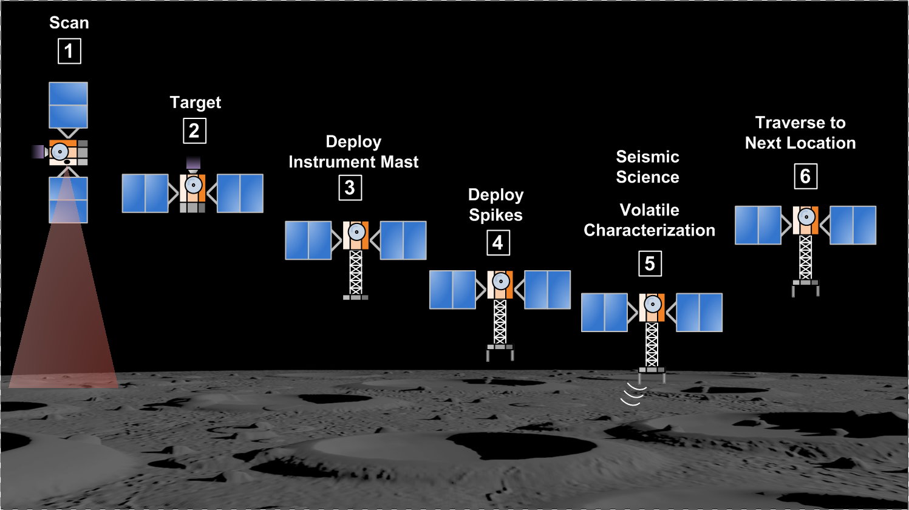
Mission Concept

Slide 11
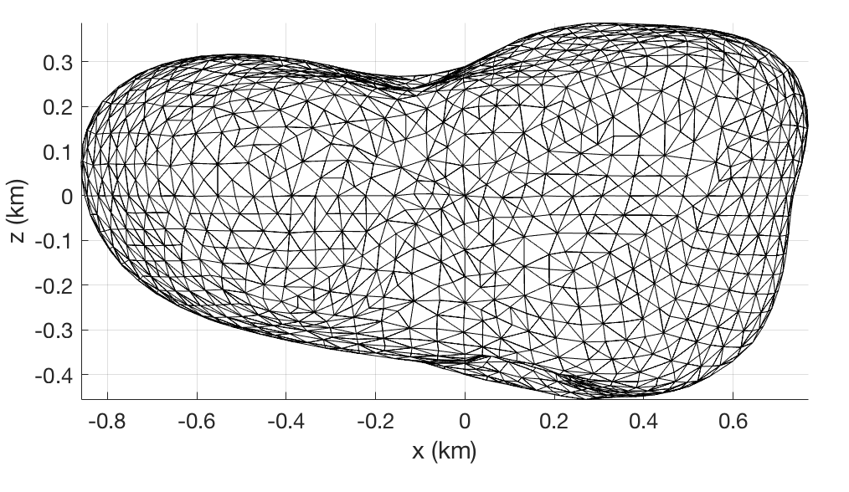
Asteroid Dynamical Environment Modeling
Asteroid’s shape described as a polyhedron
Polyhedron Model of Asteroid Castalia

Slide 12
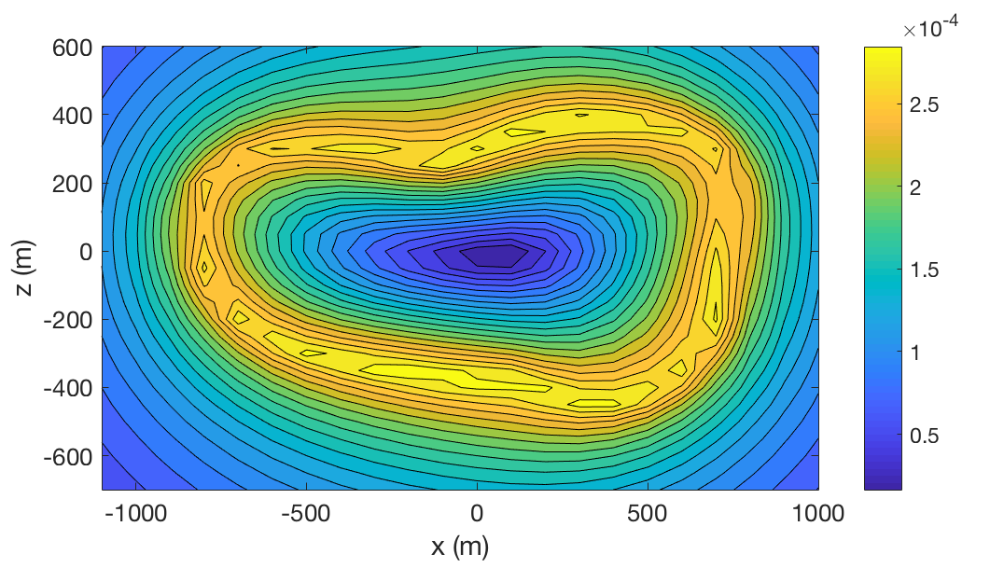
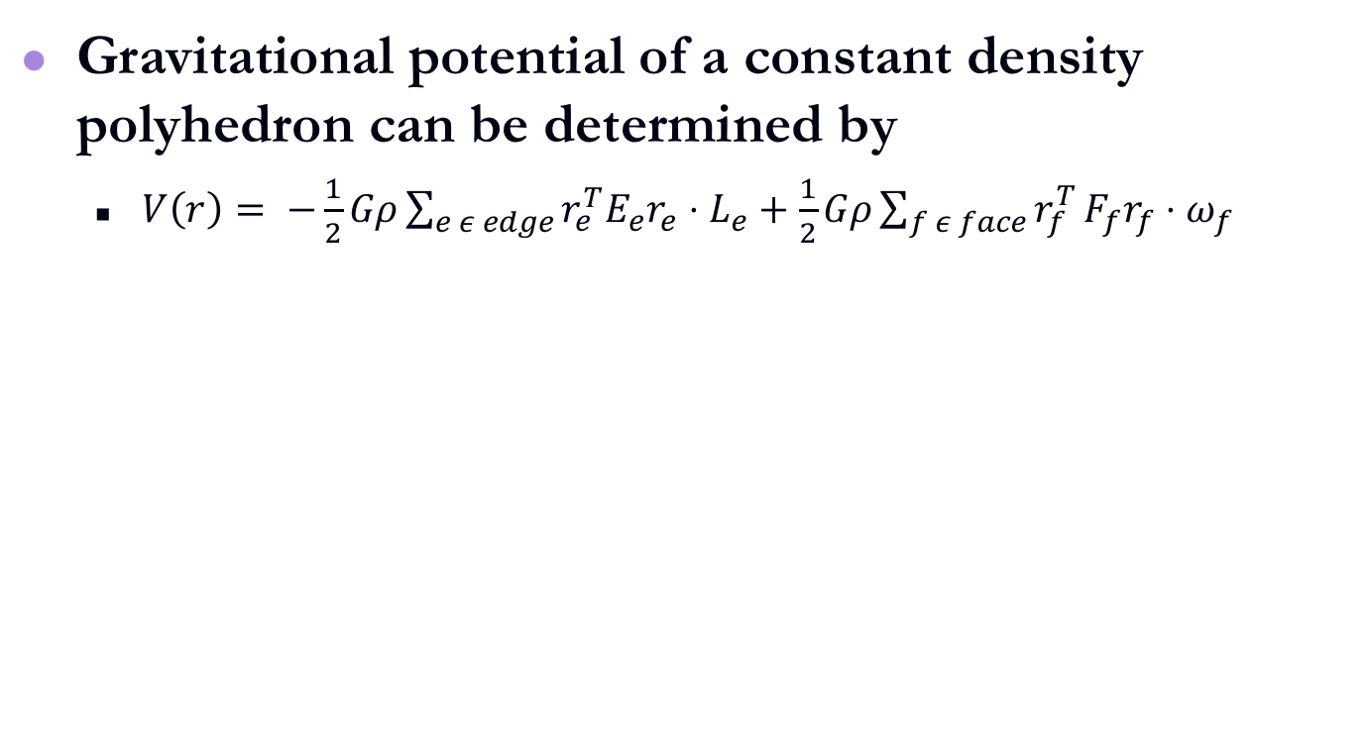
Gravitational Model
Gravitational potential of a constant density polyhedron can be determined by
  $V\left(r\right)= −\frac{1}{2}Gρ\sum_{e ε edge}{r_{e}^{T}E_{e}r_{e}⋅L_{e}}+\frac{1}{2}Gρ\sum_{f ε face}{r_{f}^{T}}F_{f}r_{f}⋅ω_{f}$
Gravitational field of asteroid Castalia

Slide 13
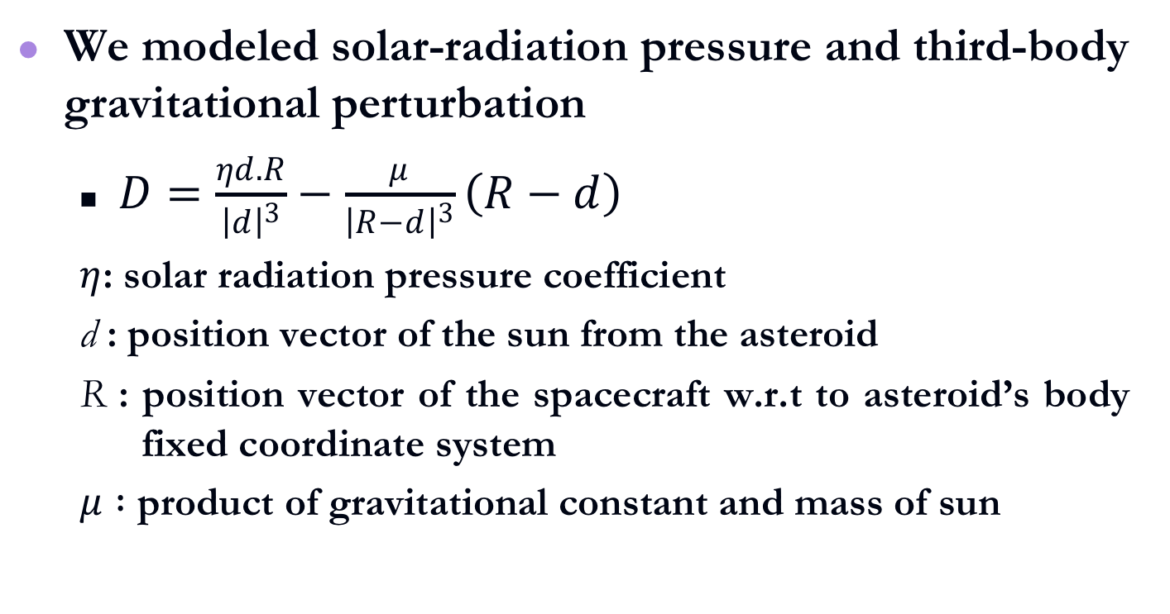
Disturbance Forces
We modeled solar-radiation pressure and third-body gravitational perturbation
  $D=\frac{ηd.R}{{\left|d\right|}^{3}}−\frac{μ}{{\left|R−d\right|}^{3}}\left(R−d\right)$
  $η$: solar radiation pressure coefficient
  d : position vector of the sun from the asteroid
  R : position vector of the spacecraft w.r.t to asteroid’s body fixed coordinate system
  $μ :$ product of gravitational constant and mass of sun

Slide 14
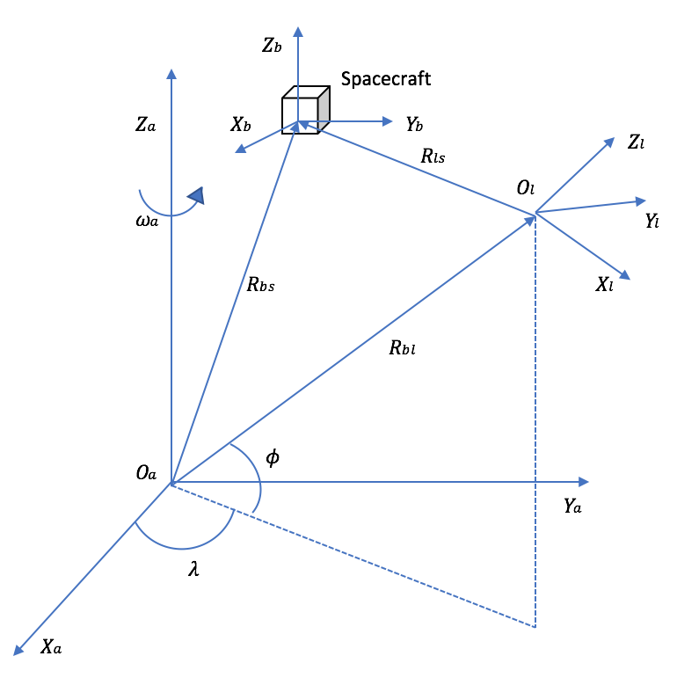
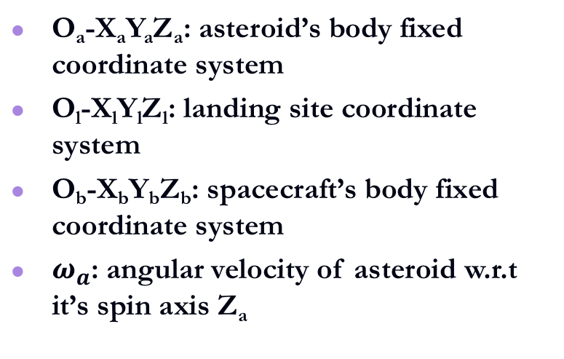
Spacecraft Dynamics Model
O_{a}-X_{a}Y_{a}Z_{a}: asteroid’s body fixed coordinate system
O_{l}-X_{l}Y_{l}Z_{l}: landing site coordinate system
O_{b}-X_{b}Y_{b}Z_{b}: spacecraft’s body fixed coordinate system
$ω_{a}$: angular velocity of asteroid w.r.t it’s spin axis Z_{a}

Slide 15
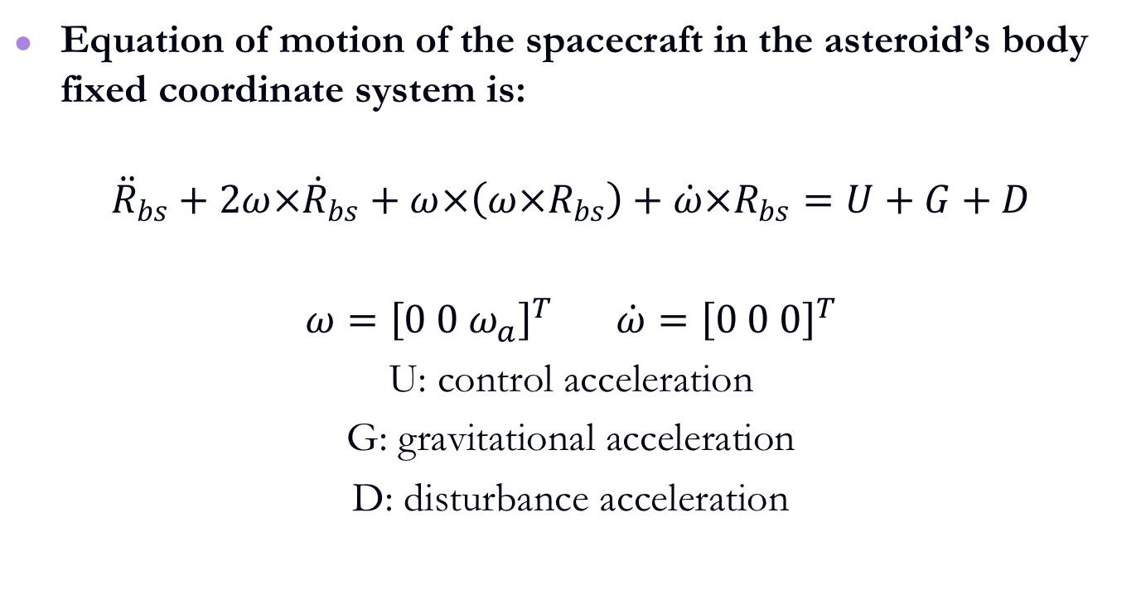
Spacecraft Dynamics Model
Equation of motion of the spacecraft in the asteroid’s body fixed coordinate system is:
$${\ddot{R}}_{bs}+2ω×{\dot{R}}_{bs}+ω×\left(ω×R_{bs}\right)+\dot{ω}×R_{bs}=U+G+D$$
$ω={\left[0 0 ω_{a}\right]}^{T}$ $\dot{ω}={\left[0 0 0\right]}^{T}$
U: control acceleration
G: gravitational acceleration
D: disturbance acceleration

Slide 16
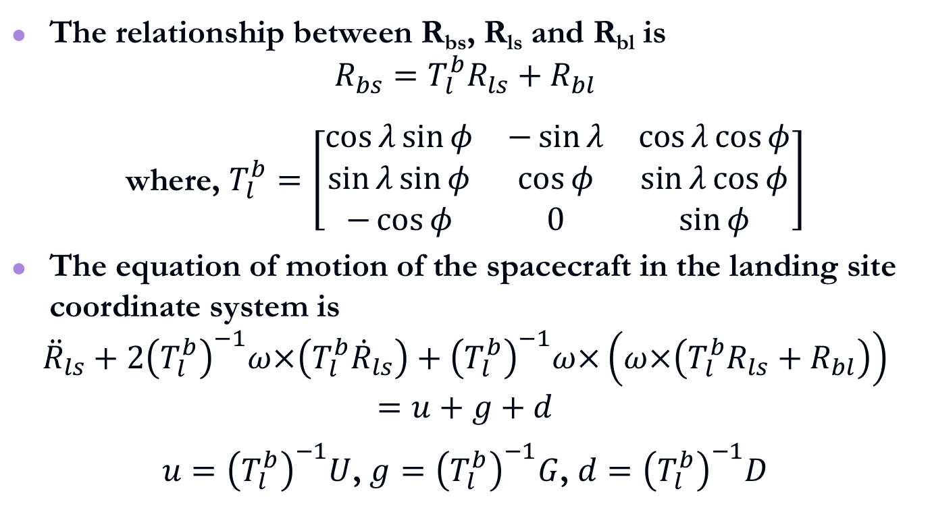
Spacecraft Dynamics Model
The relationship between R_{bs}, R_{ls} and R_{bl} is
$$R_{bs}=T_{l}^{b}R_{ls}+R_{bl}$$
where, $T_{l}^{b}=\left[\begin{matrix}\cos{λ}\sin{φ} & −\sin{λ} & \cos{λ}\cos{φ} \\ \sin{λ}\sin{φ} & \cos{φ} & \sin{λ}\cos{φ} \\ −\cos{φ} & 0 & \sin{φ}\end{matrix}\right]$
The equation of motion of the spacecraft in the landing site coordinate system is
$${\ddot{R}}_{ls}+2{\left(T_{l}^{b}\right)}^{−1}ω×\left(T_{l}^{b}{\dot{R}}_{ls}\right)+{\left(T_{l}^{b}\right)}^{−1}ω×\left(ω×\left(T_{l}^{b}R_{ls}+R_{bl}\right)\right)=u+g+d$$
$u={\left(T_{l}^{b}\right)}^{−1}U$, $g={\left(T_{l}^{b}\right)}^{−1}G$, $d={\left(T_{l}^{b}\right)}^{−1}D$

Slide 17
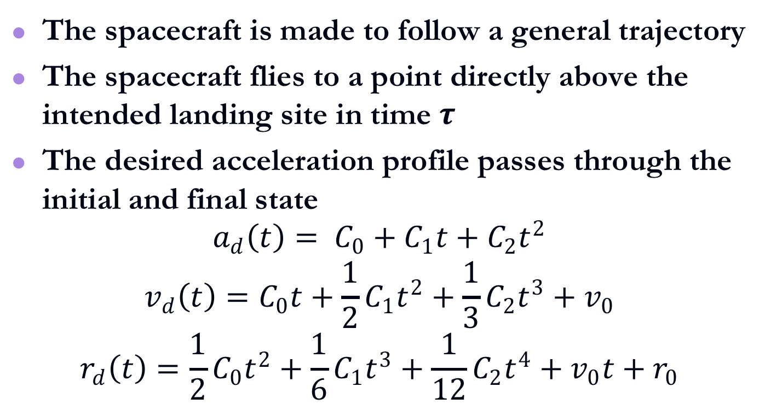
Descent Phase
The spacecraft is made to follow a general trajectory
The spacecraft flies to a point directly above the intended landing site in time $τ$
The desired acceleration profile passes through the initial and final state
$$a_{d}\left(t\right)= C_{0}+C_{1}t+C_{2}t^{2}$$
$$v_{d}\left(t\right)=C_{0}t+\frac{1}{2}C_{1}t^{2}+\frac{1}{3}C_{2}t^{3}+v_{0}$$
$$r_{d}\left(t\right)=\frac{1}{2}C_{0}t^{2}+\frac{1}{6}C_{1}t^{3}+\frac{1}{12}C_{2}t^{4}+v_{0}t+r_{0}$$

Slide 18
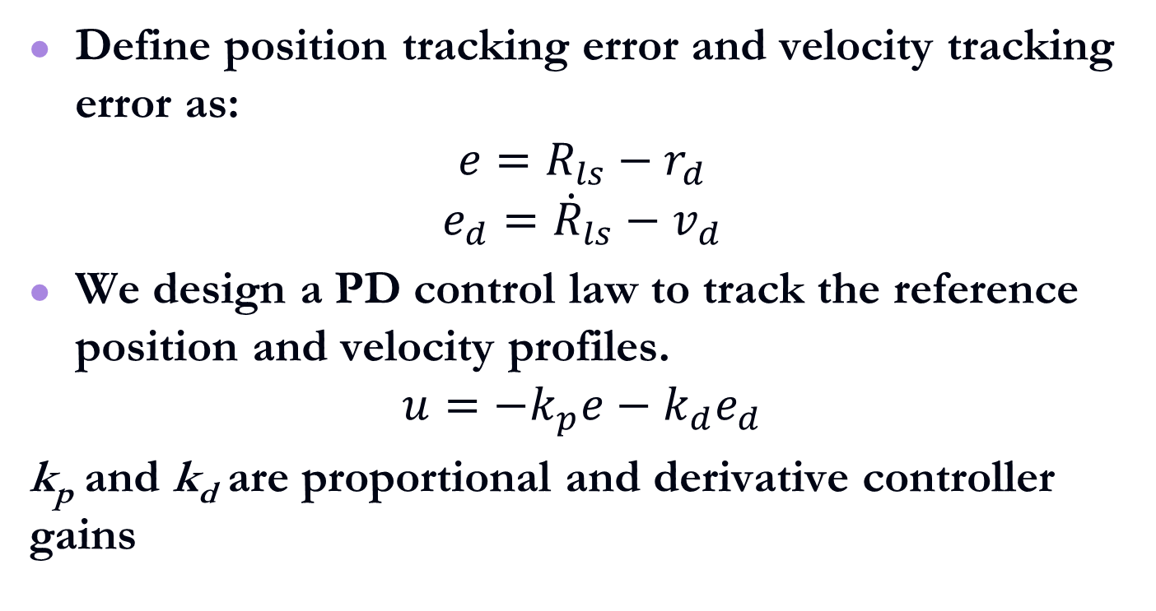
Descent Phase Controller
Define position tracking error and velocity tracking error as:
$$e=R_{ls}−r_{d}$$
$$e_{d}={\dot{R}}_{ls}−v_{d}$$
We design a PD control law to track the reference position and velocity profiles.
$$u=−k_{p}e−k_{d}e_{d}$$
k_{p} and k_{d} are proportional and derivative controller gains

Slide 19
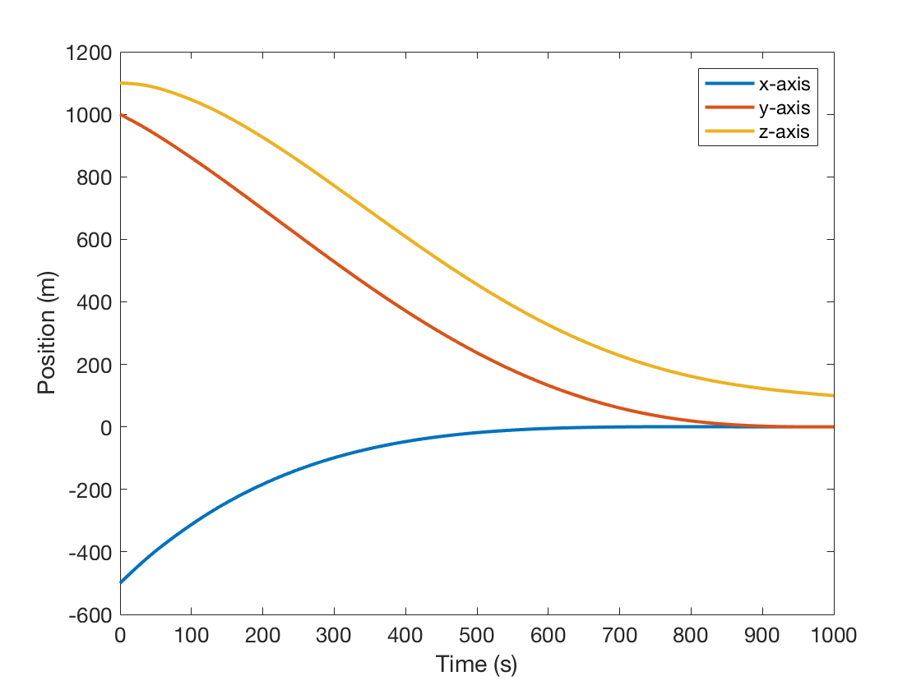
Descent Phase Simulation
Final position | [0, 0, 100] m
Parameters | Value
Mass of Spacecraft | 50 kg
Dimensions | 60 × 36 × 36 cm
Landing site | [726, 0, 286] m
Initial position | [-500, 1000, 1100] m
Initial velocity | [2.2, -1.2, -0.1] m/s
Final position | [0, 0, 100] m
Final velocity | [0, 0, -0.2] m/s
Initial and final position and velocity defined w.r.t the landing site coordinate system

Slide 20
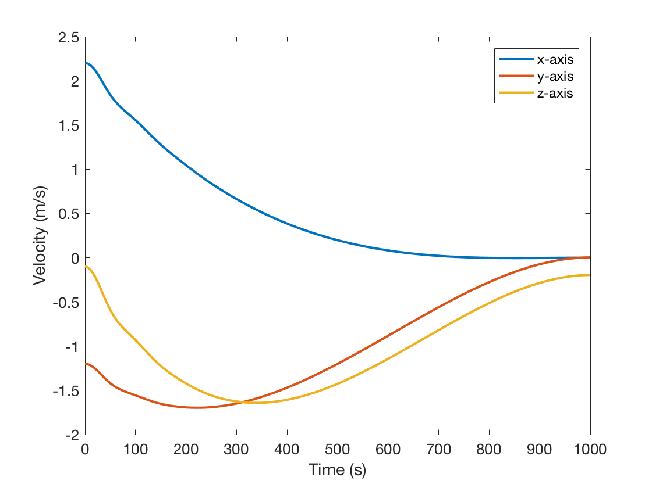
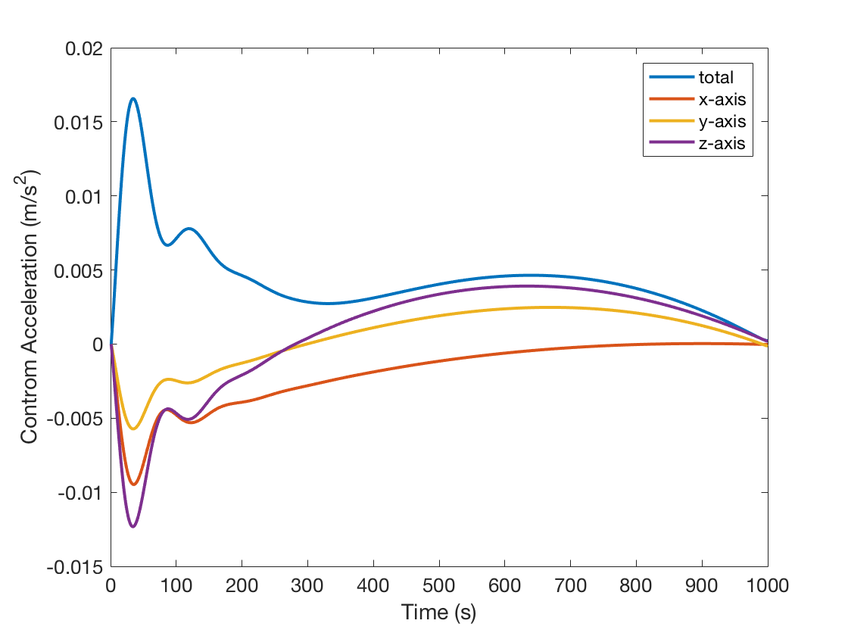
Descent Phase Simulation
Final velocity | [0, 0, -0.2] m/s
Control acceleration less than 0.02 m/s²

Slide 21
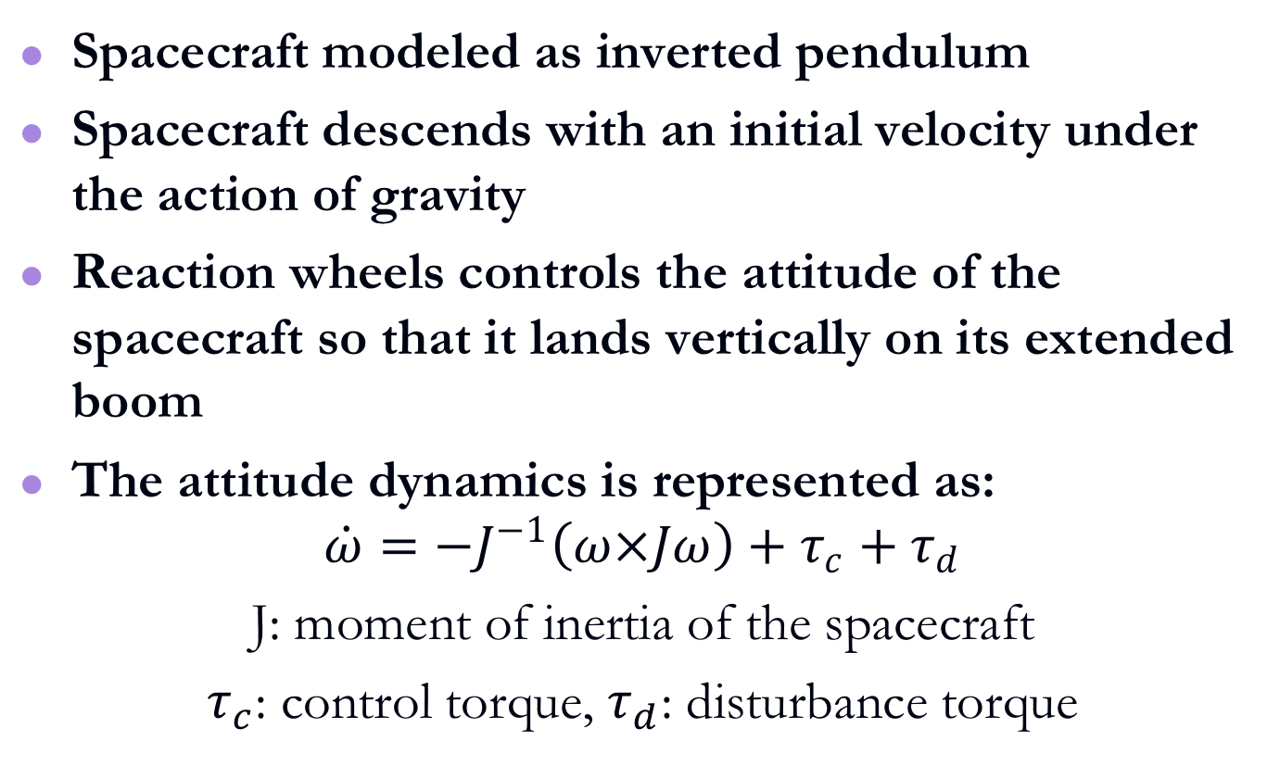
Landing Phase
Spacecraft modeled as inverted pendulum
Spacecraft descends with an initial velocity under the action of gravity
Reaction wheels controls the attitude of the spacecraft so that it lands vertically on its extended boom
The attitude dynamics is represented as:
$$\dot{ω}=−J^{−1}\left(ω×Jω\right)+τ_{c}+τ_{d}$$
J: moment of inertia of the spacecraft
$τ_{c}$: control torque, $τ_{d}$: disturbance torque

Slide 22
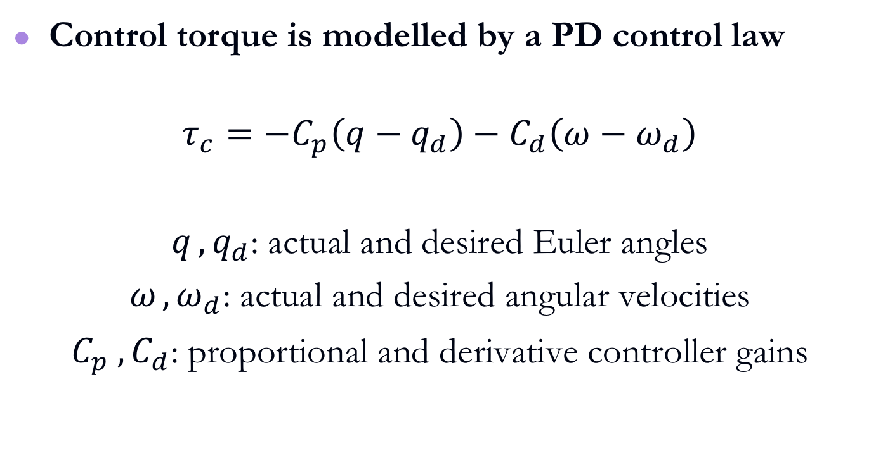
Landing Phase Controller
Control torque is modelled by a PD control law
$$τ_{c}=−C_{p}\left(q−q_{d}\right)−C_{d}\left(ω−ω_{d}\right)$$
$q_{ },q_{d}$: actual and desired Euler angles
$ω_{ },ω_{d}$: actual and desired angular velocities
${C_{p}}_{ },C_{d}$: proportional and derivative controller gains

Slide 23
Landing Phase Simulations
Parameters | Value
Reaction wheel mass | 0.75 kg
Reaction wheel dia. | 11 cm
Reaction wheel height | 3.8 cm
Maximum torque | 0.025 Nm
Initial position | [0, 0, 100] m
Initial velocity | [0, 0, -0.2] m/s
Initial Euler angles | [0.1745, -0.3491, 0.3491] rad
Initial angular velocity | [0.1, 0.2, -0.1] rad/s
Initial position, velocity, Euler angles and angular velocities defined w.r.t the landing site coordinate system

Slide 24
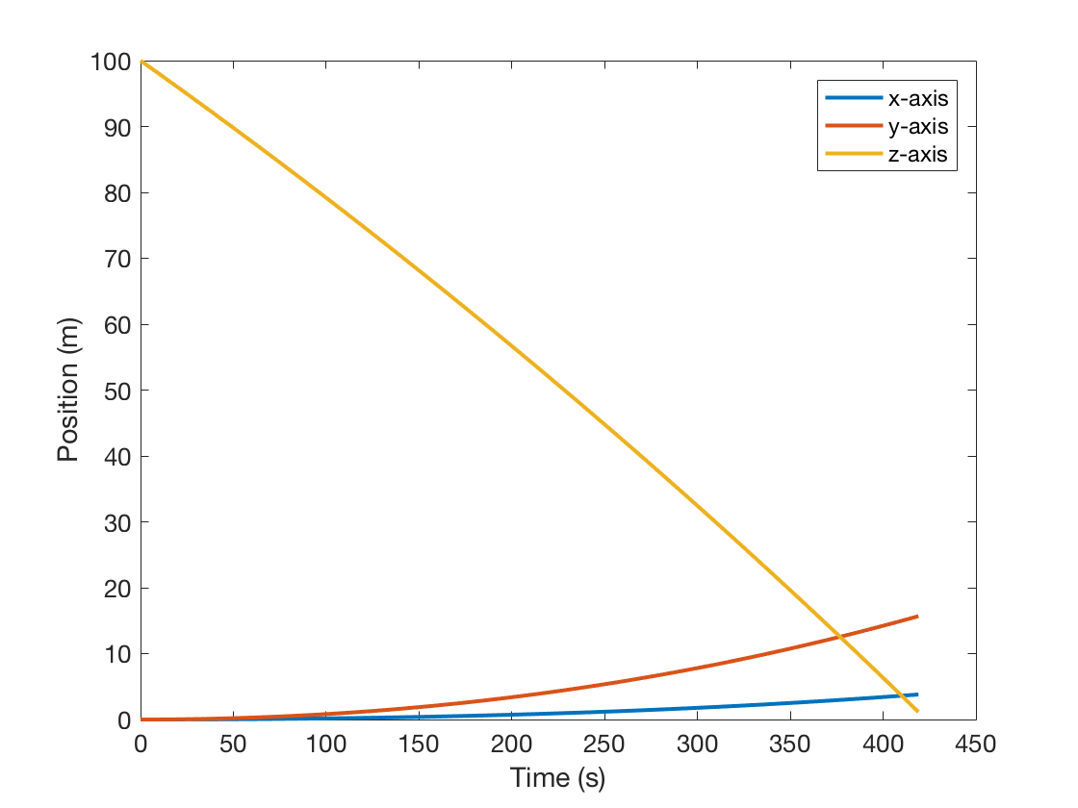
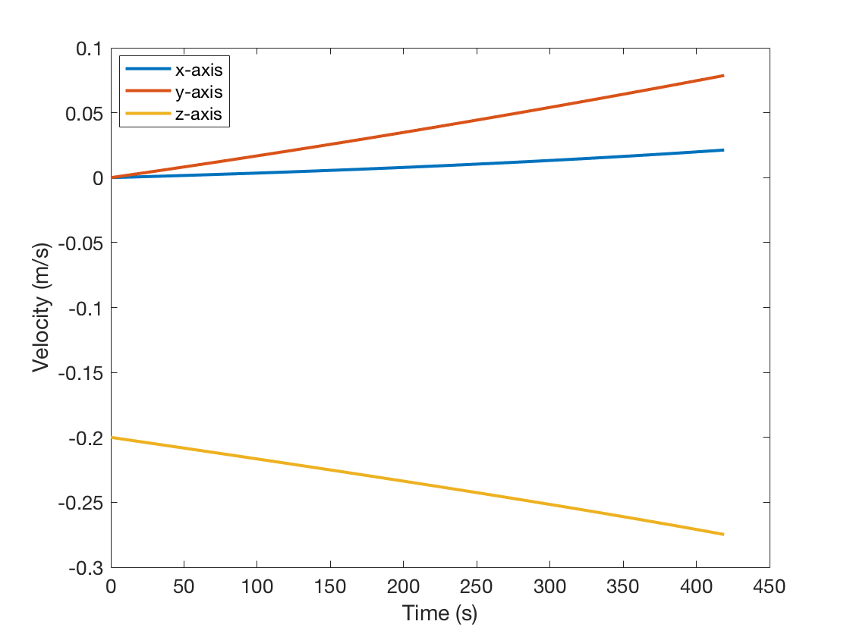
Landing Phase Simulations
Final position | [3.7, 15.6, 0] m
Final velocity | [0.02, 0.07, -0.27] m/s

Slide 25
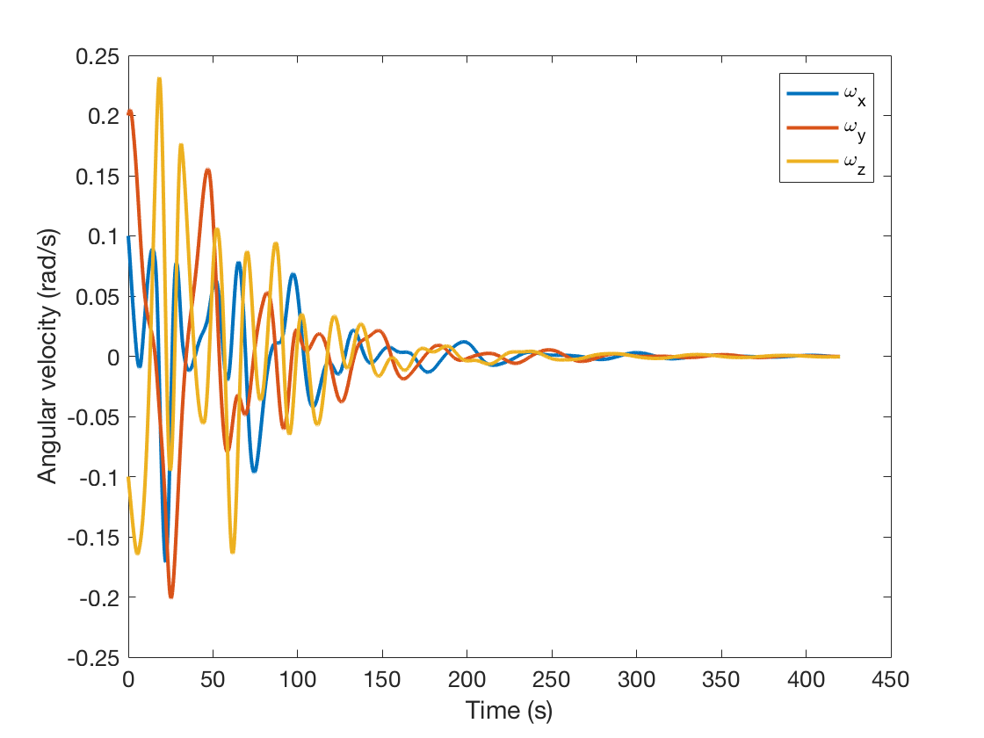
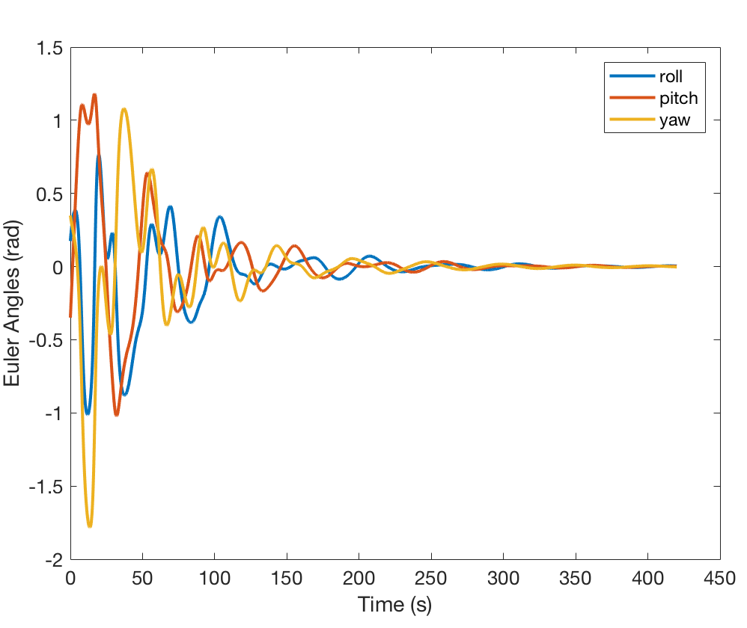
Landing Phase Simulations
Final angular velocities | [0, 0, 0] rad/s
Final Euler angles | [0, 0, 0] rad

Slide 26
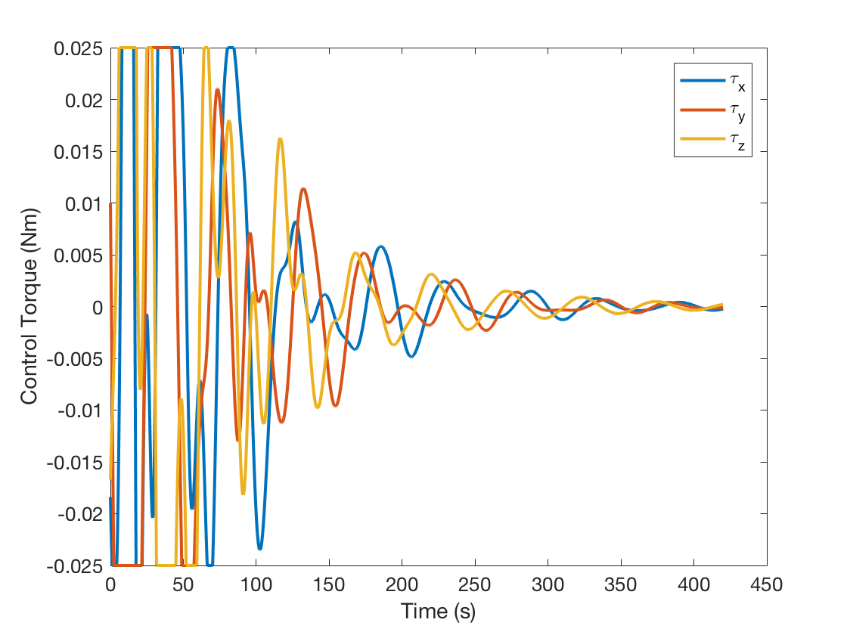
Landing Phase Simulations
Control torque less than 0.025 Nm

Slide 27
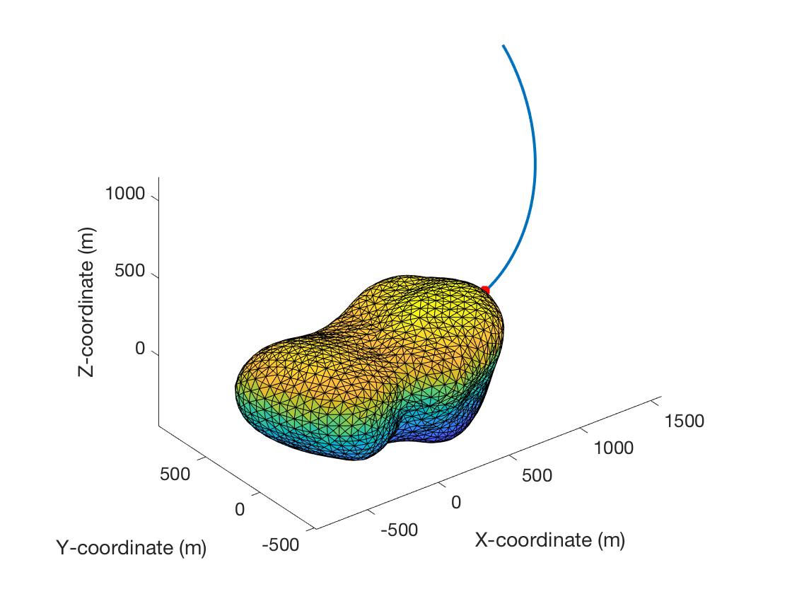
Descent and Landing Trajectory

Slide 28
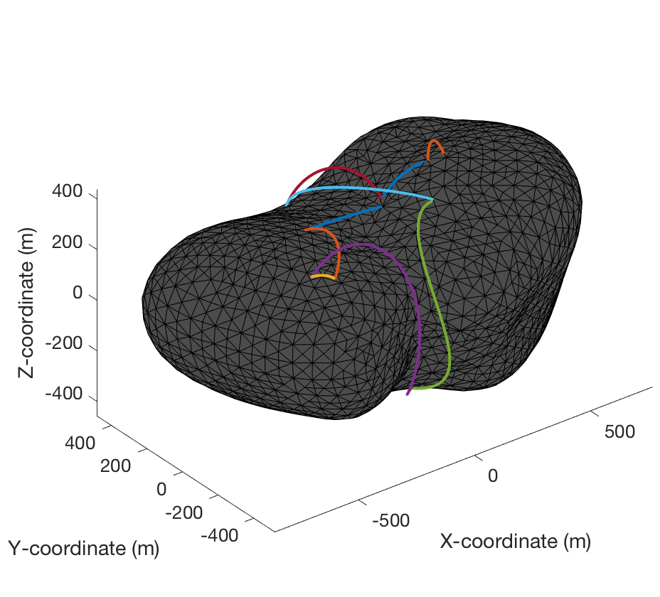
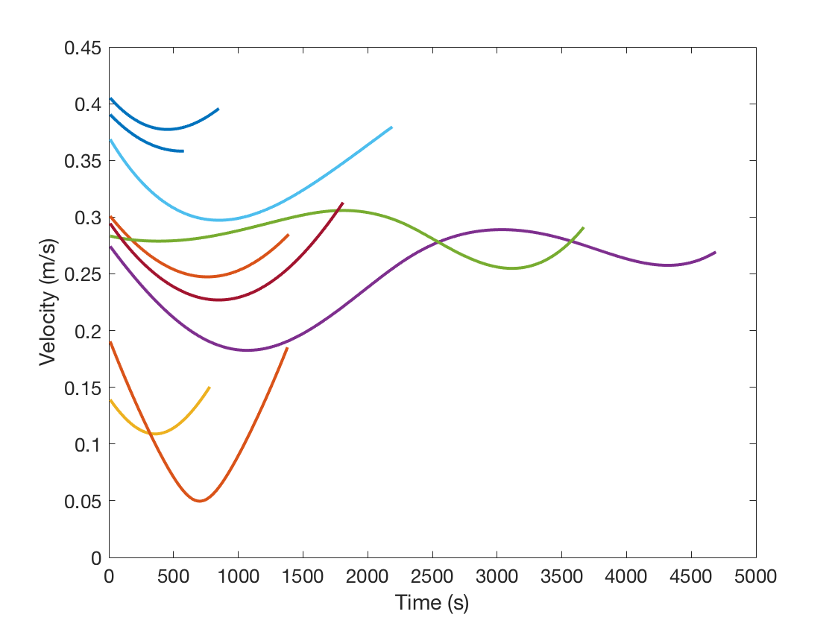
Hopping Dynamics
Simulated hopping trajectories with initial velocities between 0.1 to0.45 m/s

Slide 29
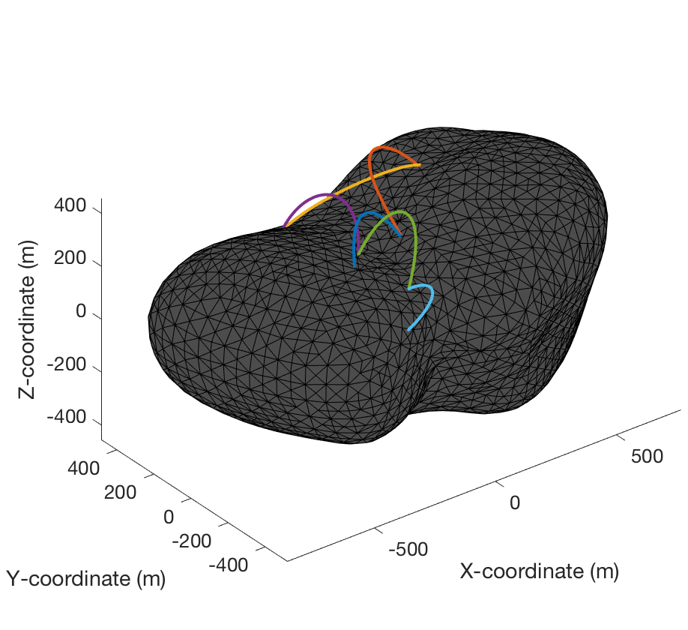
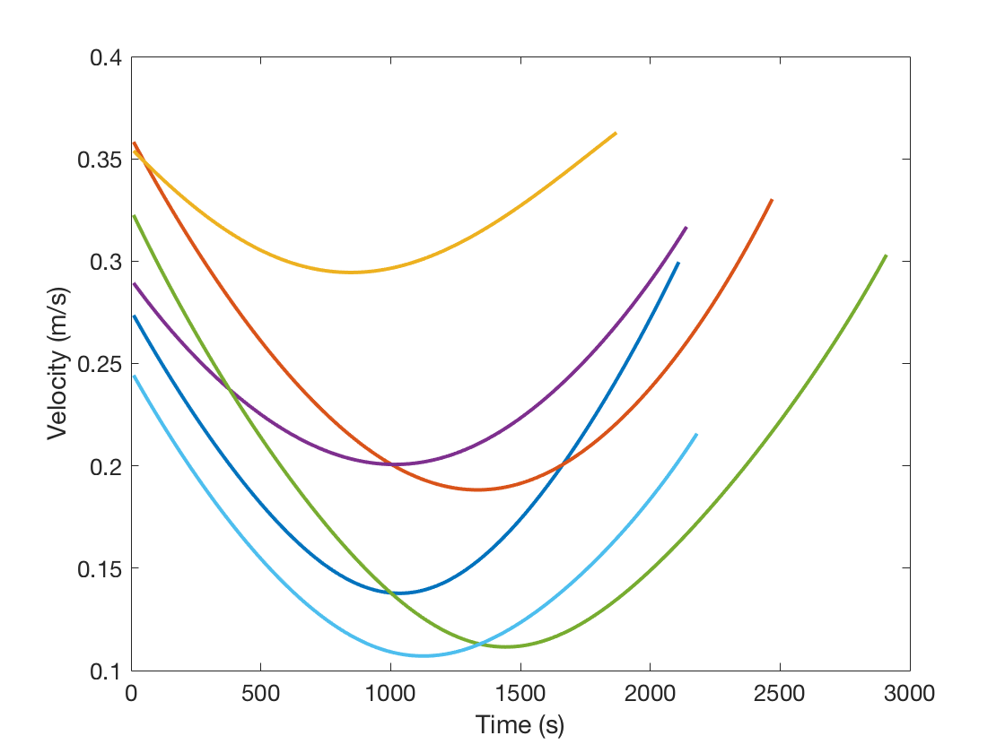
Hopping Dynamics
Large portion of the trajectories are irregular
Demonstrates extreme non-Keplerian behavior around irregularly shaped minor celestial bodies (Scheeres, 2012)

Slide 30

SPIKE Concept Videos

Slide 31
Conclusions
Presented GNC capabilities of SPIKE.
Presented detailed dynamics of the spacecraft w.r.t a small asteroid’s frame of references.
PD control law developed for a finite time descent trajectory.
Presented attitude control of the spacecraft with the onboard reaction wheels during its landing phase.
Also, presented the feasibility of SPIKE performing multiple long-range hops to explore the asteroid.

Slide 32
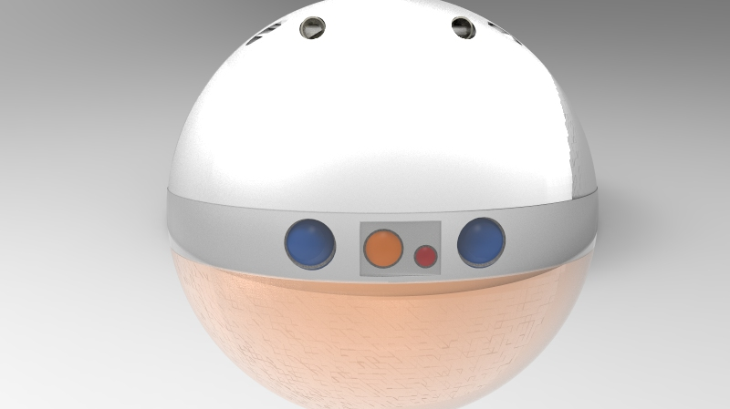
Thank You

Slide 33
Questions ?

