Slide 1

Flexible Flight Software Facilitating Evolving Devices and Interfaces
May 2, 2017
V4e
Douglas Forman
Intelligent Systems Division
NASA Ames Research Center

Slide 2
Outline
BioSentinel FSW Overview
BioSentinel H/W Availability Challenge
NASA Ames FSW Infrastructure
BioSentinel Specific Solutions
  Iris Transponder FSW Evolution
  C&DH Interface eXtension Card (IXC) Spacewire-to-Serial FSW Evolution
Notes:
This presentation will describe the BioSentinel FSW and general solutions to the challenge of late/limitted H/W availability. A couple of specific BioSentinel examples will be looked at.
Short duration, low earth orbit cubesats, that I’ve previously worked on, had the advantage that flight hardware was commercial, or even consumer, based electronics that were typically available early in the FSW development.
However, for a deep-space mission, many of the parts are either custom developments, or rad-hardened electronics with long lead times.

Slide 3
BioSentinel FSW Overview

Slide 4
BioSentinel FSW Driving Requirements
Payload/Science Maintenance
    PLRD-029 Science Data, SRD-035 IO Design, PLRD-024 SPE Detection, PLRD-025 SPE Response
Telemetry and Commanding (From Ground or Stored Onboard)
    SRD-008 Bus Telemetry Service, SRD-009 Payload Telemetry Service, SRD-037 Telemetry Delivery, SRD-038 Telemetry Rate, SRD-039 Command Rate, SRD-031 Command Receipt, SRD-032 SOH Generation, SRD-020 Command Sequencing
Electrical Power Management and Control
    SRD-026 Battery Management, SRD-028 Power Distribution, SRD-029 Power Generation
Thermal Monitoring
    SRD-024 Heater Design, SRD-012 Thermal Environments, PLRD-004 Payload Thermal Environment
Attitude Control for pointing Solar Arrays to Sun and Antennas to Earth
    SRD-019 Stabilization Mode, SRD-021 Momentum Management, SRD-016 Safe Mode Design, SRD-044 Safe Mode Transition
Operational Requirements and Constraints
    SRD-001 Freeflyer Mission Duration, SRD-007 Electro Magnetic Environment, SRD-047 MET Clock, SRD-040 Boot Sequence, SRD-014 Governing Requirements
Fault Detection and Resolution
    SRD-043 Fault Management, SRD-017 Fault Detection
Notes:
BioSentinel FSW C&DH key requirements are not extremely challenging:
Running payload experiments, storing payload data and downlinking that data.
Supporting requirements are to manage Power and Thermal and point the Spacecraft Solar Arrays to Sun; Antennas to Earth.

Slide 5
Requirements derived and BioSentinel FSW Components Allocated
OFSW
Solar Particle
Event
Detection
Command
& Mode
Processor
State
Estimator
Attitude
Control
System
Thermal
Control
System
Power
Control
System
Internal FSW Interface Layer
Scheduler
Stored
Commands
Memory
Manager
Memory
Dwell
Limit
Checker
House-
keeping
Memory
Scrub
Other
Hardware
I/O
(HWIO)
Health &
Safety
File
Manager
CCSDS File
Delivery
Checksum
Data
Storage
Telemetry
Output
Command
Ingest
System Support, O/S Services and Device Drivers
Telemetry
KEY shown in later slide
Gnd Cmds
Sensor/Actuator/Payload Data
Notes:
FSW Requirements were derived from the System Requirements and sub-allocated to various FSW Components.
We’ll talk more about how these components interface with each other later.

Slide 6
BioSentinel H/W Device Availability Challenge
Key EDU Hardware Availability is a common FSW problem
  H/W Arrives Late in Development Cycle for various reasons:
    Long Lead Time of Components
    Design/Requirement iterations
    Budget/Procurement issues
  Limited H/W access after arrival due to:
    Long duration environmental tests
    Demand for H/W by multiple stakeholders (testers, developers, integrators)
BioSentinel Key Flight Hardware Examples
  Command and Data Handling (C&DH) Hardware
    LEON3 Single Board Computer (SBC)
    Interface eXtension Card (IXC)
  Iris V2.1 Transponder
FSW in critical path
  Flight Software cannot finish until tested on EDU/Flight Hardware
  Waiting for key hardware pushes delivery date
    Not an option for BioSentinel – short time between arrival and delivery
Development/Integration without key hardware necessitates:
  Evolving Test Approach (WSIM, PIL, PHIL, HIL)
  Layered Software Architecture (cFE/CFS)
  Device Virtualization and Abstraction
Notes:
For various reasons, H/W that is needed to finish FSW is often not available as FSW is being developed.
Waiting for key hardware to arrive is typically not an option. To stay ahead of the critical path, an evolving test approach and a layered S/W architecture is needed.

Slide 7
H/W and Processor FPGA Virtualization
(on Non-Rad-Hard consumer targets)
Soft-Core LEON3 Processor (NEXYS4 target)
  Inexpensive and can run all FSW Apps; Saves the day!
  Useful, but Hardware Interfaces not flight-like
Iris Transponder H/W Simulation (ML605 target)
  Emulates low-level SPI Interface; big risk reduction!
  Useful, but no external tlm/cmd I/F for integrated testing
BioSentinel IXC (Interface eXtension Card) (A3PE-STARTER-KIT-2 target)
  SpaceWire signal issues ; learning experience
Notes:
The next best thing to real H/W is virtual H/W…. Now possible with commercially available FPGA targets. The Soft-Core Leon flashed to the nexys4 has been extemely useful.
The soft-core Leon is binary compatible with the LEAP2 that we will be flying. However, in general, the virtual H/W can be difficult to configure and comes with limitations.

Slide 8
NASA Ames Flexible FSW Infrastructure for Evolving Development
Notes:
Fortunately, BioSentinel FSW is not starting from scratch. It is based on an existing NASA Ames FSW Development infrastructure.

Slide 9
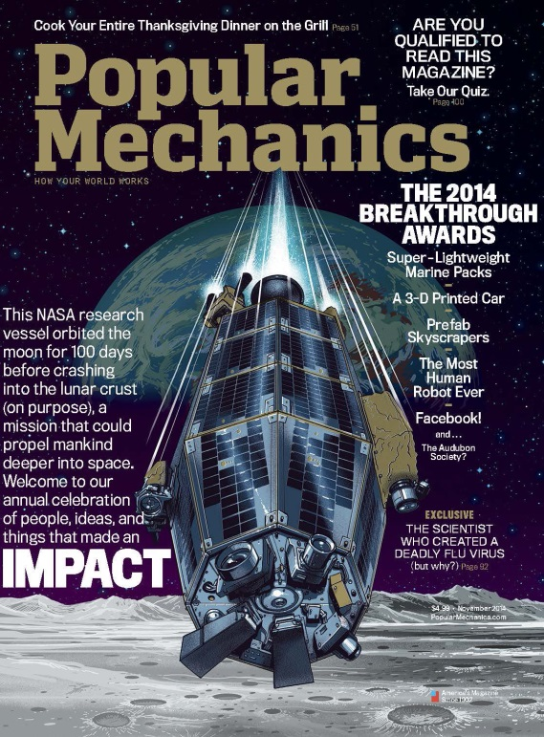
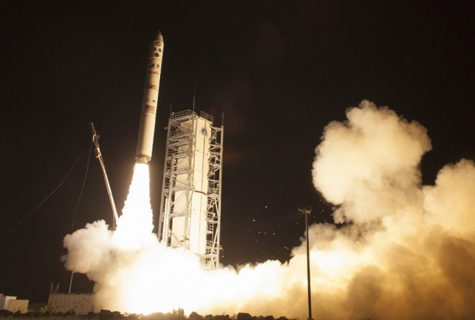
LADEE (Lunar Atmosphere and Dust Environment Explorer) Award Winning Effort
All Mission Goals Exceeded
  200% of Required Science Data Downloaded
  Lunar Laser communication successfully demonstrated
  Extended Mission
    Survives eclipse
    Allows Very Low Altitude Science
  Lots more publically available information about LADEE FSW:
  http://ieeexplore.ieee.org/document/7119109/
  http://flightsoftware.jhuapl.edu/files/2013/talks/FSW-13-TALKS/FSW-13-GUNDY-BURLET.ppt
  http://flightsoftware.jhuapl.edu/files/2014/Presentations/Day-3/Session-4/2-FSW-14-DANILO_VIAZZO.ppt
Notes:
Lunar Atmosphere and Dust Environment Explorer was considered a smallsat at the time.
It was Ame’s first time in charge of Spacecraft Bus, FSW, I&T as well as Mission Ops .
It was a huge success.
The FSW was on-time, on-budget and high-quality.

Slide 10
Common Avionics and Software Technologies (CAST) Lab
Generalized Application of LADEE FSW Development Infrastructure
  Re-use of software, tools, architectures, processes and people
  Improvements to increase efficiency and quality
Key Technologies
  Model Based Development (Simulink)
    Automatic Sim and FSW Code-Generation
    Real-time Test-beds (PIL/HIL)
  Loosely Coupled Component App-based real-time FSW Executive
  Tlm/Cmd Interface Database with Code-Generation Export Capabilities
  Continuous Build/Test Collaboration Framework
    Bamboo / JIRA / git / Confluence
Notes:
The CAST Lab at Ames has generalized the Lunar Atmospheric and Dust Environment Explorer FSW Infrastructure for use by other projects.
People in the CAST Lab may be working multiple projects using the same tools and framework on all of them.

Slide 11
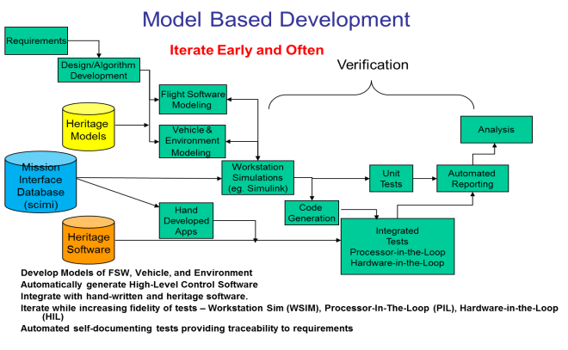
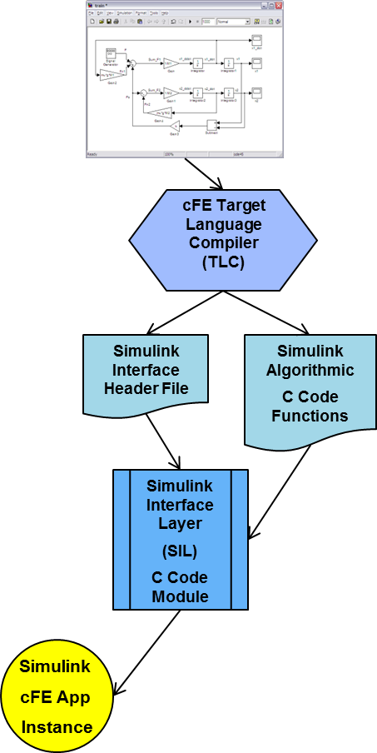
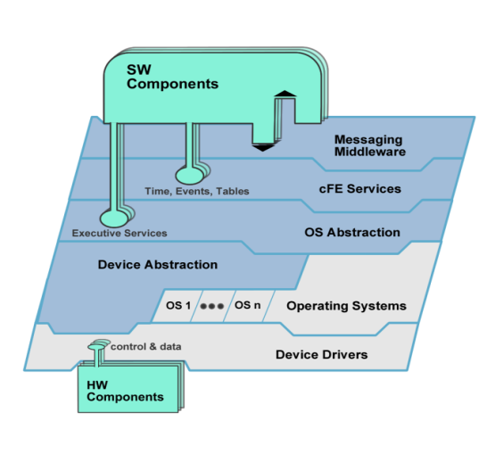

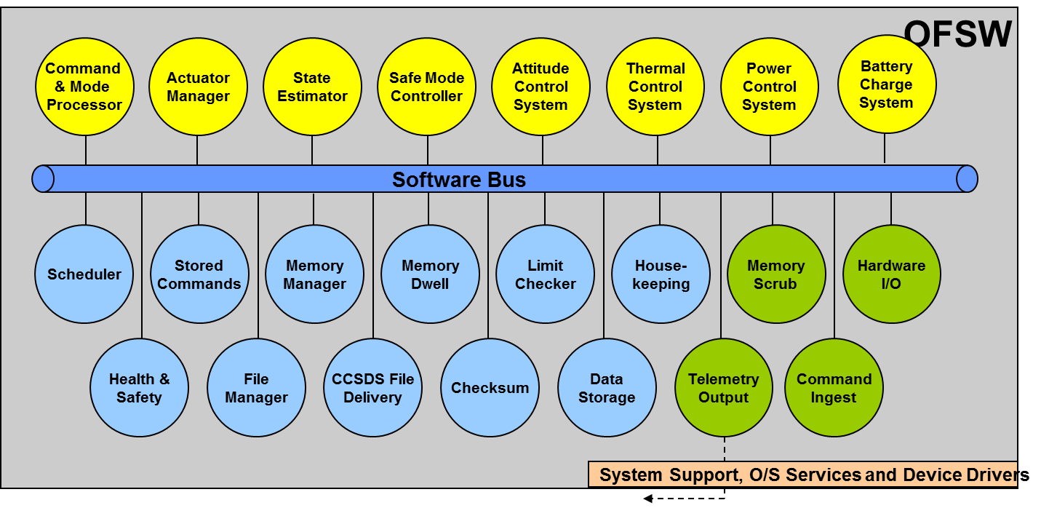
Model-Based Approach
  Auto-generation of Real-Time Code from Closed-Loop Simulink Models (Integrate early and often)
  Integrate early and often while increasing the fidelity of closed-loop testbeds: Workstation Sim , PIL, HIL
  Model and Evolving Test Platforms begin with initial analysis and live through Requirements, Implementation and Operational phases of mission (End-to-End)
Core Flight Software System (CFS) developed by Goddard
  Layered, App-Based Architecture facilitates scalability, portability and FSW re-use
  Core Flight System (cFS) is flight-qualified (Class B and A) and has a legacy of 11 successful NASA missions, in use at 6 NASA centers
  Operating System Abstraction Layer (OSAL) eases porting
  Pub/Sub Software Bus for Loosely Coupled Architecture
Simulink Interface Layer (SIL)
  Core Flight Executive (cFE) Target Language Compiler (TLC) generates cFE Pub/Sub and Table Interfaces from Simulink Models to create unique cFE App Instances
Device Abstraction/Virtualization
  Hardware I/O (HWIO) Apps provide interface between Devices and Software Bus. Leverages Posix Device I/O
Files, Tables
Notes:
CAST provided a Model-Based (Simulink) Approach integrated with a Loosely-Coupled and layered framework.
These aspects will be covered in more detail later.
In particular, we will focus on the Device Abstraction/Virtualization aspect and how that helps us develop and integrate FSW before hardware is available.

Slide 12
Recurring CAST Themes
“Don’t reinvent the wheel … ”
  “A more elegant, optimized implementation” is not a driving reason
“… but watch for square peg in round hole”
  Don’t expect full re-use of code not written for re-use
  Sometimes a new “wheel” is required
“Don’t repeat yourself”
  Eliminate redundancy; i.e. Eliminate redundancy :-)
  Auto-generate from common data/model source and Automate repetitive tasks
“Integrate Early and Often”
  Evolving integrated test-beds
“Test as you fly”
  Use Simulation Scenarios with to make FSW think it is flying
  Use Flight Ground System Scripts for unit and integration tests
“Keep it Simple for the User”
  Higher Abstraction Layers Simple; Specific Complexity (Polymorphism) in Lower Layers.
Notes:
The CAST framework was developed based upon the guiding principles of intelligent re-use and early, evolving test-beds. These quotes reflect the CAST culture.

Slide 13
CAST Simulation Testbed Infrastructure with Evolving Levels of Fidelity
WSIM – Workstation Simulation
  Closed-Loop Simulink Model
  Non-realtime ; usually faster-than-realtime
PIL – Processor in the Loop (realtime)
  Flight-like interfaces (per ICDs) between Sim and FSW
  Transport Mechanisms may be emulated with a run-time re-configuration (For example: ethernet drivers replace SPI driver)
HIL – Hardware in the Loop (realtime)
  Flight-like interfaces and Transport Mechanisms between Sim and FSW
PHIL – Mix’n’match PIL and HIL
  Some Transport Mechanism are emulated, others are flight-like
  Example: All devices use flight SpaceWire interface, but the tlm/cmd interface is ethernet.
Earlier LADEE FSW Testbed presentations have more details:
  http://flightsoftware.jhuapl.edu/files/2011/FSW11_Forman.pdf
  http://flightsoftware.jhuapl.edu/files/FSW09_Gundy-Burlet.pdf
Notes:
Here is some CAST nomenclature used for an evolving testbed approach.
WSIM is a closed loop Simulink simulation of FSW and Plant that includes H/W models and environment dynamics) C&DH is modeled mostly as delays and wires. It is great for detailed debugging of control systems.
PIL – FSW and Plant are autooded to realtime processors separate processors and connected via non-flight hardware interfaces. Typically, ethernet is used. The data interfaces are realisting
The HIL is same as the PIL, except the FSW/Plan H/W interfaces are flight-like.
None of the realtime targets require specific build-time compilation of FSW; configured at run-time.

Slide 14
System Configuration Information & Mission Interfaces (SCIMI) Database
(AKA: Cmd & Tlm Data Dictionary)
Relational Database Schema (i.e. metadata)
  Non-mission specific tables and relations
Mission Specific Content (independent of schema):
  Contains Mission information such as tlm/cmd message definitions (internal and external)
Built with Django Framework (open-source)
  Implemented with python classes
Non-mission specific python extraction tools auto-generate products from single definitive source
  C header files, matlab / simulink interfaces, Ground Software Config Files, html documentation, etc.
Notes:
Another import CAST infrastructure product is the SCIMI.
It is a non-mission-specific Relation Database Schema and set of extraction tools.
The driving use case was for internal and external interface definitions; including space/ground tlm/cmd interfaces.
Eliminates data redundancy by auto-generating products from a common source.

Slide 15
Model Based Development Approach
Requirements
Iterate Early and Often
Design/Algorithm
Development
Verification
Flight Software
Modeling
Heritage
Models
Analysis
Vehicle &
Environment
Modeling
SCIMI
Mission
Interface
Database
Workstation
Simulations
(eg. Simulink)
Unit
Tests
Automated
Reporting
Hand
Developed
Apps
Code
Generation
Heritage
Software
Integrated
Tests
Processor-in-the-Loop
Hardware-in-the-Loop
Develop Models of FSW, Vehicle, and Environment
Automatically generate High-Level Control Software
Integrate with hand-written and heritage software. Interface code generated from the SCiMI
Iterate while increasing fidelity of tests – Workstation Sim (WSIM), Processor-In-The-Loop (PIL), Hardware-in-the-Loop (HIL)
Automated self-documenting tests providing traceability to requirements
Notes:
The key to the CAST Model-Based Approach is the Simulink Closed-Loop Model that is in the center of the development process
The Mission. The SCIMI generates interface code (for example the interface between State Estimator and ACS, or the Star Tracker and the State Estimator)
Code from the Sim and FSW is auto-generated from the Simulink model subsystems and targeted to processors in the PIL and HIL test-beds

Slide 16
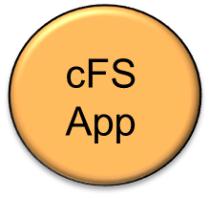
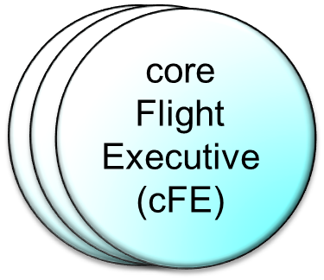
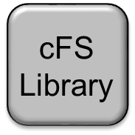
cFS Elements for Real-Time
FSW and/or SIM Execution
core Flight System (cFS)
  A Flight Software Architecture consisting of an OS Abstraction Layer (OSAL), Platform Support Package (PSP), cFE Core, cFS Libraries, and cFS Applications
core Flight Executive (cFE)
  A framework of mission independent, re-usable, core flight software services and operating environment
Each element is a separate loadable file
  Divide and Conquer
  Independent unit tests possible
  In-Flight Uploaded/Restart of App built into Core Services
cFS
App
Notes:
The Core Flight Executive provides a loosely-coupled app-based executive and software bus for communication between apps.
Apps can be developed in parallel and easily stubbed out to facilitate Early integration of components.

Slide 17

cFE / CFS Layering
Each layer “hides” its implementation and technology details.
Internals of a layer can be changed -- without affecting other layers’ internals and components.
Enables technology infusion and evolution.
Doesn’t dictate a product or vendor.
Provides Middleware, OS and HW platform-independence.
Files, Tables
Notes:
The CFS layering allows 100% re-use of the middle layers.
Only the Apps on top and HW on the bottom are mission specific.

Slide 18
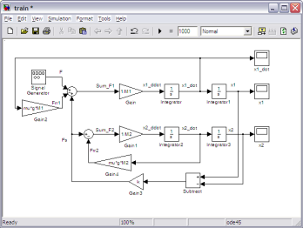
Simulink Interface Layer
Higher level Flight Software Modules modeled in Simulink
C-Software generated from Models using Real Time Workshop Embedded Coder
  cFE Template for Target Language Compiler (TLC)
    Transforms Specified Simulink Input/Output ports into cFE Message structures
      I/O ports are Simulink non-virtual buses
    Creates C Header file that defines message interfaces and entry points
      Specific Data Structures
      Macros that identify key functions
Simulink Interface Layer (SIL) provides cFE compatible app functionality:
    Uses message and entry point definitions from generated .h file
    Input Messages – Subscribed to and recv’d from Software Bus
    Output Messages – Registered and Published to Software Bus
    Event Output – Custom Block with Trigger and Format String
    Table Management – Mapped from tunable params
    Housekeeping – General Meta-Data about App
    Execution - Triggered by Specified S/W Bus Message
cFE Target Language Compiler (TLC)
Simulink Interface Header File
Simulink Algorithmic
C Code Functions
Simulink Interface Layer
(SIL)
C Code Module
Simulink
cFE App
Instance
Notes:
The other key CAST technology is the Simulink Interface Layer.
This effectively marries Model-Based Development with the Loosely-Coupled app-based cFE framework.

Slide 19
BioSentinel “Loosely-Coupled” S/C FSW Architecture ; Independent Apps
OFSW
Solar Particle
Event
Detection
Command
& Mode
Processor
State
Estimator
Attitude
Control
System
Thermal
Control
System
Power
Control
System
Software Bus
Scheduler
Stored
Commands
Memory
Manager
Memory
Dwell
Limit
Checker
House-
keeping
Memory
Scrub
Other
Hardware
I/O
(HWIO)
Health &
Safety
File
Manager
CCSDS File
Delivery
Checksum
Data
Storage
Telemetry
Output
Command
Ingest
System Support, O/S Services and Device Drivers
Telemetry
KEY
Gnd Cmds
FSW Internal
Algorithmic
App
cFS
App
Hand-written
App
Sensor/Actuator/Payload Data
FSW External
Notes:
This is what the BioSentinel Model-Based, Loosely-Coupled FSW architecture looks like:
Notice that most of the apps are re-used cFS (blue) and the algorithmic code is generated from Simulink (yellow) The HWIO is mission specific
We will take a closer look at the HWIO ….

Slide 20
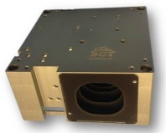
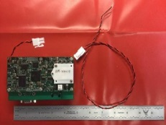
HWIO Apps in BioSentinel FSW Architecture
cFE Software Bus
BioSensor
I/O
(Payload)
LET
I/O
(Payload)
Solar Array
I/O
XACT
I/O
EPS
I/O
Sun Sensor
I/O
COMM
I/O
(SPI)
Thruster
I/O
Star Tracker, Reaction Wheels, Gyros, IMU
Analog /
Digital
I/O
Propulsion Unit
Diagnostic Mode GPIO,
Transponder Discretes,
Analog Thermistors
Device Drivers
Instruments,
Sensor and Actuators
Data to/from
Devices Over
Device Transports (i.e. RS422, SPI, SpaceWire, Ethernet etc.)
Notes:
The HWIO apps provide a virtualized interface to the algorithmic cFE apps. For example, the XACTIO app extracts sensor data from the BCT XACT unit and places it on the Software Bus for use by the State Estimator and XACTIO subscribes to do reaction wheel command produced by ACS

Slide 21
FSW Device Abstraction/Virtualization
Algorithmic Apps access data published to the cFE Software Bus by HWIO Apps
HWIO Apps act as device protocol adapters
  Adapt device data to/from S/W Bus Msgs
HWIO Apps access H/W using a standard Posix File I/O Device Driver layer
  Open, read and write calls are the same for a simulated or real H/W device
Notes:
At the bottom layer of the Device Virtualization layer is the Posix File I/O layer – This software remains the same whether you are talking to real or simulated hardware.

Slide 22
General POSIX File I/O Layering
Sim
Transport
Example:
Ethernet
Sim Platform
C&DH Platform (or Emulation)
POSIX I/O Driver Device:
Example: /let
cFE
Software
Bus
Internal
Interface
Protocol
Examples:
Space
Wire,
Memory,
PCI
Interface H/W
Examples:
Ethernet Card,
Interface Card,
UART,
GPIO,
Etc.
Posix
I/O
Simulated
Device
Example:
LET SIM APP
HWIO App
(ex: letio)
cFE Software Bus
Device Transport
Example:
RS422
External Device
Example: LET Payload
Other
cFE
App(s)
SBC (Leon 2 or
NEXYS SoftCore)
Notes:
The Posix File I/O layer allows HWIO apps to be developed with a lower fidelity device interface and simulated hardware.
For example, instead of accessing a SpaceWire card, an Ethernet Card is used. When the SpaceWire card arrives, only the Device Driver code needs to change, not the HWIO app.

Slide 23
Posix I/O Layer Advantages for FSW and Sim
Application Code can remain exactly the same whether simulated or real devices are used.
  Only the transport driver implementation changes
  Device Simulation is simple to implement
    Actual files, UDP packets, Shared Memory, UARTs etc.
  Facilitates Inexpensive Development Platforms that exercise all App code (including HWIO) in an integrated fashion.
  Same App binaries run on all targets
Allows Mix’n’Match evolution of devices
  Drivers can be over-ridden (re-loaded) at runtime
Protocol code resides in HWIO Application
  Device Cmd/Tlm interface code tested on all targets
  Realistic Device Virtualization (same in flight and sim envs)
HWIO can be developed before H/W arrives.
Notes:
HWIO can be developed before H/W devices arrive, because the way it accesses the device is abstracted in the Posix I/O Layer

Slide 24
Iris Transponder I/F FSW Evolution
Notes:
Fortunately, BioSentinel FSW is not starting from scratch. It is based on an existing NASA Ames FSW Development infrastructure.

Slide 25
Iris Transponder Ethernet PIL I/F
:
Ethernet
Sim Platform
Emulated C&DH Platform
POSIX I/O UDP Driver Device:
/downlink, /uplink, /comio
cFE
Software
Bus
Ethernet Card
(Local Network)
UDP Packets to/from
cFE
Sim Apps
Simulated
Device(s)
Comsim, to_sim, ci_sim
Posix
I/O
UDP
I/F
HWIO Apps
TO, CI, COMIO
cFE Software Bus
Other
cFE
App(s)
NEXYS SoftCore
Notes:
SPI protocol at the HWIO layer tested to Simulation based upon Interface Control Documentation

Slide 26
RS422 Tlm/Cmd I&T Configuration
Ground System
Workstation
Emulated C&DH Platform
POSIX I/O RS422/SLP Driver Device:
/downlink, /uplink
:
RS422
Memory
Mapped
Interface
RS422
SLP
Adapter
NEXYS4 System on Chip (SOC) UART Interface
Serial data to/from
External Devices
Not for flight
Posix
I/O
HWIO Apps
TO, CI
Ground Software
(ITOS)
cFE Software Bus
Other
cFE
App(s)
NEXYS SoftCore
Notes:
Similar to PIL configuration, but the telemetry and commanding use the RS422 transport; because the ethernet port is not exposed for TVAC

Slide 27
Iris Transponder SPI I/F to Emulated Iris H/W
Emulated C&DH Platform
POSIX I/O UDP Driver Device:
/downlink, /uplink, /comio
NEXYS
non-flight
SPI H/W
SPI Packets to/from External Hardware
Posix
I/O
SPI
Iris Virtual H/W
FPGA on ML605
From vendor
HWIO Apps
TO, CI, COMIO
cFE Software Bus
SPI
Other
cFE
App(s)
NEXYS SoftCore
Notes:
SPI Device Drivers tested against Hi Fidelity H/W Simulation.

Slide 28
Iris Transponder Flight Interface
C&DH Platform
POSIX I/O UDP Driver Device:
/downlink, /uplink, /comio
LEON2
Flight
SPI H/W
SPI Packets to/from External Hardware
Posix
I/O
SPI
Iris
Transponder
Device
HWIO Apps
TO, CI, COMIO
cFE Software Bus
SPI
Other
cFE
App(s)
Leon2 SBC
Notes:
Finally, testing between the real C&DH and Iris Transponder Device.

Slide 29
C&DH Interface eXtension Card (IXC) Spacewire-to-Serial FSW Evolution
Notes:
Fortunately, BioSentinel FSW is not starting from scratch. It is based on an existing NASA Ames FSW Development infrastructure.

Slide 30
Emulated SpaceWire I/F for PIL Testing
Sim Platform
XACT
IMU, Gyros, Reaction Wheels
Emulated C&DH Platform
HWIO App(s) access UDP Posix I/O Driver Devices:
/xact, /sens, /thr, /eps, /sac, /let, /brd, /das
Ethernet Card
(Local Network)
UDP Packets to/from External Device
cFE
Sim Apps
Ethernet
UDP
Ethernet UDP
Sun Sensors
cFE
Software
Bus
Thrusters
SAC
EPS
cFE
Software Bus
LET
BioSensor
Other
cFE
App(s)
NEXYS4
Soft-Core Leon
Thermistors & GPIO
Notes:
A similar, but more complex evolution for the SpaceWire-to-Serial IXC Hardware ….
UDP is used for PIL testing… cFE apps, including HWIO Apps are the same as flight…. Only the device driver implementation changes.

Slide 31
Device I/F testing without SpaceWire
BCT XACT:
IMU, Gyros, Reaction Wheels
Emulated C&DH Platform
HWIO App(s) access UARTs via Posix I/O Driver Devices:
/xact, /sens, /thr, /eps, /sac, /let, /brd
Memory
Mapped
Interface
NEXYS4 System on Chip (SOC) UART Interface
Serial data to/from
External Devices
Not for flight
Sun Sensors
Thrusters
Serial (RS422
or TTL)
SAC
EPS
cFE
Software Bus
LET
BioSensor
Other
cFE
App(s)
Engineering
Development
Units (EDUs)
NEXYS4
Soft-Core Leon
Notes:
Early testing against real external device EDUs….. All cFE Apps and HWIO apps are exactly the same as flight.
The device driver is implmented for UART I/O. Instead of some custom GSE to test the EDUs, the FSW is used.

Slide 32
BioS SpaceWire I/F with Sim for H/W-In-the-Loop (HIL) Testing
Sim Platform
XACT
IMU, Gyros, Reaction Wheels
C&DH Platform
RS422
or
TTL
HWIO App(s) access SpaceWire Posix I/O Driver Devices:
/xact, /sens, /thr, /eps, /sac, /let, /brd, /das
Interface Extension Card
(IXC)
Spacewire
Packets to/from
External Devices
With Serial, Digital or Analog Interfaces
Space
Wire
Sun Sensors
cFE
Software
Bus
Thrusters
SAC
EPS
cFE
Software Bus
LET
BioSensor
Other
cFE
App(s)
Digital / Analog
I/O
SBC (Leon 2)
Thermistors & GPIO
Notes:
The HIL tests all flight software and flight interfaces (including flight SpaceWire device drivers)

Slide 33
BioS SpaceWire I/F Flight Configuration
BCT XACT:
IMU, Gyros, Reaction Wheels
C&DH Platform
HWIO App(s) access SpaceWire Posix I/O Driver Devices:
/xact, /sens, /thr, /eps, /sac, /let, /brd, /das
Interface Extension Card
(IXC)
Spacewire
Packets to/from
External Devices
With Serial, Digital or Analog Interfaces
SpaceWire
Sun Sensors
Thrusters
Serial (RS422
or TTL)
SAC
EPS
cFE
Software Bus
LET
BioSensor
Other
cFE
App(s)
Digital / Analog I/O
Thermistors & GPIO
SBC (Leon 2)
Notes:
The Flight Configuration is the same as the HIL, except the physical cables will be shorter.

Slide 34
Conclusion
Model-Based Approach integrated with a Loosely-Coupled and layered framework enables a Flexible Infrastructure
Flexible Infrastructure with Evolving Layers and Test-Beds helps meet Hardware Availability Challenges

Slide 35
Questions?
Douglas.a.Forman@nasa.gov

Slide 36
Back-Ups

Slide 37
Flight Software Guiding Principles
COTS/GOTS elements used wherever possible
Many flight software elements are modeled in MATLAB/Simulink and then auto-coded into software applications
  Utilities → Computer Software Components (CSCs) → Computer Software Units (CSUs)
Workstation simulation (WSIM) → processor-in-the-loop (PIL) testing → hardware-in-the-loop (HIL) testing
Make use of the open source core Flight System (cFS) and core Flight Executive (cFE) open source architecture

Slide 38
Flight Software Nomenclature
Workstation Simulation (WSIM)
  FSW and Plant Simulink Models
Processor In the Loop (PIL)
  Emulated Hardware Device Interfaces
Hardware In the Loop (HIL)
  Flight-like Hardware Device Interfaces
Glue Code
  A code base and set of scripts to automate the creation of cFS applications from Model Based Designed missions
SCIMI (System Configuration Information and Mission Interfaces)
  Django/Python Relational Database Framework
  Flight/Test/Ground Files auto-generated

Slide 39
Recommended External Device Data Interface (CCSDS Space Packets)
Standardized Serial Data Interface Protocol
  Developed in conjunction with Mission Operations Lead
  Distributed to External Vendors
  CCSDS Space Packets
    With cFE compatible secondary cmd/tlm headers
  For new software on External Devices
  Wrapper approach for Legacy Devices (i.e. LET)
Advantages:
  Device data packets can go directly to/from cFE S/W Bus
  Ground System can interface directly with device over RS422
Several Device Vendors have committed:
  BioSensor, LET, EPS controller, TID, Prop System, Solar Array Controller

Slide 40
Software Bus
Hardware
I/O
Data to/from
Devices Over
Device Transports (i.e. RS422, TTL, etc.)
Device Drivers
Solar Array
Device
Propulsion
Device
EPS
Device
LET
I/O
Bio-Sensor
Payload
TID
Payload
External Devices with Serial Interfaces
XACT
Device
Sun
Sensors
Devices NOT expected to use recommended Data Interface
KEY:
Devices using
recommended CCSDS Data Interface
CCSDS
Devices NOT using
recommended CCSDS Data Interface
Notes:
These HWIO apps implement protocols for talking to Sensors, Actuators, Payloads and Communication Devices.
They may implement protocols such as SLP, CCSDS Packet Utilization Standard and
other custom protocols.

Slide 41
WSIM Workstation Simulations | Simulink on Windows, Mac, or Linux computers | Models of GN&C, Prop, Power, & Thermal Used by FSW to generate and test algorithms. Provided to MOS for limited functionality maneuver simulations.
PIL Processor-in-the-Loop | PPC750 Processor(s) in Standalone chassis or NEXYS4 Soft-core LEON C&DH with UEI Simulation | Includes all flight software functionality. Runs on 1 or 2 processors. Ethernet or Shared Memory Interfaces between FSW and Simulation Multiple copies maintained by FSW as inexpensive system for real time software & fault management development. Faster than real time (depending on selected fidelity of models and processor speed.
HIL Hardware-in-the-Loop | Avionics EDU with simulated vehicle hardware (UEI Racktangle Simulation Platform) | Highest fidelity simulators includes hardware interfaces. Run in real time. Travelling Road Show used to test payload interfaces early in development cycle Authoritative environment for verification of FSW requirements

Slide 42
Modular, Common Avionics and Software
Integrated with a range of processors
Trade study to make it easier for spacecraft to identify acceptable processors with necessary performance and budget constraints.
Initial Processors targeted:
  Beagle Bone Black
  Zynq
  PowerPC 750
  LEON
Provide a set of Software Engineering Practices and Documentation to quick start spacecraft software development effort
  Git
  Confluence/JIRA
  Bamboo Continuous Test
  NPR 7150.2 required plans
  Extensive Test Suite
  Peer Review/Formal Inspection

Slide 43
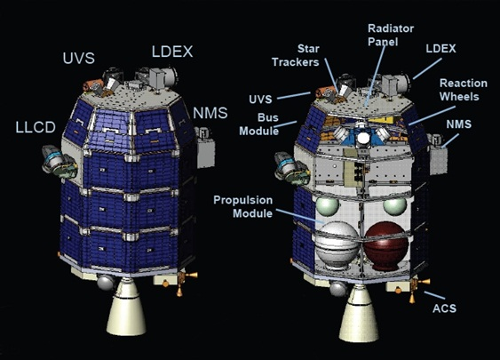
The Lunar Atmospheric Dust Environment Explorer (LADEE) Spacecraft
A small explorer class mission with the objective of investigating the Moon’s tenuous atmosphere, and to study the composition/distribution of dust in that atmosphere.

Slide 44
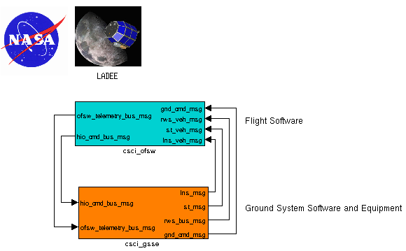
BioSentinel Flight Software
Scope
  Onboard Flight Software (Class B)
  Support Software and Simulators (Class C)
  Integration of FSW with avionics
Guiding Documents
  NPR7150.2 Software Engineering Requirements
    CMMI Level 2 or Equivalent
  NASA-STD-8739.8 NASA Software Assurance Standard
Development Approach
  Model Based Development Paradigm (prototyped process using a “Hover Test Vehicle”)
  5 Incremental Software Builds, 2 Major Releases before launch
    Final Release during mission.
Leverage Heritage Software
  GSFC OSAL, cFE, cFS, ITOS
  , VxWorks
  Mathworks Matlab/Simulink & associated toolboxes

Slide 45
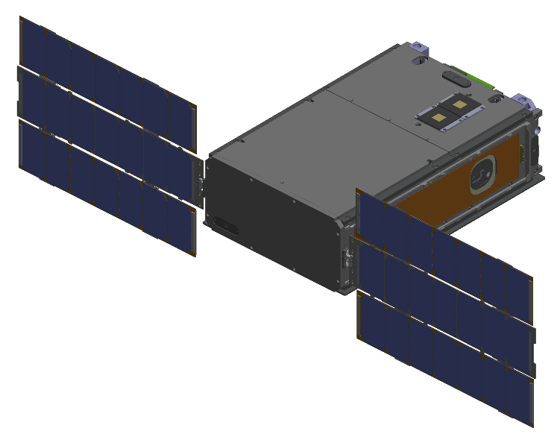
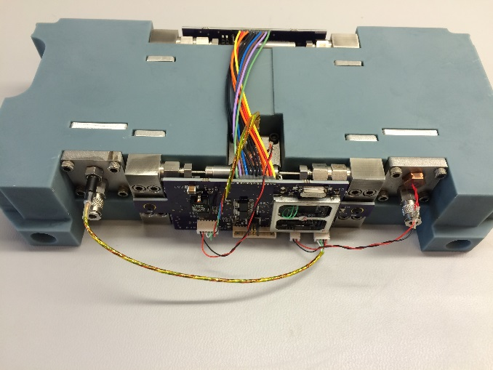
BioSentinel: A Deep Space CubeSat
A “CubeSat” class spacecraft with stowed outer dimensions of approximately 20cm x 30cm x 10 cm
Science payload will study the effects of deep space radiation on cells that are similar to those of humans
An important pathfinder to enable future human missions to the Moon, asteroids, or Mars

Slide 46
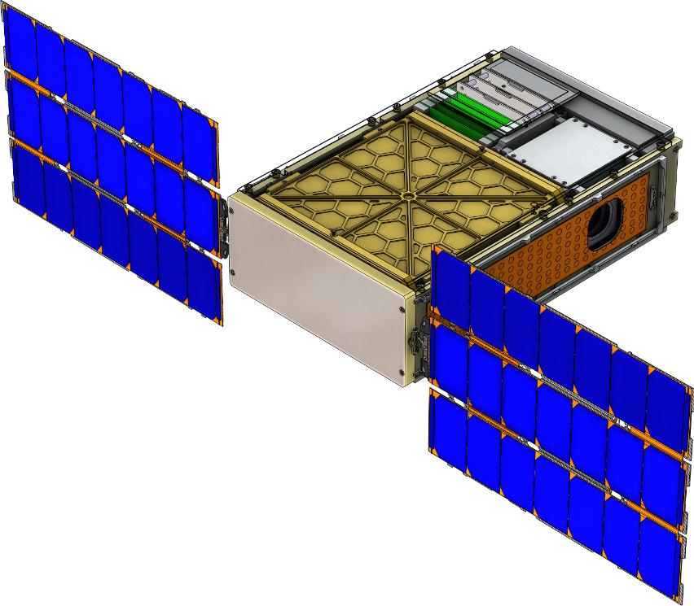
Small Spacecraft, Big Software
Science payload is controlled using a TI MSP430 microcontroller
  “Sidecar” science payload also driven with an MSP430
Electrical power system controlled with an MSP430
Attitude determination and control system has its own FPGA and LEON Processor
Radio has its own FPGA and LEON Processor
Overall spacecraft command and data handling managed with an FPGA

Slide 47
cFS Software Layers and Components
cFE App 1
cFE Apps (x5)
cFE App 1
cFS Apps (x13)
cFE App 1
cFE App 1
cFE App 1
cFE App 1
cFE App 1
cFE App 1
cFS
Library
Mission
Library
Mission
App 1
Mission
App 2
Mission
App N
Mission and cFS
Application Layer
cFE API
cFE Core
Layer
cFE Core
OS Abstraction API
cFE PSP API
Abstraction
Library Layer
OS Abstraction
Linux
OS Abstraction
RTEMS
OS Abstraction
VxWorks
OS Abstraction
Free RTOS
cFE Platform Support Packages
Real Time OS
Real Time OS
Board Support
Package
RTOS / BOOT
Layer
Mission Developed
Open source
PROM Boot FSW
3rd Party
Notes:
Missions focus on the mission applications, framework and common applications are configured for the mission and 100% reused.

Slide 48
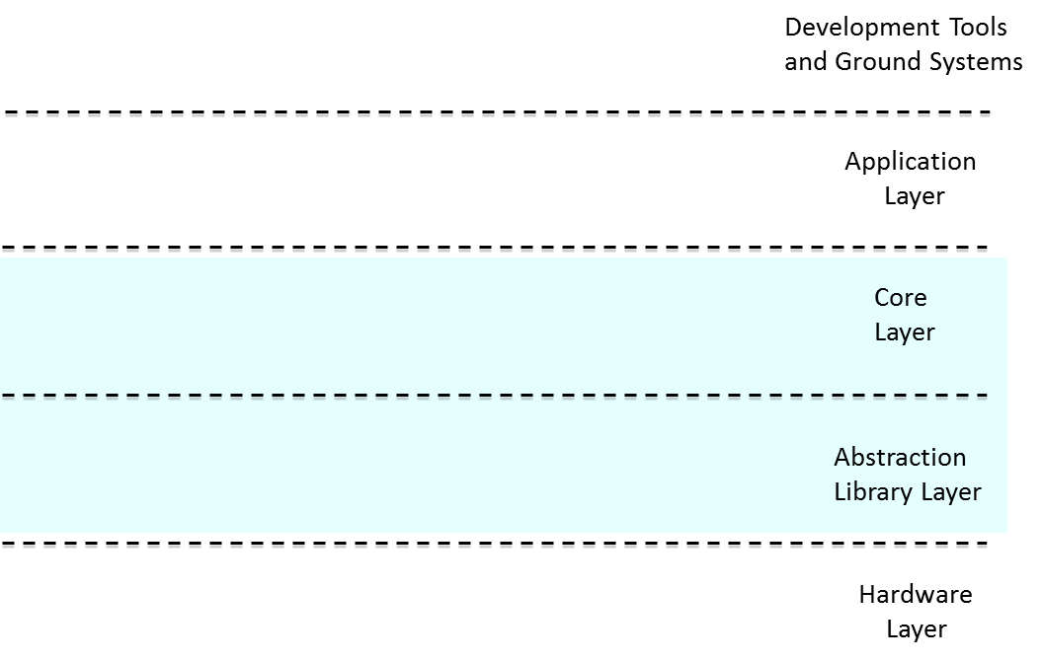
cFS Overview
Application
Development
Platform &
Run-Time
Environment
  cFS is a re-usable spacecraft flight software architecture and software suite that is both platform and project independent
  The software suite includes a common set of spacecraft applications including communications, scheduling, fault management, and many others
Notes:
CFS provides a re-usable executive and publish-subscribe communication layer in the core

Slide 49
Model
Library
Workstation Simulation (WSIM)
Spacecraft
Model
ITOS Ground System
Test Scripts
STOL
(Satellite Test Operation Language)
Cmd
Telem
Sim
IO
Dyn
Eff
Sens
C&DH
STOL to Matlab Pre-processor
Flight
Software
Local Workstation or Laptop
Simulink Only (No Autocode)
Developed early, maintained throughout development
Algorithm Development ; Requirements Analysis
ITOS Ground System Scripts ingested by Simulation
cFE Services Modeled within Simulink
  cFE Messages -> Non-Virtual Busses,
  cFE Tables -> Tunable Parameters
  cFE Scheduler -> Simulink Scheduler and Rate-Transition Blocks
49
Notes:
ITOS Ground System Scripts used in the Simulink Workstation Simulation Environment

Slide 50
Processor-in-the-Loop (PIL) Simulation
PIL
ITOS Ground System
Test Scripts
STOL
Sim
Processor
COTS “Flight”
Processor
Model
Library
Spacecraft
Model
Flight
Software
Dyn
Commands and Telemetry
Eff
Sens
Command and
Telemetry Software
(ITOS)
C&DH
Gigabit Ethernet
Gigabit Ethernet
Models auto-coded and running on RT processors
Inexpensive “flight-like” processor
Tests auto-coding process & integration with C&DH software
Integration with Telemetry Software allows early development/testing of downlink
Can be used for initial code size and resource utilization analysis
Software Development Testbed for Application layer (cFE Apps)
  Includes Device Virtualization Apps (Hardware I/O and Protocol)
  Includes vxWorks instantiation of OSAL ; but not Flight H/W Device Drivers
50
Notes:
Integrates with Tlm/Cmd System
Testbed for Application layer and tool-chain

Slide 51
Common
Model
Library
“Test Interface Controller” (Sim)
Flight Box
Sim
Processor
SACI
Spacecraft
Model
PAPI
Analog Out
SATORIS
Dyn
Analog In
ITOS Ground System
Test Scripts
STOL
Eff
Sens
Digital I/O
Flight
Software
RS422
Ethernet and cPCI Backplane
C&DH
cPCI Chassis
AMOAB
DMOAB
Commands and Telemetry
Command and
Telemetry Software
(ITOS)
cPCI Chassis
Local
Telem
Server
LADEE HIL (Hardware-in-the-Loop) Simulation
  Flight code runs on Flight Avionics EDU
  Provides testing of FSW with Avionics I/O
  Definitive answers on resource utilization
  Highest fidelity simulations for verification/validation
  Testbed for all layers including Flight Hardware Device Drivers
51
Notes:
Ground System interfaces with FSW through Flight Avionics boards
Ground System interfaces with Simulation over ethernet

Slide 52
LADEE PHIL Mix’n’Match Example:
“Test Interface Controller” Sim
Flight Box
Common
Model
Library
Sim
Processor
Ethernet I/F for
Power Control Signals
Spacecraft
Model
Analog Out
Dyn
Analog In
Eff
Sens
Digital I/O
Flight
Software
RS422
cPCI Backplane
C&DH
cPCI Chassis
AMOAB
DMOAB
Commands and Telemetry
Command and
Telemetry Software
(ITOS)
cPCI Chassis
Local
Telem
Server
Initially only DMOAB (RS422) and AMOAB Available
  No Power Boards in Avionics Box
Used Ethernet for other H/W interfaces
Re-configured during runtime initialization
  Drivers for missing H/W replaced with Ethernet Drivers
Application Code unchanged
52
Notes:
Also, very important for early integration are hybrid PIL/HIL systems:
Affectionately called “PHIL” of sometimes “mini-HIL”.
Here we have a flight-processor, network card and a subset of avionics I/O boards.
In this instance, the power and propulsion boards are not present.
Instead, the internal FSW message to those boards are transported directly to the Sim via ethernet.
The messages that would have controlled them are sent directly to the Sim over ethernet.
In the example of turning on a device, the internal SACI message now goes to a Sim HWIO app.
The Sim HWIO interprets the SACI message in order to generate the Sim S/W Bus Message for the EPS Sim.

Slide 53
Flexible Infrastructure with Evolving Layers and Test-Beds meets the Challenge
CAST Re-use (Proven Standards and tools)
  Posix File I/O, vxWorks, CCSDS Space Packets
  SpaceWire, Ethernet, RS422 / SPI
  django/python Database interface-generation Framework
  Simulink / Matlab code generation
“Test Like You Fly” / “Integrate Early and Often”
  Flight Ground Software and Database used as GSE for early Device Integration
    Minimize redundant tlm/cmd work (via SCIMI)
  Common Code used in all Closed-Loop Test Infrastructure
    Evolving Fidelity: WSIM, PIL, HIL
Efficient Layering
  Device Virtualization – HWIO Apps
    Posix File I/O
  Loosely Coupled FSW Components
    cFE / CFS
    Publish / Subscribe
  Virtual Processors

