Slide 1

Managing Thermal Requirements of a CubeSat System
Sydnie Nugent Pierce
Team Miles, NASA CubeQuest Challenge

Slide 2
The circumstances/limitations:
6U
14 kg
200 days
Deployed 412,000 km from Earth
Final distance from the Sun: 1.3 Au
Expected temperature range: 40ºC to 3ºC

Slide 3
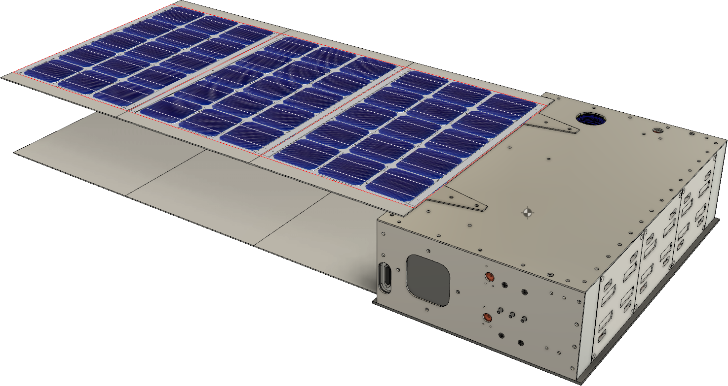
Factors affecting craft’s thermal environment:
Orientation to the sun
Solar panels
Power consumption
Energy loss

Slide 4
Systems requiring thermal consideration
Communication
Power
Control
Propulsion

Slide 5
Methods to manage thermal conditions
Sensing
Heating
Materials/Structure
Behavior

Slide 6
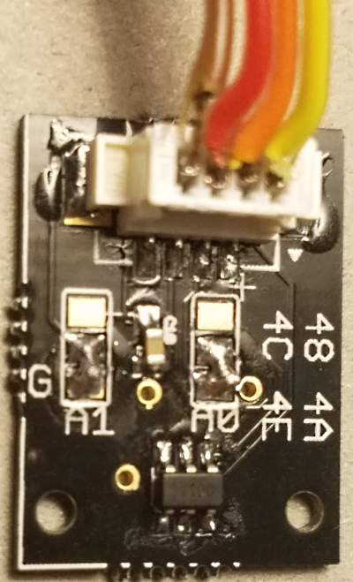
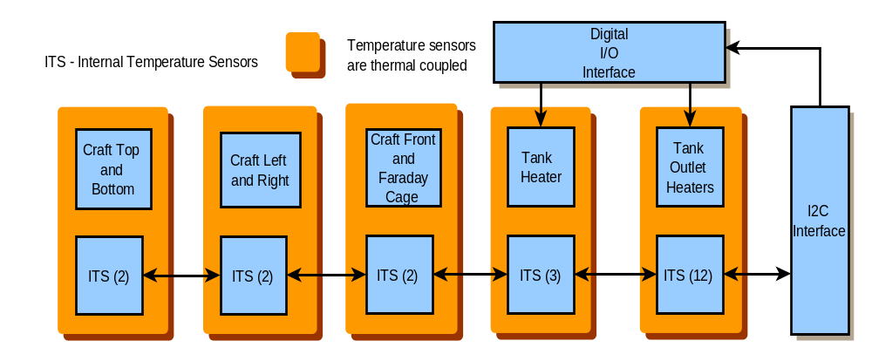
Sensing
ITS
Thermistors
Temperature sensors

Slide 7
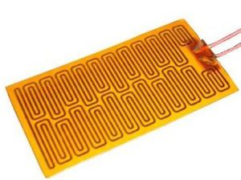
Heating
Film heaters
Operating Temperature: -200 to 200°C (-328 to 392°F) for heaters without pressure sensitive adhesive (PSA).
Maximum operating temperature for heaters with pressure sensitive adhesive is 120°C (248°F)
Maximum Thickness: 0.010" except at lead wire exit
Wattage: 2.5, 5 or 10 W/in2
Dielectric Strength: 1250 Vac

Slide 8
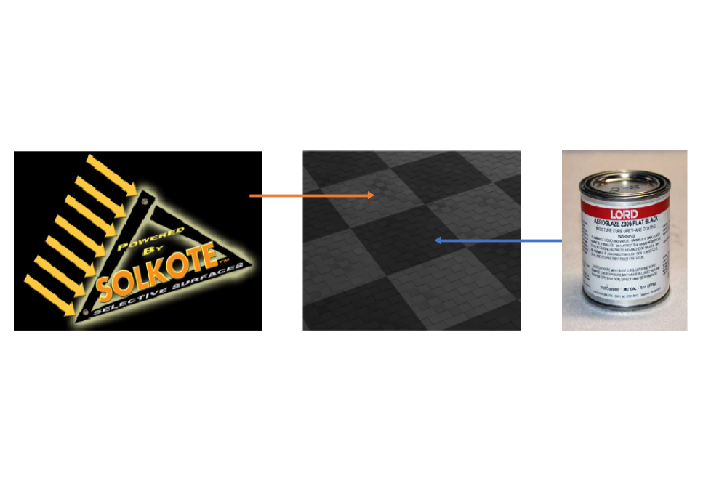
Materials/Structure
7075-T7351 Aluminum hull
Thermal coatings on hull: 3 different layers

Slide 9
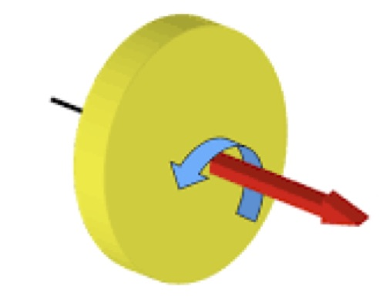
Behavior
“BBQ” roll
+ Thrust Axis

Slide 10
Thermal properties of external materials:
Material | Absorptivity | Emissivity
Z306 | 0.955 | 0.89
Solkote | 0.94 | 0.49
Al panel net | 0.9475 | 0.69
Solar panel substrate | 0.90 | 0.90
Solar cell | 0.92 | 0.85

Slide 11
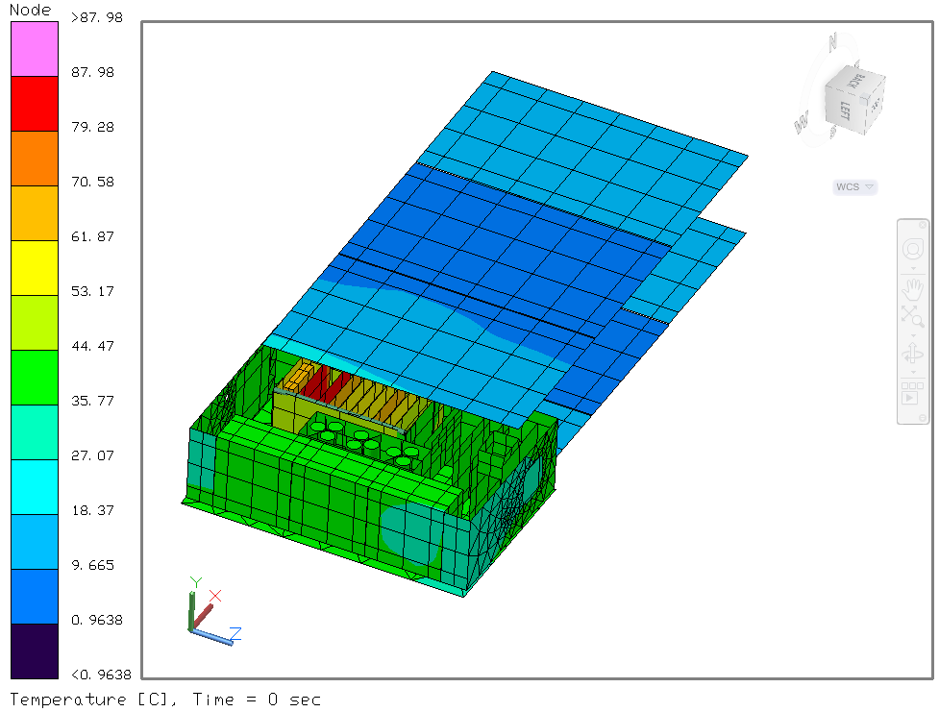
Thermal FEA simulation:
Location | Avg. Temp (ºC)
Solar Array | 11
C&DH Boards | 66
Batteries | 42
Tank | 38
Star Trackers | 41
Radio | 82
Amplifier | 63

Slide 12
Operational modes & Power usage
Mode | Gross Electrical Usage | Non-thermal Energy Leaving Craft | Net Thermal Energy
Radio receive, no thruster | 10.848W | 0W | 10.848W
Transmit, no thruster | 31.248W | 5W | 26.248W
No radio, Thrusting | 27.5W | 10.77W | 16.73W

Slide 13
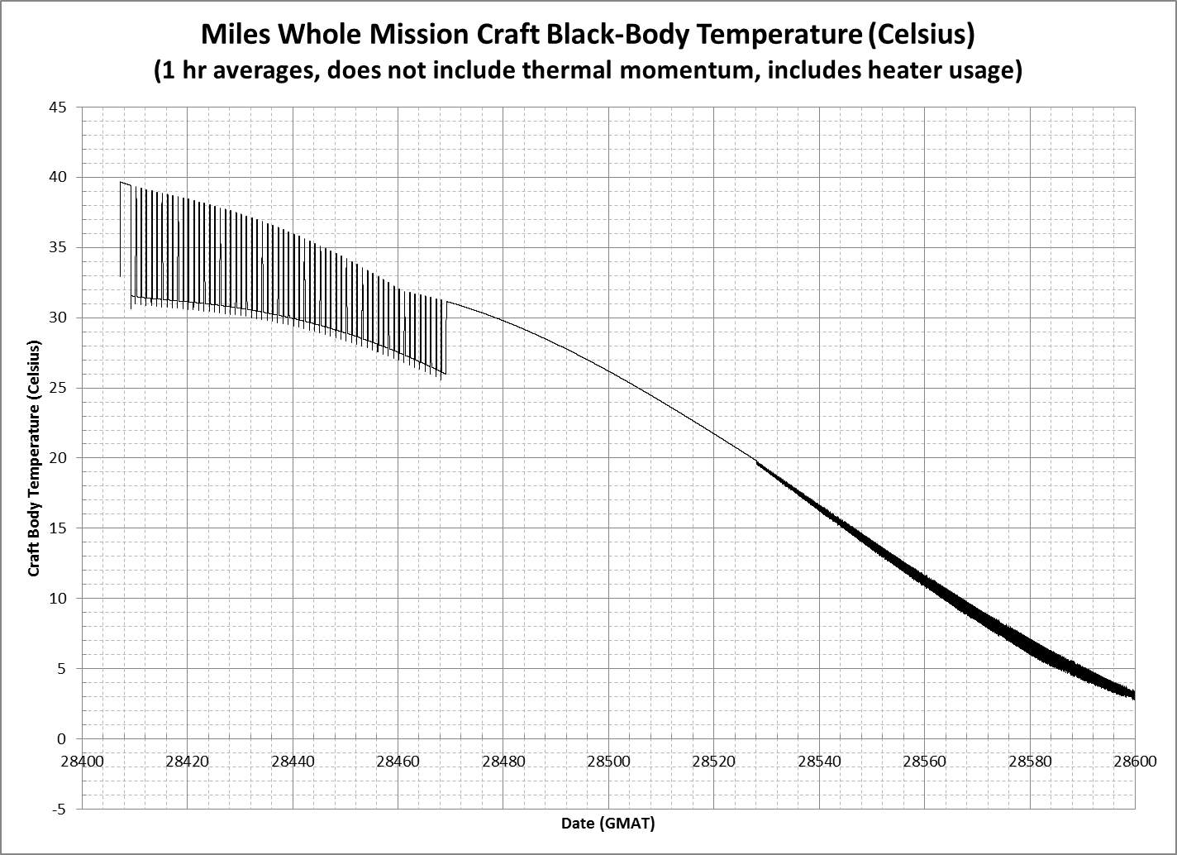
Power usage during mission

Slide 14
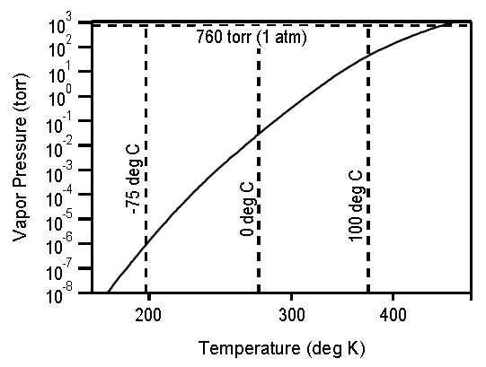
Thermal regulation of I₂
Vapor pressure
curve for I₂

Slide 15
Mass of thermal system
THERMAL | Qty | Mass (g) |  | Total (g)
Flat film heater Faraday cage (3x13cm) | 1 | 14.5 | 14.5
Temperature Sensor Boards | 6 | 1.61 | 9.66
Thermal Coating | 1 | 29 | 29 | 53.16
(Thermal Control Panels (sq.cm.)) | (12000) | (0.01) | (120) | (173.16)

Slide 16
Contact information:
Team Miles: https://miles-space.com
email: sydnie@miles-space.com

Slide 18
Thermal System

Slide 19
Keeping thermal conditions under control:
Temperature sensors
Thin-film heaters
Thermal coatings

