Slide 1
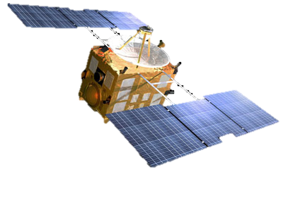



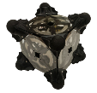
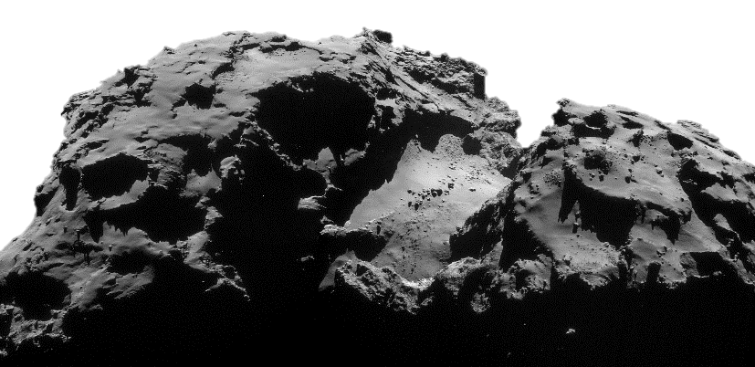
Autonomous Surface Mobility on Small Solar System Bodies with Hopping/Tumbling Rovers
Benjamin Hockman¹
Julie Castillo-Rogez², Robert Reid², Issa Nesnas²,
Andreas Frick², Jeffrey Hoffman³,Marco Pavone¹ (PI)
1
2
3

Slide 2
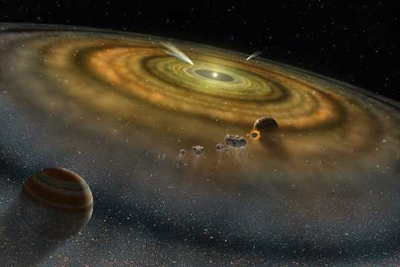
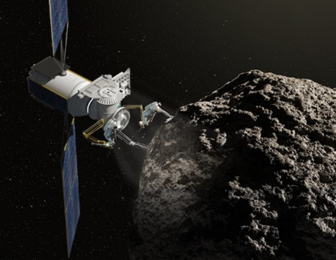

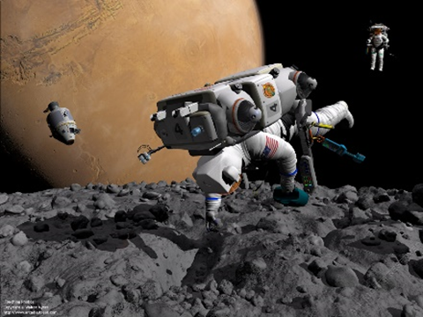
Exploring small Solar System bodies
Science
Resources
Exploration Drivers
Planetary Defense
Human Exploration

Slide 3
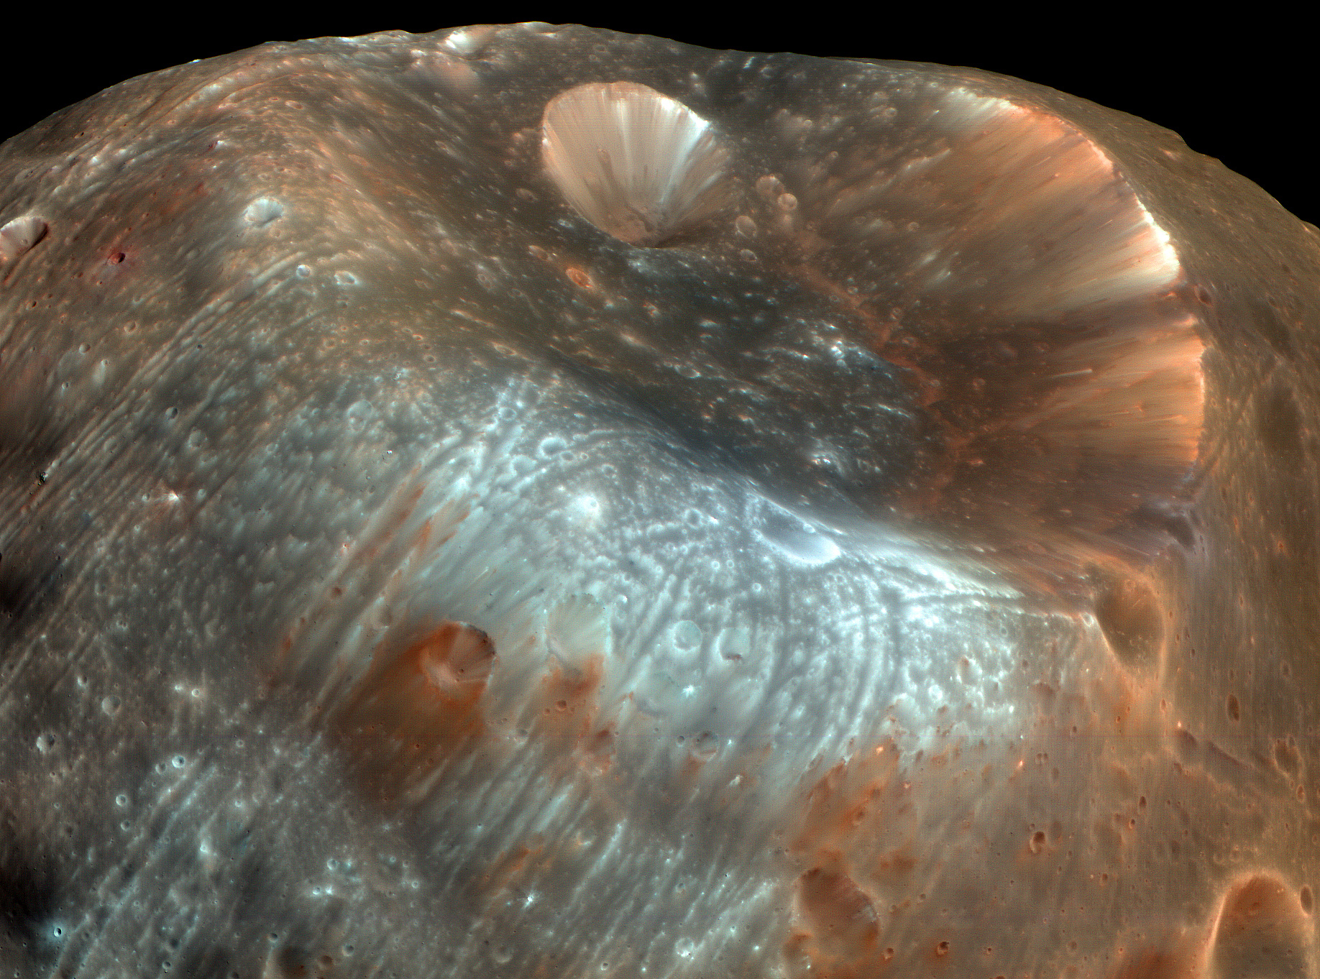
Spatially distributed geology
Need a Rover!

Slide 4
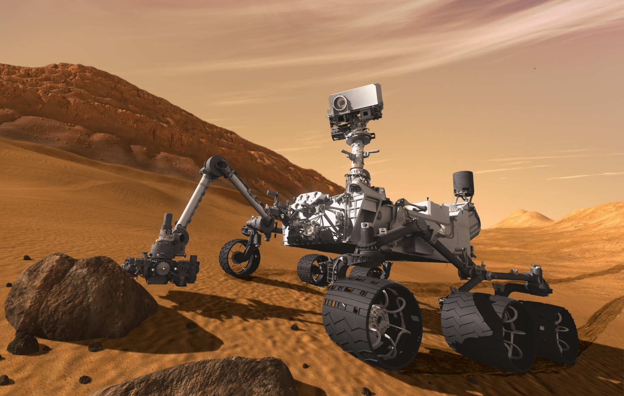
The Big Question
How would you change the design for LOW gravity environments?

Slide 5
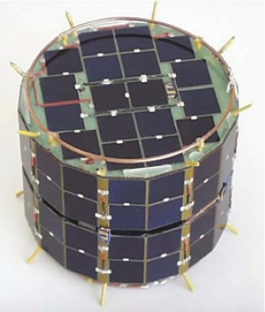
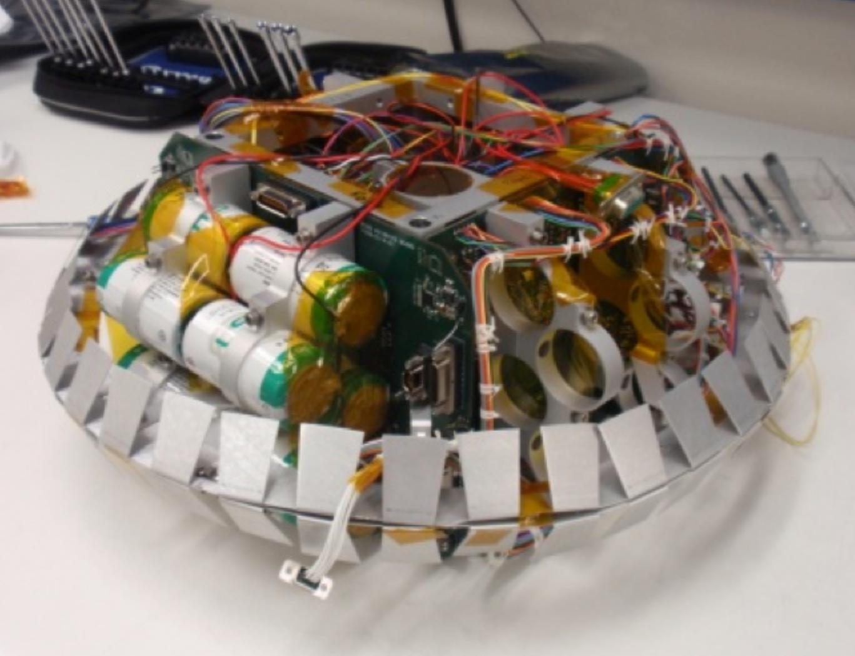
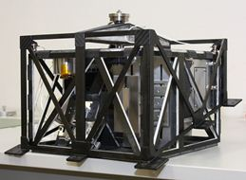
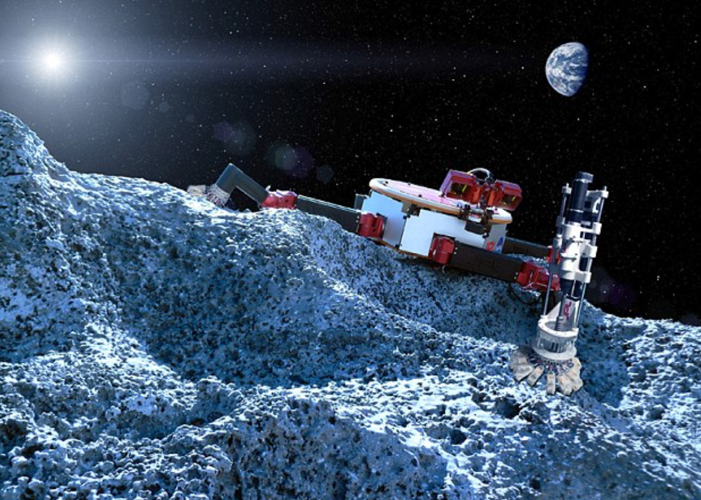
Micro-Gravity Space Rovers
Four classes of mobility:
Hopping
Wheels
Legs
Thrusters

Slide 6
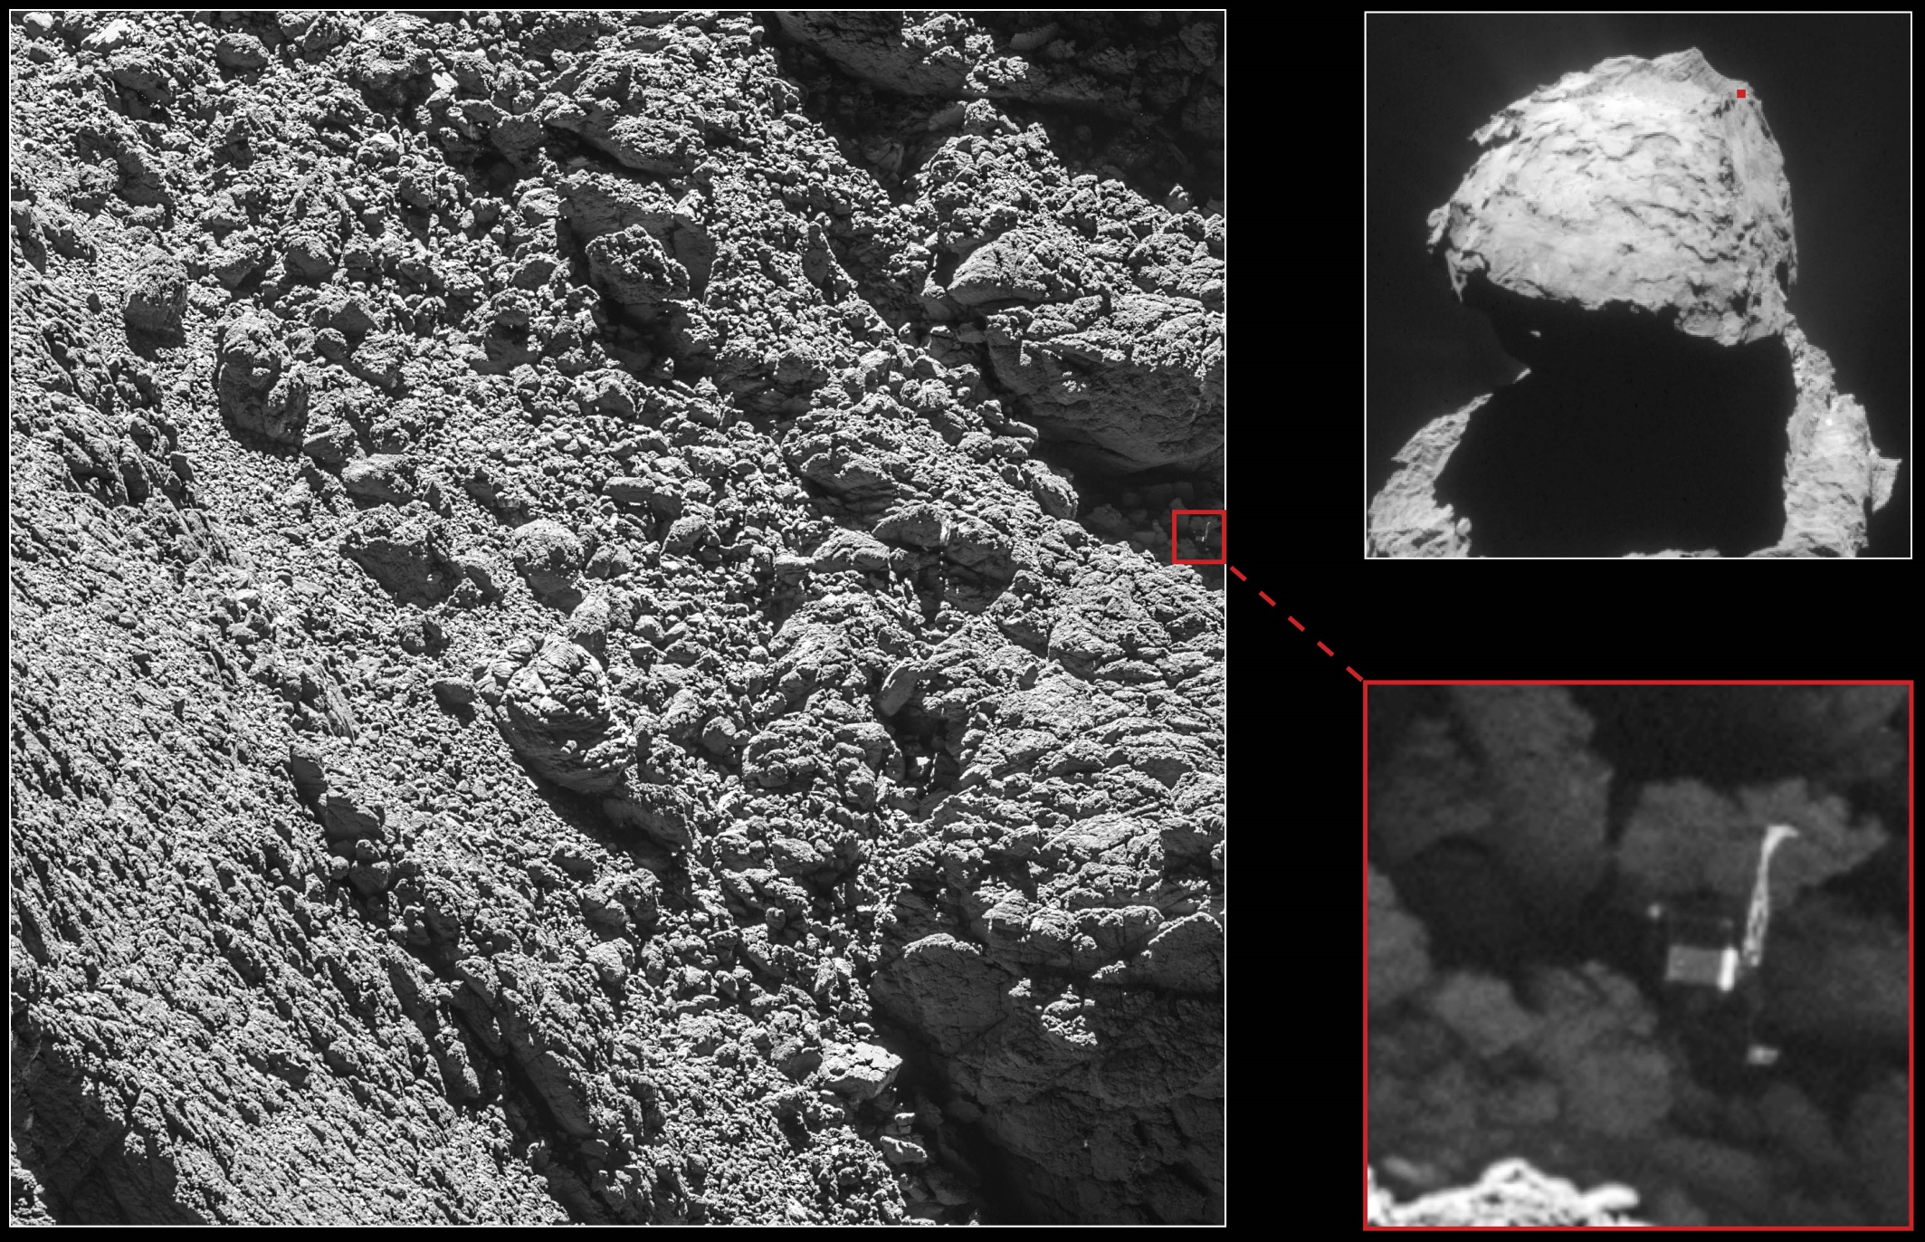

Slide 7
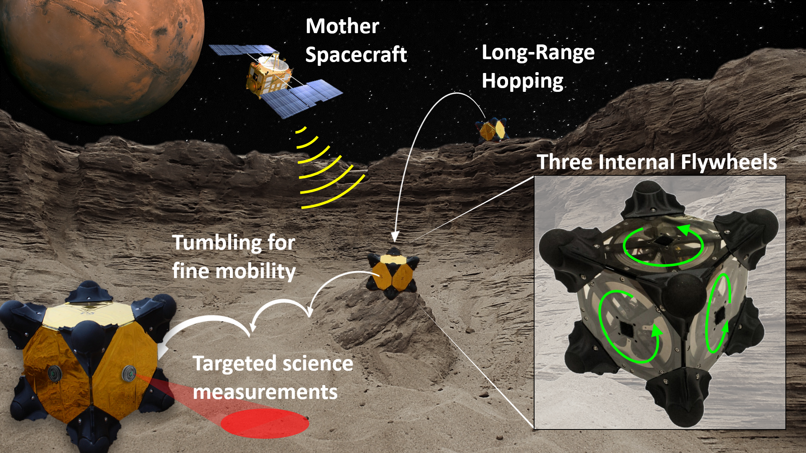
Hedgehog hopping rovers
A mission architecture that allows the systematic and affordable in-situ exploration of small Solar System bodies.

Slide 8
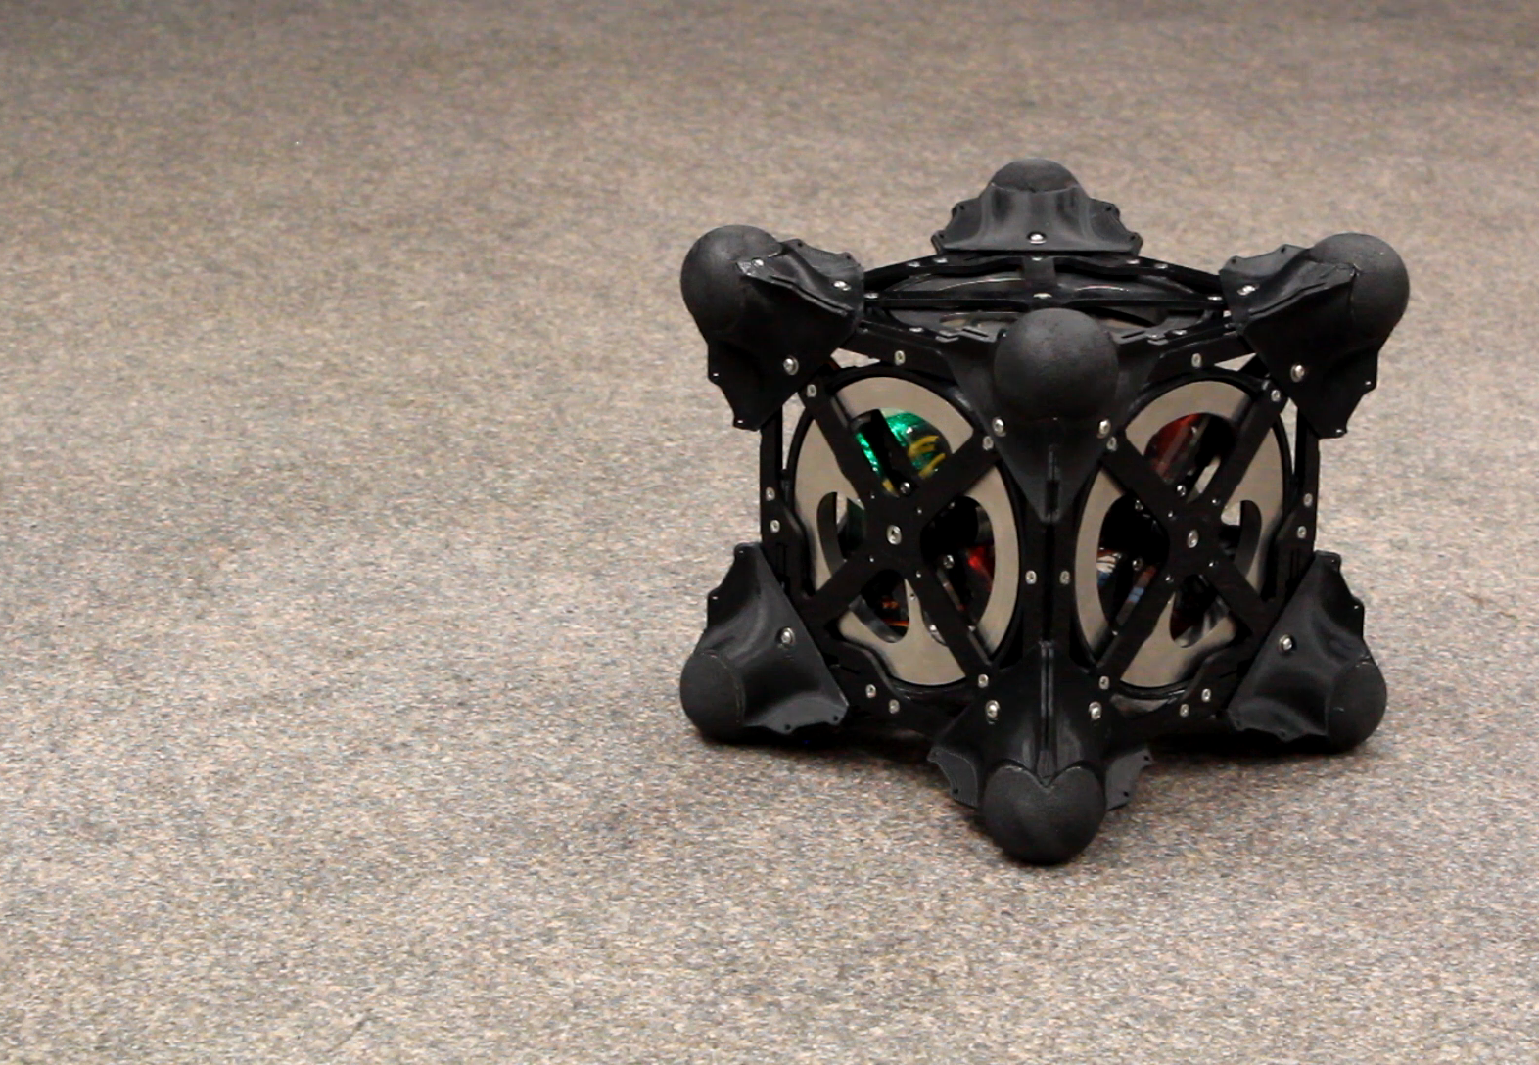
Mobility via Internal Actuation
Key idea: Swapping angular momentum
Spin up flywheels to desired speed
Hit the brakes!
Generates large torque
Angular momentum
transferred to chassis
Rover hops in a forward ballistic trajectory

Slide 9
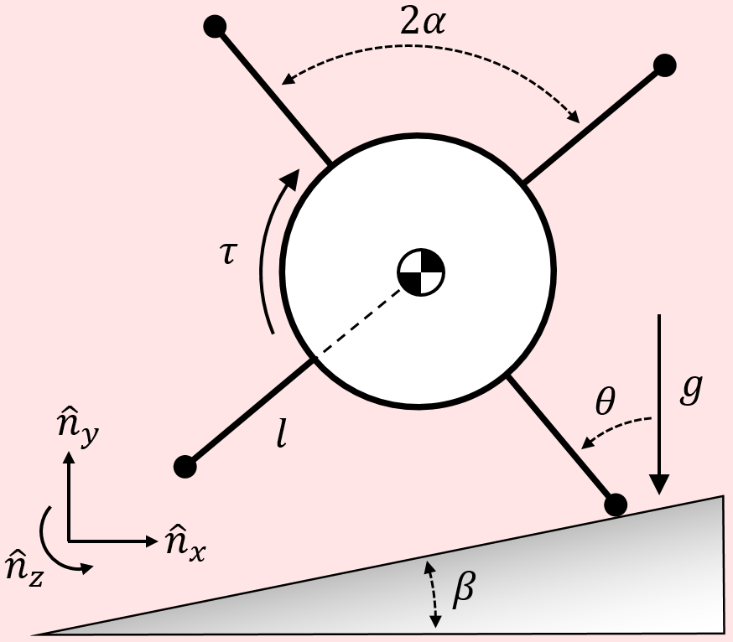
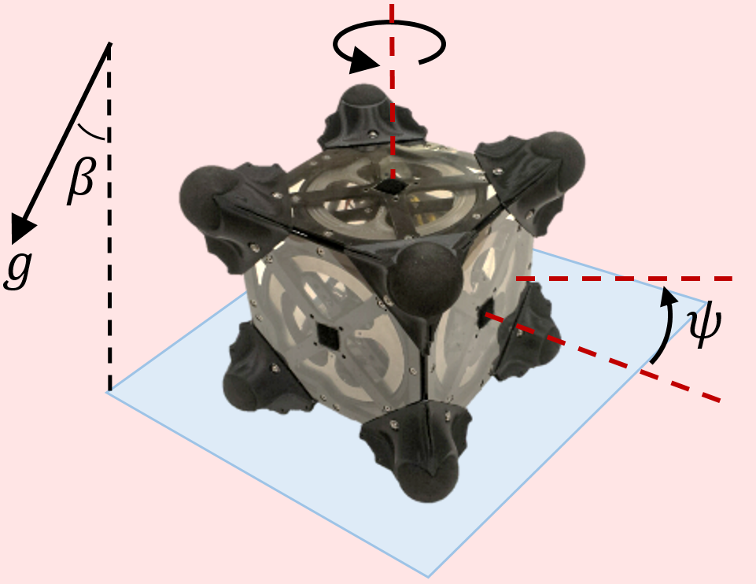
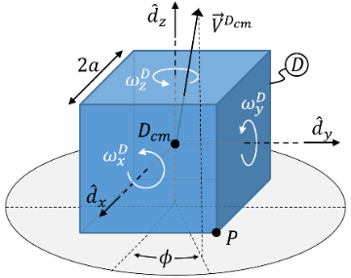
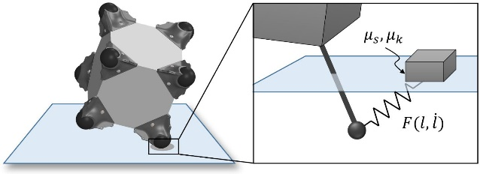
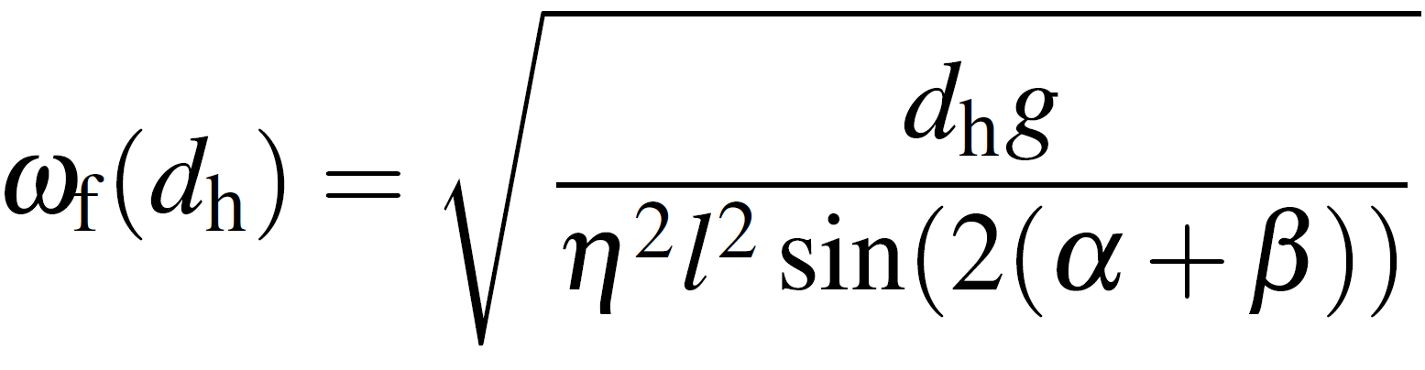
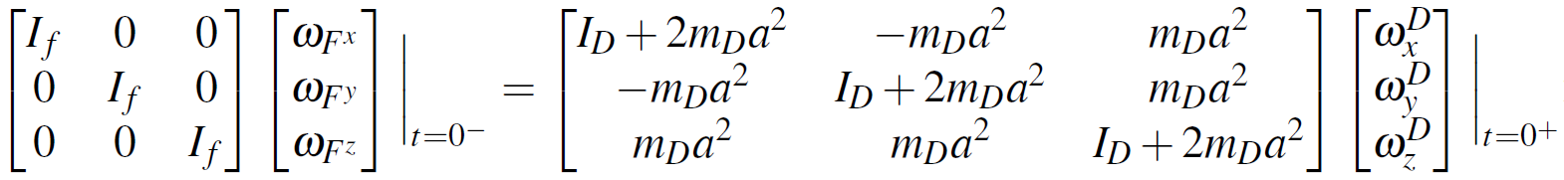
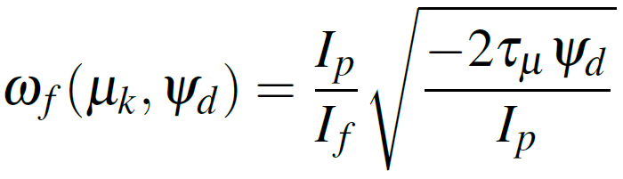
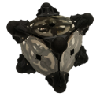
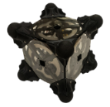
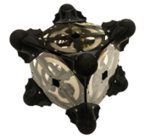

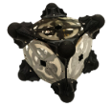
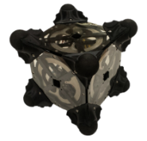
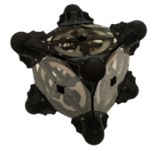


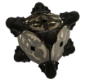
Dynamics and Control
Analytical and numerical models
[Hockman, et al. JFR, 2016]
Control Laws
A suite of controllable motion primitives
Hopping
Tumbling
Directional Hopping
Twisting

Slide 10
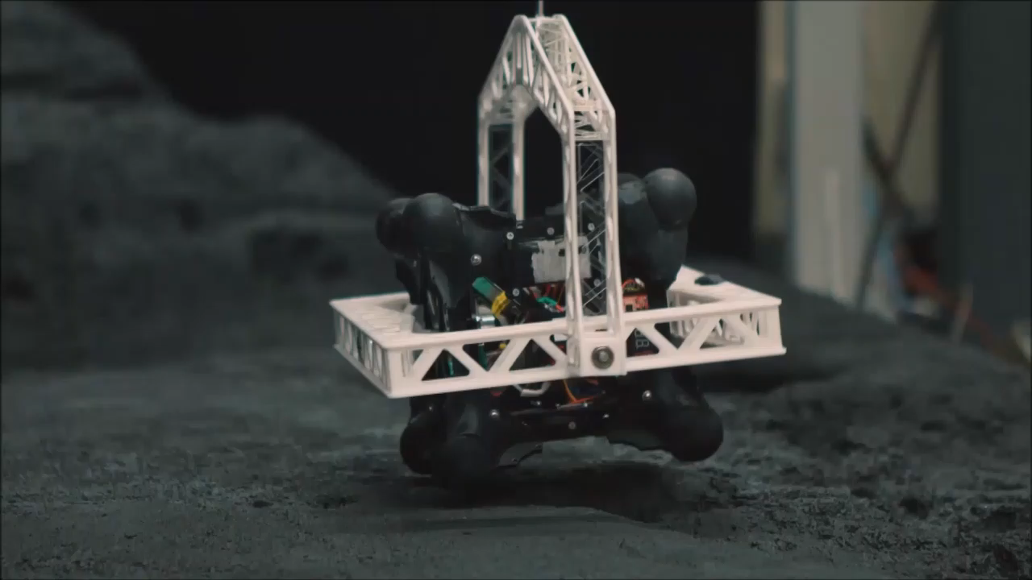
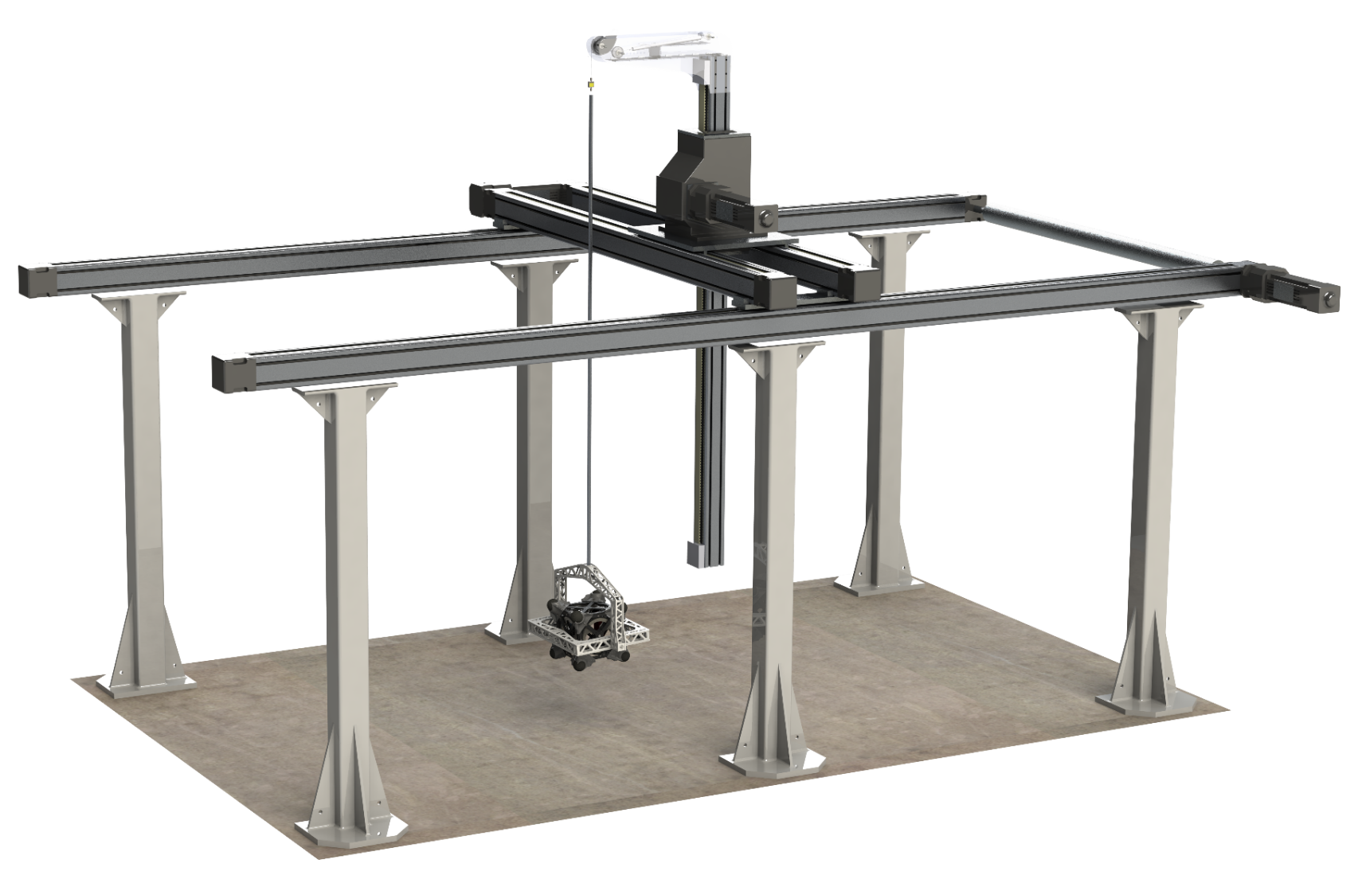
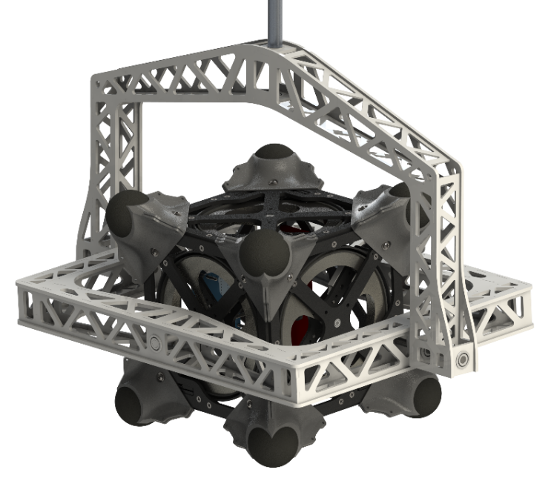
Experiments in Microgravity Test Bed
Effective gravity ≈ 0.001 g
Real time playback speed
Z
Y
Gantry
X
Yaw
Gimbal
Pitch
Roll

Slide 11
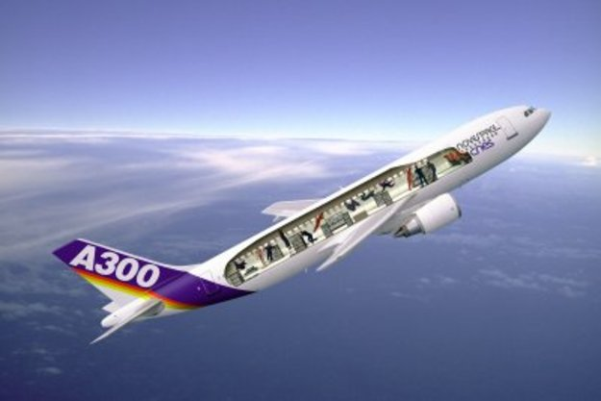
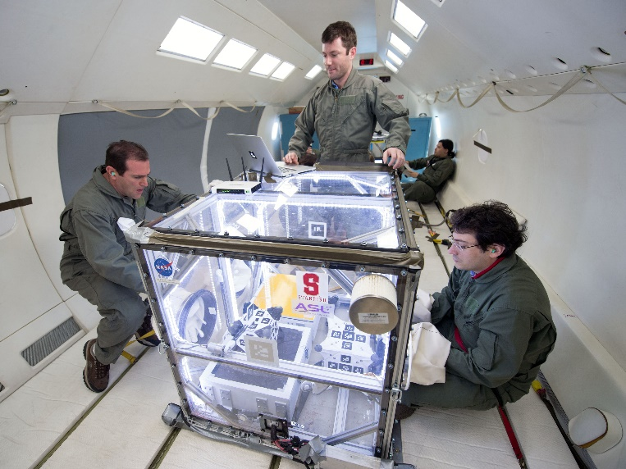
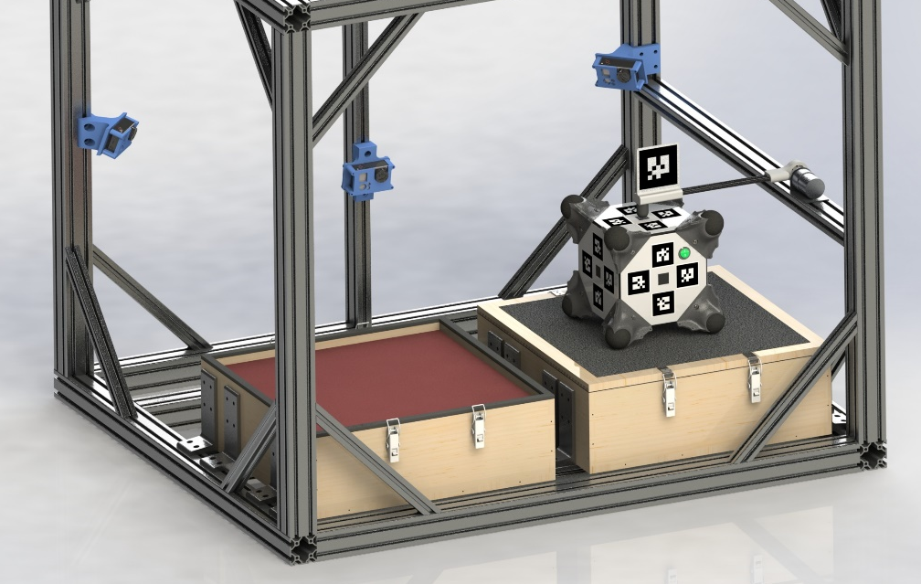
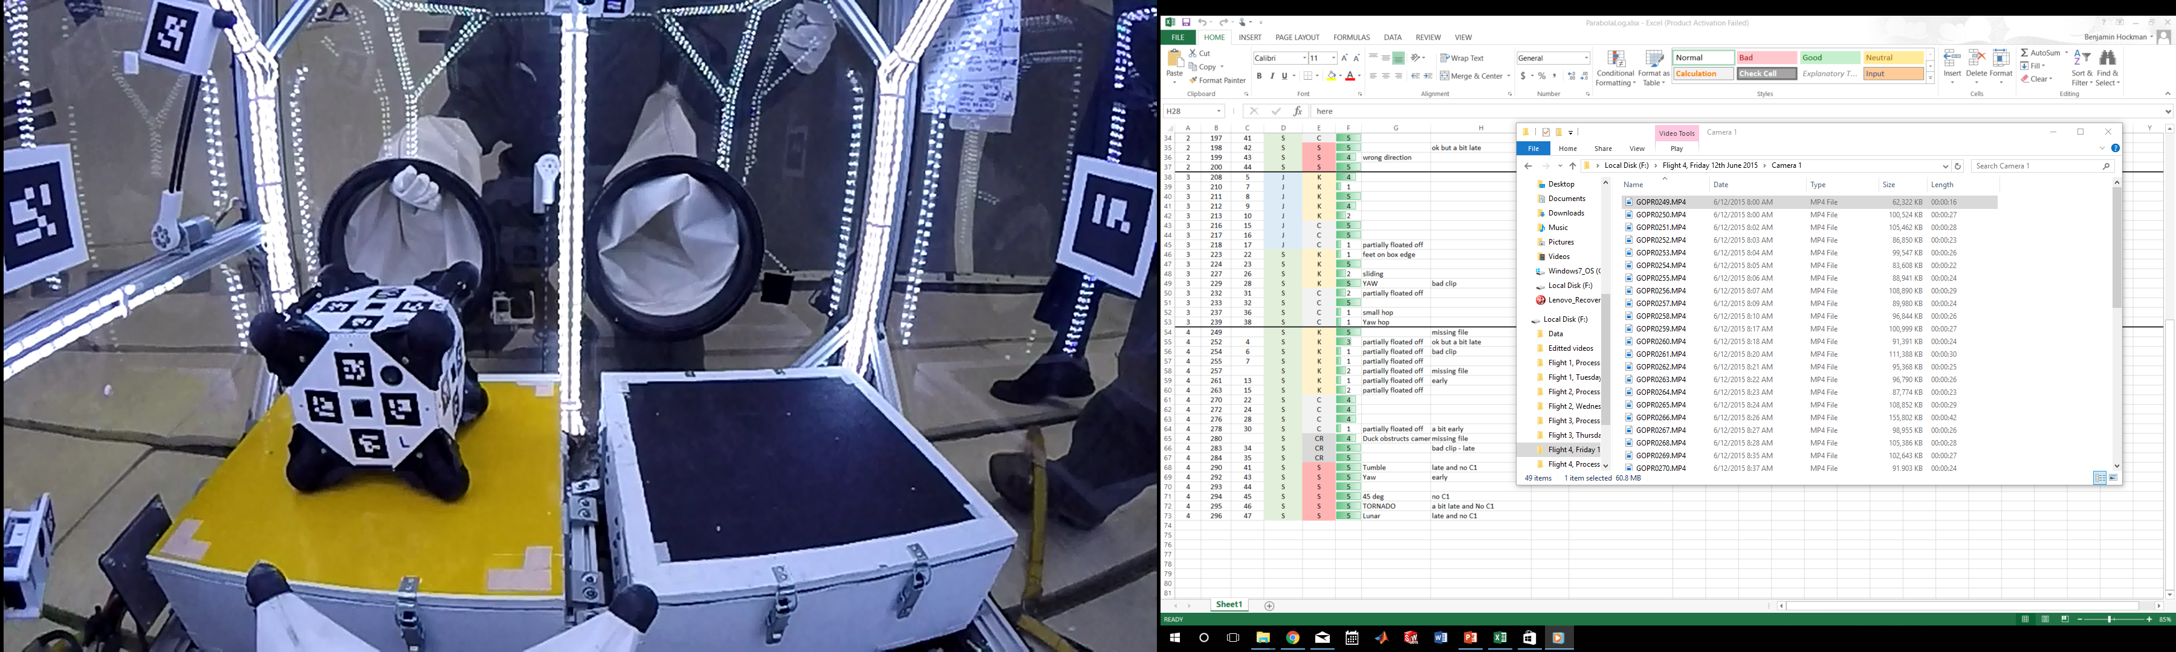
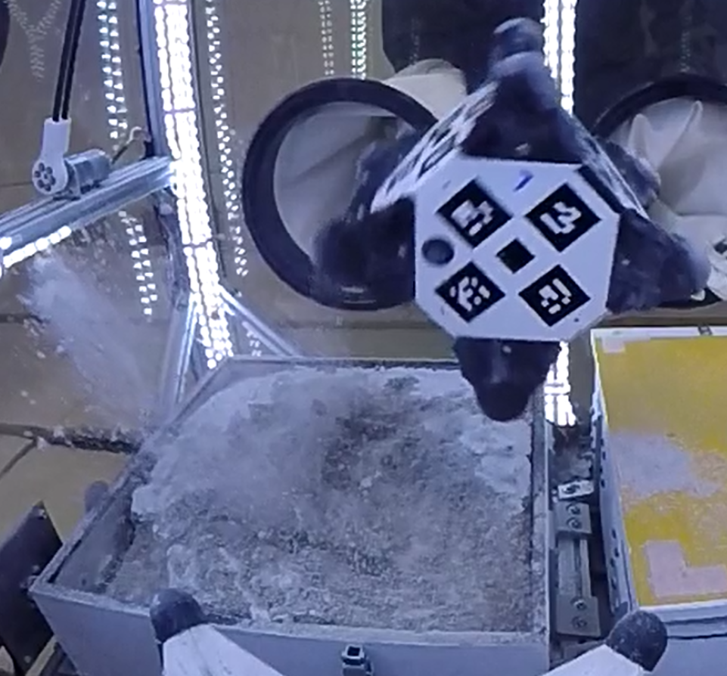
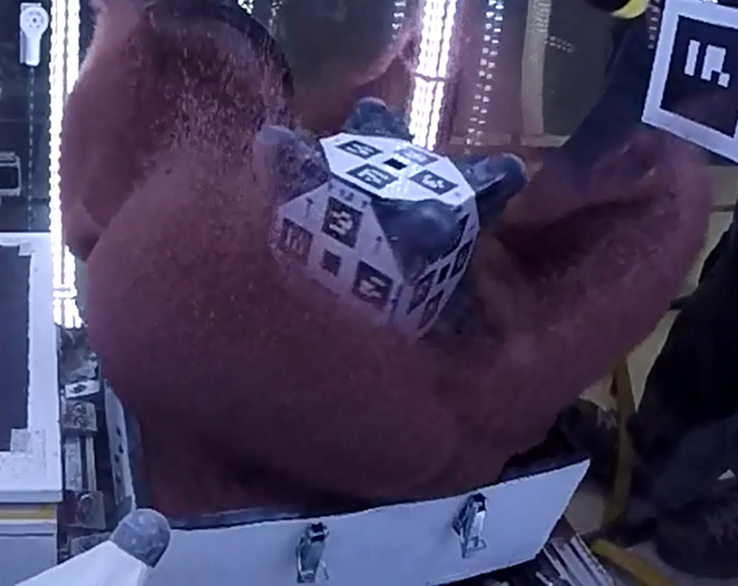
Parabolic Flight Experiments
Cameras
Retractable arm
Test Surfaces
Four different test surfaces:
Low friction
High friction
Regolith simulant
Sand

Slide 12
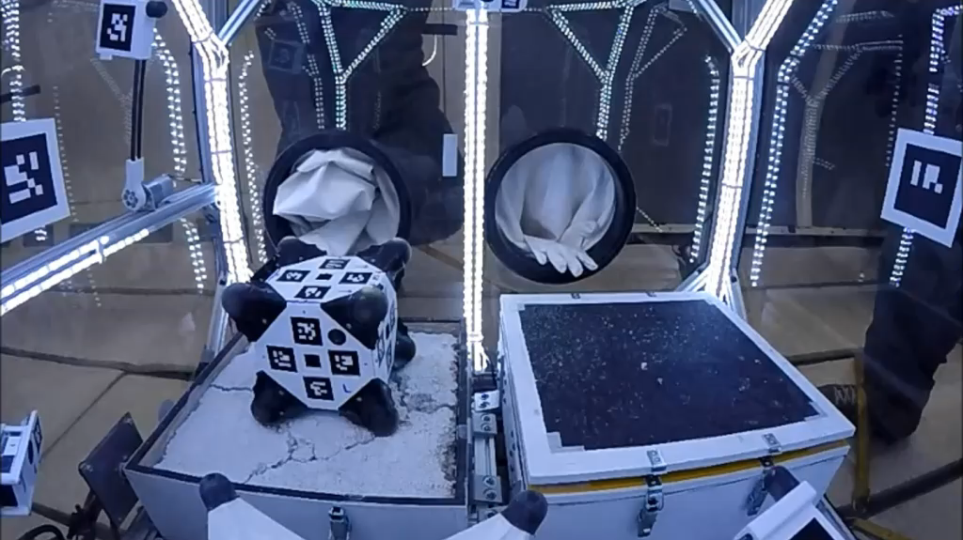
Parabolic Flight Experiments
Hopping on regolith simulant
[Hockman, et al. ISER, 2016]

Slide 13
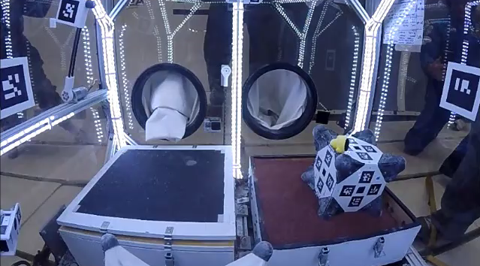
Parabolic Flight Experiments
Hopping on sand
[Hockman, et al. ISER, 2016]

Slide 14
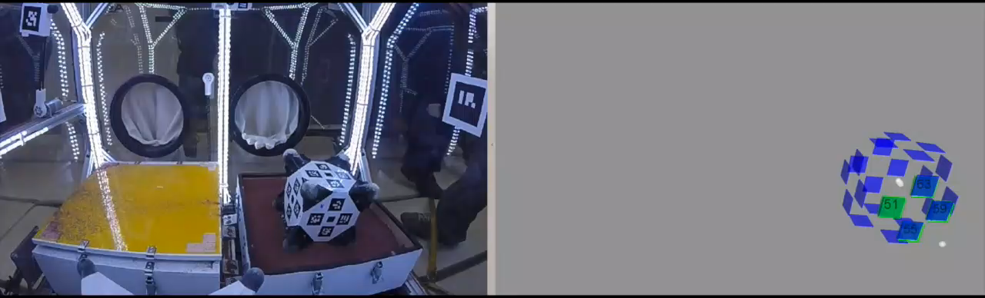
Experimental Results
Extract launch trajectory from imagery and compare with predictions
Good agreement for rigid surfaces (< 10% error)
More accurate granular media contact models needed
Bottom line: Controlled mobility is possible and uncertainty can be characterized
[Hockman, et al. ISER, 2016]

Slide 15

From controlled hopping...

Slide 16
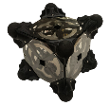
From controlled hopping...
to targeted mobility
Nonlinear two-point boundary value problem
?

Slide 17
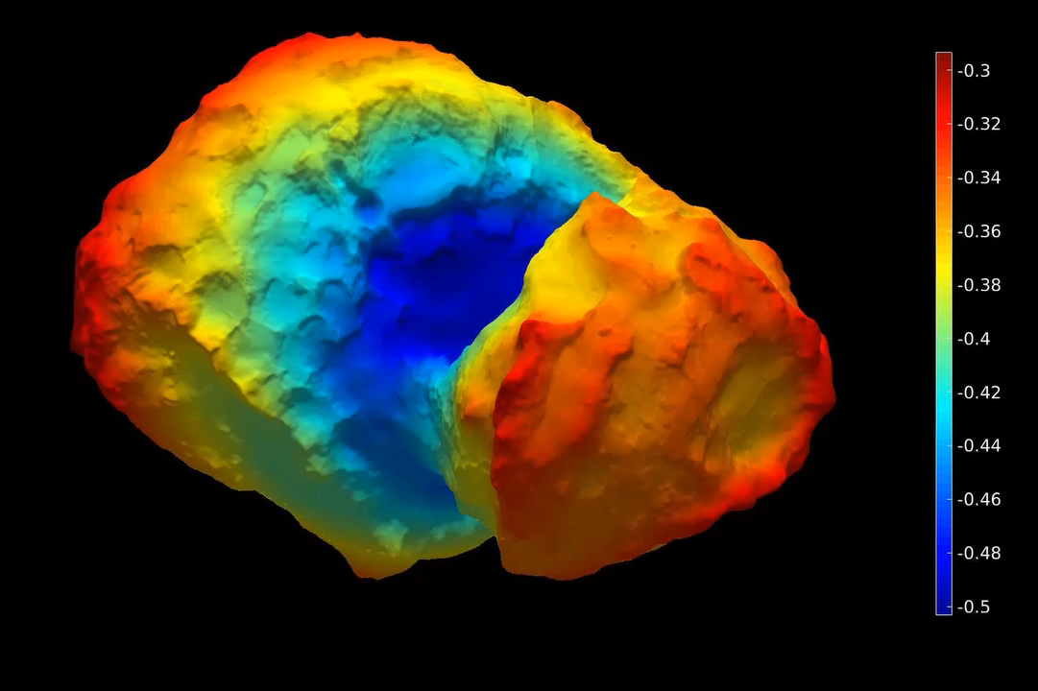
Which way is up?
Geopotential map of comet 67P

Slide 18
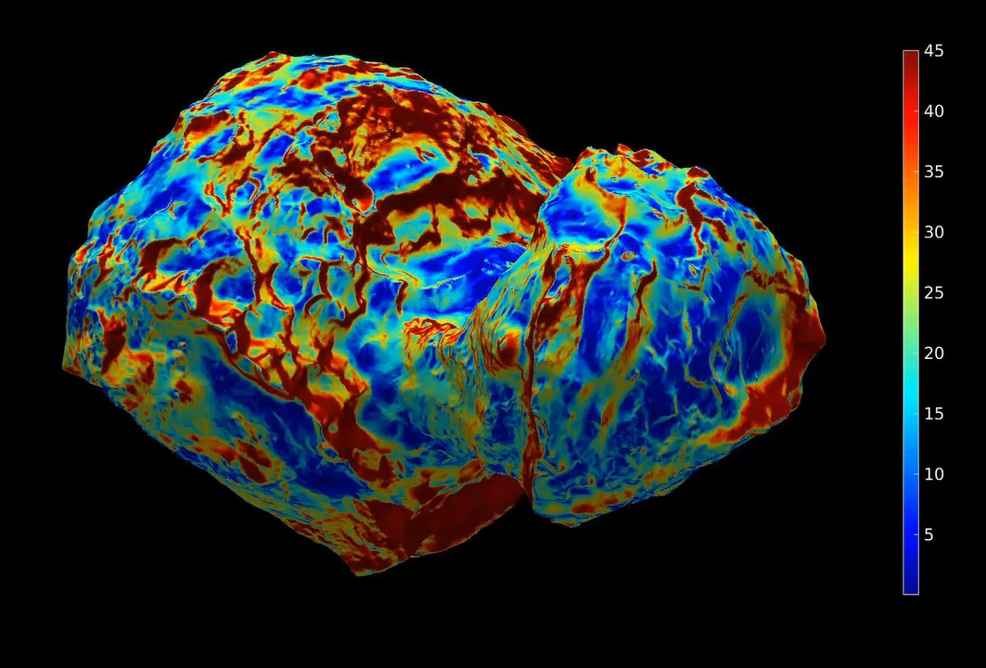
Where can the rover go?
Surface slope map of comet 67P

Slide 19
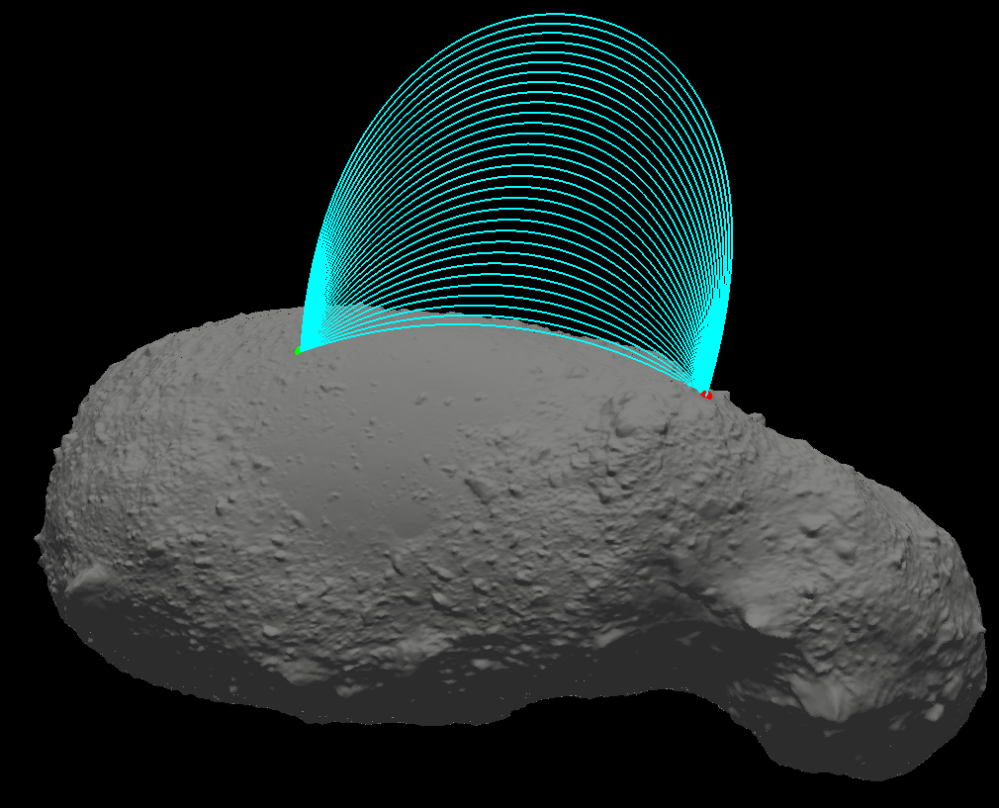
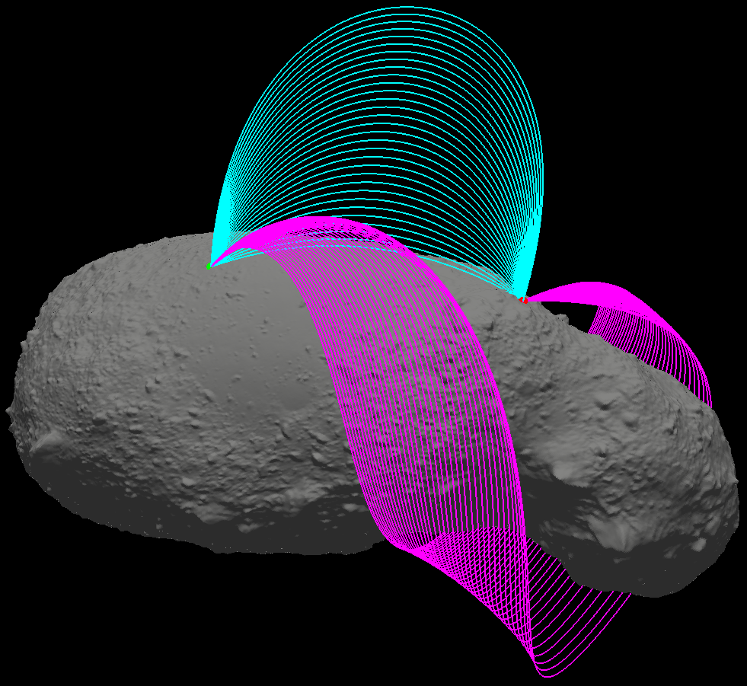
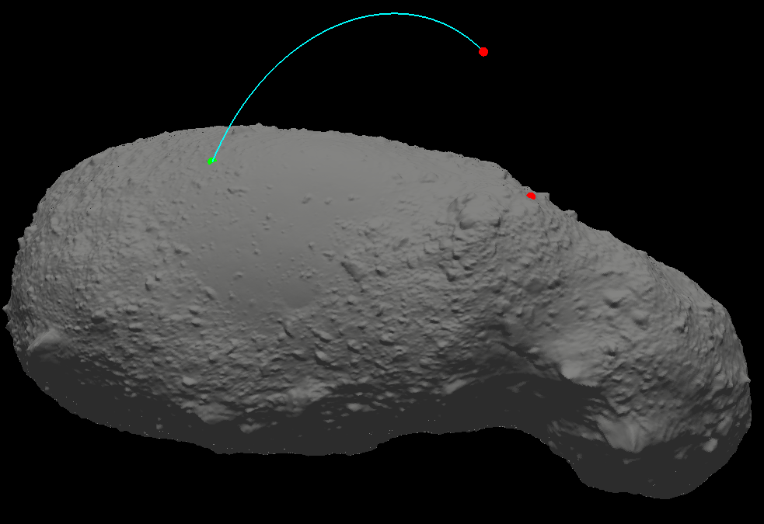
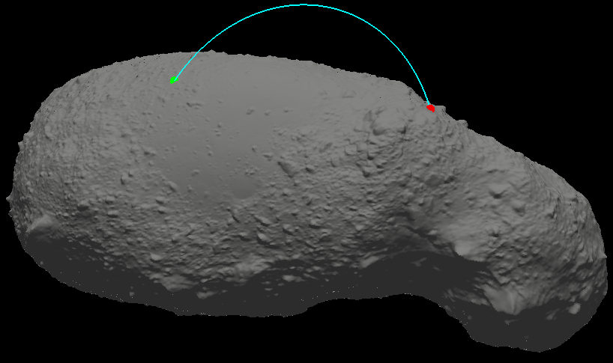
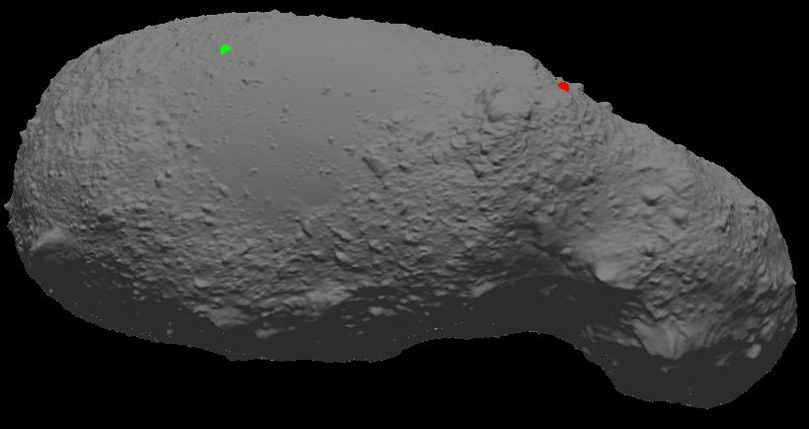

Going from A to B
Choose desired flight time, T
Initial guess using Lambert solver
Use shooting method to converge on true solution
Extrapolate solution class
Search for other
classes of solutions
error
$$v_{guess}$$

Slide 20
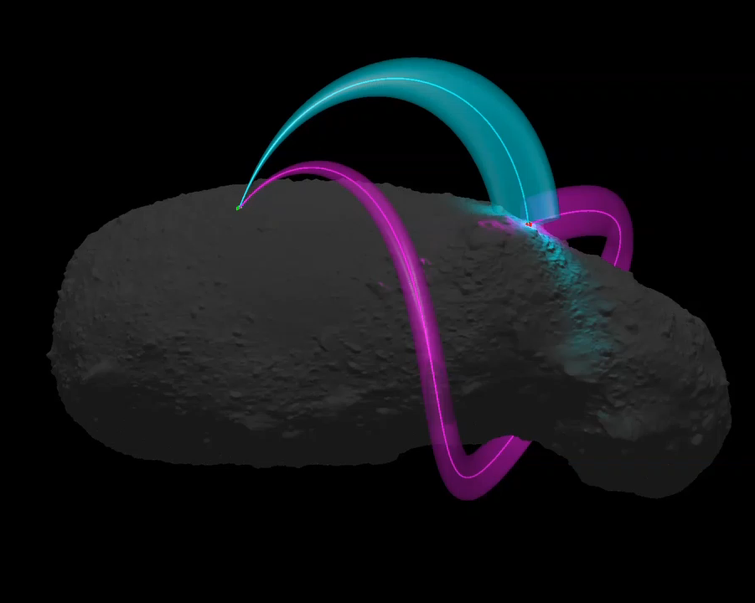
Which trajectory to choose?
Constraint on flight time, T
Constraint on hop velocity vector
Surface imaging
Illumination/shadowing
Error propagation

Slide 21

But what about bouncing?
Impact on the surface is likely to be somewhat elastic
Series of bounces produces chaotic scattering

Slide 22

Autonomous mobility as a sequential decision process
Localization: where am I?
Planning: where should I go?
Ballistic flight and bouncing
Execution: how do I get there?

Slide 23

“Learning” a control policy
Use tools from Reinforcement Learning to compute approximately optimal control policies from simulation data

Slide 24
Conclusions
Hopping rovers are a promising solution for targeted mobility in microgravity.
Models, simulations, and experiments suggest motion accuracy of ~10%.
Autonomous navigation requires very different tools than for wheeled rovers.
Ongoing and Future Work
Develop more realistic contact models for granular media and friable regolith
Extend planning algorithms to be “adaptive” and account for localization uncertainty
Impact damping strategies to mitigate bouncing
High-fidelity GPU-based framework for integrated planning and localization simulations

Slide 25

Questions
Publications
B. Hockman, R. Reid, I. A. D. Nesnas, and Marco Pavone. Experimental Methods for Mobility and Surface Operation of Microgravity Robots. International Symposium on Experimental Robotics, October 2016 (in review)
B. Hockman, A. Frick, I. Nesnas, and M. Pavone. Design, control, and experimentation of internally-actuated rovers for the exploration of low-gravity planetary bodies. In Conf. on Field and Service Robotics, Toronto, Canada, June 2015. Best Student Paper Award
R. Reid, L. Roveda, I. Nesnas, and M. Pavone. Contact dynamics of internally-actuated platforms for the exploration of small Solar System bodies. In Proc. International Symposium on Artificial Intelligence, Robotics and Automation in Space, Montreal, Quebec, June 2014.
A. Koenig, M. Pavone, J. Castillo, and I. Nesnas. A dynamical characterization of internally-actuated microgravity mobility systems. In Proc. IEEE Int. Conf. Robotics and Automation, Hong Kong, China, June 2014.
R. Allen, M. Pavone, C. McQuin, I. Nesnas, J. Castillo, T. N. Nguyen, and J. Homan. Internally-actuated rovers for all access surface mobility: Theory and experimentation. In Proc. IEEE Int. Conf. Robotics and Automation, Karlsruhe, Germany, May 2013.
M. Pavone, J. Castillo, I. Nesnas, J. Homan, and N. Strange. Spacecraft/rover hybrids for the exploration of small Solar system bodies. In Proc. IEEE Aerospace Conference, Big Sky, Montana, March 2013.
J. Castillo, M. Pavone, I. Nesnas, and J. Homan. Observational strategies for the exploration of small Solar system bodies. In Proc. IEEE Aerospace Conference, Big Sky, Montana, March 2012.
Current work funded by NSF and NASA under NIAC Phase II award
Previous work funded by NASA under JPL RTD, CIF, FOP, and NIAC Phase I award
Contact: bhockman@stanford.edu

Slide 26

System Architecture
Baselined for Phobos mission
Leverages subsystems designed for JPL’s interplanetary CubeSats (~TRL 6)
8U (20cm) design, scalable from 1U to 27U
1. C&DH/Avionics
JPL Interplanetary CubeSat C&DH Board
Processing capability for semi-autonomous ops and agile science
Leverages: NEA Scout
2. Cold Gas Propulsion (Optional)
For soft landing from ~20m/s deployment
Alternatively, volume can be used for payload or more batteries
Leverages: INSPIRE, MarCO, NEAS
3. Telecom
UHF or S band Relay to Mothership
antennas embedded in frame
Leverages: INSPIRE
4. GNC Sensors/Actuators
3 flywheels
3+ wide angle cameras
Sun Sensors + IMU
Star Tracker
Leverages: JPL Visual Odometry frameworks & VSLAM algorithms
1
3
2
5. Science Instruments
X-Ray Spectrometer
Thermocouple
Microscope
Cameras + Accelerometers
Leverages: APXS (Pathfinder/MER/MSL)
6
5
6. Electrical Power System
Lithium primary and secondary batteries ( >1000 W-h @12V)
Optional solar panels
Leverages: INSPIRE, MarCO, NEA Scout
4

Slide 27






Collaborative Localization and Mapping
A hybrid localization approach is being explored:
Coarse / Global Estimation
Fine / Local Estimation
Inertial and optical sensors provide approximate localization.
Collaborative visual SLAM allows more precise localization
IMU
Star Tracker
Sun Sensor
Two phases of visual localization:
Prior mapping by mothership: logs visual features at various illumination angles to build a global map of the body
Localization onboard deployed hybrid: Builds internal map during proximity operations and cross-references with global map during large hops.

Slide 28

Mechanical Design

Slide 29

Results
Generally good agreement between models and measured data
Low friction surfaces violate pin joint pivoting assumption
Numerical models are better but require estimates of surface elasticity properties

