Slide 1
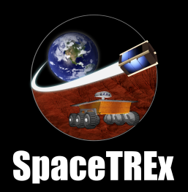
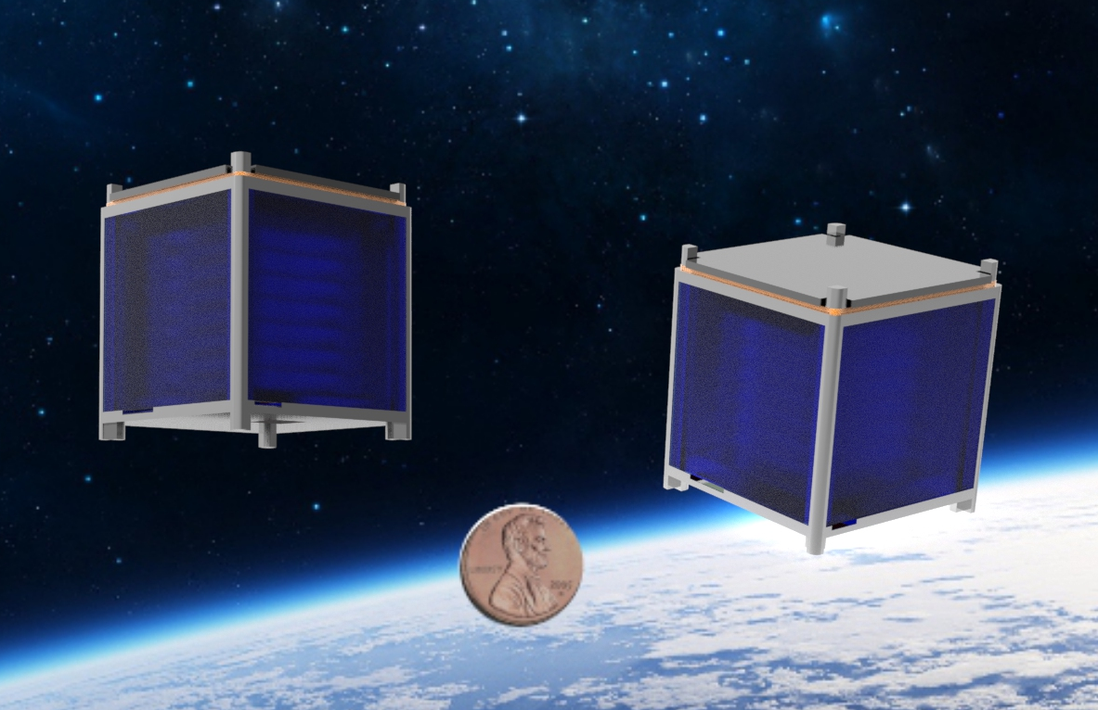

SunCube FemtoSats: A New Tool in the Interplanetary Exploration Toolbox
Jekan Thanga , Mercedes Herreras-Martinez, Andrew Warren, Aman Chandra, Ravi Teja Nallapu, Erik Asphaug
Space and Terrestrial Robotic Exploration (SpaceTREx) Laboratory
Arizona State University

Slide 2

Space and Terrestrial Robotic Exploration Laboratory
space.asu.edu

Slide 3
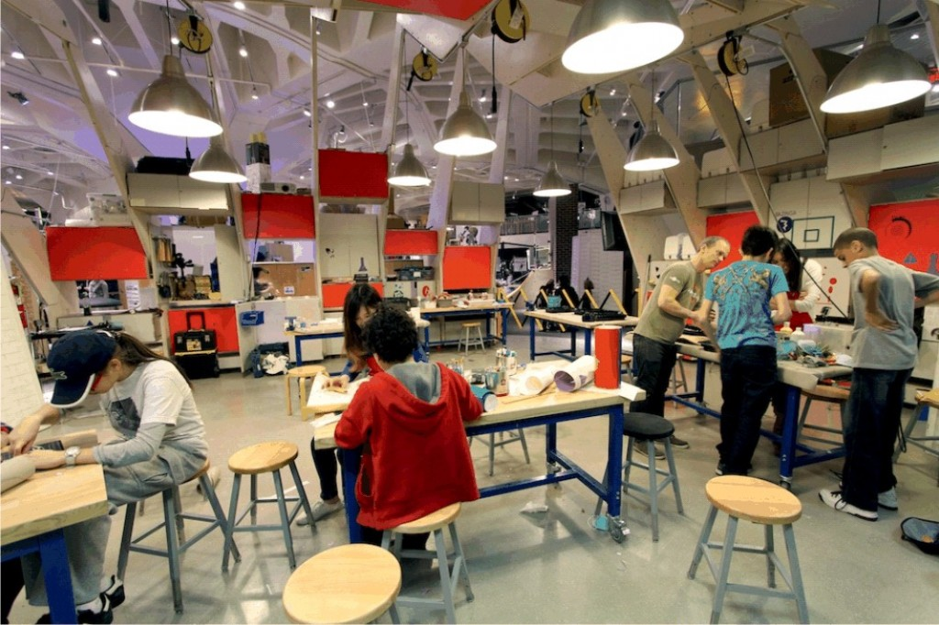
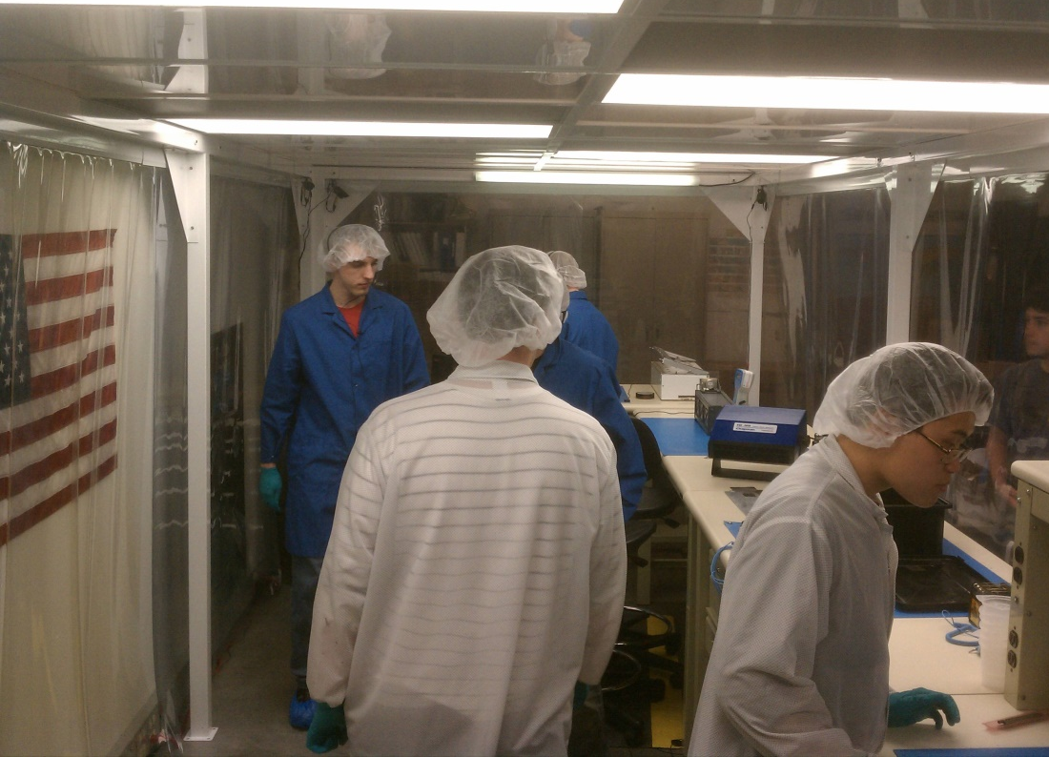
Motivation
  1. Enables access to space for educators, university, high school and middle school students

Slide 4
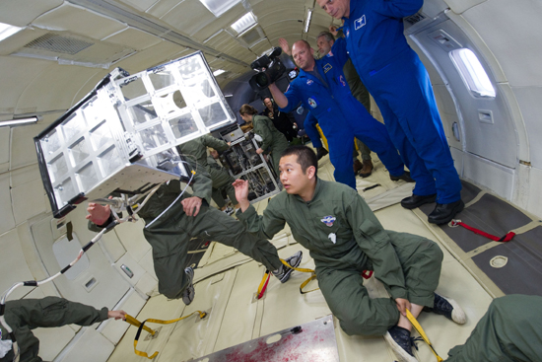
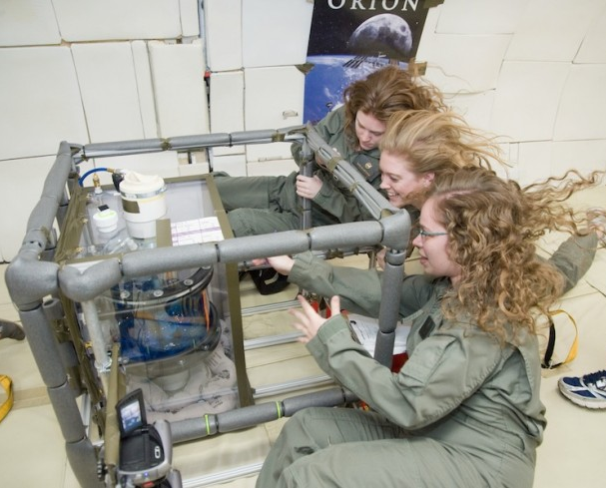
Motivation
  2. Enable low-cost access to space for researchers to send proof of concept experiments
    MEMs, Inflatables/Deployables, Propulsion, Networking, Science, Deploy-Cams

Slide 5
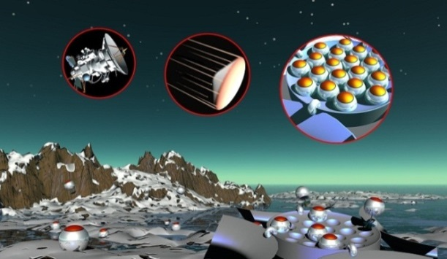
Motivation
3. Develop low-cost, truly disposable spacecraft and robots, where thousands can be sent.

Slide 6

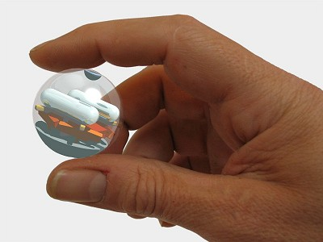
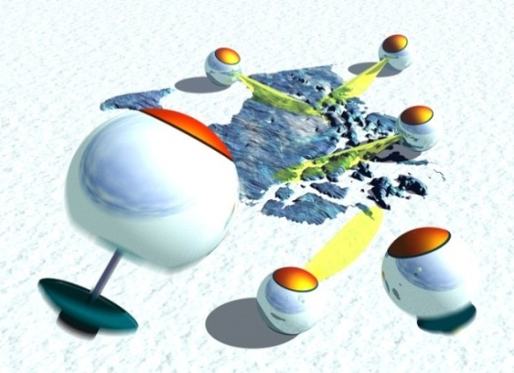

Network Exploration
[Dubowsky et al., 2006; Thangavelautham et al., 2008]

Slide 7

SunCube FemtoSat

Slide 8
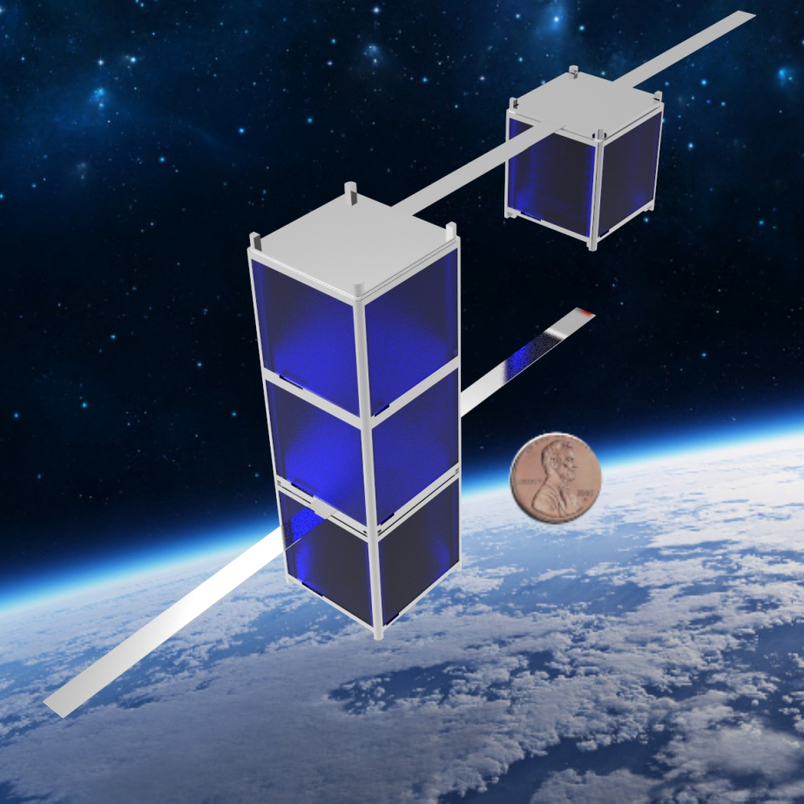
SunCube FemtoSat
We are devising a new standard
  1F
  Volume = 3 cm x 3 cm x 3 cm
  Mass = 35 g
  3F
  Volume: 9 cm x 3 cm x 3 cm
  Mass = 100 g

Slide 9
SunCube FemtoSat
Main Goal
  Specify volume and mass envelope
  Put out a reference design for 1F and 3F
  Propose a CubeSat chassis to enable deployment of 1F and 3F.
  Open Standard:
  http://suncube.asu.edu/ or http://femtosat.asu.edu/

Slide 10
FemtoSat Standard
By devising an open standard, we enable anyone to choose to build on the standard
Encourages innovation, an ecosystem of developers, users, interest groups
Standards could help push technology miniaturization and outlook in the next 15 years

Slide 11
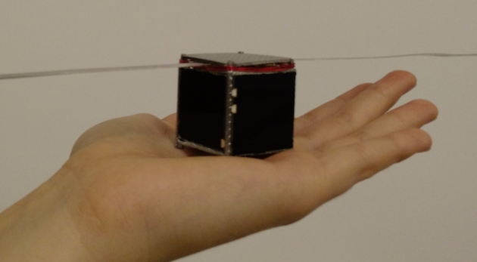
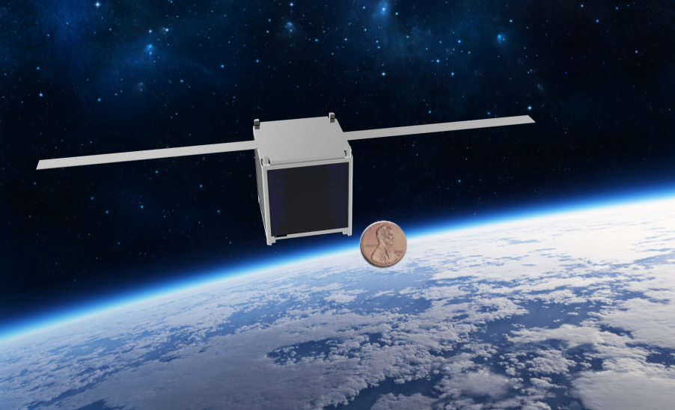
FemtoSat – 1F Reference Design
Mass: 35 g
  Volume: 3 cm x 3 cm x 3 cm
Launch Cost: $ 1 to 3k
Parts Cost: < $300
Target Orbit: LEO
Target Life: 1-2 Years
Power: 3TJ Solar Cell + Battery
Comms: UHF Radio 3-5 KBps
Camera: 3 MP CCD

Slide 12
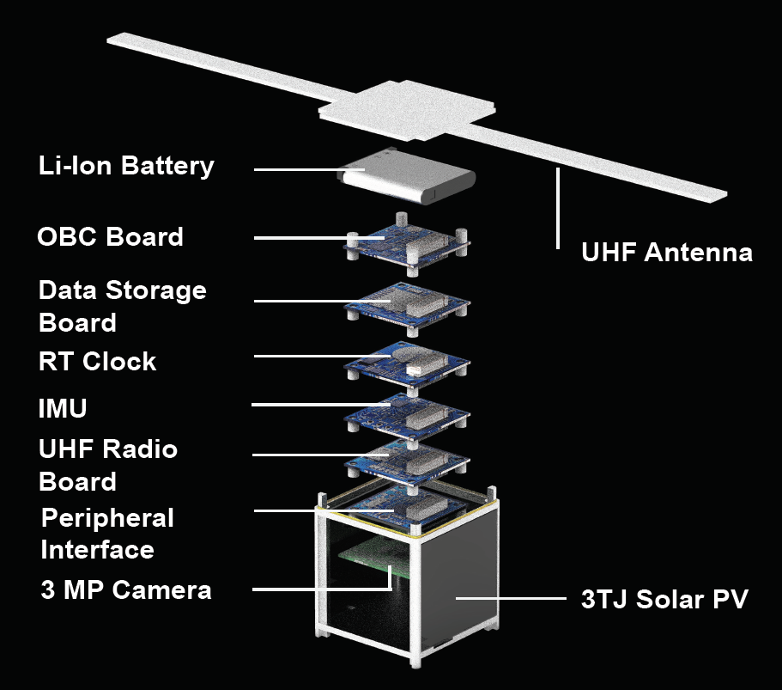
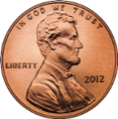
FemtoSat 1F

Slide 13
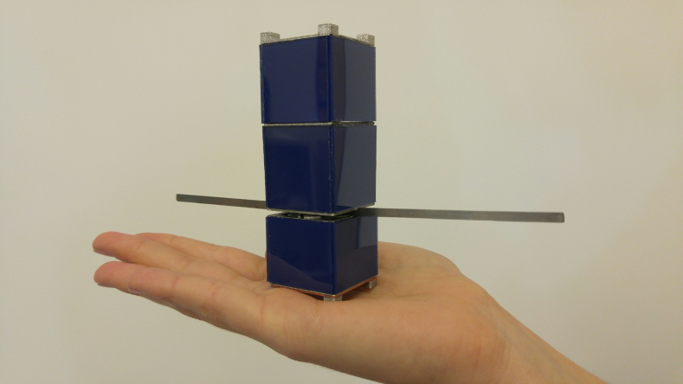
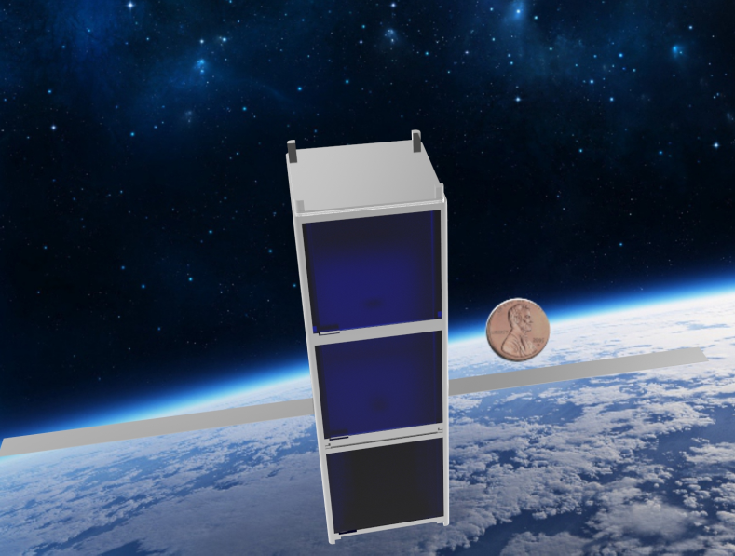
FemtoSat – 3F Reference Design
Mass: 100 g
  Volume: 9 cm x 3 cm x 3 cm
Launch Cost: $ 3 to 8k
Parts Cost: < $600
Target Orbit: LEO
Target Life: 1-2 Years
Power: 3TJ Solar Cell + Battery
Comms: UHF Radio 3-56 KBps
Camera: 3 MP CCD mono or stereo

Slide 14
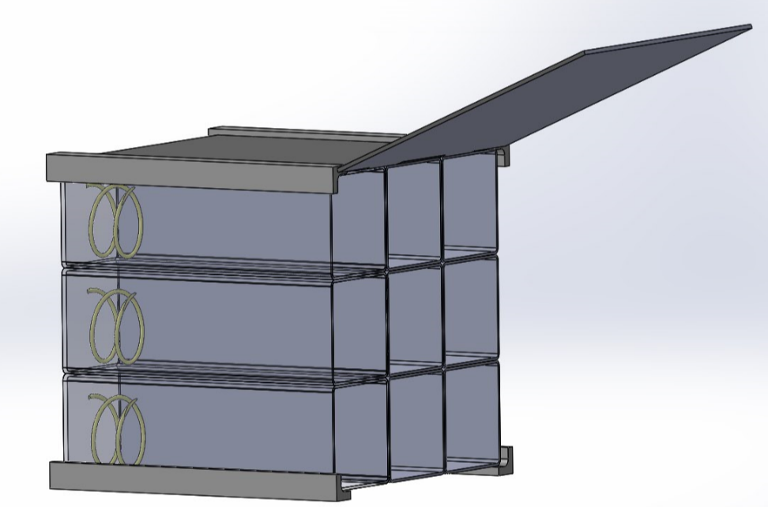
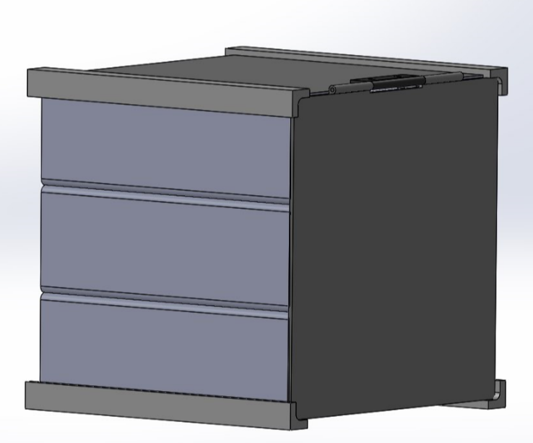
Deployment
The 1F and 3F deployed from a CubeSat PPOD.
A 1U could hold 9 3Fs or 27 1Fs
A 3U could hold 27 3Fs or 81 1Fs
F-POD Deployer

Slide 15
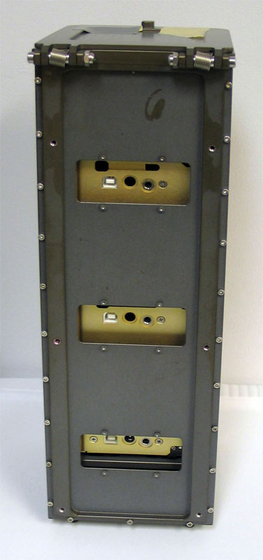
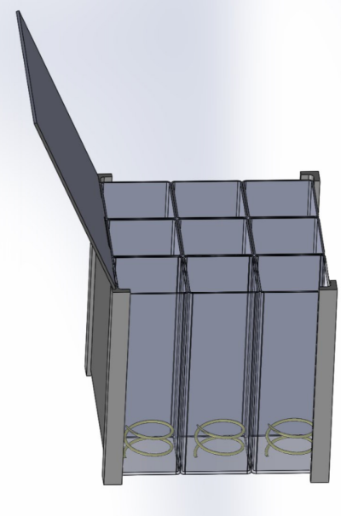

Packaging for Space
3F SunCube
1U F-POD
3U P-POD

Slide 16
Packaging for Space
Bootstrap existing CubeSat standards and the tried and tested P-POD to launch FemtoSats.
We use a design approach that stood the test of time, multiple launch providers and approaching a 99.9 % success rate.

Slide 17
Requirement Specifications
Strict rules to avoid deploying free floating artifacts, personal items etc.
Ban on human remains.
Strict rules needed to avoid littering issues.
  Case and point Mt. Everest.

Slide 18
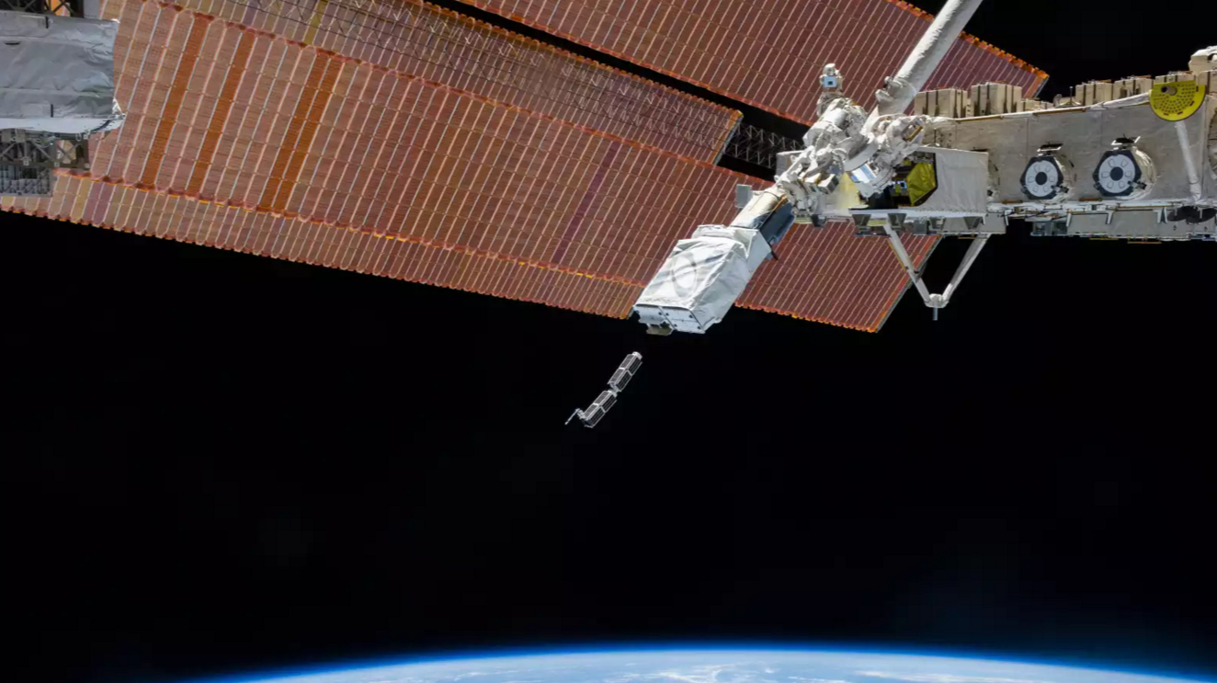

Launch Costs

Slide 19
Launch Costs
SunCube 1F
  $1,000 to the ISS via NanoRacks (1 month stay)
  $3,000 into LEO
SunCube 3F
  $3,000 to the ISS via NanoRacks (1 month stay)
  $8,000 into LEO

Slide 20
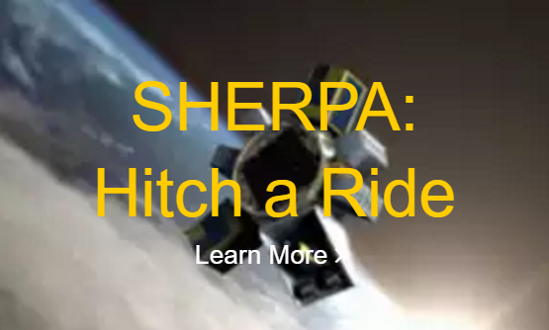
Interplanetary Travel
Interplanetary are far fewer, but several commercial opportunities on the horizon.

Slide 21
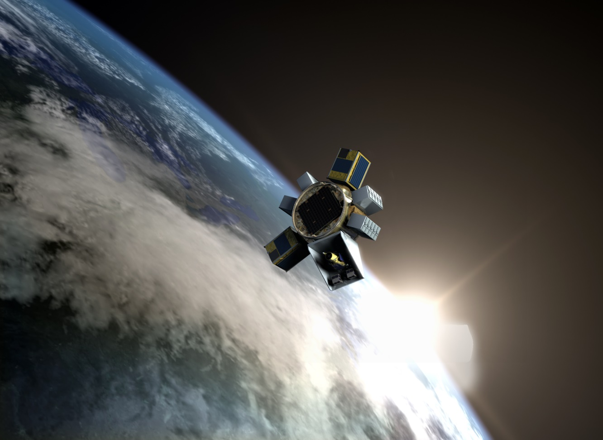

Going Interplanetary: Sherpa Option
Earth Escape
$27k for 1F
$81k for 3F
World of possibilities!!

Slide 22
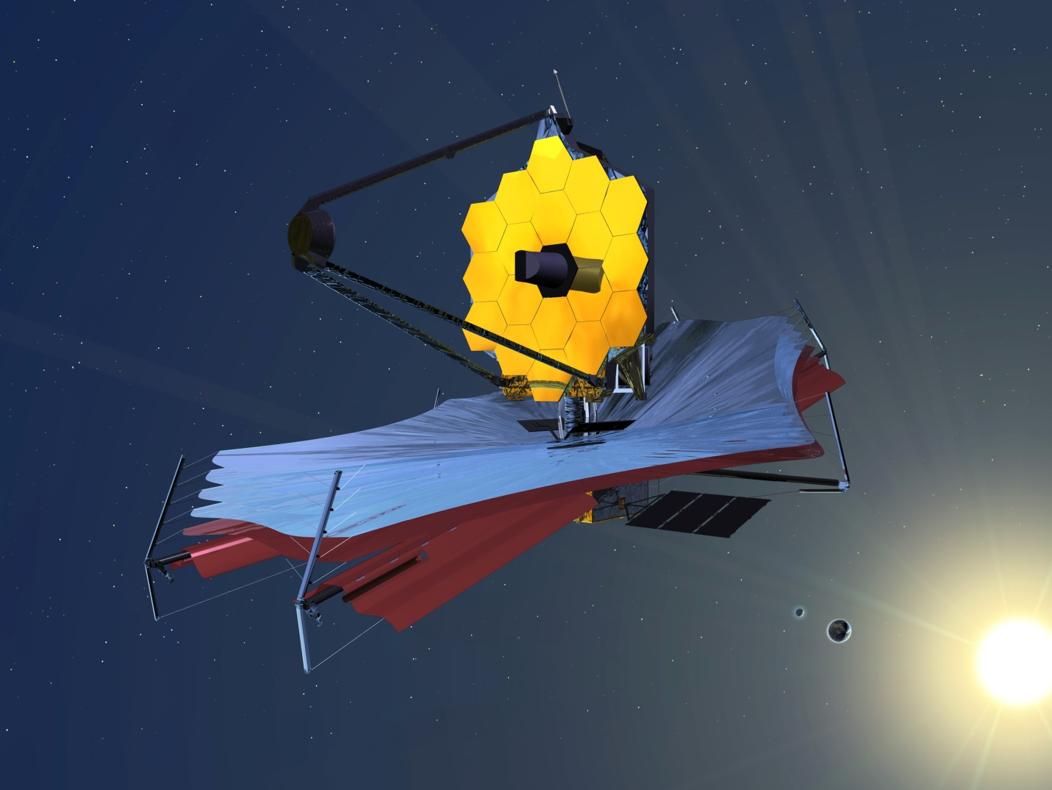

Spacecraft Selfies

Slide 23
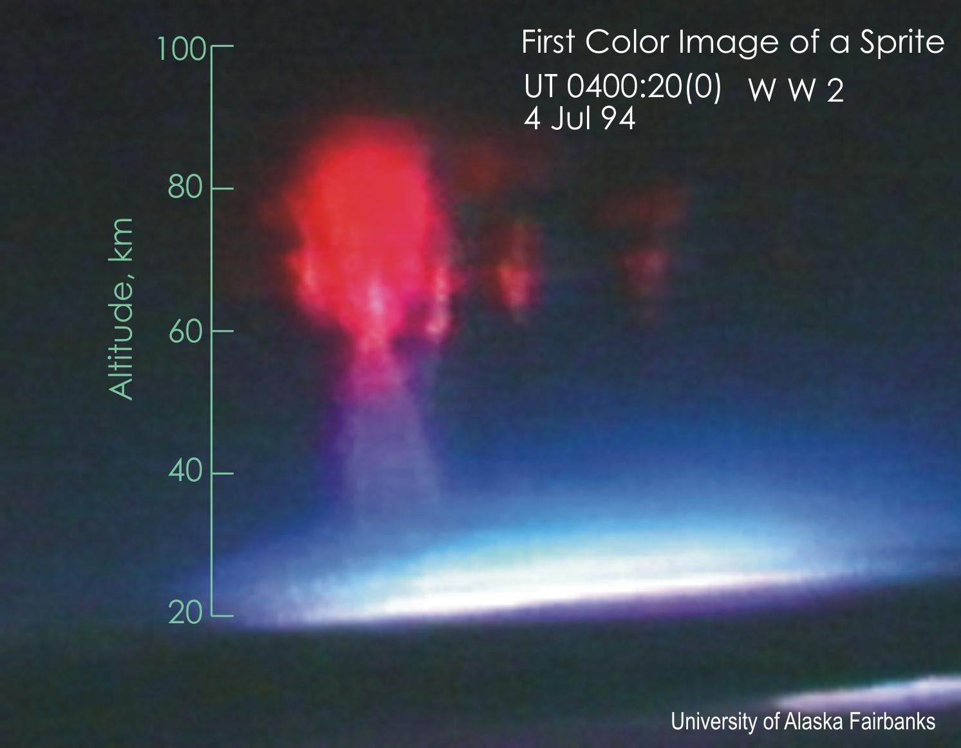
Looking for Rare Phenomena
Observe rare lightning phenomena
Climate change
Disaster relief/observation
What other rare events are out there ??

Slide 24
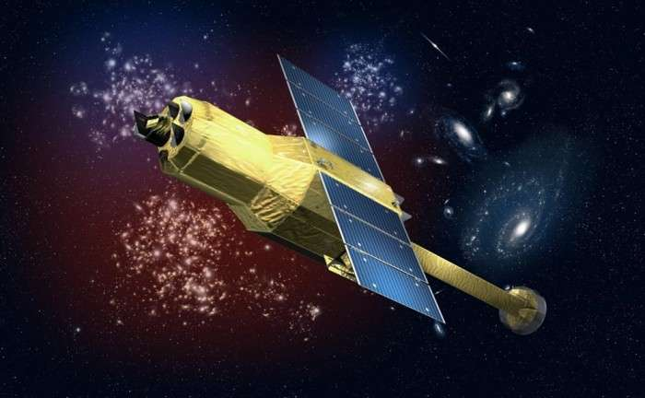

Troubleshooting

Slide 25
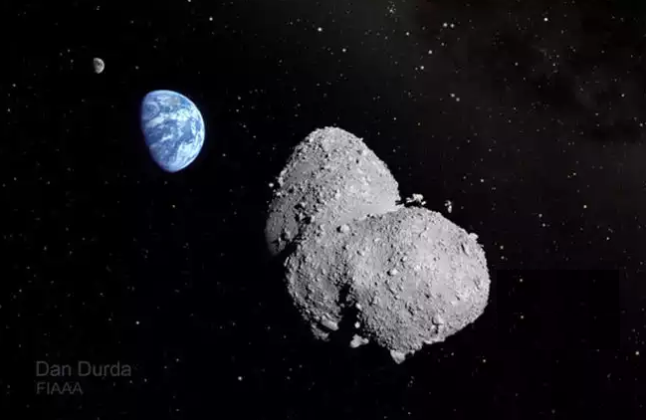
Asteroid and Comet Missions
Low mass, very small surface area – enable hovering, surface mobility on low gravity surfaces.
Requires development of Femto reaction wheels.

Slide 26
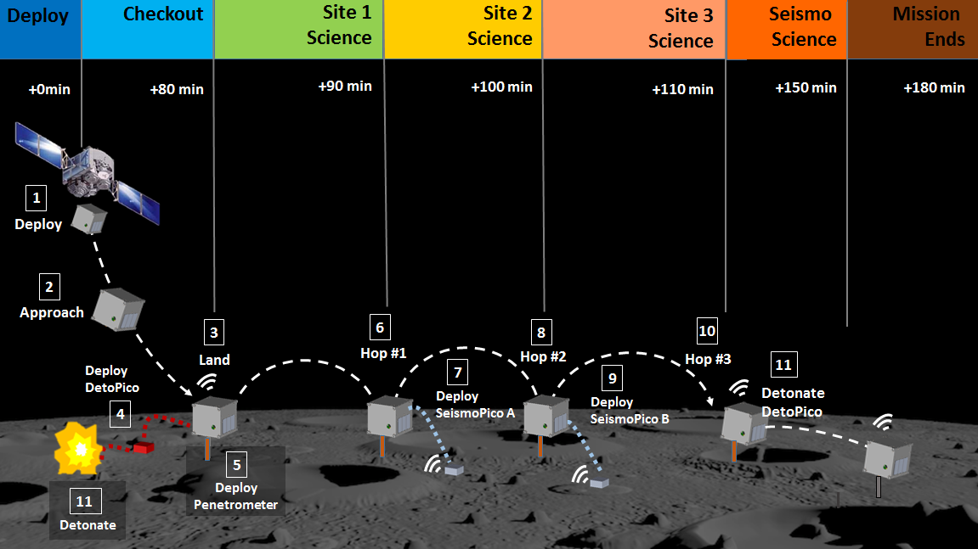
Network exploration on Asteroids & Comets
(Hernandez et al., 2015)

Slide 27
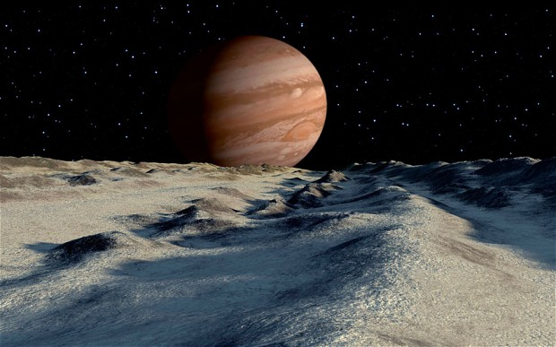
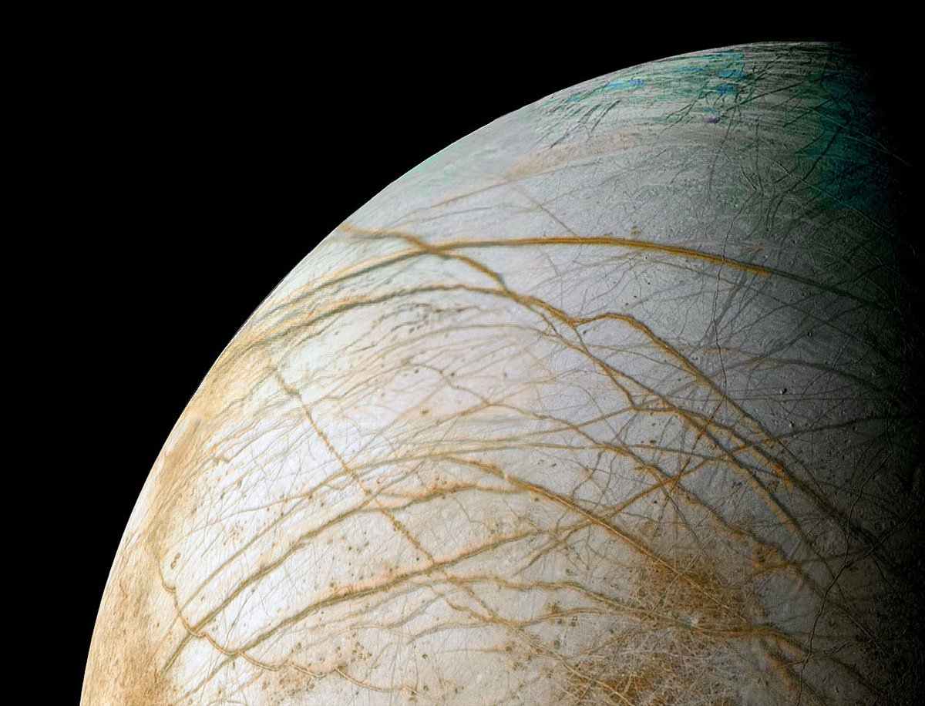
Having Many Eyes All at Once
Augment the reach of a large mission such as the Europa Flyby spacecraft.
Perform high risk, high reward science.

Slide 28
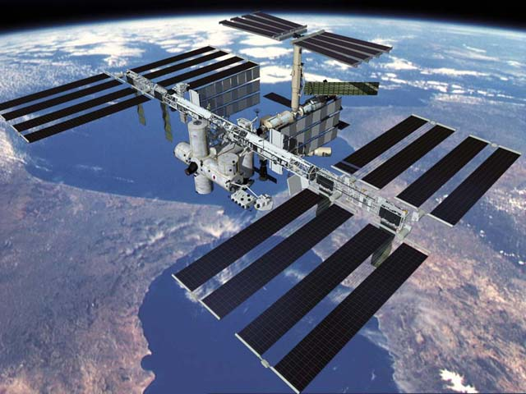




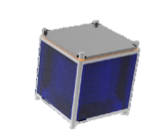


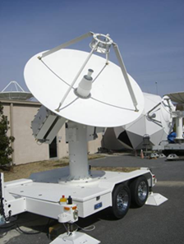
Communications
MIMO
(Multi-Input, Multi Output)
Data Rate x 7

Slide 29
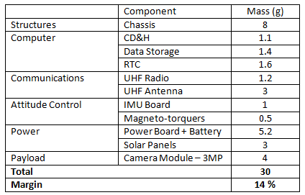
Mass Budget

Slide 30
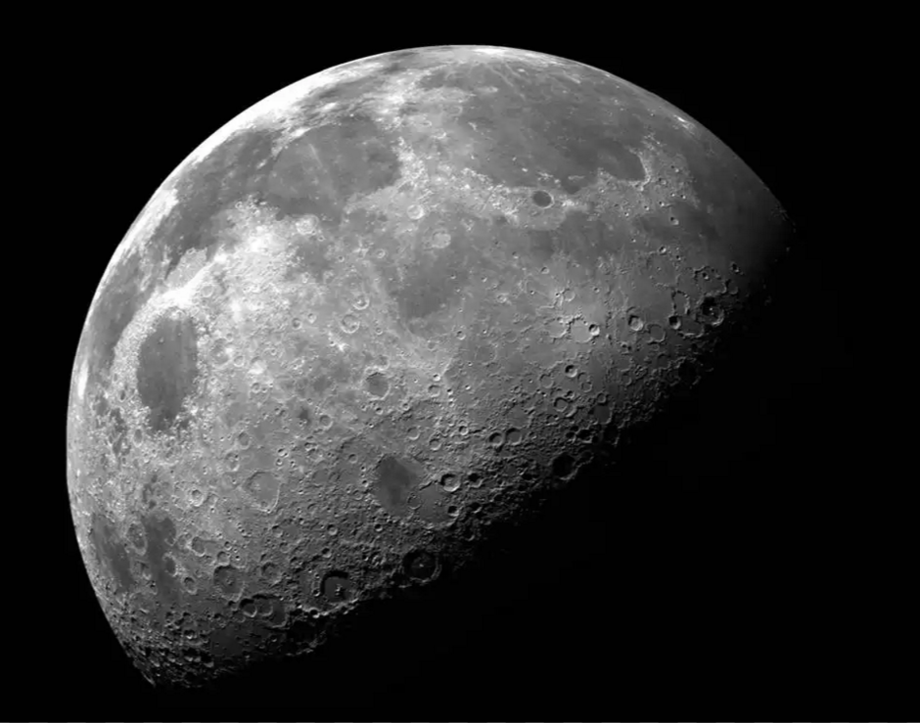
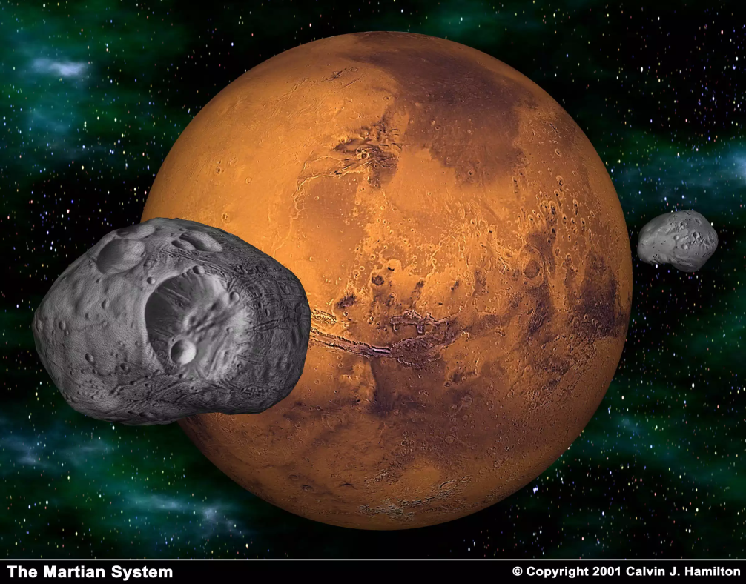
Interplanetary Exploration
Delta V = 4 km/s for 4 kg spacecraft, 0.5 kg dry mass, Isp = 200 s

Slide 31
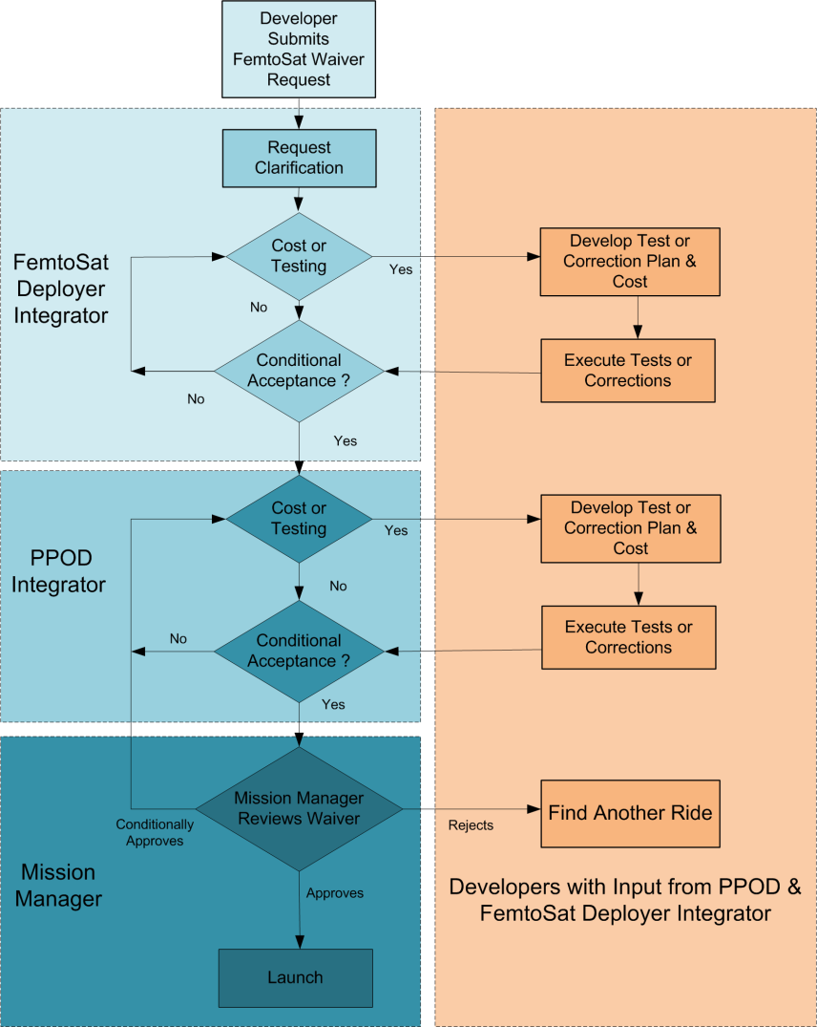
Waiver Request
Process in place to handle special requests
Requires acceptance by:
  FemtoSat Deployer Integrator
  PPOD Integrator
  Mission Manager

Slide 32
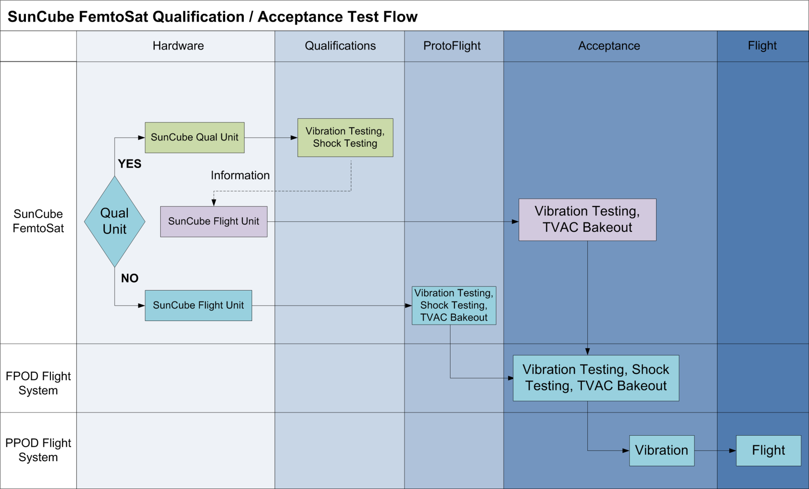
Flight Qualification Process

Slide 33
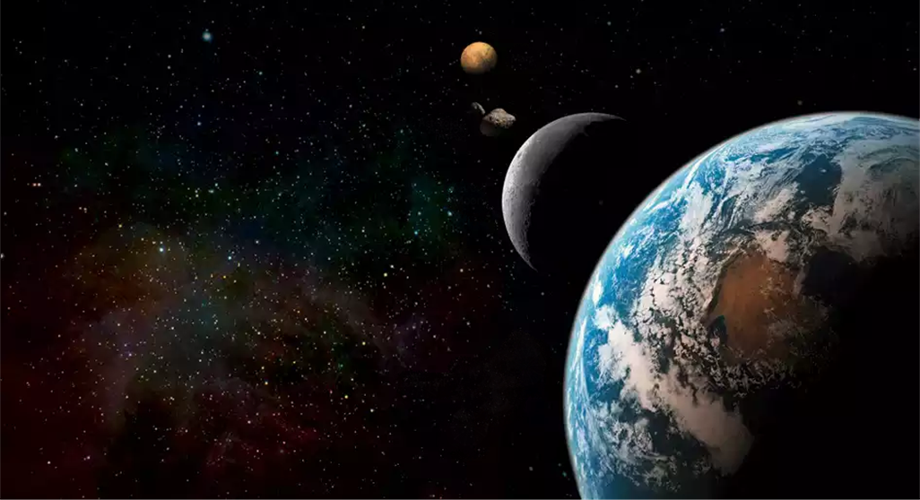

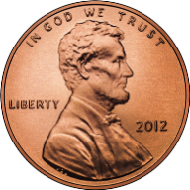
Be part of a movement.

Slide 34
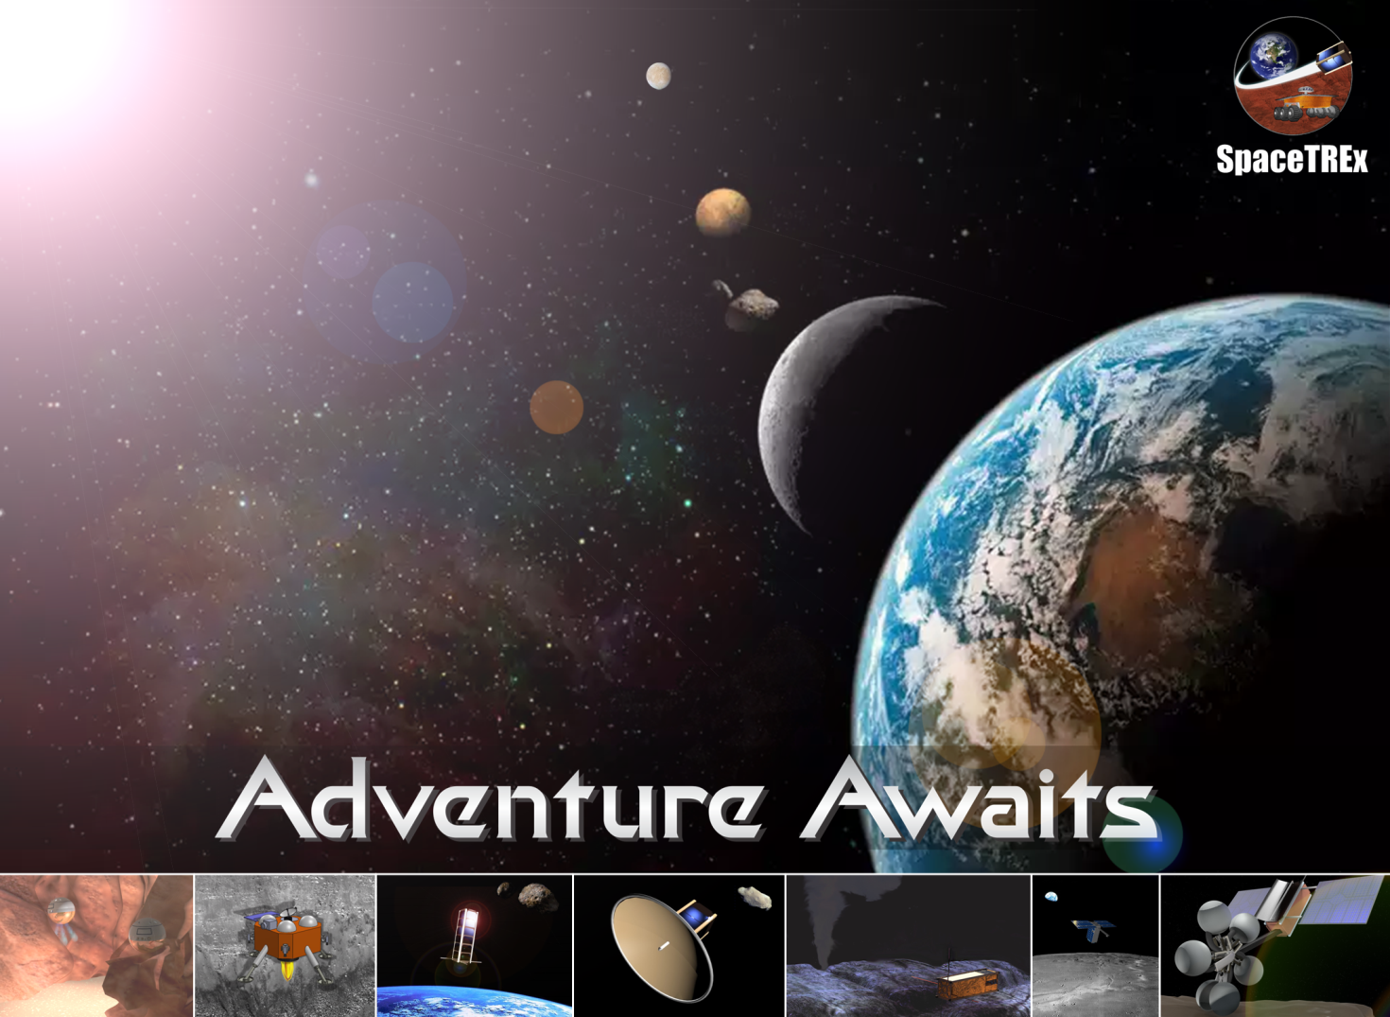
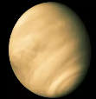

Slide 35
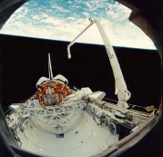
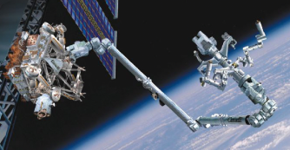
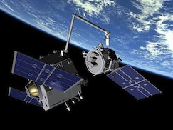
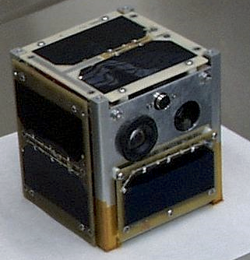
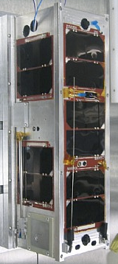
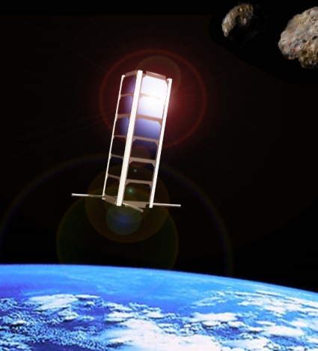
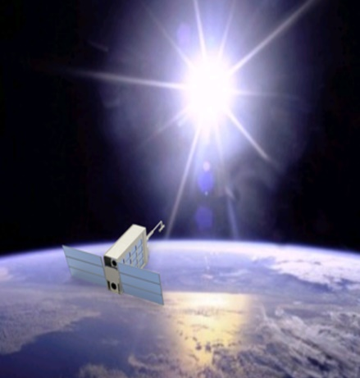

Space Missions
Canadarm
Canadarm II, Dexter
DARPA Orbital Express
CanX1
CanX2
AOSAT I
SWIMSat
SunCube FemtoSats

