Slide 1
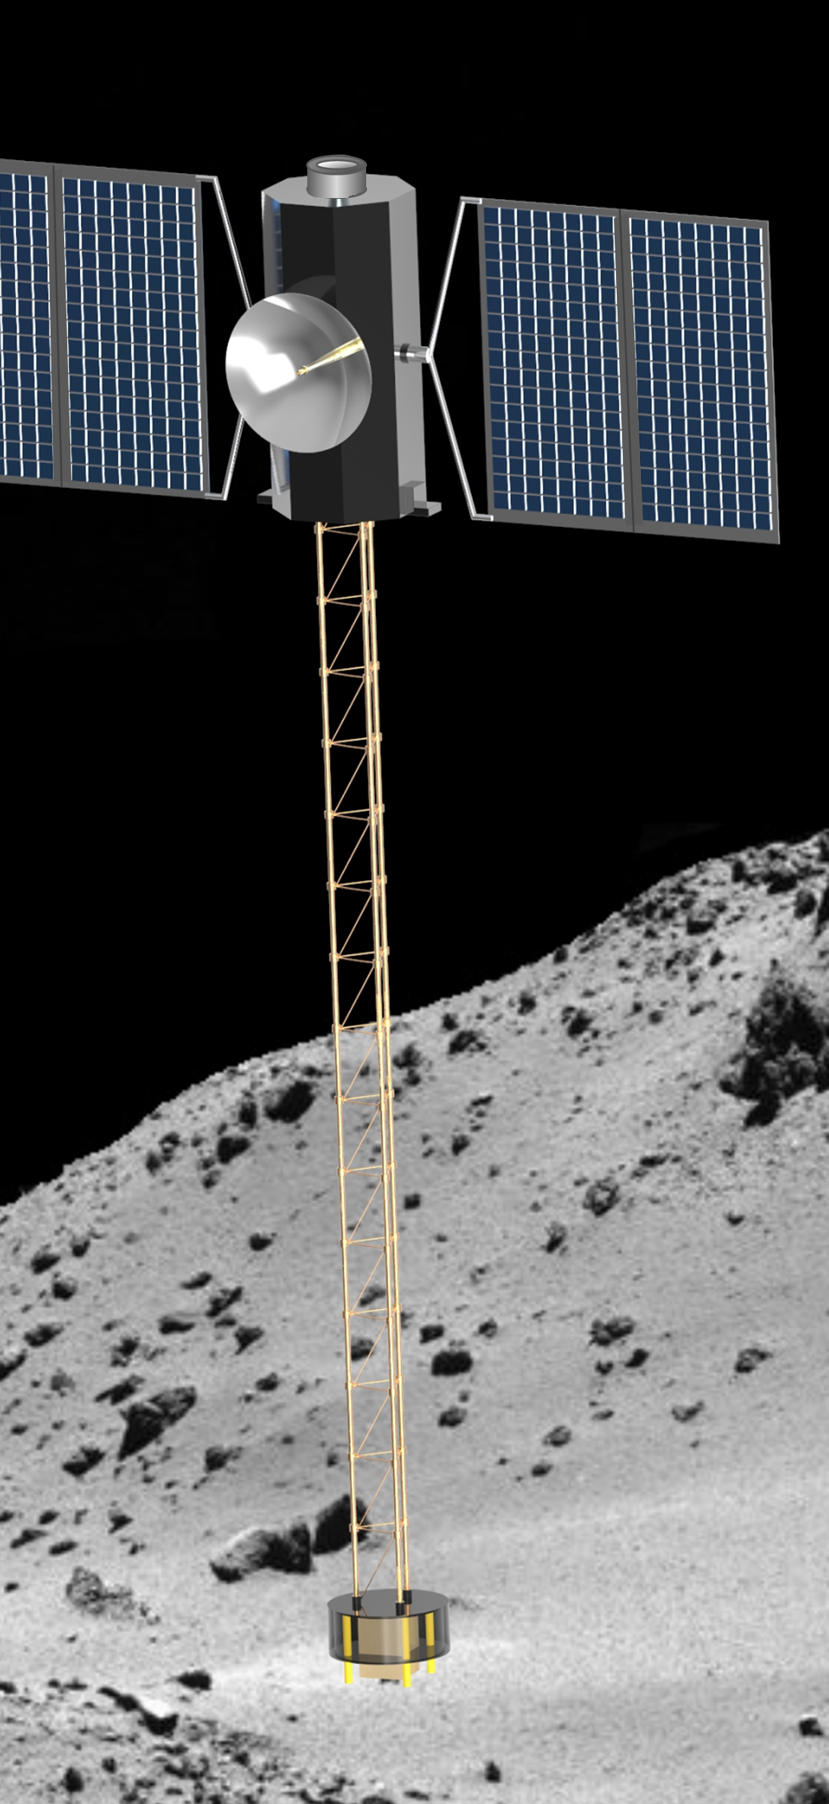


Spacecraft Penetrator for Increasing Knowledge of NEOs
Erik Asphaug, Jekan Thangavelautham, Stephen Schwartz (ASU) Roberto Furfaro, Tim Swindle (UA)
Paul Sava (CSM)
Dan Scheeres (CU)
Mathieu Choukroun, John Baker (JPL)

Slide 2
Why SPIKE?
We require a comprehensive understanding of a wide variety of common NEOs
  A scientifically significant sampling will require tens of rendezvous missions
  Each investigation must acquire subsurface geophysical and compositional data
    beyond remote sensing
  Best achieved by multiple identical smallsats built and launched at low cost (<$100M per sat)
    Each capable of in situ, comprehensive subsurface exploration e.g. GCMS, seismology, force sensing
    Each spacecraft equipped with a capable, flexible, efficient and robust propulsion system

Slide 3
Why SPIKE?
Reduce cost further using spare launch capacity
  While reaching diverse NEOs in diverse orbits
    Solar Electric Propulsion (SEP)
    Any Earth-escaping launch will suffice
  Further optimization → ESPA Ring deployment
Comprehensive subsurface exploration requires high power and high bandwidth communications
  How to fit this capability into a small surface deployable?

Slide 4
Why SPIKE?
Reduce cost further using spare launch capacity
  While reaching diverse NEOs in diverse orbits
    Solar Electric Propulsion (SEP)
    Any Earth-escaping launch will suffice
  Further optimization → ESPA Ring deployment
Comprehensive subsurface exploration requires high power and high bandwidth communications
  How to fit this capability into a small surface deployable?
The SEP bus becomes the lander
  A long deployable boom keeps the bus protected
  Supports a capable penetrating science payload
  Emphasis on 0.1-1 km NEOs → can eliminate the need for chemical propulsion → long mission lifetime

Slide 5
Asteroid and Comet Landers
A typical mission concept for asteroid regolith and interior exploration is to attain rendezvous and deploy one or more subspacecraft landers
  Hayabusa: MINERVA, MASCOT
  Rosetta: Philae
Although g is small, landing is not easy!
Small landers are severely limited
  Require miniaturized science payloads
  Solar power may be useless (dirt, burial, thermal cycle)
  Battery life is limited to hours-days
  Operations are high risk
    Might land upside-down, or sink beneath the surface, or get jammed by
    dirt, or experience static discharge, or high thermal loading
  Data transmission is limited and requires orbiter relay

Slide 6
Touch-and-Go
Hayabusa-1, Hayabusa-2
OSIRIS-REx
Comet sample return

Slide 7
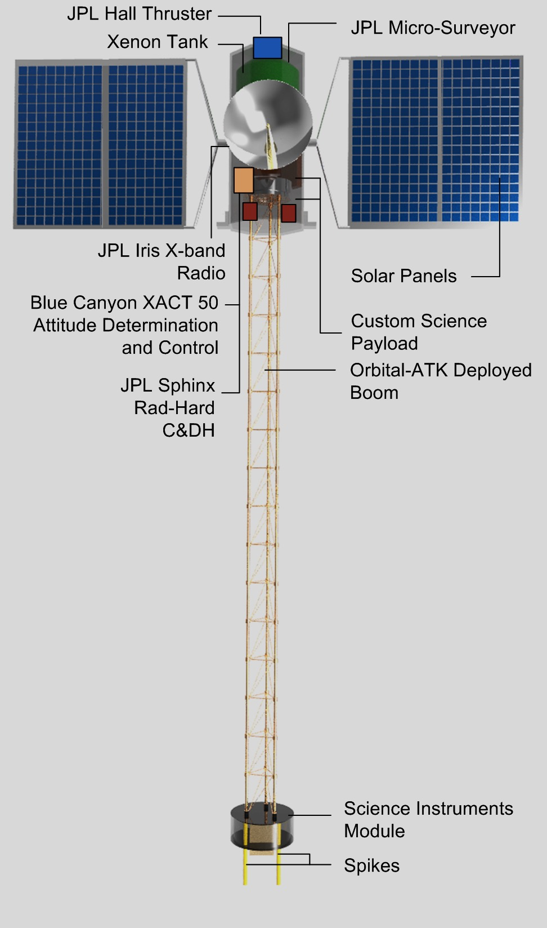
Touch-and-Stay-a-While!
Instead of a retractable arm with sampling capability, use a fixed rigid ~3-m boom with conduit for power and data
  Keeps the asteroid away from the bus/panels
  Supports a free-fall landing at ~1-10 cm/s
  Powers the science instruments module
Balancing is easy! (in principle)
  Inverse-pendulum maintained using reaction wheels → no chemical propulsion required
  Can we eliminate chemprop entirely?

Slide 8
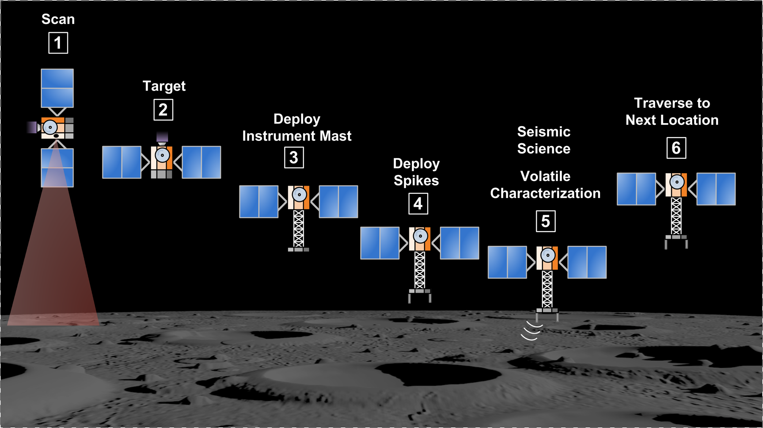
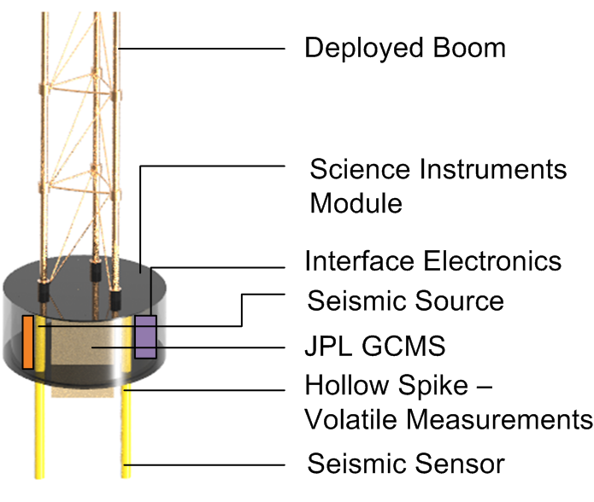
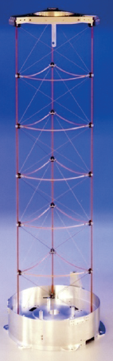
Inverted Pendulum Lander
Lightweight boom is sufficient to support free-fall (1-10 cm/s) landing stresses
The spacecraft mass (~75 kg) enables slow inertial penetration
Low impact velocity and high momentum = buried instrument suite
Initial design point: extremely lightweight truss (Orbital-ATK) withstands 180N loads.

Slide 9
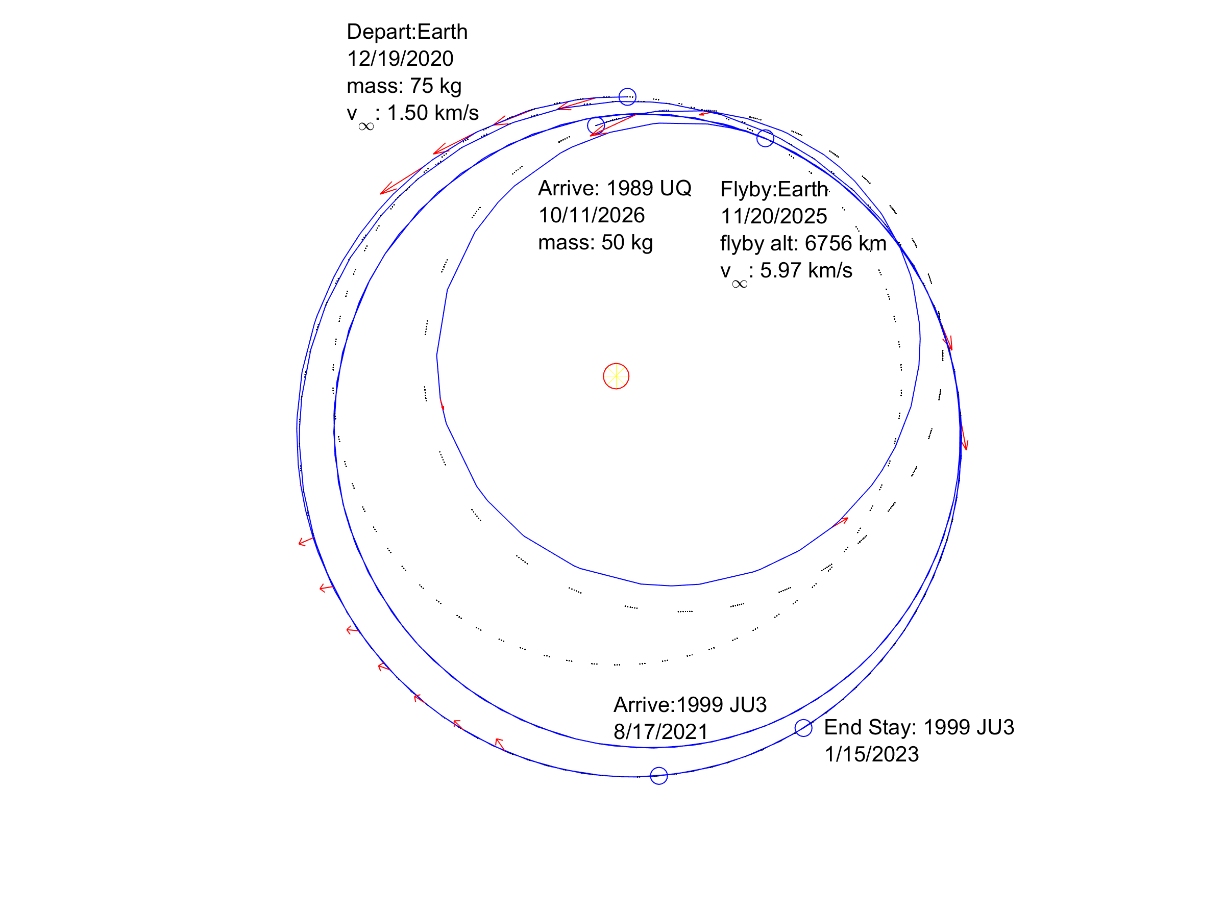
SEP: A Perfect Match for Small NEOs?
Rendezvous with a NEO can require high delta-V
  SEP has the highest I_{SP} of any mature technology
  Small, long-duration SEP systems are becoming available
    Example: MaSMi Hall thruster (Xe)
Can utilize any Earth-escaping launch opportunity
  SEP can ‘take it from there’ to attain many NEOs
  Single smallsat could visit 2-3 asteroids (mini-Dawn tour)
Once at the asteroid, solar arrays provide ample power
  ~750 W BOL; enables robust science and data transmission
SEP thrust exceeds surface gravity of a small (<1 km) NEO
  In principle, can avoid the use of chemprop systems
Example: dual rendezvous based on 75 kg (wet) 750W MicroSurveyor (JPL)

Slide 10
Goals | Measurables | Observables | Payload | Capability
Volatiles & Organics | Bound and free water content in the regolith | Abundance of H₂O ice in the regolith | Gas Chroma-tograph and Mass Spectrometer (GCMS) | Collector to acquire volatiles and organics from >30 cm below surface
 | Spatial and chemical distribution of identified organic species | Abundance and composition of carboxylic acids, PAHs and amino acids
Seismology | Seismological properties of asteroid and local regolith | Seismic reflections detected for >1 minute | Geophone Thumper Vibrators Accelero-meters Camera Imaging | Sensors buried to >30 cm depth into seismically competent material Navigation
 | Regolith response to tactile forces, compactions, vibrations and jolts | Landing/takeoff forces and accelerations Vibration response Penetration depth

Slide 11
Candidate Payload
GCMS. The SPIKE miniature gas chromatograph (GC) mass spectrometer (MS) is based upon the Spacecraft Atmosphere Monitor (SAM), a technology demonstration that will fly to the International Space Station (ISS) in 2018. SAM is intended for assessing trace volatile organic compounds and the major constituents in the atmosphere of present and future crewed spacecraft. As such, SAM will continuously sample concentrations of major air constituents (CH4, H2O, N2, O2, and CO2) and report results in two-second intervals. SAM will provide on-demand reporting on trace volatile organic compounds at ppm to ppb levels of 40+ species relevant for astronaut health. SAM is the first instrument to have successfully demonstrated a fully electrostatic micro-electro-mechanical system (MEMS) GC, requiring no pneumatics for its MEMS valves. The GC is coupled to a quadrupole ion trap mass spectrometer (QITMS). SAM can operate at sub-atmospheric pressures relevant to extra-vehicular activities, which makes it amenable to operation on airless bodies. For the SPIKE embodiment the total instrument mass is projected at 6 kg with power consumption estimated at 35 W.
Seismology. The seismic experiment consists of four components, to be assessed during the study. For activation, we will use a mechanical thumper integrated into the base of the SIM, directly above the spikes. We will also integrate tunable piezoelectric vibrators to both spikes, as a signal source and to facilitate disengaging from possibly cohesive regolith. For science we will use MEMS accelerometers in the seismology spike, plus one or more geophones. Our initial choice is to begin rigorously testing and space qualifying the 24 bit NuSeis NRU-1C by GTI, which has 120-123 dB dynamic range for 1-2 ms sampling.

Slide 12
Target Requirements: Small NEOs
Target Requirement | Probability
First asteroid target must be primitive (B, C or D) | Certain; many candidates
Regolith bed at least 1 m deep exists somewhere on the asteroid | Almost certain for NEOs >100 m diameter; can be verified by groundbased IR/radar
Clast sizes <30 cm in the target footprint (dust ponds, gravel beds are ideal) | Unknown for the smallest (~50 m) bodies considered; almost certain for 0.3–1 km
Regolith cohesion < 10 kPa in the target footprint | Could be greater if ice-cemented materials (unlikely), or as low as 10–100 Pa
Surface g < 0.3 mm/s² for gentle landing and to allow SEP-powered escape | Certain for <1 km diameter
Any asteroid
~0.1-1 km will do

Slide 13
Example Mission Concept
Launch up to 6 identical smallsats in an ESPA ring configuration
  Or, a single <$100M mission
Each unit goes to 2+ NEOs → landed science at a dozen asteroids
  Discovery cost cap <$500M
At each NEO:
  3 or more landings per asteroid → comprehensive knowledge of the body
  Each landing explores surface physics, conducts global seismology, and measures the volatile and organic subsurface composition
    Other instruments of course possible, e.g. IR/VIS/XGRS/ND
After each landing:
  The spacecraft jumps (~1 cm/s), thrusts (SEP) to stationkeeping, and lands/impacts again
  Or, departs to the next asteroid

Slide 14
Risk Mitigation / Design Study
Risk | Likelihood | Impact | Mitigation (study effort)
Spike tip breaks | Low | Medium/ Severe | Explore penetrator materials/designs; develop failsafe mode for immediate departure
Boom mechanism collapses | Low | Severe | Obtain engineering copy early to begin exhaustive testing
Bus and arrays encounter dust | Medium | Medium | Design preprogrammed auto-depart sequences and status monitors/cameras
Wobble of spacecraft | High | Low | Develop one-minute science acquisition strategies; model in detail
Spikes encounter big boulder | Medium | Medium | Design mission to low-TI targets; develop algorithms to survey for buried rocks
Spacecraft cannot extract | Medium | Medium | Develop event sequence using vibrators and thumpers and springs to get clear.
Asteroid lacking regolith | Low | Medium | Attempt landing in area of lowest thermal inertia; use thruster to increase penetration

Slide 15
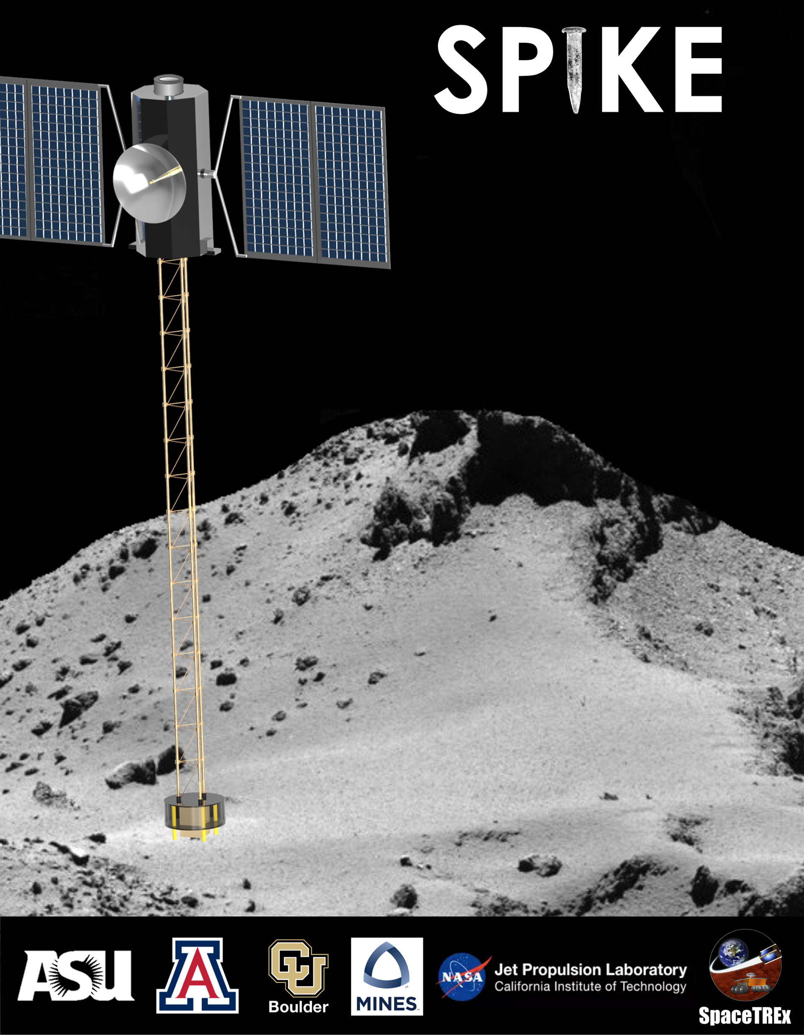
Questions?
Comments/Opinions/Advice?

