Slide 1

SunRISE: Sun Radio Interferometer Space Experiment
Interplanetary Small Satellite Conference
May 2017
Farah Alibay (JPL), Justin Kasper (UM),
Joseph Lazio (JPL), and Tim Neilsen (SDL)
Contact: farah.alibay@jpl.nasa.gov

Slide 2
How are energetic particles produced?
Goal #1: Discriminate competing hypothesis for generation of solar energetic particles (SEPs) by localizing radio emission generated by CME-accelerated electrons relative to expanding CMEs 2-20 solar radii from the Sun where the most intense acceleration occurs
Pre-Decisional Information -- For Planning and Discussion Purposes Only
Notes:
Outstanding goals in Heliophysics related to these major CME-associated SEP events are to determine where the acceleration takes place relative to the CME, to establish what precise physics is responsible for the acceleration, and to develop the ability to predict the severity of an SEP event given the properties of the CME and corona.
Particle acceleration may be due to coronal shocks or compressions driven by CMEs, by magnetic reconnection behind the expanding CME, or by stochastic acceleration mechanisms operating throughout the corona.

Slide 3
What is the magnetic connection?
Goal #2: Discriminate competing hypotheses for variable magnetic connection between active regions and inner heliosphere by reconstructing three dimensional magnetic field lines from 2-20 solar radii using emission from electron beams
Pre-Decisional Information -- For Planning and Discussion Purposes Only
Notes:
The second science objective would be to determine if a broad magnetic connection between active regions and interplanetary space is responsible for the wide longitudinal extent of some flare and CME SEPs by imaging the field lines traced by Type III bursts from 2–20 Rs

Slide 4
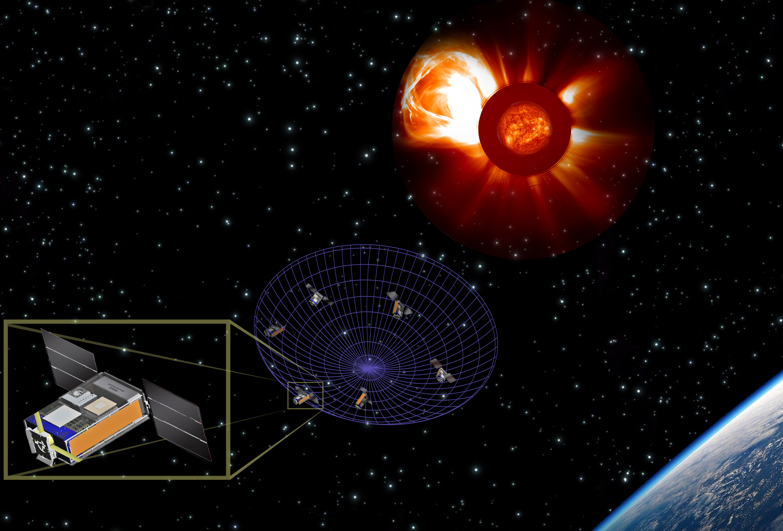
Science Implementation
Pre-Decisional Information -- For Planning and Discussion Purposes Only

Slide 5
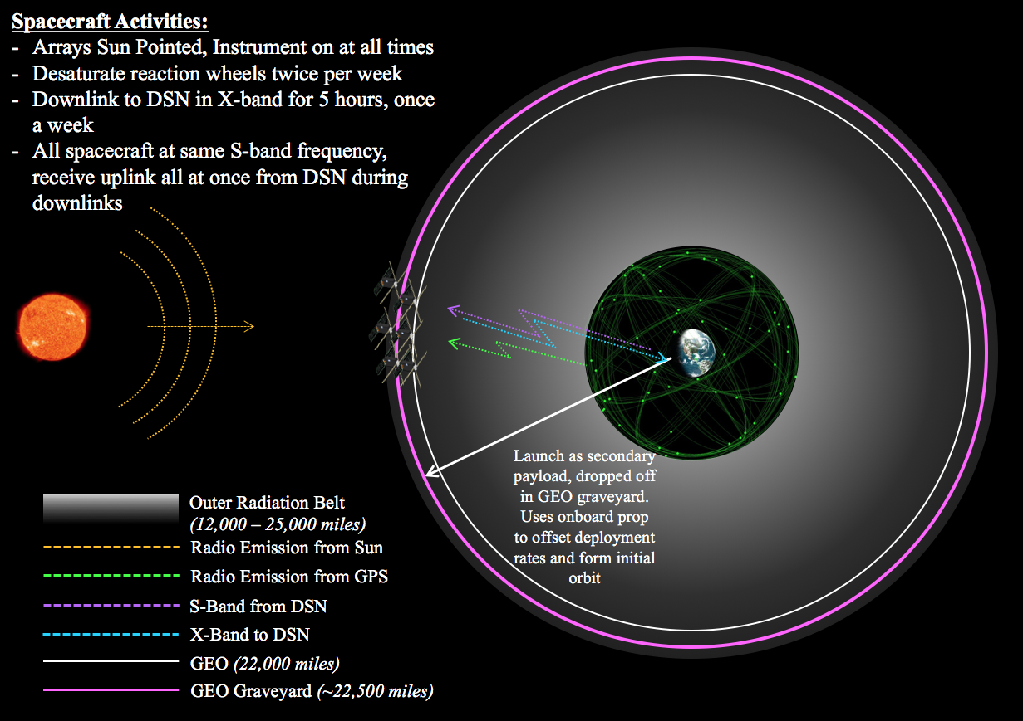
Concept of Operations
Pre-Decisional Information -- For Planning and Discussion Purposes Only

Slide 6
Position Determination
SunRISE
No Visibility
Main Beam
Side Lobe
GNSS (MEO)
GEO: Alt. 35786 km
Pre-Decisional Information -- For Planning and Discussion Purposes Only

Slide 7
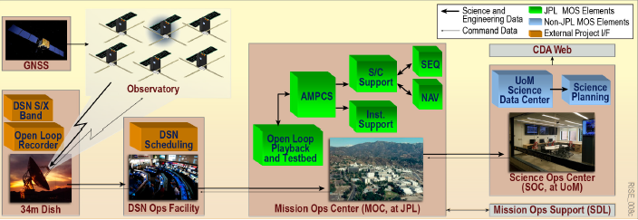
End-to-End Information System
Pre-Decisional Information -- For Planning and Discussion Purposes Only

Slide 8
SunRISE Spacecraft*
*Artist’s Concept
Pre-Decisional Information -- For Planning and Discussion Purposes Only

Slide 9
Conclusion
Mission concept would achieve Decadal Survey science for < $100M
Proposal with high heritage bus and straight-forward operations
Key enablers: GPS at GEO, FX correlator, economies of scale for multiple builds, secondary payload launch, passive formation, and MSPA.
SunRISE 3D interferometer would be a stepping stone for future, more complex, space-based interferometers
Artist’s Concept
Pre-Decisional Information -- For Planning and Discussion Purposes Only

