Slide 1
Economical Mars Transits Outside the Hohman 26 Month Transfer Window
Darrin Taylor
Outer Space Colonization
outerspacecolonization@gmail.com

Slide 2
Thank you
Thanks to Dr. Alessandra Babuscia
Thanks to the acceptance committee
Thanks to listeners for your patience

Slide 3
This is a talk about the future
Mars will have a colony
Regular human missions will transit to Mars
People will forget things
This talk is about a colonist who has just left Earth and the Hohman transfer window has just closed but they forgot their toothbrush.

Slide 4
Problem Statement
Hohman Transfer (~6 months) only available at Earth once every ~26 months. Total wait varies ~6-32 months. Thats 26 months before the toothbrush can be sent…
Rocket equation limits the practical delta V of space ships that carry reaction mass. So rockets can’t go faster.
We want an economical option that can leave any day of synod that is faster/cheaper than next Hohman transit
Hohman roundtrip of 12.2 km/s has a Mass Fraction of 26.47 at 380s Isp (SpaceX) or 15.61 at 453s Isp (NASA)

Slide 5
Solar Sail Performance
Solar Sail powered spacecraft do not carry fuel and are therefore not governed by Rocket Equation
Lifetime Delta V can far exceed that of similar mass rocket fuel.
Lifetime Delta V is determined by spacecraft lifetime and integrated photon density (distance from sun). Not a fixed number
Sails become impractical for heavy loads.
Acceleration rate limited to less than 0.5 mm/s^2
If only we could transfer this momentum to something faster…

Slide 6
“Transferred Momentum”
Two classes of spacecraft: a single “Pusher” and many Solar Sail powered “Bricks”
“Pusher” pushes “Bricks” at 8 Gs acceleration over 400m track using maglev to achieve 900 km/hr which is 250 m/s or 25.5 seconds Isp
“Bricks” match the pusher orbit and are intercepted at low differential velocity (<1m/s) and not carried by “Pusher” except for short 100 m/s segments between interception points.
No mass is permanently consumed except the photons from the sun which are inexhaustible within Earth’s lifetime.
“Pusher” acceleration is 19 mm/s^2 based on 30 watts per kg (10% solar cells by mass at 300 W/kg) and 10% efficient transfer of kinetic energy to “brick” (25.5s Isp over 100m/s segment)

Slide 7
Add or Multiply?
Carried fuel architectures Multiply the Mass Fractions when adding multiple segment lengths.
The fuel used in future segments needs to be moved by the current segment which requires more fuel to move fuel…
Fuel becomes 99% of initial mass when delta V = 45.13 * Isp *m/s^2
Transferred Momentum Adds the Fuel Fractions instead of Multiplying because it intercepts its reaction mass in flight.
The “pusher” mass at the end of each segment is the dry mass+fixed reserve. Always the same mass so segments are independent.
Over 80km/s “Bricks” at 25.5s Isp have a mass fraction of 401.
Over 80km/s 453s Isp rocket fuel has a mass fraction of 67,016,754

Slide 8
Recycle or Consume?
Rocket fuel is available for a single use. After this single use the mass is vented into space in a way unlikely to ever be usable in the future.
“Bricks” are solar sail powered spacecraft able to navigate back to a useful location to rendezvous with another “Pusher”.
CisLunar “Bricks” could be used 60-120+ times in a 30 year lifetime. The delta V removed from “Bricks” is 150-250 m/s and the CisLunar “Bricks” can accelerate at 460 m/s per month. Mass Fraction of 1.5 gives Delta V=6-12km/s
Near Martian “bricks” would deliver slightly poorer performance.

Slide 9
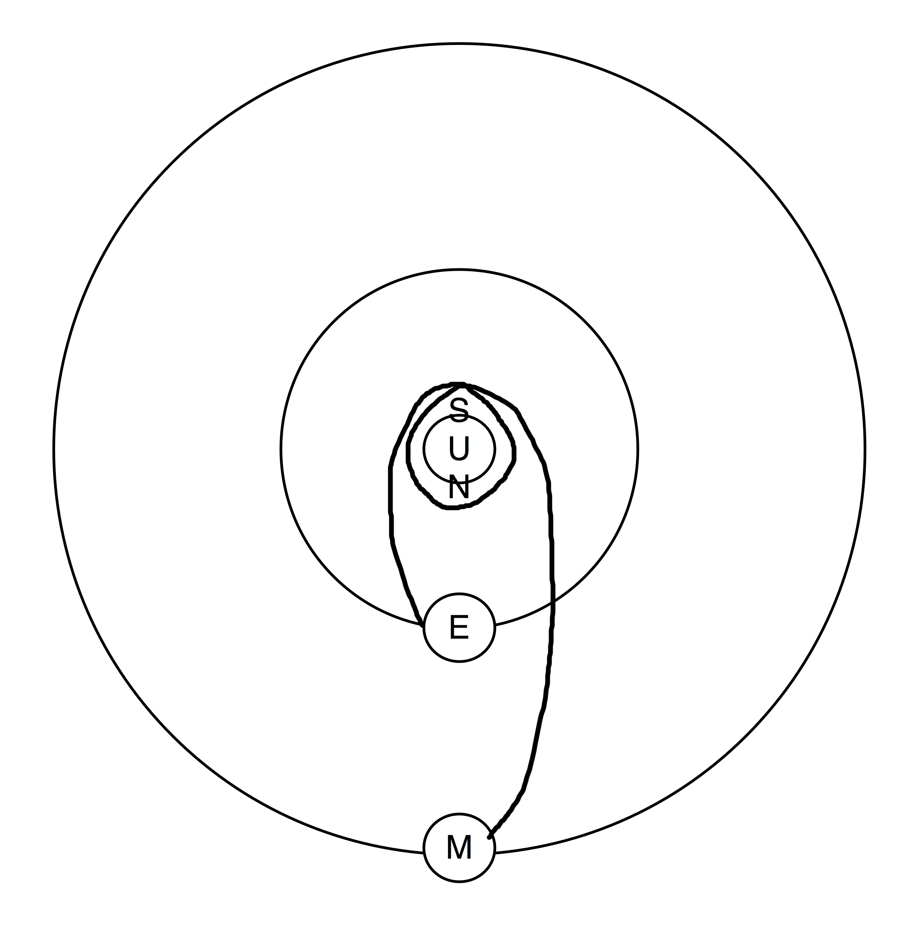
Proposed Transit

Slide 10
Excessive delta V
Optimum performance involves moving closer to Sun
Expands the lifetime delta V of solar sail “Bricks”
Allows fast phase adjustment in orbit
Lowers the delta V for realignment to Mars orbital plane
Minimizes ejected “Brick” orbital period and radius from sun. This shortens time to recycle for next trip.

Slide 11
The “Fast”Transfer
From Earth execute a Hohman transfer to 35.4 Million km from Sun.
Hold at this radius to adjust phase 0-360 degrees relative to Mars Hohman departure location.
Take Hohman transfer from 35.4 Million km to Mars
Total delta V ~80 km/s oneway, 160km/s roundtrip
Total one way transit time <281 days (9.39 months)

Slide 12
The “Medium” Transfer
From Earth execute a Hohman transfer to 96.2 Million km from Sun.
Hold at this radius to adjust phase 0-360 degrees relative to Mars Hohman departure location.
Take Hohman transfer from 96.2 Million km to Mars
Total delta V ~40 km/s oneway, 80km/s roundtrip
Total one way transit time <530 days (17.67 months)

Slide 13
The “Slow” Transfer
From Earth execute a Hohman transfer to 131.8 Million km from Sun.
Hold at this radius to adjust phase 0-360 degrees relative to Mars Hohman departure location.
Take Hohman transfer from 131.8 Million km to Mars
Total delta V ~25 km/s oneway, 50 km/s roundtrip
Total one way transit time <708 days (23.65 months)

Slide 14
Average Mass Fraction
Round trip Fuel Fraction is 800, 400, or 250
30 year lifetime “brick” reuse of 5 would give 160, 80, 50 average fuel fraction
Equivalent Isp if rocket fuel was used is 3213 s, 1858 s, 1298 s if we allow rocket fuel refueling each time at Earth.

Slide 15
Generational Recycling
“Bricks” ~46% solar sail by mass with a large fraction of the remainder being aluminum
1st Generation EOL recycling should be able to remanufacture “bricks” in space using only 50% new material from Earth.
2nd Generation EOL recycling should be able to remanufacture “bricks” in space using only 25% new material from Earth
nth Generation EOL will recycle 99% of “brick” mass requiring only 1% new material from Earth
Future average mass fractions will become 2.6, 1.8, 1.5 for the 3 transits once 99% generational recycling is achieved at End of Life

Slide 16
Conclusion
1st gen. Transferred Momentum any day Mars transit has a fuel fraction of ~6X, ~3X or ~2X of SpaceX 380 s Isp (or ~11X, ~6X, ~3X of SLS 453 s Isp) Hohman transfer.
Transferred Momentum transit time from Earth to Mars is <9.39, <17.67 or <23.65, months
Acceleration of 19 mm/s^2 is fast enough to compete against rocket fuel for interplanetary
Essentially no reaction mass destroyed or permanently consumed over entire system life.

Slide 17
Conclusion cont.
nth Generation: mass fractions for 160 km/s round trip transit could be 2.6 giving equivalent 17087 s Isp and 9.39 months each way departing daily.
nth Generation160km/s Transferred Momentum transit beats Hohman window 12.2km/s Transits by 15.9 times vs. SpaceX, 9.1 times vs. SLS
nth generation 160km/s “Transferred Momentum” uses 2.8 E15 times less reaction mass that SLS at 453 s Isp.
After arrival at Mars our colonist could expect their toothbrush in roughly 3-4 months vs. 26 months using traditional Hohman Transfer.

Slide 18
Questions
Contact info for Outer Space Colonization
outerspacecoloniztion@gmail.com
outerspacecoloniztion.com
Twitter @spacecolonize

