Slide 1
2017 Interplanetary Small Satellite Conf.
San Jose, CA, USA; 1-2 May 2017
Telecom System Design
M. Michael Kobayashi
Jet Propulsion Laboratory at
the California Institute of Technology
CL#17-1803

Slide 2
Outline
MarCO Concept of Operations and Overview
Challenging Requirements for EDL Telecom
Telecom System Elements
MarCO CubeSat Configuration
Digital Bent-Pipe Architecture
UHF Receiver Design
Link margins (DTE and InSight)
Major Telecom Test Campaigns
Conclusions

Slide 3
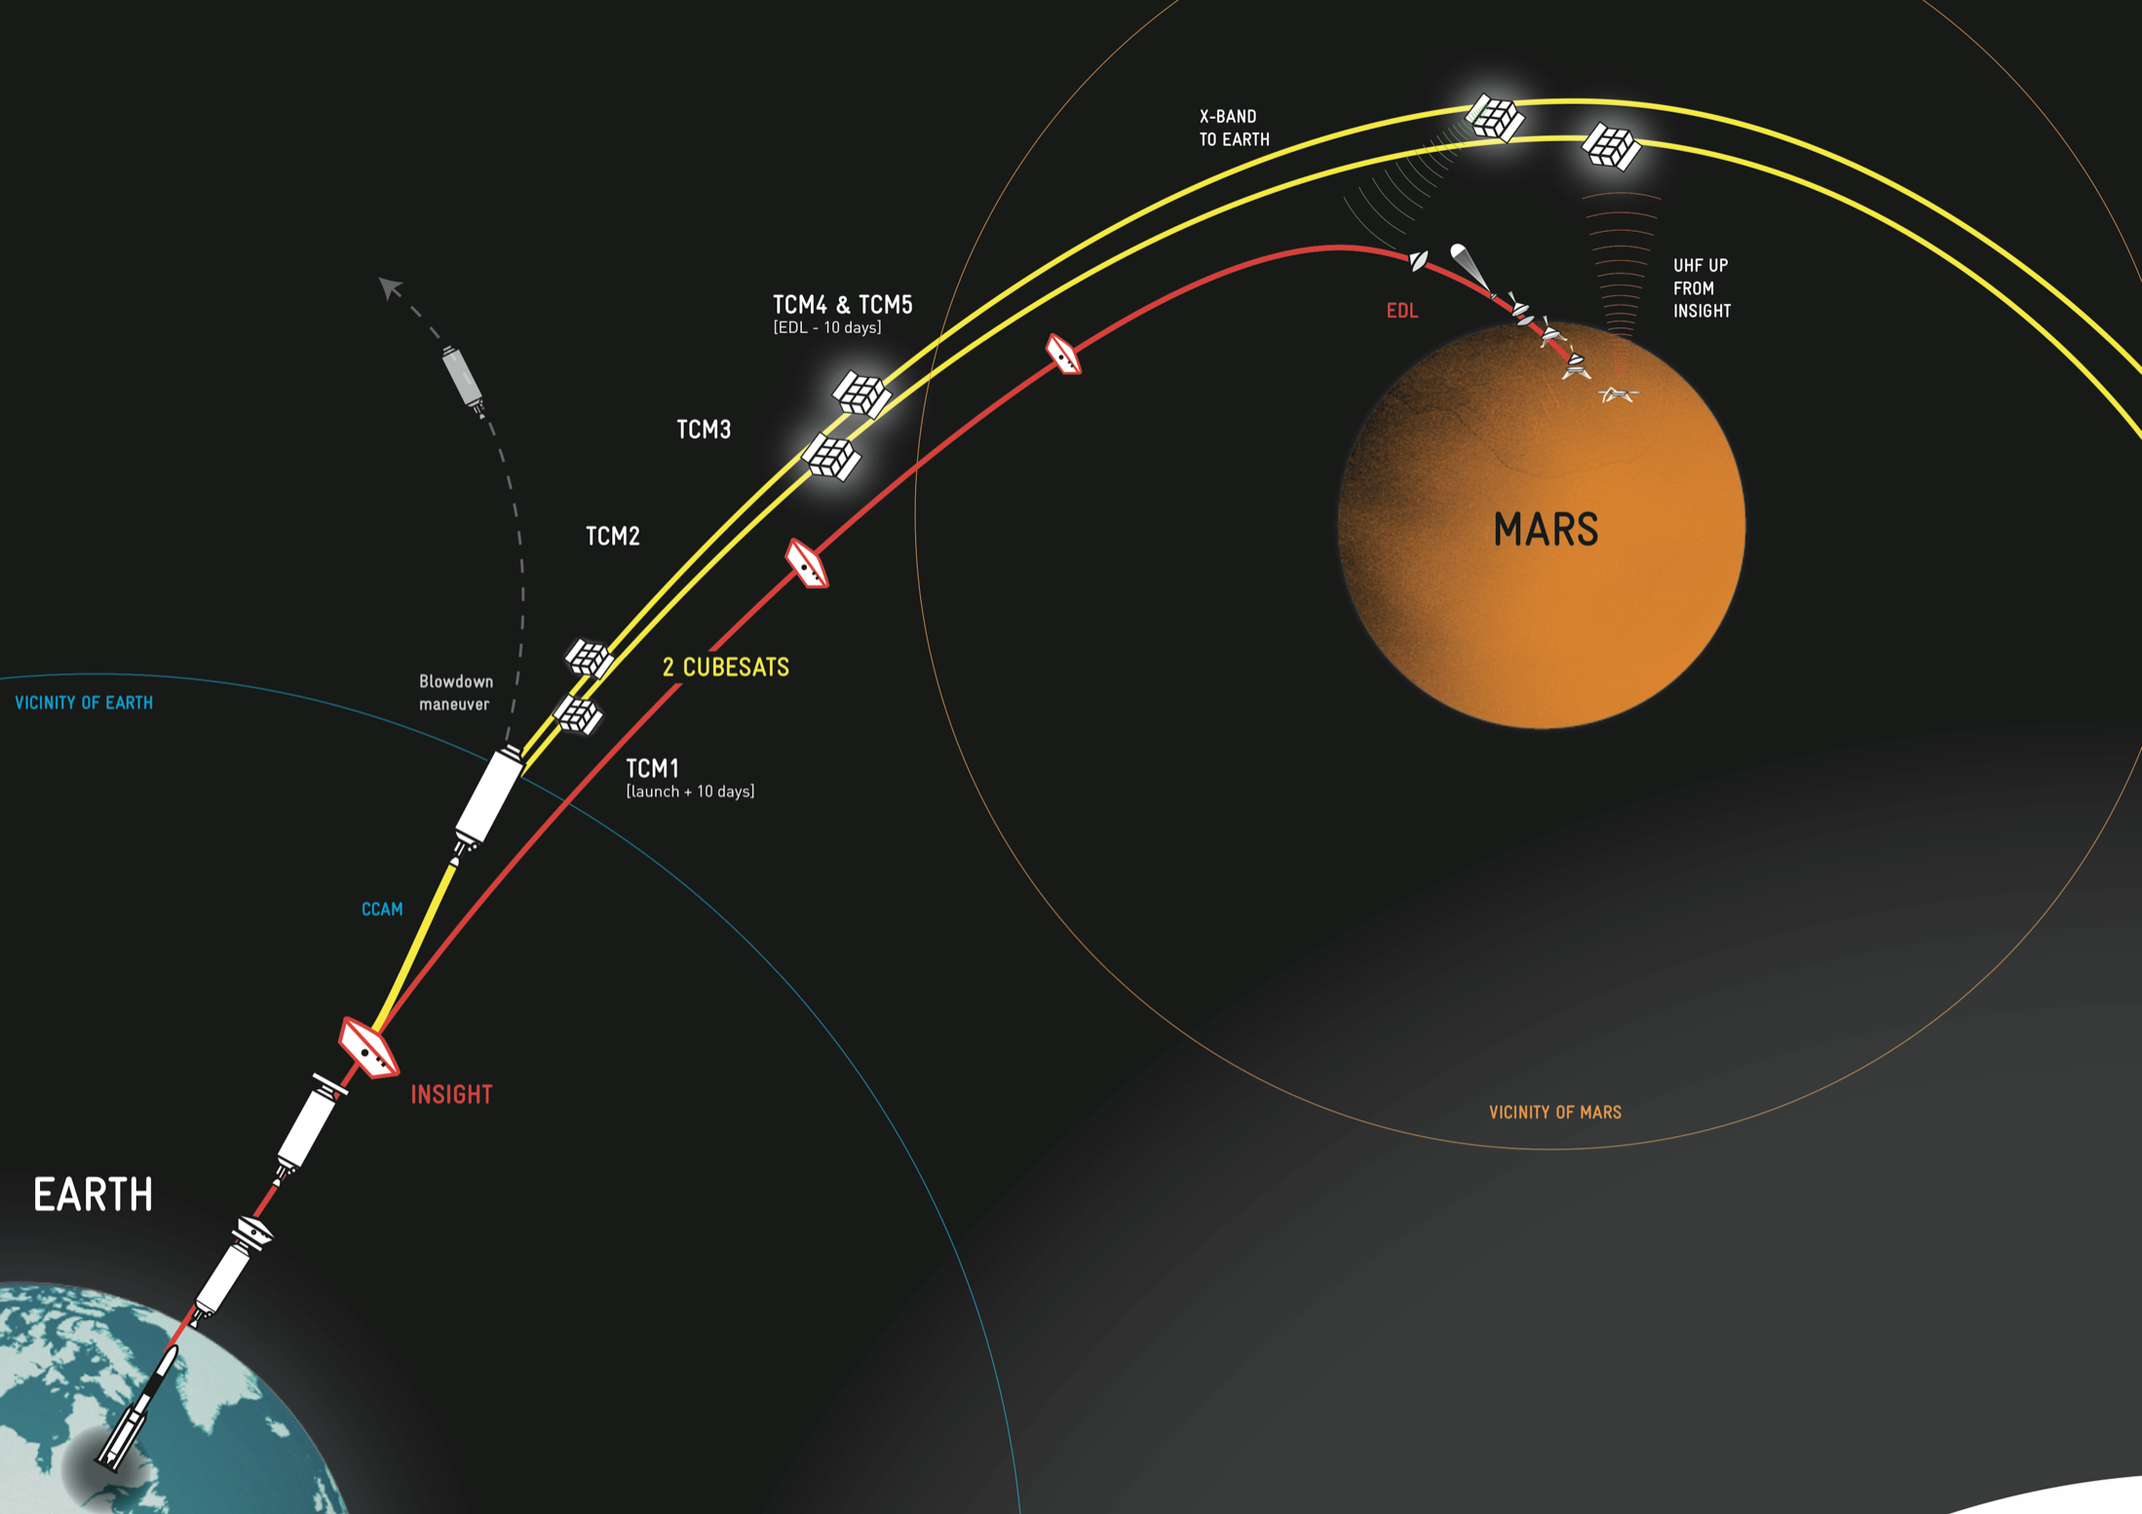
Concept of Operations
InSight EDL
Nov 2018
MarCO is a tech demo mission to provide 8kbps real-time relay during InSight’s Entry-Descent-Landing to Mars with CubeSats.
“Bring your own comm” concept
InSight Launch
May 2018

Slide 4
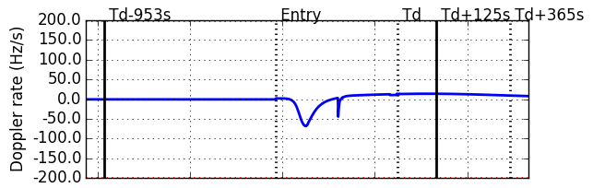
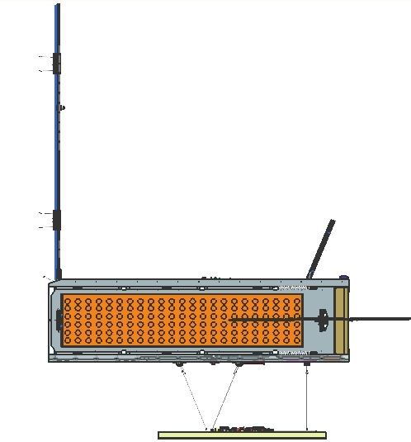

Challenging Requirements for EDL Telecom
±2° (3σ)
Parachute Deploy
To Sun
To Earth
UHF Carrier ON
UHF Tx 8kbps
Touchdown
Min. Range
Max Decel.
45°
22.75°
E-420s
E-120s
E+200s
E+390s
High spacecraft dynamics b/w MarCO and InSight
  ±20kHz Doppler shift with max 200 Hz/s rate
Direct-to-Earth at 8kbps to 70m DSN station
  X-band transmit EIRP of 59 dBm over ±2°
  Max topocentric range: 1.07 AU (160 Mkm)
Large UHF antenna angle of observation
  UHF 0 dBi gain over ±30°
  Max slant range: 3500 km
Bent-pipe Relay Transmission
  22 minutes of EDL data recording capacity
  Capability for post-EDL re-transmission
To InSight
Max Range
~ 3500 km
±30° (3σ)
InSight

Slide 5
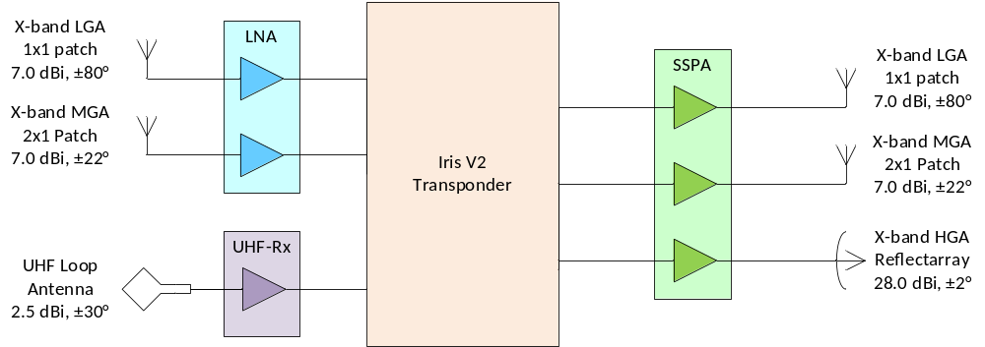
Telecom System Elements
Greatly upgraded transponder designs based on Iris V1 from INSPIRE
Novel X-band reflectarray design for DTE communications
Newly developed UHF receiver
Deployable UHF loop antenna

Slide 6
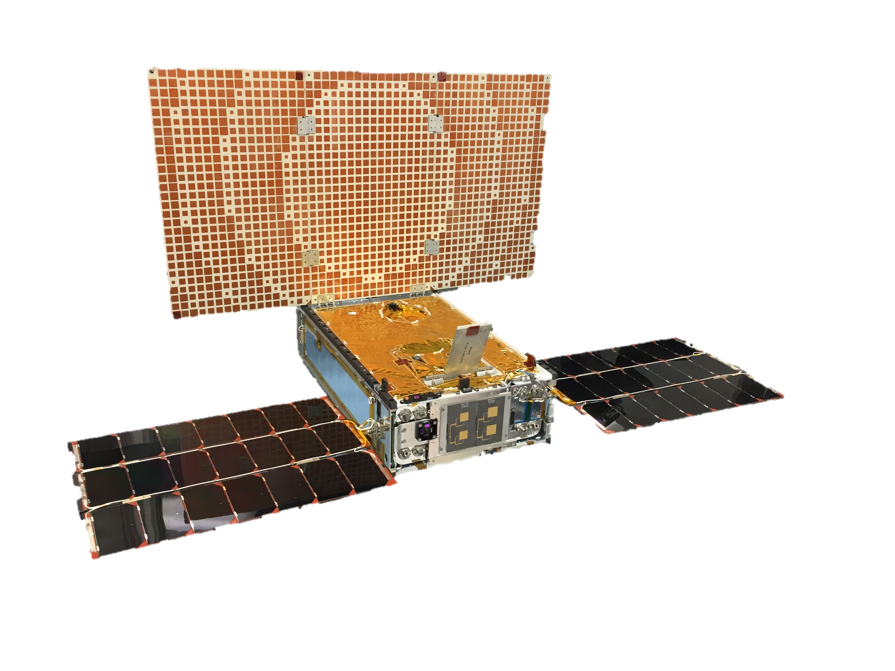
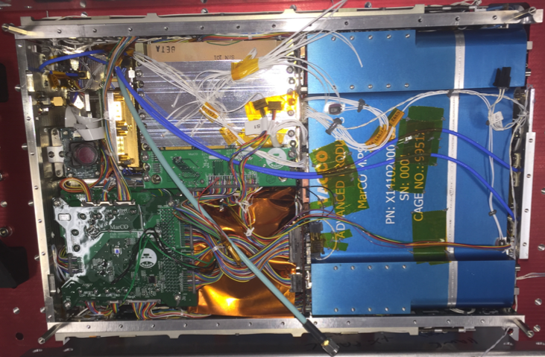
MarCO CubeSat
The “Guts”

Slide 7
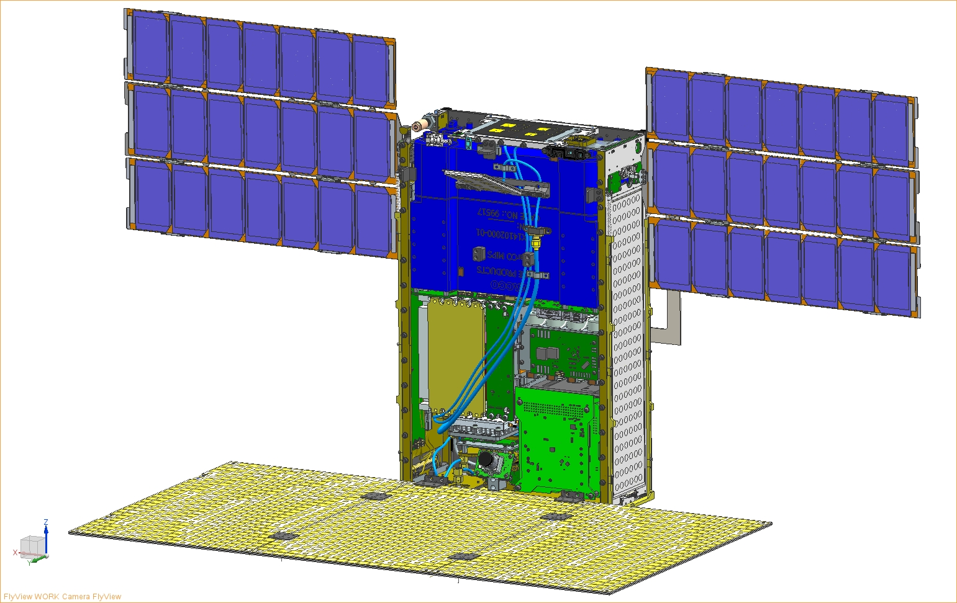
MarCO CubeSat
Antenna Feed
Sun Sensor
Solar Array
Cold Gas System
Battery Assembly
Iris Stack
SSPA & LNA Assembly
C&DH, EPS, XACT stack
Cabling & Cameras
ReflectArray

Slide 8
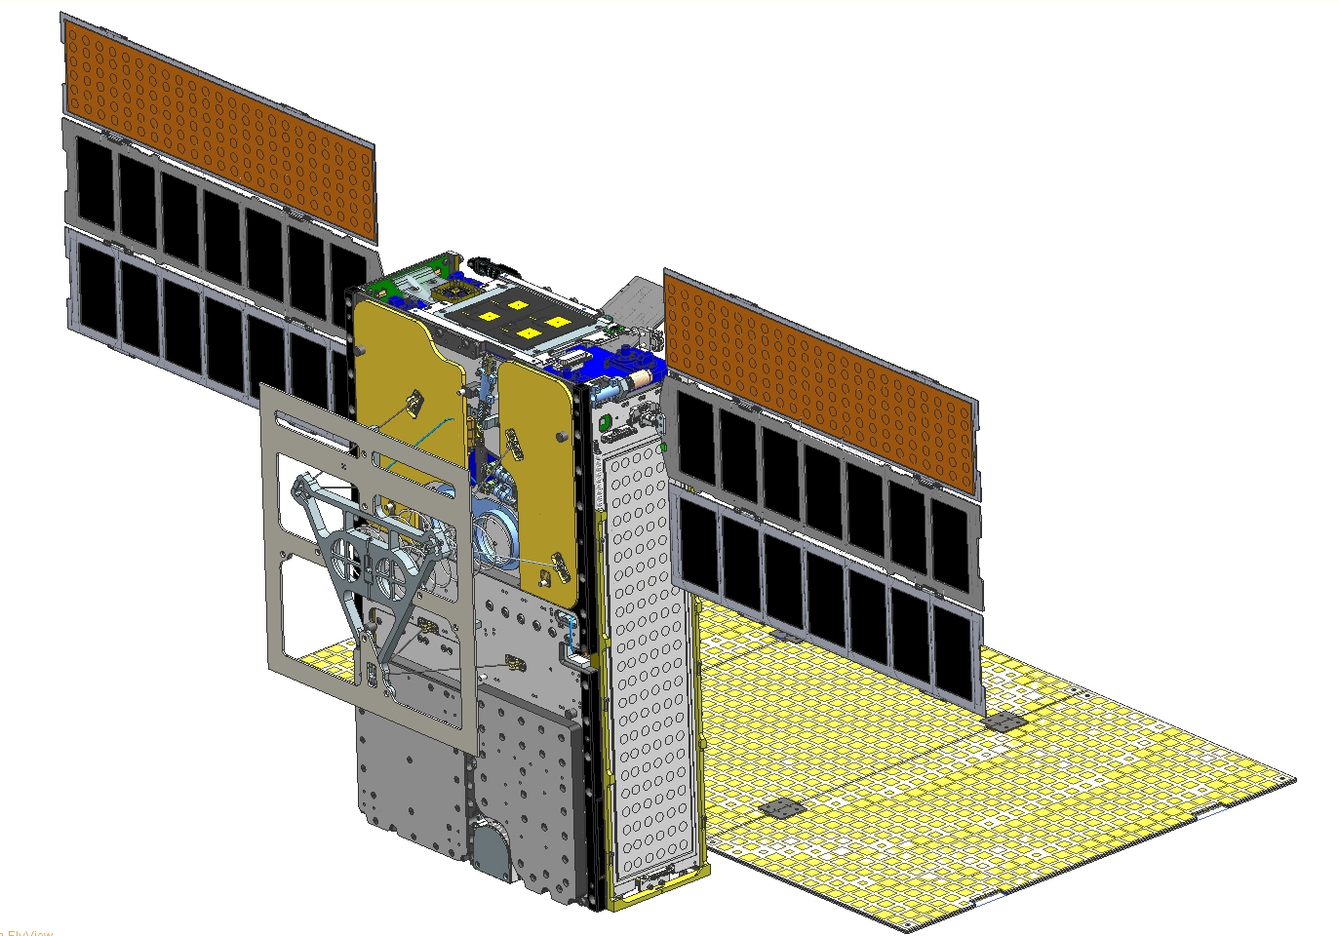
MarCO CubeSat
Tx/Rx MGA (co-boresighted with HGA)
Thrusters
Radiator
UHF Loop Antenna
Tx/ Rx LGA
(bottom, not shown)

Slide 9
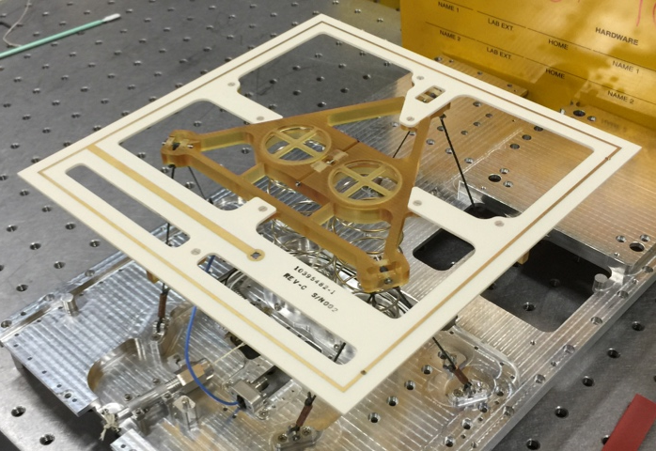
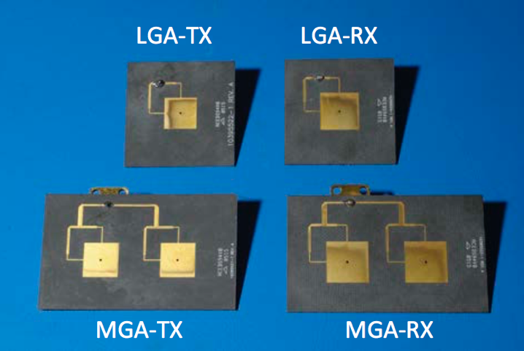
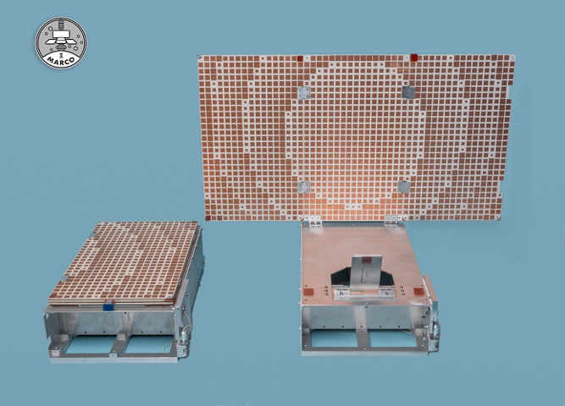
Antenna Designs
R. E. Hodges, N. Chahat, D. J. Hoppe and J. D. Vacchione, "A Deployable High-Gain Antenna Bound for Mars: Developing a new folded-panel reflectarray for the first CubeSat mission to Mars.," in IEEE Antennas and Propagation Magazine, vol. 59, no. 2, pp. 39-49, April 2017.
N. Chahat and R. E. Hodges, “Enabling deep space CubeSat missions: Telecommunication challenge”, MARS CubeSat/NanoSat Workshop, Pasadena, CA, Nov 2014.
X-band Patch Antennas
UHF Loop Antenna
X-band HGA Reflectarray

Slide 10
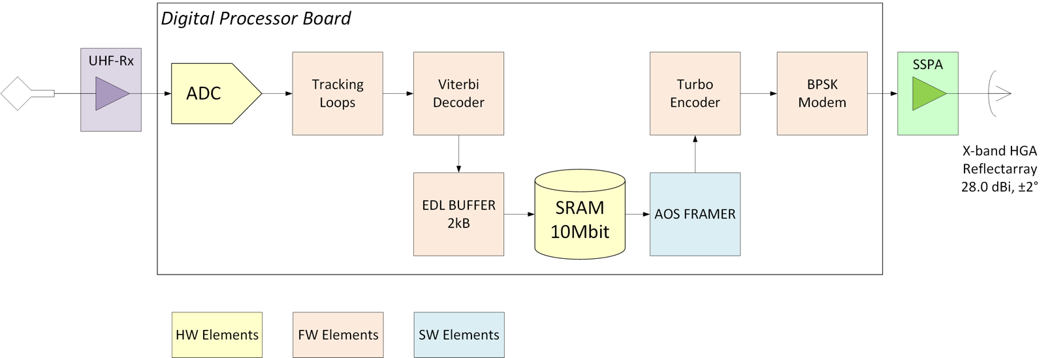


Digital Bent-Pipe Architecture
Digital bent-pipe scheme (non-analog), performed directly by the radio
  InSight transmits in raw mode, incompatible with DSN station processing
  MarCO flight system uses MSP430-based CDH running at 12 MHz with only 8kByte RAM
  MarCO requires a re-transmission mode for post-EDL
Relay is done with CDH out-of-the-loop to minimize data latency
Iris Digital Processor Board upgrades
  Embedded Leon-3FT softcore processor for EDL data management
  AOS Framer (typically on CDH unit) implemented in software
  Hardware memory elements (2MB SRAM, FLASH)
  Firmware Viterbi decoder for InSight EDL data (convolutional coded)
AOS TX FRAMES
RAW MODE
DSS-63 (70m)
Madrid
InSight

Slide 11
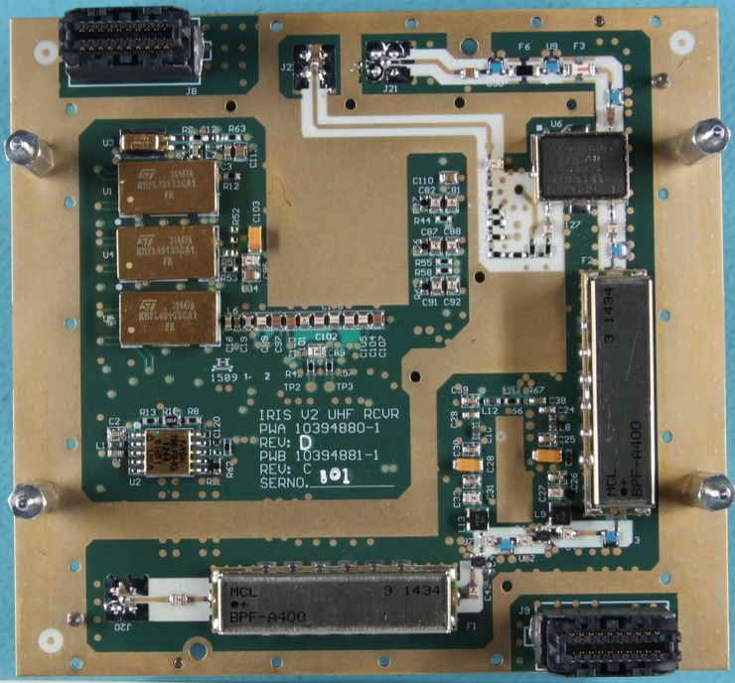
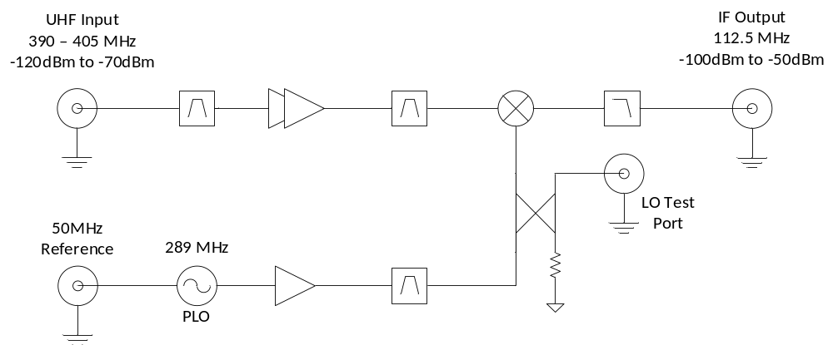
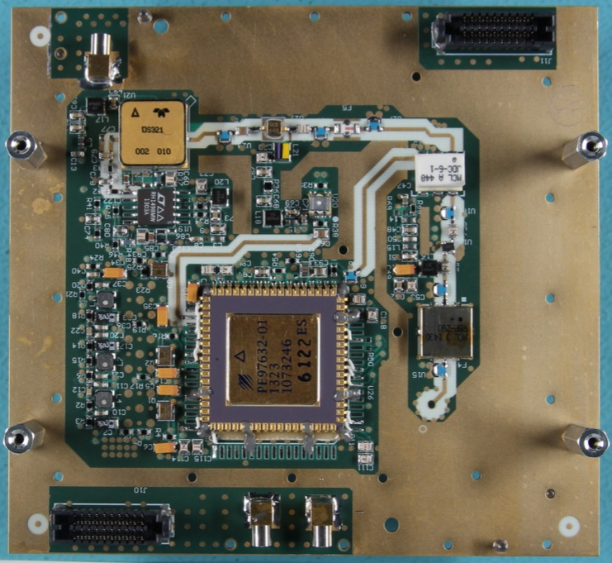
UHF Receiver Design
Shares IF amplification/filter stage with X-band Rx
  Reduces size and volume
  Only one ADC required on digital board
Traditional superheterodyne receiver with one downconverter stage
General Requirements:
  Receive frequency range: 390 – 405 MHz
  Downconvert to 112.5 MHz
  Noise figure < 5 dB
Mixer
Amps
BPF
BPF
VCO
Loop Filter
PLL

Slide 12
X-band Link Margins at EDL
Uplink Parameter |  | Units | Value
Tx Station | Transmitter Power | kW | 20.0
 | Passive/Pointing Losses | dB | -0.75
 | DSS-54, 34m Antenna Gain | dBi | 67.0
 | EIRP | dBm | 139.25
Path | Atmospheric Attenuation | dB | -0.20
 | Free Space Path Loss | dB | -273.6
MarCO Receiver | Receiving Antenna Gain (MGA) | dBi | 8.9
 | Antenna/Passive Losses | dB | -3.3
 | Total Received Power (Pt) | dBm | -129.0
 | Rcvr Noise Figure | dB | 3.5
 | Noise Spectral Density (No) | dBm/Hz | -172.0
 | Received Pt/No | dB-Hz | 43.0
Data Channel | Data Supp. (mod index = 1.5r) | dB | -2.1
 | Data Rate (62.5 bps) | dB-bps | 18.0
 | System Losses | dB | -3.0
 | Th. Eb/No (uncoded, BER=1e-5) | dB | 9.6
 | Req’d Pt/No | dB-Hz | 32.7
 | Uplink Margin | dB | 10.3
Downlink Parameter |  | Units | Value
MarCO Tx. | Transmitter Power | W | 4.6
 | Passive/Pointing Losses | dB | -4.2
 | Transmit Antenna Gain (HGA) | dBi | 28.8
 | EIRP | dBm | 61.2
Path | Atmospheric Attenuation | dB | -0.15
 | Free Space Path Loss | dB | -275.0
Receiving Station | DSS-63, 70m Antenna Gain | dBi | 74.3
 | Antenna/Passive Losses | dB | -0.3
 | Total Received Power (Pt) | dBm | -139.8
 | System Noise Temp | K | 25.5
 | Noise Spectral Density (No) | dBm/Hz | -184.5
 | Received Pt/No | dB-Hz | 44.7
Data Channel | Data Supp. (mod index = 77°) | dB | -0.23
 | Data Rate (8000 bps) | dB-bps | 39.0
 | System Losses | dB | -0.8
 | Th. Eb/No (Turbo-1/6, FER=1e-4) | dB | -0.1
 | Req’d Pt/No | dB-Hz | 40.0
 | Downlink Margin | dB | 4.7

Slide 13
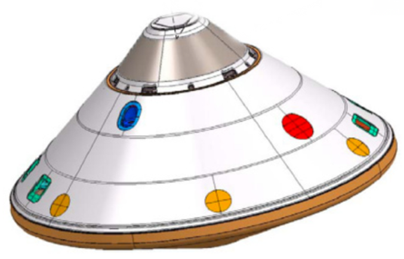
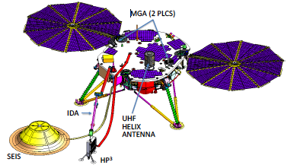
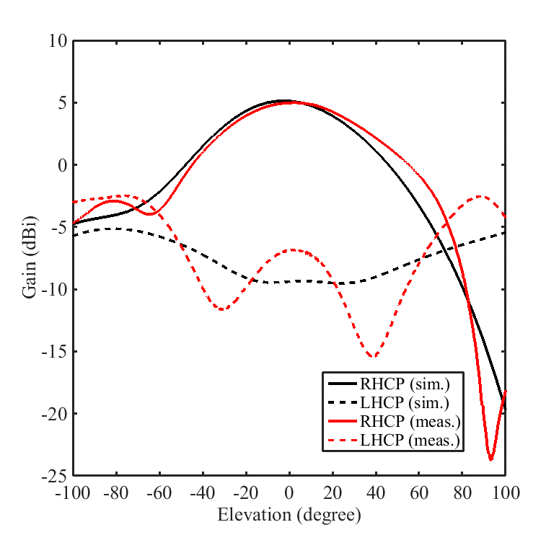
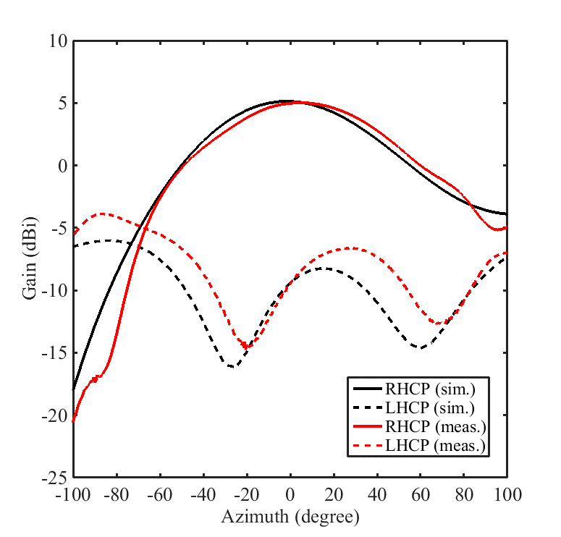
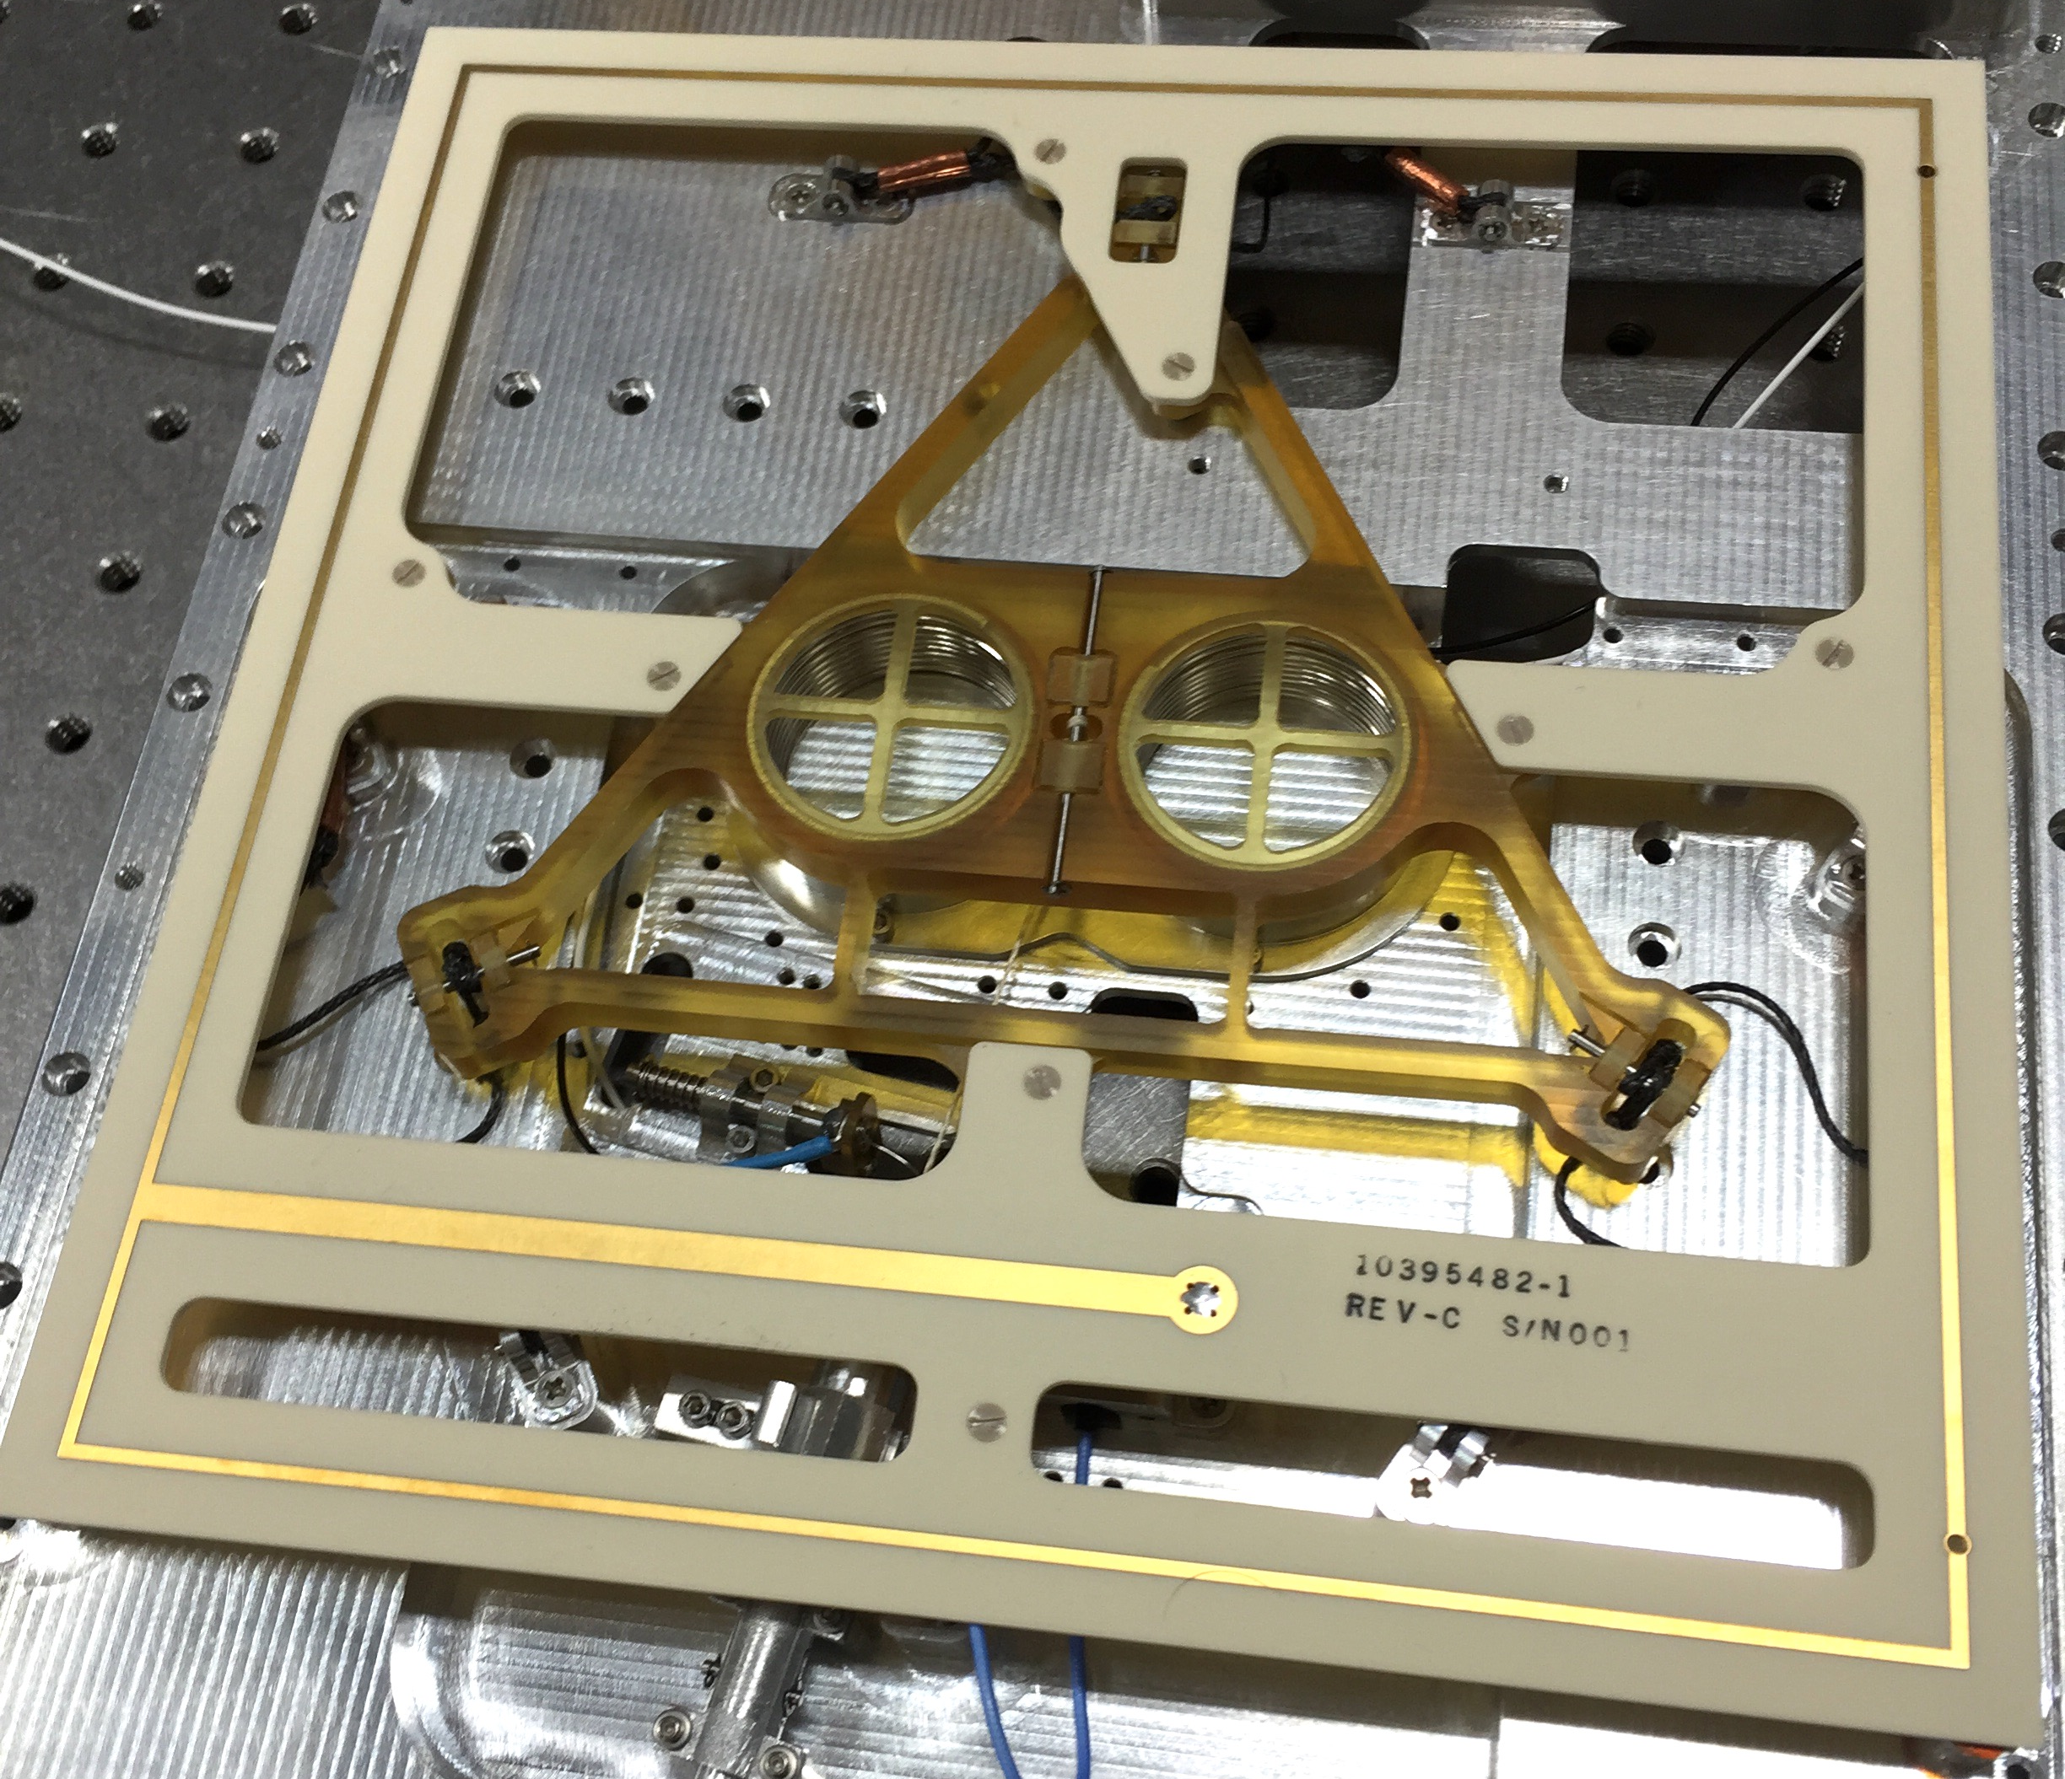
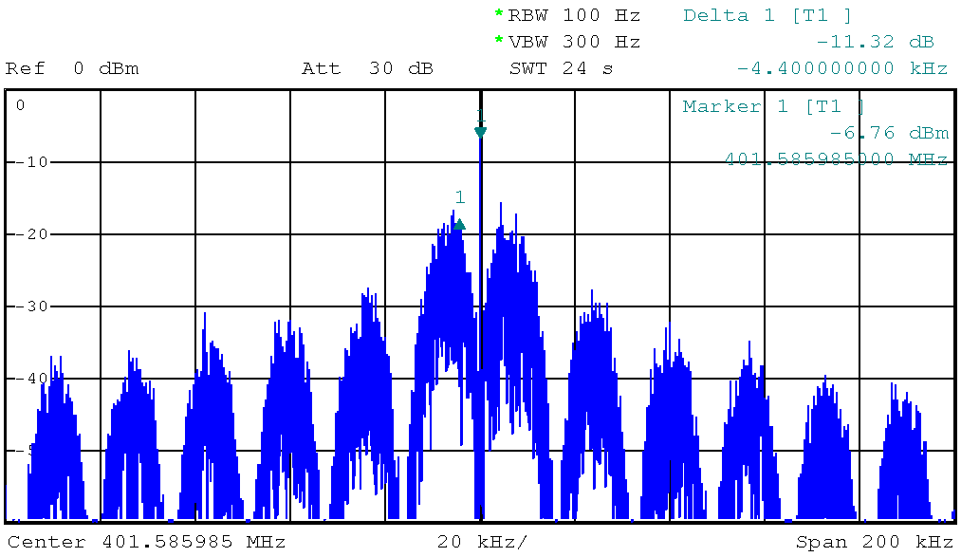
UHF Link Margins at EDL
InSight antennas may have up to 5dBi gain on boresight.
Antennas will be switching during EDL = causes dropouts
Uplink Parameter |  | Units | Value
InSight Tx. | Transmitter Power | W | 14.8
 | Passive/Pointing Losses | dB | -2.0
 | InSight Antenna Gain | dBi | -1.0
 | EIRP | dBm | 38.7
Path | Atmospheric Attenuation | dB | 0
 | Free Space Path Loss | dB | -154.9
MarCO Receiver | Receiving Antenna Gain (UHF) | dBi | 2.9
 | Antenna/Passive Losses | dB | -3.8
 | Total Received Power (Pt) | dBm | -117.1
 | Rcvr Noise Figure | dB | 3.6
 | Noise Spectral Density (No) | dBm/Hz | -170.9
 | Received Pt/No | dB-Hz | 53.8
Data Channel | Data Supp. (mod index = 60°) | dB | -1.25
 | Data Rate (8000 bps) | dB-bps | 39.0
 | System Losses + EMI | dB | -7.2
 | Th. Eb/No (RS, BER=1e-3) | dB | 3.5
 | Req’d Pt/No | dB-Hz | 51.0
 | InSight-MarCO Link Margin | dB | 2.8
Wrap-around Antenna
UHF MGA Antennas
UHF Helix Antenna
MarCO UHF Loop Antenna
Gain > 2.9dBi over ±30°
InSight Spectrum
8kbps
Manchester
RS(252,220)
Conv (k=7, r=1/2)
Residual Carrier
Mod index 60°

Slide 14
Major Telecom Test Campaigns
Iris Transponder ambient tests
Downlink tests against TDL Block-V Receiver
UHF channel simulator tests
InSight-MarCO compatibility tests at Lockheed Martin
DTF-21 DSN compatibility test
EMI/EMC “plugs-out” self-compatibility test
Unit-Level Testing
MarCO I&T
Iris Ambient
Block-V Receiver
Channel Simulator
InSight Compat
DSN Compat
EMI/EMC “plugs-out”
JPL XPDR
Dev Lab
JPL Anechoic Chamber
Lockheed Martin
JPL/DSN
DTF-21
Test Area:

Slide 15
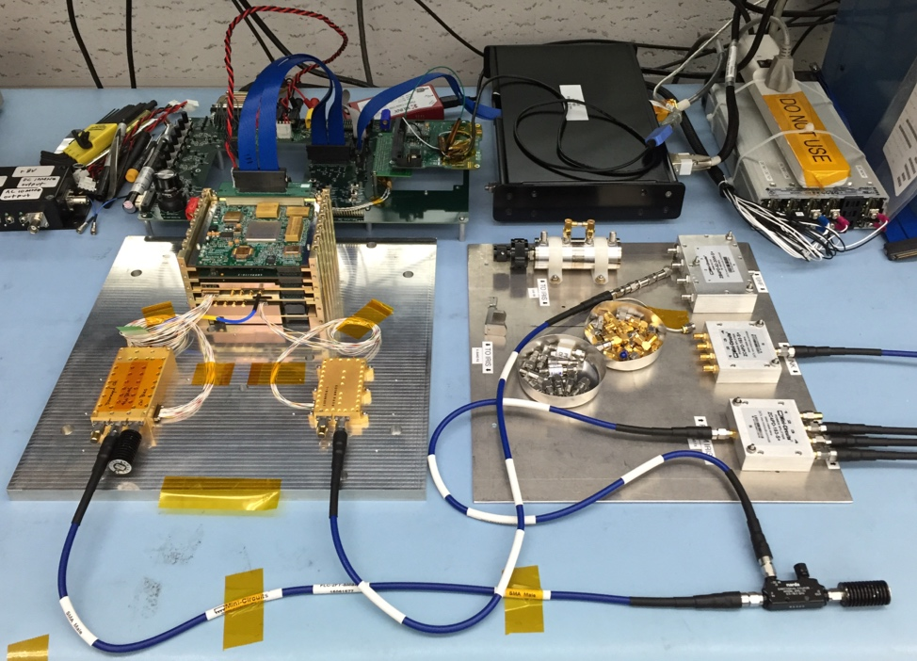
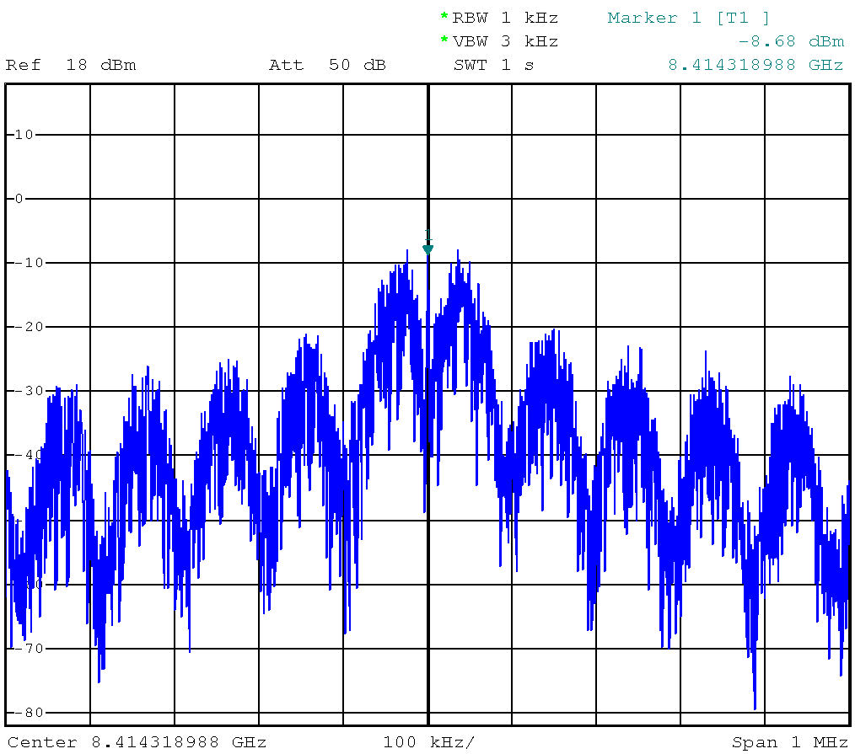
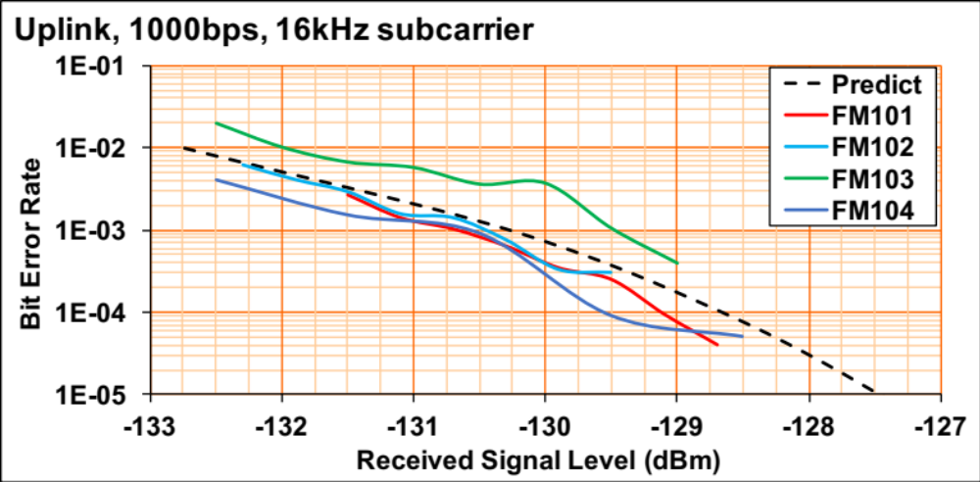
Iris Ambient Tests
Power consumption and in-rush
LNA noise figure
SSPA RF Output Power
Downlink tests at 62.5, 1k, 8k bps
Uplink tests at 62.5 and 1kbps
Uplink threshold and bit-error rate
UHF return link at 8kbps
UHF return link threshold/BER
Navigational test (Ranging, DDOR)
Downlink Spectrum
8kbps, Manchester, Turbo-1/6

Slide 16
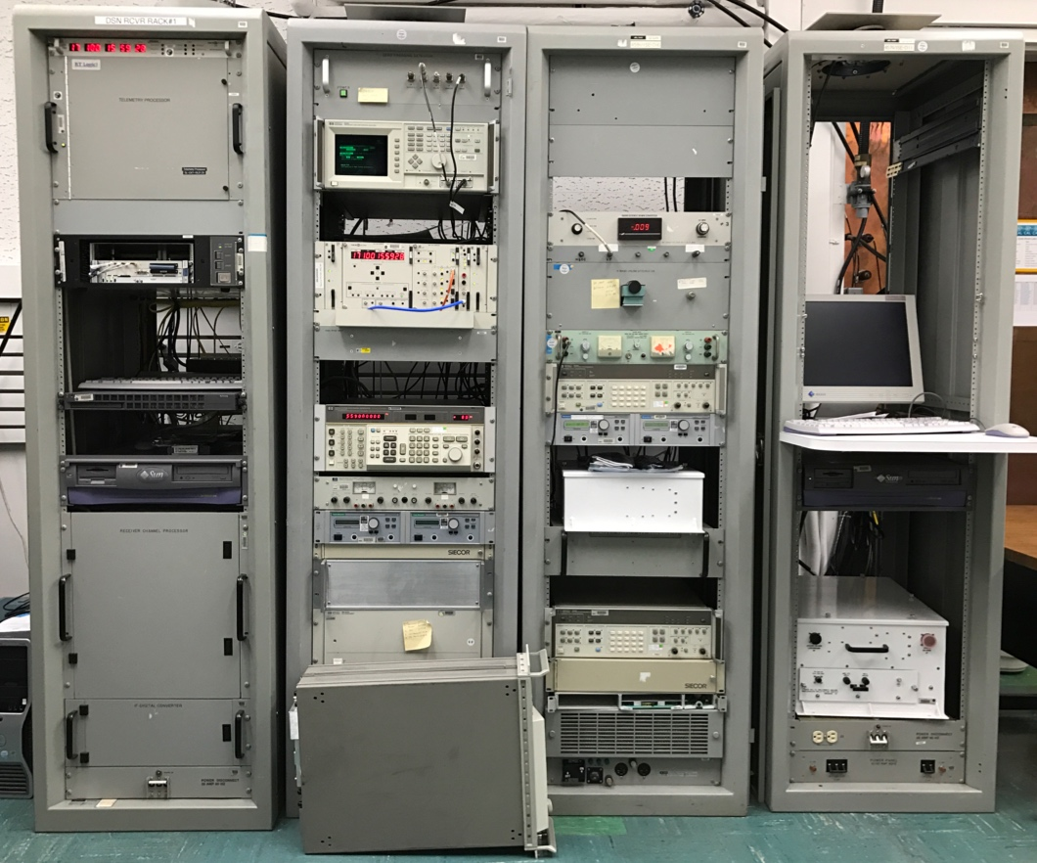
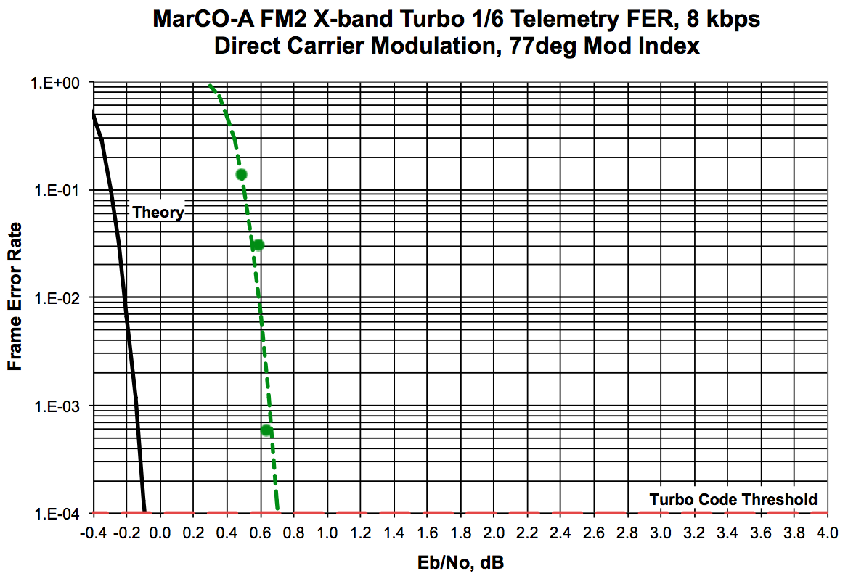
Block-V Receiver Tests
5th generation DSN receivers currently used at all DSN complexes
Supports all telemetry reception and decoding described in DSN 810-206B
Early compatibility tests before formal DSN compatibility tests
  Verifies carrier performance for acquisition and tracking
  Verifies telemetry encoding (Turbo-1/6) integrity
  Measure expected performance loss with FER curves
Telemetry Processor
RF Channel Atten.
Downlink Maintenance Terminal
Timing Synchronizer
Downlink Channel Computer
RF/IF Downconv.
Receiver & Ranging Processor
Radio Implementation Loss: 0.8 dB
IF/baseband
Downconv.
Block-V Receiver

Slide 17
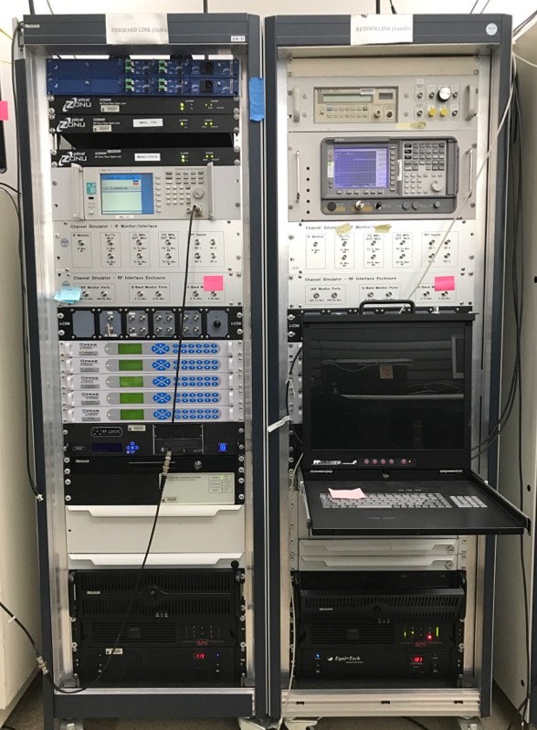
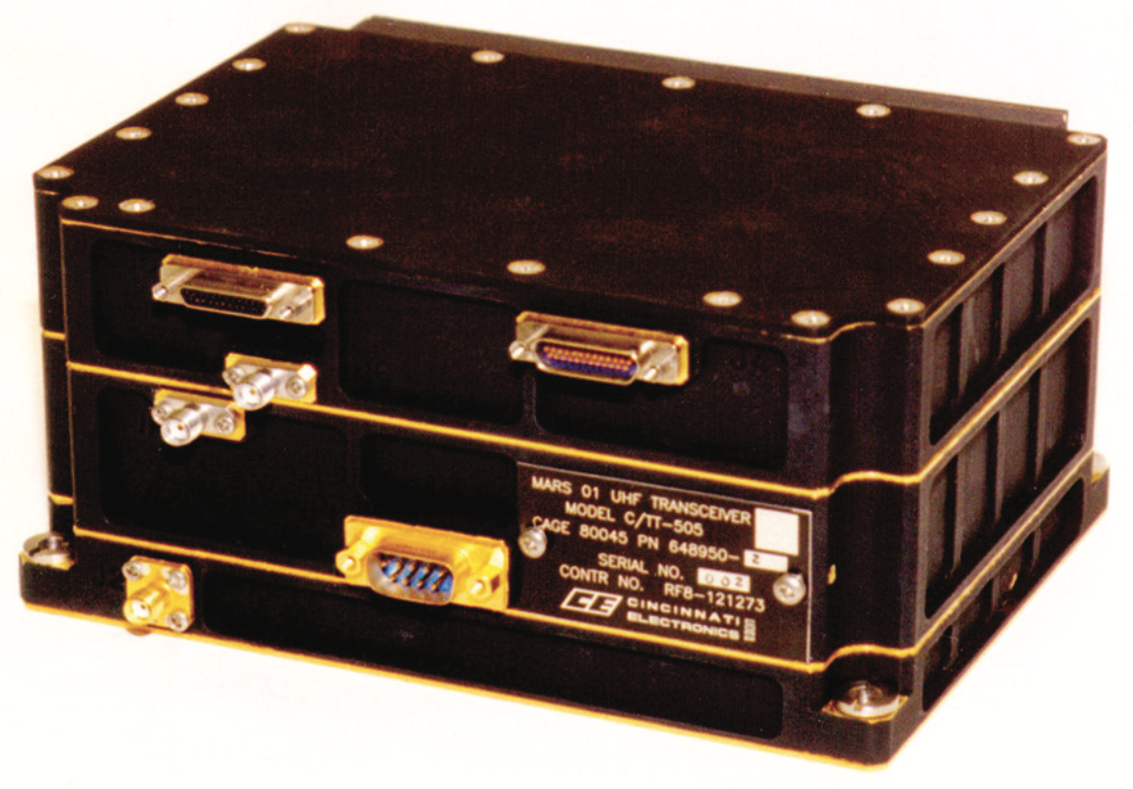
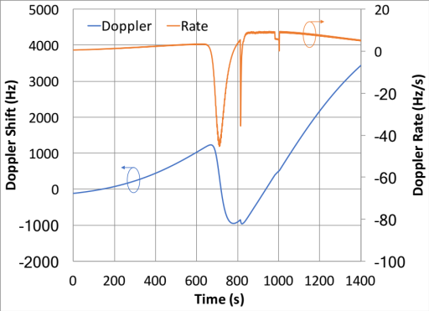
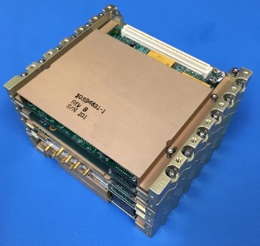
UHF Channel Simulator Tests
Flight-like end-to-end bent-pipe configuration test with Channel Simulator
  Provides Doppler profiles (expected and worst-case predicts)
  Injects signal drop-outs to stress test Iris receiver
Test Case Description | Doppler | Dropouts | Duration
Basic, short | None | None | 5 min
Basic, full | None | None | 24 min
Expected Doppler | Flight Profile | None | 24 min
Worst-Case Doppler | ±20kHz, 200Hz/s | None | 24 min
Expected Doppler + Dropout | Flight Profile | Yes | 24 min
Worst-case Doppler + Dropout | ±20kHz, 200Hz/s | Yes | 24 min
Flight-like | Flight Profile | Yes | 24 min
Retransmit | None | None | N/A
Channel Simulator
InSight Tx equivalent
Flight Profile
Block-V Receiver

Slide 18

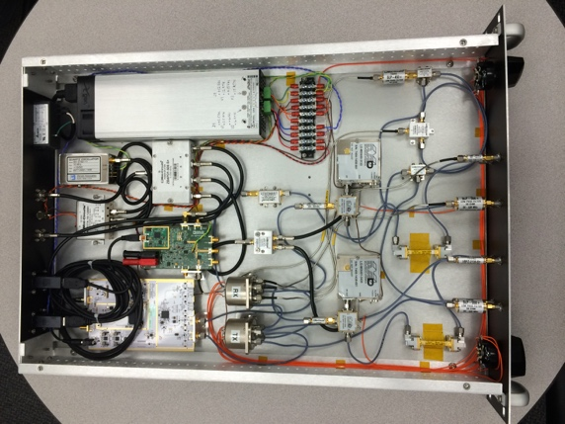
InSight-MarCO UHF Compatibility Tests
Field test conducted at Lockheed Martin (Nov 11-12, 2015)
Test Relay Partner | Description | BER | Notes
InSight Flight System UHF Transmitter | 10 min transmission 2 signal dropouts | 6.26e-5 | Symbol sync errors during dropout transitions appear as bit errors in final transmission.
 |  | 4.50e-1
 |  | 8.47e-6
InSight STL (mostly EM HW) | 10 min transmission No signal dropouts | 0 | No bit errors.
 | 1 min transmission 1 signal dropout 10 min transmission | 0 | No bit errors.
 |  | 1.66e-6 | Errors in first/last frames. Symbol sync errors during dropout transitions.
InSight STL Tx
GSE Receiver

Slide 19
DSN DTF-21 Compatibility Tests
Compatibility tests required by the DSN to demonstrate RF interoperability
DTF-21 provides an environment that represents an actual DSN Signal Processing Center for testing.
Compatibility Test | MarCO-A | MarCO-B
Uplink Receiver Threshold and AGC Calibration | Carrier Only: -140 dBm Carrier/CMD/RNG: -132 dBm | Carrier Only: -140 dBm Carrier/CMD/RNG: -132 dBm
Uplink Receiver Acquisition and Tracking | 100 Hz/s threshold: -134 dBm 200 Hz/s threshold: -131 dBm | 100 Hz/s threshold: -134 dBm 200 Hz/s threshold: -132 dBm
Uplink Receiver Tracking Range | Pass: ±20 kHz | Pass: ±20 kHz
Downlink Transmitter RF Output Power | +36.0 dBm (3.98 W) | +34.0 dBm (2.51 W)
Downlink RF Spectrum Analysis | Captured 62.5, 1k, 8k bps | Captured 62.5, 1k, 8k bps
Downlink Receiver Threshold | 5 Hz LBW: -159 dBm 20 Hz LBW: -152 dBm | 5 Hz LBW: -155 dBm 20 Hz LBW: -150 dBm
Command Performance | 1kbps threshold: -132 dBm | 1kbps threshold: -132 dBm
Telemetry Performance | Symbol Rate: 48,076.9 sps 8kbps Pt/No: 42.7 dB-Hz | Symbol Rate: 48,076.9 sps 8kbps Pt/No: 42.8 dB-Hz
Range Delay and Polarity | Range Delay: 10314 ns | Range Delay: 10797 ns

Slide 20
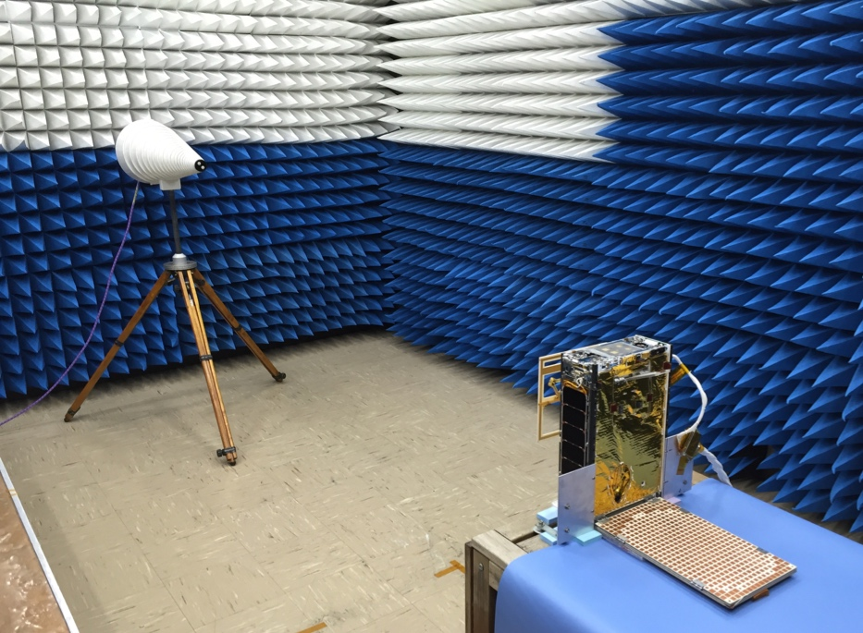
EMI/EMC Self-Compatibility Tests
Instead of traditional subsystem EMI/EMC tests, MarCO elicited a flight-system level self-compatibility test to reduce schedule.
Various configurations were tested to observe the effect on the UHF receive threshold as subsystems were turned on/off.
Results were used to update InSight-MarCO UHF link budget.
UHF Test Antenna
Plugs Config | CDH/EPS | XACT | Cam | UHF Rx Thresh | Viterbi Thresh
In | ON | OFF | OFF | -128 | -118
In | ON | ON; 3500rpm | OFF | -127 | -118
In | ON | ON; 3500rpm | ON | -124 | -117
Out | ON | ON; 3500rpm | OFF | -122 | -117
Out | ON | ON; 3500rpm | ON | -121 | -116

Slide 21
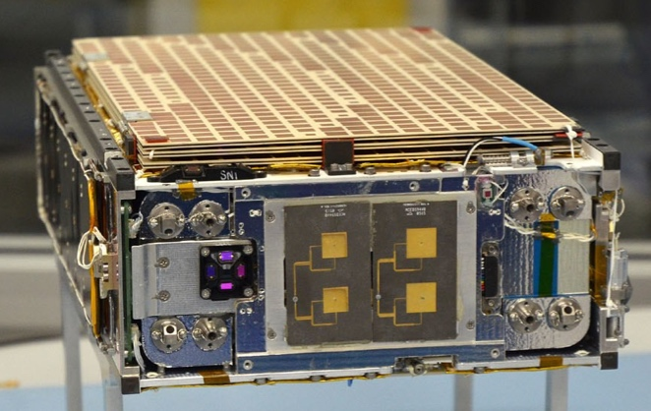
Current MarCO Status
Mar’18: Deliver FM1 & FM2 to Launch Vehicle
Stowed Configuration
Apr’18: Integrate to InSight Launch Vehicle
InSight Launch Window: May 2018

Slide 22
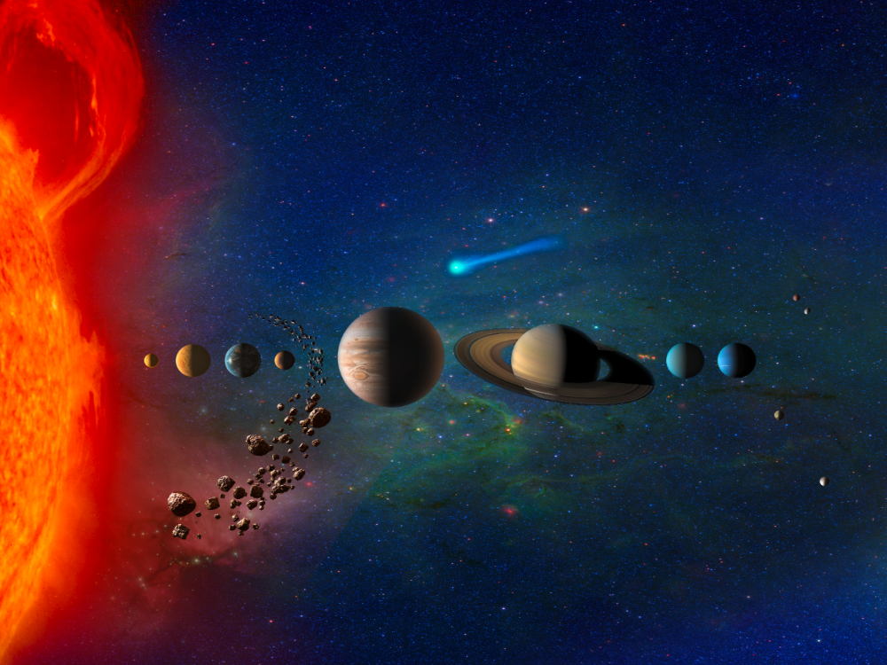
Conclusions
MarCO mission will demonstrate small spacecraft capabilities and new instruments for future (larger) planetary missions.
Go new places
Increase the frequency
Validate instrument and S/C technologies

Slide 23

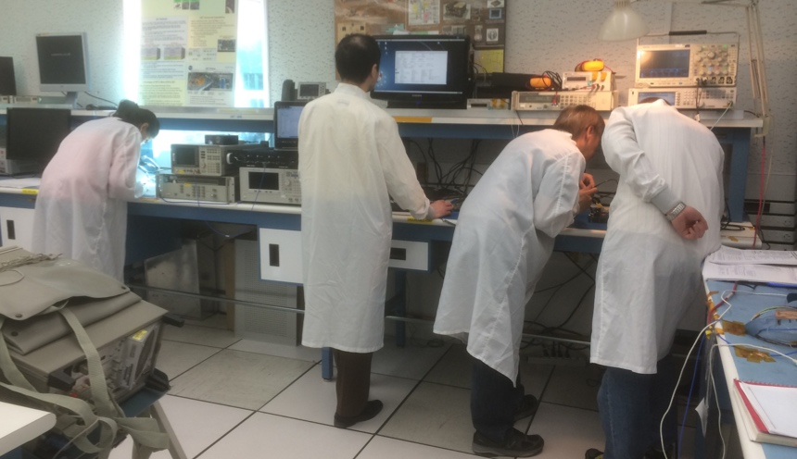
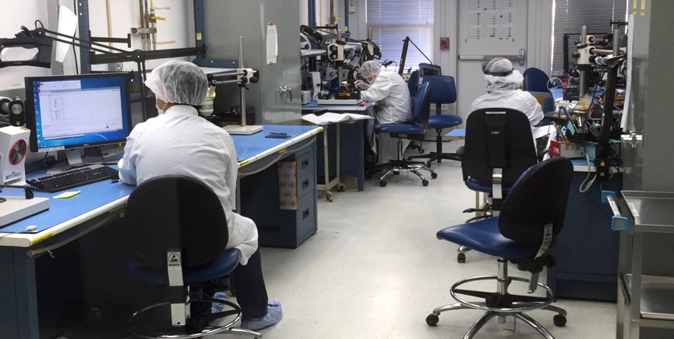

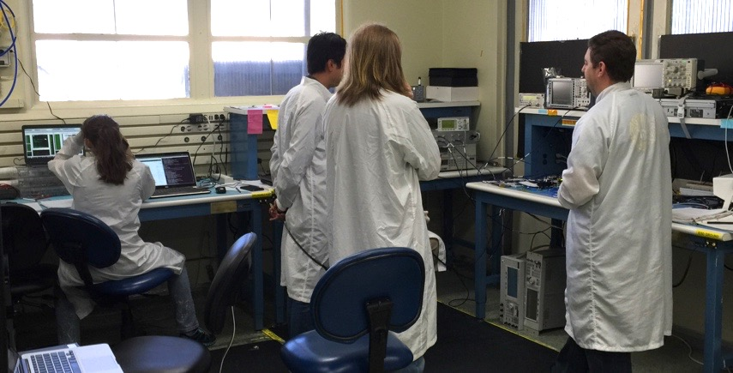
MarCO Telecom Team (and those who helped!)
Alex Hackett, Amy Smith, Anusha Yarlagadda, Brian Custodero, Bob Dengler, Charley Dunn, Danh Nguyen, Daniel Hoppe, Dave Bell Deborah Drake, Don Heyer, Dorothy Lewis, Douglas Wang, Edgar Satorius, Emmanuel Decrossas, Eric Archer, Fernando Aguirre, Gerald Walsh, Hadi Mojaradi, Heather Owen, Igor Kuperman, Jim Lux, Jimmy Chen, Joel Steinkraus, John Baker, John Leichty, Joseph Vacchione, Kameron Larsen, Kris Angkasa, Larry Epp, Mary Soria, Matthew Chase, Michael Ciminera, Michael Kilzer, Nacer Chahat, Peter Ilott, Quintin Ng, Ray Quintero, Ricardo Mendoza, Richard Hodges, Richard Rebele, Robert Cong, Ronald Morgan, Salman Haque, Samuel Zingales, Sarah Holmes, Steve Waldherr, Tatyana Dobreva, Tuyen Ly

Slide 24


