Slide 1
Inflatable Antenna for CubeSats at X-Band: results of the experimental tests
Alessandra Babuscia, Jonathan Sauder
(Jet Propulsion Laboratory, California Institute of Technology)
Aman Chandra, Jekan Thangavelautham
(Arizona State University)
Interplanetary Small Satellite Conference 2017
Part of this work was performed at the Jet Propulsion Laboratory, California Institute of Technology, under a contract with the National Aeronautics and Space Administration.
© 2017 California Institute of Technology. Government sponsorship acknowledged.
Reference herein to any specific commercial product, process, or service by trade name, trademark, manufacturer, or otherwise, does not constitute or imply its endorsement by the United States Government or the Jet Propulsion Laboratory, California Institute of Technology.

Slide 2
Outline
Introduction
Spherical Design
Feed Design
Deployment
Inflation and rigidization
Dynamic
Conclusion and future work

Slide 3
Introduction
Cubesats are now becoming a new way to explore space. They are designed to be smaller, with high stowing efficiency, and they are fabricated at a lower cost and faster development schedule than traditional spacecraft.
As CubeSats are becoming a way to explore deep space in a more affordable way than traditional spacecraft, new needs emerge: propulsion systems, thermal and radiation protection and telecommunication systems that can sustain a severely increased path loss.
Different communication technologies are in development to approach this problem and to support interplanetary exploration with CubeSats and small satellites.
The inflatable antenna is unique as it provides an extremely high stowing efficiency (20: 1), low mass (<0.5 Kg), scalability and inflation with sublimating powder.

Slide 4
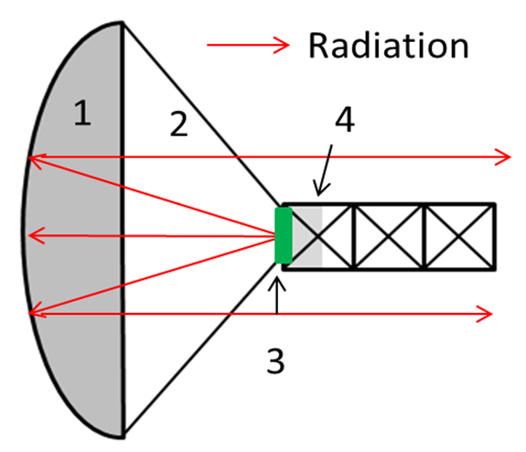
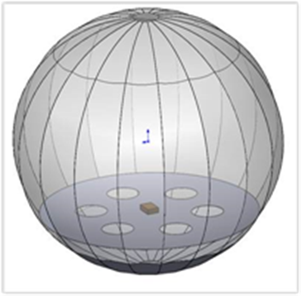
Spherical Redesign
The original inflation concept was based on the idea of using sublimating powder to inflate into a parabolic shape.
Many experiments with photogrammetry shown that when the membrane is inflate, the final shapes tends to deviate from a parabola→ the gas tends to inflate the structure into a sphere.
A new design was conceived: the inflatable antenna is now a sphere with only a portion reflective, while the rest is transparent.
Challenges are:
  Feed placement inside the reflector
  Reflector size is reduced from 1 m to 71.3 cm in diameter.
  Manufacturing
Inflatable antenna original concept, (Babuscia,2014, IEEE)
New design (Babuscia et al., 2017, IEEE)

Slide 5
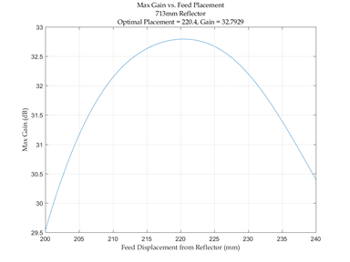
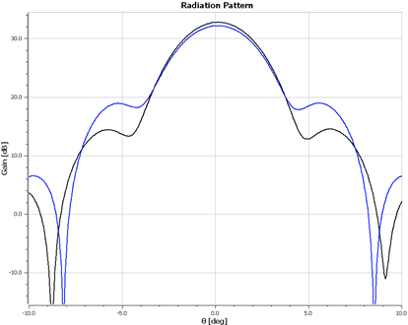
Feed design
A single RHCP patch was selected as the feed for the inflatable reflector ( Feed gain: 7.16 dBi).
Two reflector-feed configurations were considered and evaluated with TICRA GRASP:
  The first design prioritized gain maximization→ Gain is a function of both feed placement and reflector diameter and is maximum when reflector diameter is 71.3 cm and feed placement is 22 cm from the reflector.
  The second design constrained the feed placement so that the seam of the feed support structure was co-located with the reflector seam for easier manufacturing→ The seam constraint caused feed placement to be a function of reflector diameter. Therefore, gain was only a function of reflector diameter and was maximum with a reflector of 81.9 cm.
The first design was selected because of higher gain, lower sidelobes and the increased manufacturing complexity which is non-consequential. .
Max Gain vs. Feed Placement
71.3cm Reflector
Optimal Placement = 22cm, Gain = 32.79dB
33
32.5
32
31.5
31
30.5
30
29.5
Max Gain (dB)
20 20.5 21 21.5 22 22.5 23 23.5 24
Feed Displacement from Reflector (cm)
Radiation Pattern
30
20
10
0
-10
█ 71.3cm Reflector
█ 81.9cm Reflector
Gain (dB)
Babuscia et al., 2017, IEEE
-10 -5 0 5 10
Elevation Angle (degrees)

Slide 6
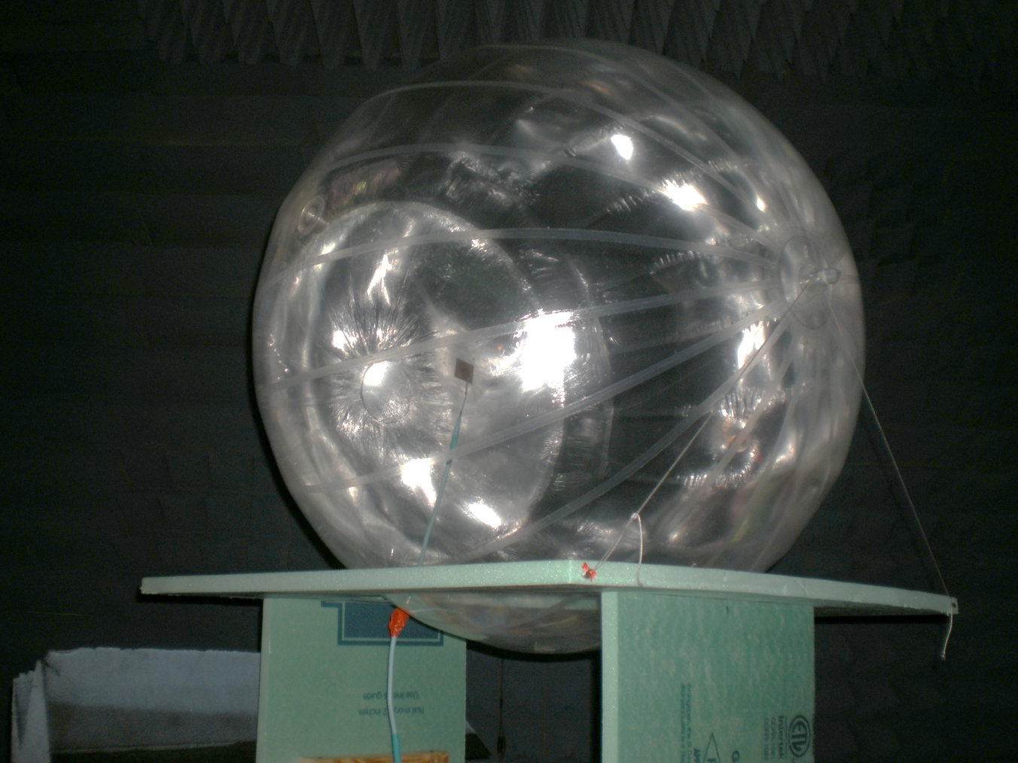
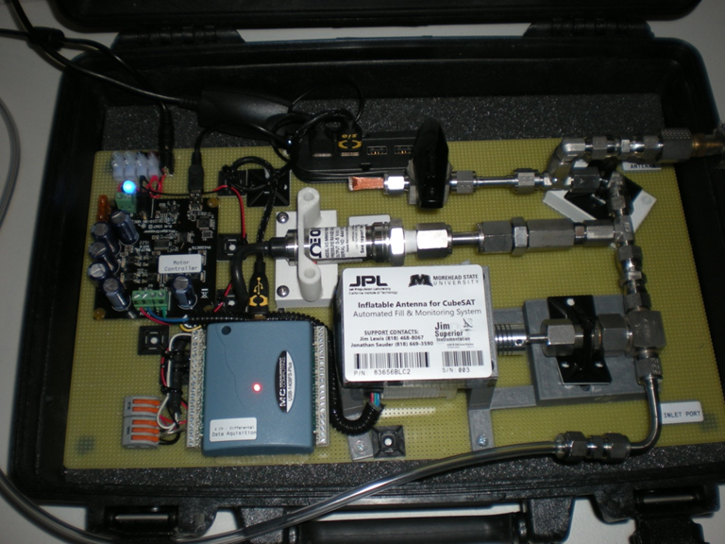
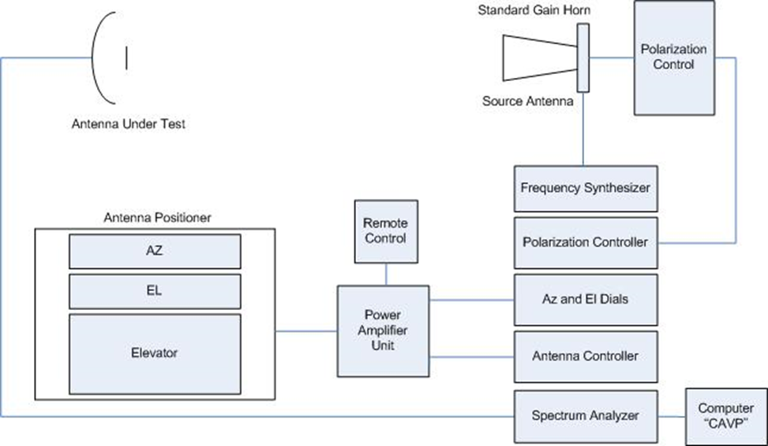
Anechoic Chamber Test: Setup

Slide 7
Anechoic Chamber Tests Results
JPL Inflatable | 19 Dec | Pattern |  |  |  | Estimated
Freq GHz | N2 Pressure PSI | Integrated Gain dBi | 3 dB Beam Width | 10 dB Beam Width |  | 3/10 Gain dBi
7.145 | 0.20 | 28.67 | 4.922 | 12.74 |  | 29.64
7.19 | 0.20 | 28.70 | 4.926 | 12.66 |  | 29.65
7.235 | 0.20 | 28.74 | 4.789 | 12.54 |  | 29.85
8.4 | 0.20 | 29.68 | 4.212 | 11.17 |  | 30.93
8.45 | 0.20 | 29.28 | 4.081 | 11.06 |  | 31.15
8.5 | 0.20 | 28.82 | 4.214 | 11.12 |  | 30.94

Slide 8
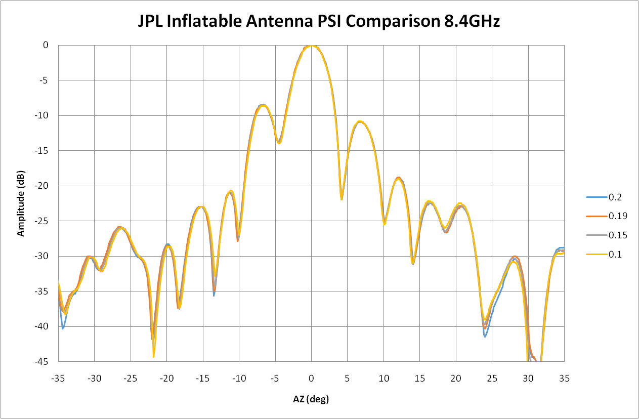
Anechoic Chamber Tests Results

Slide 9
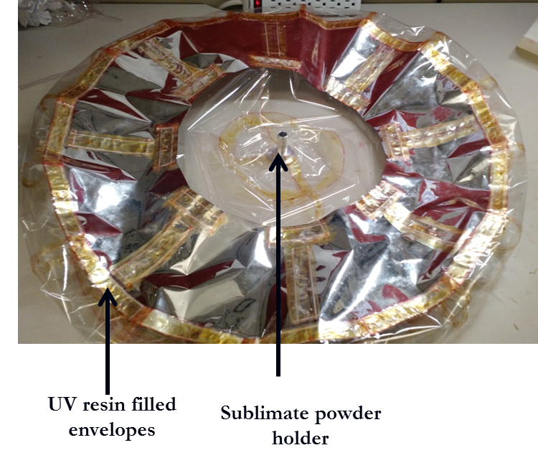
UV Rigidization
One of the critical aspects of the inflatable antenna design is its resistance to environmental phenomena, especially temperature fluctuations and micrometeoroids
Rigidization would allow the antenna to still maintain its shape even in case of puncturing and loss of pressure in the membrane.
Rigidization of the antenna structure right after deployment to avoid these temperature-driven shape fluctuations.
During this past year, the first attempt to rigidize the entire antenna shape was carried on and tested at Arizona State University.
Babuscia et al., 2017, IEEE

Slide 10
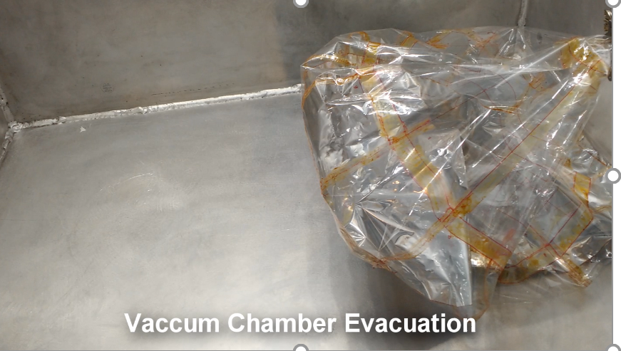
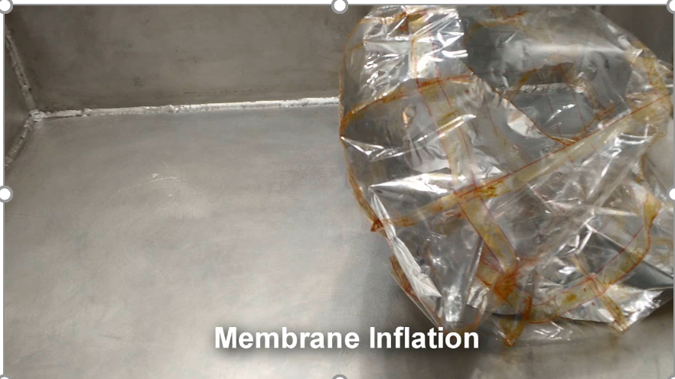
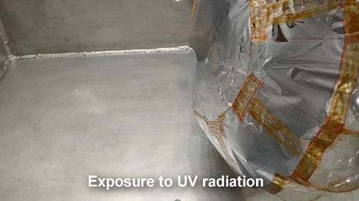
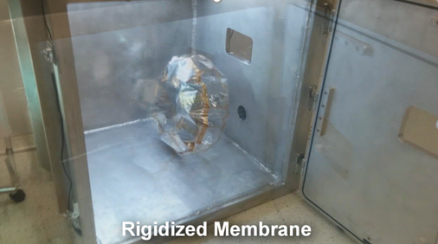
Rigidization Experiment
Babuscia et al., 2017, IEEE

Slide 11
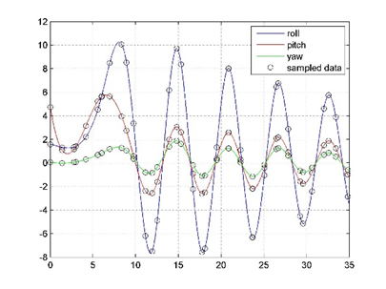
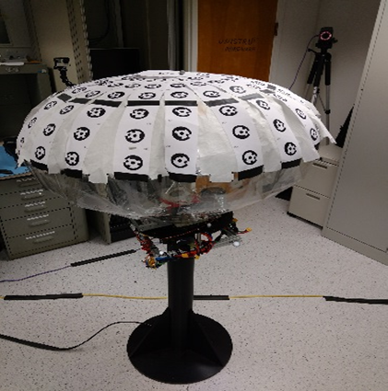
Dynamic Test on JPL Airbearinf platform: Results
Test results showed that the inflated antenna is controllable with state of the art reaction wheel systems for CubeSats.
The disturbances induced on the system by the oscillations of the antenna coupled with a flexible material were found to be negligible, and therefore compatible with foreseen mission profiles and selected hardware configurations.
Stabilized behavior
Babuscia et al., 2017, IEEE

Slide 12
Conclusions and Future Work
This presentation describes the test results for the inflatable antenna for CubeSat project.
Measurements showed between 29.6-31.2 dBi gain depending on gain integration method, pressure, frequency. They do not take into account cable loss (approx. 1 dB)
Progresses have also been made in the process of rigidizing the antenna to increase its lifetime. A full scale rigidization experiment was carried on at Arizona State University.
Finally, an effort to investigate dynamic effects was carried on through tests at the JPL small satellite dynamic testbed.
Future work includes the fabrication and test of the deployment system

Slide 13
Acknowledgments
Center of Innovation Funds Grant
Arizona State University, SpaceTrex Laboratory
Jim Welinski (Meteorological Product Inc.)
Jim Lewis (JPL)
Nacer Chahat (JPL)
Jeff Harrell and Robert Beckon (JPL)
Benjamin Malphrus (Morehead State University)

Slide 14
Thank you!

Slide 15
Questions?

Slide 16
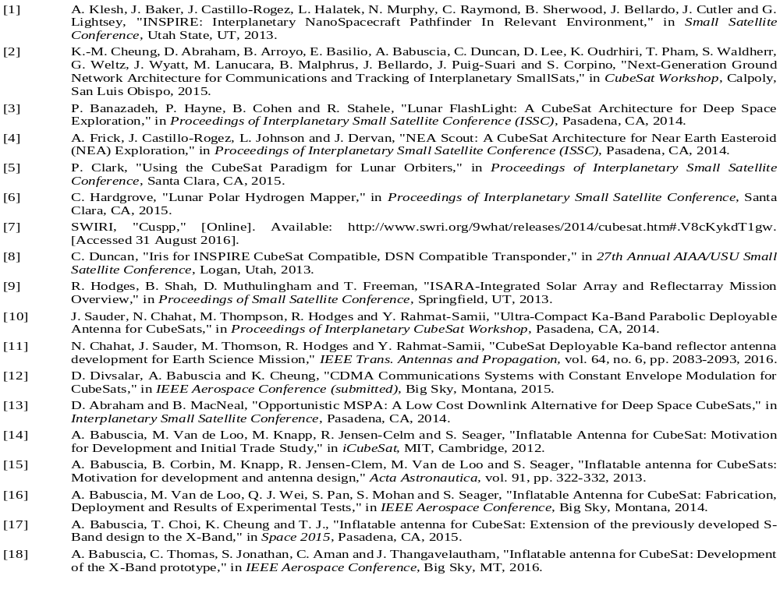
References

Slide 17
Back up

