Slide 1
CubeSat Telecom System Needs for Deep-Space Missions
2017 Interplanetary Small Satellite Conf.
San Jose, California, USA
1-2 May 2017
M. Michael Kobayashi
Jet Propulsion Laboratory at the California Institute of Technology
CL#17-1703

Slide 2
Outline
Deep-Space telecom needs
Survey of CubeSat communication systems
Overcoming large distances
Navigation in deep space
Iris Deep-Space Transponder
Iris hardware design description
Software Defined Radio heritage
Comparison of deep-space transponders
Planned deep-space CubeSat missions
Future enhancements

Slide 3
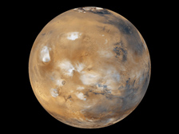

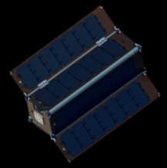
Deep-Space Telecom Needs
Trajectory
Large free-space path loss
Spacecraft dynamics effects
Navigation
Outside GPS signal range
No Earth’s magnetic fields
Environment
High ionizing radiation
Clock stability over mission duration
*IMAGES NOT TO SCALE
Copyright ©2017 California Institute of Technology. Government Sponsorship Acknowledged.
Image credit: NASA

Slide 4
Deep-Space Telecom Needs
Trajectory
Large free-space path loss
Spacecraft dynamics effects
Large aperture antennas
Low receiver sensitivity
Navigation
Outside GPS signal range
No Earth’s magnetic fields
Radiometric Navigation Techniques
Environment
High ionizing radiation
Clock stability over mission duration
Space-grade parts
Coherent Transponder
An equally capable ground station to support deep-space exploration needs is required.
*IMAGES NOT TO SCALE
Copyright ©2017 California Institute of Technology. Government Sponsorship Acknowledged.
Image credit: NASA

Slide 5
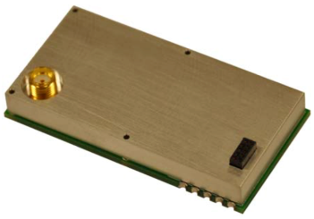
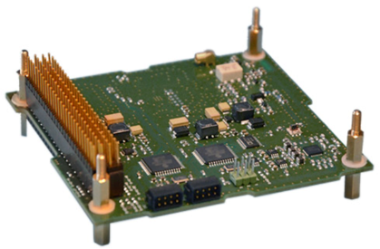
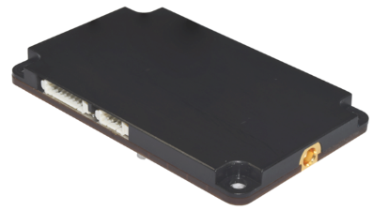
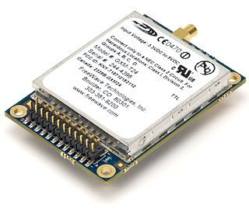
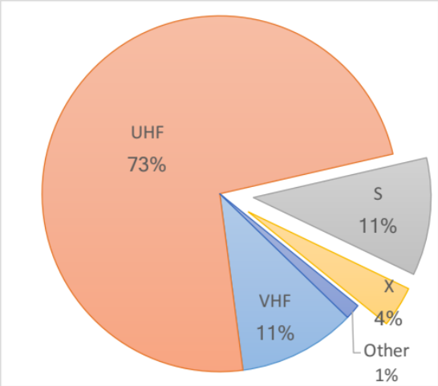
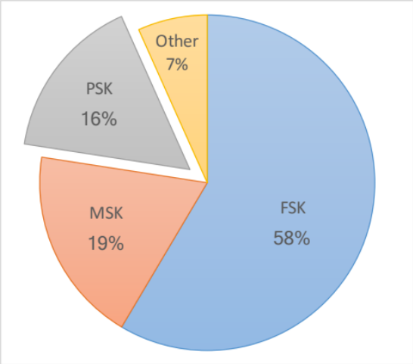
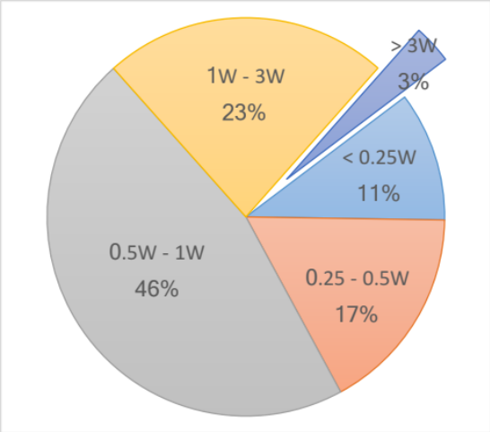
Survey of CubeSat Telecom Systems
 | AstroDev Li-1 | ISIS TRXUV | GomSpace AX100 | Freewave FGRM
Bands | VHF/UHF | VHF/UHF | VHF/UHF | S-band
Mod | FSK/GMSK | BPSK | FSK/MSK/GFSK/GMSK | GFSK
Rates (baud) | 9600 | 1200 – 9600 | 100 – 115,200 | 115,200 – 153,600
Frequency Bands
Modulation Schemes
RF Output Power
Deep-space frequency band limited to S, X, and Ka
PSK highly recommended by CCSDS for deep-space use
Higher power for farther distances necessary
* Data Source: B. Klofas, CubeSat Communications System Table, Version 13, 16 Aug 2016.
Survey of 215 CubeSats

Slide 6
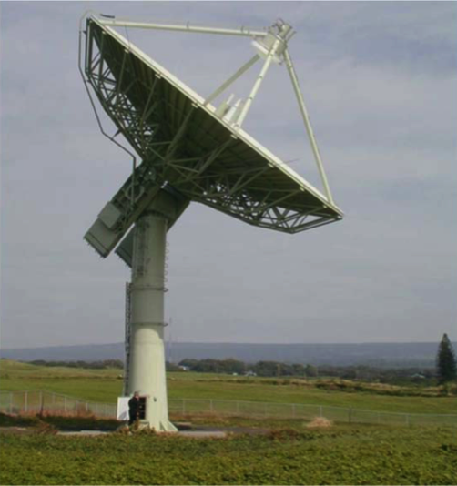
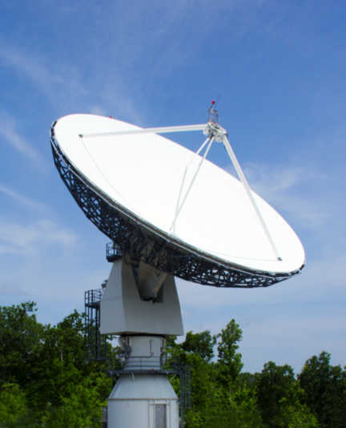
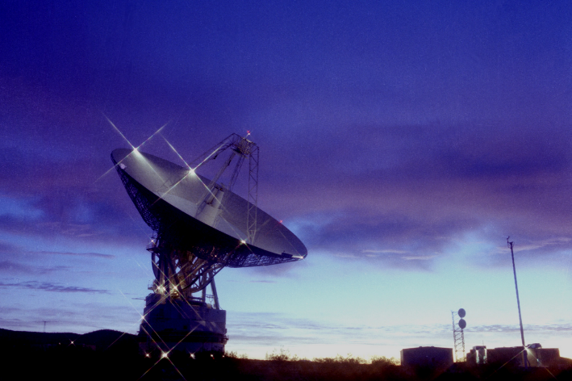
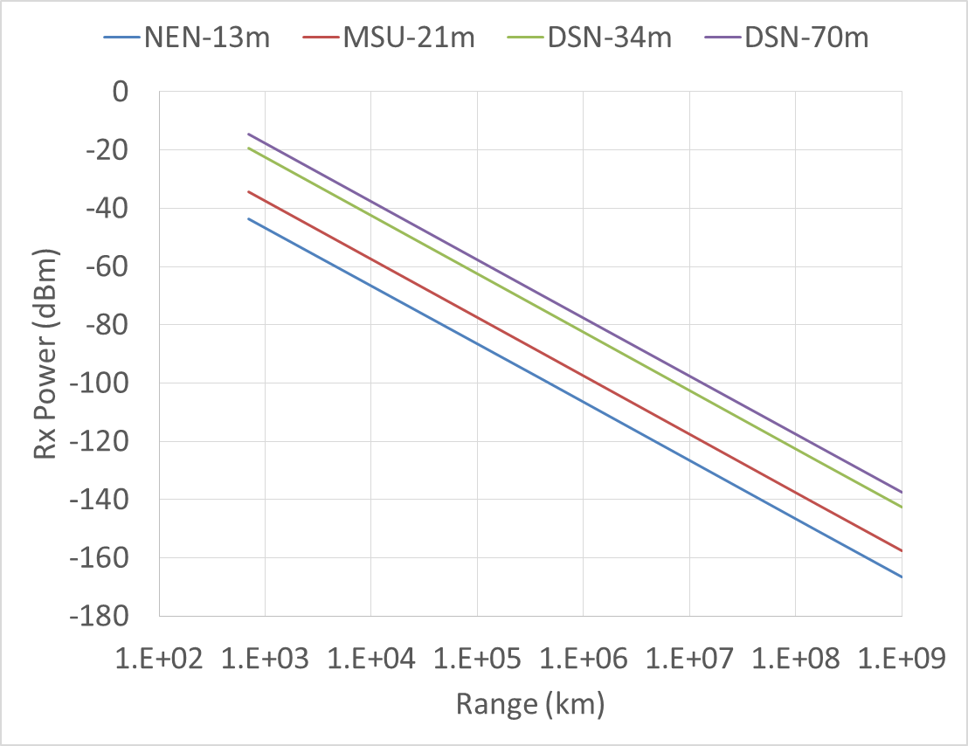
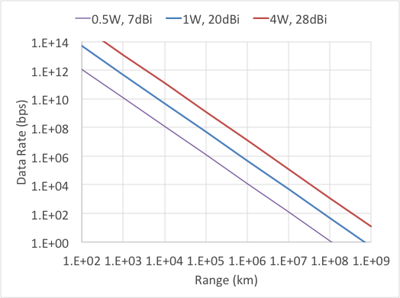
Overcoming Large Distances
Morehead State, KY
21-m Aperture
2 kW X-Xmtr*
EIRP: 125 dBm
DSS-14 (Goldstone, CA)
70-m Aperture
20 kW X-Xmtr
EIRP: 145 dBm
NEN USHI01
13-m Aperture
3 kW X-Xmtr
EIRP: 116 dBm
UPLINK
DOWNLINK
LEO
Lunar
Mars
LEO
Lunar
Mars
To DSN-34m Aperture
Convolutional r=1/2, k=7
3dB Eb/No margin
AstroDev Li-1 (9.6 kbaud)
-90
ISIS TRXUV (9.6 kbaud)
-104
Iris V2.1 (62.5 bps)
-136
SDST (62.5 bps)
-142
Iris V2.1 (62.5 bps)
Thermal Noise Floor
-174
*2kW assumed for EIRP calculation

Slide 7

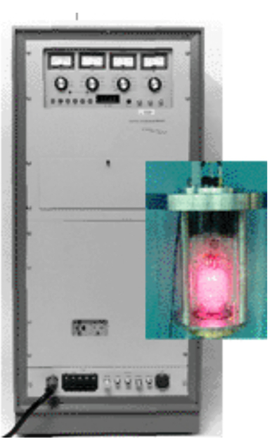

Navigation in Deep Space
Support radiometric navigation (ranging, Doppler track, VLBI) for orbit determination
  A carefully characterized Coherent Radio Transponder is necessary for turn-around ranging on the S/C
  Transmitter with special DOR tones for VLBI support (note: need two Earth stations to support)
  Earth Station equipped with navigation processing tools
Stable reference clock for reduced navigational error
  Detect milli-Hertz variations within GHz signals.
  Long integration times with low frequency drift
    Stability required over round-trip light time (ranging)
    VLBI tracking times 8-12 hours.
Overcome S/C dynamic effects
  Configurable carrier tracking loops for varying dynamics
  Pre-emphasis Doppler compensation from Earth station
Image credit: NASA/DSN

Slide 8
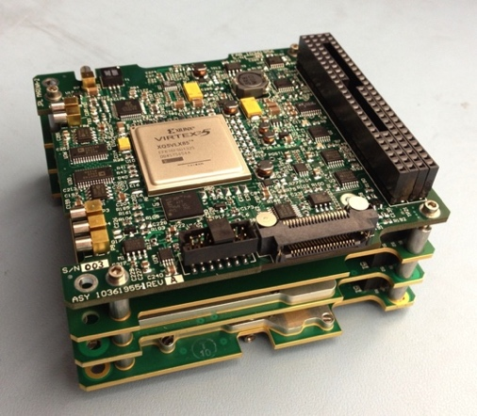
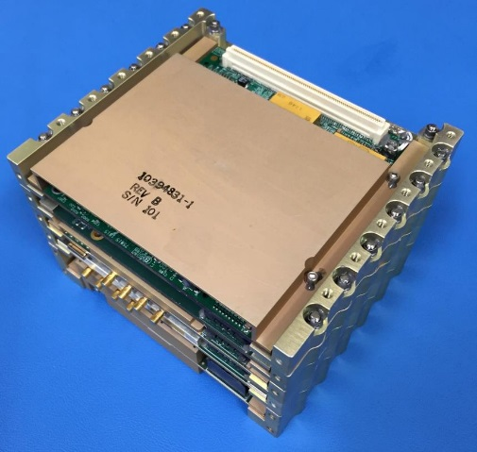
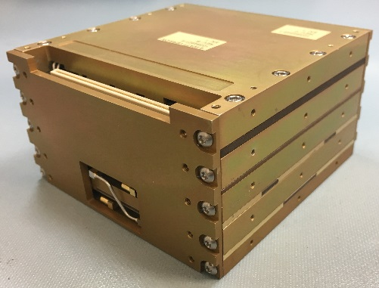
Iris Deep-Space Transponder
CubeSat/SmallSat compatible deep-space transponder
~0.5U volume (100.5 x 101.0 x 56.0 mm; transponder only)
DSN/NEN-compatible X-band uplink/downlink (7.2GHz/8.4GHz)
Software Defined Radio with Leon3-FT softcore processor
Provides navigational support (Doppler, Ranging, DDOR)
Modular hardware design for other frequency bands (UHF, S-band, Ka-band)
V1.0
Iris Specification | Units | Iris V1.0 for INSPIRE | Iris V2.0 for MarCO | Iris V2.1 for SLS EM-1
Mass | grams | 450 (no chassis) | 1210 (w/ UHF-Rx) | < 1000 (X/X-only)
Volume | U | 0.46 | 0.77 (w/ UHF-Rx) | 0.56
Bus Input Voltage | Vdc | 6.4 – 8.4 | 10.5 – 12.3 | 9.0 – 28.0
DC Power* | W | 13.0 | 35.0 | 33.7
RF Output Power* | W | 0.15 | 3.3 | 3.8
Receiver Noise Figure | dB | 5.0 – 6.0 | 3.5 | 3.5
Receiver Sensitivity | dBm | -135 @ 70Hz LBW | -139 @ 70Hz LBW | -151 @ 20Hz LBW
Uplink Data Rate† | bps | 1,000 | 62.5 & 1,000 | 62.5 – 8,000
Downlink Data Rate† | bps | 62.5 – 64,000 | 62.5 & 1,000 & 8,000 | 62.5 – 256,000
Telemetry Encoding |  | Conv & Reed Solomon | Turbo-1/6 only | Conv, Reed Solomon, Turbo 1/2, 1/3, 1/6
Radiation Tolerance | krads | N/A | 15.0 TID | 23.0 TID
S/C Interface |  | 1 MHz SPI | 1 MHz SPI | 1 MHz SPI
V2.0
V2.1
* Nominal at ambient
† Subject to link margin

Slide 9
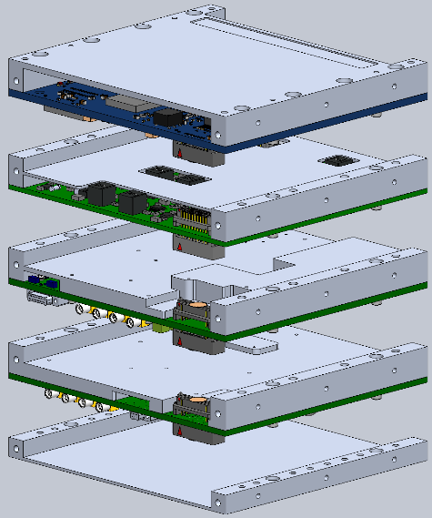
Hardware Design Considerations
Modular hardware built of slice elements
  NASA-STD-4009 (Space Telecom Radio System) guidelines
  Slices are interconnected with stacking connectors
  RF modules are generic to allow future designs with other frequency bands (UHF, S, Ka)
Radiation tolerant up to 23 krads; no destructive SEL.
EMI covers/shields to minimize radiated emissions
Emphasized efficient thermal design
S/C STRUCTURE/RADIATOR
Thermal Path
Aluminum covers
(173 W/m-K)
Nusil CV-2942 thermal compound
(0.999 W/m-K)
Thermal Vias
FPGA
1oz copper GND layers pulled to edge of PWB.
(384 W/m-K)
Nusil CV2-2646 thermal compound
(1.50 W/m-K)
RF & ICs
SN63 Solder
(50 W/m-K)

Slide 10

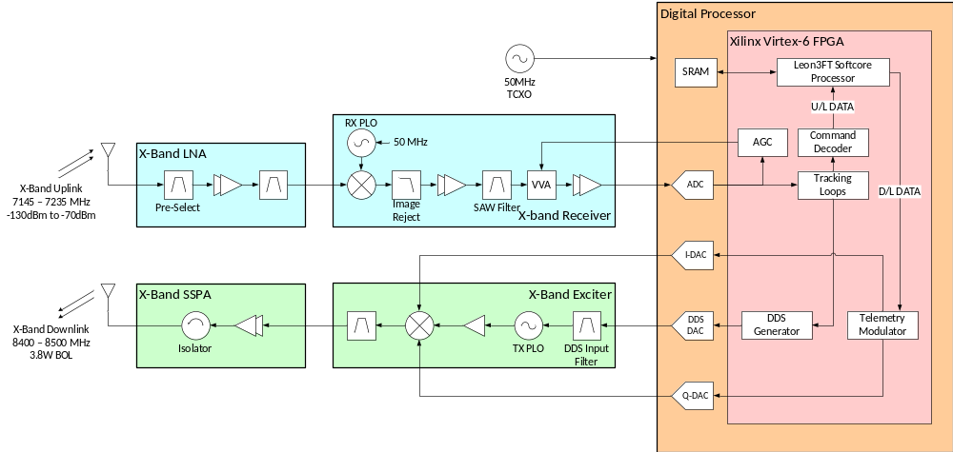
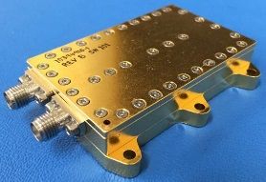
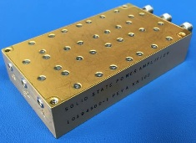
Top-Level Block Diagram
Iris LNA
Iris Transponder Stack
Modular MIC assembly
Reduce noise figure by shortening cable length from antenna
Separate gain cavities between LNA and Rx (risk of oscillations)
Iris SSPA
Modular MIC assembly
Provide superior heat dissipation path to structure/radiator
Chip-and-wire assy to reduce losses for higher efficiency
Modular stacked-slice assembly
Superheterodyne receiver with single-downconversion stage to 112.5 MHz IF
Digitally closed tracking loops (carrier, subcarrier, symbol)
Direct Digital Synthesis (DDS) reference for downlink carrier Doppler tracking
Baseband telemetry modulated direct at X-band
Embedded softcore processor (Leon3-FT) for configuration and protocol mgmt

Slide 11
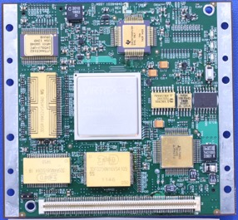
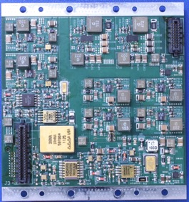
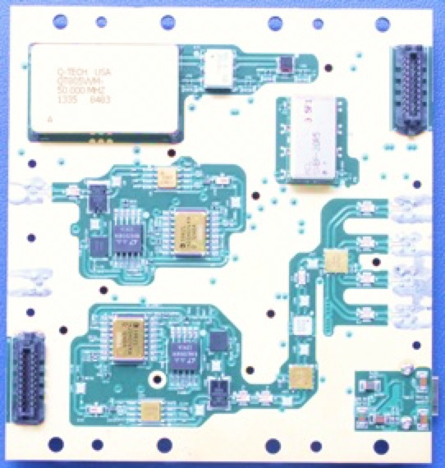
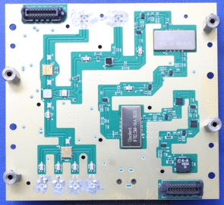
Iris Hardware Photos
Digital Processor
Power Supply
DDS DAC
Virtex-6
FPGA
Flyback Conv
SRAM
FLASH
1V Reg
Switchers
X-band Exciter
Tx-Out
X-band Receiver
IF Amps
I/Q Mixer
Rx-PLL
SAW Filters
Img-Rej
Mixer
VVAs
TCXO
Tx-PLL
Rx-In

Slide 12

Software Defined Radios
Leading the pathway to “smart radios”
  Reconfigurable to adapt to mission-specific needs
  Platform for rapid technology infusion
    Delay/Disruption Tolerant Networking
    Pseudo-noise (PN) Regenerative Ranging
    Advanced higher-order modulation schemes
    State-of-the-art Forward Error Correction algorithms

Slide 13
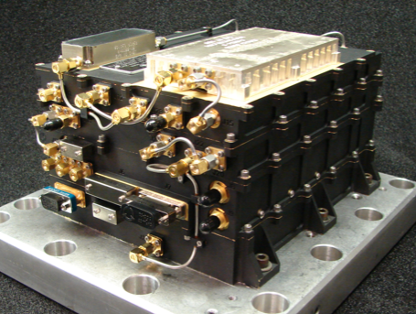
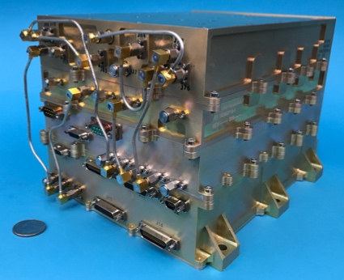
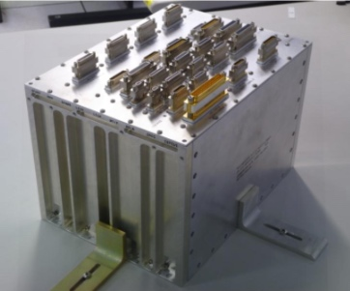
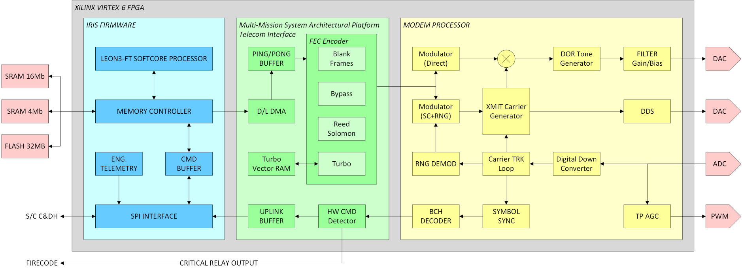
Software Defined Radio Heritage Pieces
Electra Proximity Radio | Universal Space Transponder | Multi-Mission Sys. Architectural Platform
Automatic Gain Control algorithm | Coherent transponder algorithm | Reed-Solomon encoder
Carrier/Subcarrier tracking loops | Sequential ranging demodulator | Turbo 1/2, 1/3, 1/6 encoder
Phase Shift Key modem | Delta-DOR tone generator | Hardware Command Detector
Early/Late symbol synchronizer | BCH uplink decoder | Error Detection and Correction

Slide 14


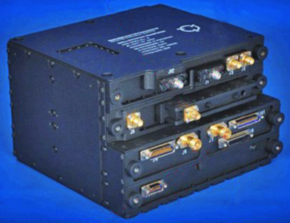
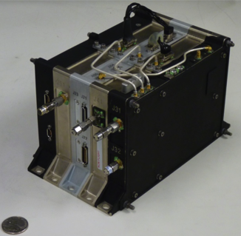
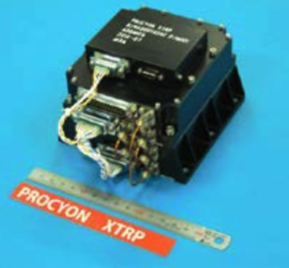
Deep-Space Transponder Comparisons
Iris (JPL)
UST (JPL)
SDST (GD)
Frontier (APL)
XTRP (JAXA)
Reconfigurable
One-Time Programmable
Mass: 1.0 kg
Mass: 4.5 kg†
Mass: 3.3 kg
Mass: 2.3 kg
Mass: 1.2 kg
XTRP
-144 dBm
15.625
1k
Command Rates
Frontier
-159 dBm
7.8125
1M
SDST
Rx Thresh.
-158 dBm
7.8125
2k
UST
-157 dBm
7.8125
37.5M
Iris V2.1
-150 dBm
62.5
8k
Rate (bps)
1
10
100
1k
10k
100k
1M
10M
100M
1G
Iris V2.1
16.0 W
62.5
6.125M
256k
UST
45.0 W
10
300M
Power (excl. SSPA)
SDST
17.9 W
10
6M
Frontier
9.5 W
1
75M
XTRP
12.0 W
8k
32k
Telemetry Rates
† Dual Channel Version

Slide 15

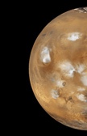
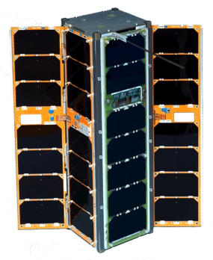
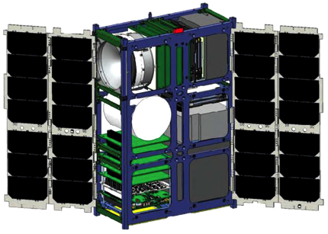
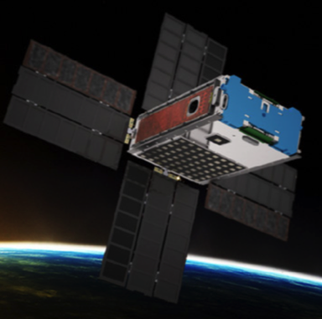

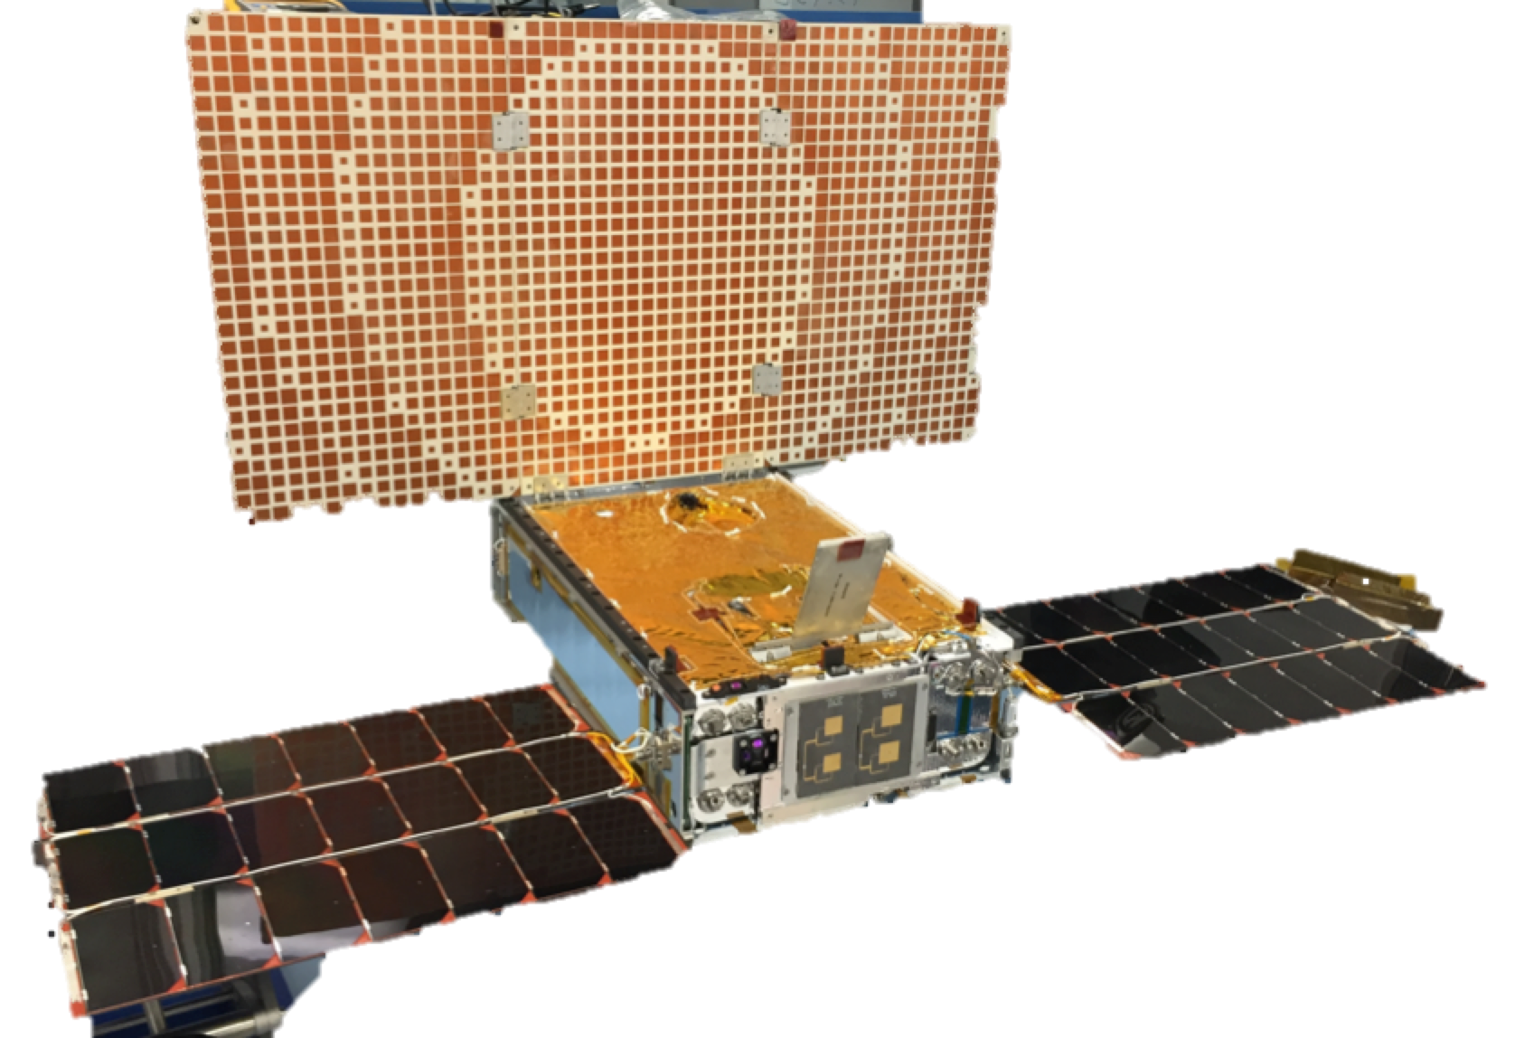
Planned Deep-Space CubeSat Missions
1.5 Mkm
0.01 AU
15 Mkm
0.10 AU
84 Mkm
0.56 AU
110 Mkm
0.74 AU
160 Mkm
1.07 AU
INSPIRE, JPL
CuSP, SwRI
BioSentinel, AMES
NEA Scout, MSFC
MarCO, JPL
Provide reduced size and cost components to enable a new class of interplanetary explorers.
Study the dynamic particles and magnetic fields that stream from the Sun and as a proof of concept for the feasibility of a network of stations to track space weather.
Use yeast to detect, measure & compare the impact of deep space radiation on living organism over long durations beyond low-Earth orbit.
Proof-of-concept of a solar sail CubeSat capable of encountering near-Earth asteroids (NEA).
Provide real-time bent-pipe relay communications during InSight’s Entry-Descent-Landing into Mars
Copyright ©2017 California Institute of Technology. Government Sponsorship Acknowledged.

Slide 16
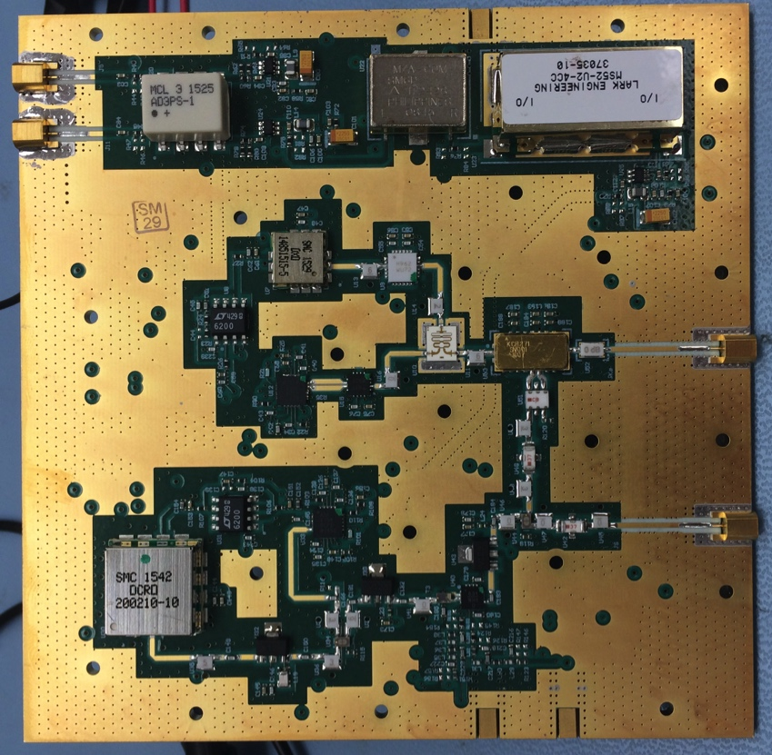
Future Enhanced Iris Capabilities
Higher downlink rates beyond 2Mbps
Low-Density Parity-Check (LDCP) code
SpaceWire interface for high-rate data transfers to S/C C&DH unit
Pseudonoise (PN) Regenerative Ranging for improved ranging SNR
Reliable space-link protocols (CCSDS Prox-1 protocol)
Delay/Disruption Tolerant Networking
Other frequency bands (UHF, S, Ka)
TRL-4 S-/Ka-band exciter
S-band RF output: 0dBm
S-band phase noise: -95 dBc/Hz
Ka-band RF output: -13dBm
Ka-band phase noise: -74 dBc/Hz
Power: 4.7W

Slide 17
Conclusion
Iris Deep-Space Transponder with radiometric tracking support for orbit determination of CubeSats.
NASA’s Deep Space Network functions for overcoming the challenges of deep-space telecom and navigation.
Software defined radios as “smart radios” to enable rapid technology infusion.

Slide 18


