Slide 1
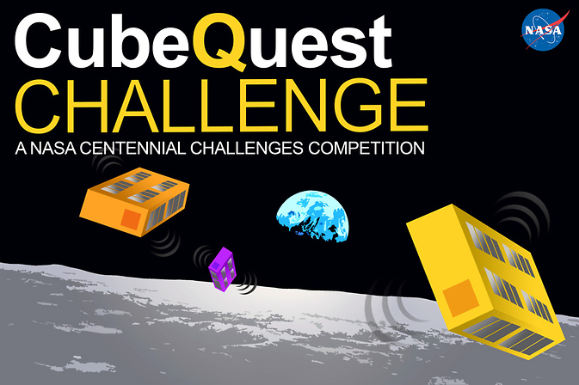
Advanced CubeSat Technologies for Affordable Deep Space Science and Exploration Missions
Ground Tournaments, the Moon, and Beyond
Jim Cockrell
Cube Quest Challenge Administrator
ISSC - 1 May 2017

Slide 2
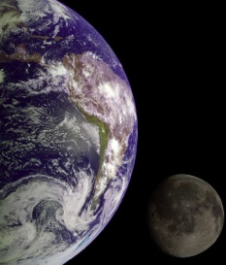

Outline
CubeSats and Future
What is Cube Quest?
  Why a Cube Quest?
  Rules and Prize Structure
Today’s Status
  GT4 Competitors
  Emerging Technologies
Next Steps
  GT4 winners
  SLS PSRs
  In-space Competition
Get your CubeSat to the moon, work the best
survive the longest
win big prizes!

Slide 3

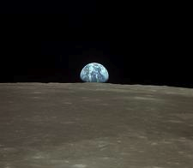
CubeSats in Deep Space
Advantages over traditional satellites:
  Low cost
  Low mass
  Standard LV interface
Developed, deployed in fraction of time, cost, of traditional “high-stakes” satellite
Interchangeable secondary payloads
  increased launch opportunities
Array of small CubeSats > single conventional probe:
  asteroid seismographs
  array of Mars weather stations
  distributed , temporally correlated measurements
  redundancy at the system level; robust system of systems
  nodes for antenna arrays or telescope arrays

Slide 4
Current CubeSat Limitations
To-date, CubeSats haven’t ventured beyond LEO:
Limitation | SoA | Deep Space Missions Need
Limited comm range | Low-gain dipoles or patches mainly used | high gain directional antennas needed
Limited comm data rate | Low power, amateur band transmitters mainly used | High-power, high frequency, wide bandwidth transmitters needed
Lacking radiation tolerance | COTS, low-cost parts used; more benign environment of LEO | Radiation shielding, fault detection, fault tolerance
Lacking in-space propulsion | Not demonstrated (except solar sails); chemical fuel/pressurized containers prohibited | High thrust, high ISP needed; chemical, electrical, solar
Depend on Earth-based nav references | Passive magnetorquers used; GPS or magnetometers sense Earth’s magnetic field | Start trackers, moon/sun sensors, radar altimeters and other sensors needed for deep space
Can CubeSats Enable More Affordable Science and Exploration Missions in Deep Space?

Slide 5
Why a CubeSat Centennial Challenge?
Achieve goals of NASA, other Government Agencies, industry?
More affordable science and exploration missions?
Unique missions (swarms, cooperative operations)
Take advantage of payload capacity; launch unobtrusively?
Future Mission Needs of Stakeholders
Drive the Challenge

Slide 6
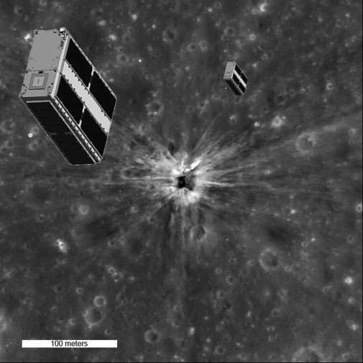

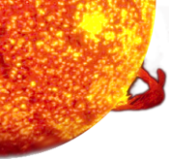



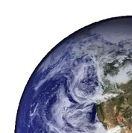

Trace Capabilities to NASA Roadmaps
Astrophysics:
  Distributed RF and Optical Arrays on affordable satellite constellation
  Affordable, time-correlated (simultaneous) multi-point observations of NEOs (mass density, albedo, etc)
Planetary Explorations:
  Distributed measurements (Ex: surface seismographic; Mars “weather systems”, multi-site impactors to detect lunar subsurface volatiles, etc.)
  Co-ordinated assets (Ex: landers paired with orbiting relays)
Heliophysics:
  Global coverage
  Multiple observations of transient events (Ex: radio occultation)
  Geographically distributed time-correlated “space weather” measurements
Earth Science
  Global coverage (multiple)
  Time correlated weather, oceanic observations
Impactor Concept
Heliophysics, Multipoint Science

Slide 7
Designing Cube Quest
Considered 5 competitive scenarios
  * Lunar flyby long-distance comm
  Lunar Impactor
  * Lunar Orbiter
  2 Sat Comm Relay
  Proximity ops in cisLunar environment
  (Lunar Lander not evaluated, as impractical dV req’t)
Each scenario depends, relatively more or less, on these subsystems:
  Propulsion
  Deep space survival
  Comm
  Power
  Pointing
Each scenario applies, relatively more or less, to future needs/goals
  Precursor missions
  Earth Science
  Heliophysics/Space Weather
  NEO surveys
* Selected Scenarios that develop the most capabilities, with greatest applicability to needs/goals
Combined Long-distance comm, Lunar Orbiter, as optimal Cube Quest “missions”

Slide 8
Stimulating Advanced Tech for Deep Space CubeSat Operations
Objective: Achieve Lunar Orbit
Requires:
  Propulsion, high dV
  Navigation without GPS or Earth’s magnetic field
Objective: Hi Data Rate, Large Data Volume, Far Comm Distance
Requires:
  High power transponder; high gain antenna; long & frequent ground station passes; deployable antennas; stable ACS; precise knowledge of Earth direction
Objective: Longevity (survival)
Requires:
  Rad hardening, redundancy, shielding
All are critical capabilities for deep space operations

Slide 9

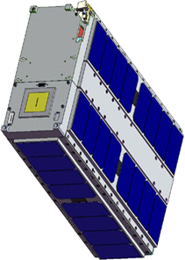
Prize Structure
Lunar Derby
While in lunar orbit
Achieve Lunar Orbit$1.5M/shared,
$1M max per team
Error-free Communication
Burst Rate- $225k/25k
Total Volume- $675k/75k
Longevity
$450k/50k
Ground Tournaments (GT)
4 Rounds
Approx every 6 months
GT-1 - top 5 win $20k
GT-2 - top 5 win $30k
GT-3 - top 5 win $30k
GT-4 - top 5 win $20k
Total $500k
Top 3 qualified GT-4 teams launch free on EM-1
Deep Space Derby
While range ≥4M km
Farthest Distance
$225k/25k
Error-free Communication
Burst Rate- $225k/25k
Total Volume- $675k/75k
Longevity
$225k/25k
Qualify for 1 of 3 EM-1 launch slots
- or –
get your own ride
Total $5.0M
Prize Money

Slide 10




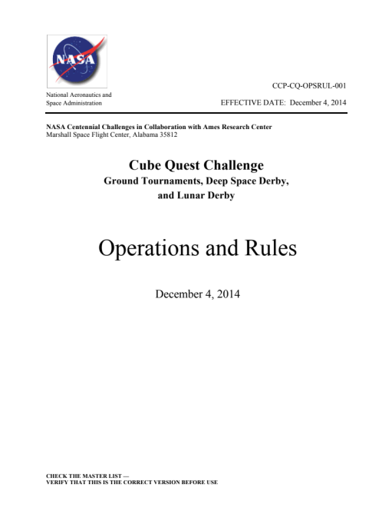
Ground Tournaments
5 Judge Panel
2 NASA
3 Non-NASA leaders
  Industry
  Academic
  DoD
Teams submit GT documents
GT Winners:
Top 5 Teams Scoring > 3.0/5.0
40% Likelihood of Mission Success
60% Compliance with Rules, SLS IDRD, SLS Saftey Rqts
Total GT Score
Team of technical SMEs
Rules
GT Workbook
SLS IDRD
SLS Safety Rqts (or equiv. launch provider rqts)

Slide 11
Rules and Constraints
SLS Safety and Interface Requirements
SLS Payload Safety Reviews (to fly on EM-1)
Or equivalent, for 3rd-party launches
Any allowable part of the spectrum
subject to FCC public freq. alloc. and licensing regs
Comm data eligible for prizes
Comm data format per Rules, to qualify
Comply with Orbital Debris and Planetary Protection laws and regs
DSN tracks all trajectories; checks lunar orbit, 4M km range
May use NASA DSN – at your cost
http://www.nasa.gov/cubequest/reference

Slide 12
Versatility of CubeQuest Rules
EM-1 or procure your own launch
Propulsion or no propulsion
  Deep Space Challenge does not require propulsion
  365-day time rule should allow exotic trajectories to lunar orbit
Use NASA SCaN (NEN, DSN) at your own cost
  NASA uses DSN to enforce rules
  DSN costs and limited aperture time incentivize teams to develop alternative ground stations
Competition start date is EM-1 launch or 3rd party launch date
  End date is 365 days after EM-1 launch or 356 days after 3rd party launch, whichever occurs first

Slide 13
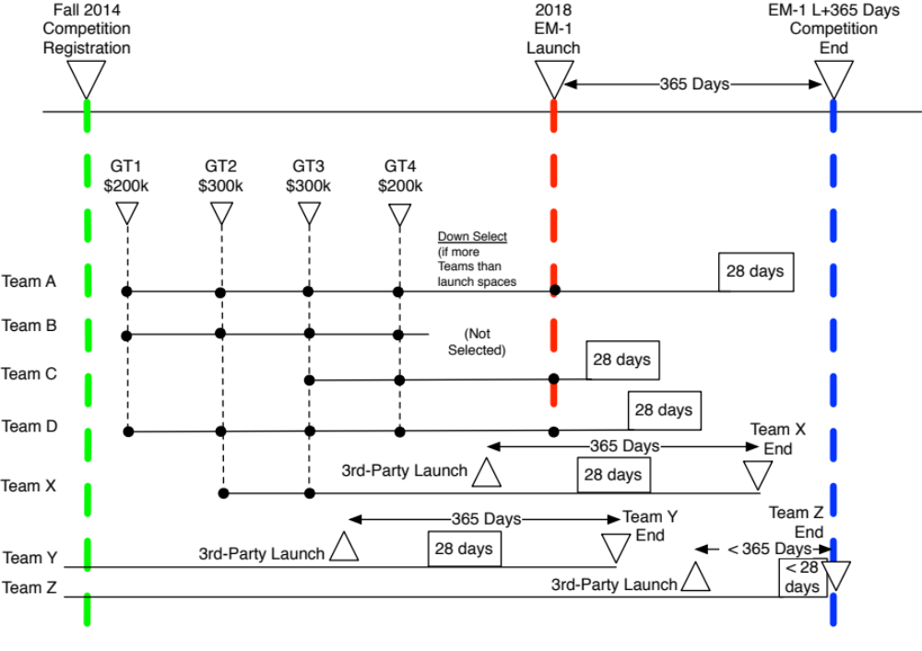
Current Status
Today
GT-1 GT-2 GT-3 GT-4

Slide 14

Centennial Challenges Program
NASA STMD’s Centennial Challenges Program, initiated in 2005, named after Wright Brothers’ Kitty Hawk flight
Engages public in advanced technology development
Prizes for solving problems of interest to NASA and the nation
Competitors based in US; not supported by government funding.
Since 2005, there have been eight challenge categories, resulting in more than 20 challenge events to date.
More than $6 million in prize money has been awarded to more than 17 different teams
Summer 2013, work began on Cube Quest Challenge
Current
Centennial Challenges:
Sample Return Robot
3-D Printed Habitat
Mars Ascent Vehicle
Cube Quest

Slide 15
Ground Tournaments Lead to EM-1 Launch
GT1 | GT2 | GT3 | GT4 | EM-1
1. Alpha Cubesat - Xtraordinary Innovative Space Partnerships, Inc 2. Cislunar Explorers - Cornell University 3. HuskySat - University of Washington 4. Lunar CubeQuestador - Missouri University of Science and Technology 5. MIT KitCube - Massachusetts Institute of Technology 6. Novel Engineering - Novel Engineering Inc. 7. OpenOrbiter Lunar I - University of North Dakota 8. ERAU Eagles - Embry-Riddle Aeronautical University 9. Project Selene - Flintridge Preparatory School 10. Heimdallr- Ragnarok Industries, Inc. 11. SEDS UC San Diego - University of California - San Diego 12. Team Miles - Fluid & Reason LLC 13. True Vision Robotics - Isakson Engineering | 1. Alpha CubeQuest, XISP Inc 2. CisLunar Explorers, Cornell University 3. Eagles-Quest, Embry-Riddle Aeronautical University 4. Earth Escape Explorer (CU-E3), University of Colorado 5. Goddard Orbital and Atmospheric Testing Satellite (GOATS), Worcester Polytechnic Institute 6. Lunar CubeQuestador, Missouri University of Science & Technology 7. MIT KitCube, Massachusetts Institute of Technology 8. Heimdallr, Ragnarok Industries Inc. 9. SEDS Triteia, SEDS University of San Diego 10. Team Miles, Fluid & Reason LLC | 1. Team Miles ­ Fluid & Reason, Tampa, Florida (placed first in GT-1 and fifth in GT-2) 2. Cislunar Explorers - Cornell University, Ithaca, New York 3. CU-E3- University of Colorado, Boulder 4. KitCube - Massachusetts Institute of Technology, Cambridge, Massachusetts 5. SEDS Triteia - University of California, San Diego 6. Ragnarok, Ragnarok Industries Inc. 7. MIT KitCube, Massachusetts Institute of Technology 8. Goddard Orbital and Atmospheric Testing Satellite (GOATS), Worcester Polytechnic Institute | 1. Team Miles ­ Fluid & Reason, Tampa, Florida 2. Cislunar Explorers - Cornell University, Ithaca, New York 3. CU-E3- University of Colorado, Boulder 4. SEDS Triteia - University of California, San Diego 5. Heimdallr, Ragnarok Industries Inc. | ?

Slide 16
Current Teams – GT4 April-May 2017
* - indicates EM-1 Qualifier
Industry
Academia
*Cislunar Explorers
Cornell University
*Heimdallr
Ragnarok Industries, Inc
*Team Miles
Fluid & Reason LLC
* SEDS UC San Diego
University of California- San Diego
* CU-E3
University of Colorado – Boulder
Lunar Derby
Deep Space Derby
Lunar & Deep Space Derby

Slide 17
CubeQuest Emerging Technologies
Comm
  UHF, S-, X-, C- band
  Mainly patch antennas – from moon and beyond
  Deployable antennas
Ground Stations
  DSN
  WFF UHF
  AMSAT X- and S-band
  Commercial
  Univ dishes
  Arecibo
Propulsion
  Busek green monoprop
  EP (Xenon and Iodine)
  3D printed thrusters
  Electrolysis of water for fuel
Other Technologies
  Rad hardened CPU, memory, error checking and redundancy
  Blue Canyon GNC / ADCS
  Custom design:
    Sun sensors
    Star trackers
    Reaction wheel
    Imagers / quaternions

Slide 18
Emerging Technologies – Propulsion, Other
  Propulsion
    COTS
      Busek green monopropellant
      ConstantQ plasma thruster (Iodine)
      Phase Four plasma (Xenon) spin off from U of Michigan
      Standard Micro Propulsion System from Vacco, cold gas, for attitude control
    Custom In-House
      3D printed cold gas for attitude control
      Electrolysis of water for H2 and O2, for 3D printed titanium thruster fuel and oxidizer
      Hydrogen peroxide monopropellent for 3D printed Inconel 716
  Other Tech
    Rad-hard components
      deep space radiation, longer mission lifetimes intensify effect. Lunar orbit provides a proving ground for radiation-based experiments or technology demonstrations.
      1 team plans Resilient Affordable CubeSat Processor (RACP), a microcontroller and 3 ARM 15 SoC uPs., with a health monitoring and management system to check processors and subsystems
    Navigation Systems
      No GPS or magnetic field in cis-lunar space
      Clue Canyon Technologies XACT star tracker, sun sensor and reaction wheels.
      Or combinations of their own sun sensors, and COTS inertial sensors for ADS.
      GEO-hard Miniature Integrated Star Tracker (MIST) from Space Micro,
      In-house ADCS, with in-house reaction wheels, in-house star tracker and sun sensors
      Navigate using Raspberry Pi camera to image Earth, Sun and Moon,and gyro using transformation matrix to spacecraft body from and inertial frame.

Slide 19
Emerging Technologies - Communications
Communication Technologies
  RF Bands Utilized
    S-Band
      Commonly used but cutting-edge for CubeSats
      Teams plan S-band for radio comm and trajectory determination
    X-Band
      DSN primarily uses X-band, but CubeSats haven’t the power to use before
      Teams plan X-band to commercial gnd stns or DSN
    C-Band
      Has some use in general sat comms; 5cm band is amateur band
      Team plans AMSAT in C-band
    UHF
      Often used in CubeSats in amateur bands, to lots of amateur gnd stns
      Team plans UHF for long distance using WFF 18m dish
  Antenna Design
    Patch Antennas
      Commonly used on CubeSats due to small size and low cost; but lacking in gain
    Deployables
      1 team plans to use a reflectarray on reverse side of solar panel, fed by deployable feed horn

Slide 20
What’s the Status?
GT-4 the final Ground Tournament underway!
  Document submittals received April 6
  Supplemental submittals April 19 (test results)
GT-4 winners to be announced at SmallSats-Deep Space Symposium

Slide 21
SmallSats – Deep Space June 7-8 at ARC
Co-Produced by Small Satellite Technology Program, Small Satellite Systems Virtual Institute, and Centennial Challenges Program
Invited speakers include:
  Leaders from SMD, HEOMD, STMD
  SSSVI and SSTP Program Managers
  EM-1 payload developers
  Cube Quest Teams
  More!
The event culminates in the prize awards to the winners of the Cube Quest Challenge Ground Tournament and top 3 winners selected for EM-1

Slide 22
Summary
CubeSats will soon enable affordable science and exploration missions in deep space
Cube Quest Challenge rewards citizen inventors to help NASA, stimulate and industry, for the public benefit
Competitors already advancing CubeSat technology
Cube Quest Challenge may serve as pathfinder for other ambitious prize challenges

Slide 23
Advanced CubeSat Technologies for Affordable Deep Space Science and Exploration Missions
Questions?

