Slide 1
BioSentinel - A Deep Space Radiation BioSensor Mission
Bob Hanel – Project Manager
Vanessa Kuroda – Telecomm Lead
James Chartres – Mission Systems Engineer
Hugo Sanchez – Spacecraft Bus Systems Engineer
Interplanetary Small Satellite Conference 2017
San Jose, CA
5/1/17
Authors Affiliated with NASA Ames Research Center, Moffett Field, CA

Slide 2
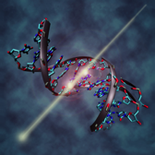
BioSentinel Project Objectives
Advanced Exploration Systems (AES) selected BioSentinel to fly on the Space Launch System (SLS) Exploration Mission (EM-1) as a secondary payload
  Payload selected to help fill HEOMD Strategic Knowledge Gaps in Radiation effects on Biology
  Delivery to Dispenser Integrator, Tyvak, by 4/30/18
  Current EM-1 Launch Readiness Date (LRD): 9/30/18
Key BioSentinel Project Objectives
  Develop a deep space nanosat capability
  Develop a radiation biosensor useful for other missions
  Define & validate SLS secondary payload interfaces and accommodations for a biological payload
Collaborate with two other AES selected missions (non-biological) for EM-1
  Near Earth Asteroid (NEA) Scout (MSFC)
  Lunar Flashlight (JPL)

Slide 3
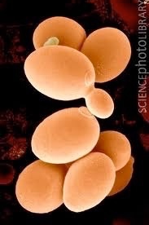
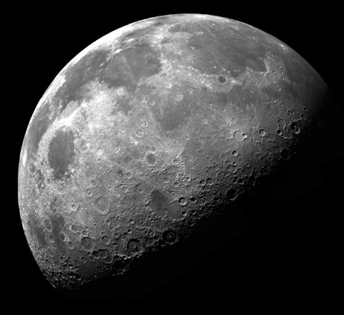

BioSentinel Science Concept
Quantify DNA damage from space radiation environment
  Space environment cannot be reproduced on earth
  Omnidirectional, continuous, low flux with varying particle types
  Health risk for humans spending long durations beyond LEO
  Radiation flux can spike 1000x during a Solar Particle Event (SPE)
Correlate biologic response with LET Spectometer data
  BioSensor payload uses engineered S. cerevisiae yeast
  Measures rate of Double Strand Breaks (DSB) in DNA
  Linear Energy Transfer (LET) Spectrometer measures particle energy and count
Yeast assay uses microfluidic arrays to monitor for DSBs
  Three strains of S. cerevisae, two controls and engineered strain
  Wet and activate multiple banks of micro-wells over mission lifetime
  DSB and associated repair enable cell growth and division
  Activate reserve wells in event of a Solar Particle Event (SPE)

Slide 4
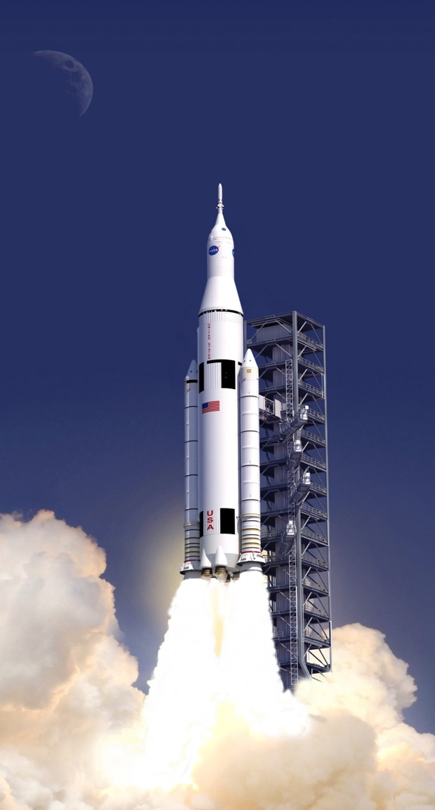
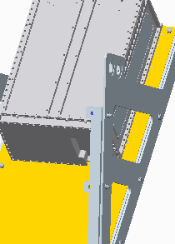
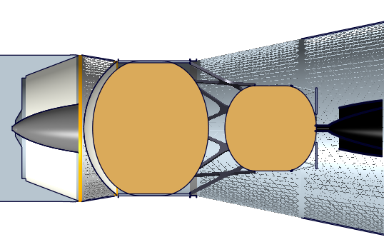

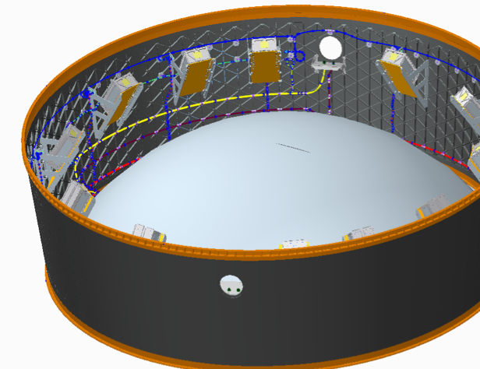
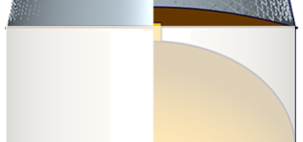
Secondary Payload Location on SLS EM-1
6U Dispenser
Orion Multi-Purpose Crew Vehicle (MPCV)
MPCV Stage Adapter (MSA)
Interim Cryogenic Propulsion Stage (ICPS)
Space Launch System (SLS)
Bracket & Shelf
Launch Vehicle Adapter (LVSA)
Core Stage
13 - dispenser locations that each support a 6U (14 kg) secondary payload
1 - bracket location allocated to a sequencer
EM-1 only accommodates 6U payloads; EM-2 may accommodate 12U payloads

Slide 5
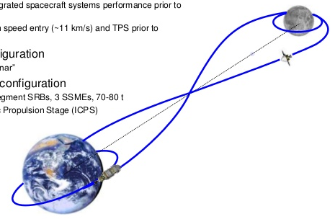
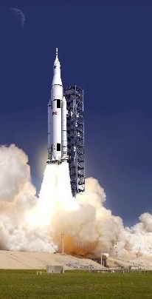
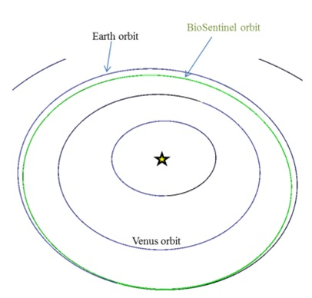
BioSentinel EM-1 Mission
Launch
Lunar Transfer & Fly-by
BioSentinel: Escape into Heliocentric Orbit
Mission Orbit
Lunar Transit
3-7 days
Launch
Secondary P/L
Deployment
(L+4-5 hrs)
Artist’s rendering of the Space Launch System
Up to 13 secondary payloads deployed and powered within the same 2 hour window
Low relative velocity between secondary payloads
BioSentinel will not perform a delta-V maneuver, will follow ICPS into disposal orbit
Final orbit of secondary's to be determined
Will likely be Earth-interior, heliocentric orbit
Far outside the LEOs typically occupied by CubeSats
  Range to Earth of 0.73 AU at 18 months
  Far outside the protective shield of Earth’s magnetosphere

Slide 6
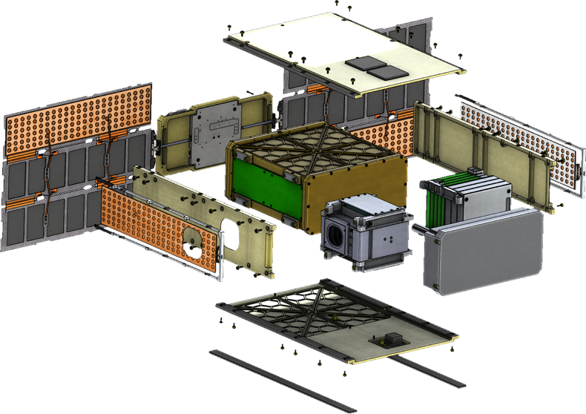
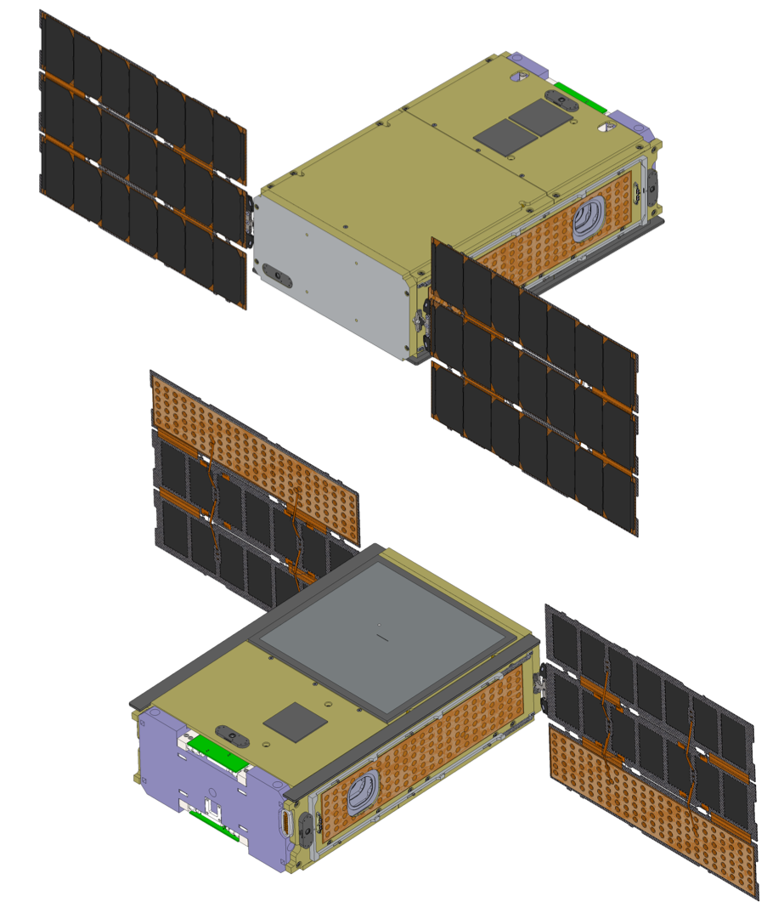
BioSentinel FreeFlyer Spacecraft: Physical Overview
Low-Gain Antenna
Avionics, Power, and Transponder Stack
Solar Array Gimbal
Solar Arrays
BioSensor Payload
Propulsion System (CF₃)₂CH₂
Radiation Sensor Payloads:
TID + LET spectrometer
Batteries
Integrated Guidance Navigation & Control Unit
Medium-Gain Antenna
Only showing 2-Panel Gimbaled Solar Array

Slide 7
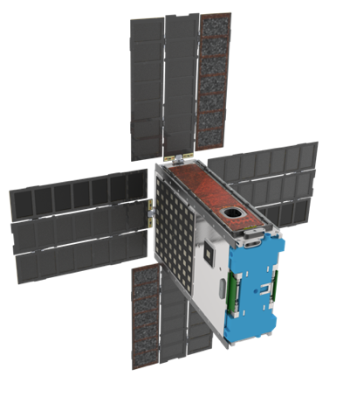
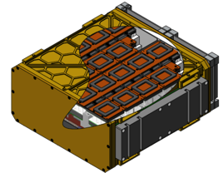
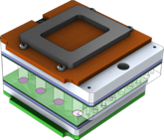
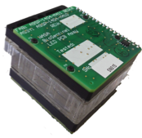
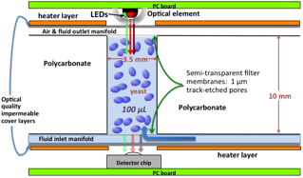
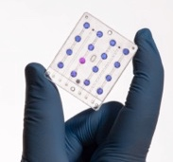
BioSensor – Optical Measurement of Yeast in Fluidic Card Well
6U Spacecraft
~4U BioSensor Payload
Microfluidic cards (x18)
Fluidic Card with Optical Detection System
Fluidic Card cross section of a single well
Fluidic Card
Detector & LED Boards

Slide 8
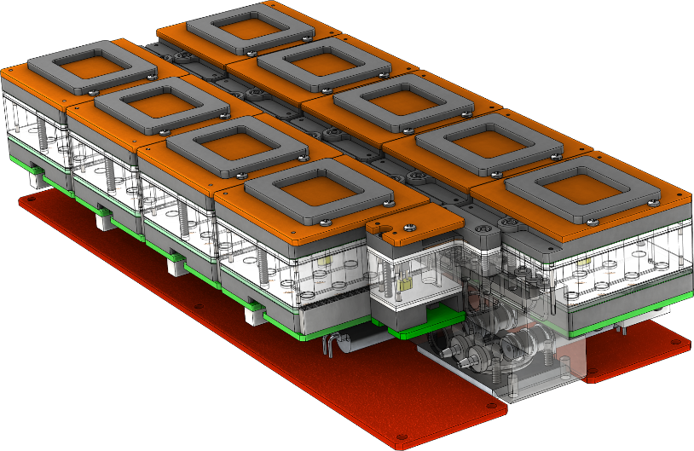
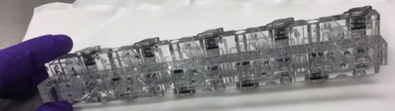
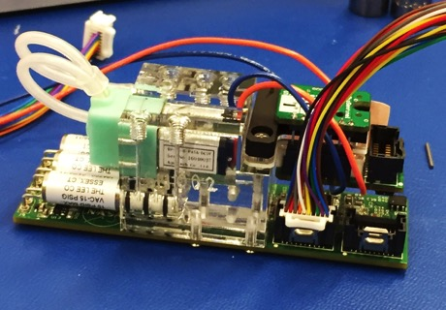
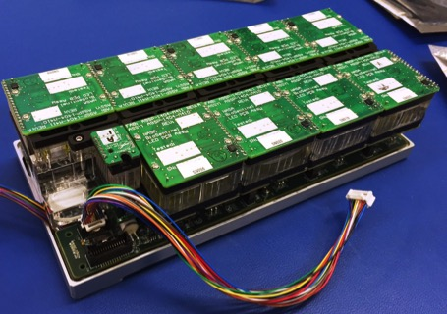
BioSensor Payload Hardware
9-Card Manifold with Bubble Traps & Desiccant
Nutrient Supply Manifold with Electronics
BioSensor 9-Card Manifold Assembly

Slide 9
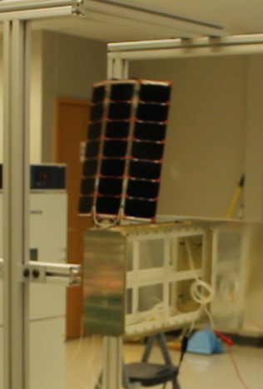
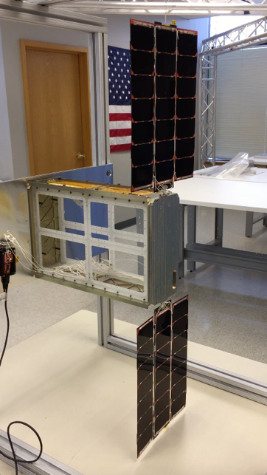
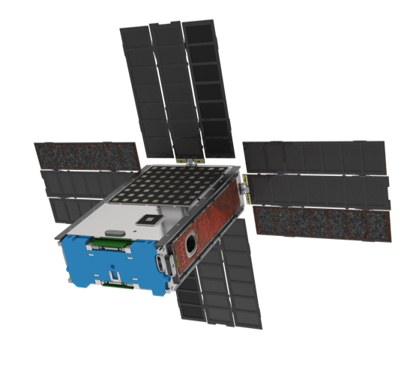
Solar Array: 2-Panel Gimbal, Adding 2-Panels
BioSentinel 2-Panel Gimballed Solar Array EDU
1-Panel deployment test
2-Panel gimbal test
BioSentinel with 4-Panel Solar Array.
The plan is to keep the 2-panel Gimbaled Hawk array deployed from the 1x3 U sides (trifolds) and then add 2 – 2x3U panels that are also hinged to the gimbal housing
Notes:
-need more power for transponder, trajectory – earth interior to exterior
-power/comm trade, power/thermal trade
-few subsystems are interlinked
-software -> fault management

Slide 10
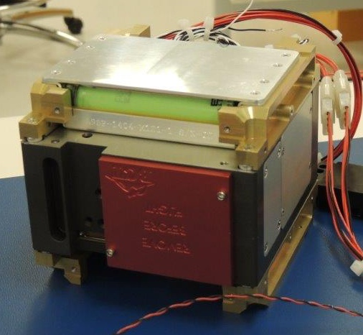
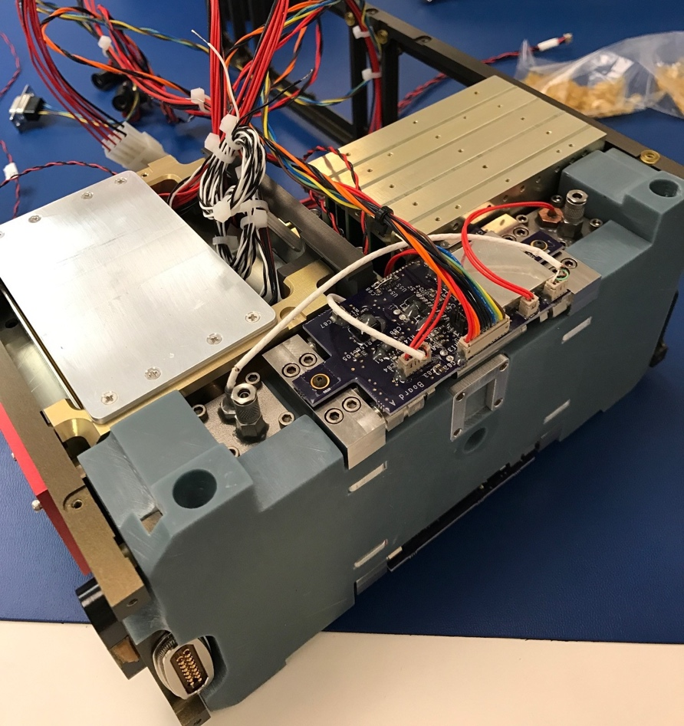
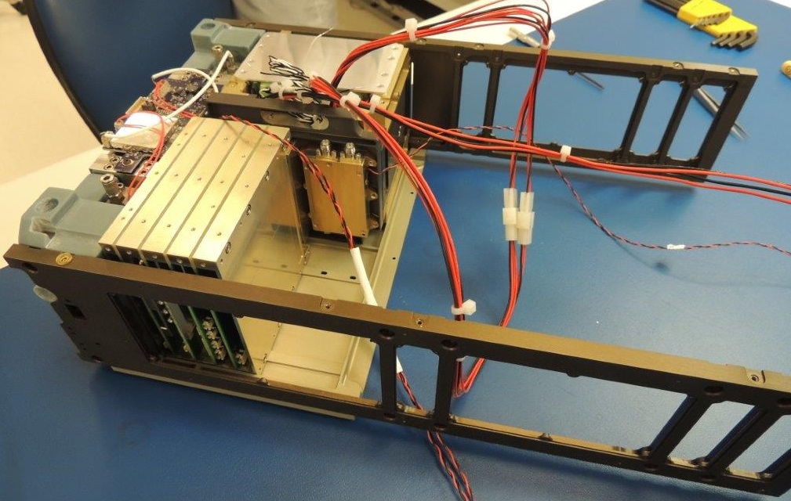
Spacecraft Subsystem Fit Check
XACT ADCS unit sandwiched between 2 battery packs (top & bottom)
Initial fit check of Structural Panels, Propulsion System, XACT, 2 Battery Packs, Iris Transponder Thermal Simulator, Sun Sensor, Dispenser Separation Connector

Slide 11
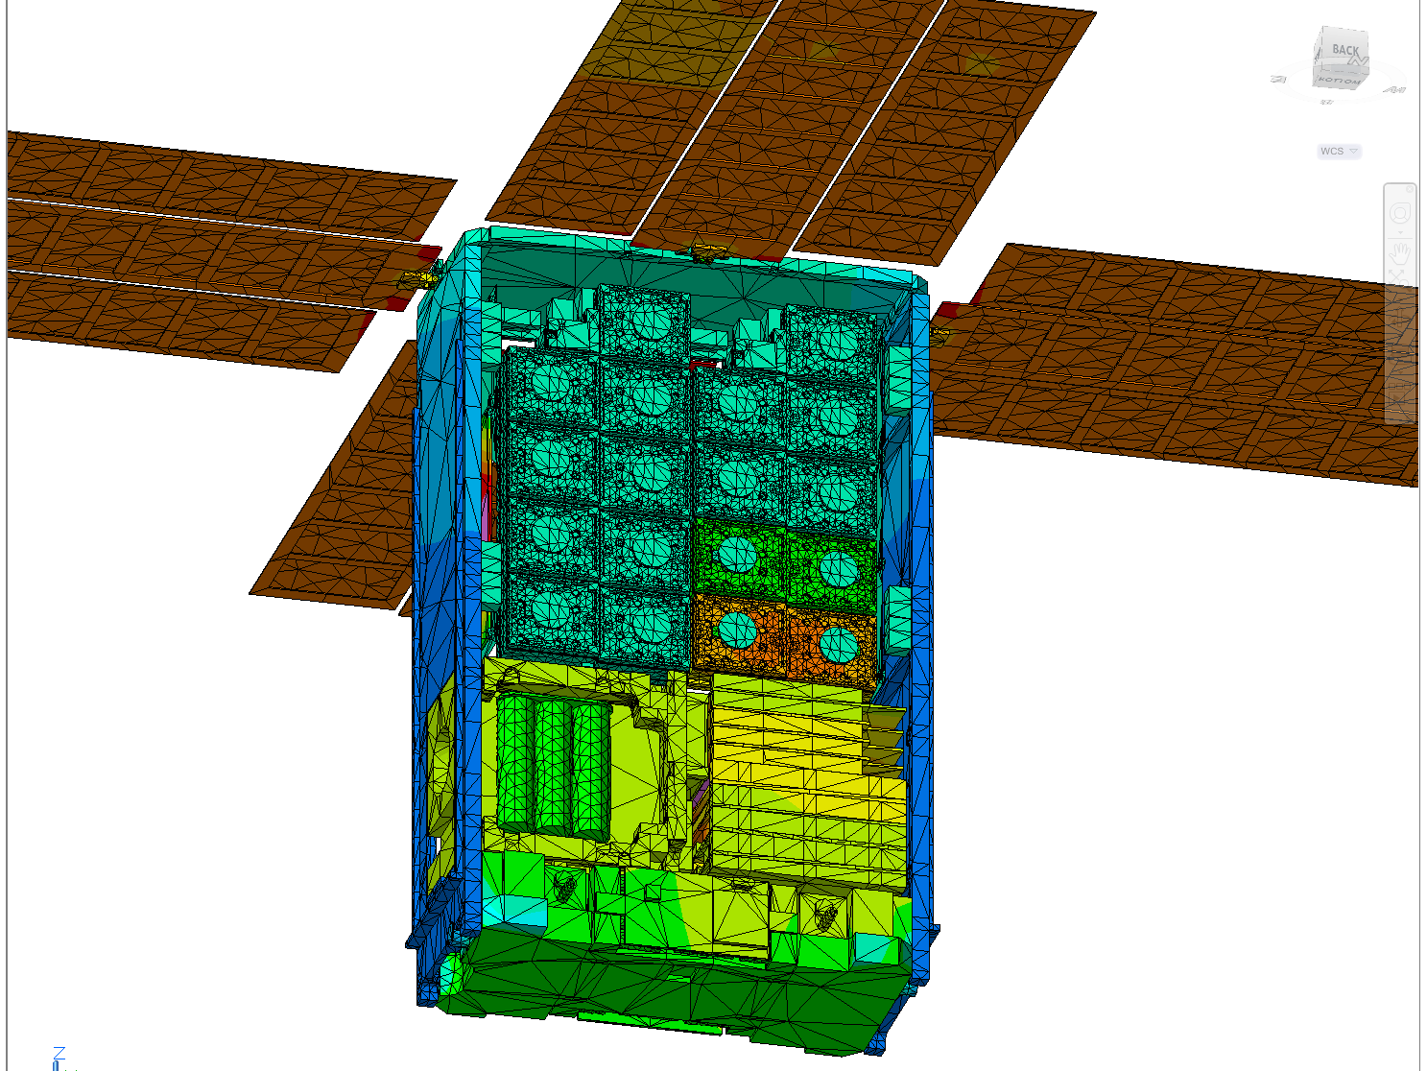
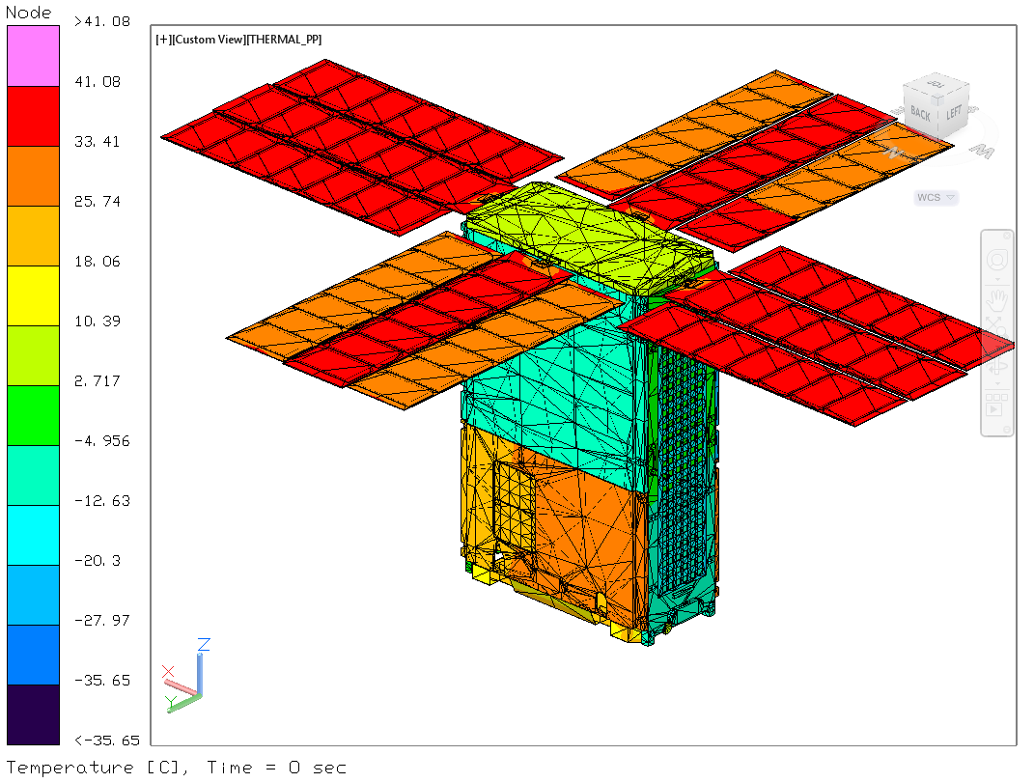
Thermal System Analysis
Thermal challenge is to keep warm spacecraft bus subsystems isolated from BioSensor (4-6°C). Cards raised to 23°C during cell growth phase

Slide 12
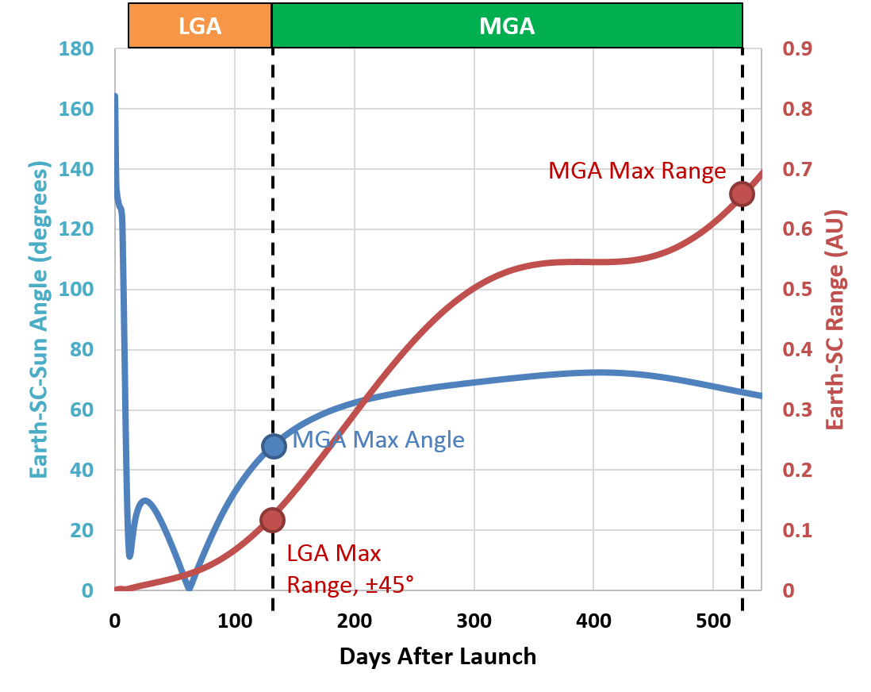
Comm Mode Timeline
Nominal Comm Mode operations will use one of two transmit antennas depending on range and Earth-SC-Sun Angle
  The LGA will be used until data volume requirements require the MGA
  The MGA cannot be used in conditions where the Earth-SC-Sun Angle is too high due to thermal constraints
34-meter DSN Antenna
LGA ± 90° BW 8000 bps 3dB @ 52 days
LGA ± 45° BW 500 bps 3dB @ 118 days
LGA ± 15° BW 500 bps 3dB @ 130 days
MGA ± 5° BW 8000 bps 3dB @ 150 days
MGA ± 5° BW 1000 bps 3dB @ 305 days
MGA ± 5° BW 500 bps 3dB @ 515 days

Slide 13
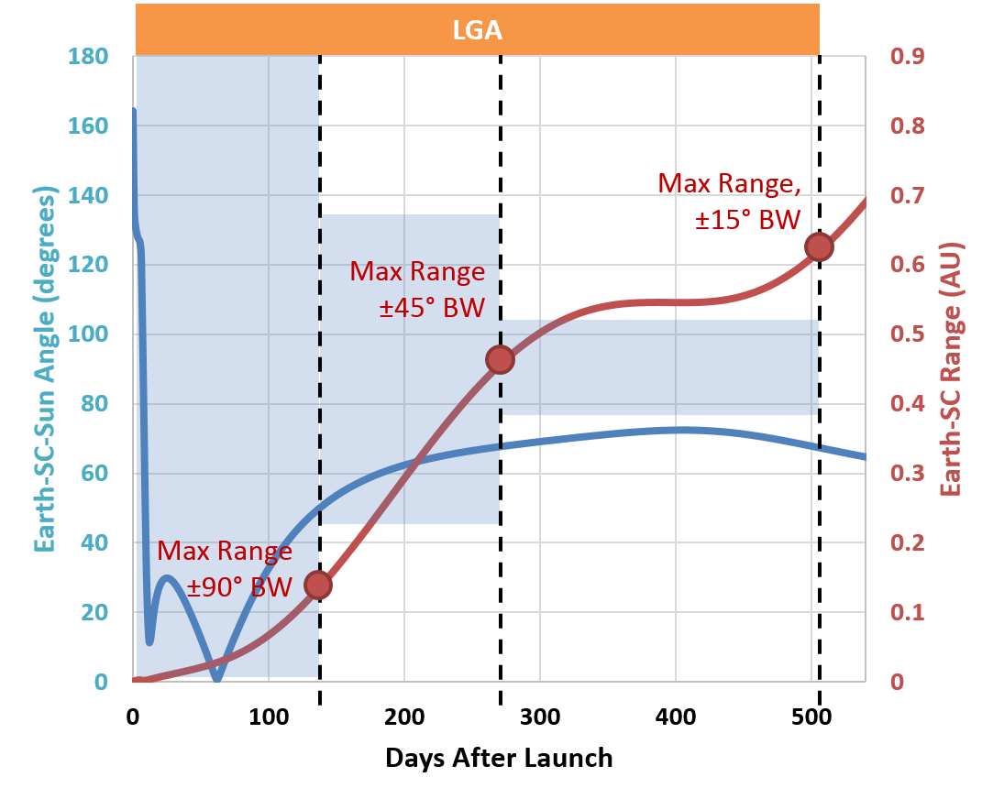
Safe Mode Timeline
70-meter DSN ground antenna is required to close link budget with LGA antenna in later mission
  MGA cannot be pointed without star tracker and >0° body angle
  >5° body angle is not thermally sustainable
Safe Mode recovery becomes harder between 258 and 491 days due to reduced comm window duration
LGA ± 90° BW 500 bps 3dB @ 87 days
LGA ± 90° BW 62.5 bps 3dB @ 137 days
LGA ± 45° BW 500 bps 3dB @ 144 days
LGA ± 45° BW 62.5 bps 3dB @ 258 days
LGA ± 15° BW 500 bps 3dB @ 167 days
LGA ± 15° BW 62.5 bps 3dB @ 491 days

Slide 14
BioSentinel Mission Phases
Phase | Entry | Exit | Duration | Summary & Objectives
Pre-Launch | Loading of biology | L/V Lift-off | ~6 months | Configure BioSentinel for launch, then power-off
Launch | L/V Lift-off | Launcher Deploys BioSentinel | ~5 hours | Powered off Survive launch environments and deployment
Initialization | BioSentinel separates from SLS | Complete S/C checkout | ~14 days | Power-on, reduce tip-off rates, deploy solar arrays, transition to safe mode Ground station initial acquisition and tracking Check-out of S/C systems Lunar fly-by likely to occur
Science | Nominal Spacecraft SOH | Final BioSensor card is expired | 365 days (goal of 540) | Collect data from all payloads Execute card experiments per science timeline Respond to SPE events Collect Spacecraft SOH
Decommissioning (note, not same as Project Phase F) | End of Nominal Science Operations | Final pass with decommissioning command | ~7 days | Ensure all data downlinked Solar array switches open to ensure battery never recharges

Slide 15

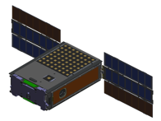




BioSentinel Month-in-the-Life ConOps
Monitor Bus Functions
Transmit to DSN
(Daily, 30 minute contact, ATS)
3
1
Media A: 4 weeks
Media B: 2 weeks
1
2
2
Wet new cards with Media A
(2 fluidic cards every 6 weeks, ATS)
Collect science data
(Continuous, RTS)
Wet cards with Media B
(4 weeks after Media A, RTS)
Major Functions | Sub-functions
Select card | Determine fluidic card Select μ-controller Select pump and valve set
Apply Fluids | Open inlet valve Open plate valve Open nutrient valves Activate Pump
Configure Thermal Control | Apply cold set points to other cards Warm set points for Media B
Close System | Close inlet valve Close plate valve Close nutrient valves De-activate pump
Major Functions | Sub-functions
Readout BioSensor (15 min cadence) | Determine fluidic card Select u-controller Select and power well LEDs Select and readout sensor Iterate all wells
Readout TID sensor (5 min cadence) | Apply power to sensor Wait for stabilization Sample analog readouts
Readout LET Spectrometer sensor (1 hour cadence) | Acquire binned data Store data in file system
Monitor for SPE | Sample TID readout Sample LET shutter info Wet new card if SPE detected
Major Functions | Sub-functions
Align spacecraft | Determine vector to Earth Slew to Earth vector
Power Tx | Power transmitter
Broadcast data | Broadcast SOH On CFDP command, transmit BioSensor, LET, TID data
Deactivate Tx | Power off transmitter
Realign spacecraft | Slew back to sun vector
1
2
3

Slide 16
Preliminary Operational Staffing Profile
Mission Phase | Length | Mission Operations Staffing Profile | Assumptions/Comments
Pre-Launch | ~ 30 day | 4x5 support for monitoring of BioSentinel DSGC pre-launch profile | DSGC must start while BioSentinel is at KSC
Launch & Ascent | ~ 1 day | Full team will staff the MOC | BioSentinel is powered off. No real-time stream of data from S/C into the MOC during L&A
Initialization | ~ 14 days | 24x7 console support for L + 5 days to check out S/C bus systems, ensure payloads are functional, perform orbit determination and update activity plan | Launch dispersions and deployment uncertainty will require BioSentinel re-plan cycle. No propulsive maneuver to achieve heliocentric orbit.
Science (early) | ~ 60 days | 8x5 console support to monitor first two biosensor experiments and to assist in planning and executing calibration activities as needed Surge support if needed | Autonomous momentum dumping
Science (routine) | ~ 305 days | One planning cycle every week with goal of two weeks Uplink console supports once per week, available for other with notice Continuous trending of S/C bus data Console staff on-call to respond to SPE | Review of DSN schedule every month, for three months in the future Limited real-time changes to schedule and plan except for SPE response
Extended Science | ~ 180 days | Continuation of Science

Slide 17
BioSentinel Back-Up Charts
Questions & Back-Up Charts

Slide 18
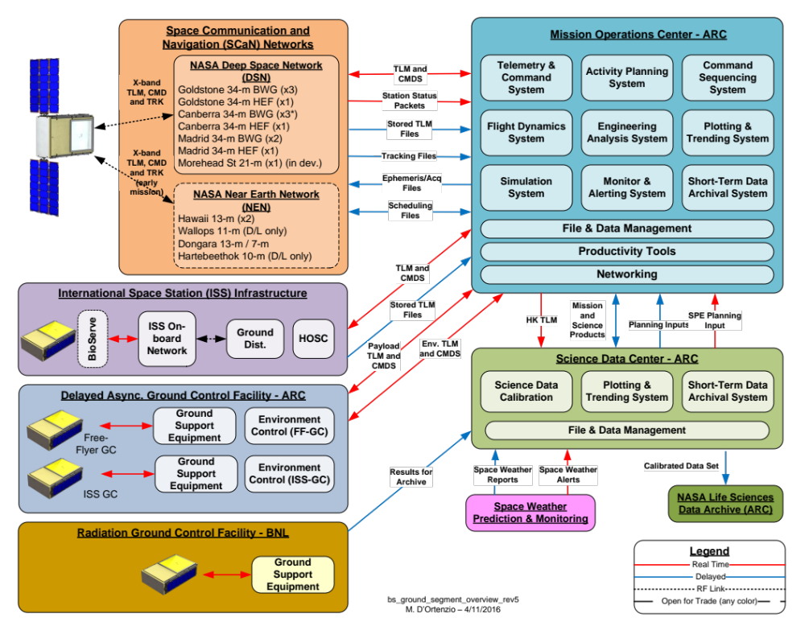

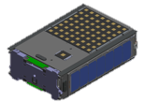
Ground System Architecture

Slide 19
BioSentinel FreeFlyer Spacecraft Bus Summary
Power
  ~64 W generated power EOL
  2- Panel gimballed deployable HaWK arrays & 2 additional 2x3 U deployable panels - MMA
  Panasonic 18650 batteries
  ARC design EPS and switch controllers
Structure
  6U nominal volume
  ARC Nanosat heritage
  EcAMSat provided baseline for BioSentinel development
Thermal
  Cold biased system
  Heaters, thermistors, paint, reflective tape for control
Supports Payloads
  Yeast based BioSensor Payload
  LET Spectrometer – JSC RadWorks
  4U volume
LEON3 RT based C&DH - Space Dynamics Lab
  Embedded VxWorks OS with cFS/cFE
  Port of LADEE FSW for Bus
  Port of EcAMSat / SporeSat FSW for P/L
3-axis controlled GNC system
  XACT Integrated GN&C Unit - Blue Canyon
    3 Reaction Wheels
    Star Tracker
    CSS, IMU for safe mode
  5° pointing requirement
Propulsion – Lightsey Space Research
  3D printed system
  Null tipoff rates and momentum management
  Seven cold gas R236cf thrusters
  ~60 sec Isp
  ~200 grams propellant
Communications
  X-Band to DSN @ 62.5 - 8000 bps
  LGA and MGA patch antennae - JPL
  IRIS v2.1 coherent transponder - JPL

Slide 20
Overview - Orbital Impact on Communications

Slide 21
BioSentinel Teaming
Mission Management - Bob Hanel, Dawn McIntosh, James Chartres, Mario Perez, Elwood Agasid, Vas Manolescu, Matt D’Ortenzio
Science - Sharmila Bhattacharya, Sergio Santa Maria, Diana Marina, Macarena Parra, Tore Straume, C. Mark Ott, Sarah Castro, Greg Nelson, Troy Harkness, Roger Brent
Payload - Charlie Friedericks, Rich Bielawski, Eric Tapio, Tony Ricco, Travis Boone, Ming Tan, Aaron Schooley, Mike Padgen, Lance Ellingson, Griffin McCutchenson, Diana Gentry, Dayne Kemp, Scott Wheeler, Susan Gavalas, Edward Semones
Spacecraft and Bus - Hugo Sanchez, Matthew Sorgenfrei, Jesse Fusco, Vanessa Kuroda, Craig Pires, Shang Wu, Abe Rademacher, Josh Benton, Doug Forman, Ben Klamm
Affiliations
NASA Ames, NASA JSC - RadWorks, LLUMC, Univ. Saskatchewan
Support
NASA Human Exploration and Operations Mission Directorate (HEOMD); Advanced Exploration Systems Division – Jitendra Joshi, Jason Crusan Program Execs.

Slide 22
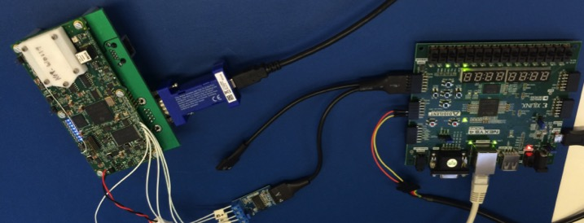
BioSentinel – LET Spectrometer
Radiation LET spectrometer supplied by JSC RadWorks
Both LET EDUs have been delivered to ARC
LET EDU#1 will be used to support a EDU spacecraft bus level vibe and thermal test.
LET EDU#2 used in Flatsat testing
First Flight Unit delivery to Ames scheduled for 5/31/17.
C&DH Processor Simulator
LET Spectrometer EDU
RS-422 Interface

Slide 23
Assumptions
Mission Timeline
  Initialization (2 weeks) – Launch thru Day 14
  Science Baseline (12 Months) Day 15 – 380
  Extended Science (6 Months) Day 381- 563
  Antenna gain depends on angle off boresight
  LGA – 0° = 7 dB, 15° = 6 dB, 30° =???, 45° = 3 dB, 50° = 2 dB, 90° = -7 dB
  MGA – 0° = 23 dB, 5° = 21 dB, 9.5° = 20 dB
Thermally limited Body Angle & Time constraint
  Body Angle (Theta) -5° ≤ Theta ≤ 45°;
  Maximum Communication Time – 30 Minutes
    For simplicity, a maximum of 30 minute is assumed for any Body Angle > 0°
    Thermal model shows that ~60 minutes can be achieved at 45° (100% margin)
    Current best estimate for minimum comm time required for mission operations
      At 62.5bps = 62.5*60*30 = 112.5 kb
      At 8kbps = 8000*60*30 = 14.4Mb
Risks with assumptions
  Thermal model is inaccurate and 30 minutes at 45° is not achievable
  Required data volumes (currently TBD) are higher than 30 minutes at 62.5bps (112.5kb)

Slide 24
Assumptions
Mission Timeline
  Initialization (2 weeks) – Launch thru Day 14
  Science Baseline (12 Months) Day 15 – 380
  Extended Science (6 Months) Day 381- 563
  Antenna gain depends on angle off boresight
  LGA – 0° = 7 dB, 15° = 6 dB, 30° =???, 45° = 3 dB, 50° = 2 dB, 90° = -7 dB
  MGA – 0° = 23 dB, 5° = 21 dB, 9.5° = 20 dB
Thermally limited Body Angle & Time constraint
  Body Angle (Theta) -5° ≤ Theta ≤ 45°;
  Maximum Communication Time – 30 Minutes
    For simplicity, a maximum of 30 minute is assumed for any Body Angle > 0°
    Thermal model shows that ~60 minutes can be achieved at 45° (100% margin)
    Current best estimate for minimum comm time required for mission operations
      At 62.5bps = 62.5*60*30 = 112.5 kb
      At 8kbps = 8000*60*30 = 14.4Mb
Risks with assumptions
  Thermal model is inaccurate and 30 minutes at 45° is not achievable
  Required data volumes (currently TBD) are higher than 30 minutes at 62.5bps (112.5kb)

Slide 25
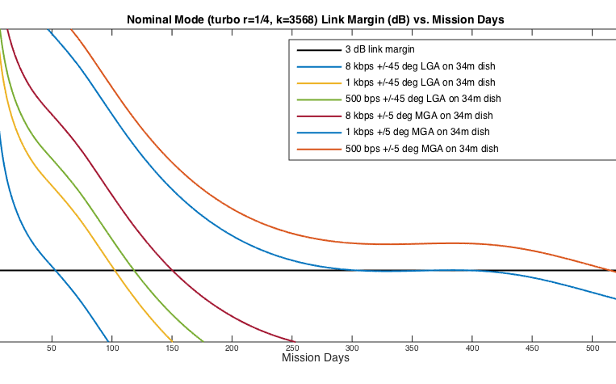
BioSentinel Link Margin (dB) vs. Mission Days

