Slide 1
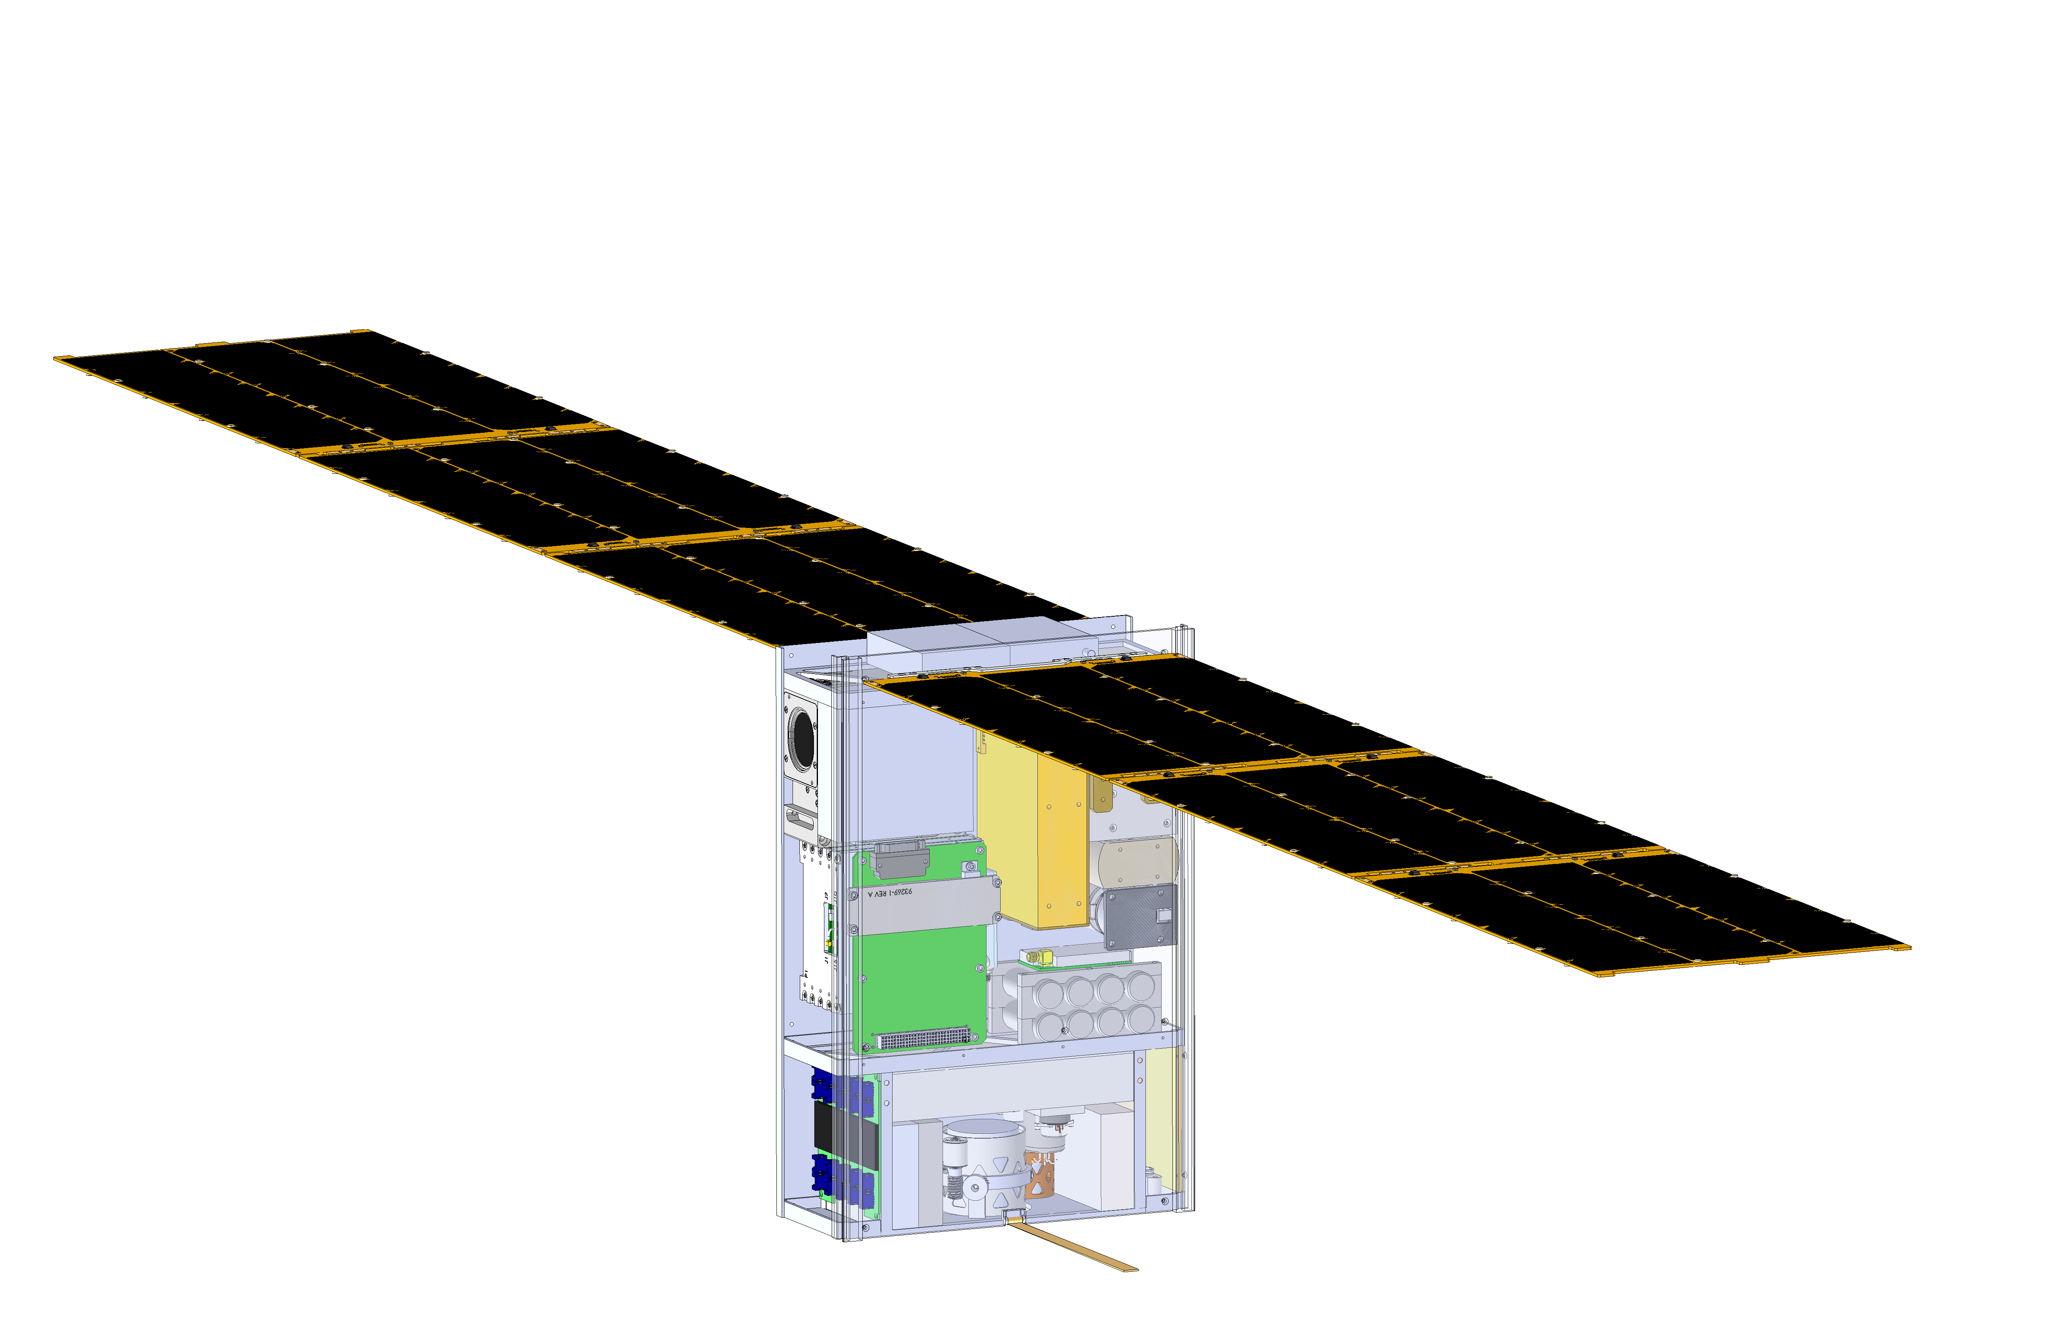
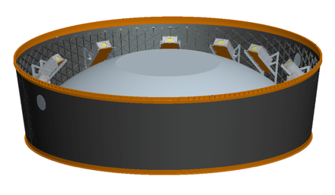
Broadband InfraRed Compact High-resolution Exploration Spectrometer:
Lunar Volatile Dynamics for the Lunar Ice Cube Mission
P.E. Clark, CalTech/Jet Propulsion Laboratory, Science PI
Morehead State University PI, Bus, Ground Communication, Science Operations: B. Malphrus (PI), B. Twiggs, Jeff Kruth, Kevin Brown, M. Coombs, R. McNeill; NASA/GSFC Payload: C. Brambora, T. Hurford, R. MacDowall, D. Reuter, W. Farrell, D. Patel, S. Banks, E. Mentzell, R. Manriquez;
NASA/GSFC Flight Dynamics: D. Folta, P. Calhoun;
Busek Propulsion: M. Tsay, J. Frongillo;
Vermont Technical College Software: C. Brandon, P. Chapin
National Aeronautics and Space Administration
Jet Propulsion Laboratory
California Institute of Technology
Pasadena, California
www.nasa.gov
© 2016. All rights reserved.
Government sponsorship acknowledged.
EM1 Deployment System for the ‘lucky 13’
Jet Propulsion Laboratory
California Institute of Technology

Slide 2
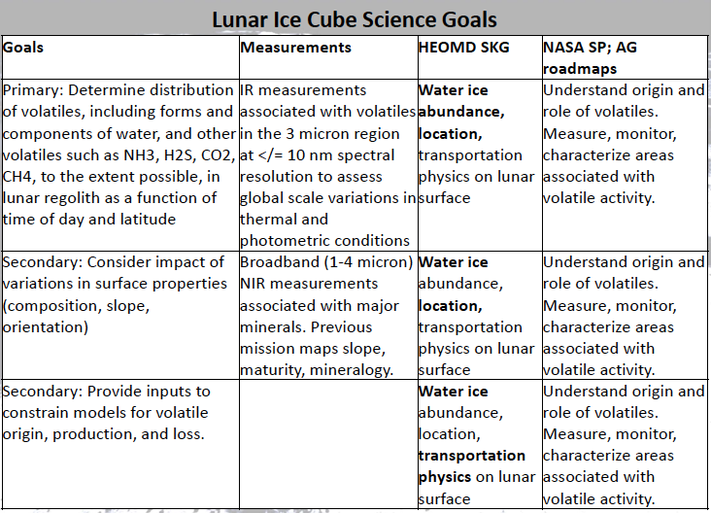

Slide 3
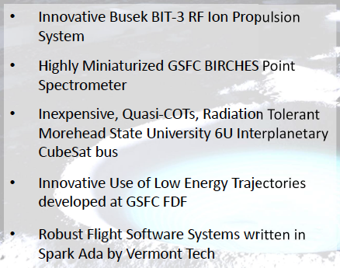
Technology Goals
Demonstrate Enabling Technologies for Interplanetary Cubesats

Slide 4
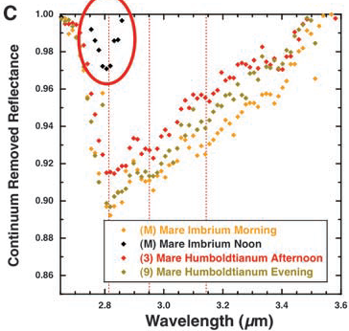
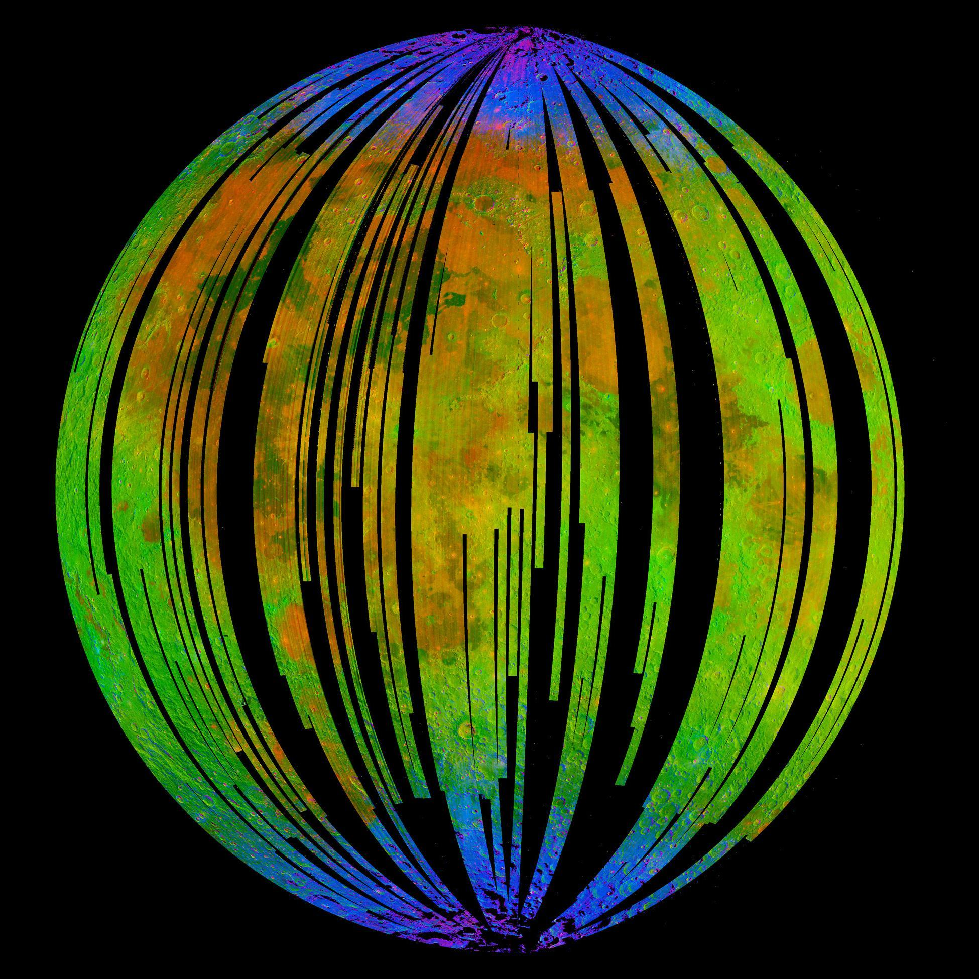
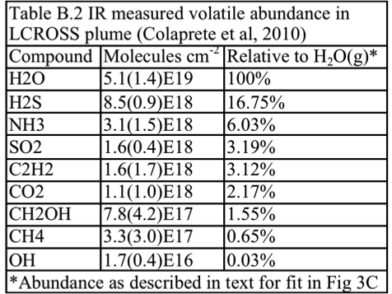
Lunar IceCube versus Previous Missions
Mission | Finding | IceCube
Cassini VIMS, Deep Impact | surface water detection, variable hydration, with noon peak absorption | water & other volatiles, fully characterize 3 μm region as function of several times of day for same swaths over range of latitudes w/ context of regolith mineralogy and maturity, radiation and particle exposure, for correlation w/ previous data
Chandrayaan M3 | H2O and OH (<3 microns) in mineralogical context nearside snapshot at one lunation
LCROSS | ice, other volatile presence and profile from impact in polar crater
LP, LRO, LEND LAMP DVNR LOLA LROC, LADEE | H+ in first meter (LP, LEND) & at surface (LAMP) inferred as ice abundance via correlation with temperature (DIVINER), PSR and PFS (LROC, LOLA), H exosphere (LADEE)
Early evidence for diurnal variation trend in OH absorption by Deep Impact (Sunshine et al. 2009) which will be geospatially linked by Lunar IceCube.
M3 ‘snapshot’ lunar nearside indicating surface coating OH/H₂O (blue) near poles (Pieters et al, 2009)

Slide 5
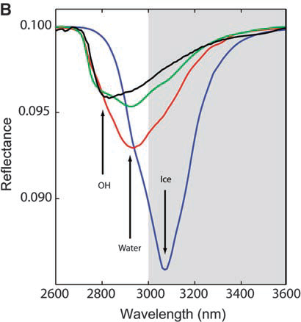
Species | μm | description
Water Form, Component
water vapor | 2.738 | OH stretch
 | 2.663 | OH stretch
liquid water | 3.106 | H-OH fundamental
 | 2.903 | H-OH fundamental
 | 1.4 | OH stretch overtone
 | 1.9 | HOH bend overtone
 | 2.85 | M3 Feature
 | 2.9 | total H2O
hydroxyl ion | 2.7-2.8 | OH stretch (mineral)
 | 2.81 | OH (surface or structural) stretches
 | 2.2-2.3 | cation-OH bend
 | 3.6 | structural OH
bound H2O | 2.85 | Houck et al (Mars)
 | 3 | H2O of hydration
 | 2.95 | H2O stretch (Mars)
 | 3.14 | feature w/2.95
adsorbed H2O | 2.9-3.0 | R. Clark
ice | 1.5 | band depth-layer correlated
 | 2 | strong feature
 | 3.06 | Pieters et al
Other Volatiles
NH3 | 1.65, 2. 2.2 | N-H stretch
CO2 | 2, 2.7 | C-O vibration and overtones
H2S | 3
CH4/organics | 1.2, 1.7, 2.3, 3.3 | C-H stretch fundamental and overtones
Mineral Bands
pyroxene | 0.95-1 | crystal field effects, charge transfer
olivine | 1, 2, 2.9 | crystal field effects
spinels | 2 | crystal field effects
iron oxides | 1 | crystal field effects
carbonate | 2.35, 2.5 | overtone bands
sulfide | 3 | conduction bands
hydrated silicates | 3-3.5 | vibrational processes
anticipate wavelength of peak for water absorption band to be structural<bound<adsorbed<ice
Ice Cube measurements will encompass the broad 3 um band to distinguish overlapping OH, water, and ice features. Will have near 10 nm resolution in this band
Yellow = water-related features in the 3 micron region

Slide 6
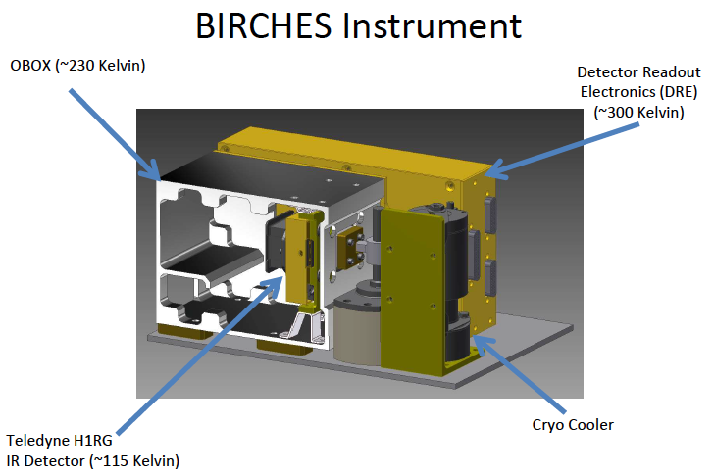
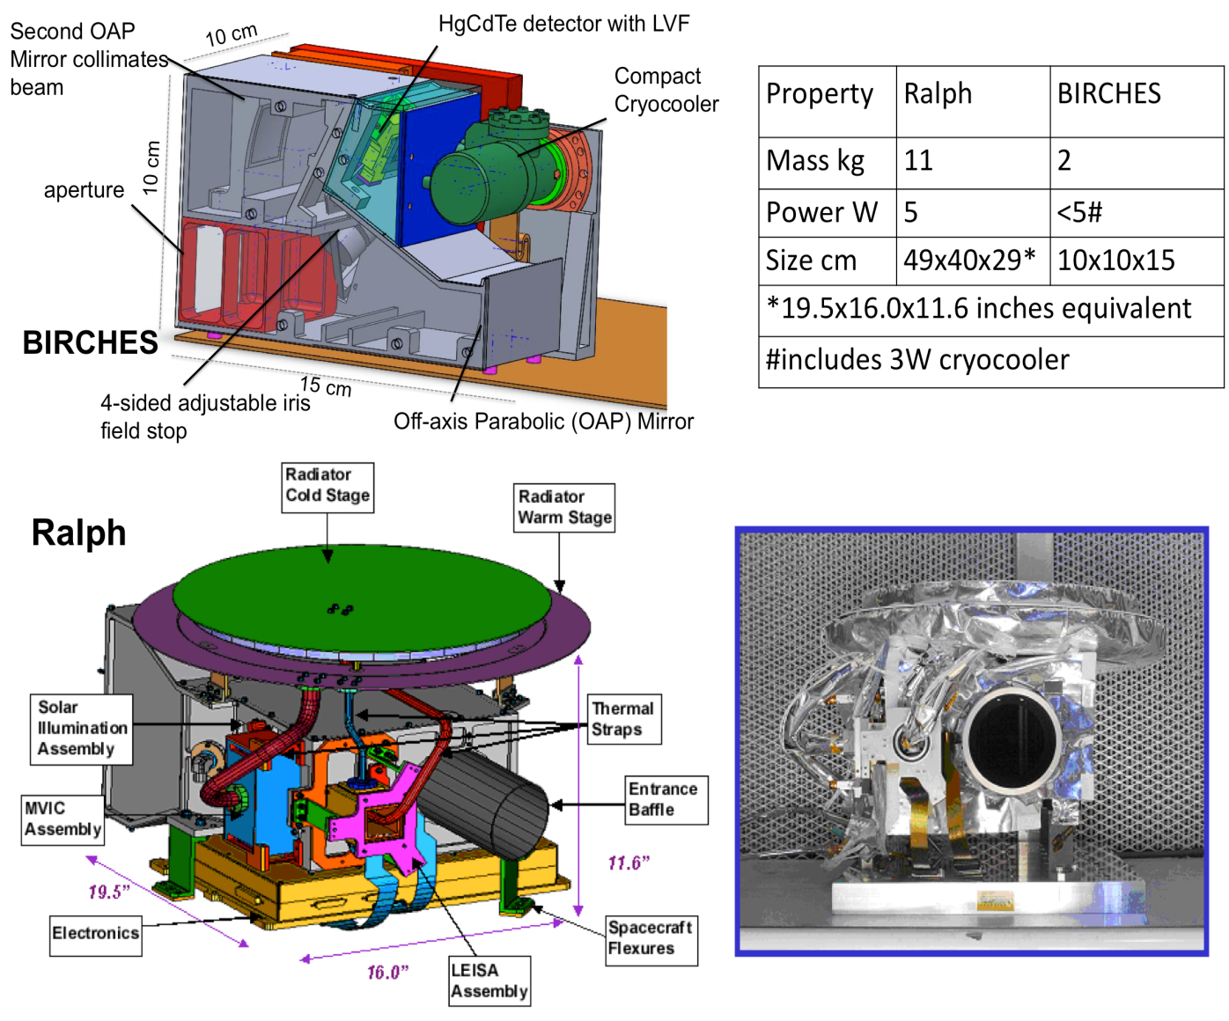
BIRCHES compactness
Property | Ralph | BIRCHES
Mass kg | 11 | 3
Power W | 5 | #10-20 W
Size cm | 49 x 40 x 29 | 10 x 10 x 15
# includes 3 W detector electronics, 1.5 W AFS controller, 5-10 W cryocooler

Slide 7
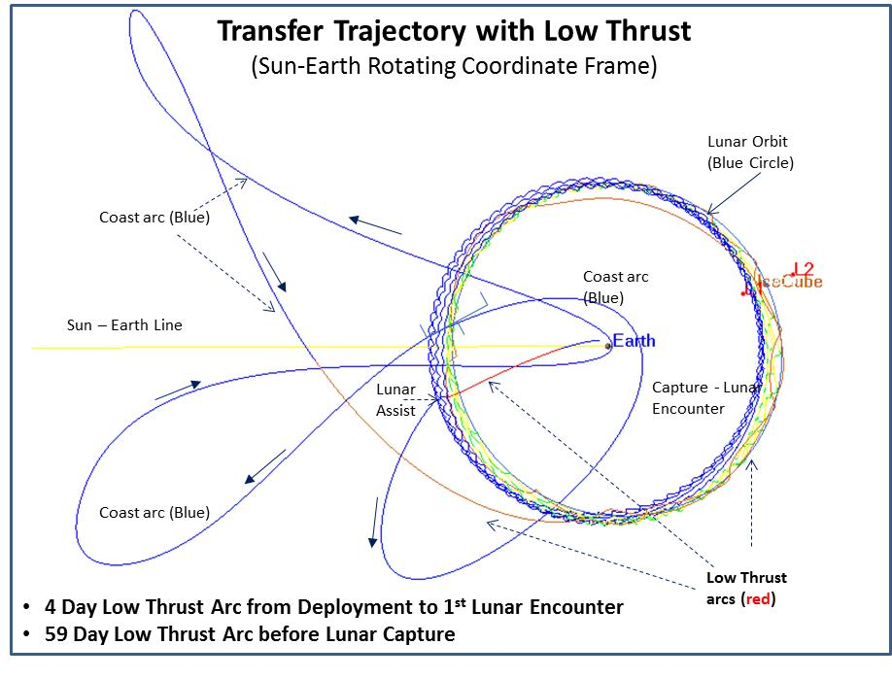
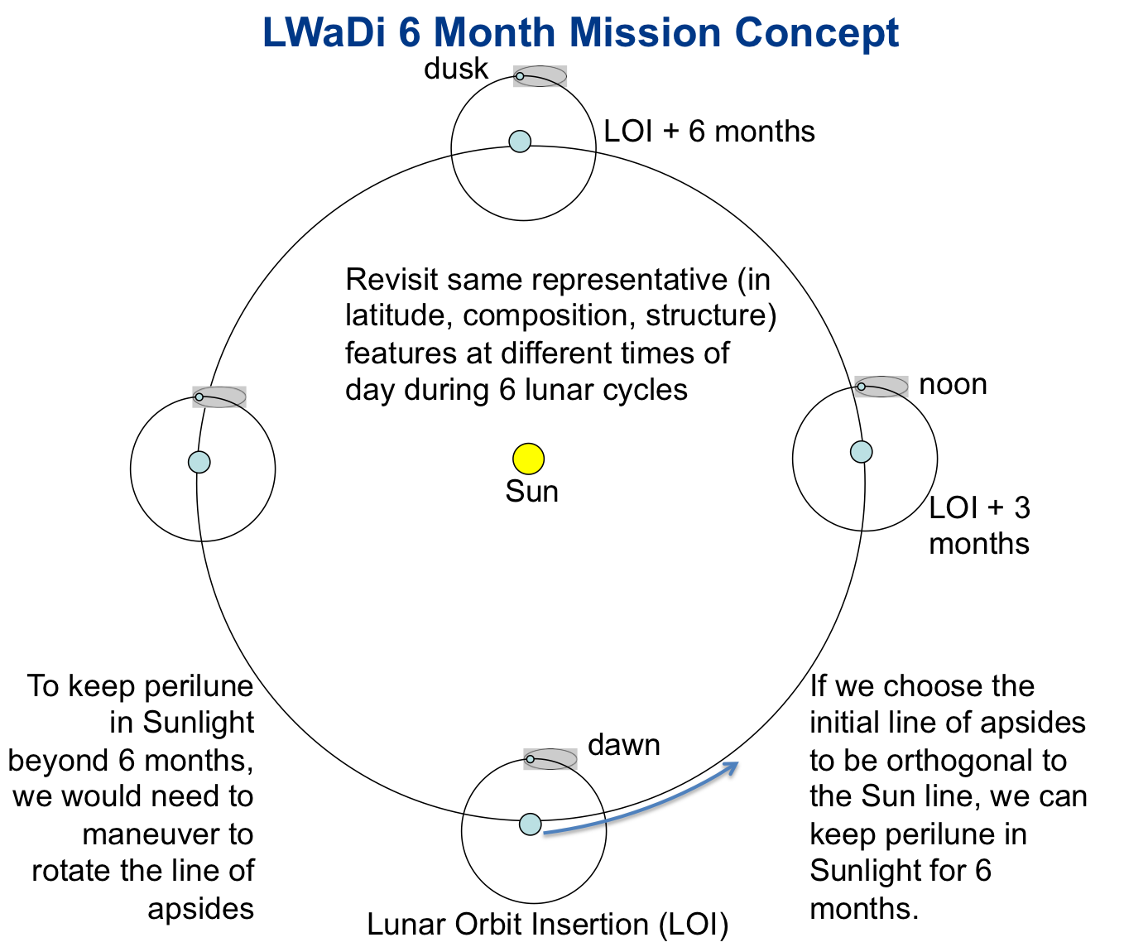
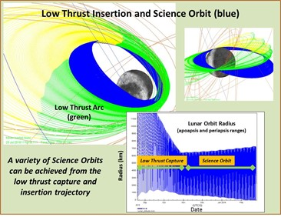
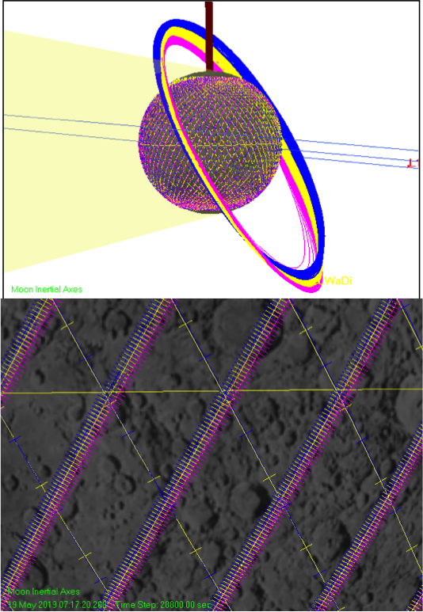

Slide 8
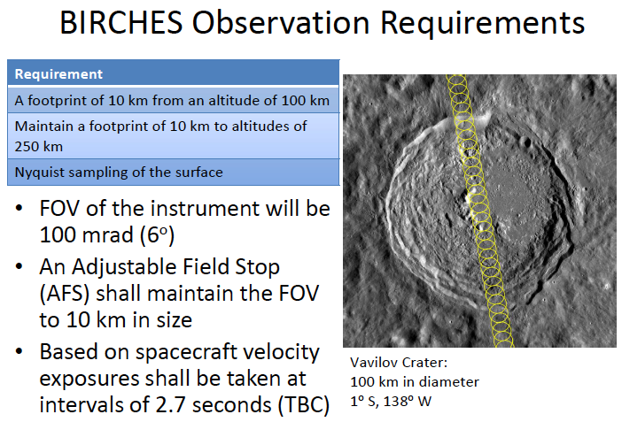
Footprint 10 km in along track direction regardless of altitude, consecutive observations separated by a couple of kilometers; greater overlap of consecutive tracks at poles, separted by a couple of kilometers

Slide 9
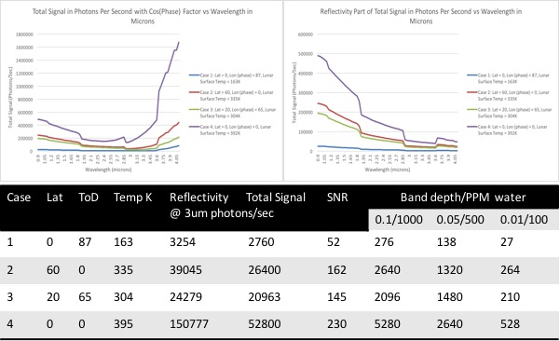

Slide 10
Current Challenges
Thermal Design: major cubesat challenge. Thermal models indicate dedicated radiator maintains temperature of optics box <220K, BIRCHES instrument maintained within operational range. All aluminum design of optical bench minimizes impact of terminator-equator temperature variation. Calibration of optical system will allow anticipated minimal effects to be removed. Microcryocooler maintains detector <115 K.
Optics: Cover will be needed to prevent sunlight from entering instrument. Minimal mass and volume impact solutions being explored. Adjustable Field Stop design allows window spot size to be maintained over changes in altitude from 10 to 100 km.
Human-rated launch vehicle challenges: Very high Vibration and Shock survival in original requirements documents: deployer design will mitigate and original margins were very high Very large survival temperature range in requirements documents: partially mitigated by ‘rolling’ spacecraft once Orion deployed +1.5 hours) Solutions being negotiated.
Radiation issue: Attention being paid to NEPP by entire team thanks to efforts of Cliff Brambora
Communication, navigation and tracking: DSN developing new capabilities for multiplexing communication. Iris version 2 provides much improved bandwidth at expense of power.
Data Management: PDS requirement at PDR presents major challenge.

Slide 11
Baseline Success Criteria
Lunar Surface Coverage for same swaths as function of 3 or more times of day | Minimum 10% near equator, 100% at poles for 6 month mission
Polar regional coverage for overlap with two other orbiters | TBD
Equatorial periapsis for symmetrical coverage | 100 km +/- 5 km vertical/horizontal
Footprint | <300 sq km
Spectral resolution @ 3 μm | 10 nm
Avoid 3 micron region saturation | preflight loaded and tested software to control adjustable aperture size. combine integration periods as necessary.
Downlink of collected data | 128 kbps to downlink all science data daily
dynamic range in water-related abundances | Four orders of magnitude
Access to Phase 1 and 2 data (last slide) | Deliver to PDS EDRs. Incorporate NAIF/SPICE for positioning and pointing information. Level 1 products to include calibrated data, more as resources permit, leveraging community resources

Slide 12
Conclusions
IceCube to place an IR spectrometer in lunar orbit to look for surface OH, water, other volatiles
Examines changes in surface volatile content as function of temperature and illumination conditions to get at dynamics issues! (like Sunshine et al., 2009 observation)
Utilizes MSU cubesat bus with Busek propulsion and commercial subsystems modified for deep space, GSFC payload and flight dynamics expertise with low energy manifolds to lunar capture, and JPL science PI and deep space communication expertise
Creating a tailored solution with a standard platform.
Our goal is to deliver high priority measurements on lunar volatiles via a HEOMD NextSTEP mission selected to demonstrate technology for propulsion and compact volatile-detecting instrument capability

Slide 13
LunarCubes Are Here!!!!
pamela.e.clark@jpl.nasa.gov

Slide 14
Backup Slides

Slide 15
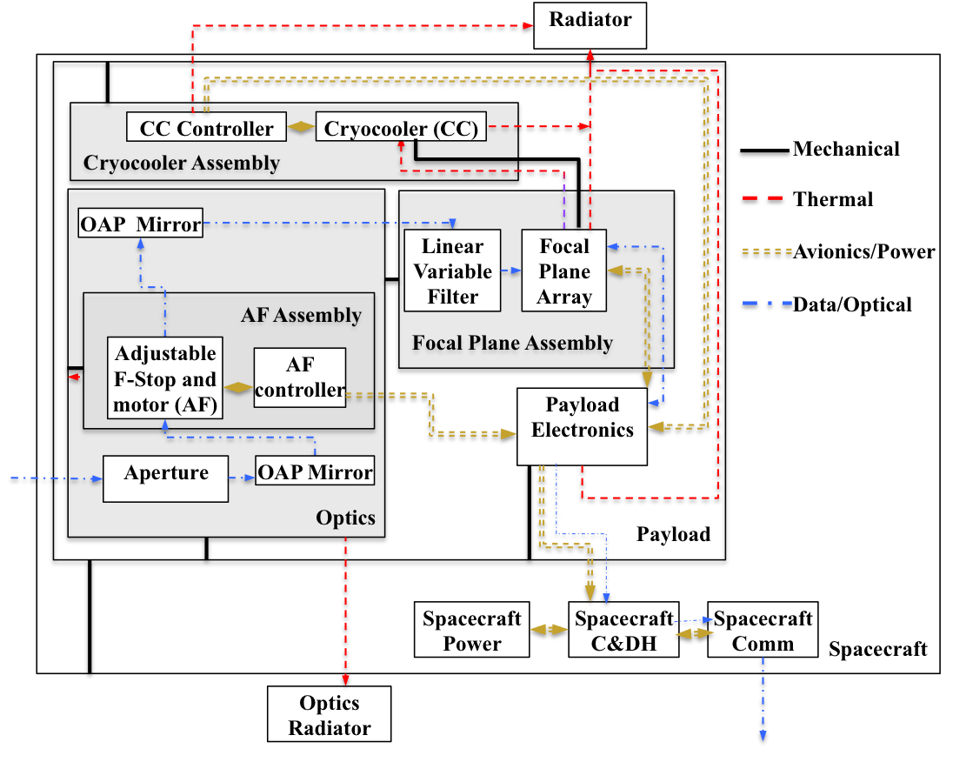
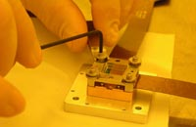
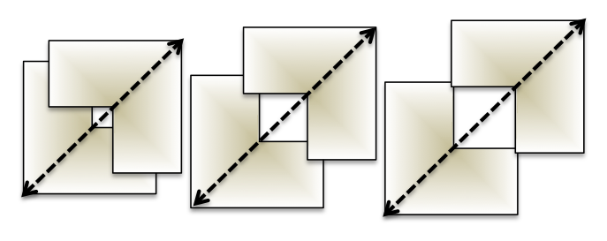
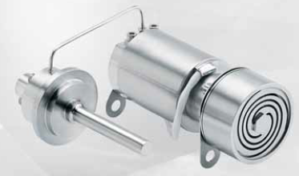
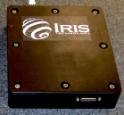
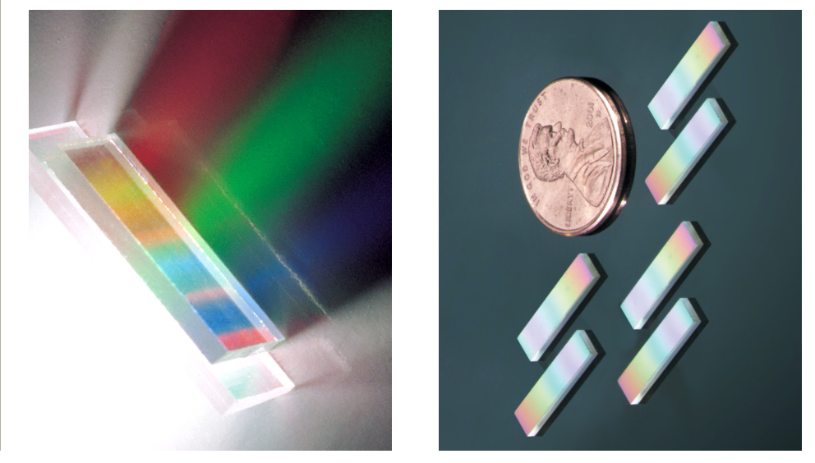
Spectrometer Schematic and Components
BIRCHES utilizes a compact Teledyne H1RG HgCdTe Focal Plane Array and JDSU linear variable filter detector assembly leveraging OSIRIS REx OVIRS.
Adjustable Iris maintains footprint size at 10 km by varying FOV regardless of altitude
COTS AFRL developed AIM SX030 microcryocooler with cold finger to maintain detector at ≤115K and iris controller
JDSU LV filters

Slide 16
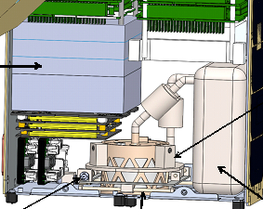
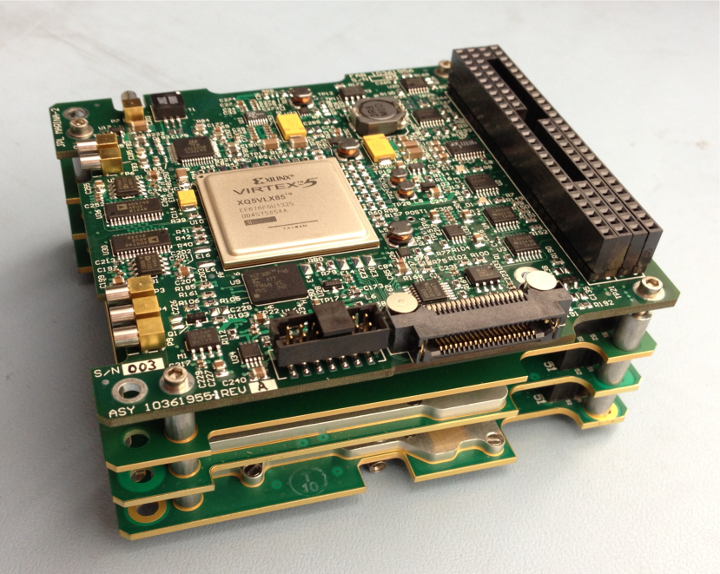
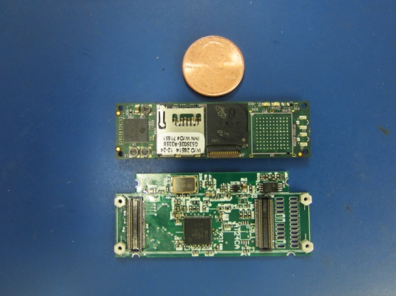
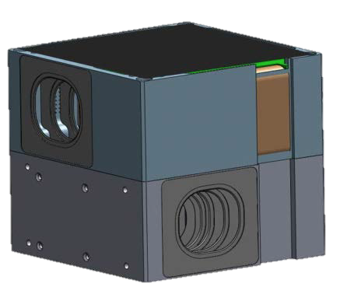
Bus Components
Propulsion: 2U Busek Gimbaled Iodine Ion Propulsion Drive (EP) with external e- source to offset charge build up. Models indicate no contamination problem.
Thermal Design: with minimal radiator for interior the small form factor for BIRCHES means that interior experiences temperatures well within 0 to 40 degrees centrigrade, except for optics box which has a separate radiator. Thermal modeling funded via IRAD work.
Communication, Tracking: X-band, JPL Iris Radio, dual X-band patch antennas. MSU has 21-m dish that is becoming part of the DSN. Anticipated data rate 128 kb/s
C&DH: very compact and capable proton 400K (trade volume, complexity, cubesat heritage, live with the fact this hasn’t flown in deep space)
GNC/ACS: Modified Blue Canyon system. Multi-component (star trackers, IMU, RWA) packages with heritage available, including BCT XB1, which can interface with thrusters (trade cost, volume, cubesat heritage, live with the fact this hasn’t flown in deep space)

Slide 17
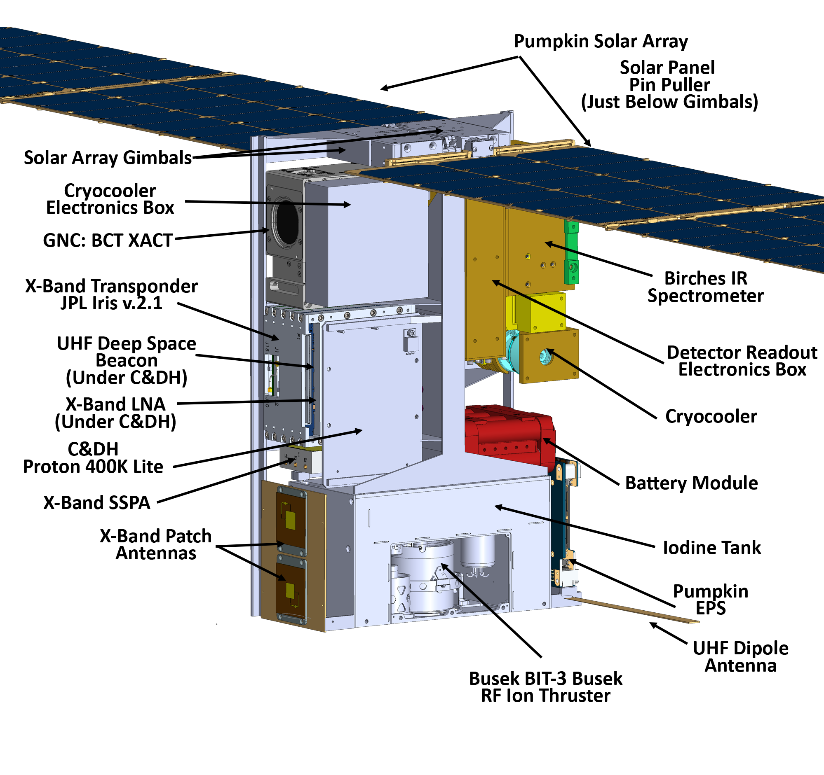
Lunar Ice Cube Bus

Slide 18
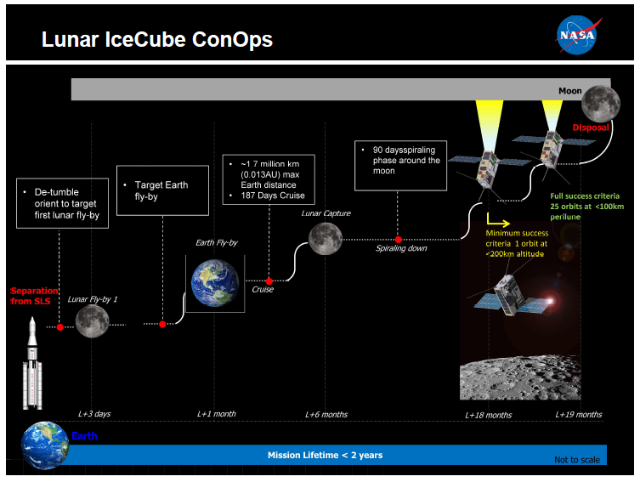

Slide 19
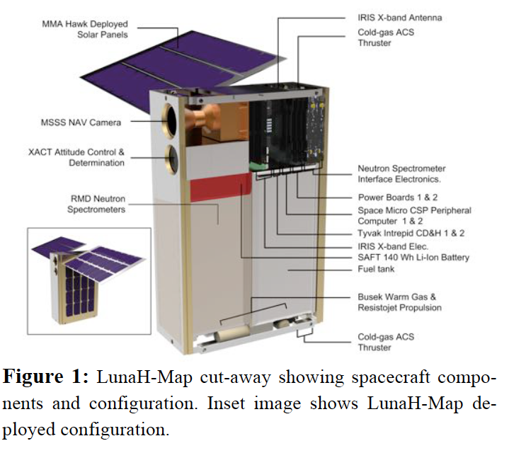
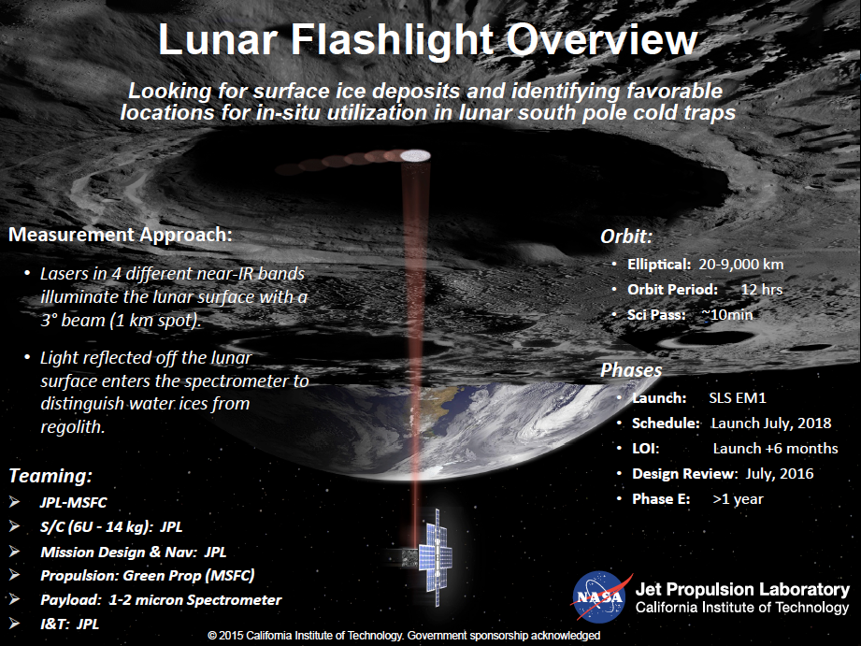
Other EM1 Mission Complimentarity
Lunar Flashlight: Detect surface ice for PSRs polar region by measuring laser stimulated emission at several ice-associated lines.
LunaH Map: Detect ice in top layer (tens of centimeters) of regolith for PSRs polar region by measuring decrease in neutron flux (anti-correlated with protons) using neutron spectrometer.
Lunar IceCube: Determine water forms and components abundances as a function of time of day, latitude, and lunar regolith properties using broadband point spectrometer.

