Slide 1
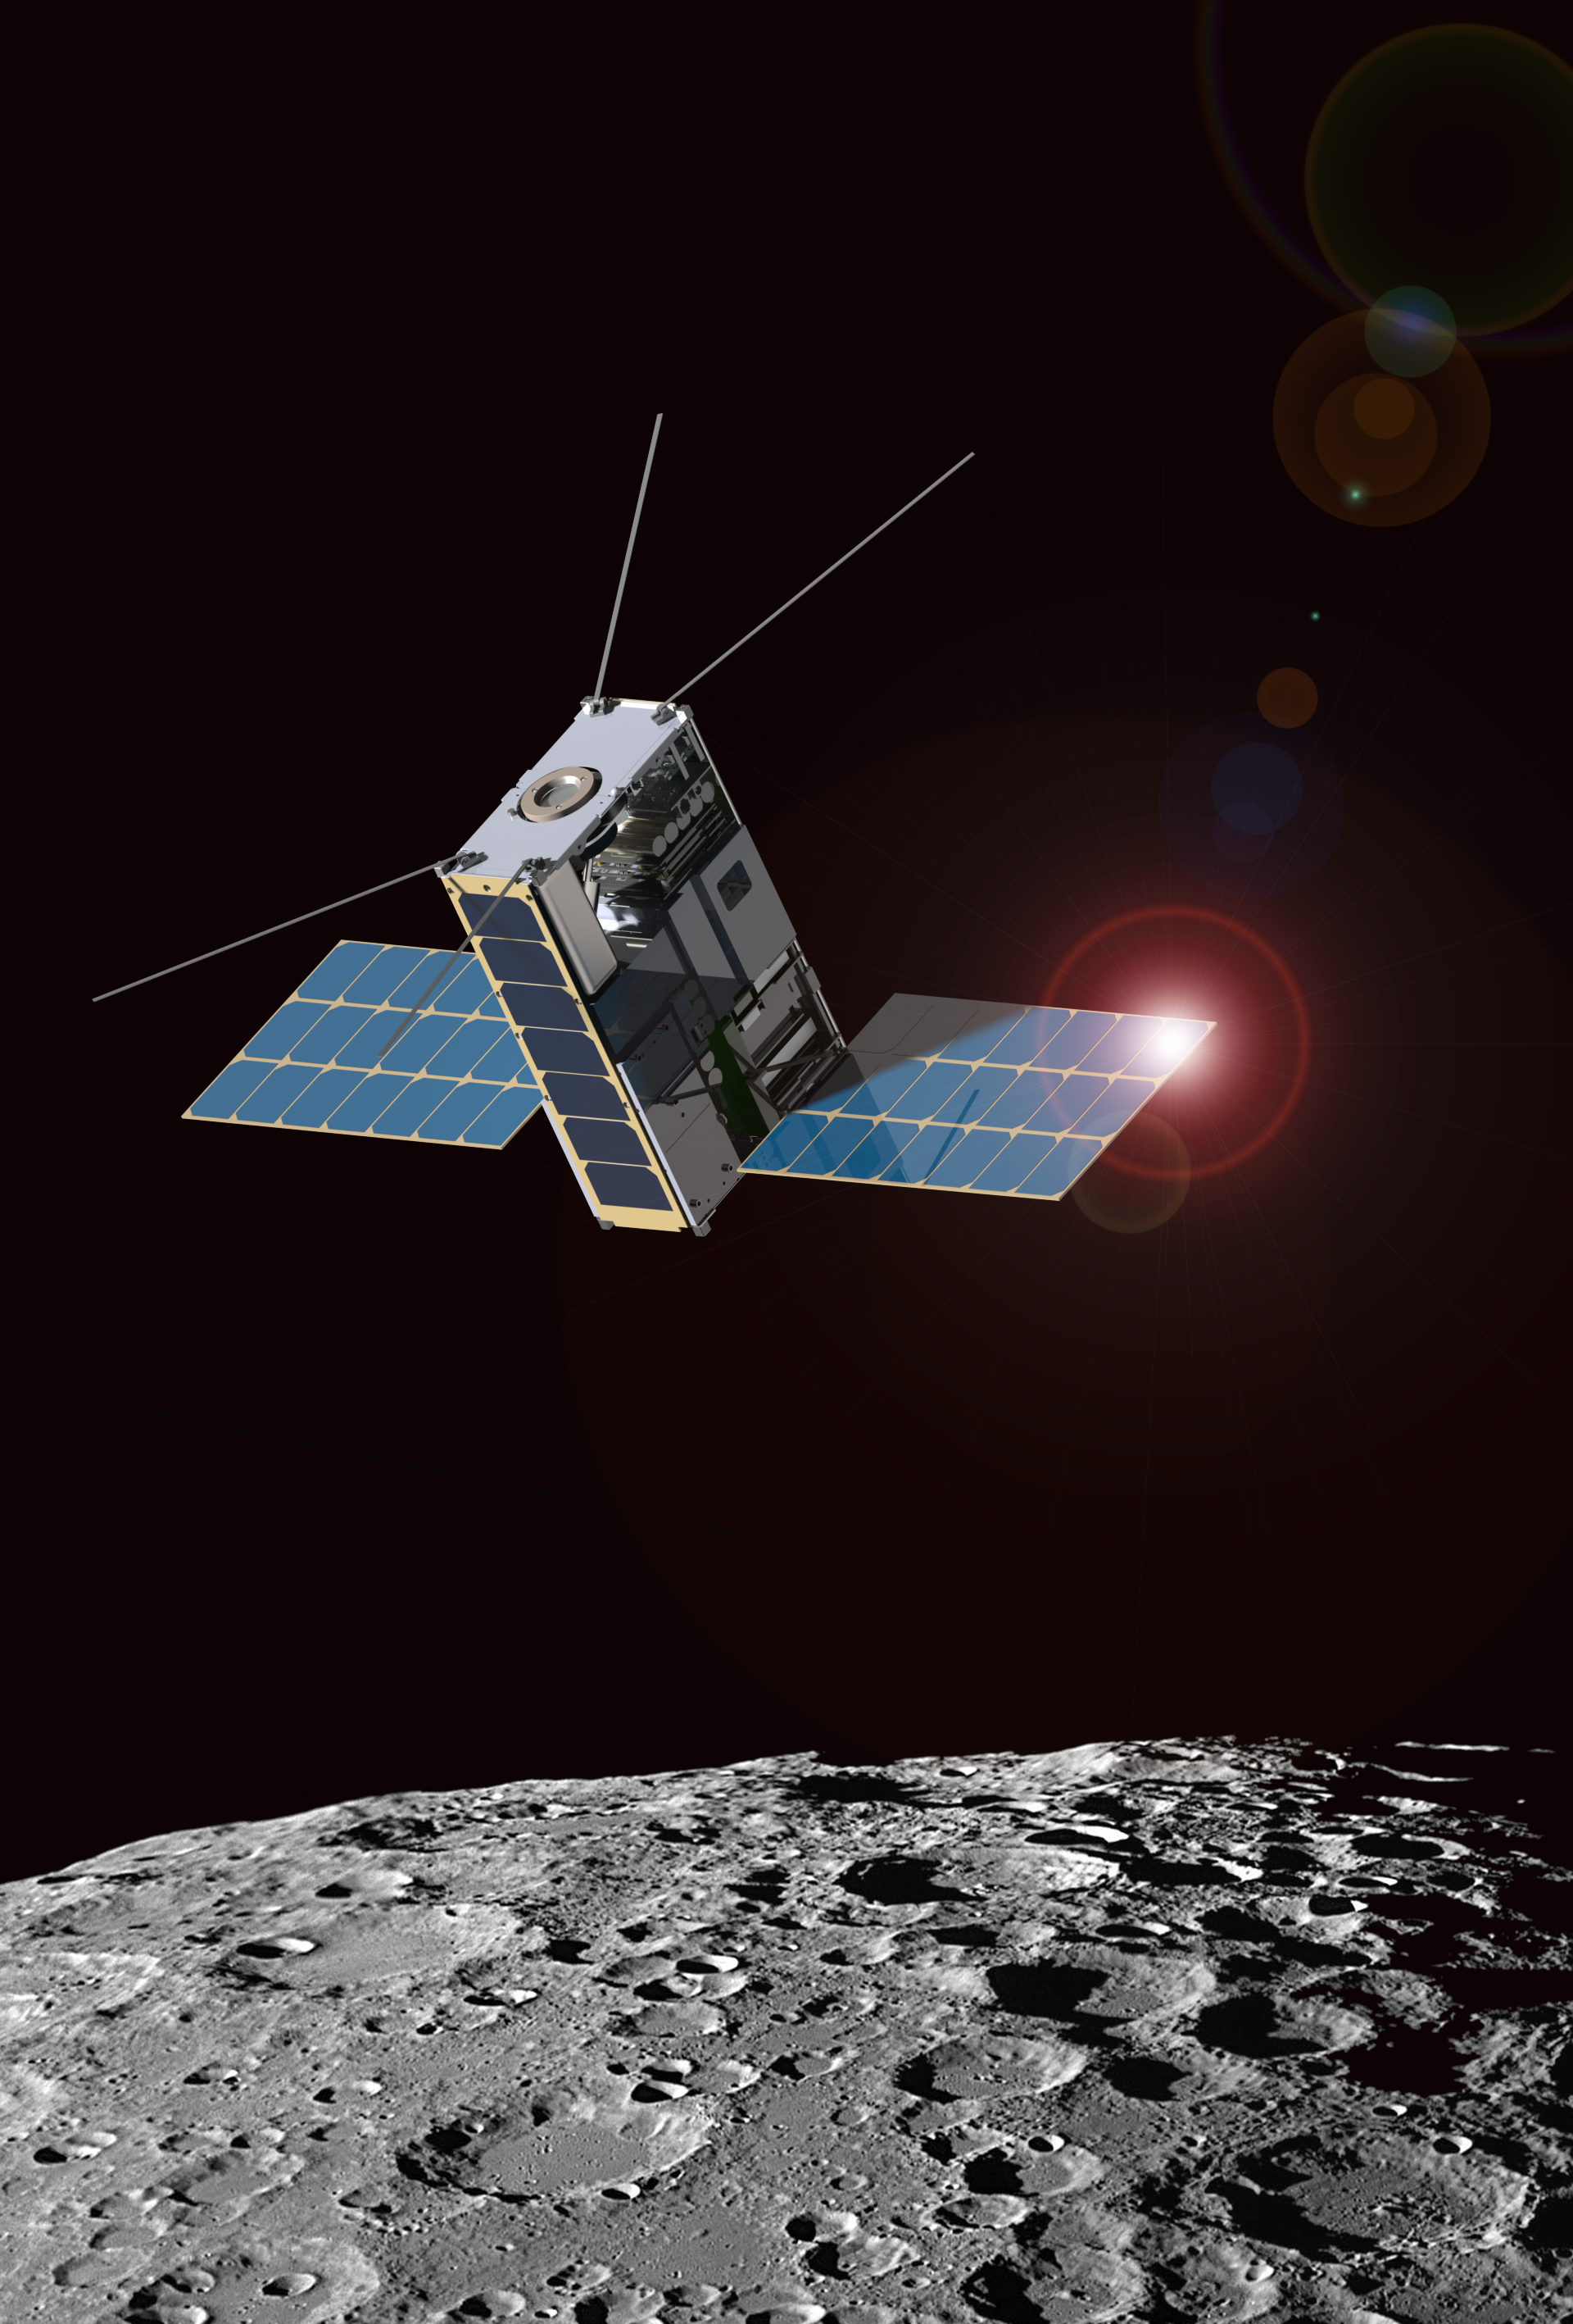
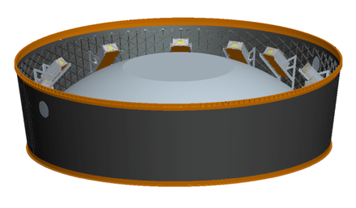
Lunar Ice Cube Orbiter:
Lunar Volatile Dynamics from a First Generation Deep Space CubeSat
P.E. Clark, CalTech/Jet Propulsion Laboratory, Science PI
B. Malphrus, Morehead State University, PI
NASA/GSFC Payload: D. Reuter, T. Hurford, R. MacDowall, N. Petro, W. Farrell, C. Brambora, D. Patel, S. Banks, P. Coulter
NASA/GSFC Flight Dynamics: D. Folta, P. Calhoun
Morehead State University Bus, Mission Ops, Ground Communication: B. Twiggs, Jeff Kruth, Kevin Brown, R. McNeill
Busek: M. Tsay, V. Hruby
Vermont Technical College: Carl Brandon, Peter Chapin
National Aeronautics and Space Administration
Jet Propulsion Laboratory
California Institute of Technology
Pasadena, California
www.nasa.gov
With JPL and non-JPL authors: © 2015. All rights reserved.
Government sponsorship acknowledged.
Jet Propulsion Laboratory
California Institute of Technology
National Aeronautics and Space Administration
Jet Propulsion Laboratory
California Institute of Technology
Pasadena, California
www.nasa.gov
With JPL and non-JPL authors: 2015. All rights reserved.

Slide 2
Science Goals
Understanding the role of volatiles in the solar system
Enabling broadband spectral determination of composition and distribution of volatiles in regoliths (the Moon, asteroids, Mars) as a function of time of day, latitude, regolith age and composition.
Providing geological context by way of spectral determination of major minerals.
Enabling understanding of current dynamics of volatile sources, sinks, and processes, with implications for evolutionary origin of volatiles.
IceCube addresses NASA HEOMD Strategic Knowledge Gaps related to lunar volatile distribution (abundance, location, transportation physics water ice).
IceCube complements the scientific work of Lunar Flashlight by by observing at a variety of latitudes, not restricted to PSRs

Slide 3
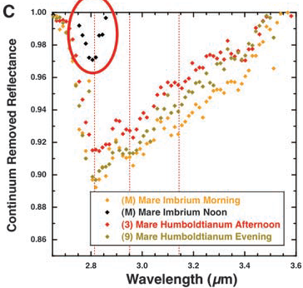
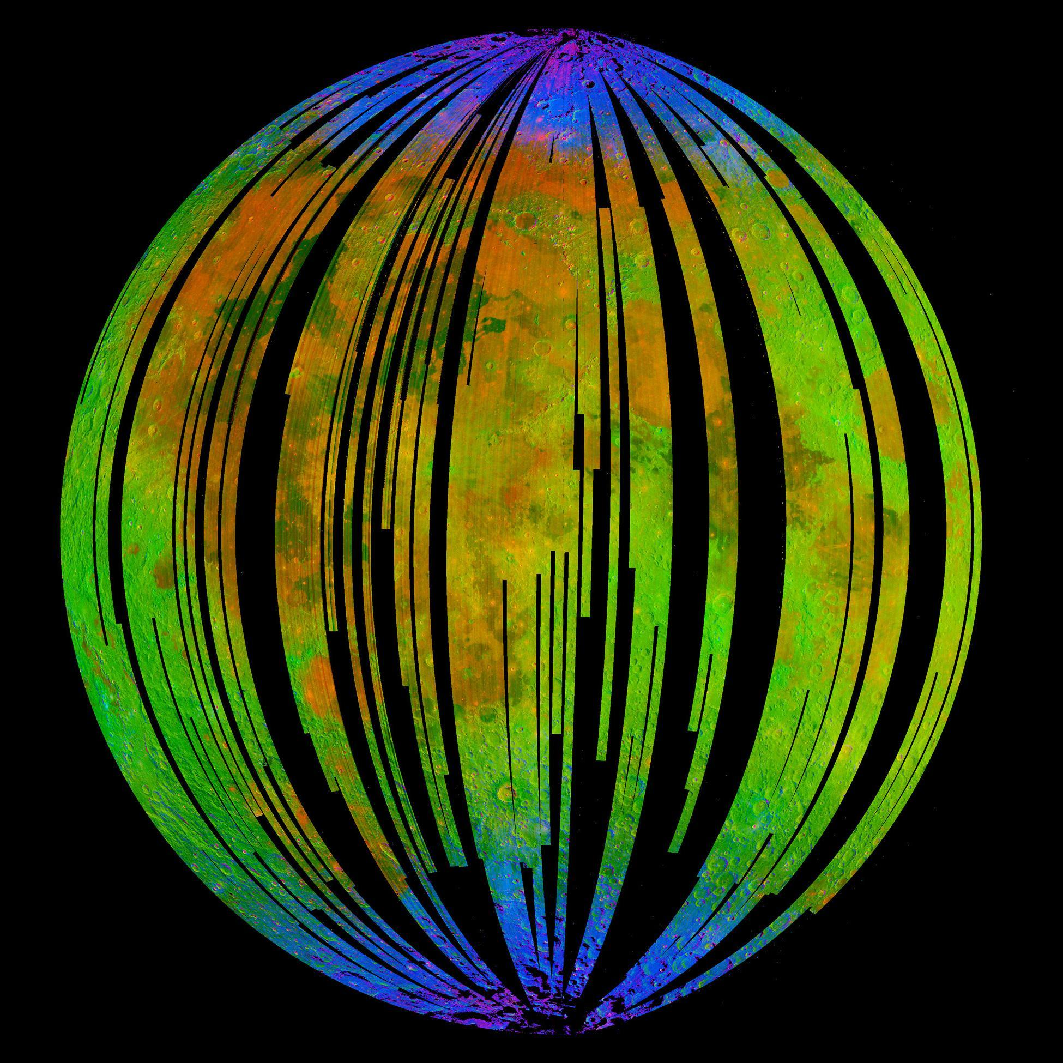
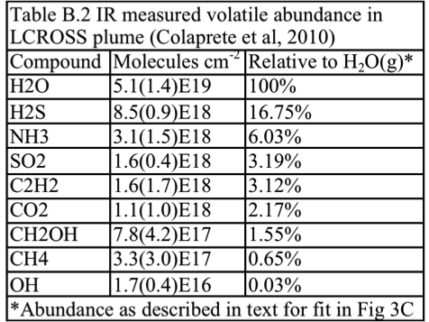
Lunar IceCube versus Previous Missions
Mission | Finding | IceCube
Cassini VIMS, Deep Impact | surface water detection, variable hydration, with noon peak absorption | water & other volatiles, fully characterize 3 μm region as function of several times of day for same swaths over range of latitudes w/ context of regolith mineralogy and maturity, radiation and particle exposure, for correlation w/ previous data
Chandrayaan M3 | H2O and OH (<3 microns) in mineralogical context nearside snapshot at one lunation
LCROSS | ice, other volatile presence and profile from impact in polar crater
LP, LRO, LEND LAMP DVNR LOLA LROC, LADEE | H+ in first meter (LP, LEND) & at surface (LAMP) inferred as ice abundance via correlation with temperature (DIVINER), PSR and PFS (LROC, LOLA), H exosphere (LADEE)
Early evidence for diurnal variation trend in OH absorption by Deep Impact (Sunshine et al. 2009) which will be geospatially linked by Lunar IceCube.
M3 ‘snapshot’ lunar nearside indicating surface coating OH/H₂O (blue) near poles (Pieters et al, 2009)

Slide 4
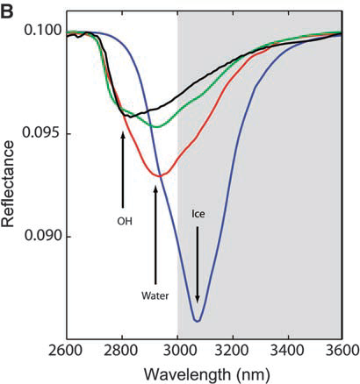
Species | μm | description
Water Form, Component
water vapor | 2.738 | OH stretch
 | 2.663 | OH stretch
liquid water | 3.106 | H-OH fundamental
 | 2.903 | H-OH fundamental
 | 1.4 | OH stretch overtone
 | 1.9 | HOH bend overtone
 | 2.85 | M3 Feature
 | 2.9 | total H2O
hydroxyl ion | 2.7-2.8 | OH stretch (mineral)
 | 2.81 | OH (surface or structural) stretches
 | 2.2-2.3 | cation-OH bend
 | 3.6 | structural OH
bound H2O | 2.85 | Houck et al (Mars)
 | 3 | H2O of hydration
 | 2.95 | H2O stretch (Mars)
 | 3.14 | feature w/2.95
adsorbed H2O | 2.9-3.0 | R. Clark
ice | 1.5 | band depth-layer correlated
 | 2 | strong feature
 | 3.06 | Pieters et al
Other Volatiles
NH3 | 1.65, 2. 2.2 | N-H stretch
CO2 | 2, 2.7 | C-O vibration and overtones
H2S | 3
CH4/organics | 1.2, 1.7, 2.3, 3.3 | C-H stretch fundamental and overtones
Mineral Bands
pyroxene | 0.95-1 | crystal field effects, charge transfer
olivine | 1, 2, 2.9 | crystal field effects
spinels | 2 | crystal field effects
iron oxides | 1 | crystal field effects
carbonate | 2.35, 2.5 | overtone bands
sulfide | 3 | conduction bands
hydrated silicates | 3-3.5 | vibrational processes
anticipate wavelength of peak for water absorption band to be structural<bound<adsorbed<ice
Ice Cube measurements will encompass the broad 3 um band to distinguish overlapping OH, water, and ice features. Will have near 10 nm resolution in this band
Yellow = water-related features in the 3 micron region

Slide 5
Influences on Measurable Signal at Volatile Bands
Influences | Effect
Time of day | hydroxyl, water production/release as function of temperature, solar exposure
Latitude | greater impact of local topography near poles
Solar output | transient variations induced by solar output or events
regolith composition | variation in availability of OH, FeO
shadowing (slope orientation) | minimal or irregular illumination, lower temperature, potential cold trap
regolith maturity | variation in extent of space weathering induced reduction by hydrogen
feature type (impact or volcanic construct) | geomorphology induced cold trapping or internal volatile release
age | age-induced structural degradation reduces influence of local topography
major terrane (highland, maria) | combined age and composition effects

Slide 6
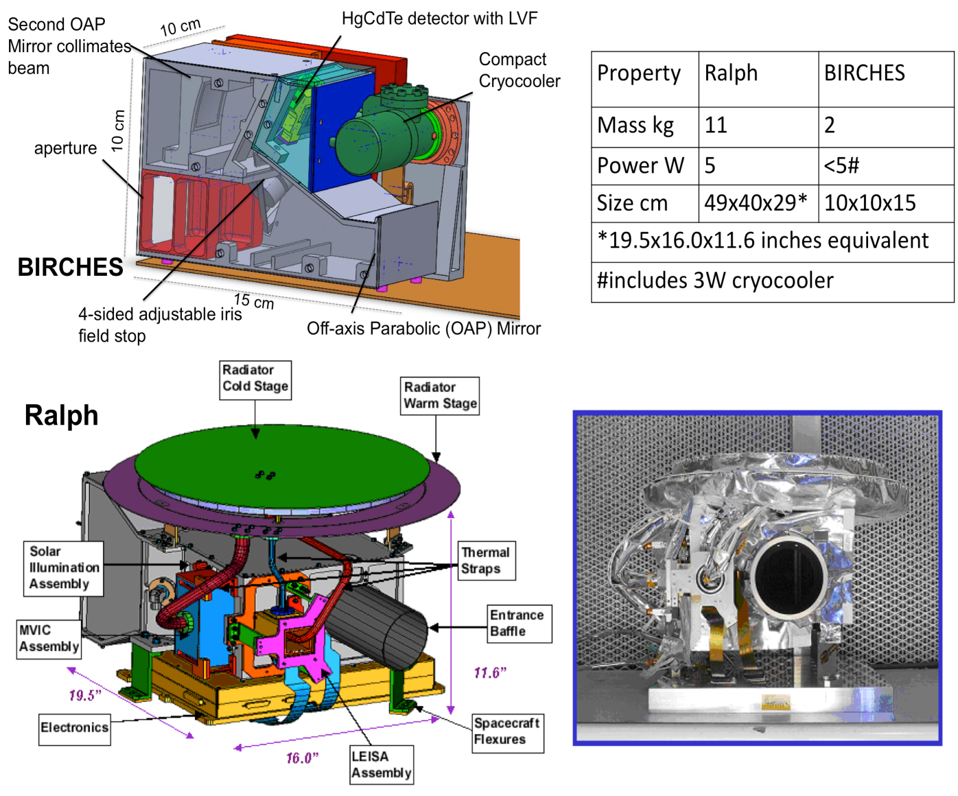
Mission Payload BIRCHES: Broadband IR Compact High Resolution Exploration Spectrometer
Broadband (1 to 4 um) IR spectrometer with HgCdTe and compact line separation (LVF)
Compact microcrycooler to ≤ 120K to provide long wavelength coverage
compact optics box designed to remain below 220K
OSIRIS Rex OVIRS heritage design
Property | Ralph | BIRCHES
Mass kg | 11 | 2.5
Power W | 5 | #10-15 W
Size cm | 49 x 40 x 29 | 10 x 10 x 15
# includes 3 W detector electronics, 1.5 W iris controller, 5-10 W cryocooler

Slide 7
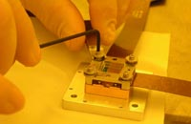
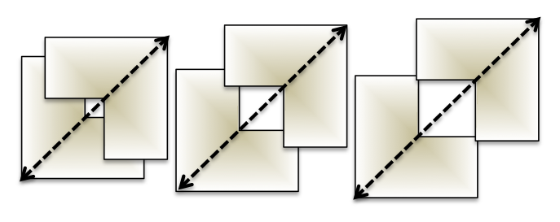
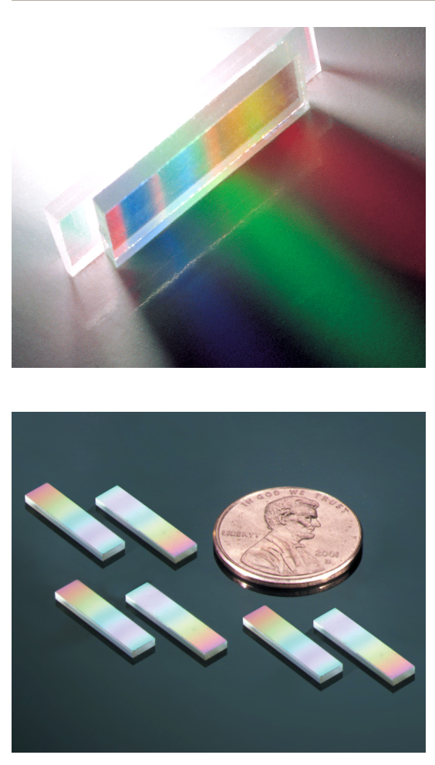
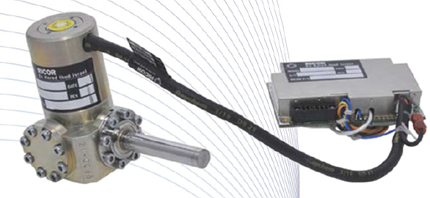
Spectrometer Components
CC controller
Cryocooler (CC)
Radiator
Detector Interface Electronics
Optics Box
OAP
LV Filter
Focal Plane Array
Adjustable Iris (AI)
AI controller (stepper motor)
Spacecraft C&DH
BIRCHES utilizes a compact Teledyne H1RG HgCdTe Focal Plane Array and JDSU linear variable filter detector assembly leveraging OSIRIS REx OVIRS.
Spacecraft Power
Aperture
OAP
Special Radiator
BIRCHES block diagram illustrates simplicity and flexibility of design.
Off the shelf tactical cryocooler with cold finger to maintain detector at ≤120K
Adjustable Iris maintains footprint size at 10 km by varying FOV regardless of altitude
JDSU LV filters

Slide 8
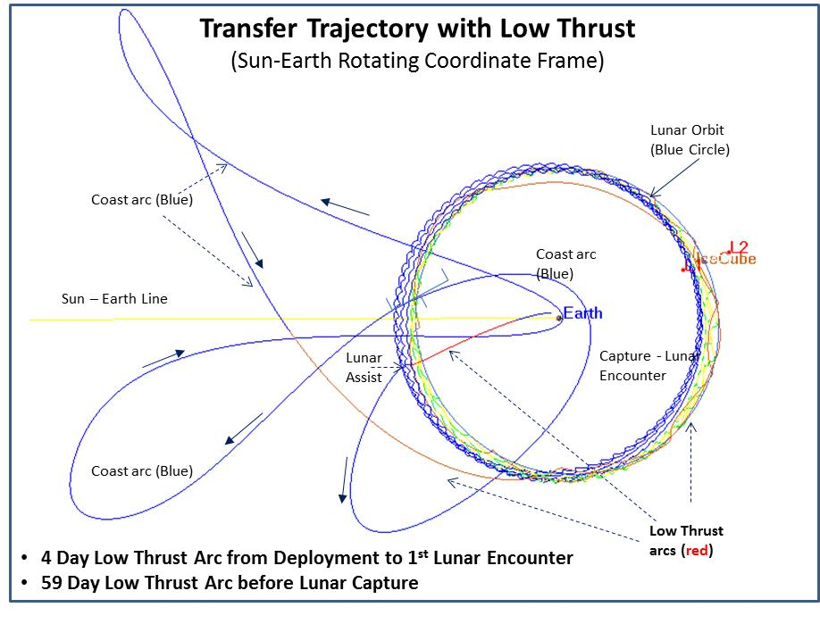
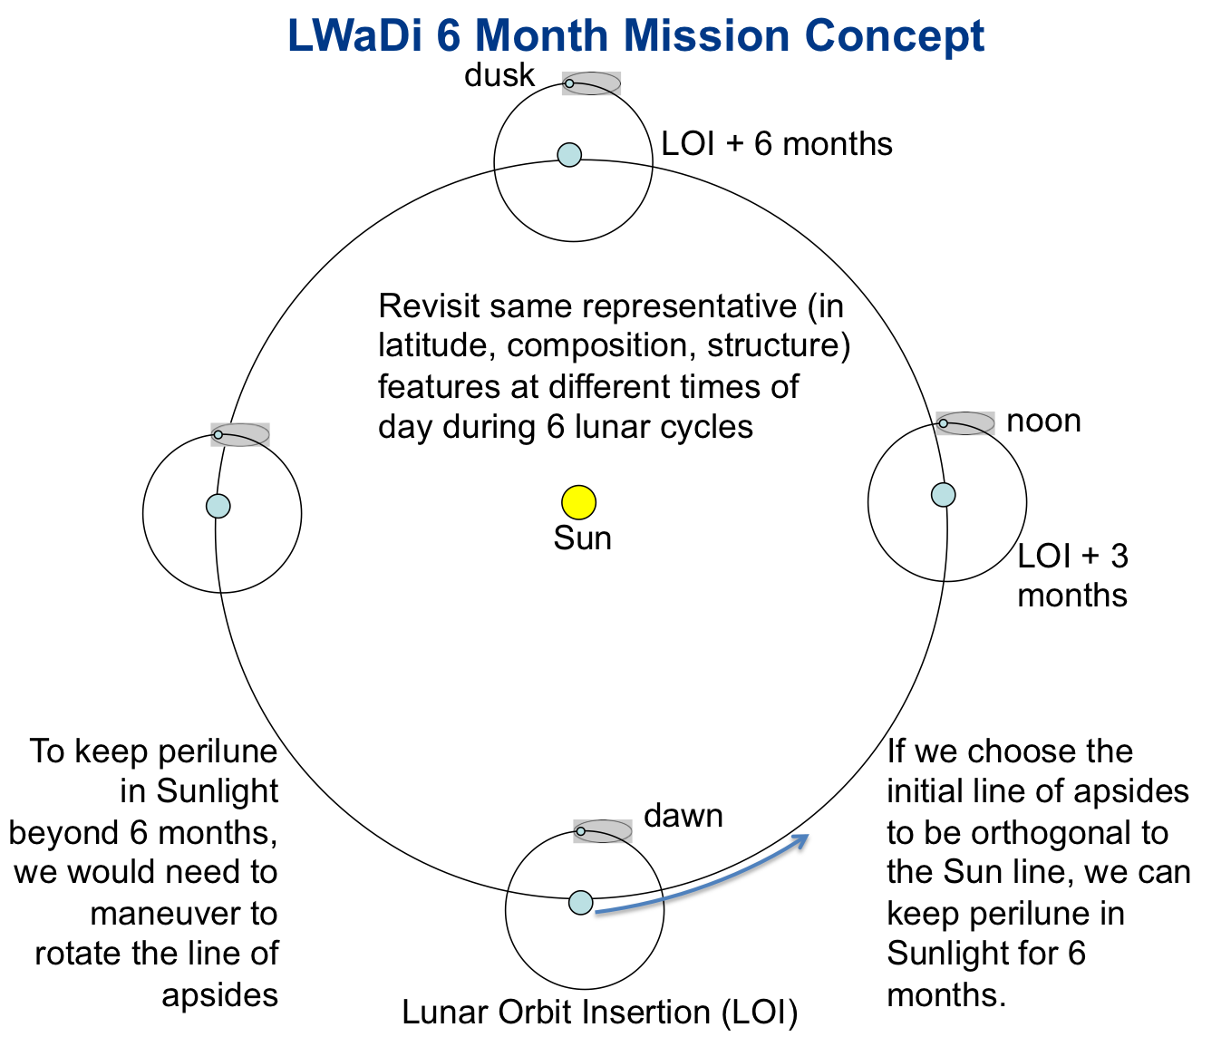
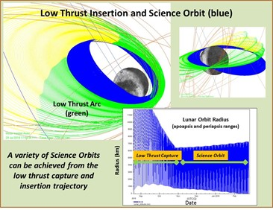
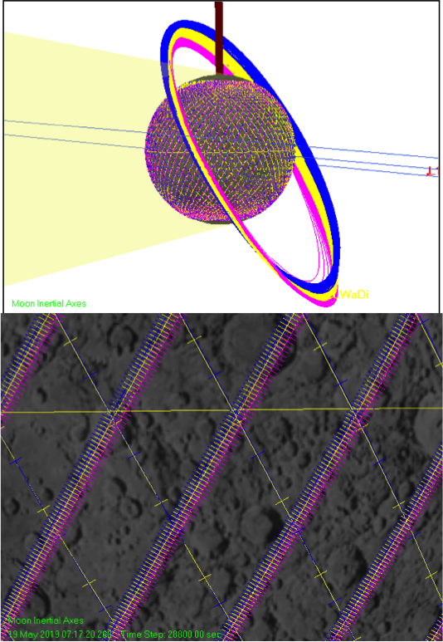

Slide 9
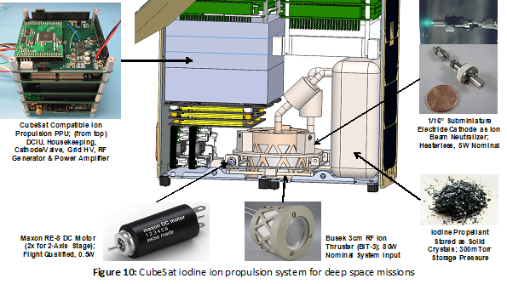
Busek Iodine ion propulsion system (EP)
-External electron source to offset charge build-up Volume ~ 2 U, EM life testing 2016

Slide 10
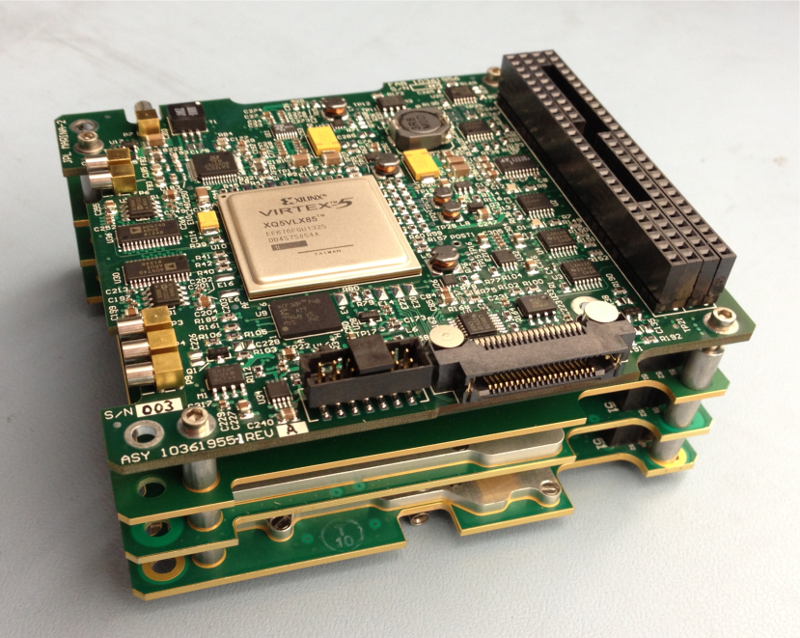
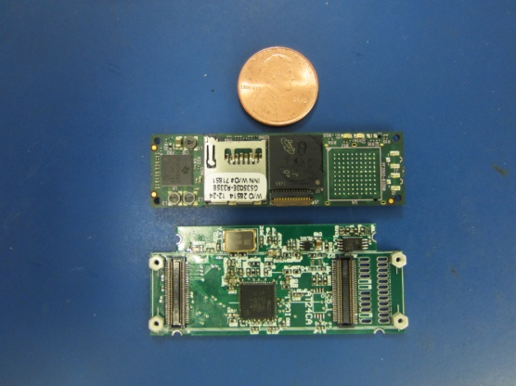
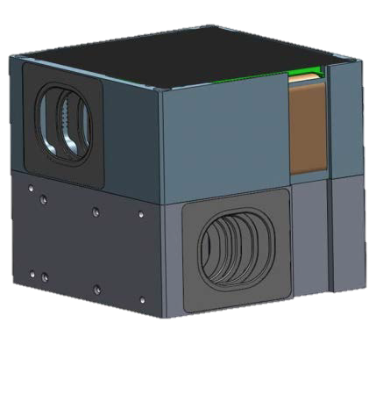
Bus Components
Thermal Design: with minimal radiator for interior the small form factor meant that interior experienced temperatures well within 0 to 40 degrees centrigrade, except for optics box which has a separate radiator. Thermal modeling funded via IRAD work.
Communication, Tracking: X-band, JPL Iris Radio, dual X-band patch antennas. MSU has 21-m dish that is becoming part of the DSN. Anticipated data rate ~ 50 kb/s
C&DH: very compact and capable Honeywell DM microprocessor, at least one backup C&DH computer (trade volume, complexity, cubesat heritage, live with the fact this hasn’t flown in deep space)
GNC/ACS: Modified Blue Canyon system. Multi-component (star trackers, IMU, RWA) packages with heritage available, including BCT XB1, which can interface with thrusters (trade cost, volume, cubesat heritage, live with the fact this hasn’t flown in deep space)

Slide 11
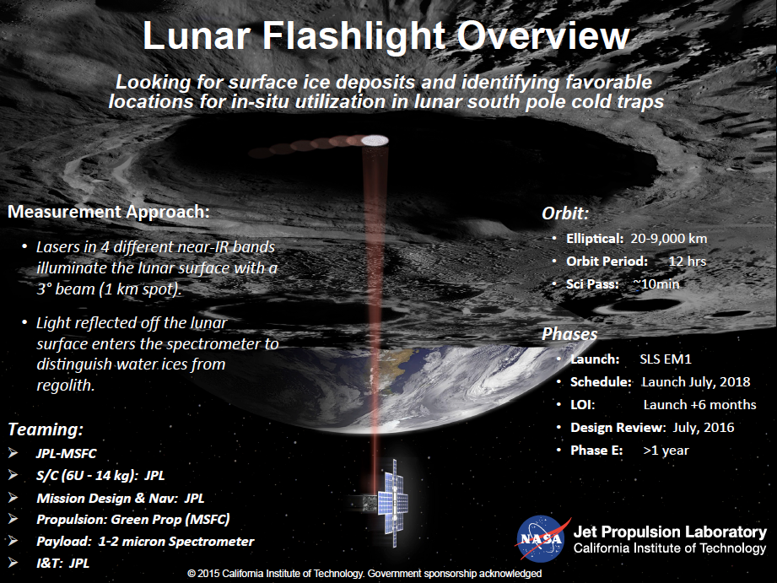
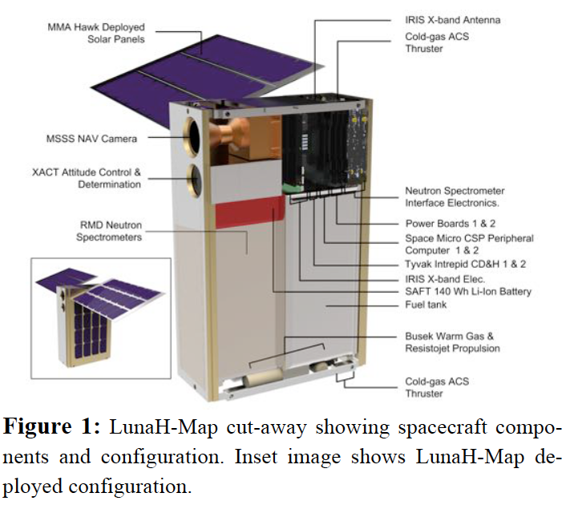
Other EM1 Mission Complimentarity
Lunar Flashlight: Detect surface ice for PSRs polar region by measuring laser stimulated emission at several ice-associated lines.
LunaH Map: Detect ice in top layer (tens of centimeters) of regolith for PSRs polar region by measuring decrease in neutron flux (anti-correlated with protons) using neutron spectrometer.
Lunar IceCube: Determine water forms and components abundances as a function of time of day, latitude, and lunar regolith properties using broadband point spectrometer.

Slide 12
Current status and issues
Data Access and Archiving: Discussions with LMMP on arrangements for data access and archiving. Proposal to PDART.
Volume: Additional volume accommodation for Iris radio and propulsion system. Building compact electronics.
Very high Vibration and Shock survival in requirements documents: deployer design will mitigate considerably and original margins are very high
Very large temperature range survival in requirements documents: partially mitigated by ‘rolling’ spacecraft once Orion deployed +1.5 hours).
Radiation issue: Deployment opportunity starts in the second lobe of the Van Allen Belt: 8 to 11 hours to get out…however only relatively small Total Ionizing Dose to deal with.
Thermal Design: major cubesat challenge. Using dedicated radiator to minimize temperature of optics box (<240K). Using microcryocooler to maintain detector at 120K.

Slide 13
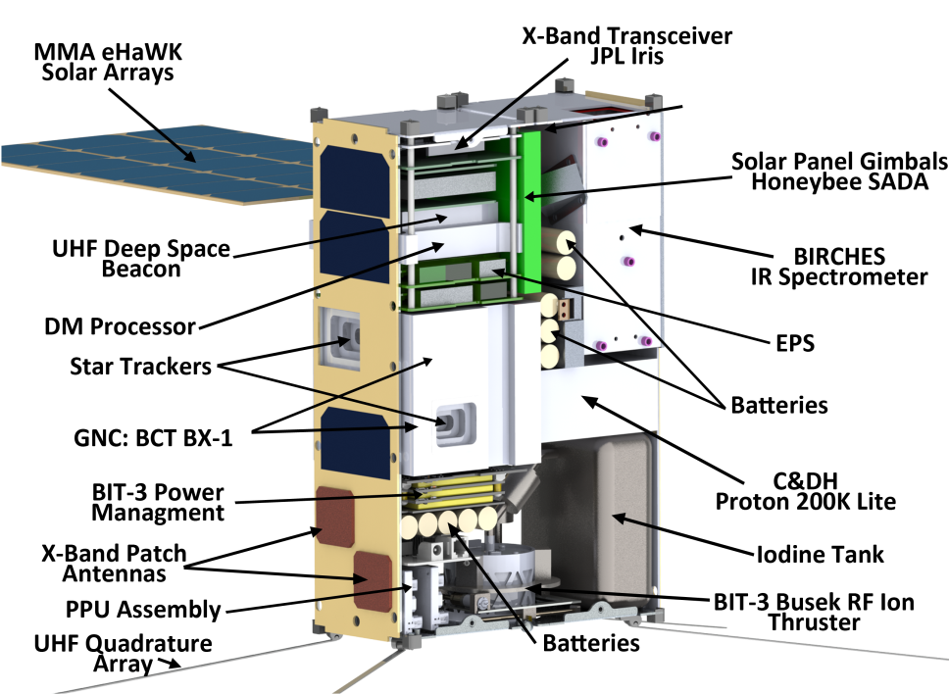
IceCube Concept: Morehead CubeSat Bus

Slide 14
Conclusions
IceCube to place an IR spectrometer in lunar orbit to look for surface OH, water, other volatiles
Correlate volatiles with surface mineralogy, surface temperature, illumination, solar wind, etc
Examine changes in surface volatile content to get at dynamics issues! (like Sunshine et al., 2009 observation)
Uses MSU cubesat bus, with Busek propulsion
Enabling GSFC flight dynamics: Use of low energy manifolds to get into lunar capture
  Propulsion solution and flight dynamic requirements uniquely solved in a self-consistent way
  Creating a tailored solution with a standard platform

Slide 15
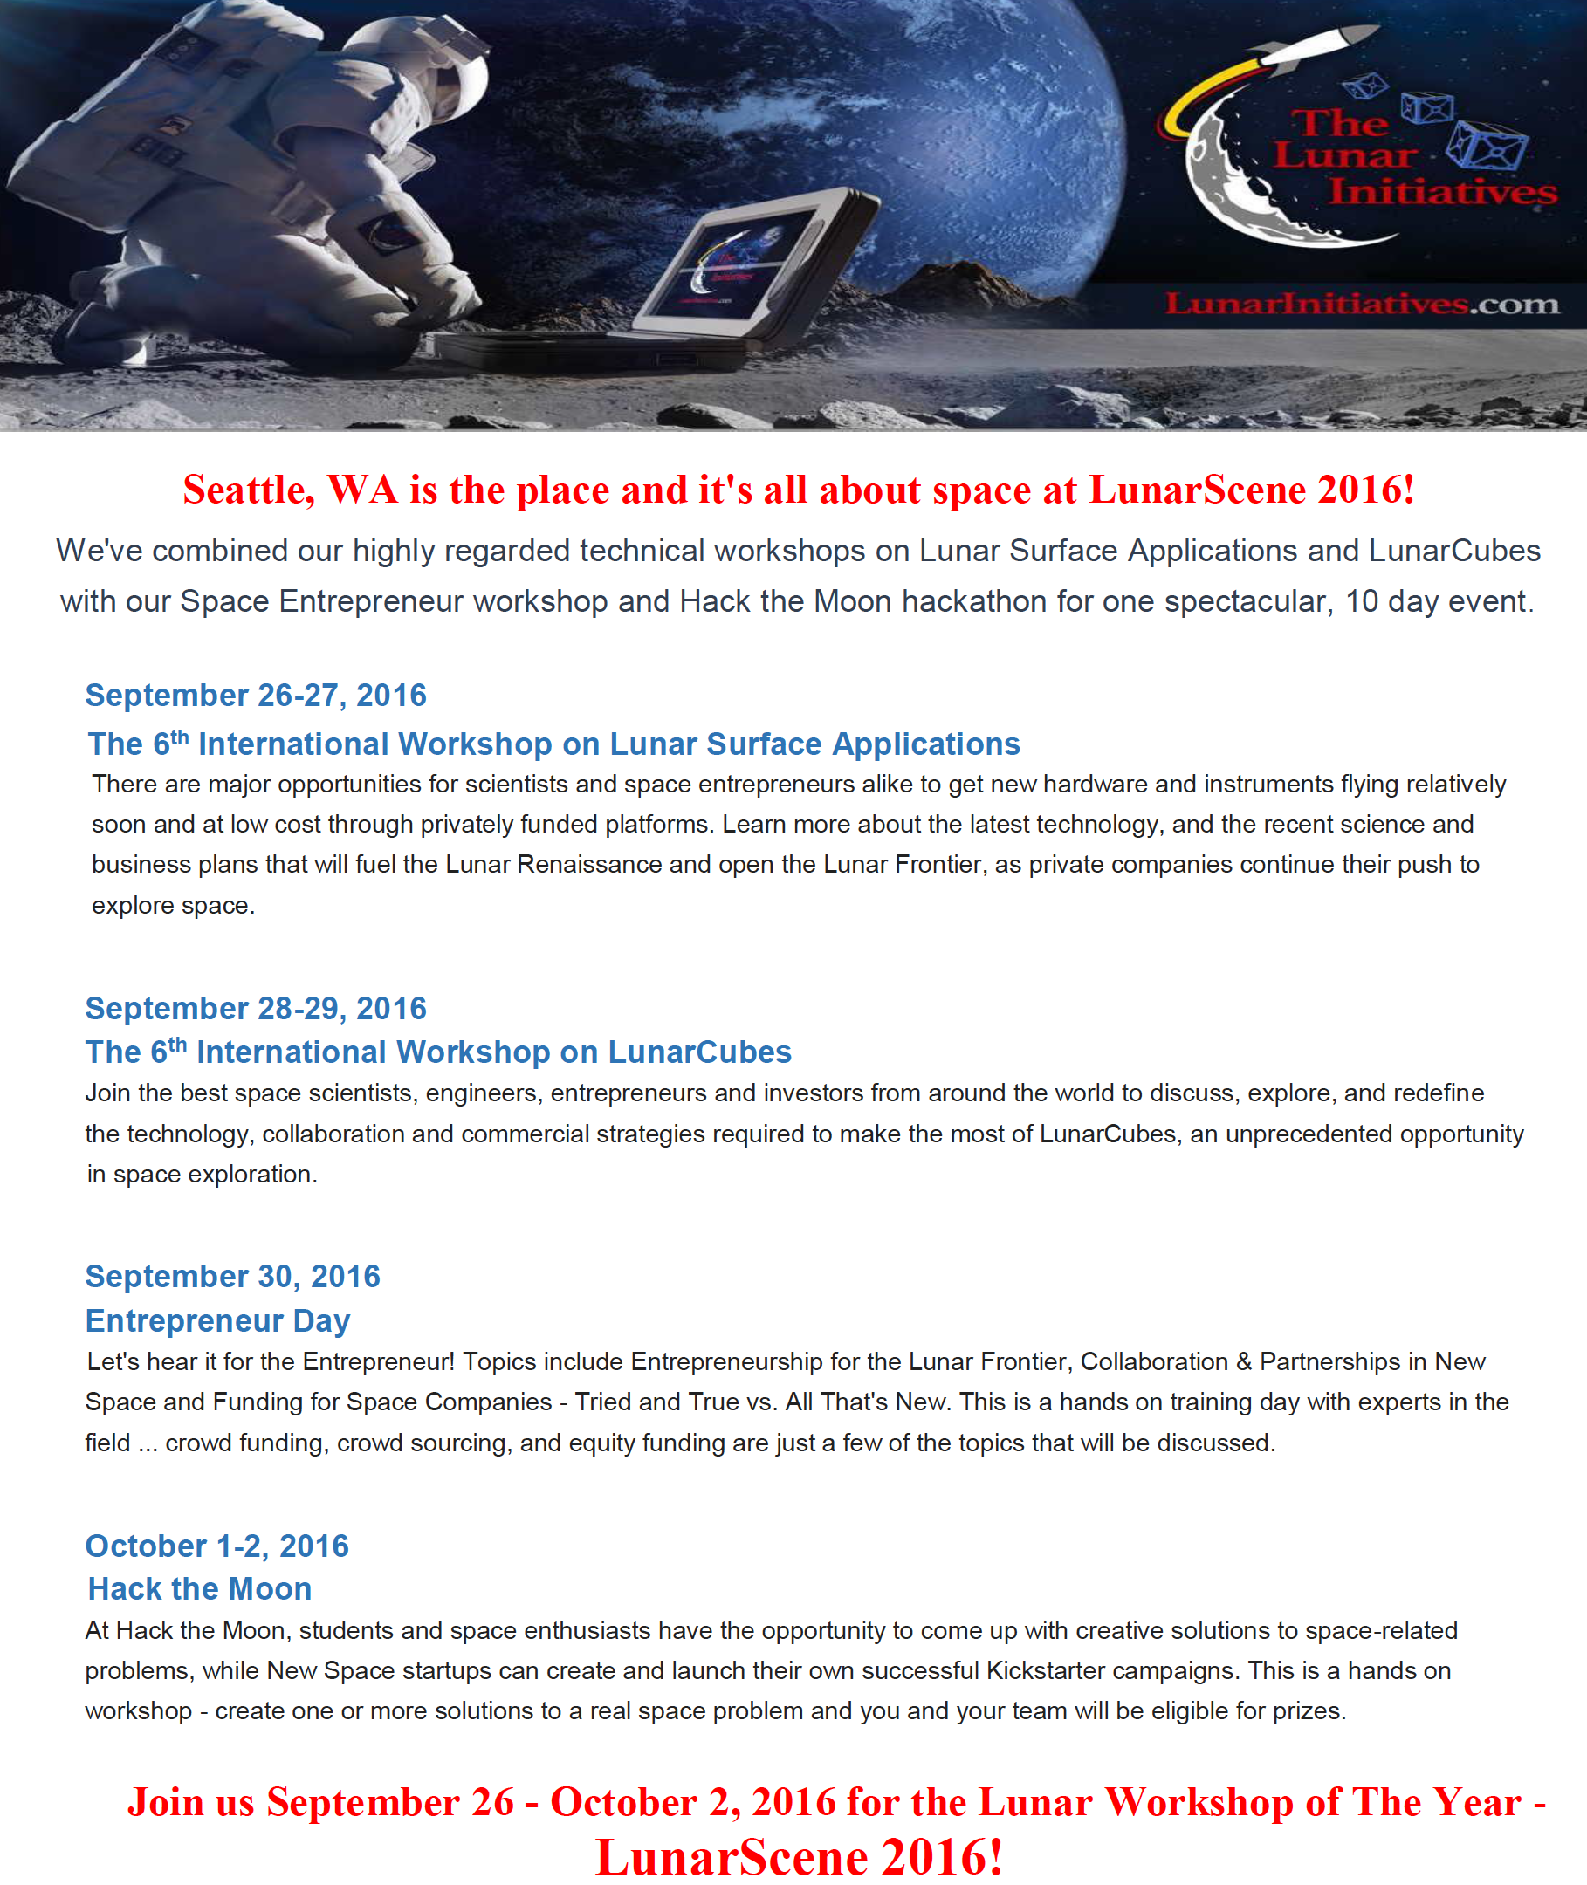
www.lunarworkshops.com
pamela.e.clark@jpl.nasa.gov

