Slide 1
The Plume Chaser Mission:
Two-Spacecraft Search for Organics on the Dwarf Planet Ceres
Dr. Jonas Jonsson
Mission Design Division
NASA Ames Research Center

Slide 2
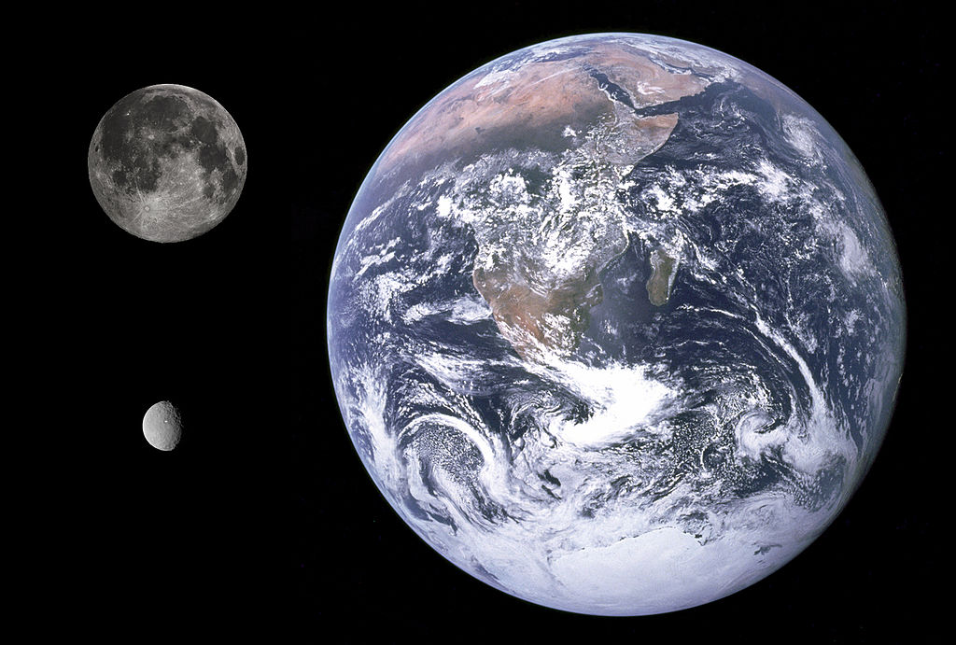
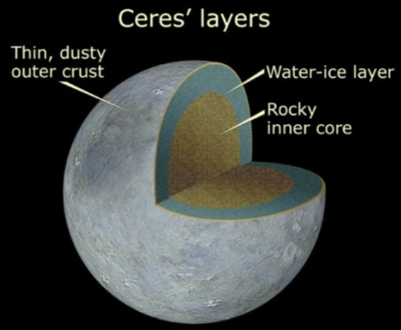
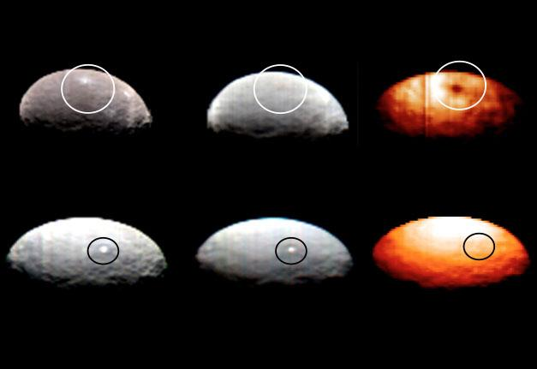
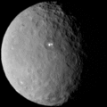
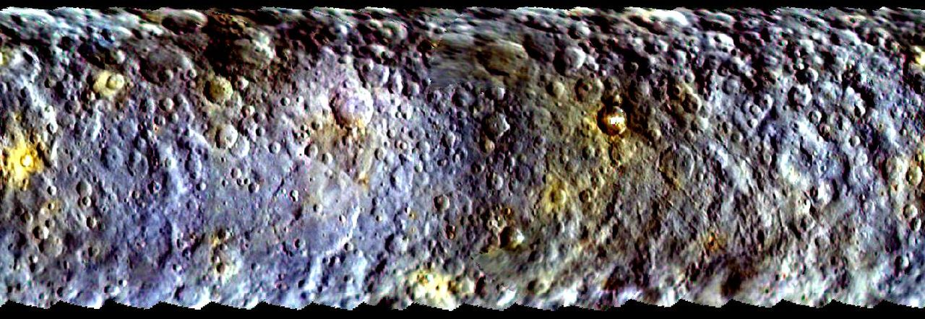
Ceres
Aphelion: 2.9773 AU
Perihelion: 2.5577 AU
Orbital period: 4.60 yr
Avg. orbital speed: 17.905 km/s
Mean radius: 476.2±1.7 km
Mean density: 2.077±0.036 g/cm3
Surface gravity: 0.28 m/s2
Escape velocity: 0.51 km/s
Mean surf. Temp.: 168 K
Max surf. Temp.: 235 K
NASA, ESA, and A. Feild (STScI)
NASA/JPL-Caltech/UCLA/MPS/DLR/IDA
NASA/JPL-Caltech/UCLA/ASI/INAF
NASA/JPL-Caltech/UCLA/MPS/DLR/IDA
NASA/JPL-Caltech/UCLA/MPS/DLR/IDA

Slide 3
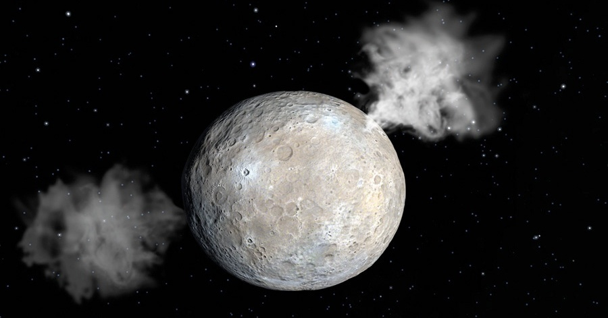
Why is Ceres so interesting?
Differentiated structure with a anhydrous silicate core with water-rich mantle
The relatively rare CM chondrites are thought to originate from here
Spared from the effects of the Late Heavy Bombardment (LHB)
HST detected up to 8 features releasing 10^26 molecules (~6 kg) of material / s
HSO found water vapor in the vicinity of 2 mid-latitude dark regions
Thermal models suggest liquid water below the surface
Could there be cryovolcanism and liquid water bodies under the frozen crust?
Figure adapted from an illustration by Chris Butler/SPL

Slide 4
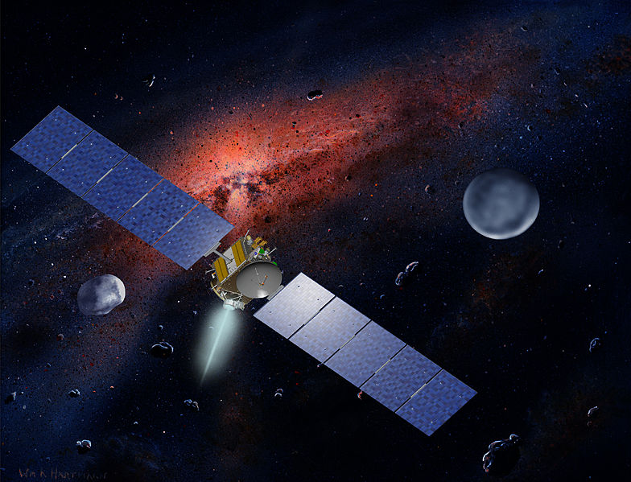
Why another mission to Ceres?
Dawn arrives close to aphelion, while plume activity was observed at perihelion
Dawn instruments are not capable of measuring needed critical isotopic composition of volatiles
Dawn has no impactor to enable
  the release subsurface volatiles
  imaging before and after an impact event
NASA
→ Plume Chaser has a different, but complementary mission concept to Dawn

Slide 5
Science Objectives
Primary Science Objectives
A.1 | Search for evidence of organics in the Ceres water vapor/plume
A.2 | Determine the column water content and location of highest density
A.3 | Determine the elemental composition (C, H, O, N) of any carbon rich plume particles
A.4 | Characterize the particles in the plume for dissolved salts
Secondary Science Objectives
B.1 | Characterize the silicate dust in the plume and relate it to other solar system objects, such as meteorites and comets
B.2 | Characterize the mechanical, chemical and geological properties of the crust by observing the impact site before and after impact
B.3 | Look for surface compositional changes on the surface associated with venting; characterize composition differences involving water or possible organics

Slide 6
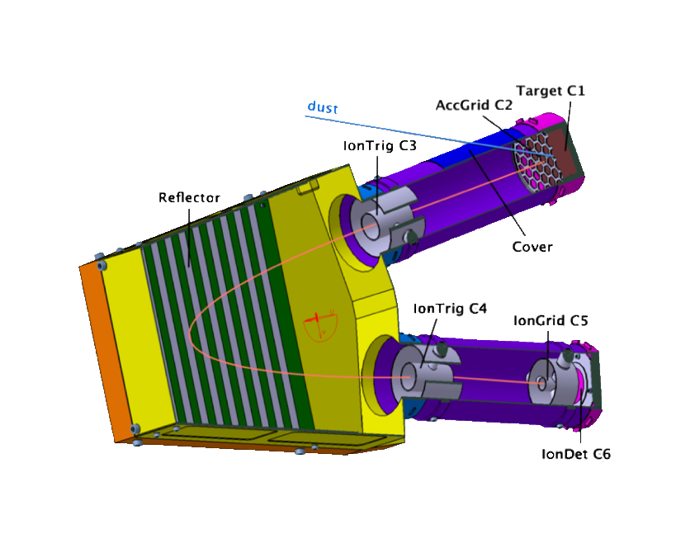
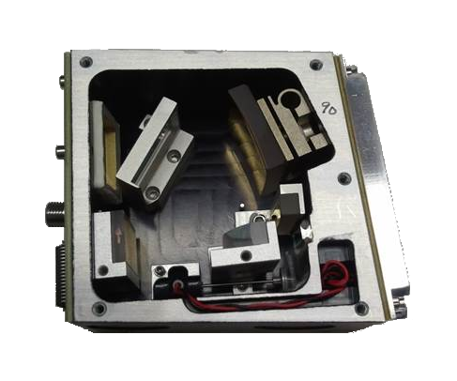
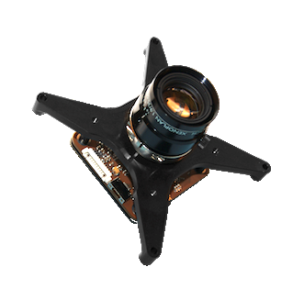
Instrumentation
ENIJA Mass Spectrometer
TRL 4
Particle size: 10 nm – 100 um
Particle mass: 1 – 2000 amu
NASA ARC/Draper Lab. NIR spectrometer
TRL 4
Range: 1.6 – 3.4 um
Resolution: 0.15 um
GomSpace NanoCam C1U camera
TRL 9
Spectrum: 400 – 1000 nm
FOV: 9.22 deg
Resolution: < 80 m/pixel from 650 km
University of Stuttgart
NASA Ames
GomSpace

Slide 7
Mission Concept: Sniff, Wait, and Impact
Sniff
  Venting from the surface of Ceres is common
  Permanent exosphere
  Densest parts will be localized and studied
Wait
  Venting is not common on Ceres, but likely at perihelion
  S/C must remain in orbit until a plume event occurs and can subsequently be maneuvered through it
Impact
  Venting is rare on Ceres
  Sporadic occurrences under extremely favorable conditions
  Trace exosphere might be beyond detection limits
  To guarantee scientific return, impactor will create a plume to fly through

Slide 8
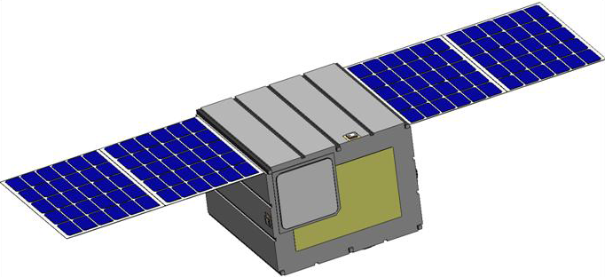
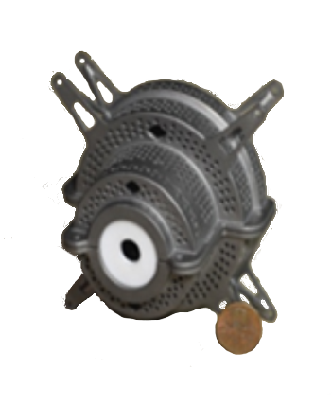
The Two Spacecraft
Same design for both S/C
  Size: 40x40x30 cm^3
  Dry mass: 40 kg
  Wet mass: <190 kg
  Fit within ESPA Grande frame
3D printed Ti tank/structure
MMA Design solar array
  200 W EOL
Propulsion
  CubeSat Ambipolar Thruster (CAT)
  ISP: 1200
  Size: 1U
  Propellant: Iodine
University of Michigan

Slide 9
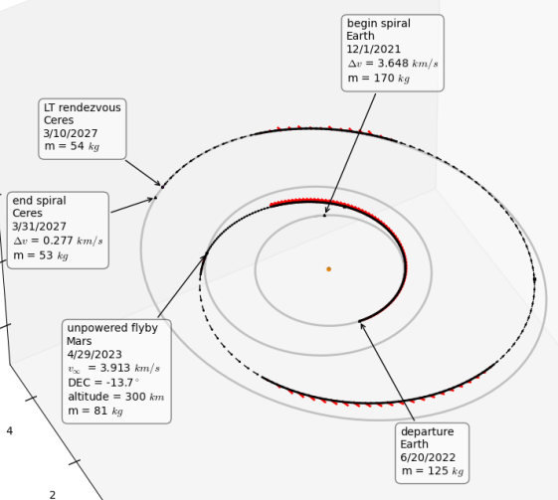
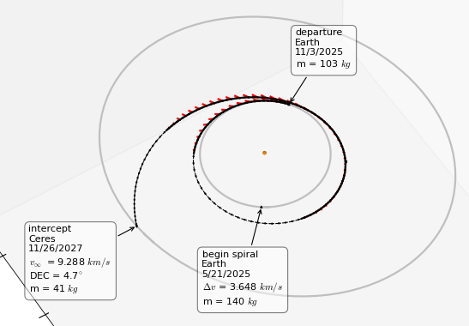
Trajectory Design
Starting from GTO
Plume Chaser
  Dry mass: 43 kg
  Propellant: 120 kg
  Overall duration: 4.8 yrs
  Delta-V: 14.4 km/s
  1 year science orbit before decommision
Plume Maker
  Impact mass: 41 kg
  Propellant: 99 kg
  Overall duration: 2.1 yrs
  Delta-V: 14.5 km/s
  Impact speed: 9.3 km/s

Slide 10
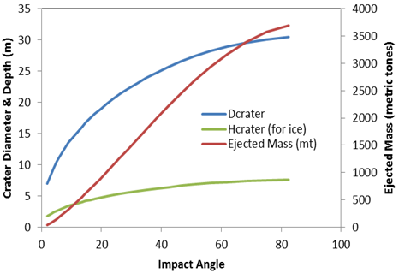
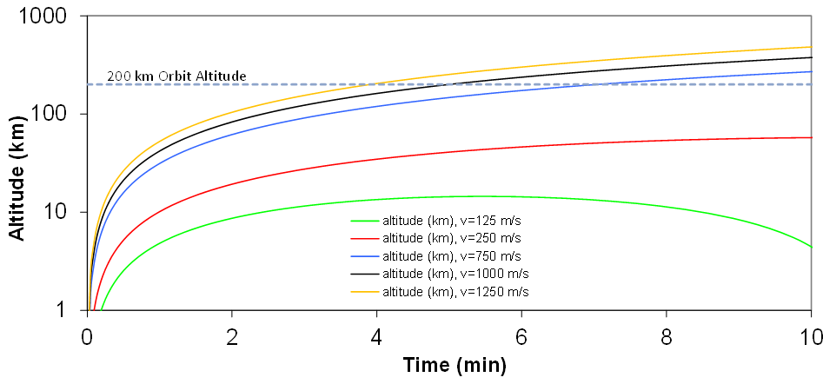
Impacting
To create a crater
  Speed: 9.3 km/s
  Mass: 40.9 kg
  Energy: 1764.5 MJ
  Crater
    > 10 m wide
    > 3 m deep
To create a plume
  Reach above 200 km
  With particle velocity 750-2000 m/s

Slide 11
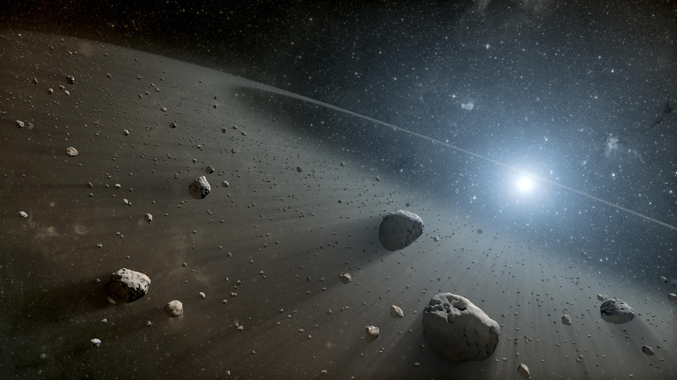
Conclusions
Jonas.Jonsson@nasa.gov
NASA/JPL-Cal Tech

