Slide 1


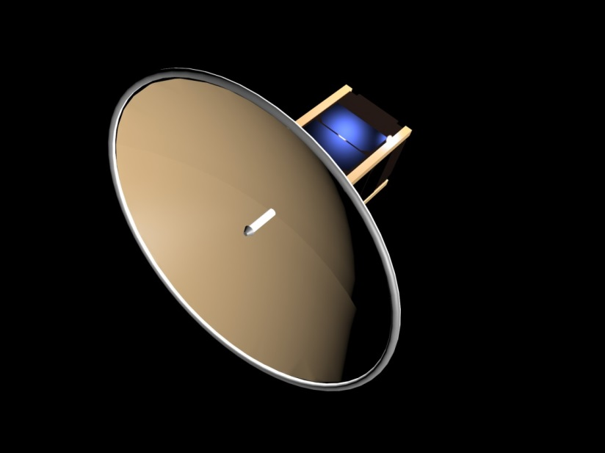
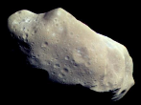
CubeSat Based Inflatable Antennas and Structures for Interplanetary Communication and Tracking
Mithun Ravichandran and Jekan Thanga
Space and Terrestrial Robotic Exploration (SpaceTREx) Laboratory
School of Earth and Space Exploration (SESE)
Arizona State University
http://space.asu.edu
Notes:
1

Slide 2
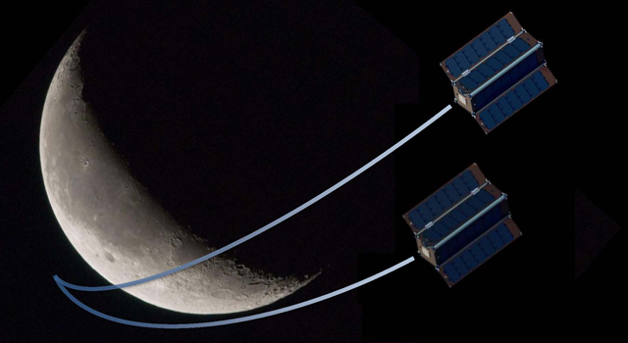
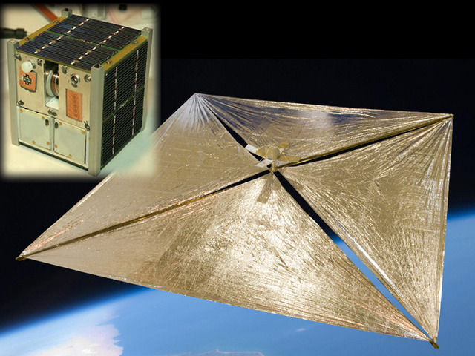
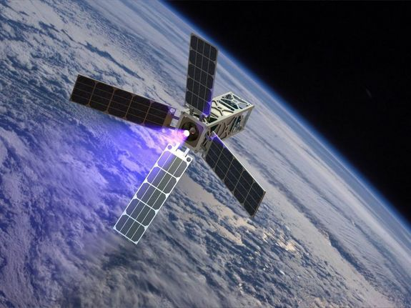
Interplanetary Cubesats
Klesh, INSPIRE JPL
ARES Institute
Longmier, U. of Michigan

Slide 3

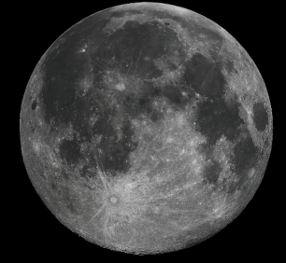
Case Study
Parabolic antenna (f/d = 0.5)
Data rate = 128 Kbps
Frequency = 2.45 Ghz [S-band]
Lunar Orbit

Slide 4
Deployment Comparison
Parameter | Non-deployable Antenna | Deployed Antenna
Distance | 384,300 km [Moon] | 384,300 km [Moon]
Data Rate | 128 Kbps | 128 Kbps
Frequency | 2.45 Ghz [S-band] | 2.45 Ghz [S-band]
Ground Station Antenna Diameter | 2 m | 2 m
Spacecraft Antenna Diameter | 0.09 m | 2 m
Data Link Margin | 4.27 dB | 17.9 dB
Spacecraft Power for Communications | 50~ W | 2.5 W

Slide 5
Motivation
Inflatable offer a promising technology pathway for interplanetary CubeSat communication and tracking.
  Very high deployed volume
  Very low mass
  High-packing efficiency
  Quick deployment
  Relative simplicity

Slide 6
Objectives
Research inflatable technology that maximizes stowed-to-deployed ratio of interplanetary communication antennas and long-distance tracking devices.
Understand the limits
Develop validated physical models
Determine design principles
Develop open-source rigidizable inflatable design and optimization tools for system engineers.

Slide 7
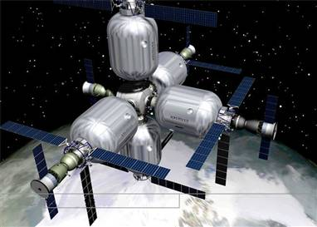
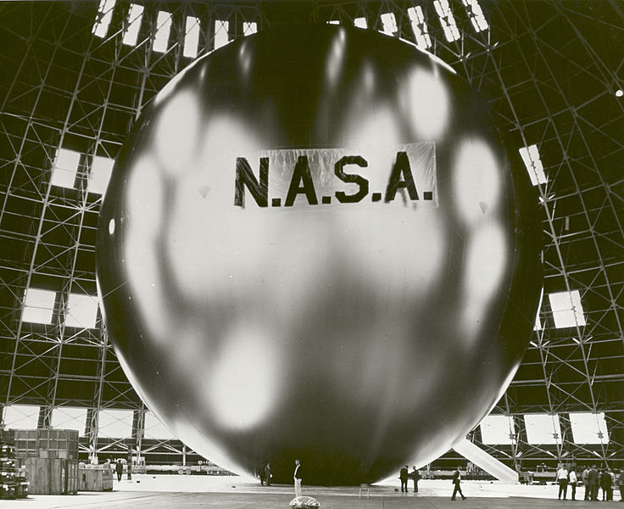
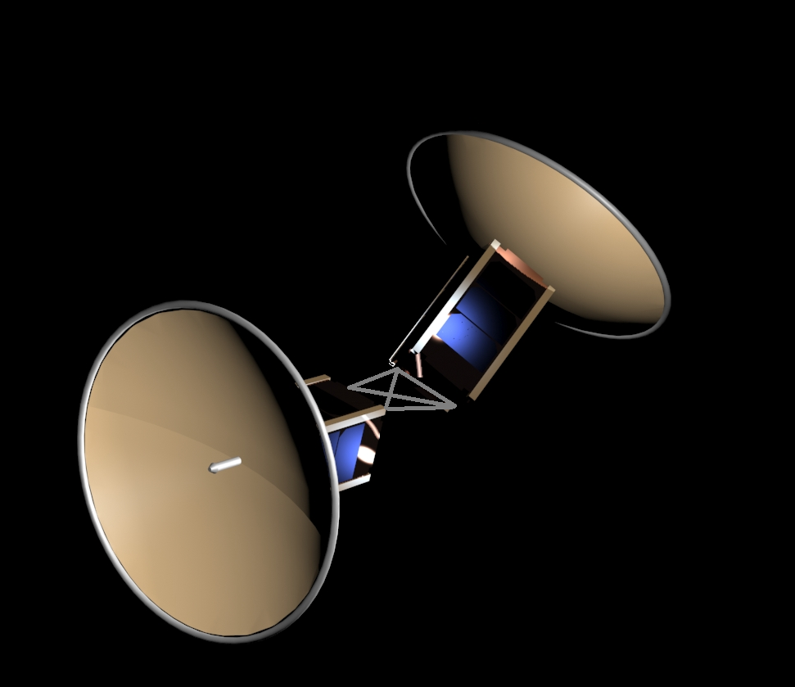
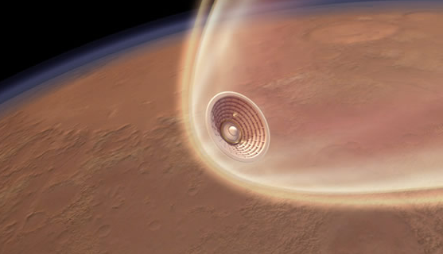
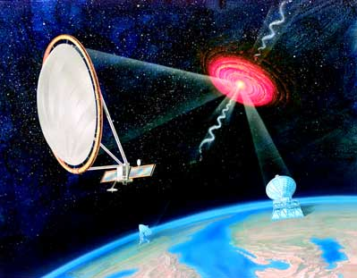
Inflatables
Communication Relays
Bigelow Aerospace
Inflatable Habitats
Communication
NASA GRC
ARISE NASA /JPL
Hypersonic Decelerator
Radio Telescopes

Slide 8
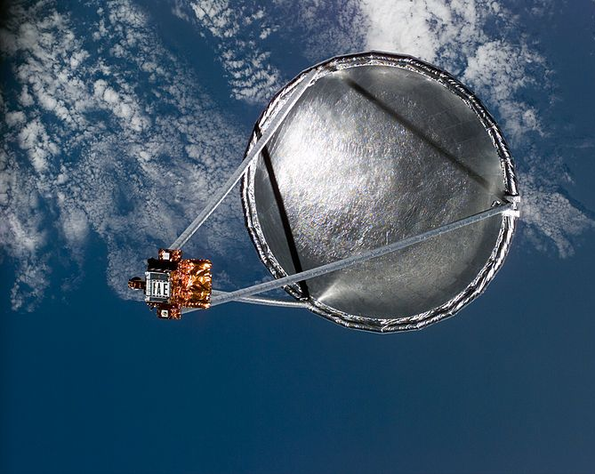
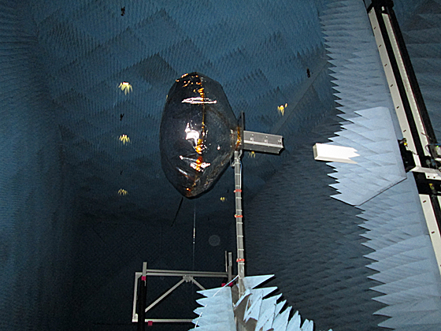
Related Work
Inflatable Antenna Experiment (1996) [NASA/JPL/LGarde]
[Steiner, Freeland, Veal, 1996]
First large-scale inflatable antenna
14 m diameter, canopy and torus
mylar/kevlar structure, mass: 60 kg
Nitrogen gas for inflation
Inflatable antenna for Cubesats
[Babuscia et al., 2013]
First proposed design for cubesat
Sublimating powder maintains inflation
Target Capability: 100 kbps from GEO
NASA/JPL/LGarde
[Babuscia et al., 2013]

Slide 9
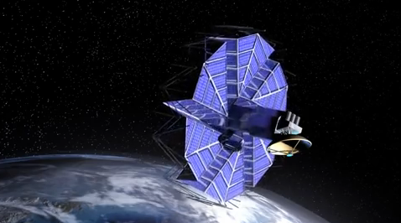
Related Work
Origami Structures for Space [BYU & JPL, 2013]
[Zirbel et al., 2013]
Rigid structures that can unfold using origami techniques
Solar Panel Deployment
Can these techniques be applied for inflatables ?
BYU/JPL

Slide 10
Challenges
Micro-meteorites
  Rigidization [Cadogan and Scarborough, 2001]
    UV, Stretched Aluminum, Passive Cooling
  Sublimating Powder [Babuscia et al., 2013]
  Fabric Strength [Freeland et el., 1997], [Cadogan and Scarborough, 2001]
  Laminates, Thermosetting Materials, Vectran
Packing density and Deployment
  Simple folding techniques, origami structures for space [Zirbel et al., 2013]
  Repeatability and Reliability

Slide 11
Inflatable Advantage
Material | Mass | Proposed System Advantage
Al 6065-T4 | 34 kg | 84x
Ti-6Al-4V | 14 kg | 35x
Nomex Al Honeycomb | 12 kg | 31x
Benecor Ti Honeycomb | 5 kg | 13x
Proposed Kapton UV Cured Inflatable | 0.4 kg | -

Slide 12
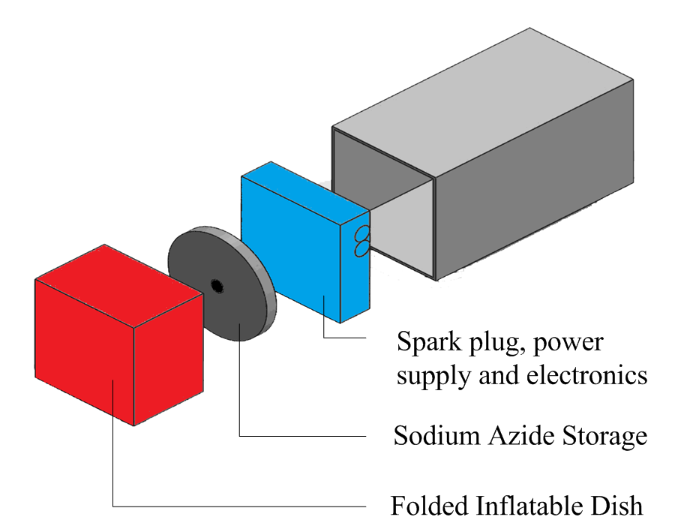
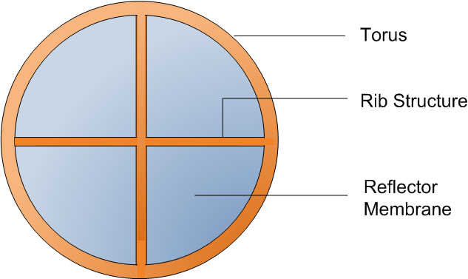
Inflatable System Design
Subsystem Component | Mass
Spark-plug, electronics | 50 g
Battery Power Supply | 125 g
Sodium Azide Canister | 50 g
Sodium Azide | 100 g
Rib and Torus Bladder | 25 g
Reflector Membrane | 50 g
Total | 400 g

Slide 13
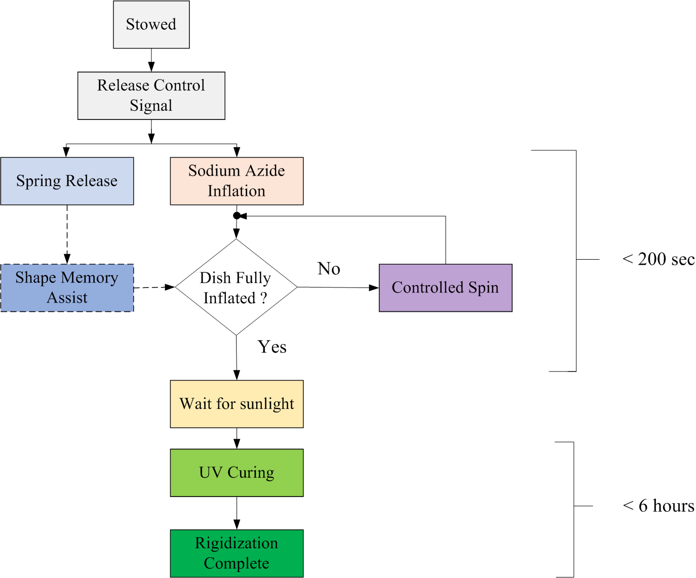
Deployment Steps

Slide 14

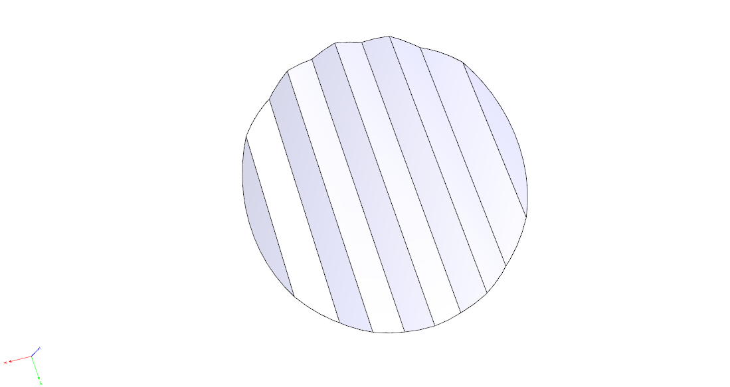

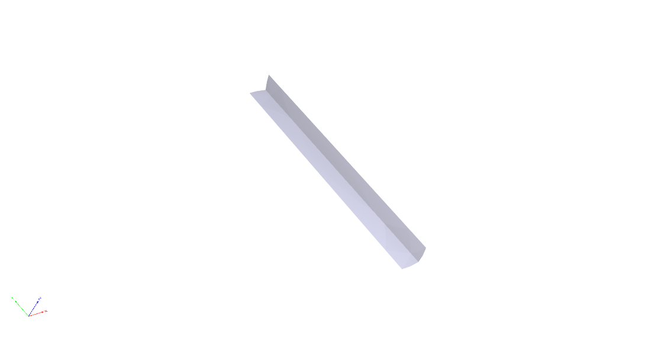
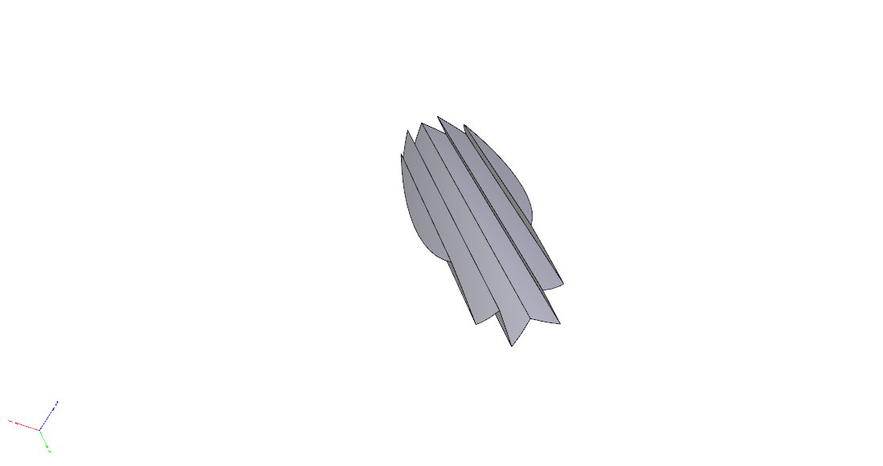
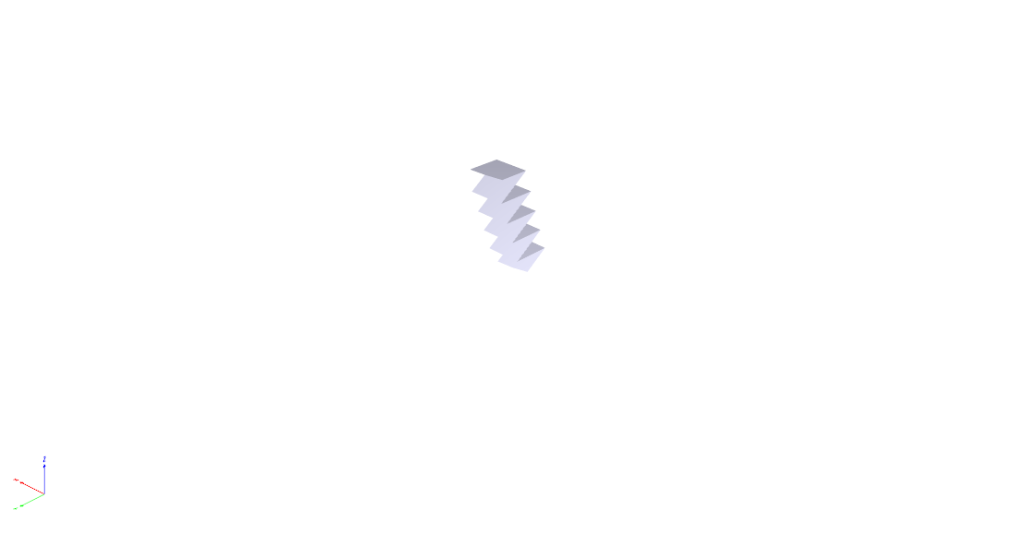

“Accordion” Folds

Slide 15
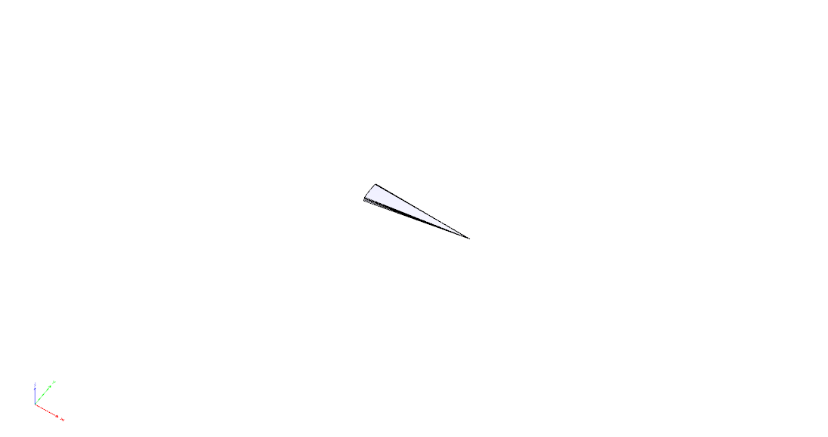
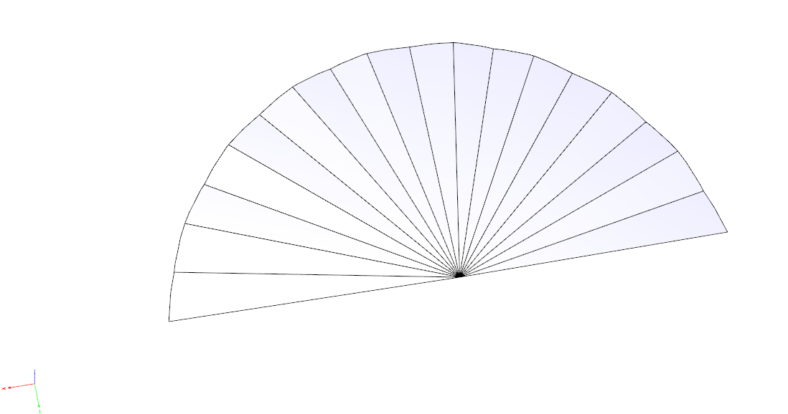
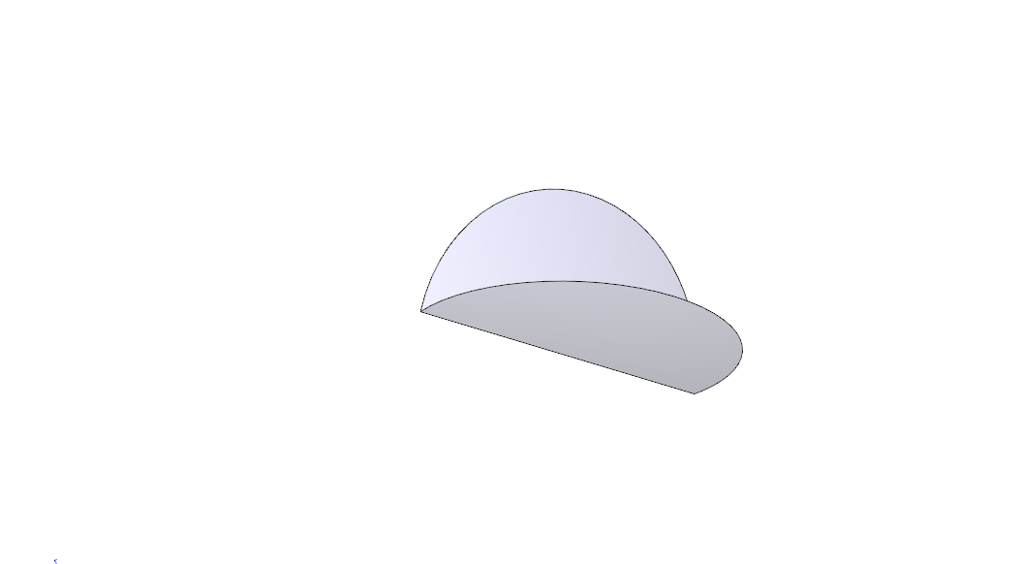
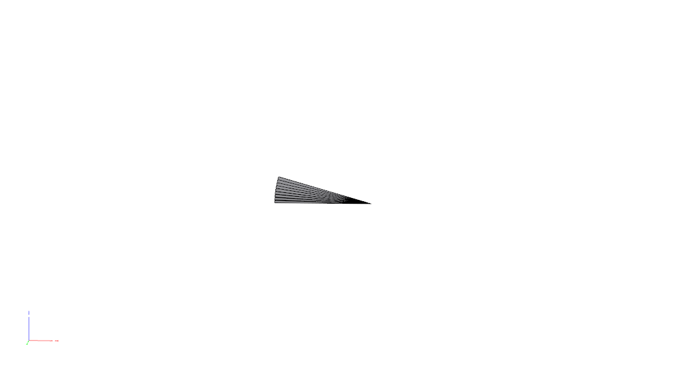
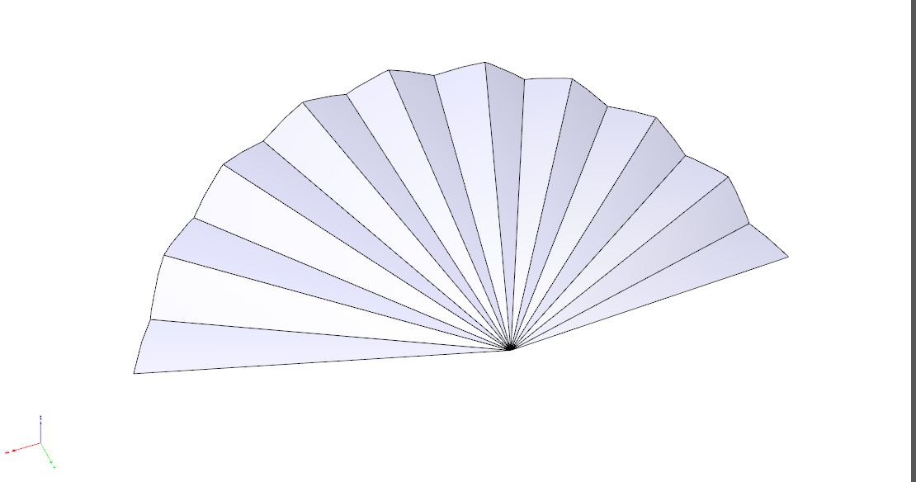

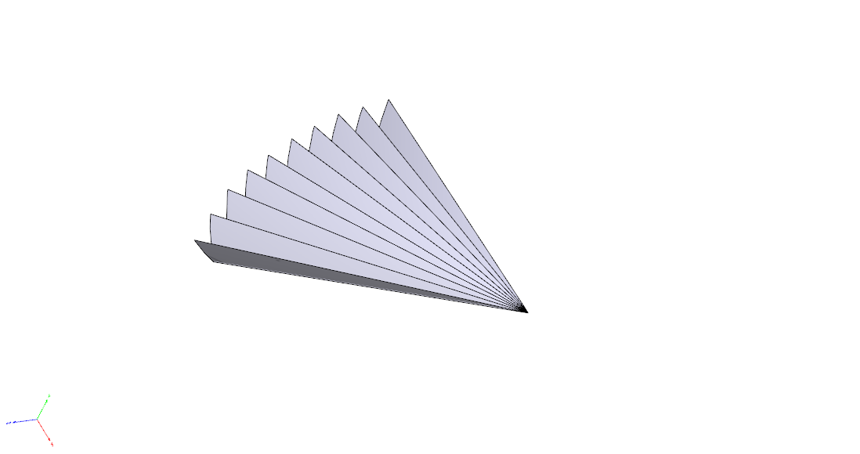
“Radial Accordion” Folds
Unfurl from a spiral roll.

Slide 16
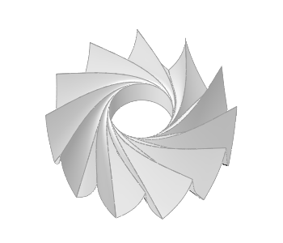

Origami Deployment

Slide 17
Deployment Techniques - Comparison
 | Method | Folds | Short Folds | Deployment Time | Stowed Volume | Deployed/Stowed Volume
1 | Exponential - Short Folds | 10 | 10 | 50 s | 0.7 L | 110
2 | Square - Accordion + Short Folds | 31 | 11 | 140 s | 0.9 L | 90
3 | Radial - Accordion + Short Folds + Roll | 37 | 1 | 160 s | 0.8 L | 100
4 | Square - Accordion Folds | 40 | 0 | 180 s | 0.9 L | 90
5 | Origami - Basic | 75 | - | 170 s | 0.5 L | 150
Techniques need to be experimental validated.

Slide 18
Discussion
Significant potential at least 10 to 30 folds mass advantage over conventional structures
All the deployment techniques considered are tricky
  Minimize short-folds
  Preference for (1) rolling (2) accordion folds
    Rolling - Spacecraft spin
    Accordion folds – spring or shape memory
Feedback control required to guarantee unfolding
  Rolling - Can be started and stopped, repeated
  Linear unfolding - shape memory process could be repeated in theory but can get in the way

Slide 19
Future Work
Details simulation of deployment dynamics
Identification of preferred deployment technique
Laboratory demonstration of concept
A controls approach to increase reliability of deployment system with options for redundancy.
Flight demonstration – 2015/2016

Slide 20
Thank You!

Slide 21
References
Roederer, A. "Historical overview of the development of space antennas." Space Antenna Handbook (2012): 250-313.
Melancon, P. S., and R. D. Smith. "Fleet Satellite Communications (FLTSATCOM) Program." 8th Communications Satellite Systems Conference. Vol. 1. 1980.
Rahmat-Samii, Y., A. I. Zaghloul, and A. E. Williams. "Large deployable antennas for satellite communications." Antennas and Propagation Society International Symposium, 2000. IEEE. Vol. 2. IEEE, 2000.
Campbell, T. G., et al. "Development of the 15-meter hoop-column antenna system." In its Large Space Antenna Systems Technol., 1984 p 167-212 (SEE N85-23813 14-15) 1 (1985): 167-212.
Bernasconi, Marco C., and Giuseppe G. Reibaldi. "Inflatable, space-rigidized structures. Overview of applications and their technology impact." Acta Astronautica 14 (1986): 455-465.
Cassapakis, Costa, and Mitch Thomas. "Inflatable structures technology development overview." AIAA paper (1995): 95-3738.
Freeland, R. E., et al. "Large inflatable deployable antenna flight experiment results." Acta Astronautica 41.4 (1997): 267-277.
Thomson, Mark W. "The Astromesh deployable reflector." Antennas and Propagation Society International Symposium, 1999. IEEE. Vol. 3. IEEE, 1999.
Rogers, C. A., et al. "Technology assessment and development of large deployable antennas." Journal of Aerospace Engineering 6.1 (1993): 34-54.
Cadogan, David P., and Stephen E. Scarborough. "Rigidizable materials for use in gossamer space inflatable structures." AIAA paper 1417 (2001): 2001.
Babuscia, Alessandra, et al. "Inflatable antenna for cubesats: Motivation for development and antenna design." Acta Astronautica 91 (2013): 322-332.
Babuscia, Alessandra, et al. "CommCube 1 and 2: A CubeSat series of missions to enhance communication capabilities for CubeSat." Aerospace Conference, 2013 IEEE. IEEE, 2013.
Schenk, M., et al. "Inflatable Cylinders for Deployable Space Structures."
Zirbel, Shannon A., et al. "Accommodating Thickness in Origami-Based Deployable Arrays." Journal of Mechanical Design 135.11 (2013): 111005.

